Slide 1

BluePow Barrier

Slide 2

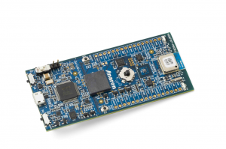
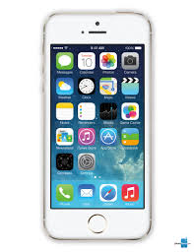
BLOCK DIAGRAM
BLE Ethernet Adapter
Home Appliances
CLOUD
(Exosite)
End User

