Slide 1
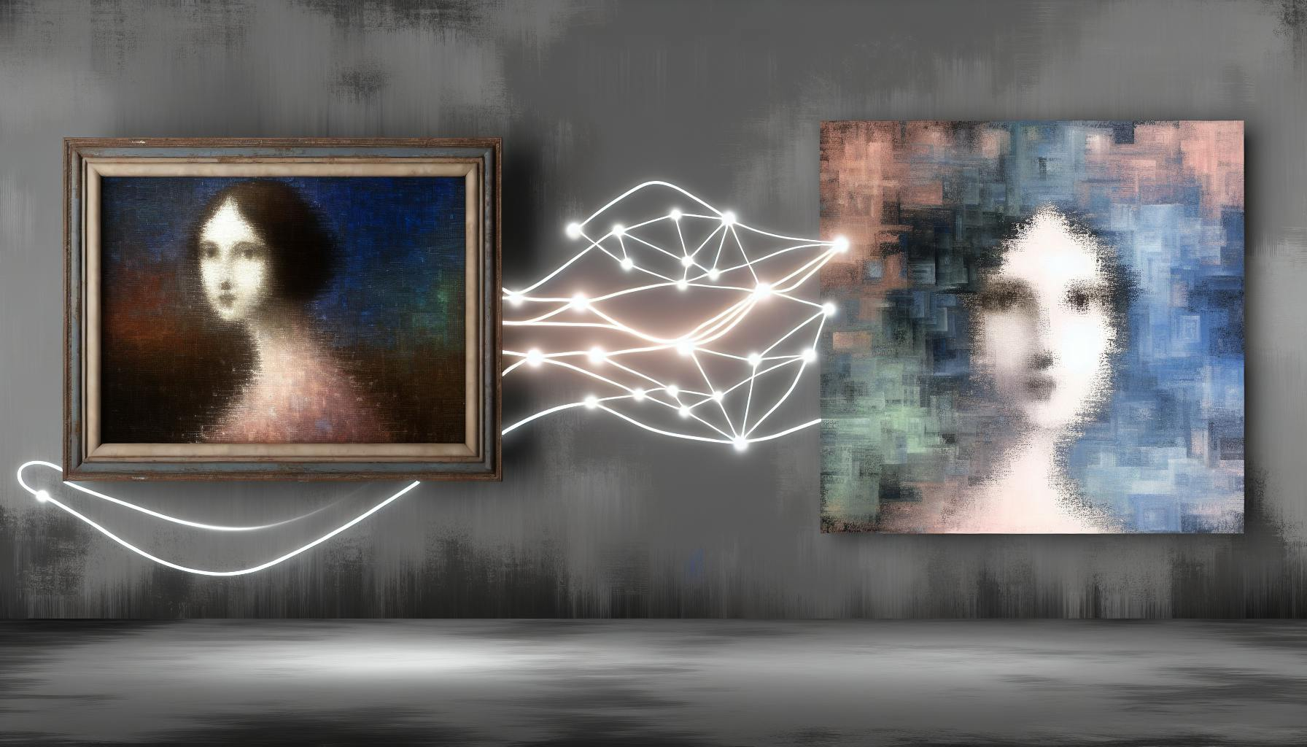
Title: Multi-Style Neural Transfer: Applying Diverse Artistic Styles to Image Quadrants
By : Rushitha Buddharaju , Srilatha Korrapati

Slide 2
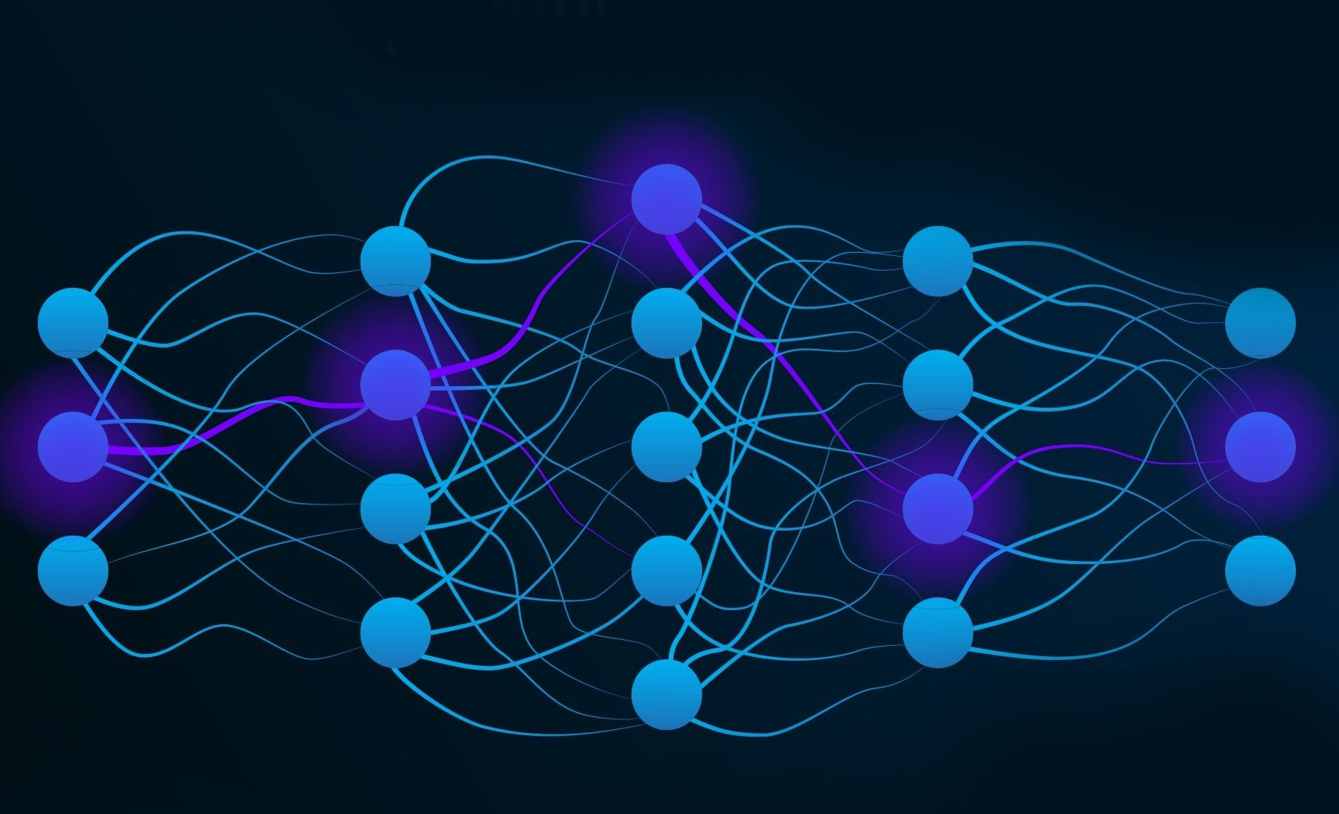
Introduction
In digital art, neural style transfer is a cool technique that transforms images with different artistic styles. Unlike the old way of using just one style for the whole image, the new way lets us mix things by applying various styles to different parts of the same picture. This leads to questions like how to blend different styles smoothly while keeping the whole image looking good. By exploring these ideas, we hope to make neural style transfer more flexible and creative, inspired by how real artists use various techniques and ideas.

Slide 3
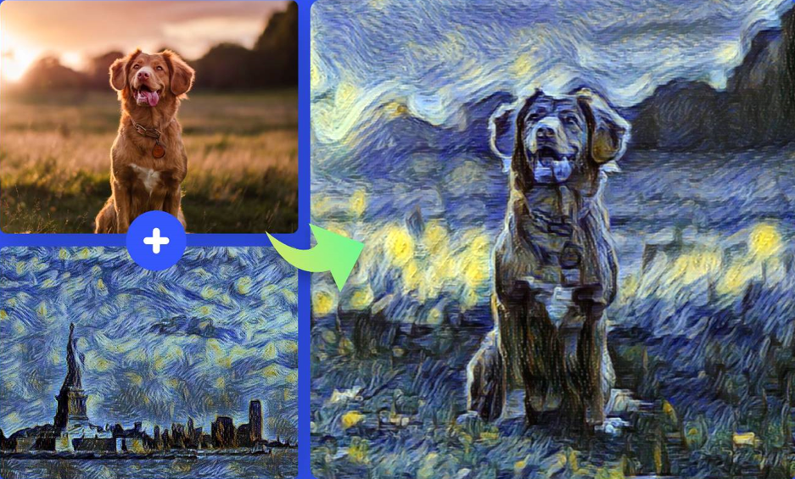
What is Image Style Transfer?
Image style transfer is a technique that mixes the style of one image with the content of another to create a new unique image. It's like combining the brushstrokes of a famous painter with a photo of a landscape with some dog or something to make a piece of art that looks both artistic and realistic. This process uses algorithms to analyze the visual features of each image and blend them, resulting in a visually interesting and creative output that merges different artistic styles

Slide 4
Background
Neural Style Transfer (NST) has evolved significantly since it was first introduced.
Gatys et al. (2015): Demonstrated that convolutional neural networks (CNNs) could separate and recombine the content and style of images, opening new possibilities for AI in creative tasks.
Johnson et al. (2016): Developed a real-time style transfer method, reducing the computational cost by using a feed-forward network. This made style transfer practical for consumer and mobile applications.
Li et al. (2017): Introduced a universal style transfer method using feature transforms, allowing the application of various styles without retraining the model.

Slide 5
Goal of our project
Most NST methods focus on applying a single style to an entire image. Our research builds on these advancements by proposing a multi-style transfer method that applies different styles to separate quadrants of an image. Unlike semantic style transfer, which uses semantic understanding, our approach relies on geometric regions to combine various styles within a single artwork. This aims to expand the creative possibilities and improve the artistic quality of style transfer.
By dividing an image into quadrants and applying distinct styles to each quadrant, we aim to explore and answer two key research questions:
How can we mix different art styles in separate parts of an image and still keep it looking good and cohesive?
What are the visual and meaning-related effects of combining different art styles in a single image?

Slide 6
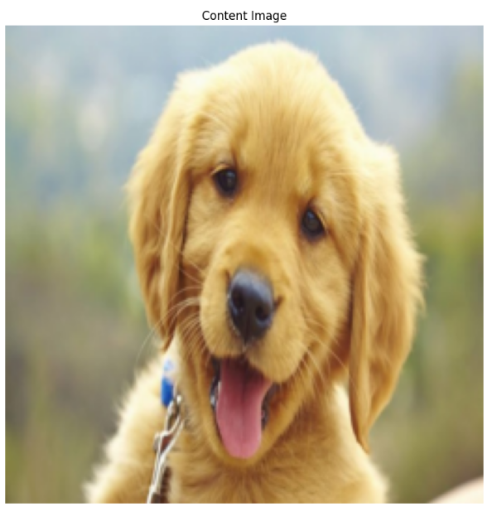
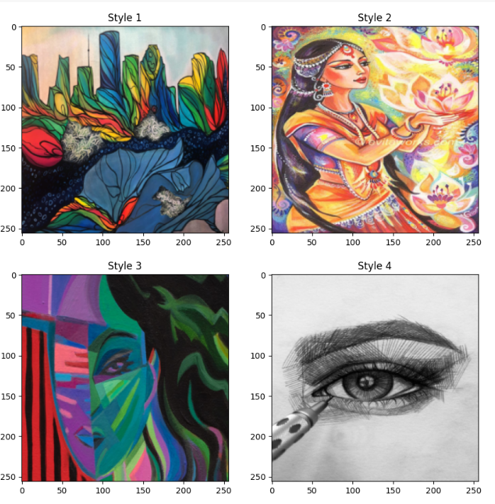
Data collection
We utilized the "Image Style Transfer" dataset from Kaggle, (https://www.kaggle.com/datasets/duttasd28/image-style-transfergoogle-images )
This dataset is ideal for our project, containing high-quality content and style images organized into two directories: "train" with approximately 11 content images and "art" with around 8 style images.
Most images are in JPEG format, with an average resolution of 512 x 512 pixels.

Slide 7
Implementation
VGG19 Network:
We use a pre-trained VGG19 network from ImageNet for extracting content and style features.
Content Representation: Uses 'conv4_2' layer.
Style Representation: Uses 'conv1_1', 'conv2_1', 'conv3_1', 'conv4_1', and 'conv5_1' layers.
Preprocessing Steps:
Resizing: All images are resized to 256 x 256 pixels for uniformity.
Normalization: Pixel values are scaled to [0, 1] and standardized using ImageNet parameters (Mean: [0.485, 0.456, 0.406]; Std: [0.229, 0.224, 0.225]).
Data Augmentation: Content images undergo random horizontal flips and rotations up to 10 degrees to improve model generalization and reduce overfitting.
Quadrant Division:
Each content image is divided into four quadrants, allowing us to apply different styles to different regions. This division is done programmatically for consistency and enables independent processing of each quadrant.

Slide 8
Implementation
Optimization Process
For each quadrant, create a target image starting with the content of that quadrant.
Minimize both content loss and style loss:
Content Loss: Squared difference between the target's feature values and the content image.
Style Loss: Sum of squares of the Euclidean distance of the Gram matrices of the target and style images.
Use Adam optimizer with a learning rate of 0.003 for 5000 iterations per quadrant.
Combining Quadrants:
Arrange the styled quadrants back into their original positions to form the final image.

Slide 9
Challenges
Initial Results:
Poor results due to fewer iterations.
CPU execution was time-consuming.
3000 iterations took almost 2 hours on CP
Improved Results:
Increased iterations with GPU resulted in significantly better outcomes.
Higher iterations allowed for finer detail and style application.
Using GPU reduced execution time to a few minutes.

Slide 10
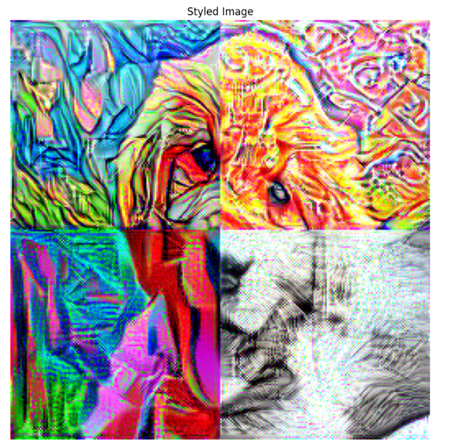
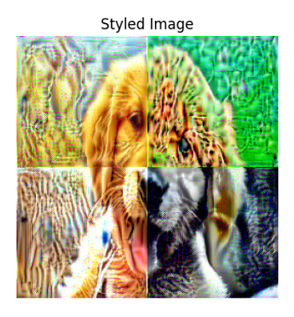
Results
Improved results
Initial results

Slide 11
Conclusion
Our project on multi-style neural transfer allows different artistic styles to be applied to various parts of a single image, offering more creative freedom than traditional methods that use only one style per image. By segmenting the image and optimizing the process, we preserved the content while adding diverse artistic effects. Despite challenges in blending styles smoothly, our method shows promise in creating cohesive artwork. Using a pre-trained VGG19 network and other techniques helped us achieve our goals. Future work will focus on improving transitions and applying this method to videos and animations.

