Slide 1
Secure data hiding in images using steganograhy
CAPSTONE PROJECT
Presented By:
RUSHMITHA POLIMERA
CSE
NRI INSTITUTE OF TECHNOLOGY

Slide 2
OUTLINE
Problem Statement
Technology used
Wow factor
End users
Result
Conclusion
Git-hub Link
Future scope

Slide 3
Problem Statement
In the digital age, the need for secure communication has become increasingly important. Traditional methods of data transmission can be intercepted, leading to unauthorized access to sensitive information. Steganography, the art of hiding data within other non-secret data, offers a solution by embedding secret information within digital media, such as images, in a way that is not easily detectable

Slide 4
Technology used
Libraries:
OS: file and directory manipulation, environmental variable access and process management.
OpenCV(open source computer vision): provides extensive capabilities for image and video processing.
Pillow (PIL): A Python Imaging Library that provides easy-to-use methods for opening, manipulating, and saving image files
Platforms:
IDLE(Integrated Development & Learning Environment):IDLE provides an interactive Python shell (REPL) where users can execute Python commands and see the results immediately. This is useful for testing small snippets of code quickly.
OpenStego: An open-source tool for steganography, allowing users to hide data in images.

Slide 5
Wow factors
Incorporating "wow factors" into a project on secure data hiding in images using steganography can significantly enhance its appeal and effectiveness. Here are some innovative ideas and features that could serve as wow factors for your project:
1. Real-Time Data Hiding and Extraction
Implement a feature that allows users to hide and extract data in real-time, providing instant feedback and visualization of the changes in the image.
2. Multi-Layered Security
Combine steganography with encryption and watermarking. For example, encrypt the data before embedding it and add a digital watermark to the image to verify its authencity
3. Adaptive Steganography
Use machine learning algorithms to adaptively choose the best pixels for data embedding based on the image content, ensuring minimal distortion and maximizing capacity.
4. User -Friendly Interface with Visual Feedback
Create an intuitive graphical user interface (GUI) that visually represents the embedding process, showing how much data can be hidden and the quality of the stego image in real-time.
5. Support for Various Media Types
Extend the application to support not just images but also audio and video files, allowing users to hide data in multiple formats.

Slide 6
End users
Organizations: Individuals:
Businesses privacy-Conscious users
Government agencies Whistleblowers
Military Circumventing censorship
Cybercriminals: Other users:
Malware distributors Artists
Data thieves Historians
Organized crime

Slide 7
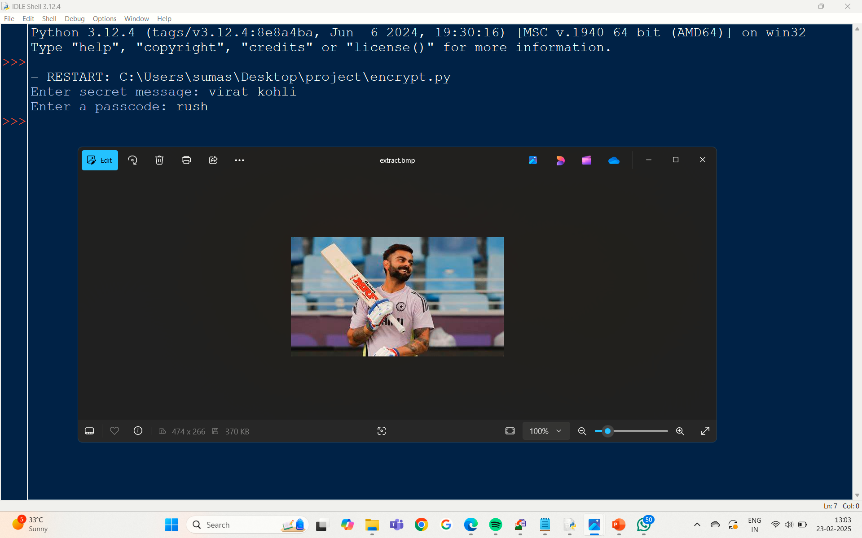
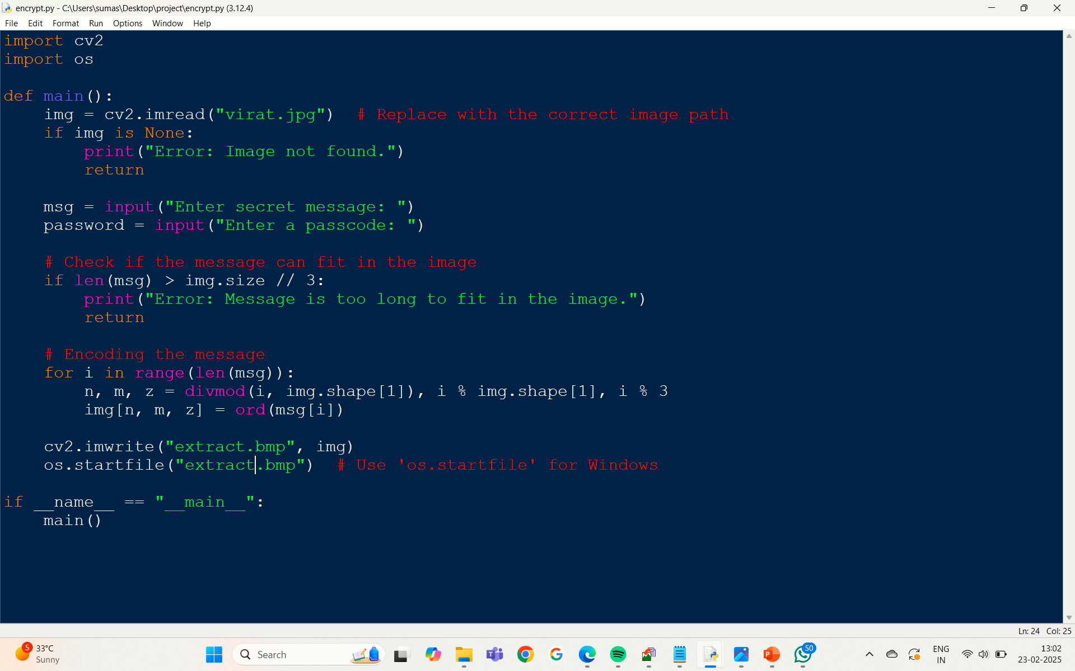
Results

Slide 8
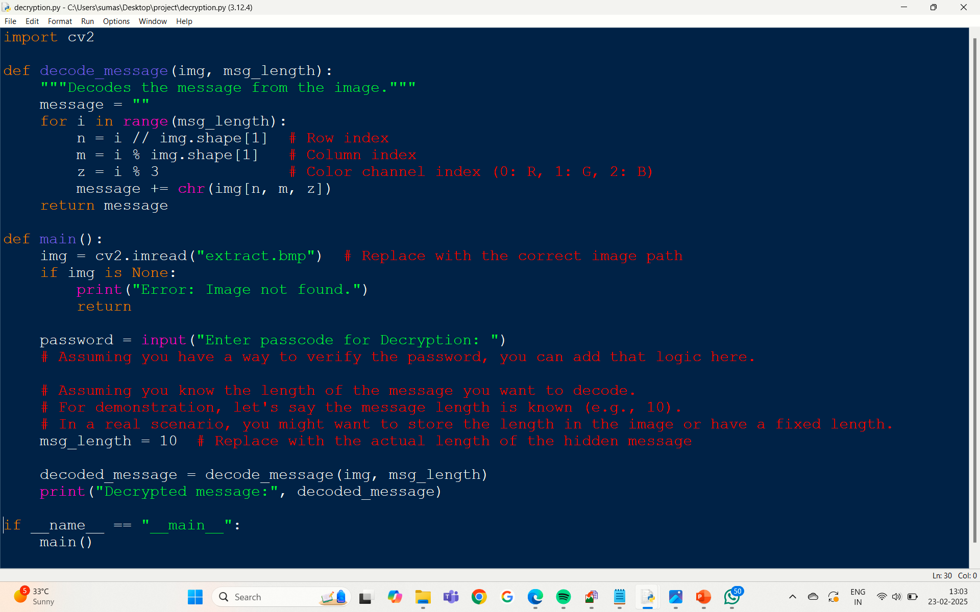
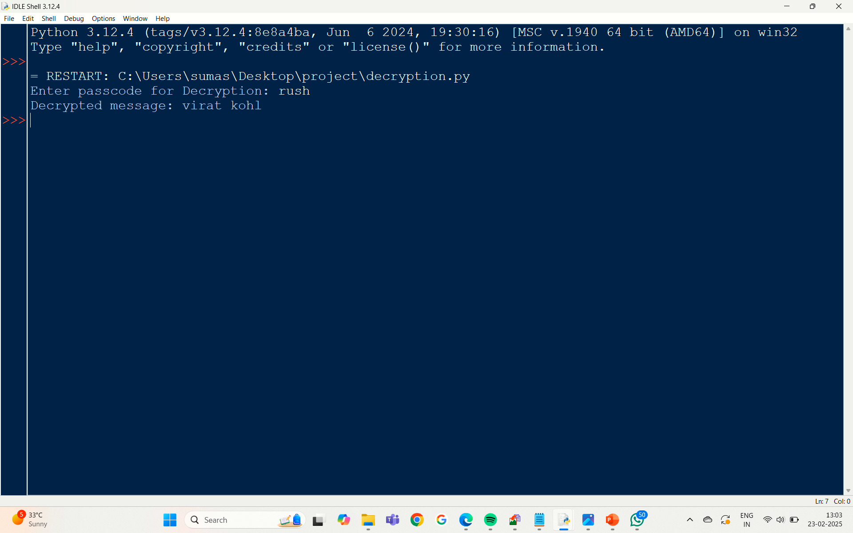
results

Slide 9
Conclusion
In an era where digital communication is ubiquitous, the need for secure methods of data transmission has never been more critical. This project on secure data hiding in images using steganography addresses this need by providing a robust framework for embedding and extracting sensitive information within digital images. By leveraging advanced techniques and innovative features, the project aims to enhance the confidentiality and integrity of data while maintaining the visual quality of the cover images.
The implementation of real-time data hiding and extraction, multi-layered security measures, and adaptive algorithms not only improves the effectiveness of the steganography process but also makes it user-friendly and accessible. The incorporation of educational components and community-sharing features fosters a deeper understanding of digital security principles, empowering users to make informed decisions about their data privacy.

Slide 10
GitHub Link
https://github.com/Rushmitha-19/steganography

Slide 11
Future scope(optional)
1. Integration of Machine Learning
Adaptive Algorithms: Implement machine learning algorithms to improve the selection of pixels for data embedding based on image characteristics, enhancing both capacity and imperceptibility.
Anomaly Detection: Use machine learning techniques to detect anomalies in stego images, which could indicate attempts at steganalysis or unauthorized access.
2. Support for Additional Media Types
Audio and Video Steganography: Extend the application to support hiding data in audio files and video streams, allowing for a broader range of use cases in multimedia communications.
3D Models and Textures: Explore the possibility of embedding data in 3D models and textures, which could be useful in gaming and virtual reality applications.
3. Enhanced Security Features
Multi-Layer Encryption: Implement multi-layer encryption techniques to further secure the hidden data, making it more resistant to attacks.
Digital Watermarking: Combine steganography with digital watermarking to provide an additional layer of security and authenticity verification for the stego images.

Slide 12
THANK YOU

