Slide 1

DEPARTMENT OF COMPUTER SCIENCE AND ENGINEERING
Air Quality Index Forecasting Via Genetic Algorithm-Based Improved Extreme Learning Machine
PRESENTED BY: UNDER GUIDANCE OF:
A.SRI UHA VARSHA 21RG1A0503 Mrs.E AVYAKTHA
P.BHAVANA 21RG1A0542 B.Tech,M.Tech R.AKSHITHA 21RG1A0548 ASSISTANT PROFESSOR
U.RUSHMITHA 21RG1A0560

Slide 2
CONTENT
Abstract
Introduction
Existing System
Literature Survey
Proposed Method
Hardware & Software Requirements
Advantages
Applications
Result Analysis
Future Scope
Conclusion
References

Slide 3
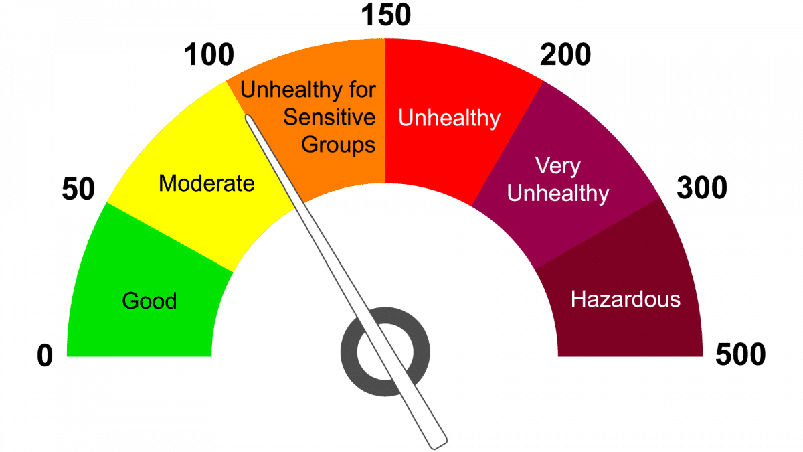
ABSTRACT
Air quality has always been one of the most important environmental concerns for the general public and society. Using machine learning algorithms for Air Quality Index (AQI) prediction is helpful for the analysis of future air quality trends from a macro perspective.
When conventionally using a single machine learning model to predict air quality, it is challenging to achieve a good prediction outcome under various AQI fluctuation trends. In order to effectively address this problem, a genetic algorithm-based improved extreme learning machine (GA-KELM) prediction method is enhanced.
To address the issue of the conventional limit learning machine where the number of hidden nodes and the random generation of thresholds and weights lead to the degradation of the network learning ability, a genetic algorithm is then used to optimize the number of hidden nodes and layers of the kernel limit learning machine.
Finally, the least squares method is applied to compute the output weights of the model. Genetic algorithms are able to find the optimal solution in the search space and gradually improve the performance of the model through an iterative optimization process.

Slide 4
INTRODUCTION
According to the Chinese Ambient Air Quality Standards (GB3095-2012), there are six conventional air pollutants used to measure air quality: sulfur dioxide (SO2), nitrogen dioxide (NO2), particulate matter with a particle size less than 10 microns (PM10), particulate matter with a particle size less than 2.5 microns (PM2.5), ozone (O3), and carbon monoxide (CO) .
The International Energy Agency estimates that air pollution causes 6.5 million premature deaths per year, while long-term exposure to pollutants, such as fine particles or traffic-related pollutants, is linked to higher rates of lung cancer, coronary heart disease, and other illnesses.
In order to more comprehensively assess the health effects of air pollution, numerous air quality monitoring stations have been set up in major cities. Air quality predictions can be made based on the data collected from these stations. Monitoring, modeling, and accurate predictions are important for having a clear understanding of future pollution levels and their associated health risks.
The proposed GA-based improved extreme learning machine (GA-KELM) algorithm is applied to air quality prediction, and its performance is compared with that of community multi-scale air quality modeling system (CMAQ), support vector regression (SVR), and deep belief network-back propagation (DBN-BP). The results show that the accuracy of the proposed GA-KELM algorithm is reliable for air quality prediction. An improved extreme learning machine model based on a genetic algorithm is designed and applied to AQI prediction.

Slide 5
EXISTING SYSTEM
The existing system typically uses a single machine learning model, such as traditional neural networks, for predicting air quality.
Some of the prominent models referenced include the Community Multi scale Air Quality (CMAQ) modeling system, Support Vector Regression (SVR), and Deep Belief Network with Back-Propagation (DBN-BP).
DISADVANTAGES
Single Model Limitations: Using a single machine learning model often results in suboptimal performance due to the varied and fluctuating nature of AQI data.
Slow Learning: Traditional neural networks can suffer from slow learning processes.
Local Minima: Neural networks tend to get stuck in local minima, which affects prediction accuracy.
Complex Training Process: Training neural networks can be complex and time-consuming.
Random Parameter Selection: For methods like Extreme Learning Machine (ELM), the number of hidden nodes and the random generation of thresholds and weights lead to a degradation in the network's learning ability and prediction accuracy.

Slide 6
LITERATURE SURVEY
In this literature survey, we review key studies related to air pollution monitoring, forecasting, and control, with a focus on the application of machine learning techniques for air quality prediction. Li et al. (2019) highlighted air pollution as a global problem that requires local solutions, emphasizing the importance of addressing air quality issues at the regional level.
Agarwal and Sahu conducted air quality prediction studies by employing statistical models. Lary et al.
Proposed a hybrid prediction method that combines a linear regression- based temporal prediction method with an ANN-based spatial prediction method for pollutant concentrations. Zheng et al.
In this study, PM2.5 prediction for Hyderabad city was carried out using various machine learning models viz. decision tree (DT), K-Nearest Neighbors (KNN). A deep learning model, the Long Short-Term Memory (LSTM) model, was also used in this study. The results obtained were finally compared based on error and R2 value. - P.R. Gokul

Slide 7
PROPOSED METHOD
The proposed system is a Genetic Algorithm-based Improved Extreme Learning Machine (GA-KELM).
This system introduces a kernel method to generate a kernel matrix that replaces the output matrix of the hidden layer in the ELM.
A genetic algorithm (GA) is used to optimize the number of hidden nodes, the thresholds, and the weights of the ELM.
The Root Mean Square Error (RMSE) is employed as the fitness function for the GA.
The Least Squares Method is applied to compute the output weights of the model.

Slide 8
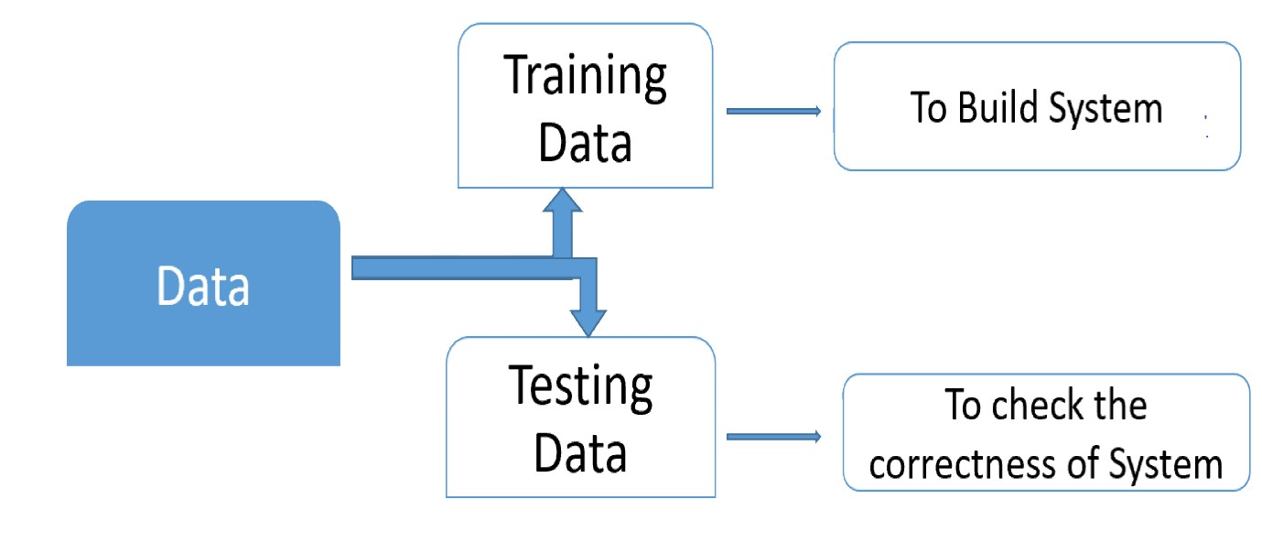
ARCHITECTURE DIAGRAM

Slide 9
REQUIREMENTS
Hardware Requirements:
System : Intel I-3, 5, 7 Processor.
Hard Disk : 512 GB.
Ram : 8 GB
Software Requirements
Operating system : Windows 7,8,10 Ultimate, Linux, Mac.
Front-End : Python.
Coding Language : Python.
Software Environment : Anaconda (jupyter or spyder)

Slide 10
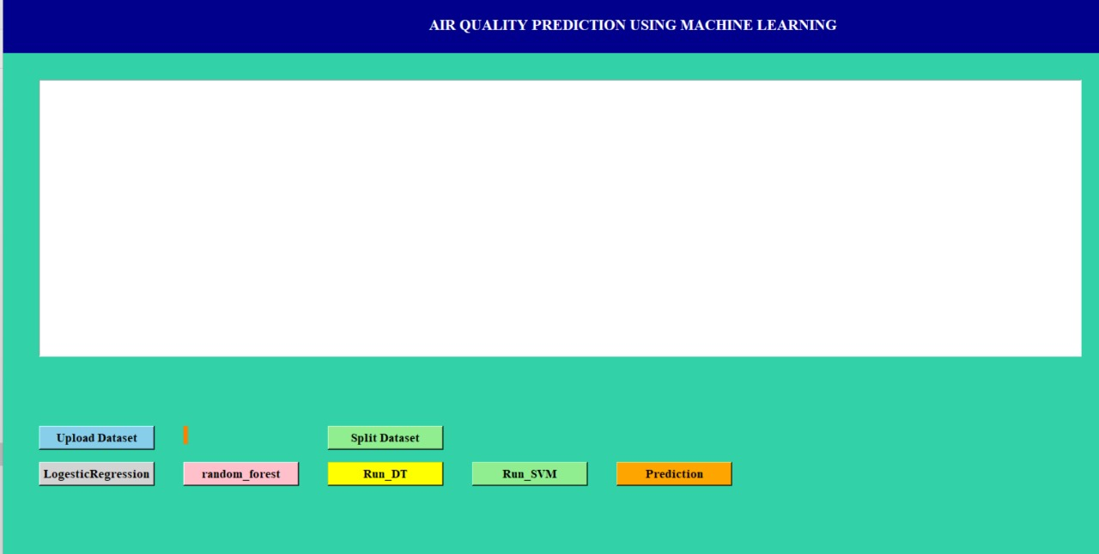
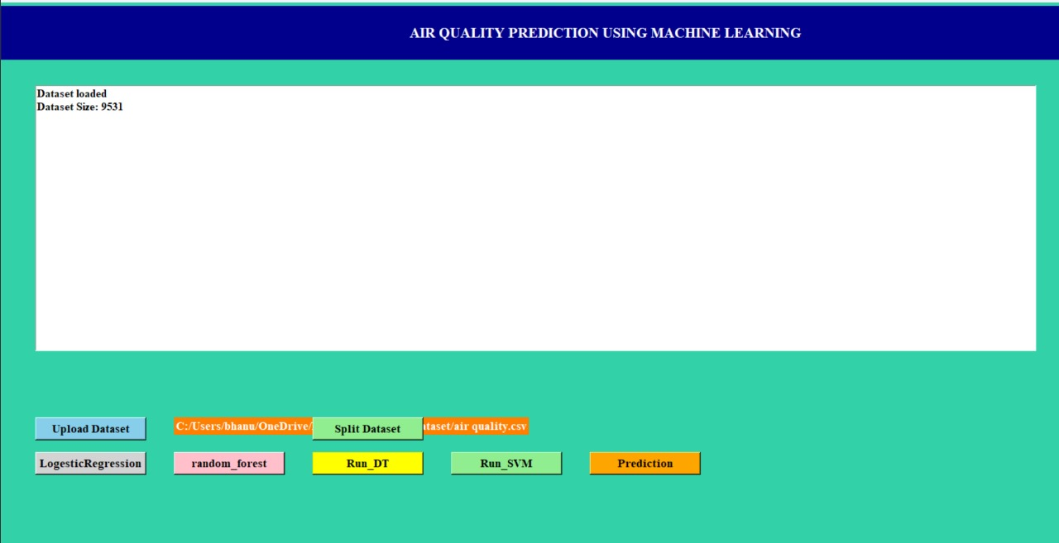
OUTPUT

Slide 11
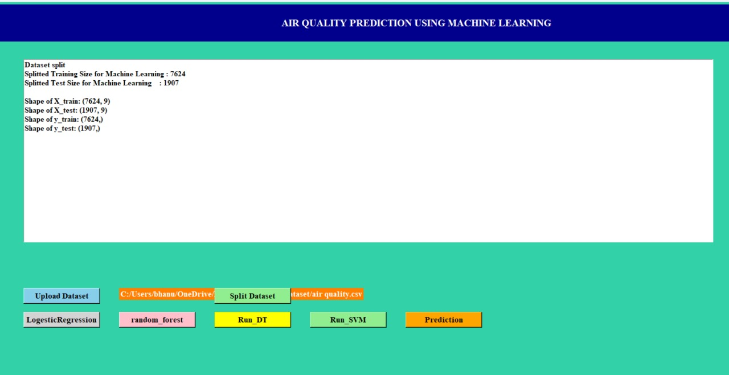
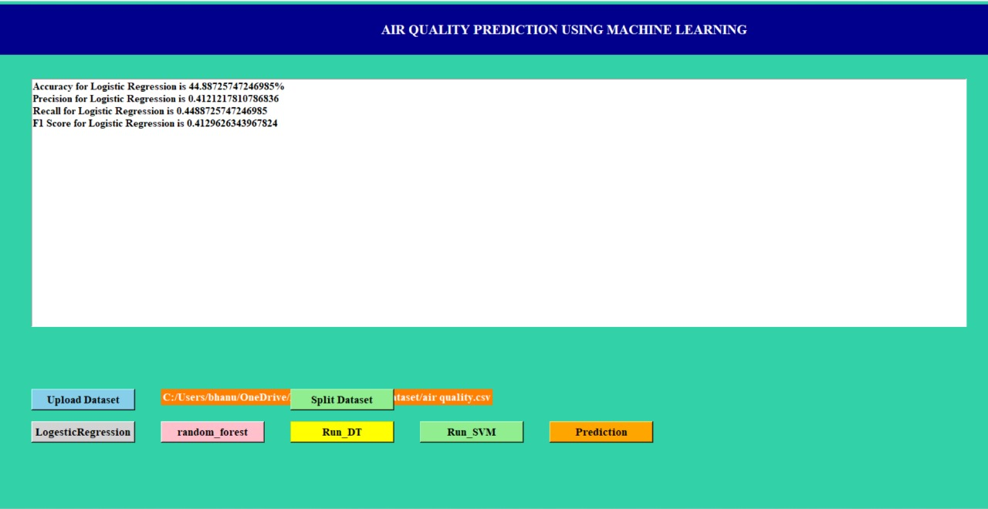

Slide 12
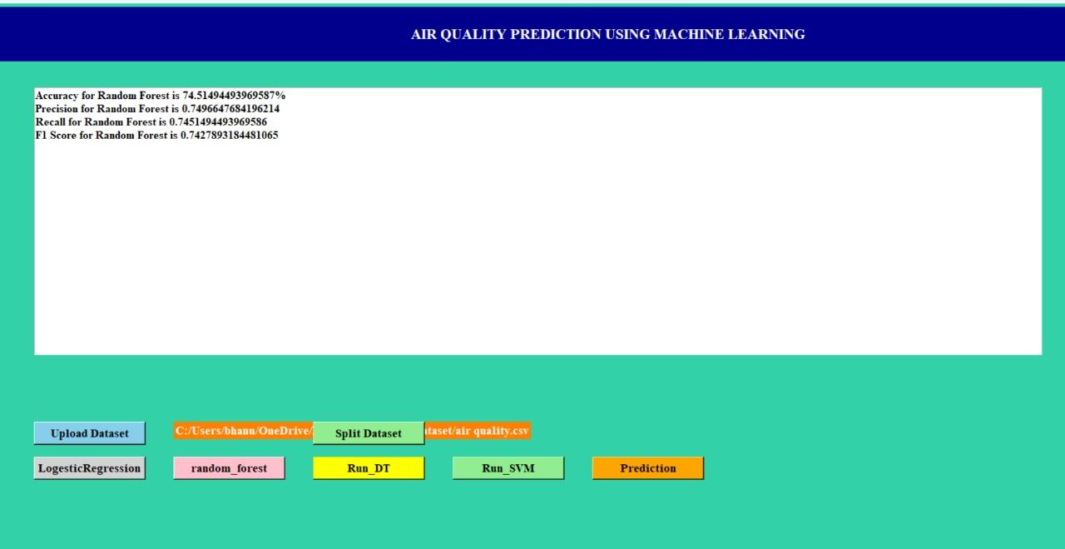
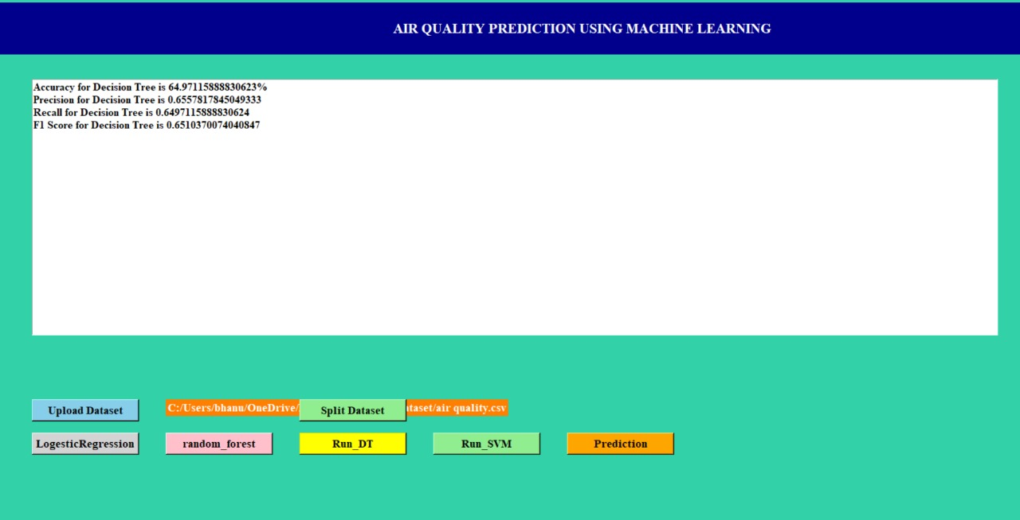

Slide 13

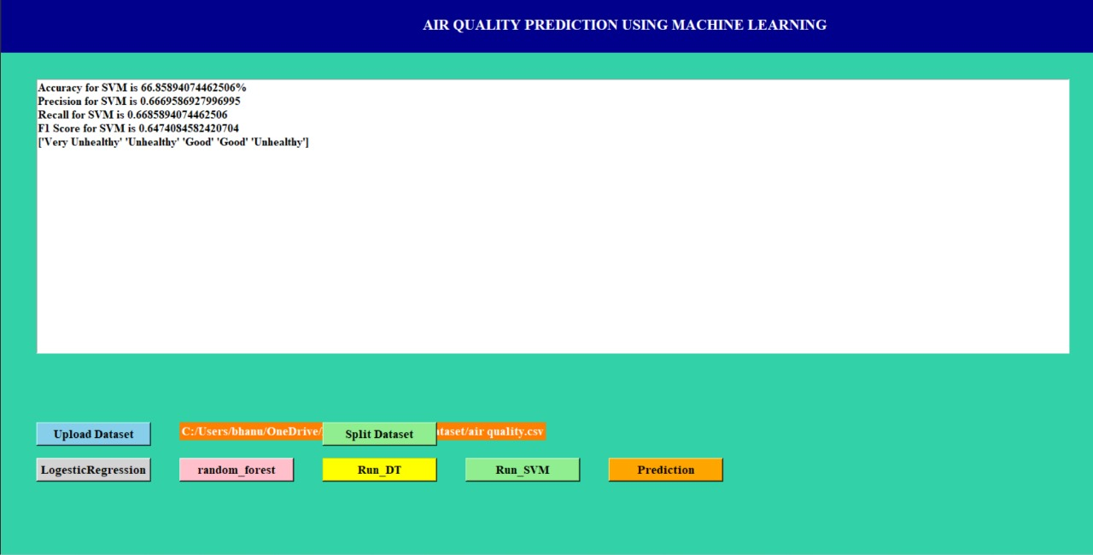

Slide 14
ADVANTAGES
Improved Prediction Accuracy: The use of a kernel method in ELM and optimization via GA enhances the prediction accuracy by addressing the random parameter selection issue.
Optimized Network Structure: GA optimizes the number of hidden nodes and layers, as well as the thresholds and weights, leading to a more effective and efficient learning process.
Faster Training: The proposed GA-KELM trains faster compared to traditional methods.
Enhanced Stability: The optimization process via GA improves the stability of the results, reducing variability and enhancing reliability.
Iterative Improvement: GA iteratively finds the optimal solution in the search space, progressively improving model performance.
Comparative Superiority: Experiments demonstrate that GA-KELM outperforms existing models like CMAQ, SVR, and DBN-BP in terms of accuracy and training speed.

Slide 15
APPLICATIONS
Air Quality Index (AQI) forecasting has several important applications, including:
Public Health: Accurate AQI forecasts help inform the public about potential health risks, allowing individuals to take precautions, such as staying indoors or wearing masks on high pollution days.
Policy Making: Governments and environmental agencies use AQI forecasts to implement policies and regulations aimed at reducing pollution levels. This can include traffic restrictions, industrial emission controls, and public advisories.
Environmental Monitoring: Continuous monitoring and forecasting of AQI help in assessing the effectiveness of pollution control measures and in making necessary adjustments.
Research and Development: Scientists and researchers use AQI data to study the impact of various pollutants on health and the environment. This data is crucial for developing new technologies and strategies to combat air pollution.
Urban Planning: Urban planners use AQI forecasts to design cities in ways that minimize pollution exposure, such as creating green spaces and optimizing traffic flow.
Machine learning models, such as Artificial Neural Networks (ANN), Random Forest (RF), and Support Vector Regressor (SVR), are commonly used for AQI forecasting due to their ability to handle complex and non-linear relationships between pollutants and meteorological factors.

Slide 16
FUTURE SCOPE
The future scope of Air Quality Index (AQI) forecasting using a Genetic Algorithm-Based Improved Extreme Learning Machine (GA-KELM) is quite promising. Here are some key areas where this approach can make significant contributions:
Advanced Monitoring Technologies: The development of more sophisticated sensors and monitoring devices will enable more accurate and widespread air quality data collection.
Machine Learning and AI: The use of machine learning and artificial intelligence will enhance the predictive capabilities of air quality models, allowing for more accurate and timely forecasts.
Integration with Smart Cities: Air quality monitoring systems will be integrated into smart city infrastructures, providing real-time data to manage urban pollution more effectively.
Public Health Initiatives: Improved air quality forecasting will support public health initiatives by providing data that can be used to issue health advisories and implement pollution control measures.
Climate Change Mitigation: Understanding the relationship between air quality and climate change will help in developing strategies to mitigate the impact of climate change on air quality.

Slide 17
CONCLUSION
A correct analysis and accurate prediction of air quality remains a primary condition to achieve the objective of sustainable development.
Our project focus on the problem of prediction model design, and investigates the problems related to the optimization of the model parameters. The GA-KELM model is experimentally proven to be more efficient than the classical shallow learning and can effectively explore and learn the interdependence of multivariate air quality correlation time series such as temperature, humidity, wind speed, SO2, and PM10.
In conclusion, our study highlights the significance of the GA-KELM model in predicting air quality. We have addressed the optimization challenges and demonstrated its superiority over traditional methods.
Furthermore, the integration of pollutant emission factors and meteorological factors into the evaluation system will advance the accuracy and reliability of air quality measurement and assessment.

Slide 18
REFERENCES
[1] X. Li, L. Jin, and H. Kan, ‘‘Air pollution: A global problem needs local fixes,’’ Nature, vol. 570, no. 7762, pp. 437–439, Jun. 2019.
[2] Y. Han, J. C. K. Lam, and V. O. K. Li, ‘‘A Bayesian LSTM model to evaluate the effects of air pollution control regulations in China,’’ in Proc. IEEE Big Data Workshop (Big Data), Dec. 2018, pp. 4465–4468.
[3] L. Bai, J. Wang, X. Ma, and H. Lu, ‘‘Air pollution forecasts: An overview,’’ Int. J. Environ. Res. Public Health, vol. 15, no. 4, p. 780, 2018.
[4] Y. Ding and Y. Xue, ‘‘A deep learning approach to writer identification using inertial sensor data of air-handwriting,’’ IEICE Trans. Inf. Syst., vol. E102-D, no. 10, pp. 2059–2063, 2019.
[5] S.-Q. Dotse, M. I. Petra, L. Dagar, and L. C. De Silva, ‘‘Application of computational intelligence techniques to forecast daily PM10 exceedances in Brunei Darussalam,’’ Atmos. Pollut. Res., vol. 9, no. 2, pp. 358–368, Mar. 2018.
[7] S. Abirami, P. Chitra, R. Madhumitha, and S. R. Kesavan, ‘‘Hybrid spatio-temporal deep learning framework for particulate matter (PM2.5) concentration forecasting,’’ in Proc. Int. Conf. Innov. Trends Inf. Technol. (ICITIIT), Feb. 2020, pp. 1–6.
[8] Y. Cheng, S. Zhang, C. Huan, M. O. Oladokun, and Z. Lin, ‘‘Optimization on fresh outdoor air ratio of air conditioning system with stratum ventilation for both targeted indoor air quality and maximal energy saving,’’ Building Environ., vol. 147, pp. 11–22, Jan. 2019.

Slide 19
THANK YOU

