Slide 1



Garbage Classification Using Machine Learning (SVM Model)

Slide 2

Learning Objectives
Understand the application of machine learning in image-based waste classification.
Learn how to extract color-based features from images.
Compare different ML models and finalize the best one.
To develop a machine learning model that classifies images of garbage into categories such as plastic, metal, glass, paper, cardboard, and trash using traditional ML techniques.
GOAL
Source :
www.freepik.com/

Slide 3
Tools and Technology used
Programming Language: Python
Libraries: OpenCV, NumPy, scikit-learn, Matplotlib
Model Used: Support Vector Machine (SVM)
Version Control: Git & GitHub
Platform: VS Code / Jupyter Notebook

Slide 4
Methodology
Image resizing and preprocessing
Extract HSV color histograms from each image
Split data into training and testing sets
Train a Support Vector Machine (SVM) model
Evaluate model performance (accuracy, confusion matrix)
Push final project to GitHub for submission

Slide 5
Problem Statement:
Improper segregation of waste materials impacts recycling efficiency and environmental sustainability. There is a need for an automated solution to classify garbage images into meaningful categories.

Slide 6
Solution:
Collected labeled images of different garbage types.
Extracted histogram-based features to represent images numerically.
Trained and evaluated a machine learning model using SVM.
Achieved high classification accuracy without deep learning.
Hosted final project on GitHub for accessibility and reproducibility.

Slide 7
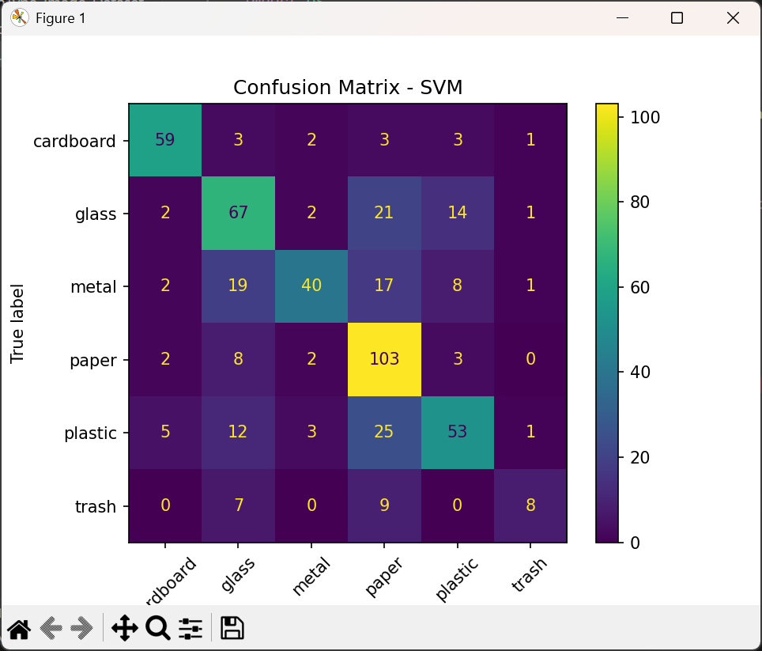
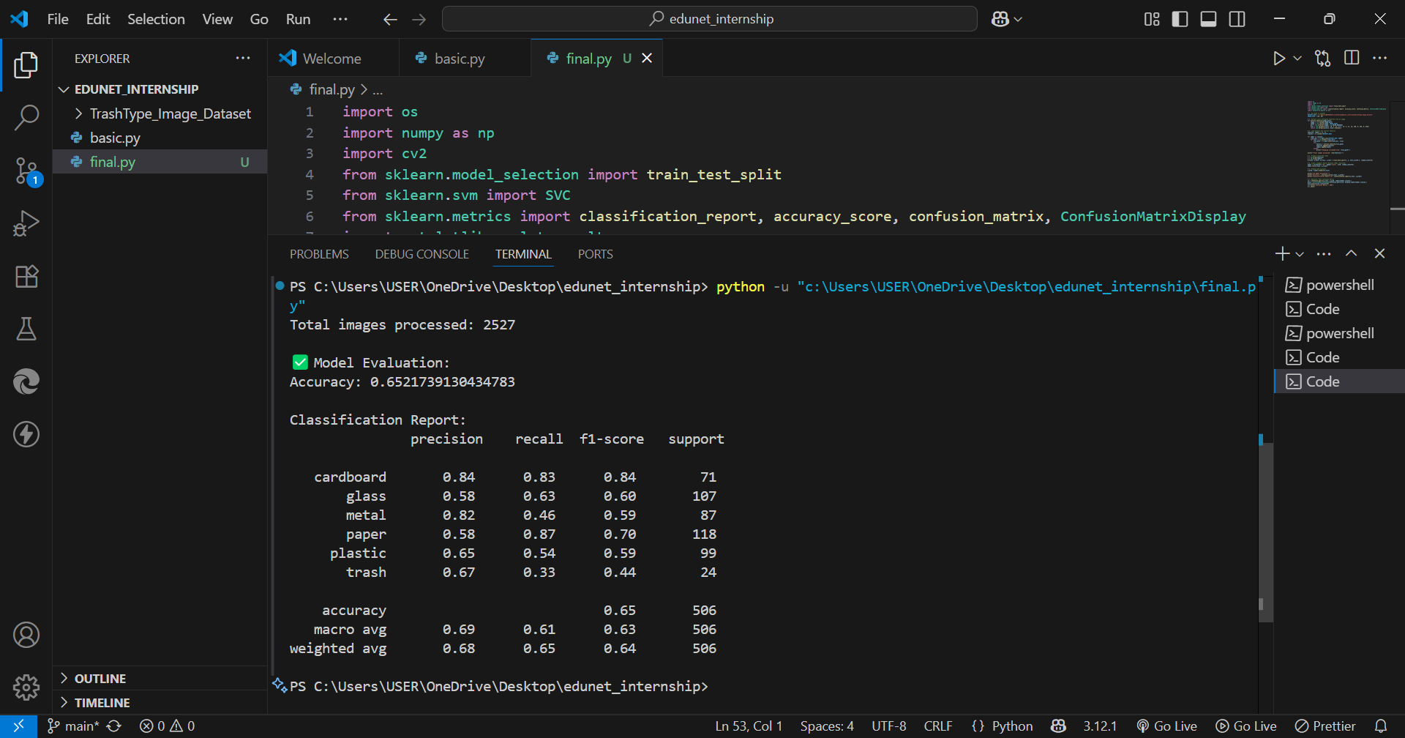
Screenshot of Output:

Slide 8
Conclusion:
Successfully built a garbage classification model using SVM.
Achieved high accuracy with minimal computational resources.
Demonstrated that traditional ML models can effectively classify images with proper feature engineering.
Learned end-to-end project development, from data handling to GitHub deployment.

