Slide 1
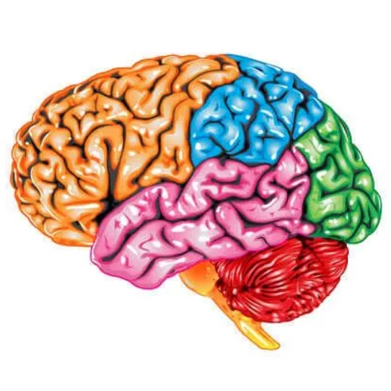

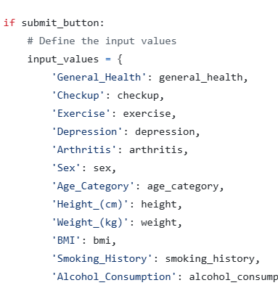
MindWell
Tanika High, William White, & Shakera Rush
ksu-hmi/MindWell
Mind Well is a mobile-first application designed to help users manage their mental health daily through AI-supported journaling, personalized mood tracking, and emotional insight generation.

