Slide 1
Unit Testing
SE3070 - Case Studies in Software Engineering
Semester 2, 2025
SLIIT

Slide 2
Learning Outcomes
After completing this topic, you will be able to,
Explain why testing is essential for safe refactoring.
Write unit tests in Java
Apply good techniques in writing unit tests for proper coverage.
Successfully apply unit testing in refactoring

Slide 3
Contents
What is Testing?
Why do Testing?
Test Pyramid
Unit Testing
Unit Testing Frameworks
What to check in Unit Tests
Test-Driven Development
Best Practices in Testing
Additional Topics to Read
Summary

Slide 4

What is Testing?
What is a test?
For a given input, validate if (actual behavior==expected behavior)
Types of testing
Unit, Integration, System, Acceptance
Test pyramid
Many unit tests
Fewer integration tests
Few End to end tests
Automation & repeatability are essential

Slide 5
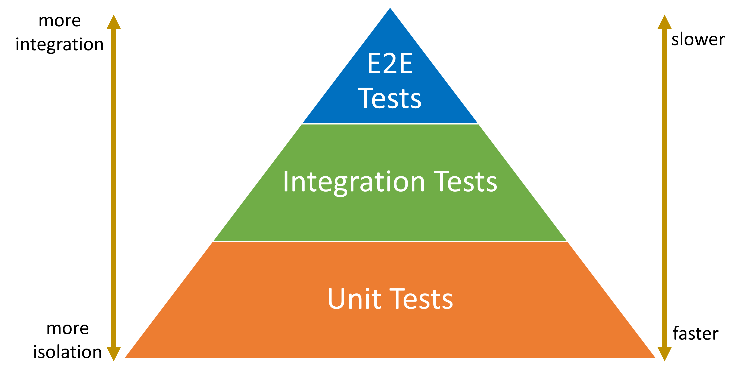
Test Pyramid
Source: https://juliocasal.com/blog/Should-You-Write-Unit-Tests

Slide 6
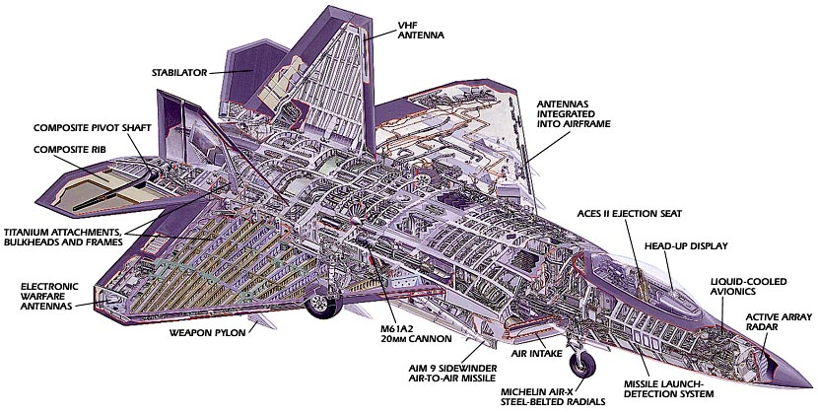
Why do Testing?
Lockheed Martin F-22 Raptor schematic diagram. Source: https://www.king-titanium.com/titanium-exporter/f22_schematic.jpg

Slide 7
Why do Testing?
How many components are in an F22 Raptor?
Likely hundreds of thousands to millions (exact figure not public).
What if Lockheed Martin assembled a fighter with "untested" parts (i.e. parts built but not verified for proper operation)?
The aircraft would not work, with problems far too complex to even comprehend.
Would be cheaper to entirely scratch that off and start over.

Slide 8
Why do Testing?
What was the cause of failure here?
Implementation complexity was not managed.
Each individual part should have been tested first before being integrated with other parts.
Gradually integrate and verify the components then (creating sub-systems)
If adding a new component causes a problem, then the problem must be with the recently added part – fix that part.
Apply this process until a working complete system is produced

Slide 9
Why do Testing?
There are two approaches to writing programs
Approach 01 - Write all the code and hope for the best before compiling and running it.
Usually results in a program which does not work at all
Approach 02 - Incremental change
Write a small piece of code and test it
Write a little more code and test that too
Integrate the two verified pieces of code
...continue until the product is complete

Slide 10
What is Unit Testing?
Large programs contain main smaller "pieces".
Commonly known as Units.
A unit is usually a Class or a Method in an OOP context.
Unit testing is done to test these small pieces in isolation before they are integrated with other pieces.
Benefits
Cheap and fast feedback
Prevents regressions - eables safe refactoring
See this article

Slide 11
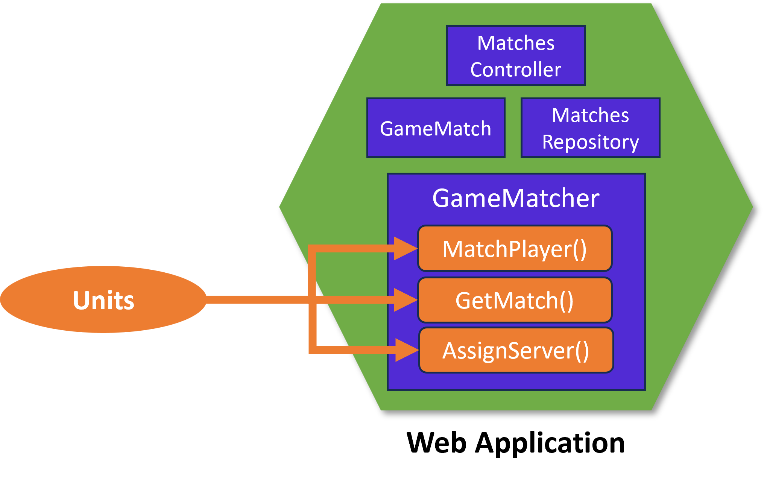
What is Unit Testing?
Source: https://juliocasal.com/assets/images/what-is-a-unit.png

Slide 12
What is Unit Testing?
Unit tests create objects, call methods and check results
Unit tests work by comparing actual vs expected results via Assert statements.
Automate unit tests so they can run often (many times daily)
Ensures changes don’t break the code
Regression testing
Prevents system instability

Slide 13
Refactoring and Unit Testing
Refactoring changes internal code but must preserve behavior
Lack of tests when refactoring/ development can result in fear of change and sometimes, catastrophic failure
Knight Capital case - $440M in 30 minutes loss due to faulty release
Having tests help avoid regression bugs
Ensures existing features keep working after changes
Tests provide the safety net for software evolution

Slide 14
Unit Testing frameworks
Usually these automated tests are handled by a unit testing framework + an IDE
Adding tests, running tests require only little developer intervention
After running the tests the unit testing framework presents the results of the tests on the IDE.
You get an overview of what tests passed and what failed
Some well-known unit testing frameworks include,
JUnit, NUnit (and many other xUnit frameworks)
TestNG
[YouTube] Java Unit Testing with JUnit
Note: Tests can be run programmatically too.

Slide 15
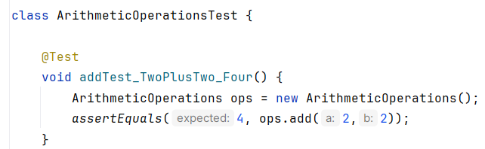
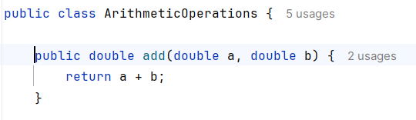
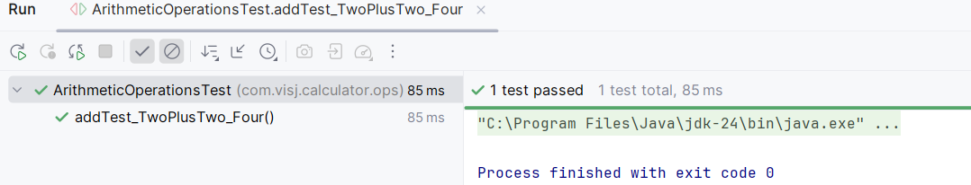
Unit Testing frameworks
JUnit simple test example
Method to be tested
Test case (i.e. the unit test)
Execution result

Slide 16
Components of a unit test
Assertions
Unit Testing works on Assertions.
An Assertion is a condition that is expected to be true in order to pass the test.
E.g. AssertTrue(), AssertEquals(), AssertNull(), AssertNotNull() etc.
Annotations
special markers (prefixed with @) that tell the test framework how to run certain methods
E.g. @Test, @BeforeEach, @AfterEach etc.
Test Case
A test Case is one @Test method that checks a specific behavior/scenario.
A unit test can be composed of one more test cases.

Slide 17
Components of a unit test
Annotation
Assertion
Test Case

Slide 18
Common Parts of a unit test
Some common assertions in JUnit
assertEquals(expected, actual) - checks values are equal
assertNotEquals(unexpected, actual) - checks values are not equal
assertTrue(condition) - checks condition is true
assertFalse(condition) - checks condition is false
assertNull(object) - checks object is null
assertNotNull(object) - checks object is not null
assertThrows(Exception.class, executable) - checks code throws an exception
assertAll(...) - Asserts that all supplied executables do not throw exceptions.
fail(message) - Fails a test with the given failure message

Slide 19
Common Parts of a unit test
Some common annotations in Junit
@Test - marks a method as a test
@BeforeEach - runs before every test
@AfterEach - runs after every test
@BeforeAll - runs once before all tests
@AfterAll - runs once after all tests
@Disabled - disables a test
@ParameterizedTest - runs a test with different inputs
@RepeatedTest(n) - repeats a test multiple times

Slide 20
What to check in Unit Tests
Positive test cases (happy path)
Verify the method under test works correctly with valid inputs.
Negative test cases (sad path)
Confirm invalid inputs trigger the right failures or exceptions.
Boundary/edge cases
Test inputs at the limits (min, max, zero, null, NaN, etc.).
Equivalence classes
Test one representative value from each input category instead of every possible value.
Determinism
Ensure the method under test gives the same result every time for the same inputs, independent of time, randomness, or environment.
See Code example provided.

Slide 21
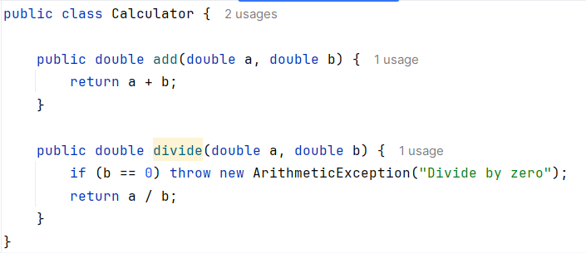
What to check in Unit Tests
Calculator Class

Slide 22
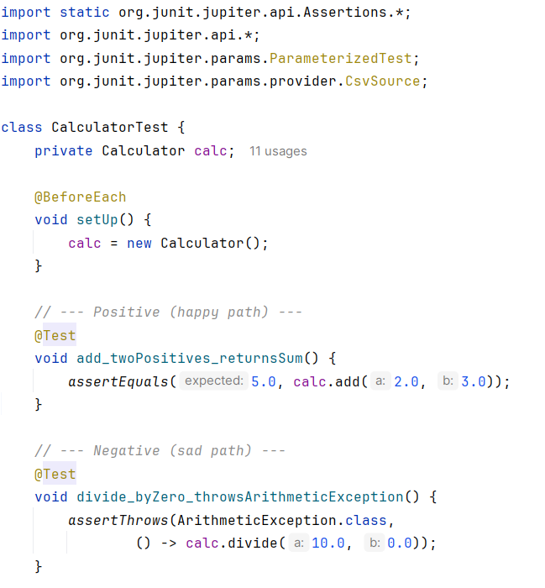
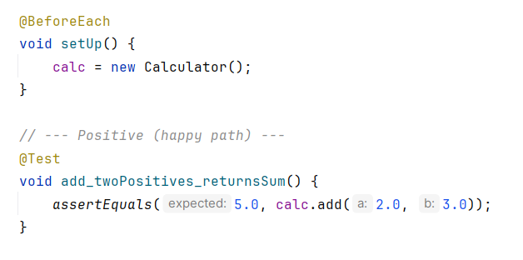
What to check in Unit Tests
Positive test case
A fragment of CalculatorTest Class

Slide 23
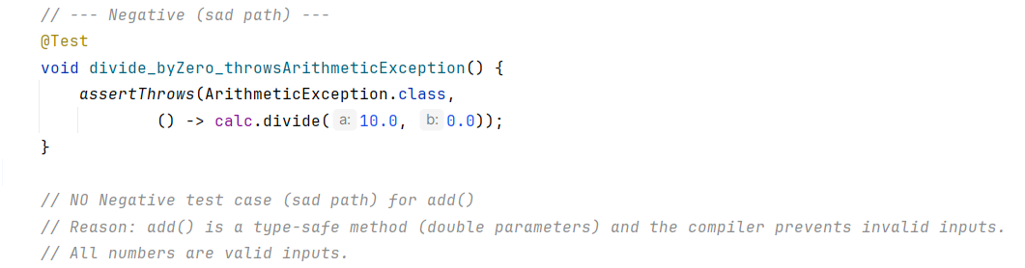
What to check in Unit Tests
Negative test case

Slide 24
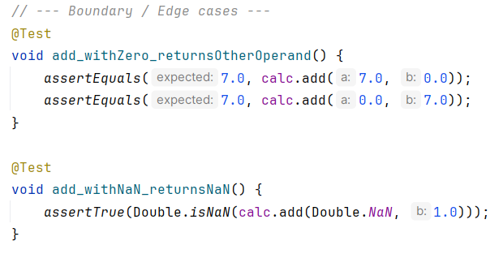
What to check in Unit Tests
Boundary checks
Notes:
ZERO / ZERO = NaN

Slide 25
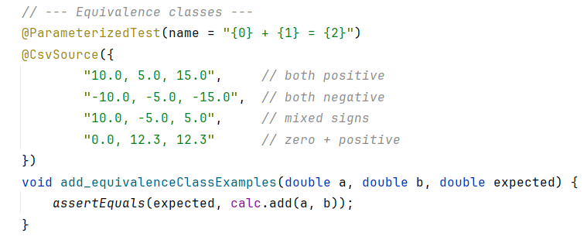
What to check in Unit Tests
Equivalence checks

Slide 26
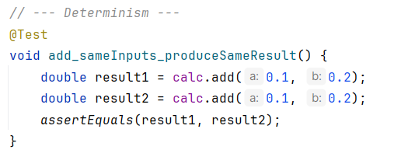
What to check in Unit Tests
Determinism checks

Slide 27
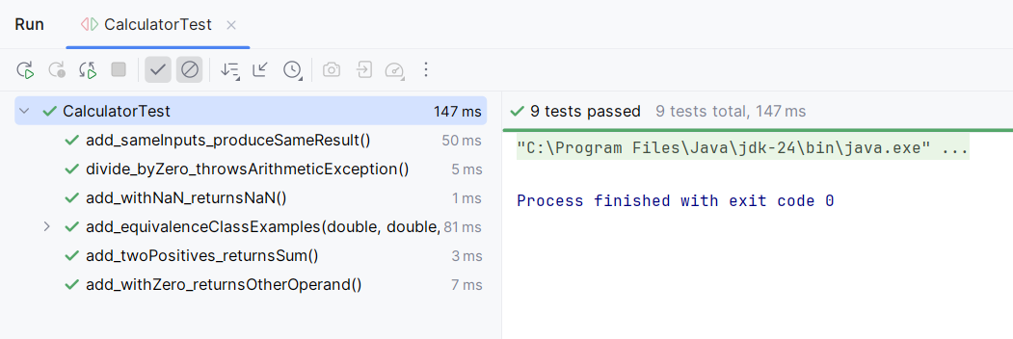
What to check in Unit Tests
Test Results

Slide 28
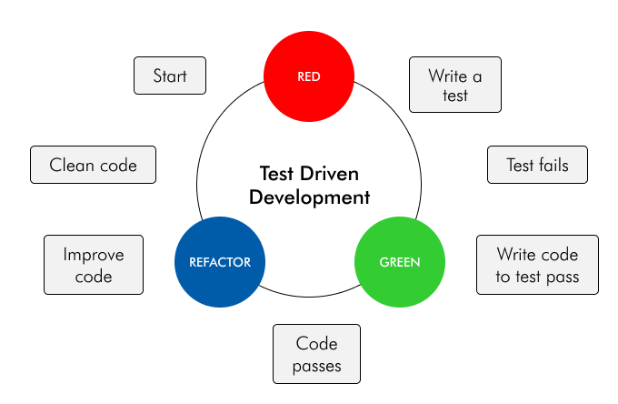
Test Driven Development
Source: https://www.zealousys.com/blog/what-is-test-driven-development/

Slide 29
Test Driven Development
Write a Test
Start by writing a small test for the next piece of functionality.
Run the Test. The test will fail because the feature isn’t implemented yet. This ensures the test is valid.
Write the Minimum Code - Implement just enough code to make the test pass.
Avoid over-engineering at this stage.
Run All Tests
Verify the new test passes.
Ensure no old tests are broken.
Refactor - Improve the code structure while keeping all tests green.
Remove duplication, simplify, and clarify design.
Repeat - Continue the cycle for each new feature or requirement.

Slide 30
Test Driven Development
Test-Driven Development (TDD)
Tests are written before code.
Drives design - encourages thinking about interfaces and responsibilities.
Produces simpler, cleaner solutions (avoids over-engineering).
Provides immediate feedback with every cycle.
Bugs are caught early, reducing debugging effort.
Writing tests after coding
Tests are written after implementation.
May miss design flaws because design is already fixed.
Often leads to more complex code with weaker guidance.
Feedback is delayed until after coding is complete.
Bugs found later, increasing debugging and rework.

Slide 31
Unit Testing + Refactoring
Start with a test capturing expected behavior
Write tests first if you don’t have them
Apply refactoring techniques
e.g., Extract Method, Introduce Parameter Object
Re-run tests
If all unit tests pass -> behavior unchanged -> no regression issues

Slide 32
Best practices in unit testing
Read this article.

Slide 33
Additional Topics to read
Test Doubles
Simulate real dependencies so a unit can be tested in isolation
Read this article on test doubles
Integration Testing
Verify interactions between modules/subsystems
Discover interface mismatches, data flow issues, hidden dependencies
Read this article on Integration Testing
API Testing
[YouTube] Unit testing and integration testing in CI/CD

Slide 34
Summary
Testing is essential - it provides confidence that software works correctly, prevents regressions, and enables safe refactoring.
Unit Testing focuses on small components, giving fast and cheap feedback compared to higher-level tests.
Test-Driven Development (TDD) is a natural extension to unit testing.
Testing + Refactoring together they form a continuous improvement loop
Tests act as a safety net
Refactoring keeps the codebase clean and maintainable
Industry practice - unit testing is not isolated; it integrates intoCI/CD pipelines, ensuring reliable and automated qualitychecks.

Slide 35
References
Martin Fowler, "Refactoring: Improving the Design of Existing Code", 2nd Edition - Chapters 4.
JUnit 5 User Guide | Writing Tests
Why Test Driven Development Matters: Best Practices to Implement TDD

Slide 36

Thank you!
Vishan Jayasinghearachchi
Department of Software Engineering vishan.j@sliit.lk

