Slide 1


EN
UFI Phone
v0.5.0
Private carrier calls and SMS on the screens you already own
Tested UFI003 profile with Ucell
Android, Linux and Windows release artifacts
TUIT startup pitch / 24 September 2026
Notes:
Product evidence: UFI Phone v0.5.0 at repository commit 3cd8b565191dec47d1df9f079d8dd2b0ecd5529b. The repository documents direct local SMS, incoming and outgoing ordinary carrier calls, two-way audio, call history, incoming-call UI, radio-mode recovery, Android, Linux and Windows clients.
https://github.com/Ruskuv1708/ufi-sms-telegram-forwarder/commit/3cd8b565191dec47d1df9f079d8dd2b0ecd5529b
https://github.com/Ruskuv1708/ufi-sms-telegram-forwarder/blob/3cd8b565191dec47d1df9f079d8dd2b0ecd5529b/README.md
The cover illustration contains no customer data and does not depict the tested physical device.

Slide 2
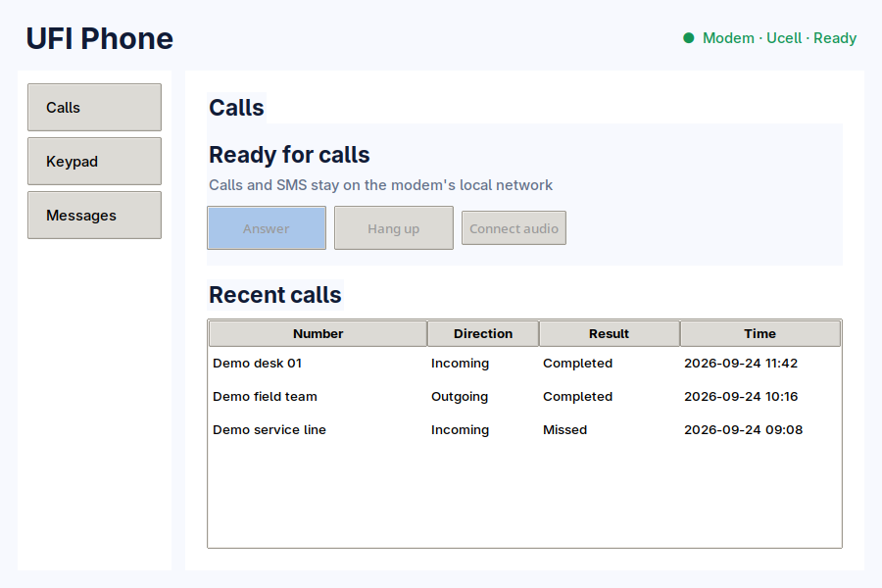
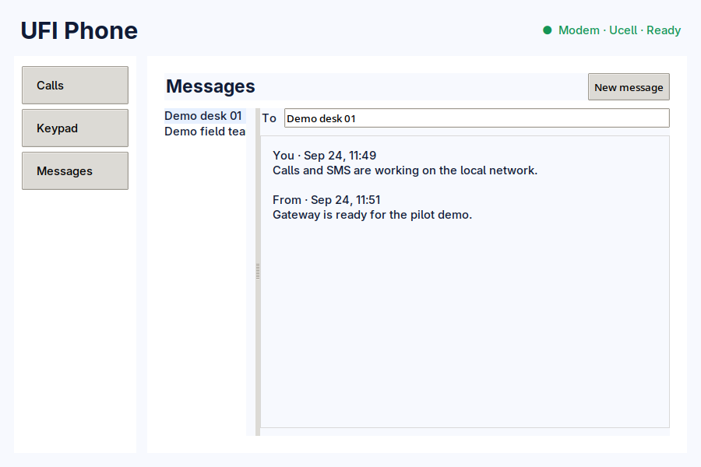
02
UFI PHONE
UFI Phone, running today
Real desktop-client captures: calls and SMS stay on the modem's local network
CALLS & HISTORY
DIRECT SMS
Answer, hang up, connect two-way audio and retain the latest 100 calls.
Read and send messages directly over the authenticated private LAN.
Captured from the Linux desktop client with synthetic demo data; no customer information is shown.
TUIT startup pitch, 24 Sep 2026
02
Notes:
Product capture and repository evidence: the two images are direct captures of the shipped Linux desktop client in desktop/ufi_phone_desktop.py. The capture harness disables network polling and injects clearly synthetic call and message records; no gateway token, private configuration, real phone number or customer message is used.
The interface supports direct local SMS receive/read/send, incoming and outgoing ordinary carrier calls, two-way audio and up to 100 local call-history entries. Telegram remains an optional compatibility path and the installer leaves it disabled.
https://github.com/Ruskuv1708/ufi-sms-telegram-forwarder/blob/3cd8b565191dec47d1df9f079d8dd2b0ecd5529b/README.md
https://github.com/Ruskuv1708/ufi-sms-telegram-forwarder/blob/3cd8b565191dec47d1df9f079d8dd2b0ecd5529b/docs/product-vision.md

Slide 3
03
UFI PHONE
Product architecture and technical limits
The tested UFI003 owns the SIM, radio state, carrier call and SMS store
Android
Mobile
network
Tested UFI003
SIM, radio and gateway
Authenticated
private LAN
Linux
Windows
Voice path: LTE data hands the call to WCDMA/HSPA for 2G/3G circuit-switched audio.
Operator VoLTE availability does not give this modem a usable IMS stack.
Scope: non-emergency ordinary calls only, one active call and one audio client.
The guarded installer accepts the exact tested UFI003 profile. Look-alike hardware is refused.
TUIT startup pitch, 24 Sep 2026
03
Notes:
Technical boundary: the tested UFI003 firmware has no usable IMS stack. Ucell calls work by moving from LTE data to WCDMA/HSPA for circuit-switched voice, then returning to LTE. Operator VoLTE availability and modem IMS capability are separate facts.
https://github.com/Ruskuv1708/ufi-sms-telegram-forwarder/blob/3cd8b565191dec47d1df9f079d8dd2b0ecd5529b/README.md
https://github.com/Ruskuv1708/ufi-sms-telegram-forwarder/blob/3cd8b565191dec47d1df9f079d8dd2b0ecd5529b/hardware-profiles.json
https://github.com/Ruskuv1708/ufi-sms-telegram-forwarder/blob/3cd8b565191dec47d1df9f079d8dd2b0ecd5529b/docs/uzbekistan-market-and-operator-compatibility.md
The gateway is restricted to the modem LAN and requires a pairing token. The current scope excludes emergency numbers, short codes, service codes, supplementary services and native IMS/VoLTE.

Slide 4
04
UFI PHONE
Release packaging and platform status
Artifacts verified at 116de47, with the product and deck workspace current at 3cd8b56
Platform | What ships | Built evidence | Remaining gate
Android | UFI Phone v0.5.0 with responsive Calls, Keypad and Messages UI. Landscape keypad fixed | API 36 AAB built | Publisher account, upload signing, Play forms and closed test if applicable
Linux | Desktop calls, SMS, local history, two-way audio and an application menu launcher | x86_64 executable built | Support QA on target Linux distributions
Windows | Portable desktop app with calls, SMS, history and PortAudio support | x86_64 executable built | Installer signing and support QA
UFI003 gateway | Device doctor, guarded installer, calls, SMS, audio and radio recovery | Exact profile tested | Near-match hardware remains refused
TUIT startup pitch, 24 Sep 2026
04
Notes:
Build evidence: GitHub Actions run #3 for build commit 116de4779f0a3eed155390c43de84b1bb24f3df5 finished successfully and produced three artifacts: Android AAB (660 KB), Linux x86_64 executable (23 MB) and Windows x86_64 executable (11.9 MB).
https://github.com/Ruskuv1708/ufi-sms-telegram-forwarder/actions/runs/35964803887
https://github.com/Ruskuv1708/ufi-sms-telegram-forwarder/commit/116de4779f0a3eed155390c43de84b1bb24f3df5
The current repository state is 3cd8b565191dec47d1df9f079d8dd2b0ecd5529b. It consolidates the product, presentation source and release-artifact documentation in one workspace.
https://github.com/Ruskuv1708/ufi-sms-telegram-forwarder/commit/3cd8b565191dec47d1df9f079d8dd2b0ecd5529b
Android targets API 36. The repository contains the responsive Google-style Calls, Keypad and Messages interface, including the corrected landscape keypad. Only the ordinary Android companion belongs in Google Play. The privileged modem gateway remains behind the exact-profile installer.
https://github.com/Ruskuv1708/ufi-sms-telegram-forwarder/blob/3cd8b565191dec47d1df9f079d8dd2b0ecd5529b/distribution/google-play/release-checklist.md
https://github.com/Ruskuv1708/ufi-sms-telegram-forwarder/blob/3cd8b565191dec47d1df9f079d8dd2b0ecd5529b/docs/adding-hardware-profiles.md

Slide 5
05
UFI PHONE
First-year cost benchmark for ten devices
UFI Phone uses one tested gateway and screens the organization already owns
$10
founder purchase price for the tested modem
Pilot pricing hypothesis
$49 starter kit + $3 per active device each month
= $409 in year one
The pilot must measure installer time, support workload and profile-maintenance cost before launch pricing is set.
*Hypothesis, not a launched offer. Carrier plan, taxes and existing screens are excluded. The products do not provide the same feature set.
TUIT startup pitch, 24 Sep 2026
05
Notes:
Sources and assumptions:
- Apple showed a $150 difference between Wi-Fi and Wi-Fi + Cellular at the same base iPad storage tier on 24 September 2026. Ten devices add $1,500. https://www.apple.com/shop/buy-ipad/ipad
- RingCentral Essentials started at $19.99 per user each month with annual billing on 24 September 2026. Ten users for 12 months cost $2,398.80, rounded to $2,399. https://www.ringcentral.com/shared/content/plans-and-pricing.html
- UFI Phone pilot pricing remains a hypothesis: $49 starter kit + $3 × 10 active devices × 12 months = $409 in year one. The $10 modem price is the founder's purchase price and is not a supplier quote or validated scalable BOM.
This compares budget anchors rather than equivalent products. RingCentral includes a broad UCaaS feature set. Cellular iPad pricing buys data connectivity rather than this local carrier-call gateway.

Slide 6

06
UFI PHONE
Uzbekistan launch market
Start with one tested operator and one exact device profile
36.35M
mobile subscriptions in Uzbekistan as of 1 April 2025
INITIAL USERS
Retail and service desks using one public number on existing Wi-Fi screens
Campus offices and labs that need a departmental SIM on tablets and PCs
Field sites where a fixed PBX or a full UCaaS suite is disproportionate
GO TO MARKET
Start with paid Ucell pilots on the tested UFI003.
Add operators only after SIM and tariff acceptance.
Channel hypothesis: modem resellers and local IT installers.
TUIT startup pitch, 24 Sep 2026
06
Notes:
Market evidence: Uzbekistan had 36.3483 million mobile subscriptions, or 96.6 per 100 residents, as of 1 April 2025. The national competition authority identifies six operators. These figures show market scale and do not forecast UFI Phone demand.
https://stat.uz/files/538/2025-Choraklik-natijalar-january--march-ang/3940/Report-for-January-March-2025.pdf
https://raqobat.gov.uz/ru/rezultaty-analiza-rynka-uslug-mobilnoj-svyazi/
https://github.com/Ruskuv1708/ufi-sms-telegram-forwarder/blob/3cd8b565191dec47d1df9f079d8dd2b0ecd5529b/docs/uzbekistan-market-and-operator-compatibility.md
Customer segments, channel design and paid-pilot sequencing remain hypotheses for validation. The image is generated and illustrative; it contains no real customer, call or message data.

Slide 7
07
UFI PHONE
Uzbekistan operator compatibility
VoLTE on the operator network is separate from IMS support inside this UFI003
Operator | Network evidence | UFI003 evidence | Commercial claim
Ucell | Official VoLTE offer | Tested: LTE data, SMS, calls and two-way audio. Voice falls back to WCDMA/HSPA | Reference operator
Mobiuz | VoLTE page documents 2G/3G fallback | No project SIM test yet | Validate SIM and tariff
Uzmobile | VoLTE page documents 2G/3G handover | No project SIM test yet | Validate SIM, APN and LTE return
Beeline | VoLTE for compatible USIM and device | Modem IMS unusable. Circuit-switched path untested | Validate intended tariff
Humans | Mobile service uses the Uzmobile network | MVNO provisioning remains untested | Test separately
Perfectum | CDMA and 5G SA/VoNR device paths | Incompatible with this exact UFI003 | Unsupported on this hardware
TUIT startup pitch, 24 Sep 2026
07
Notes:
Operator evidence:
- Ucell VoLTE/ViLTE announcement: https://ucell.uz/en/company_news/ucell_volte_vilte-_texnologiyalarining_yangi_ufqlari
- Mobiuz VoLTE and 2G/3G fallback: https://corp.mobi.uz/en/uslugi/volte/?VOICE=Y
- Uzmobile VoLTE and 2G/3G handover: https://uztelecom.uz/en/for-individuals/mobile-communication/gsm/services/additional-services/volte/
- Beeline VoLTE requirements: https://b2b.beeline.uz/en/products/services/volte
- Humans network information: https://qr.humans.uz/ru/telecom
- Perfectum CDMA and supported-device ecosystem: https://perfectum.uz/uz/cdma and https://perfectum.uz/uz/pages/sotni-ustroistv
- Project compatibility report and required SIM acceptance matrix: https://github.com/Ruskuv1708/ufi-sms-telegram-forwarder/blob/3cd8b565191dec47d1df9f079d8dd2b0ecd5529b/docs/uzbekistan-market-and-operator-compatibility.md
Only Ucell has passed the project's LTE data, direct SMS, incoming/outgoing call and two-way-audio tests on this exact UFI003. Mobiuz, Uzmobile, Beeline and Humans require actual SIM and tariff validation. Perfectum paths are unsupported on this hardware.

Slide 8
08
UFI PHONE
90-day commercialization plan
Release packaging is ready. Operator acceptance and publisher prerequisites now determine the pilot
DAYS 0–30
DAYS 31–60
DAYS 61–90
Release and measure
Operator acceptance
Pilot and expand
Play account, support email and upload key
Play App Signing and store declarations
12 testers for 14 days if the new-account rule applies
Signed release tag with synthetic assets
Mobiuz, Uzmobile, Beeline and Humans
SIM and tariff matrix
Ten cold boots per operator
Calls, audio, SMS and return to LTE
Three paid Ucell sites
Measure setup, missed events and support
Improve Phone UX and calling
Profile a second modem
Start the macOS protocol package
Commercial risks: 2G/3G fallback availability, operator and tariff approval, privileged gateway signing, and Play review.
APPLE ROADMAP
Telecom mentor
Four operator SIMs
Three pilot sites
Play tester cohort
TUIT ASK
macOS first. iPadOS follows for foreground calls and SMS. Reliable background ringing needs compliant push and adds a cloud dependency.
TUIT startup pitch, 24 Sep 2026
08
Notes:
Publisher and platform sources:
- Google Play checklist and current project prerequisites: https://github.com/Ruskuv1708/ufi-sms-telegram-forwarder/blob/3cd8b565191dec47d1df9f079d8dd2b0ecd5529b/distribution/google-play/release-checklist.md
- Target API requirements: https://support.google.com/googleplay/android-developer/answer/11926878?hl=en
- Android App Bundles: https://developer.android.com/guide/app-bundle
- Play App Signing: https://developer.android.com/studio/publish/app-signing
- Production access for new personal accounts: https://support.google.com/googleplay/android-developer/answer/14151465?hl=en
- Apple platform roadmap: https://github.com/Ruskuv1708/ufi-sms-telegram-forwarder/blob/3cd8b565191dec47d1df9f079d8dd2b0ecd5529b/docs/apple-platform-roadmap.md
- Apple local-network privacy: https://developer.apple.com/documentation/technotes/tn3179-understanding-local-network-privacy
- CallKit: https://developer.apple.com/documentation/CallKit
- macOS notarization: https://developer.apple.com/documentation/Security/notarizing-macos-software-before-distribution
macOS is the recommended first Apple platform. An iPadOS foreground companion can use the local modem connection, but reliable background incoming calls require a compliant push architecture. That choice adds a server and changes the current local-only privacy model. Milestones and pilot counts are proposed targets, not completed outcomes.

