Slide 1

Introduction

Slide 2
Agenda
Background.
The V in MVC
TSX (Typescript Extension Syntax).
Developer tools..
React Component basics.
Material Design.
Notes:
TSX in React refers to TypeScript XML. It is a syntax extension for JavaScript, similar to JSX (JavaScript XML),

Slide 3


React
A Javascript framework for building dynamic Web User Interfaces.
A Single Page Apps technology.
Open-sourced in 2012.
Client-side framework.
More a library than a framework.

Slide 4
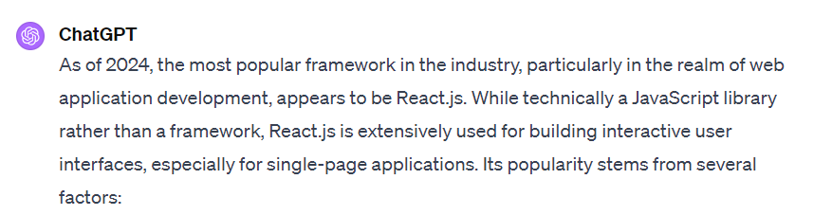
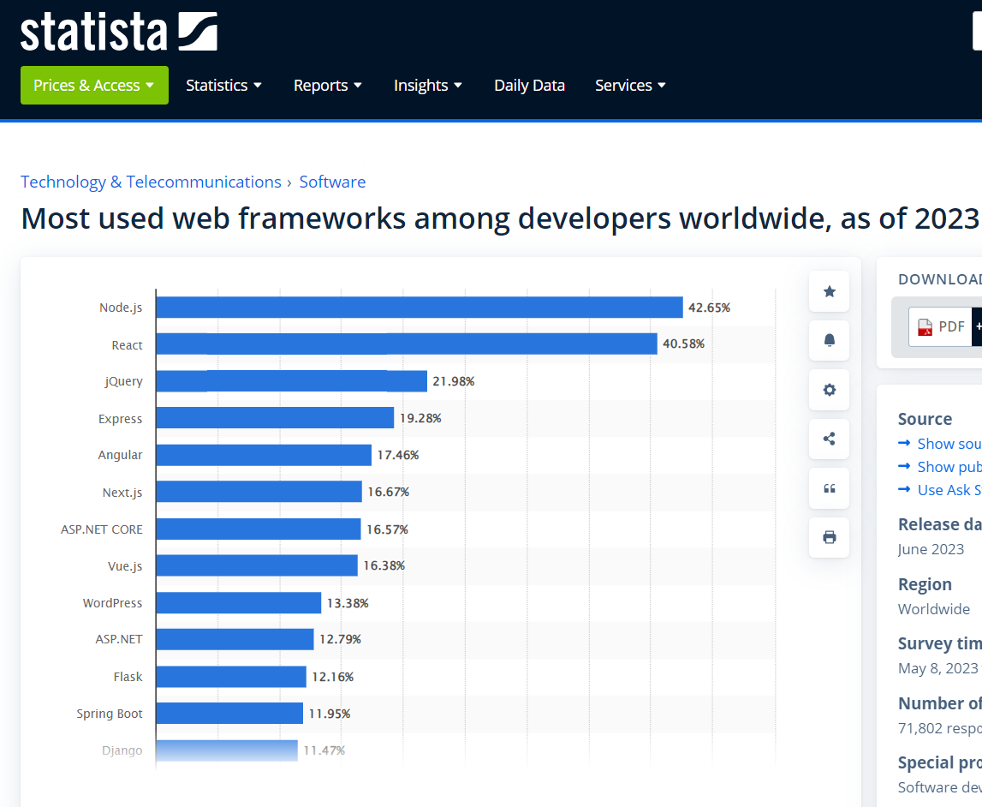
Why React?

Slide 5
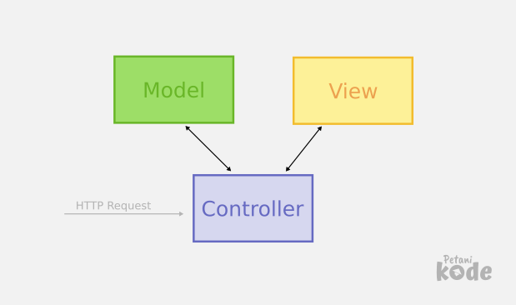
Before React
MVC pattern – The convention for app design. Promoted by market leaders, e.g. AngularJS (1.x), EmberJS, BackboneJS.
React is not MVC, just V.
It challenged established best practice (MVC).
Templating widespread use in the V layer.
React based on “components”.
This Photo by Unknown Author is licensed under CC BY
Notes:
Templating: Handlebars, Angular has its own built-in templating syntax that allows developers to easily define dynamic and interactive user interfaces.

Slide 6

React Components
Philosophy: Build components, not templates.
All about the User Interface (UI).
Not focused on business logic or the data model (MVC)
Component - A unit comprised of:
UI description (HTML) + UI behaviour (JS)
Two aspects are tightly coupled and co-located.
Pre-React frameworks decoupled them.
Benefits:
Improved Composition.
Greater Reusability.
This Photo by Unknown Author is licensed under CC BY-NC-ND
Notes:
Where is business logic – in the functional components and Contexts Functional Components: functional components can now manage state and side effects, which allows embedding business logic directly within the component. Hooks like useState, useEffect, and custom hooks enable components to handle data fetching, state management, and more. Middleware???

Slide 7
Creating the UI Description. (Vanilla React)
React.createElement() – create a HTML element.
ReactDOM.createRoot() – which existing DOM node to attach the created element.
React.createElement() arguments:
type (h1, div, button etc).
properties (style, event handler etc).
children (0 -> M).
We don’t use createElement() directly – too cumbersome.
ReactDOM.createRoot () arguments:
DOM node on which to mount a new element.

Slide 8
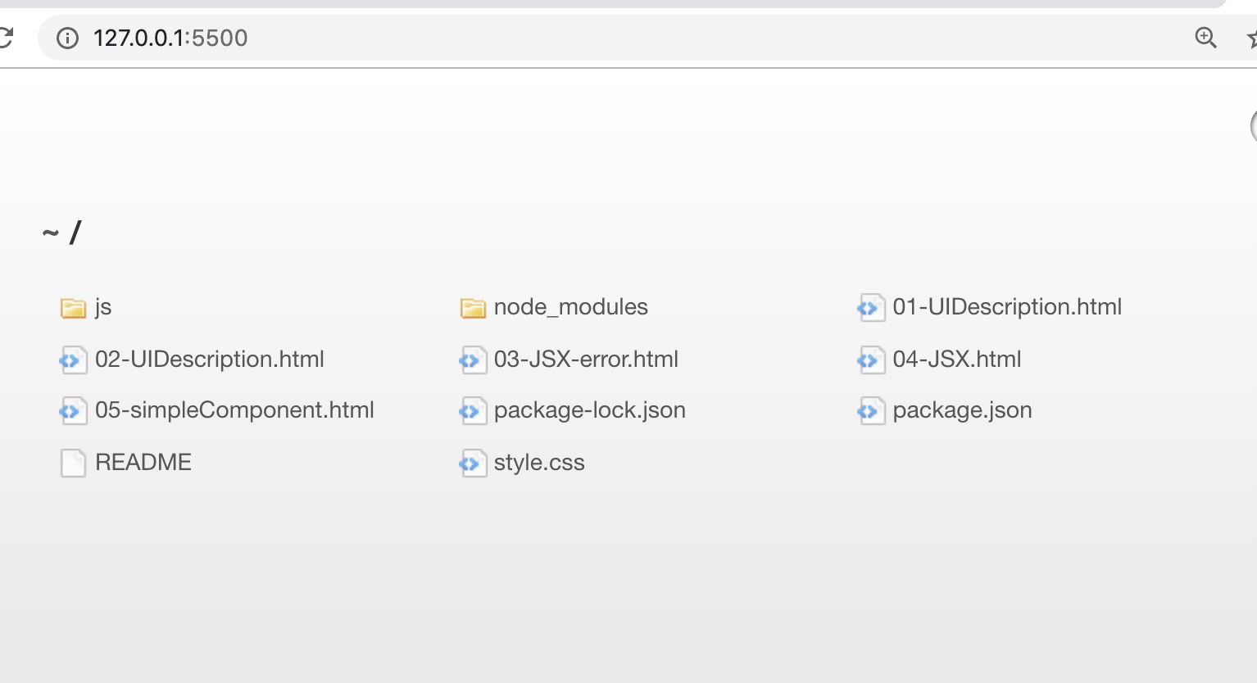
In-Class Code Demos. (See lecture archive)
See Archive accompanying these slides.
Run code using VS Code Live Server extension.

Slide 9

TypeScript with React
Used to add type definitions to JavaScript codebases.
TypeScript supports JSX (=>TSX)
Include in your React project using @types/react and @types/react-dom
Needs to be Transpiled to Javascript to run in Browser/Client.
This Photo b Unknown Author is licensed under CC BY
Notes:
Why bother? . Type Safety
TypeScript provides static typing, allowing you to catch errors early in the development process, such as type mismatches or incorrect function arguments, leading to fewer runtime errors and bugs.
2. Improved Developer Experience
Auto-completion, code navigation, and refactoring are significantly enhanced in TypeScript, thanks to its understanding of the shapes of objects. This makes the development process faster and more efficient.
3. Better Code Quality and Maintainability
TypeScript's type system encourages more explicit contracts for component APIs, making the code easier to read and maintain. It also enforces type checking at compile time, ensuring that components are used correctly.
4. Easy Integration with React
TypeScript integrates seamlessly with React. TypeScript's JSX support allows you to use it directly within your TypeScript files (.tsx), and the React TypeScript definitions are robust and well-maintained.

Slide 10
UI description implementation (the imperative way)
See the demos:
Ref. 01-UIDescription.html.
Nesting createElement() calls (Ref. 02-UIDescription.html)
----------------------------------------------------------------------
Imperative programming is a programming paradigm that uses statements that change a program's state.
focuses on describing how a program operates, step by step.
Declarative programming is a programming paradigm … that expresses the logic of a computation without describing its control flow.
focuses on what the result should be without specifying how it should achieve the results
Notes:
What’s the DOM: The DOM, or Document Object Model, is a programming interface for web documents. It represents the page so that programs

Slide 11
UI description implementation (the declarative way)
TSX – TypeScript XML.
Declarative syntax for coding UI descriptions.
Retains the full power of Typescript.
Allows tight coupling between UI behavior and UI description.
However, must be transpiled before being sent to browser.
Reference 03-JSX-error.html and 04-JSX.html
Notes:
It allows you to write HTML tags in TypeScript files. TypeScript supports JSX and provides type-checking for JSX code, enabling developers to use JSX syntax within TypeScript files (.tsx extension) for building user interfaces in a more expressive and HTML-like syntax.

Slide 12
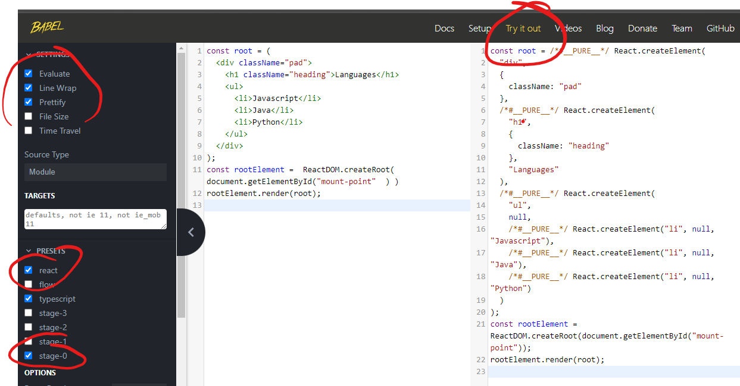
REPL (Read-Evaluate-Print-Loop) transpiler.
Reference
04-JSX.html

Slide 13

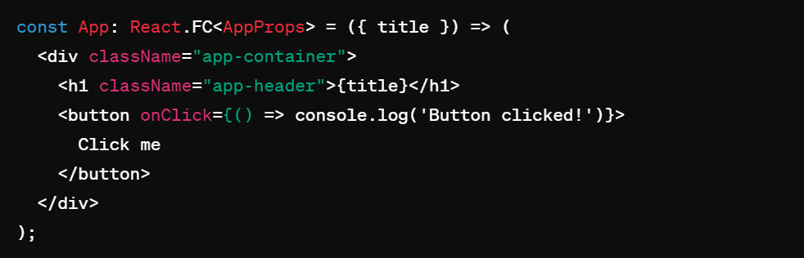
TSX(TypeScript XML)
JSX(Javascript XML) is a file syntax extension used by React. JSX resembles HTML, allowing developers to write UI components with an HTML-like (it is actually XML).
TSX is the TypeScript version of JSX, TypeScript is a superset that adds static typing in JavaScript.
Typsscript files containing TSX use the .tsx extension.
Some minor HTML tag attributes differences, e.g. className (class), htmlFor (for).
Allows UI description to be coded in a declarative style and be in-lined in TypeScript.
Combines templating with the power of TS.

Slide 14
Transpiling TSX.
Browsers don’t do Typescript!
Needs to be Transpiled to Javascript
What can we use to Transpile?
The Babel platform.
The Vite library.
How?
Manually, via REPL or command line.
When experimenting only.
Using an instrumented web server – Vite library instrumentation.
Ideal for development.
Using bundler tools as part of the build process – Vite again.
Production standard.

Slide 15
React Components.
We develop COMPONENTS.
A TS function that returns a UI description, i.e. TSX.
We reference a component like a HTML tag.
e.g.
const rootElement =
ReactDOM.createRoot(document.getElementById("mount-point"));
rootElement.render( <DynamicLanguages/> );
Reference 05-simpleComponent.html

Slide 16

React Developer Tools - Vite
Features:
Scaffolding/Generator.
Development web server: auto-transpilation on file change + live reloading (HMR – Hot Module Replacement).
Builder: build production standard version of app, i.e. minification, bundling.

Slide 17

React Developer Tools - Storybook
Features:
A development environment for React components.
Allows components be developed in isolation.
Promotes more reusable, testable components.
Quicker development – ignore app-specific dependencies.

Slide 18

Introduction to

Slide 19

Installation:
$ npm install @storybook/react
The tool has two aspects:
A web server.
$ ./node_modules/.bin/start-storybook -p 6006 -c ./.storybook
Performs live re-transpilation and re-loading.
Web browser user interface.
Start up using package.json script

Slide 20

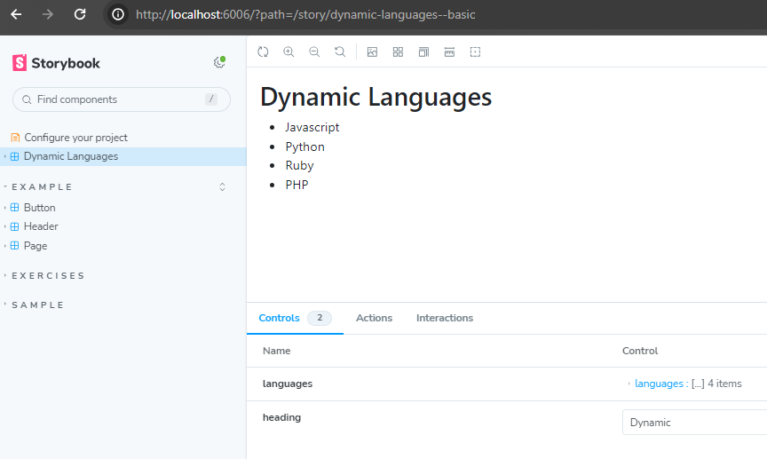
Storybook User interface.
Component
Rendering.
Component arguments and actions (callbacks)
Component catalogue
Notes:
Storybook Controls gives you a graphical UI to interact with a component's arguments dynamically without needing to code. It creates an addon panel next to your component examples ("stories"), so you can edit them live.

Slide 21
What is a Story?
A component may have several STATES
State affects how it renders.
Each state case termed a “STORY”
Example: DynamicLanguages component.
States might be:
Default – 5 or less languages → Render full list
Boundary – empty list → Render ‘No languages’ message
Exceptional – More than 5 languages → Render first 5 and a ‘See More…’ link to display next 5.
Stories are a design consideration written in Component Story Format (CSF)
They are functions that describes how to render components

Slide 22
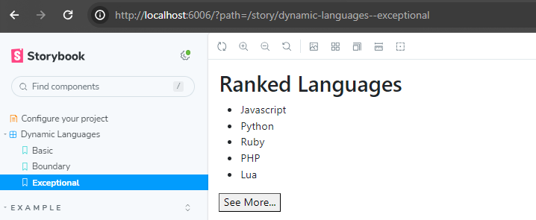
List a component’s states/stories under its name:
Set of Component Stories: (i.e. Basic, Boundary, Exceptional)

Slide 23
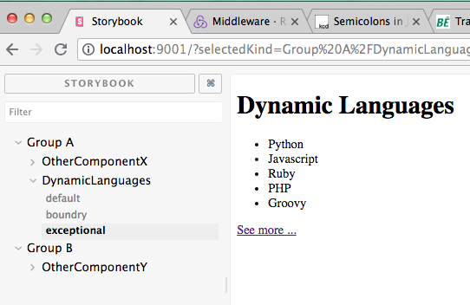
Define component groups when component catalogue is large.
helps others team members with searching.

Slide 24
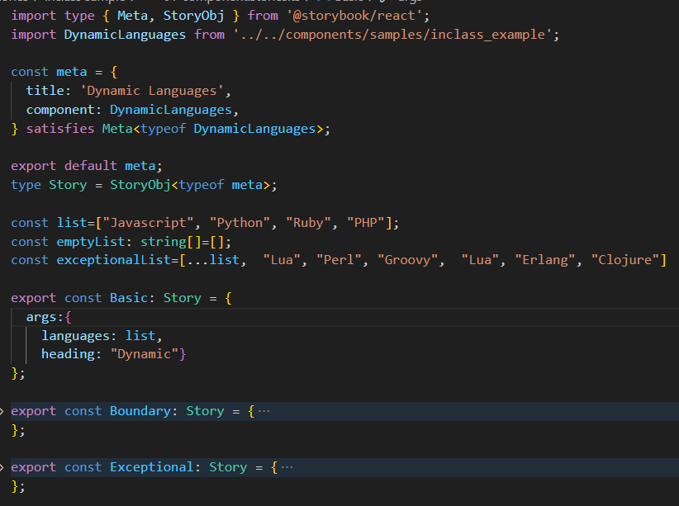
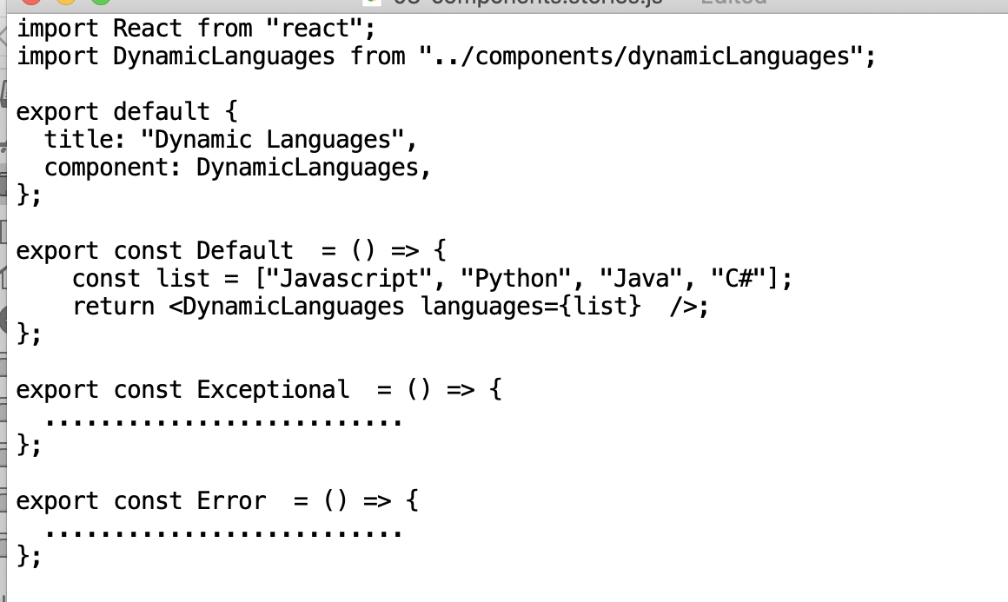
Writing stories
.stories.ts file extension (convention)
1 Stories file per component
default export; Metadata; How Storybook lists components.
Story implemented as a function.
Named exports.
UpperCamelCase
3 stories for this component
Notes:
Meta<typeof Button>: This type annotation specifies that meta should conform to the Meta type. . The Meta type is generic, meaning it can operate on different types of inputs. In this case, it's being used with our Component, making it specific to the Dynamic Languages component.

Slide 25
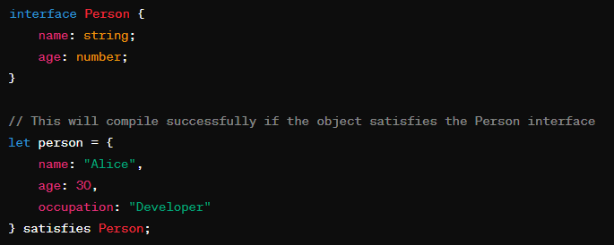

Aside: The satisfies Operator
TypeScript 4.9 introduces a new operator, satisfies
Allows you to check that an expression matches a particular type.
Used in Stories to ensure an object conforms to a type without casting
Would cause a compile error if age was missing

Slide 26
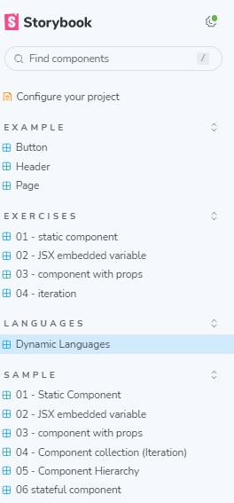
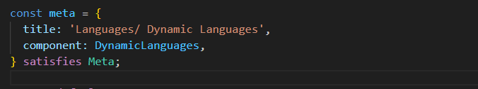

Grouping stories.
Use directory pathname symbol ( / ) to indicate component grouping (i.e. group/subgroup/….).

Slide 27
… back to components . . .

Slide 28
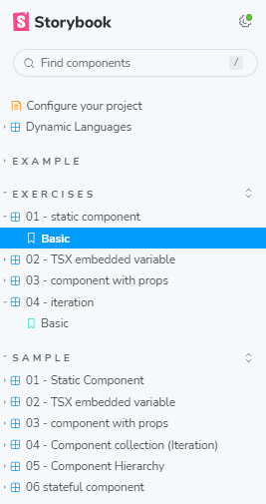
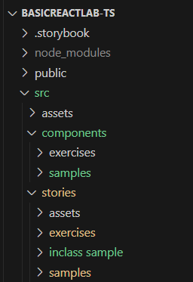
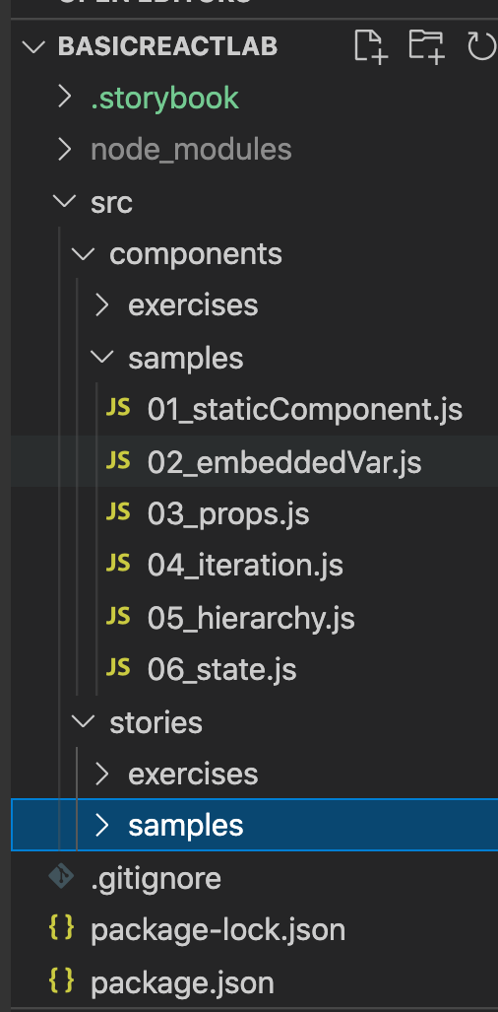
Demo Samples (See lab exercise)
Configuration – boilerplate
Lab exercise
Sample
Components
Stories

Slide 29
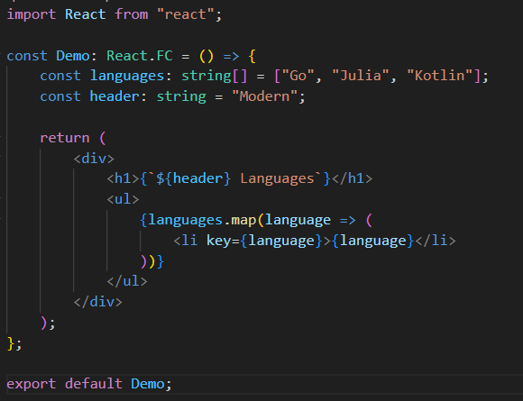
TSX - embedded variables.
Use { } to reference variable embedded in TSX.
Curly braces can contain any valid TS expression.
Reference src/components/samples/02_embeddedVariables.tsx
Notes:
defining a functional component in React using TypeScript. Here's a breakdown of what's happening:
const Demo: This is declaring a constant named Demo. In React, it's conventional to start component names with a capital letter.
React.FC: This is a TypeScript type that stands for "React Function Component". It's a type provided by the @types/react package, which provides TypeScript definitions for React. By typing Demo as React.FC, you're telling TypeScript that Demo is a functional component.

Slide 30
Reusability.
We achieve reusability through parameterisation.
props – Component properties / attribute / parameters.
Passing props to a component:
<CompName prop1Name={value} prop2Name={value} . . . . />
Access inside component via props object:
const ComponentName React.FC<PropInterface> = (props) => {
const p1 = props.prop1Name
. . . . . . . .
Props are Immutable.
Part of a component’s design.
Reference src/components/samples/03_props.tsx (and related story).

Slide 31

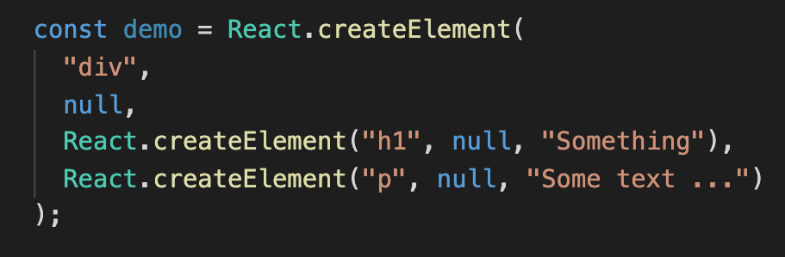
Aside.
We can assign a single TSX element to a variable.
Why?

Slide 32
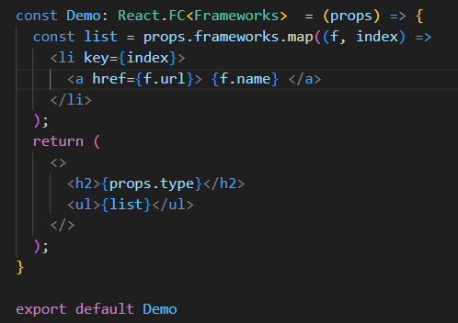
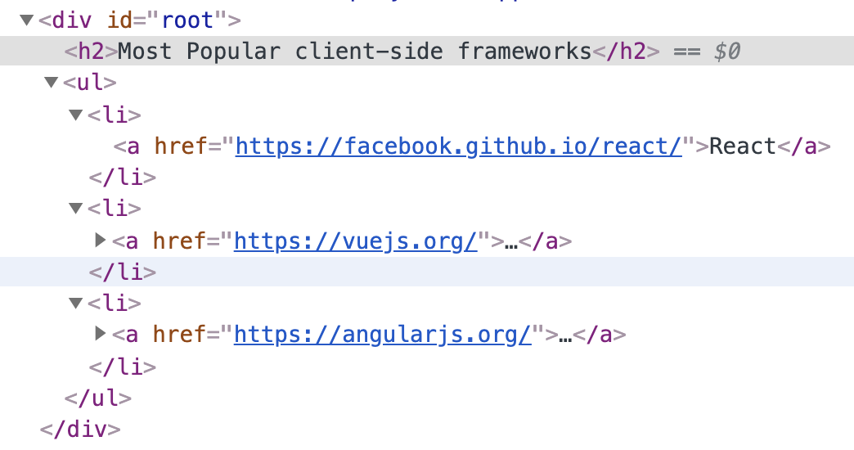
Component collection - Iteration
Use case: Generate an array of (similar) component from a data array.
Reference: src/components/samples/04_iteration.tsx
map used to to create a new array based on the frameworks array passed in through the `props` object.
Required HTML produced by component.
(From Chrome Dev Tools)
Notes:
his is calling the map method on the frameworks array. map is a built-in JavaScript method that creates a new array by applying a function to every elem

Slide 33
Component return value.
Examples:;
return <MyComponent prop1={…..} prop2={……} /> ;
return (
<div>
<h1>{this.props.type}</h1>
<MyComponent prop1={…..} prop2={……} />
<p>
. . . . . .
</p>
</div>
) ;
Must enclose in ( ) when multiline.

Slide 34
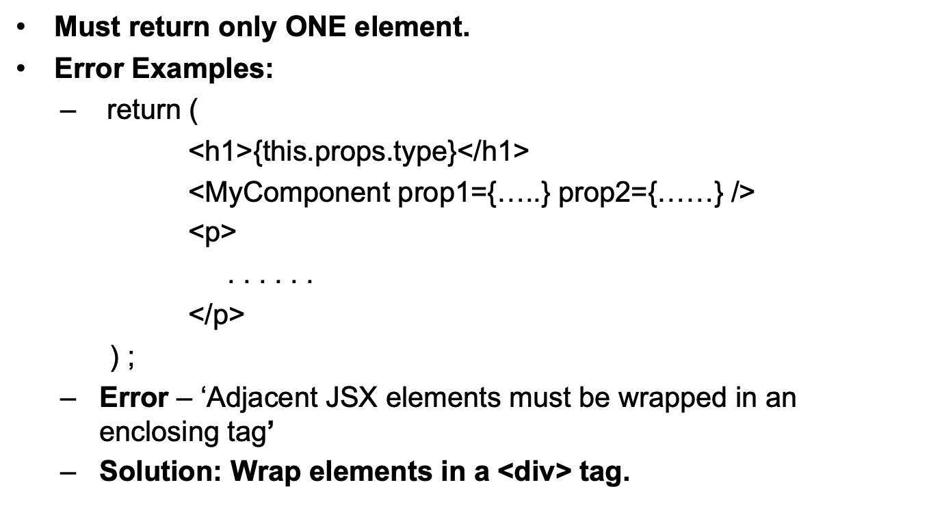
Component return value.

Slide 35
Component return value.
Old solution:
return (
<div>
<h1> ……</h1>
<MyComponent …… />
<p> …….. </p>
</div>
) ;
Adds unnecessary depth to DOM → affects performance.
Alternative solution:
return (
<>
<h1> ……</h1>
<MyComponent …… />
<p> …….. </p>
</>
) ;
<> </> – special React element, termed Fragment.
No DOM presence.

Slide 36
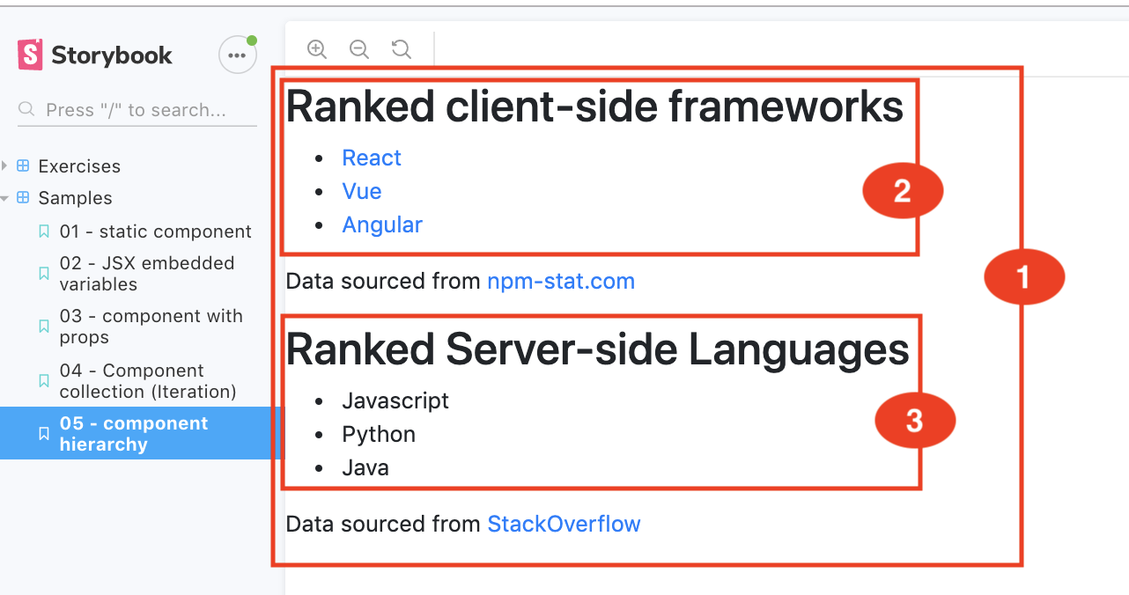
Component Hierarchy.
All React application are designed as a hierarchy of components.
Components have children – nesting.
Ref. src/components/samples/05_hierarchy.ts.

Slide 37
Summary.
TSX.
UI description and behaviour tightly coupled.
Can embed variables/expressions with braces.
All about components.
A function that takes a props argument and returns a single TSX element .
Components can be nested.
Storybook tool.
Develop components in isolation.
Story – the state (data values) of a component can affect its rendering (and behaviour).

