Slide 1
Connectivety Map
compared with RNA-Seq from mose

Slide 2
Goal
Compare RNA-Seq from kidney Egf/Tgfa KO mice with connectivety map L1000
Find closest drug to reverse changes or replicate them

Slide 3
Part1: RNA-Seq
Data from Serge's raw-reads of RNA-Seq
Summary:
Egf does not change with Nx
Tgfa-mut is less affected by Nx

Slide 4
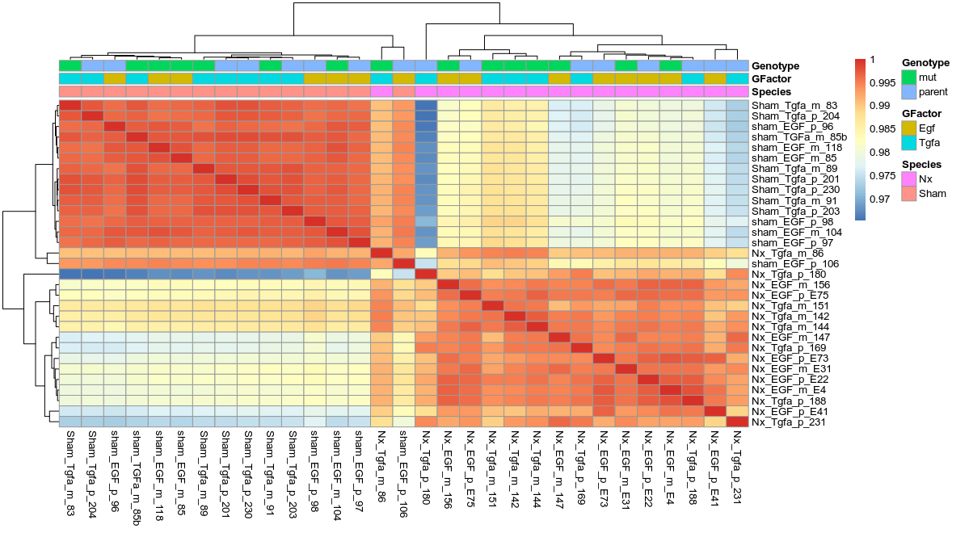
RNA-Seq both Nx and Sham
sham
Nx
sham
Nx
Nx is the biggest factor of change
*condition is misstyped as species!

Slide 5
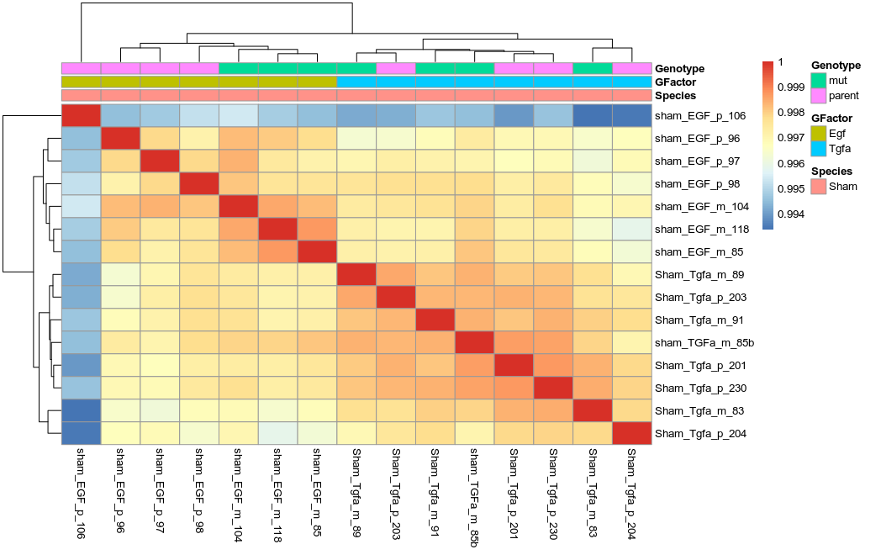
RNA-Seq: sham
-Tgfa differ a little from Egf
-Egf mut differ from p

Slide 6
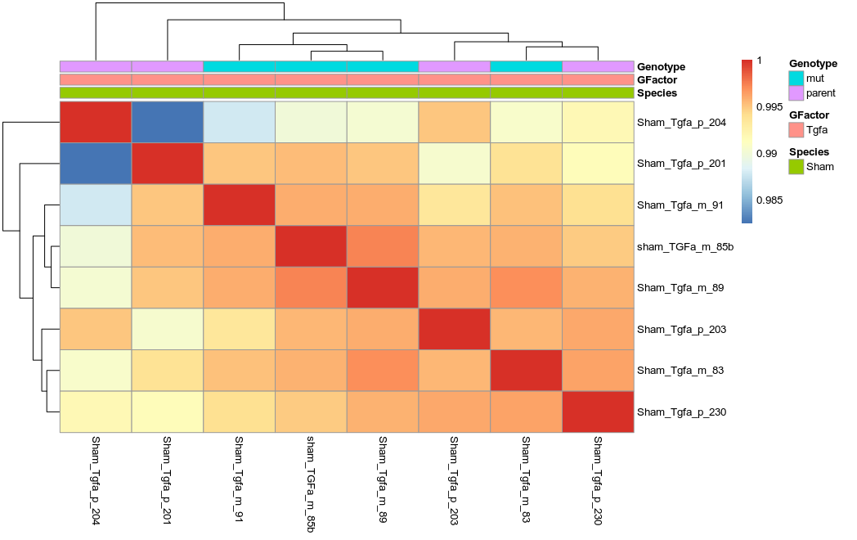
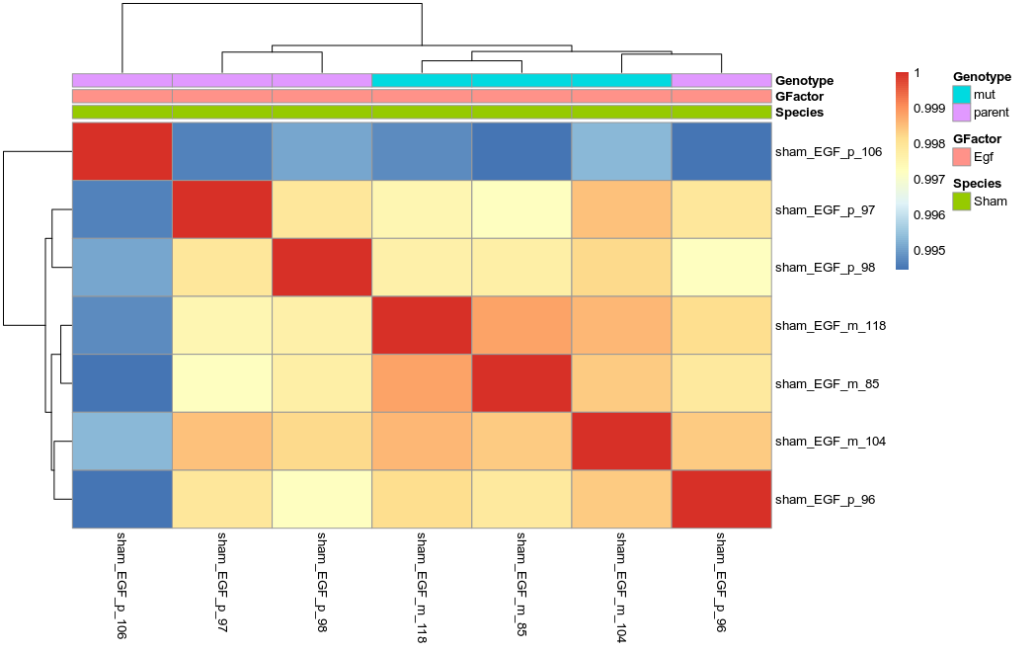
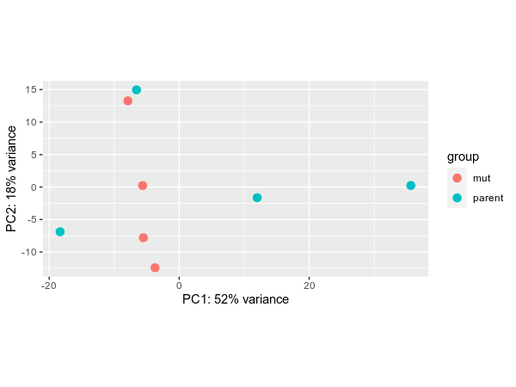
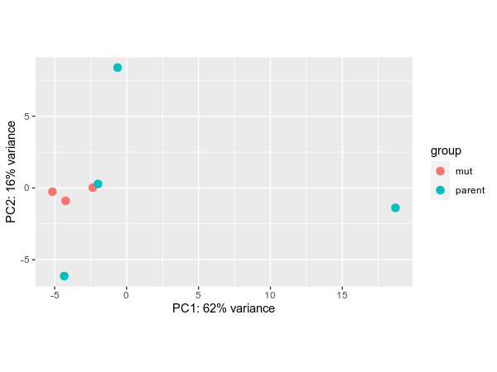
RNA-Seq: sham
Tgfa
Egf

Slide 7
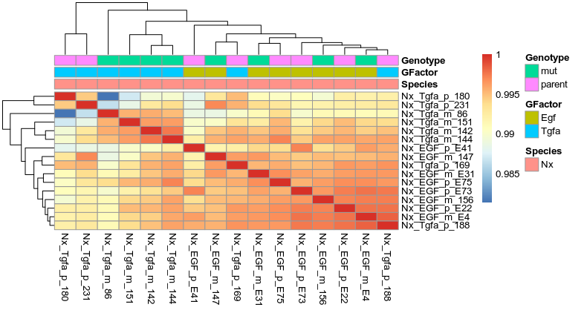
RNA-Seq - Nx

Slide 8
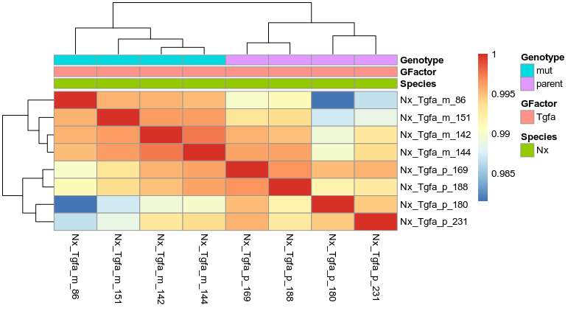
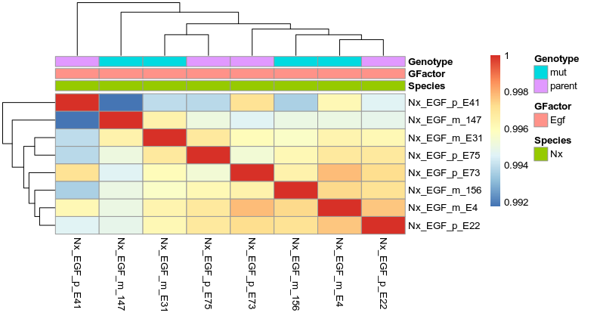
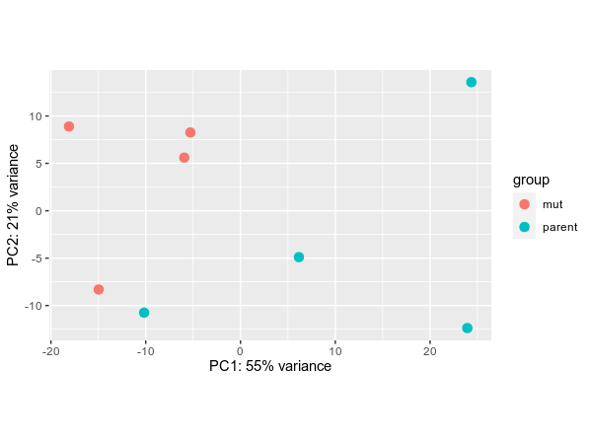
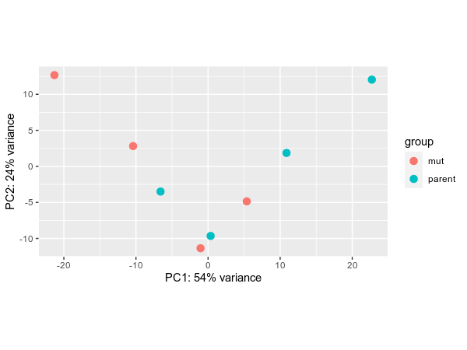
RNA-Seq - Nx
Tgfa
Egf

Slide 9
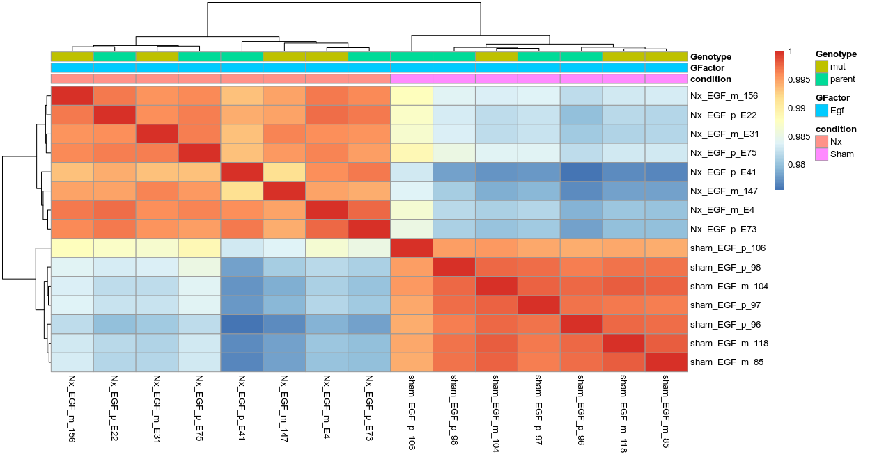
EGF
Nx
sham

Slide 10
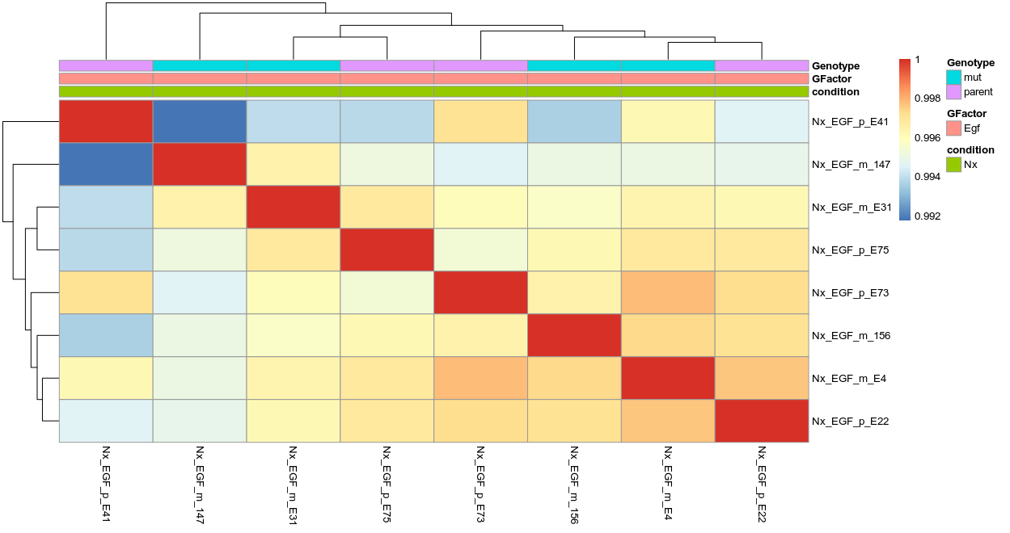
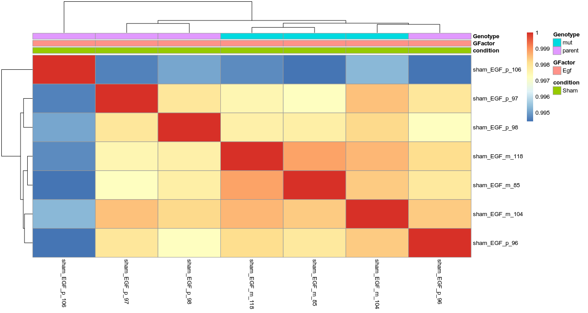
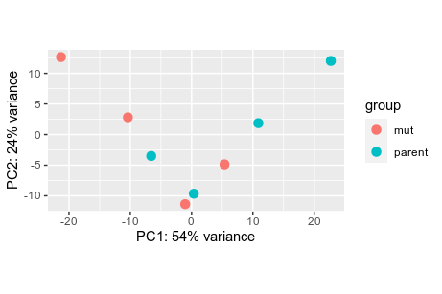
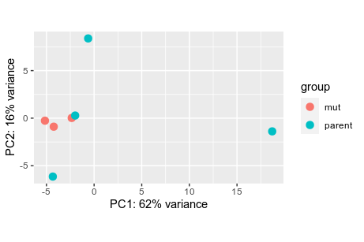
EGFmut is not affecting Nx, but affects sham
Nx
sham

Slide 11
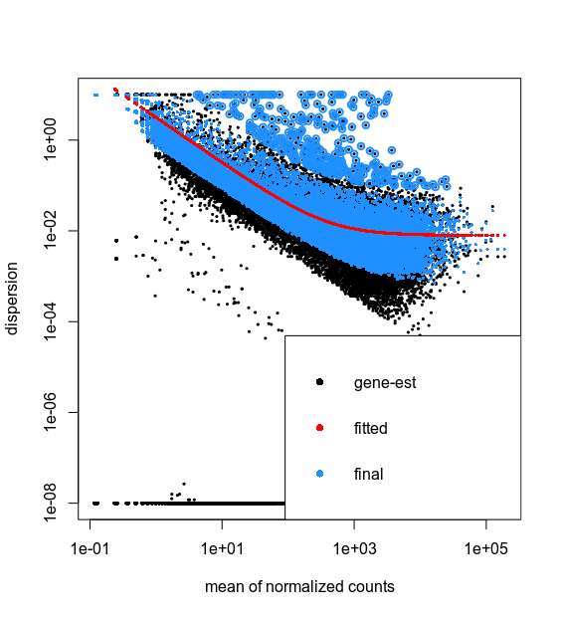
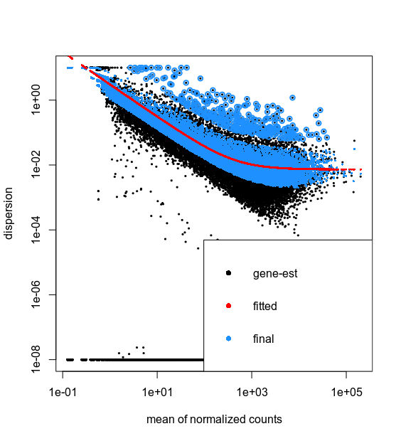
EGF dispersion
Nx
sham

Slide 12
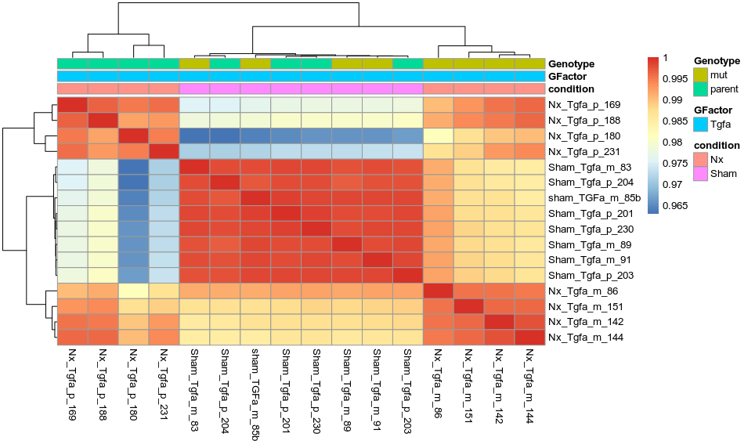
Tgfa
Nx Tgfa(p)
sham
Nx Tgfa(mut)
-Tgfa differ in Nx/Sham
-Tgfa differ in Nx: mut/p

Slide 13
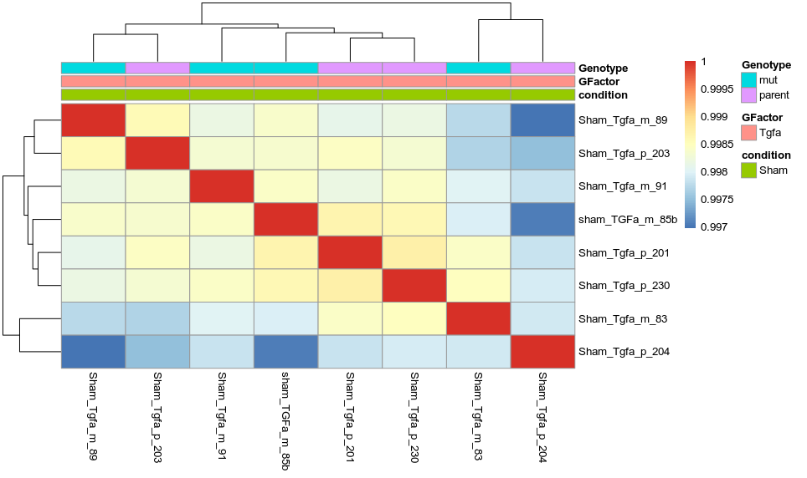
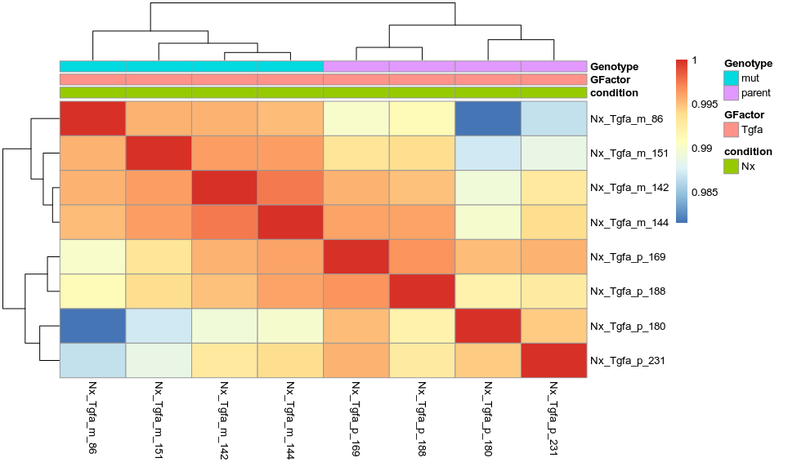
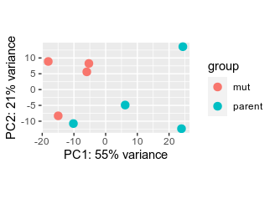
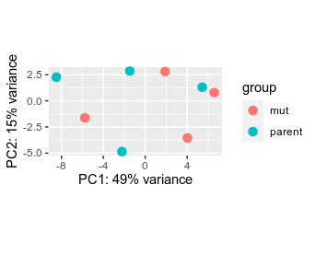
Tgfamut has perfect separation in Nx, no effect in sham
Nx
sham

Slide 14
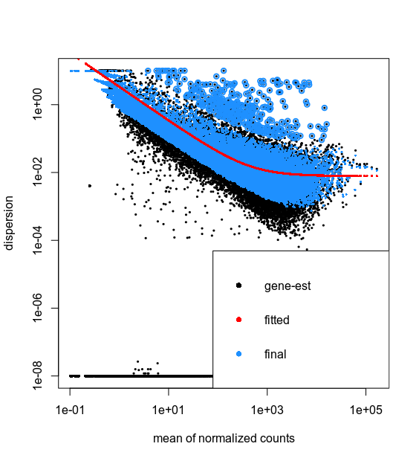
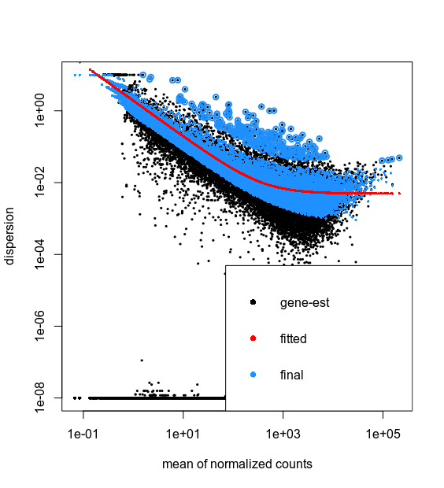
Tgfa dispersion
Nx
sham

Slide 15
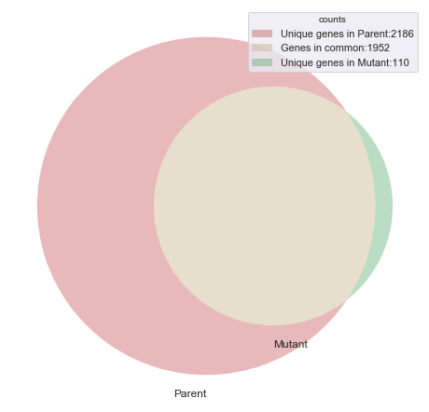
Sham vs Nx
Parent sham vs Parent Nx
4138 genes
Mut Sham vs Mut Nx
2062 genes
1952 in common
We focus on genes that change in parent but not in mutant with Nx (the red)

Slide 16
Genes that differ after Nx
most genes in mutant change the same way as in the parent, but less sever:
Increased in parent == increased in mutant
decreased in parent == decreased in mutant
those that differ have couple of interesting genes in them
increased in parent / decrease in mutant | decreased in parent / increase in mutant
DPP7, HMCN2, SCG5, GLMP, PKLR, TYW3, COQ3, ANGPTL3, SESN2, CIT, AACS, FUCA2, BTBD11, PPM1H, KCNK5, H4C2, ETV5 | INO80D, CAMSAP1, BAZ2B, CTDSPL2, ARID1A, VGLL4, BHLHE41, KMT2B, OTUD4, MAP3K21, IL17RB, KMT2A, NCBP3, MBTD1, BPTF, FOXN3, BTBD7, JAK2
*log2FC is ignored

Slide 17
Selecting RNA-Seq genes
Selected genes:
+50 reads on average
p-value<0,05
FC > 5% (log2FC: < -0,58 or >0,58)

Slide 18
Part2: cMAP

Slide 19
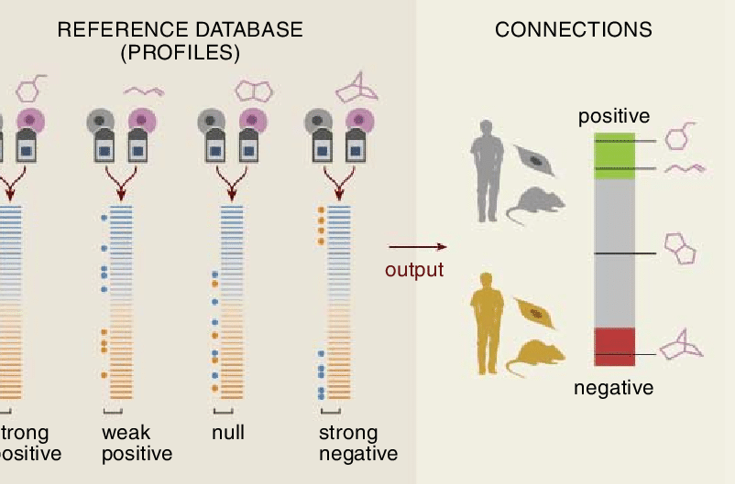

Connectivity map: L1000 platform (phase I)
1.5 million experimets:
~20K perturbation,4.5K knockdown and 3K over-expressions in ~100 cell-lines in triplicates
Not all cells are treated with all conditions
The data is available on GEO under submission number **GSE92742**

Slide 20
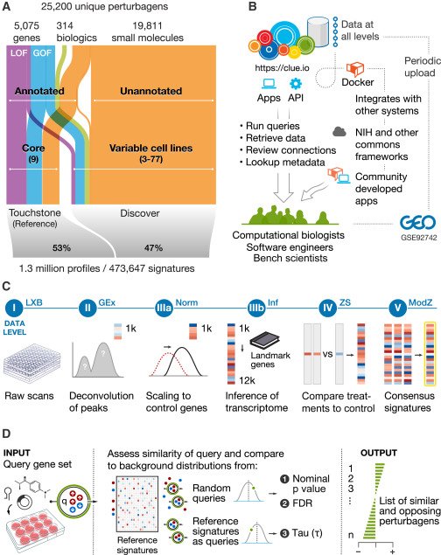
Connectivity map: L1000 platform (phase I)
The data base can show emmediately the factors/perturbation that affect any gene.
Drawbacks:
Hard to work with list of genes
(max 150 genes *2)
Solution:
Download data
Do it yourself

Slide 21
Selecting RNA-Seq genes
Only 1473 genes out of DEG 1952 gene are measured in the L1000 assay.
There are 3911 samples of HA1E at 24 h (2382 compound in 13x3 plates)

Slide 22
Normalize the two experiments
RNA-Seq and L1000 are different techniques, we cannot compare them directly.
We morph data into tretary system: -1, 0 and +1.
The data will indicat if a gene changes negatively, no change or positively

Slide 23
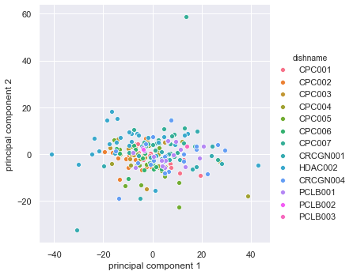
DMSO noise
Each plate has one column of DMSO
Almost no samples look too far from the others.

Slide 24
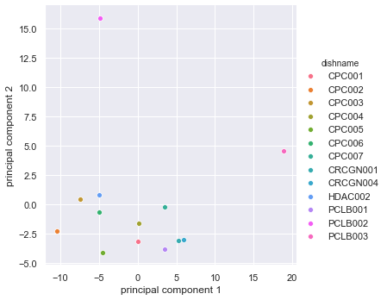
Average DMSO per plate
Using average of all samples treated with DMSO in each plate we make PCA
Two plates may have issues.

Slide 25
Normalize DMSO
We normalize all sample to average of DMSO reads in each plate.
We consider:
z-score>1,5 as positive increase (value=1)
z-score< -1,5 as negative (value= -1)
z-score -1,5 to 1,5 as no significant change (value= 0)

Slide 26
Normalize all samples
new_Value= z-score (sample) - average(z-score(DMSOs in the same plate))
Only significant genes from RNA-Seq mouse-Tgfa

Slide 27
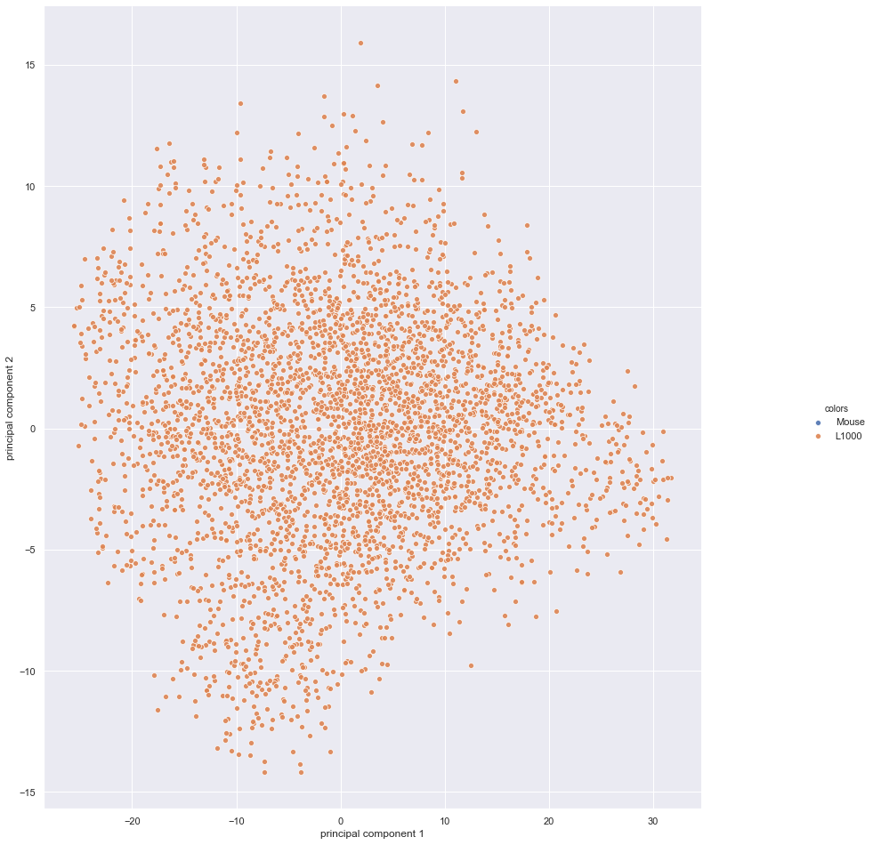
PCA for all HA1E
No special clustering

Slide 28
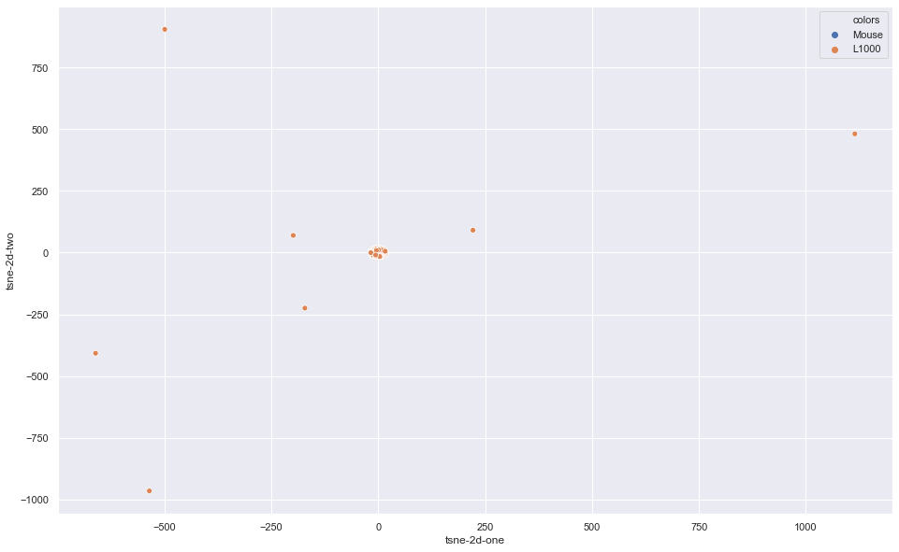
t-SNE for all HA1E
Useless!

Slide 29
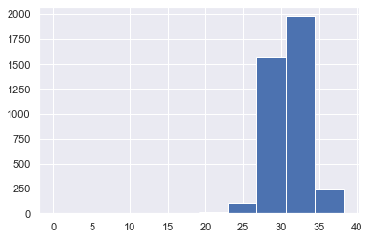
Eucledean Distance between RNA-Seq and L1000
0 is exact
No close samples
The closest are DMSO and HDAC inhibitors, the furthest is anti-tumoral agents (see later)

Slide 30
Eucledean Distance between RNA-Seq and L1000
0 is exact
No close samples
The closest are DMSO

Slide 31
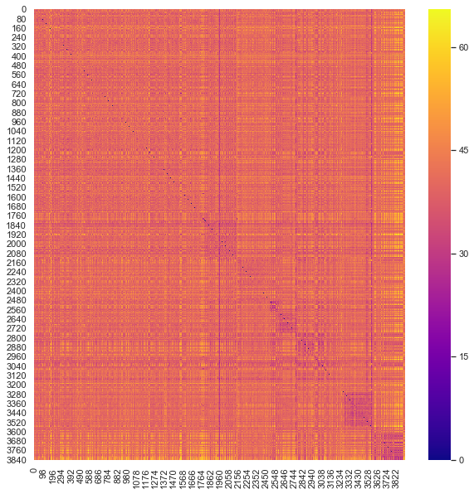
Sample correlation
Families of drugs show similarities (purple boxs)
RNA-Seq is not among them

Slide 32
Results!

Slide 33
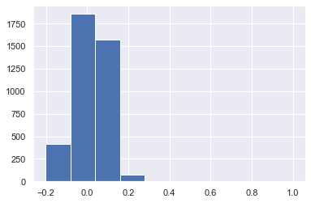
Sample correlation
Correlation of RNA-Seq with L1000 is 0,3 max
Corr- pearson over 0,2: HDAC inhibitors (trichostatin-a, panobinostat), apoptotic agent (PAC-1) and enzyme inhibitor (benzohydroxamic-acid)
Corr- pearson less than 0,2: Anti-tumoral Topo1 inhibitor (irinotecan), Topo2 inhibitor (doxorubicin), adipogenesis inhibitor (piceatannol), hedgehog mod (MW-SHH-54) and alkaloids (avrainvillamide-analog-2)

Slide 34
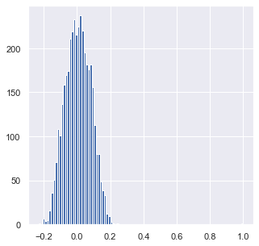
Sample correlation (no DMSO /plate correction)
Corr- pearson over 0,18: p38 inhibitor (EO-1428), alkaloids(homoharringtonine), HDAC inhibitors (trichostatin-a, panobinostat), apoptotic agent (PAC-1), cholonirgic inhibitors (ipratropium, naltriben) and enzyme inhibitor (benzohydroxamic-acid, ICI-63197, MDL-28170 )
Corr- pearson less than 0,2: Anti-tumoral Topo1 inhibitor (irinotecan), Topo2 inhibitor (doxorubicin), adipogenesis inhibitor (piceatannol), hedgehog mod (MW-SHH-54) and alkaloids (avrainvillamide-analog-2). corticosteroids (clobetasol), GABAA receptors inhibitor (gabazine), PINK1 activator (kinetin-riboside)

Slide 35
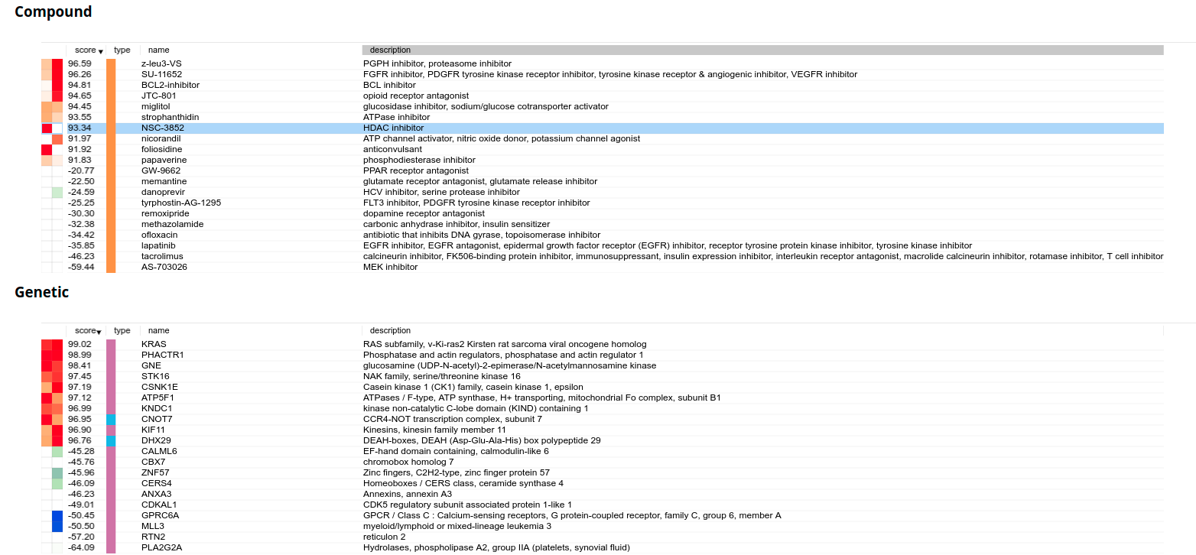
Compare to clue.io
The website reveals that some HDACi are affecting Tgfa in all cells. (not the one we got, but still!)

Slide 36
When testing the cMAP on the site
The query accepts only 150 genes upregulates and 150 genes downregulted
Compares treatment with DMSO (total!)
Different for each cell-line
Different from the analysis I did
3 lists

Slide 37
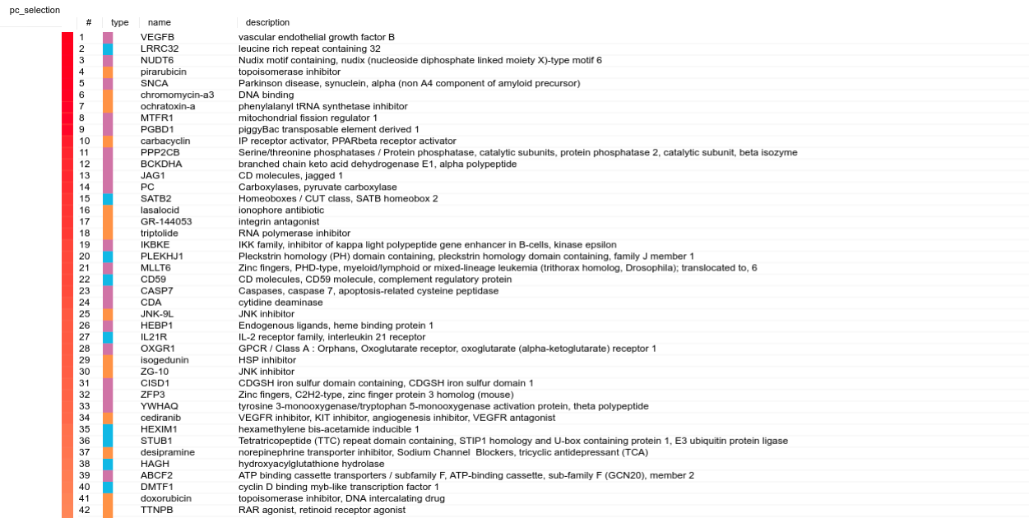
Compare to clue.io
Top 150 downregulated genes and top 150 upregulted genes from mouse experiment were submitted throught the website https://clue.io/query
With HA1E

Slide 38
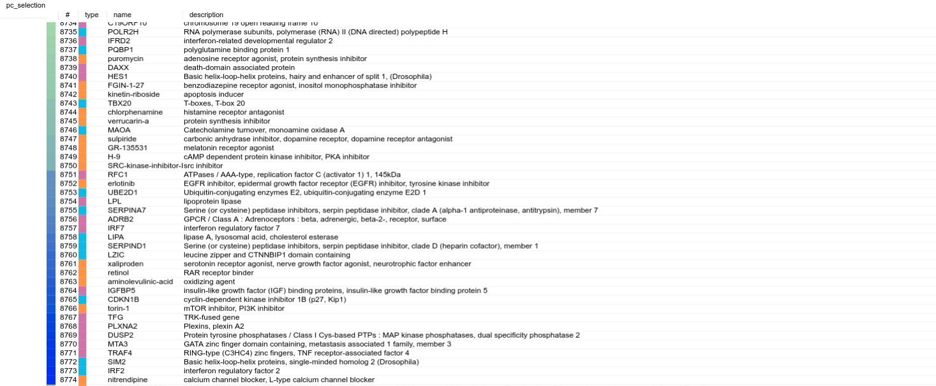
Compare to clue.io
Top 150 downregulated genes and top 150 upregulted genes from mouse experiment were submitted throught the website https://clue.io/query
With HA1E

Slide 39
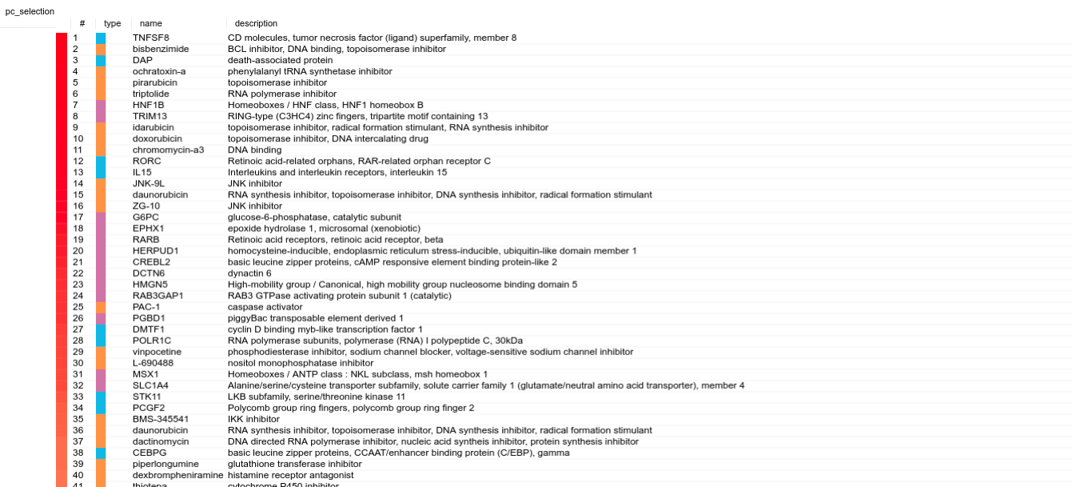
Compare to clue.io
Top 150-300 downregulated genes and top 150 upregulted genes from mouse experiment were submitted throught the website https://clue.io/query
With HA1E

Slide 40
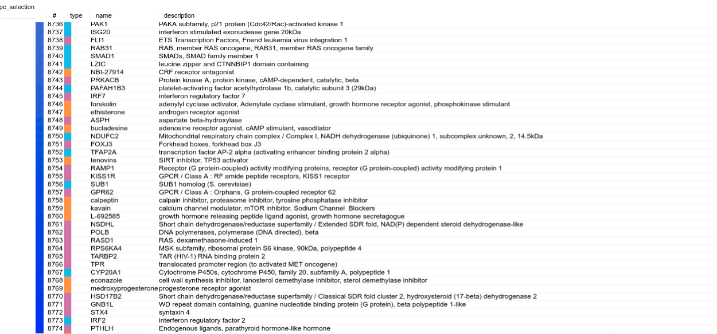
Compare to clue.io
Top 150-300 downregulated genes and top 150 upregulted genes from mouse experiment were submitted throught the website https://clue.io/query
With HA1E

Slide 41
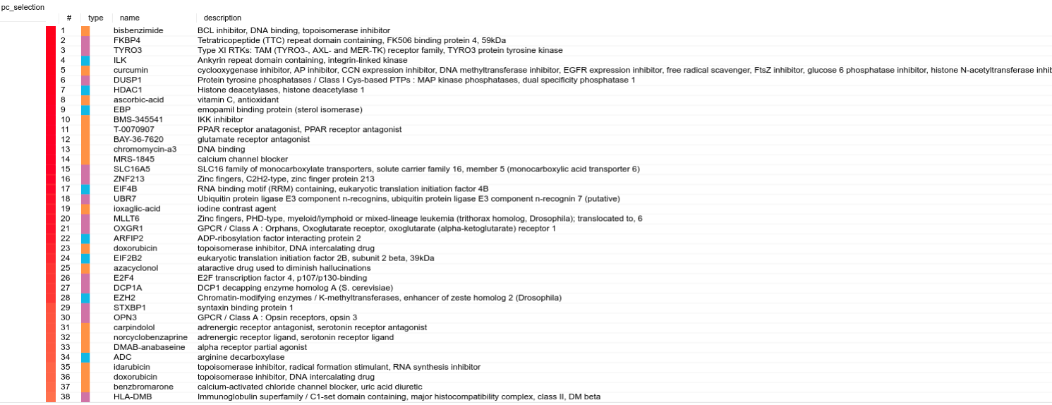
Compare to clue.io
Top 301-450 downregulated genes and top 150-300 upregulted genes from mouse experiment were submitted throught the website
https://clue.io/query
With HA1E

Slide 42
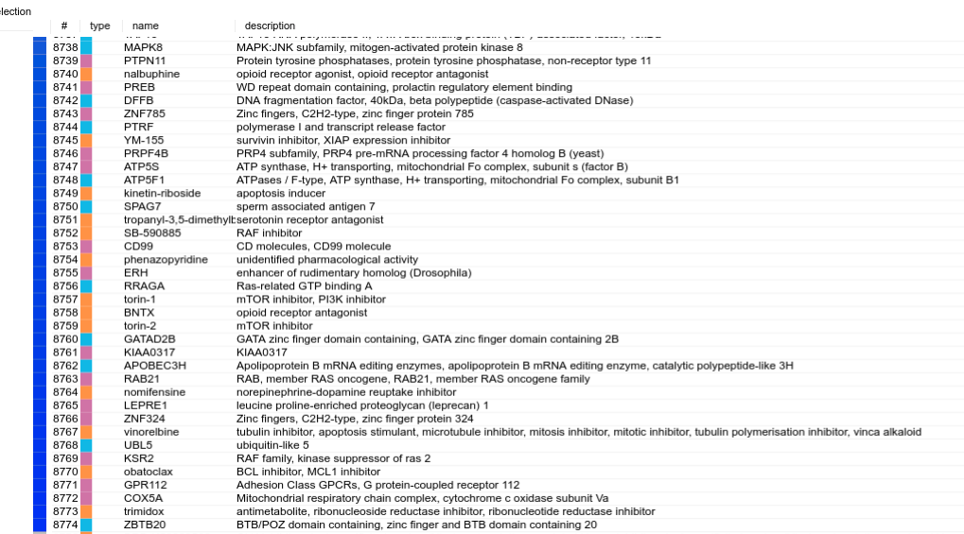
Compare to clue.io
Top 301-450 downregulated genes and top 150-300 upregulted genes from mouse experiment were submitted throught the website
https://clue.io/query
With HA1E

Slide 43
The common drugs
Factors affecting positively corresponing to Tgfa KO genes | Factors affecting negatively corresponing to Tgfa KO genes
"chromomycin-a3" DNA binding agent "UBR7" Ubiquitin protein ligase E3 component n-recognins "OXGR1" GPCR / Class A : Orphans "idarubicin" Topoisomerase inhibitor "ZG-10" JNK inhibitor "JNK-9L"JNK inhibitor "F10" Chymotrypsin "ochratoxin-a" Phenylalanyl tRNA synthetase inhibitor | "RAB21" GTPases gene "torin-1" MTOR inhibitor "kinetin-riboside" Apoptosis stimulant "DAXX" ? "TRAF4" gene "C19ORF10" gene "LZIC" gene "KLHDC9" gene
common in top 200 factors of the three lists | common in low 200 factors of the three lists

Slide 44
The common between the two methods
Similar to Tgfa-KO
Topo-isomerase inhibitors
Anti tumoral
Different from Tgfa-KO
Apoptosis stimulant

Slide 45
For now!

