Slide 1

Question 1: Is there any correlation between the results and the revenue of the football club?

Slide 2
About transfers:
10 seasons (07/08 – 16/17)
Top 5 Europe Leagues
5.890 transfers
Total 17.192.435.000 euro

Slide 3
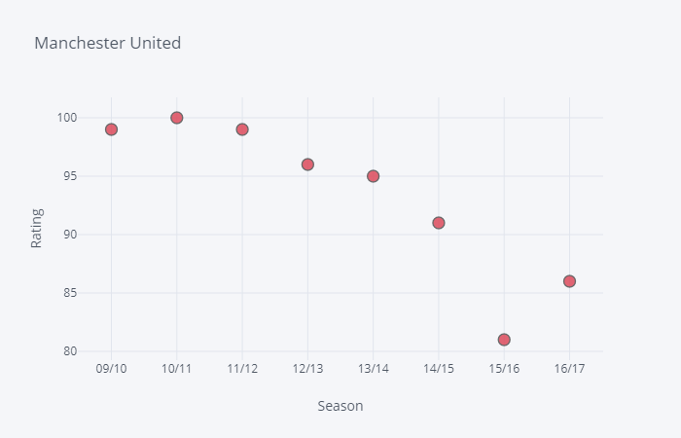
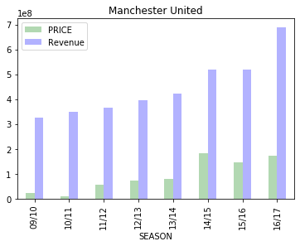
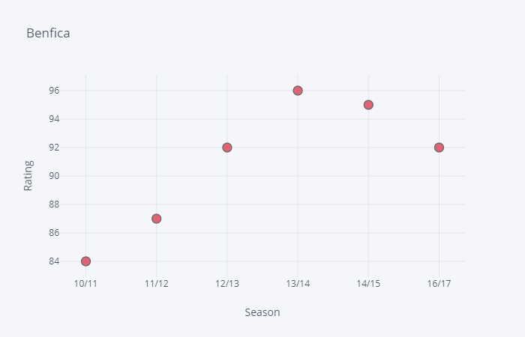
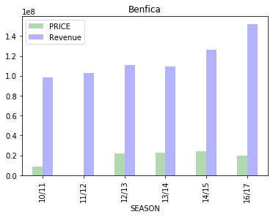

Slide 4
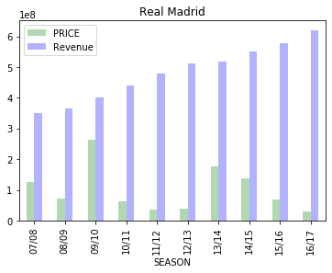
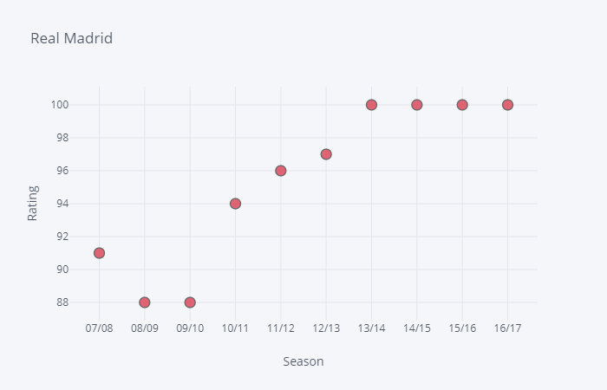

Slide 5

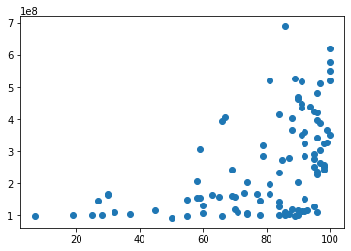
Answer 1:
Results of the correlation indicated that there was a positive association between revenue and results of football club (r = .49)
Revenue
Rating

Slide 6
Question 2: Does the transfer strategy affect the rating?

Slide 7
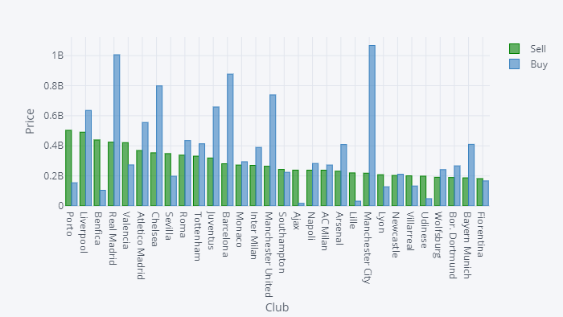
Transfers

Slide 8
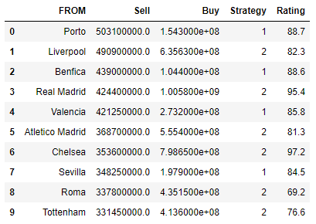
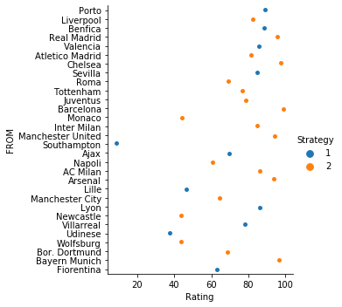
Strategies comparison
Correlation 0.22

Slide 9
Answer 2:
Results of the correlation indicated that there was not a positive association between revenue and results of football club (r = .22)

