Slide 1
Testing for Normality
Diagnostic Analytics

Slide 2
…
Most statistical procedures require us to verify at least two assumptions :
the normality assumption
the assumption of absence of outliers

Slide 3
…
There are two categories of methods used to check the normality assumption:
Numerical methods
Graphical methods

Slide 4
…
Numerical methods:
Skewness and kurtosis indicators
The Shapiro-Wilk normality test
Graphical methods:
The histogram
The Q-Q plot

Slide 5
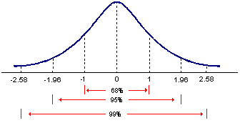
Z Score Dəyəri

Slide 6
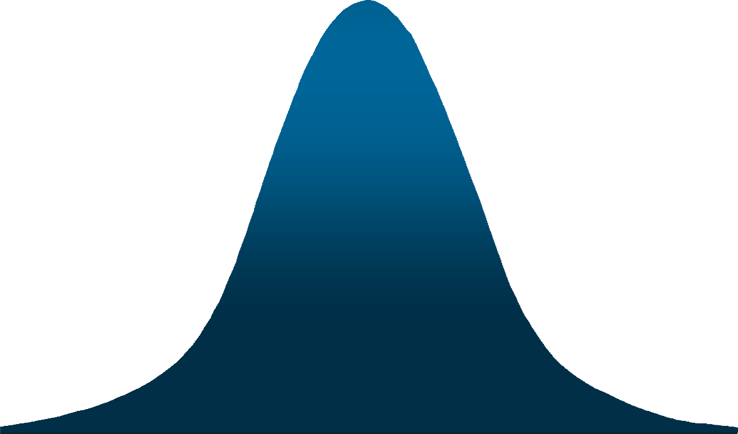
Empirik qayda
For data having a bell-shaped distribution:
Approximately 68% of the data values will be within one standard deviation of the mean.

Slide 7
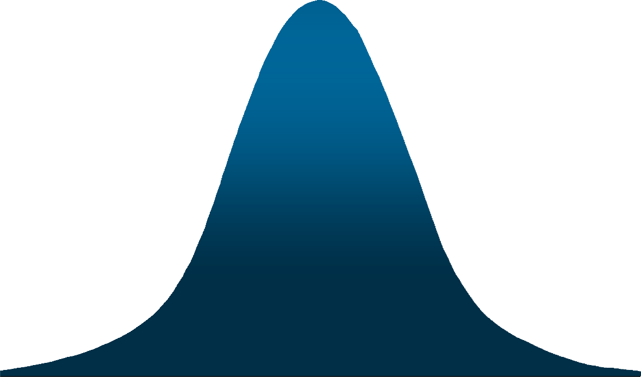
Empirik qayda
36
For data having a bell-shaped distribution:
Approximately 95% of the data values will be within two standard deviations of the mean.

Slide 8

Empirik qayda
37
Normal paylanmış data üçün:
Almost all (99.7%) of the items will be within three standard deviations of the mean.

Slide 9
…
The variable is normally distributed with a 99% confidence level if both standard scores lie in this interval: (-2.58, 2.58).

Slide 10
…
The hypotheses of the Shapiro-Wilk test:
H0: the variable is normally distributed
H1: the variable is not normally distributed
We accept the null hypothesis if we have Sig.>0,05

Slide 11
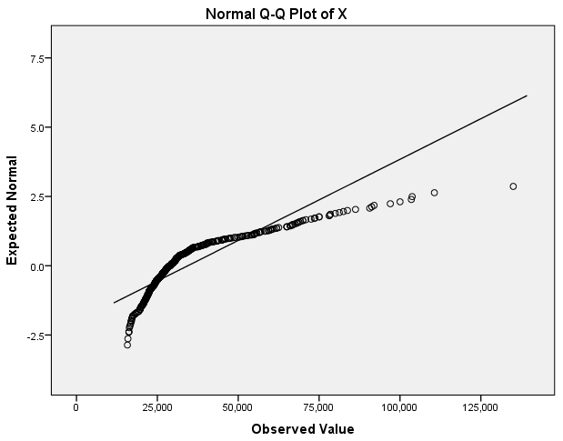
The Q-Q plot for a positively skewed distribution

Slide 12
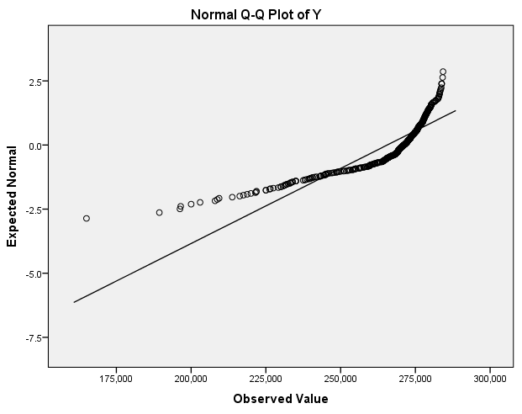
The Q-Q plot for a negatively skewed distribution

Slide 13
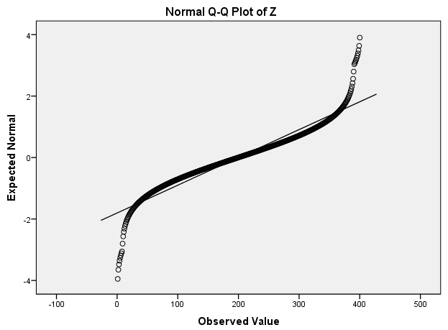
The Q-Q plot for a leptokurtic distribution

Slide 14
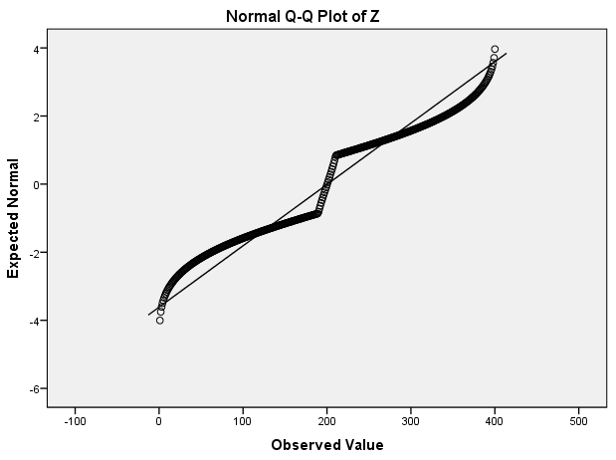
The Q-Q plot for a platikurtic distribution

Slide 15
The Outliers
Diagnostic Analytics

Slide 16
…
The outliers – or extreme values – can represent a danger for the analysis, because they directly affect mean and standard deviation. That’s why we should detect, and in some cases remove the outliers before running such tests.

Slide 17
…
There are two methods for identifying the outliers:
A numerical method, based on the standardized values
A graphical method, bases on the boxplot chart

Slide 18
How to manage the outliers?…
There are three kinds of outliers, depending on their source:
Data entry errors, due to lack of attention, negligence, tiredness etc.
Measurement or data collecting errors, due either to human mistakes or to equipment malfunction.
Real non-typical, unusual values in your population. These are the so called genuine outliers.

Slide 19
How to manage the outliers?…
There are two basic solutions for dealing with genuine outliers:
Remove the outliers from the data series
Keep the extreme values in the data series

Slide 20
How to manage the outliers?…
If we decide to keep the outliers, we have other four possible routes to choose from:
Run a nonparametric test, because these tests are less sensitive to outliers.
Replace the outliers with values closer to the normal. Let’s suppose that our data series look like this:
2.7 | 2.2 | 5.9 | 3.4 | 3.0 | 3.7 | 2.8

Slide 21
How to manage the outliers?…
Solutions for managing the outliers (continued)
Run the parametric test regardless, being aware of the possible effects of the outliers.
Perform a so called sensitivity analysis: run both the parametric and the nonparametric test. If the results are similar, we can conclude that the outliers do not affect our findings.

Slide 22
Values of Coefficient - interpretation…
Value of r | Strength of correlation
Up to 0,30 | Small (weak correlation)
Between 0,30 and 0,70 | Medium (moderate correlation)
Over 0,70 | Large (strong correlation)

Slide 23
Sign of Pearson’s correlation coefficient - interpretation…
Assumptions:
The two variables are continuous.
The variable values are pairs (there are two values, two measurements for each sample case).
The relationship between the variables is approximately linear. The Pearson correlation coefficient is sometimes called the linear correlation coefficient.
The variables are approximately normally distributed.
There are no significant outliers among the data.

Slide 24
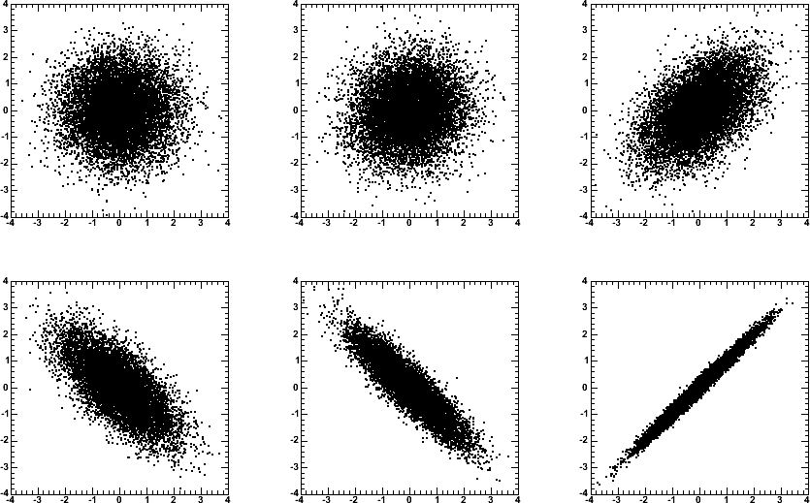
Visualization of correlation
r = 0 r = 0.1
r = 0.5
r = -0.7
r = -0.9
r = 0.99

Slide 25
…
Assumptions:
Both variables are ordinal and/or continuous (we cannot use Spearman if one of the variables is nominal).
The variable values are pairs (we have two measurements for every sample case, one for each variable)
The relationship between the variables is monotonic (increasing or decreasing).

Slide 26
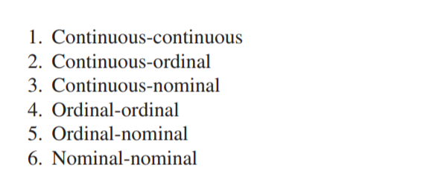
Variable Combinations Scenarios

Slide 27
1.Countinuous-Countinuous
Pearson
Spearman

Slide 28
A. Pearson Correlation
Assumptions:
1. Continuously <<<<corr>>>> Continuously
2. Normal Disturbition (+)
Assumptions:
Both variables are ordinal and/or continuous (we cannot use Spearman if one of the variables is nominal).
The variable values are pairs (we have two measurements for every sample case, one for each variable)
The relationship between the variables is monotonic (increasing or decreasing).

Slide 29
Features of Correlation Coefficient, r
Unit free
Ranges between –1 and 1
The closer to –1, the stronger the negative linear relationship
The closer to 1, the stronger the positive linear relationship
The closer to 0, the weaker any positive linear relationship

Slide 30
Scatter Plots of Data with Various Correlation Coefficients
Y
Y
Y
X
X
X
r = -1
r = -.6
r = 0
Y
Y
Y
X
X
X
r = +1
r = +.3
r = 0

Slide 31
B. Spearman Correlation
Assumptions:
Continuously <<<<corr>>>> Continuously
Discrete <<<<corr>>>> Continuously
Discrete <<<<corr>>>> Discrete
2. No Distribution Assumption (-)
An important feature of the Spearman rank correlation coefficient is its reduced sensitivity to extreme values compared with the Pearson correlation coefficient.

Slide 32
2.Countinuous-Ordinal
Kendall Correlation

Slide 33
3. Countinuous-Nominal
Point-Biserial correlation (k=2)
Eta-Squared and Omega-Squared (k>2)

Slide 34
4. Nominal-Nominal
A. Yule Q and Yule Y (2x2 contingency tab) – Only R

Slide 35
5. Ordinal-Ordinal
A. Yule Q and Yule Y (2x2 contingency tab) – Only R

Slide 36
6. Ordinal-Nominal
A. Point-Biserial correlation (k=2)

