Slide 1


ADB Day 1
John Cabibbo
jcabibbo@fullsail.com
AIM: jcabibbo@fullsail.com

Slide 2
What should you know already?
HTML
CSS
JavaScript
OOP
Json
JQuery
SQL (MySQL)
GIT

Slide 3
What will you learn?
Non Relational Databases
Mongo
CRUD
A server side language (PHP, CF, Python)
API integration with JQuery and Json.

Slide 4
Structure
4 Labs (45% total)
1 Practical (Total: 35%)
Screen captures are due every day (2-6, 5%). These should include a summary of what you learned the previous class. Day 7 will be a student lecture. (5%) At least 3 screen captures & the student lecture must be submitted to pass this course. Late work will be accepted -25% per 24 hours.
GPS (10%)

Slide 5
Grading
Assignment | Percent
4 Labs | 45%
1 Practical | 35%
Screen Captures | 5%
Student Lecture | 5%
GPS | 10%

Slide 6
Assignments
Intro to MongoDB (iTunes Import)
Due: Start of Day 2
Mongo / MySQL Sync (PHP, CF or Python)
Due: Start of Day 3
Create APIs to MongoDB
Due: End of Day 5
Blog using APIs.
Due: End of Day 7

Slide 7
Office Hours
By Appointment
AIM or Email
My Calendar:
https://www.google.com/calendar/embed?src=11ricrk7e4m7fuo8pqs8mng6pk%40group.calendar.google.com&ctz=America/New_York

Slide 8
Full Sail Class Policies
Set cell phones to silent
Attendance
Tardy after: 15
1 hour after: 30
Excused absences require documentation
Late assignments will be accepted with a penalty of 25% per day.
See the student manual regarding behavior

Slide 9
The Little MongoDB Book
http://openmymind.net/2011/3/28/The-Little-MongoDB-Book/

Slide 10
Day 1 Agenda
Review SQL
Download & Install Mongo
Managing Documents

Slide 11
What is a DB (Database)?
Why do we need one? Why not use a text file?
What are the benefits?
Performance
Consistency
Availability
Portability
Security

Slide 12
Relational Databases
Data is stored in tables
Developed in the 70’ & 80’s.
Tables are composed of rows and columns.
Tables are related to other tables through “relationships” (Foreign Keys)
My SQL
Oracle
MS SQL Server

Slide 13
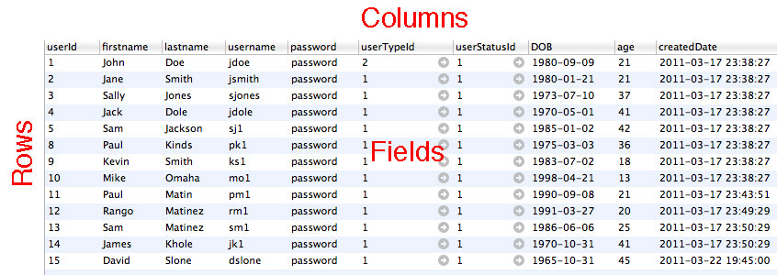
Database Objects
Tables, Rows, Columns & Fields

Slide 14
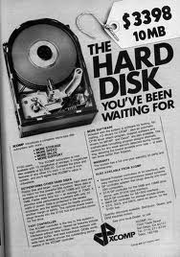
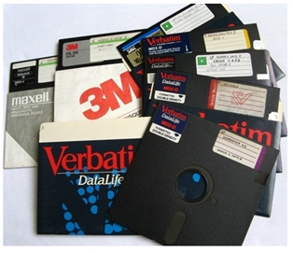
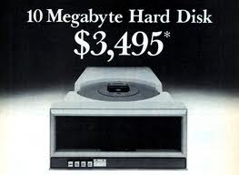
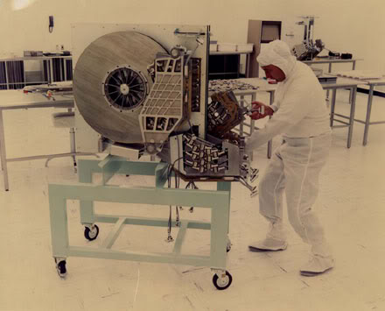
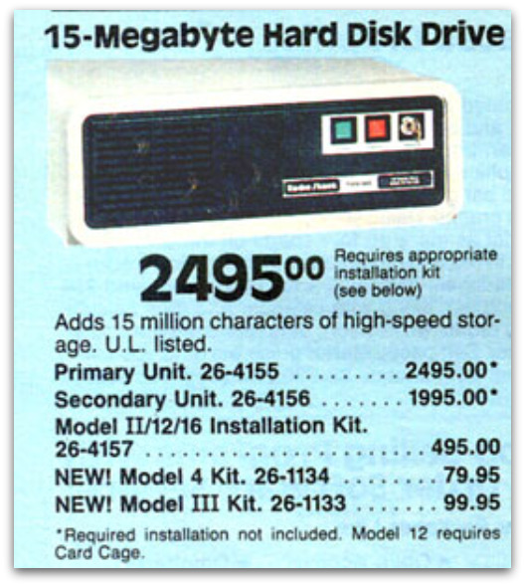
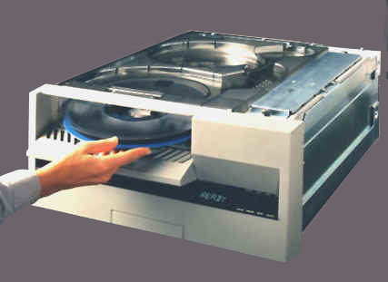
Relational Databases

Slide 15
Non-Relational Databases
Data is stored documents (for Mongo).
Data is schema-less
Relationships are not defined.
Horizontality Scalable
Benefits: Performance, Maintenance, Lower Cost
Cons:Disk Space, Consistency

Slide 16
Non-Relational Databases
Couchbase
Mongo
Big Table (Google)
Memcache

Slide 17





Non-Relational Databases

Slide 18
99.999% Uptime

Slide 19
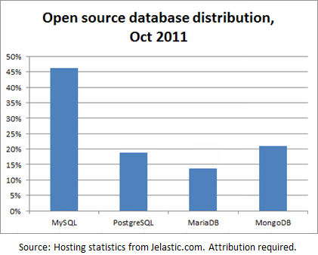
Database Installations

Slide 20
Who Uses MongoDB?
For a complete list: http://www.mongodb.org/display/DOCS/Production+Deployments

Slide 21
Review SQL
CRUD
Select
Insert
Update
Delete
Primary Keys
Foreign Keys
Natural vs Surrogate
Joins
Inner
Outer
Cross – Cartesian Product

Slide 22
Review SQL
Indexes & Constraints
Unique
Non-Unique
Order of Operations
Views
Normal Form (1-3)
Select
Aggregates
Group by
Count
Having
Unions

Slide 23
Terminal Short Cuts
Pre Lion: http://www.macupdate.com/app/mac/24105/cd-to
Lion: http://stackoverflow.com/questions/420456/open-terminal-here-in-mac-os-finder
App Store: go2shell

Slide 24
Terminal Review
pwd – present working directory
ls – list the contents of my current location.
cd ___ – change to the directory
cd .. – go back one directory
mkdir ___ - creates a new directory
ln –s /Applications/MAMP/htdocs htdocs -Symbolic Links

Slide 25
Download & Install
http://www.mongodb.org/downloads
OS X 64-bit (Latest stable version)
Unzip and move to Desktop
Rename the folder “mongodb”
MongoHub
http://mongohub.todayclose.com/
We will be working (mostly) in terminal & not a GUI.
Get use to it!

Slide 26
Starting Mongo
Open a terminal window from mongodb/bin.
Create a directory to hold your database files:
mkdir db
Set this directory as the DB path & start the database:
./mongod --dbpath db
Look in your DB directory.
Leave the window running.
To start terminal access:
./mongo
You will be running these commands every time you
start mongo.

Slide 27
Starting Mongo
To ensure the server is running, go to:
http://127.0.0.1:28017/
To create a change to a database:
use DATABASENAME
We’ll be using adbXXXX.

Slide 28
Creating Documents
var x = {type:'user', name: 'John Doe'}
Type ‘x’ to display the document.
This document only exists locally. It is not saved
to the database yet.
To save to the database:
db.adbXXXX.save(x)

Slide 29
File Locations
Check your DB directory. Once you save your first document, the database is created to the file system.

Slide 30
Creating Documents
Documents can also be created with a single line of code:
db. adbXXXX.save({type: ’user', name:’Joe Smith'})
Let’s add 2 users.

Slide 31
Returning Documents
To return all of the documents in your database:
db.adbXXXX.find()
db.adbXXXX.find().pretty

Slide 32
Creating Documents
Create 10 users (total)
4 documents with an age field. (Numeric)
4 documents with height field. (Numeric)
4 documents with an eyeColor field. (Text)
All documents must have a type = ‘user’ and a name.
Do not change the previous 2 users we added.

Slide 33
Json vs Bson
JavaScript Object Notation
Binary JSON
In Mongo, a single document is limited to 16 meg.

Slide 34
Returning Documents
To return filtered data:
db.adbXXXX.find({type:'user'})
To sort your data:
db.abdXXXX.find({type:'user'}).sort({ name: 1 })or
db.adbXXXX.find({type:'user'}).sort({name:-1})

Slide 35
Sort Order
0-9A-Za-z
Caps com before lower case
Remember, as Mongo is scheme-less, field type may be mix.

Slide 36
Returning Documents
db.adbXXXX.find().limit(N)
db.adbXXXX.find().skip(N)
db.adbXXXX.find().count()

Slide 37
Filtering Documents
db.adbXXXX.find({type: 'user', age: { $gt: 22 }})
db.adbXXXX.find({type: 'user', age: { $lte: 25 }})

Slide 38
Filtering Documents
db.adbXXXX.find({name: {$gte:"j",$lte:"jz"}})
Similar to :
where name like ‘j%’

Slide 39
Filtering Documents
db.addXXXX.find({name: {$regex:"^S"}})
Returns names starting with an "S"

Slide 40
Common Regular Exps
^S – Starts with S followed by N characters
c$ - Ends in a c preceeded by N characters

Slide 41
Filtering Documents
db.adbXXXX.find({name: {$type:2}})
Returns string fields

Slide 42
Operators: $or
db.adbXXXX.find( { $or: [ { age: 23 }, { name: 'John Doe'} ] } )
db.adbXXXX.find( { $or: [{age: { $gt: 21 }}, {height :{$gte:70}} ] } )

Slide 43
Operators: $exists
db.adbXXXX.find( { age: { $exists : true } } );
db.adbXXXX.find( { height: { $exists : false } } );

Slide 44
Operators
$ne
$in
$nin
$size
http://www.mongodb.org/display/DOCS/Advanced+Queries#AdvancedQueries-%24or

Slide 45
Returning Documents
To limit the documents returned:
db.abdXXXX.find({type: 'user'}).sort({ name: 1 }).limit(1)
To load a document for editing:
x = db.abdXXXX.findone({type: 'user'})

Slide 46
Updating Documents
x= db.adbXXXX.findOne({name: 'John Doe'})
x.age = 23
db.adbXXXX.save(x)

Slide 47
Aggregate Functions
To perform a distinct function:
db.adbXXXX.distinct('type')

Slide 48
Group (aggregate)
db.adbXXXX.group({
cond: {age: { $exists: true }},
key: {type: true},
initial: {totalAge: 0, count: 0},
reduce: function(obj,prev){
prev.totalAge += obj.age;
prev.count++; },
finalize: function(out){ out.avgAge = out.totalAge / out.count; } })

Slide 49
Deleting Documents
db.adbXXXX.remove({name:'John Doe'})

Slide 50
Helpful Links
Query Documentation: http://www.mongodb.org/display/DOCS/Advanced+Queries#AdvancedQueries-%24or
http://education.10gen.com
http://www.youtube.com/user/mongodb

Slide 51
Due for Day 2
Screen cast on a database related topic
Lab 1

