Slide 1


ADB Day 3
John Cabibbo
jcabibbo@fullsail.com
AIM: jcabibbo@fullsail.com

Slide 2
Agenda
Push Labs 1 & 2
Screen Casts (Submit on USB or YouTube)
Review
Scaling
Embed or Nested Documents

Slide 3
Review
db.adbXXXX.insert();
db.adbXXXX.update({QUERY},{UPDATE})
$set
$inc
$unset

Slide 4
Review
Arrays / Embedded Documents
$push
$pushAll
$pop
$pull
$pullAll

Slide 5
Review
db.adbXXXX.getIndexKeys()
db.adbXXXX.ensureIndex({ name : 1 })
db.adbXXXX.reIndex()

Slide 6
Commands
db.adbXXXX.find().limit(N)
db.adbXXXX.find().skip(N)
db.adbXXXX.find().count()
db.adbXXXX.find().sort(field:1)
db.adbXXXX.distinct(’field')

Slide 7
Schema-less
Each document has it’s own structure.
Horizontality Scalable (Sharding)
Ease of future changes

Slide 8
Performance - Blocks
A block is the minimum amount of data that can be read or written.
Both the database and OS have a block size.

Slide 9
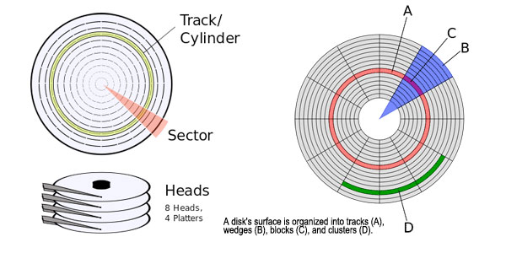
Blocks

Slide 10
Scalability vs Functionality
For scalability, MongoDB sacrificed functionality.
No Joins
Transactions (Committing Multiple Queries at once)

Slide 11
Embed or Not to Embed
{ _id:5,
name:’John Smith’,
type:’user’,
address:’123 Main St’,
city:’Orlando’,
state:’FL’,
zip:’32801’,
cell: ‘321-555-1212’
work: ‘407-897-0101’
}

Slide 12
Embed or Not to Embed
We could force relations even though no constraints exist.
{ _id:12344,
user_id:’5’,
type:’address’,
address:’123 Main St’,
city:’Orlando’,
state:’FL’,
zip:’32801’
}

Slide 13
Embed or Not to Embed
{ name:’John Smith’,
type:’user’,
address: [
{ type:’home’,
street: ’123 Main St’,
city:’Orlando’, state:’FL’, zip:’32801’
},
{ type: ‘vacation’,
street: ’555 Hickory Trail’,
city:’Albany’, state:’NY’, zip:’32801’
}
],
phone: [
{number:‘321-555-1212’, type:’cell’},
{number:‘407-555-1456’, type:’work’}
]
}

Slide 14
Embed or Not to Embed
{ name:’John Smith’,
phone: [
{type:’home’, number:’407-555-1212’},
{type:’work’, number:’407-777-1212’},
{type:’cell’, number:’321-787-1212’}
]}

Slide 15
Embed or Not to Embed
db.adbXXXX.find( {"phone.number":"407-555-1212"} )
db.adbXXXX.find(
{"address.state":”FL"}
)

Slide 16
Indexing Embed Documents
db.adbXXXX.ensureIndex({ name : 1 })
db.adbXXXX.ensureIndex({ “address.zip”: 1 })

Slide 17
MongoDB
Document Size Limit 16meg
Sub-documents can be indexed

