Slide 1


ADB Day 4
John Cabibbo
jcabibbo@fullsail.com
AIM: jcabibbo@fullsail.com

Slide 2
Agenda
Screen Casts
Architecture
Backup & Recovery

Slide 3
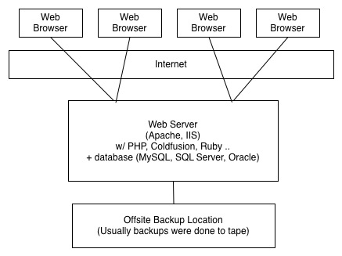
Architecture
Circa 1997

Slide 4
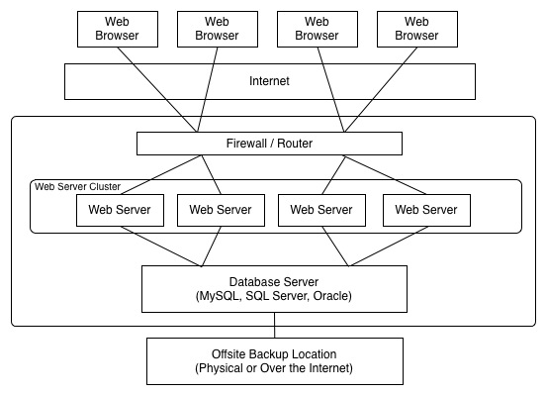
Architecture

Slide 5
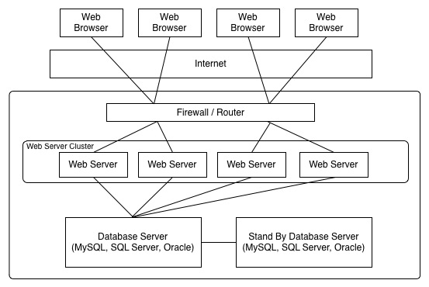
Architecture

Slide 6
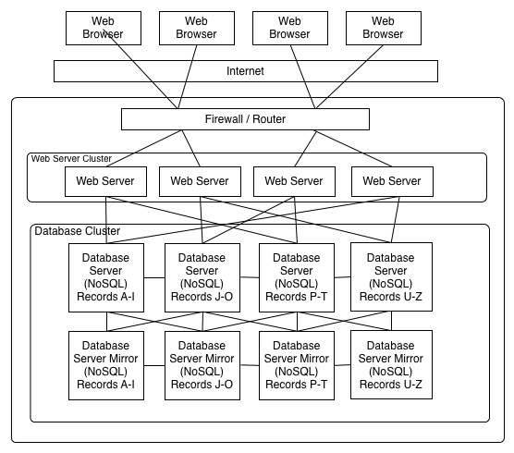
Architecture

Slide 7
How large can it get?
How many servers does Google have?
2011: 900,000
Current: 1,791,040
By 2013: 2,376,640

Slide 8
Backup & Recovery
Similar to a SQL Dump
./mongodump -d adbXXXX -o DIR
./mongorestore DIR

Slide 9
mongoImport
-d or –db Database
-c or –collection Collection
--type json|csv|tsv
--file Exported file
Under mongodb/bin create import and copy your csv and json files there.
http://docs.mongodb.org/manual/reference/mongoimport/

Slide 10
mongoImport
Json:
./mongoimport -d DATEBASE -c COLLECTION -file import/grades.js
CSV:
./mongoimport -d DATABASE-c COLLECTION --type csv --file import/contacts.csv -fields firstname,lastname,username,dob,userStatus,userType,createdDat

Slide 11
mongoExport
./mongoexport --db adbXXXX --collection adbXXXX --csv --out /Users/jcabibbo/Desktop/adbXXXX.csv --fields _id,type,name,age,height

