Slide 1


ADB Day 6
John Cabibbo
jcabibbo@fullsail.com
AIM: jcabibbo@fullsail.com

Slide 2
Agenda
Screen Casts (Submit on USB or YouTube)
Lecture & Lab Review

Slide 3
Databases & Collections
show dbs
use DBNAME
show collections

Slide 4
Creating Documents
var x = {type:'user', name: 'John Doe'}
Type ‘x’ to display the document.
This document only exists locally. It is not saved
to the database yet.
To save to the database:
db.adbXXXX.save(x)

Slide 5
Creating Documents
Documents can also be created with a single line of code:
db. adbXXXX.save({type: ’user', name:’Joe Smith'})

Slide 6
Returning Documents
To return all of the documents in your database:
db.adbXXXX.find()
db.adbXXXX.find().pretty

Slide 7
Json vs Bson
JavaScript Object Notation
Binary JSON
In Mongo, a single document is limited to 16 meg.

Slide 8
Returning Documents
To return filtered data:
db.adbXXXX.find({type:'user'})
To sort your data:
db.abdXXXX.find({type:'user'}).sort({ name: 1 })or
db.adbXXXX.find({type:'user'}).sort({name:-1})

Slide 9
Filtering Documents
db.adbXXXX.find({type: 'user', age: { $gt: 22 }})
db.adbXXXX.find({type: 'user', age: { $lte: 25 }})

Slide 10
Sort Order
0-9A-Za-z
Caps com before lower case
Remember, as Mongo is scheme-less, field type may be mix.

Slide 11
Filtering Documents
db.adbXXXX.find({name: {$gte:"j",$lte:"jz"}})
Similar to :
where name like ‘j%’

Slide 12
Regular Expressions
db.adbXXXX.find({name: {$regex:"a"}})
Returns names containing an "a"
db.adbXXXX.find({name: {$regex:"s$"}})
Returns names ending in an "s"
db.adbXXXX.find({name: {$regex:"^S"}})
Returns names starting with an "S"

Slide 13
Filtering Documents
db.adbXXXX.find({name: {$type:2}})
Returns string fields

Slide 14
Operators: $or
db.adbXXXX.find( { $or: [ { age: 23 }, { name: 'John Doe'} ] } )
db.adbXXXX.find( { $or: [{age: { $gt: 21 }}, {height :{$gte:70}} ] } )

Slide 15
Operators: $exists
db.adbXXXX.find( { age: { $exists : true } } );
db.adbXXXX.find( { height: { $exists : false } } );

Slide 16
$all & $in
Db.adbXXXX.find({age : {$in:[30,45,50]} } )
Return docs where age=30 or age=45 or age=50
Db.adbXXXX.find( { field: { $all: array} } );
Field = [2,3,4,5,6]
Array = [5,6]

Slide 17
Commands
db.adbXXXX.find().limit(N)
db.adbXXXX.find().skip(N)
db.adbXXXX.find().count()
db.adbXXXX.find().sort(field:1)
db.adbXXXX.distinct(’field')

Slide 18
Group (aggregate)
db.adbXXXX.group({
cond: {age: { $exists: true }},
key: {type: true},
initial: {totalAge: 0, count: 0},
reduce: function(obj,prev){
prev.totalAge += obj.age;
prev.count++; },
finalize: function(out){ out.avgAge = out.totalAge / out.count; } })

Slide 19
Insert
db.adbXXXX.insert(x);
x = {}
If the collection does not exist, then the insert method will create the collection.
If the document does not specify an _id field, then MongoDB will add the _id field and assign a unique ObjectId for the document before inserting.

Slide 20
Updating Documents
x= db.adbXXXX.findOne({name: 'John Doe'})
x.age = 23
db.adbXXXX.save(x)

Slide 21
Update
db.adbXXXX.update( {FILTER}, {VALUE} );
db.adbXXXX.update( {_id:0}, {“age”:26} );
Rewrites the entire record matching the condition.

Slide 22
$set
db.adbXXXX.update( {FILTER}, {$set: {VALUE}} );
db.adbXXXX.update( {_id:0}, {$set: {”age”:25}} );
Sets age but leaves the other fields.

Slide 23
$unset
db.adbXXXX.update({FILTER},{$unset :{FIELD,:1}})
db.adbXXXX.update({_id:0},{$unset :{age:1}})

Slide 24
$inc
db.adbXXXX.update( {FILTER}, {$inc: {COLUMN: 1}} );
db.adbXXXX.update( {"name":"John Cena"}, {$inc: {age: 1}} );

Slide 25
Arrays
x = {type:'user',
name: 'Mark Zuckerburg',
age:28,
favNum:[1,3,5,7,11]
}

Slide 26
Arrays of Objects
x = {type:'user',
name:'Ben Forta',
age:58,
children:[
{name:'Sally’,age:8},
{name:'Billy’,age4},
{name:'Jimmy’,age:12}
]
}

Slide 27
$push & $pushAll
db.adbXXXX.update( {FILTER}, {$push: {VALUE}} );
db.adbXXXX.update( {_id:0}, {$push: {“hobby”: ”snow boarding”}} );
db.adbXXXX.update( {_id:0}, {$pushAll: {“hobby": [“Billards”,”Finger Painting”]}} );

Slide 28
$pop
db.adbXXXX.update( {_id:0}, {$pop: {“hobby”:1}} );
Pops off the last element

Slide 29
$pop
db.adbXXXX.update( {_id:0}, {$set: {age:30}}, {upsert:true} );
If record exists, update else insert.
{_id:0,age30}

Slide 30
Deleting Documents
db.adbXXXX.remove({name:'John Doe'})

Slide 31
Indexes
db.adbXXXX.getIndexKeys()
db.adbXXXX.ensureIndex({ name : 1 })
db.adbXXXX.reIndex()

Slide 32
Embed or Not to Embed
{ user_id:’5’,
type:’address’,
address:’123 Main St’,
city:’Orlando’,
state:’FL’,
zip:’32801’
}

Slide 33
Embed or Not to Embed
{ name:’John Smith’,
address:[
{ type:’home’,
street: ’123 Main St’,
city:’Orlando’, state:’FL’, zip:’32801’
},
{ type: ‘vacation’,
street: ’555 Hickory Trail’,
city:’Albany’, state:’NY’, zip:’32801’
}
]
}

Slide 34
Embed or Not to Embed
{ name:’John Smith’,
phone: [
{type:’home’, number:’407-555-1212’},
{type:’work’, number:’407-777-1212’},
{type:’cell’, number:’321-787-1212’}
]}

Slide 35
Embed or Not to Embed
db.adbXXXX.find( {"phone.number":"407-555-1212"} )
db.adbXXXX.find(
{"address.state":”FL"}
)

Slide 36
Explain
find(KEY:VALUE).explain()
BasicCursor = no index used
millis = milisconds taken
indexOnly = Only the index was used, not the table

Slide 37
Explain & Indexes
db.user.find({lastname:'Smith'}).explain()
db.user.getIndexKeys() or db.user.getIndexes()
db.user.ensureIndex({lastname:1})
db.user.dropIndex({lastname:1})

Slide 38
Hinting Index
hint({score:1}) Hints and index
hint({$natural:1}) Hints to use no index

Slide 39
Geospacial Indexes 2D
x, y coordinates
location:[x,y]
ensureIndex({location:'2d'})
ensureIndex({location:'2d'}, type:1) Ascending
getIndexes()
find({location:{$near:[x,y]}})
Orders by distance ascending

Slide 40
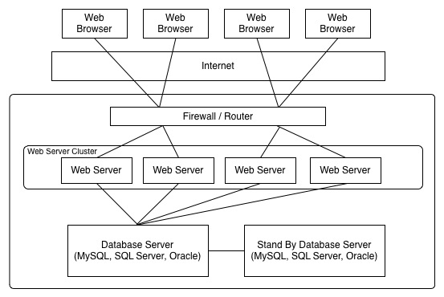
Architecture

Slide 41
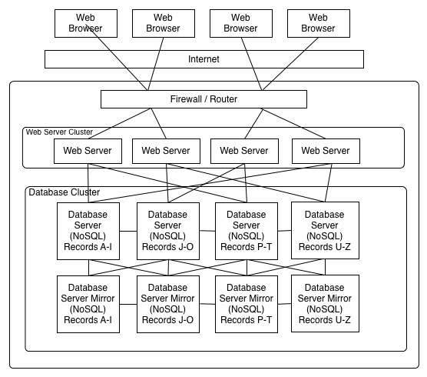
Architecture

Slide 42
Backup & Recovery
Similar to a SQL Dump
To perform a backup:
./mongodump -d adbXXXX -o DIR
To perform a restore:
./mongorestore DIR

Slide 43
mongoImport
-d or –db Database
-c or –collection Collection
-type json|csv|tsv
-file Exported file
Under mongodb/bin create import and copy your csv and json files there.
http://docs.mongodb.org/manual/reference/mongoimport/

Slide 44
mongoImport
Json:
./mongoimport -d DATEBASE -c COLLECTION -file import/grades.js
CSV:
./mongoimport -d DATABASE-c COLLECTION --type csv --file import/contacts.csv -fields firstname,lastname,username,dob,userStatus,userType,createdDat

Slide 45
mongoExport
./mongoexport --db adbXXXX --collection adbXXXX --csv --out /Users/jcabibbo/Desktop/adbXXXX.csv --fields _id,type,name,age,height

