Slide 1
FAIRWAY GOLF CLUB
The First AI-Powered Golf Improvement Club
Investor Pitch | July 2026
Notes:
Title slide. AI-powered indoor golf improvement club at Workhouse Arts Center, Lorton, Virginia.

Slide 2
THE PROBLEM
Golf simulators are everywhere. Golf improvement is nowhere.
Existing indoor golf businesses are:
Dark, dingy rental spaces
No ambiance, no community, no reason to come back
Zero personalization
Every visit starts from scratch — no data, no continuity
Entertainment-only
Fun once, but doesn't make you a better golfer
No technology moat
Anyone can buy a simulator; nobody's building the software layer

Slide 3
THE SOLUTION
Every visit makes you a better golfer.
Golfer360 Profile
Personalized Coaching
AI-powered digital profile captures every shot, every session. Your progress is tracked and visualized.
Salesforce Agentforce delivers AI coaching recommendations based on YOUR data, not generic tips.
Premium Experience
Community & Accountability
Backyard luxury feel — walnut tones, comfortable seating, craft beer from next door.
Memberships, leagues, and progress tracking keep golfers coming back weekly.

Slide 4
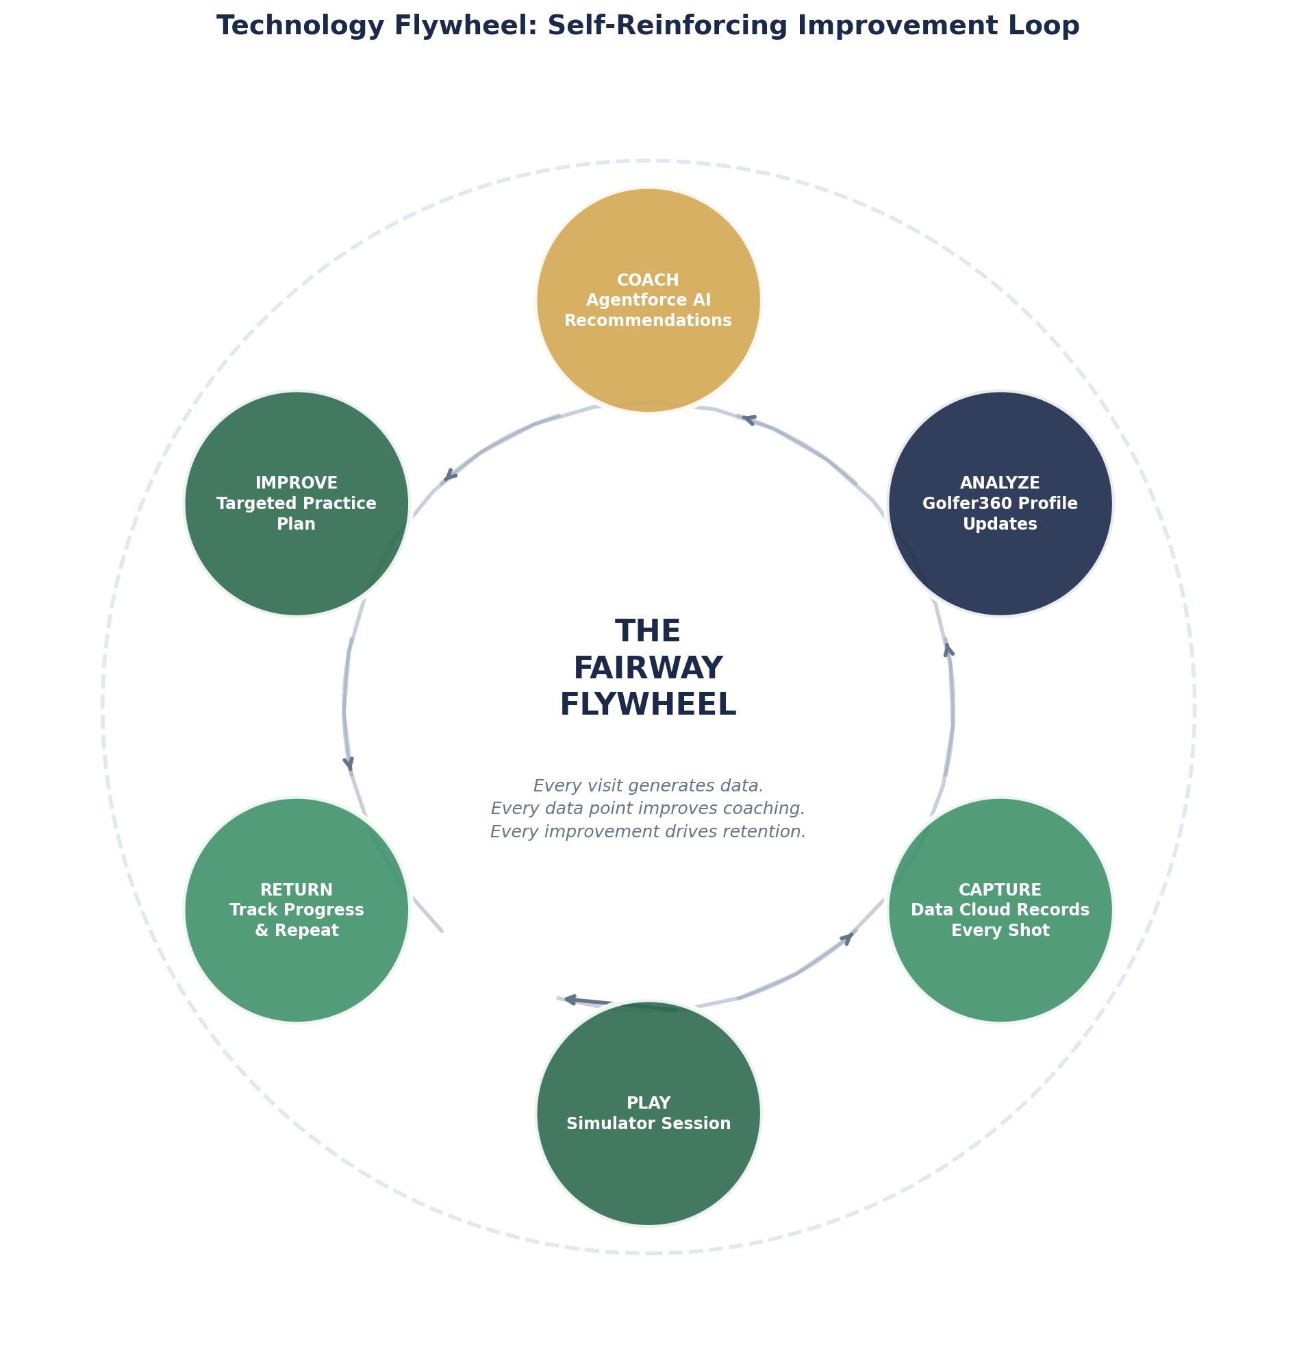
Notes:
The Fairway Flywheel: self-reinforcing loop. Every visit generates data → better coaching → improvement → retention → return.

Slide 5
THE TECHNOLOGY MOAT
Built on enterprise-grade Salesforce infrastructure by a Salesforce professional.
Salesforce CRM
Tableau
Member management, booking, communications
Performance dashboards for members
Data Cloud
Experience Cloud
Unified golfer profiles from every session
Member portal & self-service booking
Agentforce AI
Automation
Personalized coaching & recommendations
Lights, HVAC, booking — minimal staff needed

Slide 6
BUSINESS MODEL
Revenue Stream | Pricing | Notes
Hourly Rentals | $55-70/hr | Primary revenue — walk-ins and bookings
Memberships | $99-299/mo | Bronze/Silver/Gold tiers — recurring revenue
AI Coaching | $49/mo add-on | Agentforce-powered improvement plans
Corporate Events | $500-2K/event | Team building, client entertainment
Leagues & Lessons | $200-500/season | Community engagement, retention driver
Beverage Sales | Bunny Man partner | ABC license — sell craft beer on-site

Slide 7
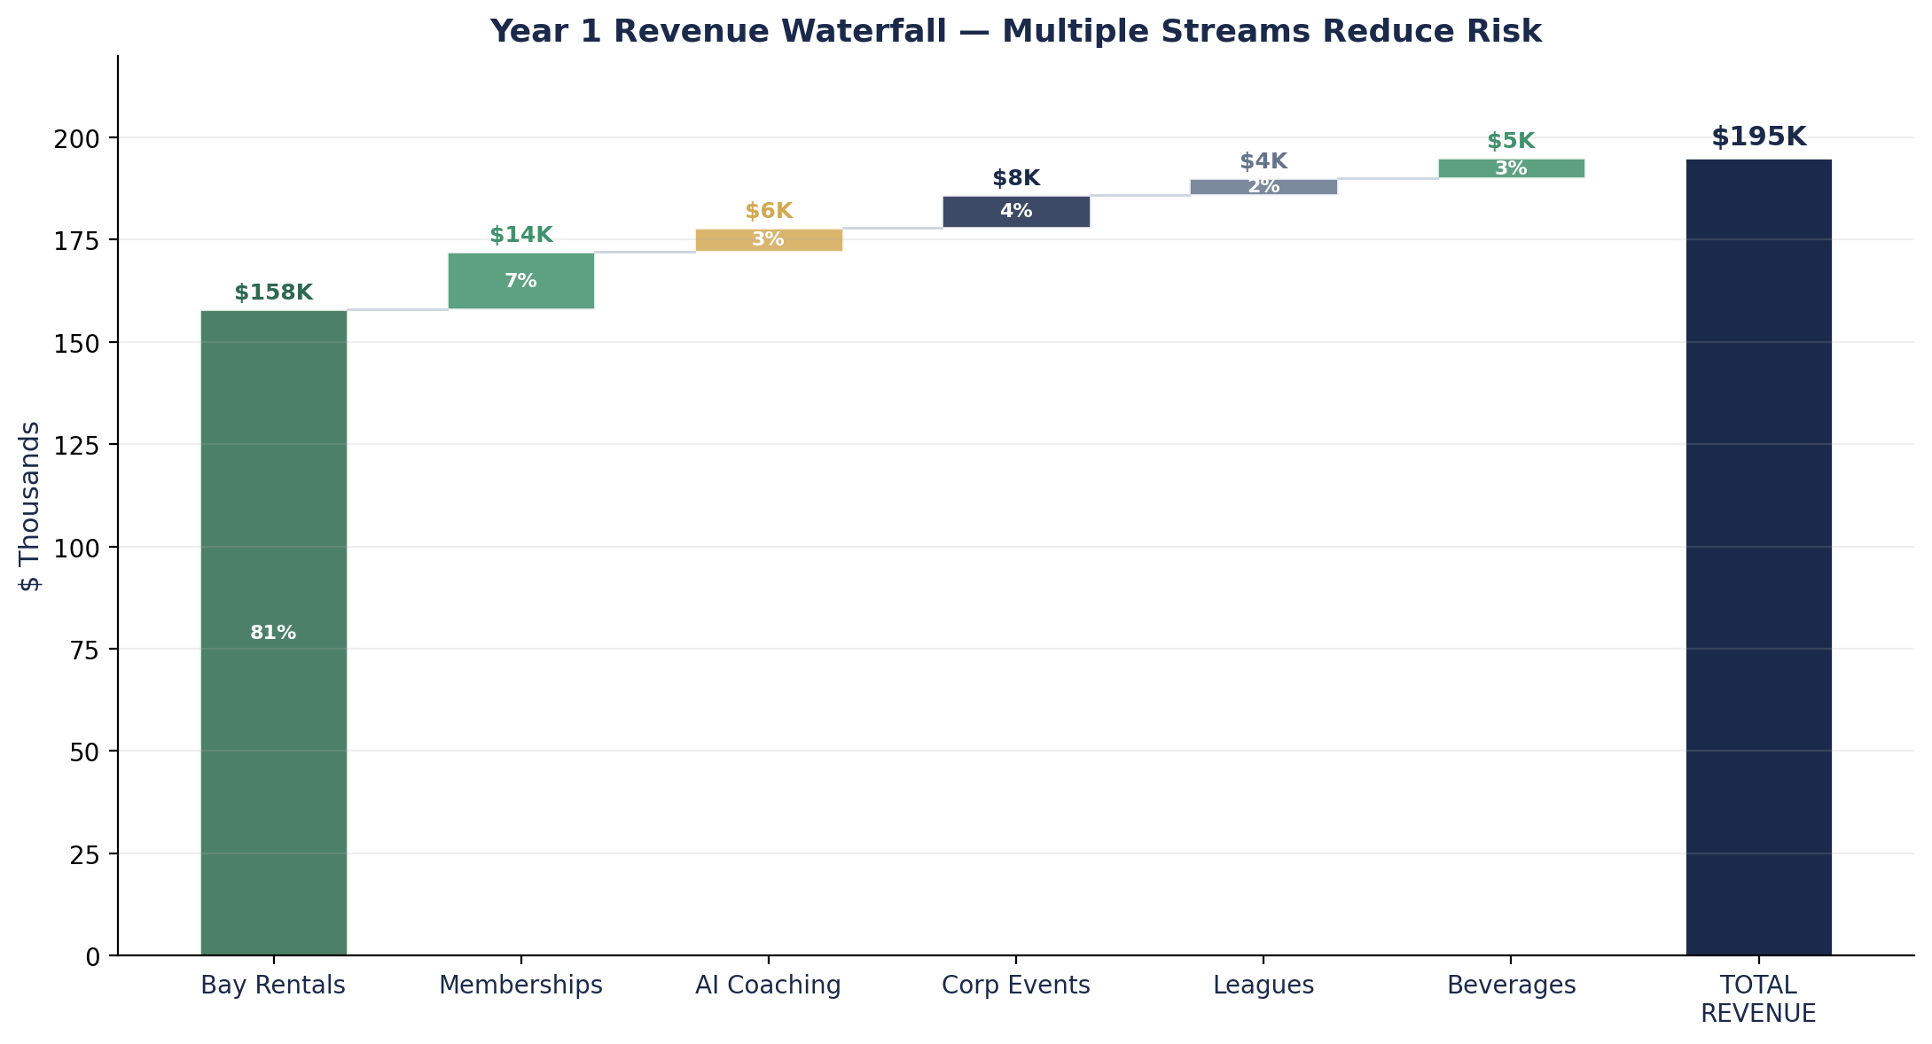
Notes:
Revenue waterfall shows diversified income. Bay rentals are primary but memberships, events, and coaching add margin and reduce risk.

Slide 8
LOCATION: WORKHOUSE ARTS CENTER
9518 Workhouse Way, Lorton, Virginia 22079
Historic campus with existing foot traffic and community events
Affluent surrounding area — $97K+ median household income
Bunny Man Brewing on-site — built-in beverage partnership
Family-friendly arts district — attracts target demographics
5 golf courses within 7 miles — proven active golfer population
Fort Belvoir (51,000+ employees) less than 10 minutes away
Zero direct indoor golf competition south of Springfield

Slide 9
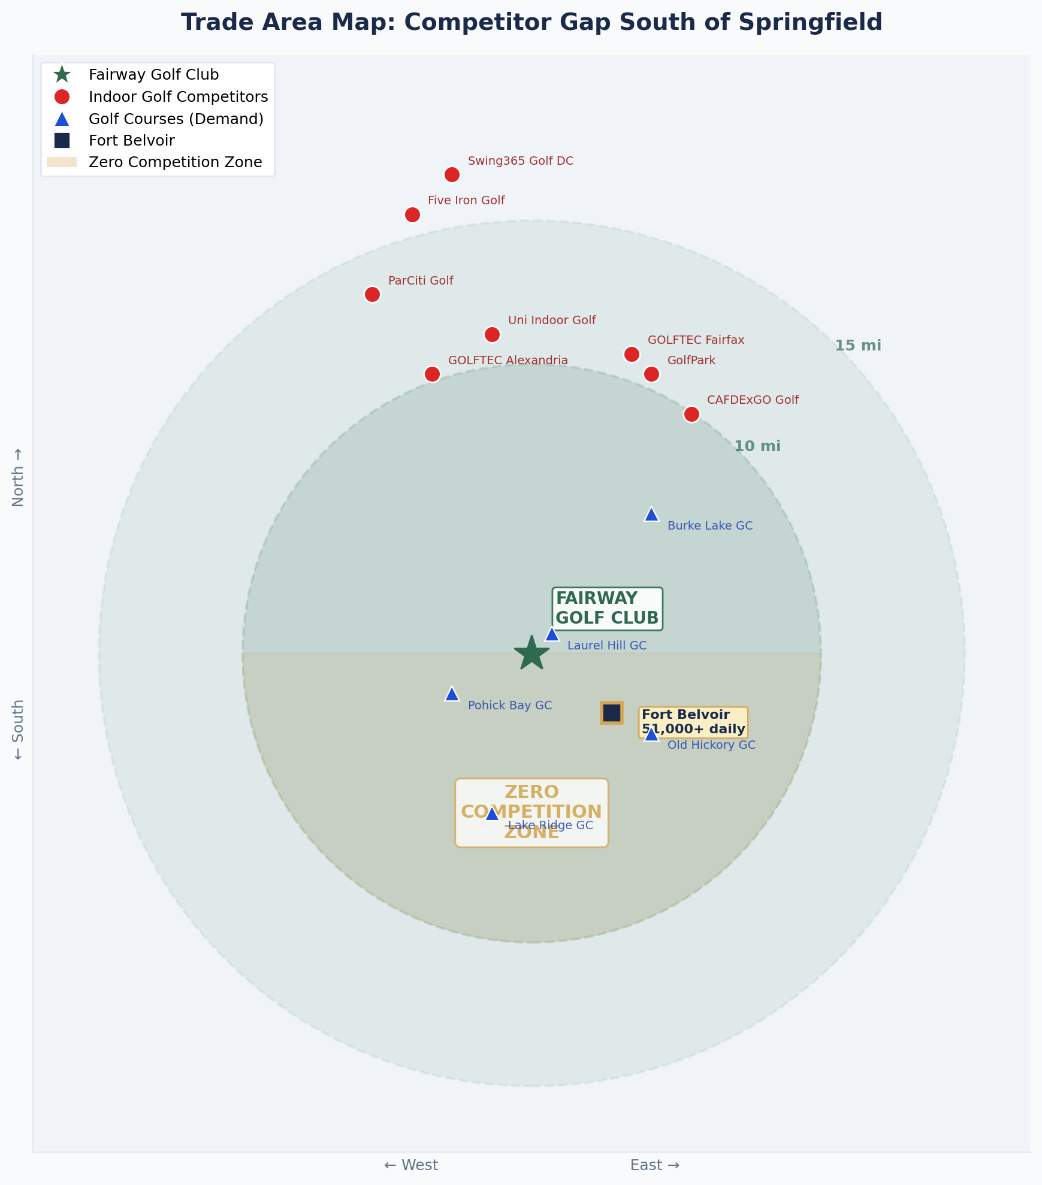
Notes:
Trade area map: ALL 8 competitors clustered north of Springfield. South corridor (100K+ residents) is completely unserved. Fairway fills this gap.

Slide 10
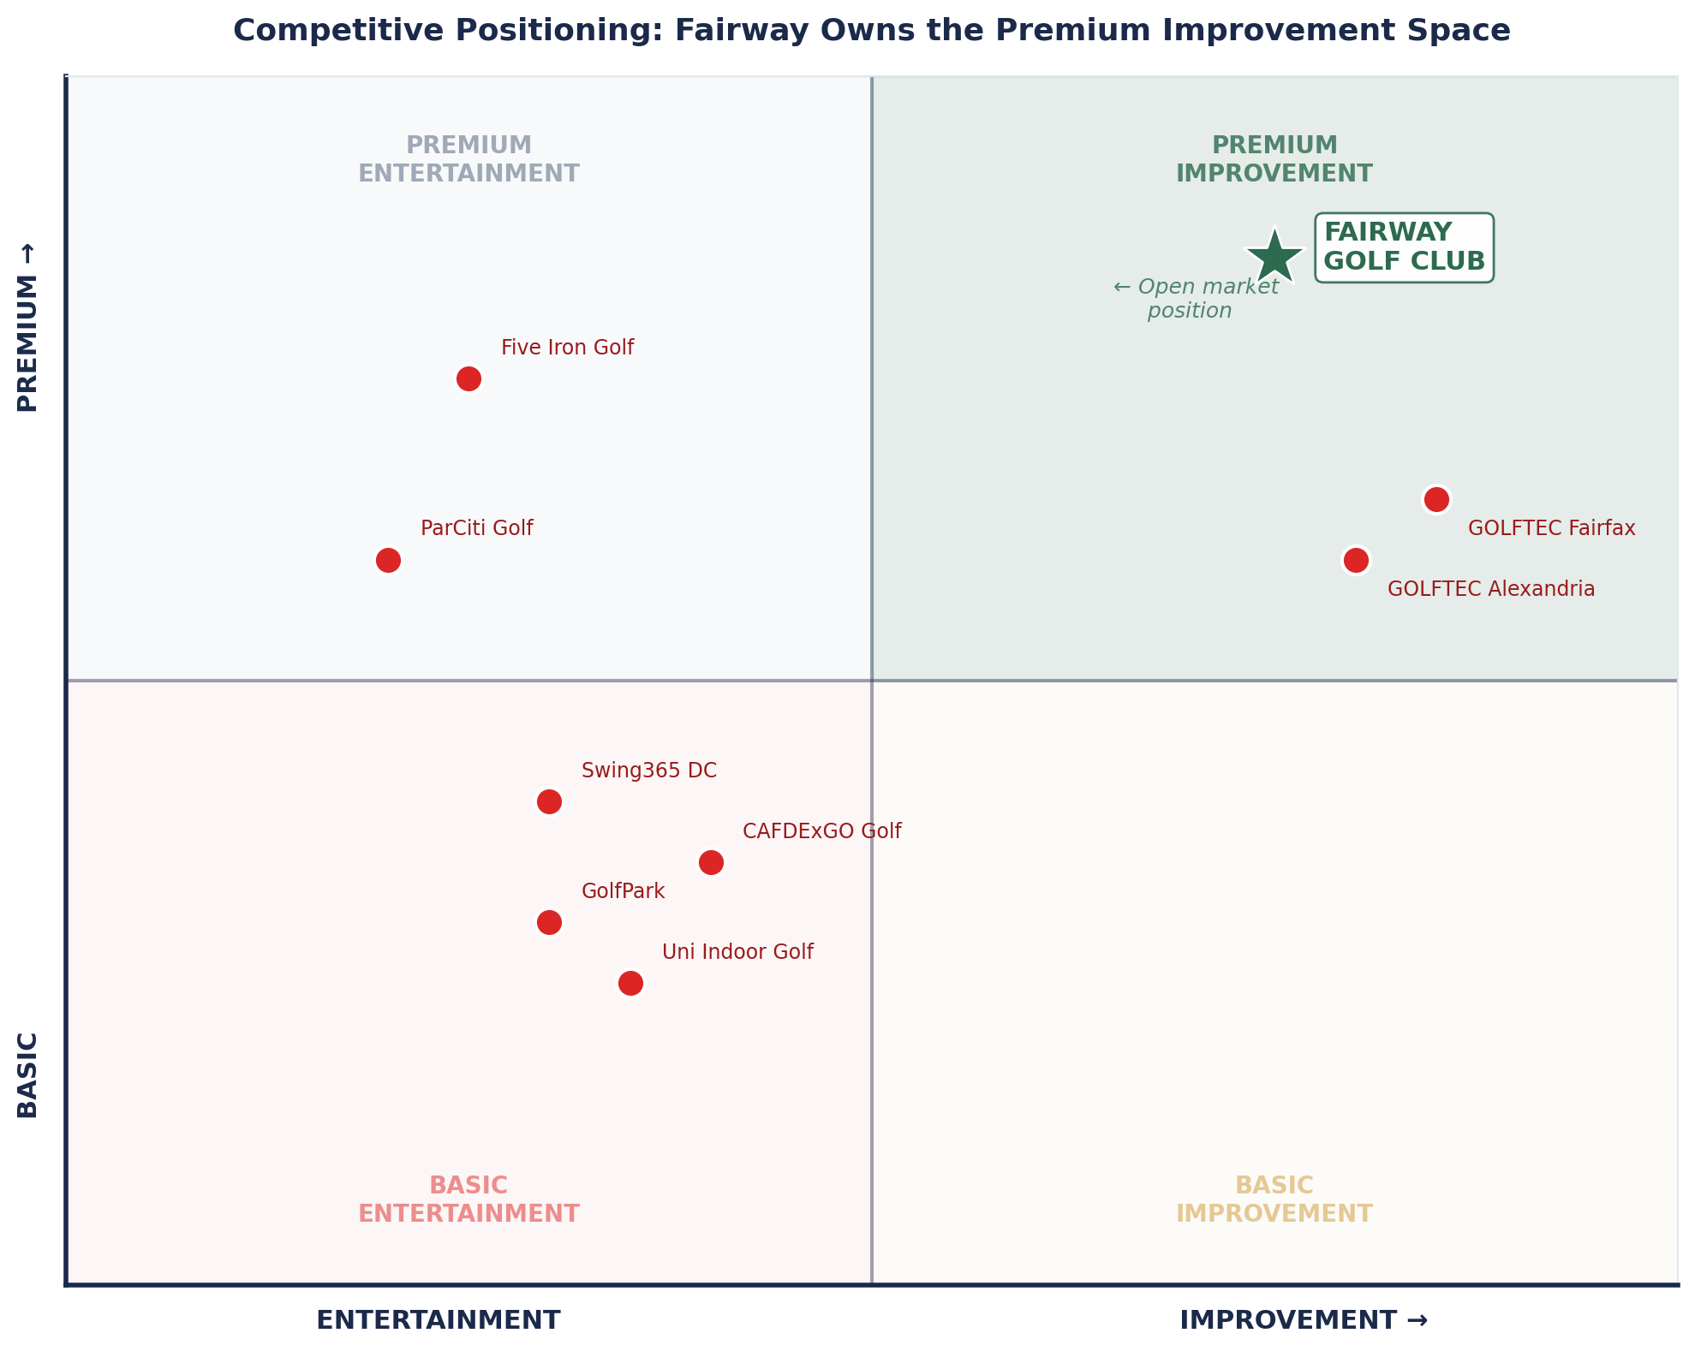
Notes:
Positioning matrix: Fairway owns the Premium+Improvement quadrant alone. GOLFTEC is improvement but expensive lessons-only. Five Iron is premium but entertainment-only.

Slide 11
PHASED GROWTH STRATEGY
Risk is minimized: small investment, founder maintains income, expand only after demand is proven.
PHASE 1
PHASE 2
Year 1 — Validate
Year 3 — Scale
2 simulator bays
$150K startup investment
$55/hr, 12 hrs/day operation
2 part-time staff
40% utilization target
Founder keeps $227K day job
Expand to 4 bays
$100K additional investment
65%+ utilization proven
Full-time staff model
Founder goes full-time CEO
Franchise model exploration

Slide 12
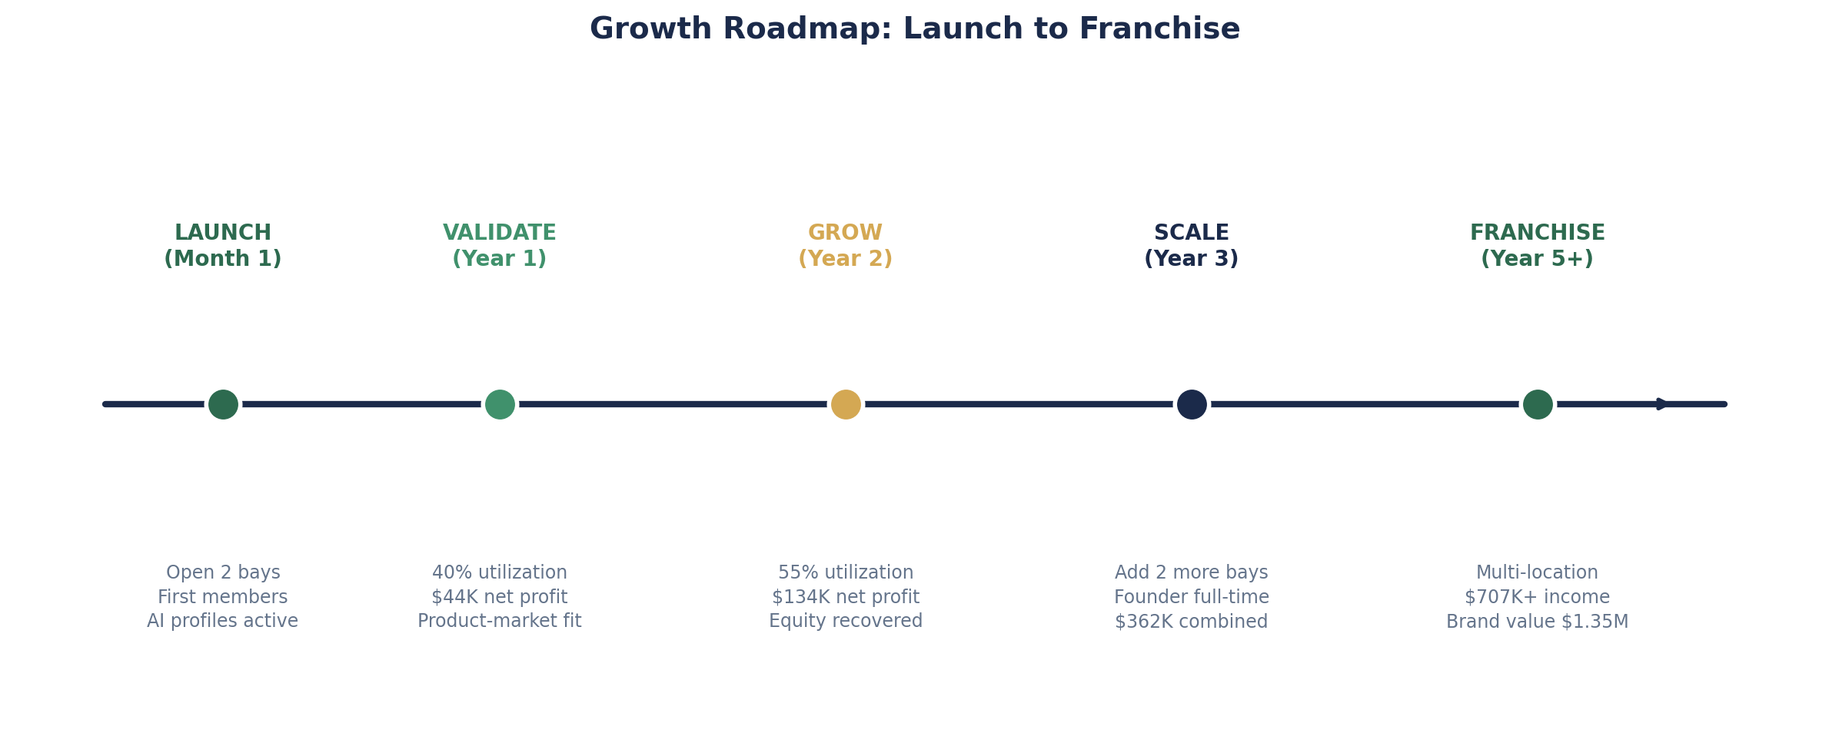
Notes:
Visual timeline: Launch → Validate (Y1, 40%, $44K) → Grow (Y2, 55%, $134K) → Scale (Y3, 4 bays) → Franchise (Y5+, $707K).

Slide 13
FINANCIAL PROJECTIONS
$44K
$134K
$362K
$707K
Year 1 Net
Year 2 Net
Year 3 Combined
Year 5 Combined
After debt service
Investment recovered
Quit day job viable
Household income

Slide 14
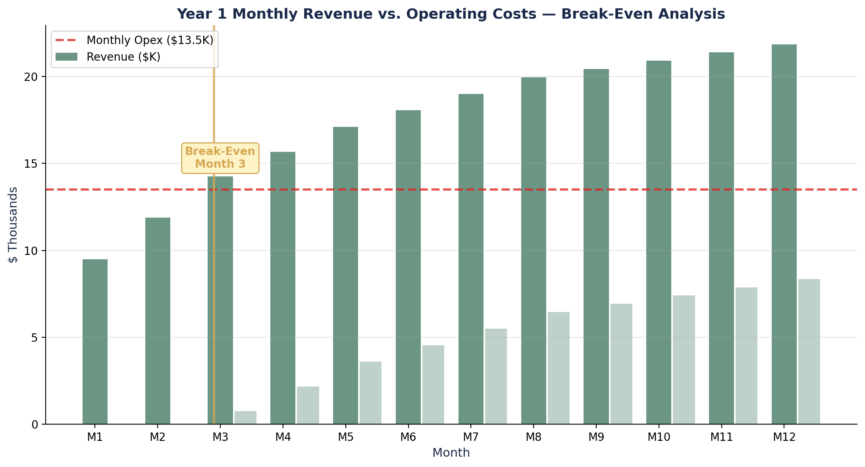
Notes:
Break-even at Month 3 with conservative utilization ramp. Revenue exceeds $13.5K/mo opex by month 3 as utilization hits 30%.

Slide 15
THE ASK
$150,000
Phase 1 Total Investment
$75K equity + $75K loan (8%, 5-year term)
Startup costs: simulators, build-out, technology, ABC license, working capital
Use of Funds
Simulator equipment & install: ~$60K
Build-out & premium finishes: ~$45K
Technology & Salesforce setup: ~$20K
Working capital & licenses: ~$25K

Slide 16
WHY THIS FOUNDER
Salesforce Expert
Professional CRM/AI background — the technology platform IS my day job
Low-Risk Operator
Keeping $227K/yr job through Phase 1 — no desperation, only discipline
1 Mile from Location
Can manage operations personally; no absentee ownership
Golfer + Customer
I understand the frustration firsthand and built the solution I want to use
Automation Mindset
Designed for 2 part-time staff, not 10 — technology replaces headcount

Slide 17
BRAND: READY TO LAUNCH
Domain
fairwaygolfclub.co
Secured
Virginia SCC
No conflicts
Clear
USPTO IC 041
No exact match
Available
State Trademark
Virginia filing
Pending ($30)
Federal ITU
Nationwide priority
Pending ($350)
Franchise-ready brand: "Fairway Golf Club" is protectable as a repeatable location concept.

Slide 18
APPENDIX
Optional Supporting Data — Market Research & Financial Detail
Include or exclude the following slides based on audience depth.

Slide 19
[OPTIONAL] LOCAL DEMOGRAPHICS
10-15 mile trade area from Lorton, VA 22079
300K+
$97K+
51,000+
5
Trade Area
Population
Median HHI
(Ft Belvoir CDP)
Fort Belvoir
Employees
Golf Courses
Within 7 Miles
Community | Profile
Lorton / Fairfax Station | HHI $120K+, family-oriented, golf-active
Springfield / Burke | HHI $110K+, strong golf course density
Woodbridge / Dale City | Population 80K+, underserved for indoor golf
Fort Belvoir | Military families, disposable income, recreation-seeking

Slide 20
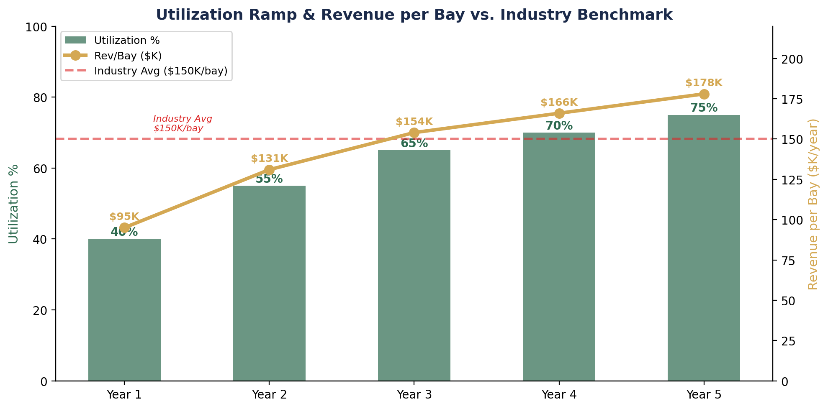
[OPTIONAL] UTILIZATION & REVENUE PER BAY
Notes:
Crosses industry average revenue/bay by Year 3. Conservative utilization ramp validates before scaling.

Slide 21
[OPTIONAL] 5-YEAR FINANCIAL DETAIL
 | Year 1 | Year 2 | Year 3 | Year 4 | Year 5
Bays | 2 | 2 | 4 | 4 | 4
Utilization | 40% | 55% | 65% | 70% | 75%
Gross Revenue | $190K | $261K | $617K | $664K | $712K
Operating Expenses | $144K | $144K | $288K | $296K | $305K
Debt Service | $18K | $18K | $18K | $18K | $18K
Net Business Income | $44K | $134K | $175K | $200K | $225K
Day Job (Net) | $141K | $145K | — | — | —
Total Household | $185K | $279K | $175K* | $200K* | $225K*
* Year 3+: Founder transitions to full-time CEO. Household = business income only.

Slide 22
[OPTIONAL] STARTUP COST BREAKDOWN
Budget Details:
2x Premium Simulators
$60K
Uneekor or Foresight
Build-Out & Finishes
$45K
Walls, flooring, lighting, furniture
Salesforce + Tech
$20K
CRM, screens, network, kiosk
Working Capital
$25K
ABC license, 3-mo reserve, marketing
Total: $150,000

Slide 23
[OPTIONAL] FORT BELVOIR — MILITARY MARKET
51,000+
7,637
$97,290
< 10 min
Daily Workers
& Residents
CDP
Population
Median
Household Income
Drive to
Workhouse
Golf is a top recreation activity for military personnel
No on-base indoor golf simulators — unmet demand
High disposable income with stable employment
Corporate budgets from DoD contractors (SAIC, Leidos, Booz Allen)

Slide 24
FAIRWAY GOLF CLUB
Every visit makes you a better golfer.
fairwaygolfclub.co
Russell Evans | russell@fairwaygolfclub.co

