Slide 1
A Hybrid AI Framework for
Arabic Fake News Detection
and Fact Verification
Sarah
Russell
Youssef
Text Classification
RAG Retrieval
Verdict Engine
Supervisor: Dr. Cherry · June 2026

Slide 2
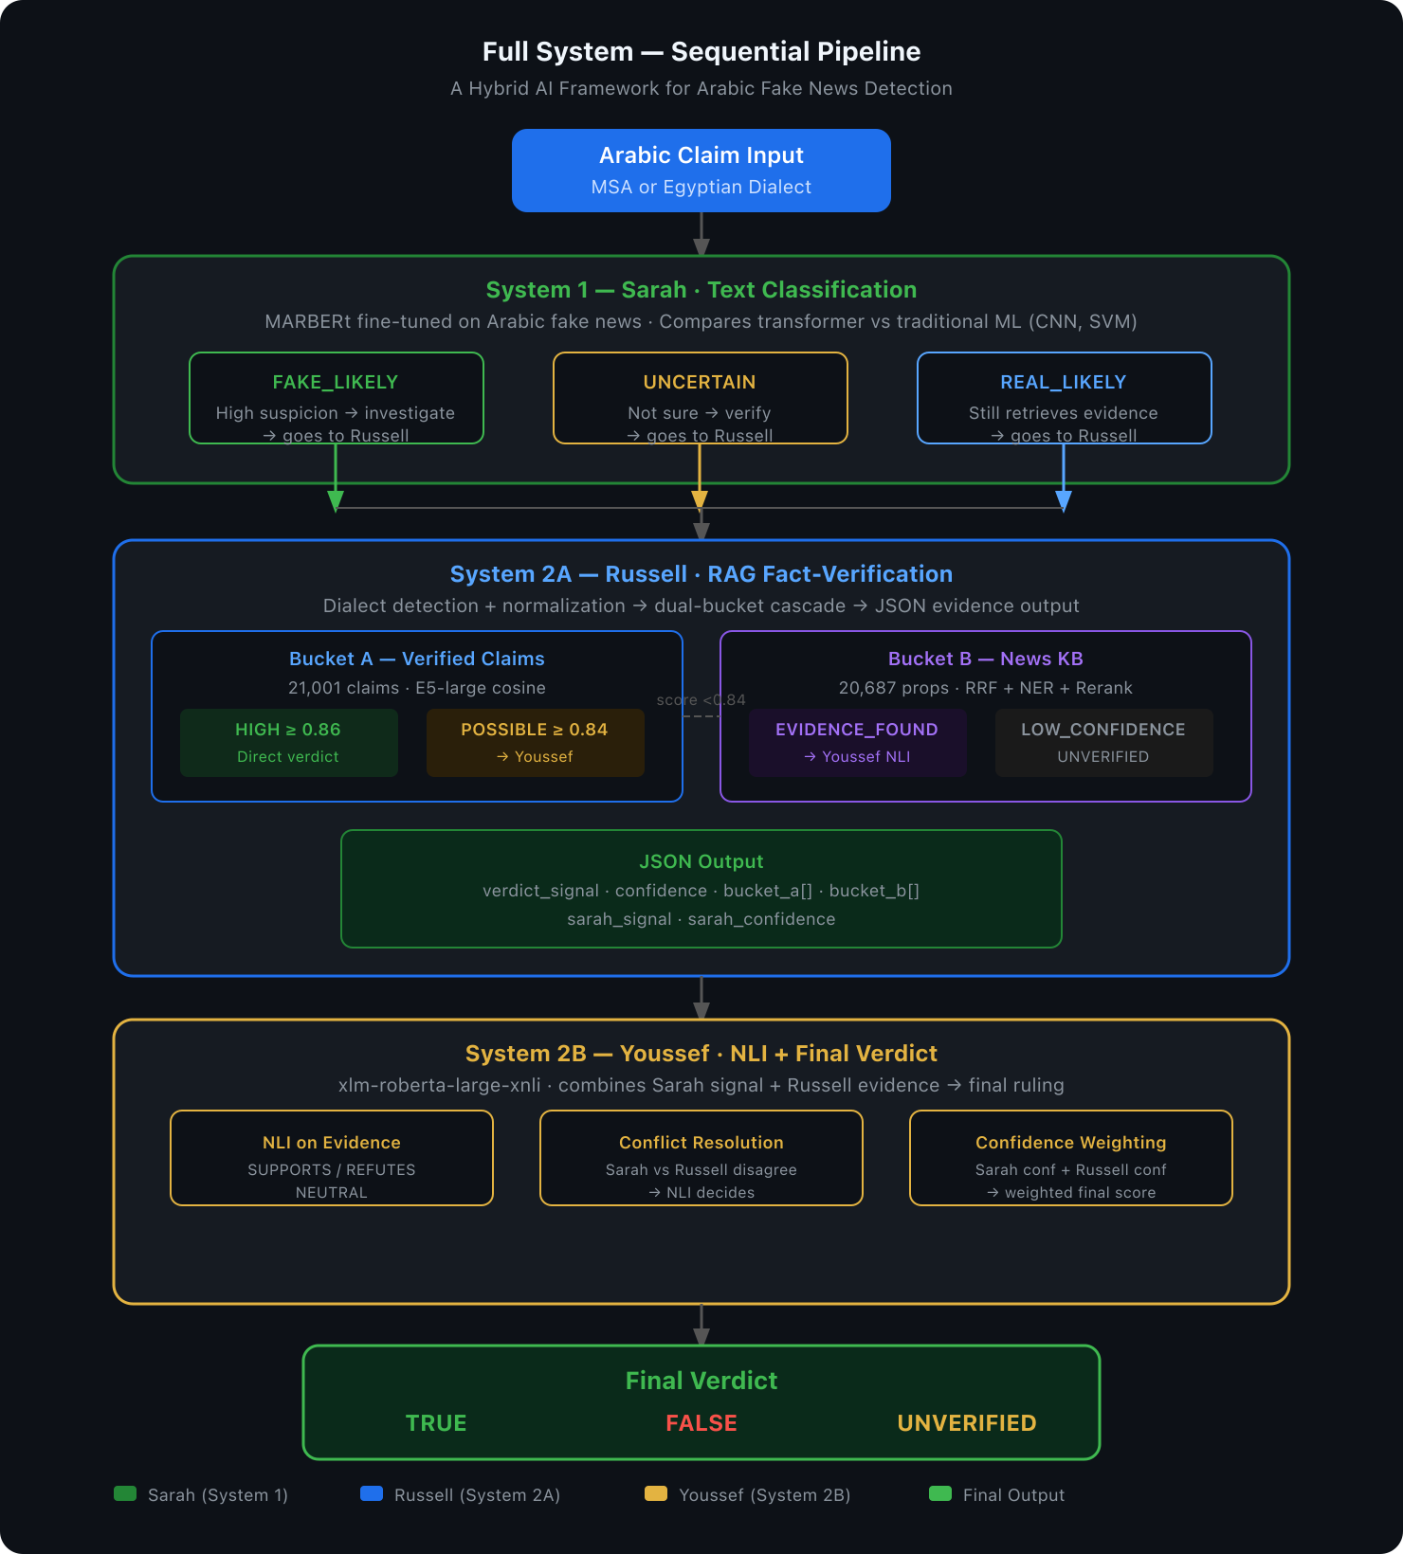
System Overview
Sequential three-system pipeline — Arabic claim → classification → retrieval → verdict

Slide 3
System 1 — Sarah
Text Classification
Output Signals
Model
MARBERt fine-tuned on Arabic fake news dataset
FAKE_LIKELY
High suspicion → sent to Russell for verification
Comparison
Transformer vs CNN vs SVM — evaluates multiple approaches
UNCERTAIN
Borderline → Russell retrieves evidence
Dialect Support
Handles both MSA and Egyptian Arabic input
REAL_LIKELY
Looks true → still verified by Russell
All three outputs → forwarded to Russell with confidence score

Slide 4
System 2A — Russell
RAG Fact-Verification Engine
Bucket A — Verified Claims
Bucket B — News Knowledge Base
21,001 claims · AraFacts + Saheeh Masr
20,687 propositions · 25 Arabic sources
E5-large multilingual embeddings
1. RRF hybrid: BM25 + E5-large fusion
HIGH ≥ 0.86
Direct verdict
POSSIBLE ≥ 0.84
→ Youssef NLI
2. NER entity boosting
3. Cross-encoder reranker (top-20 → top-5)
Egyptian dialect normalization via CAMeL
EVIDENCE_FOUND → Youssef NLI
LOW_CONFIDENCE → UNVERIFIED
Score < 0.84 → escalate to Bucket B
Papers Implemented
ARAG
RRF + NER boosting
E5-large
Multilingual embeddings
BM25 + ISRI
Arabic stemming
Cross-Encoder
Reranking

Slide 5
Evaluation Results — System 2A
200 AraFacts pairs · K=5
Bucket A Retrieval — v1 vs v2
Paraphrase Robustness (Bucket A)
System
P@1
R@3
MRR
Level
P@1
BM25 only (v1)
0.880
0.920
0.899
Light rewording
1.000
AraBERT only (v1)
0.415
0.630
0.527
Medium rewrite
0.960
Hybrid v1
0.885
0.930
0.909
Heavy rewrite
0.920
BM25 only (v2)
0.910
0.940
0.929
Egyptian Dialect
0.980
E5-large only
0.965
0.980
0.972
RRF Hybrid v2
0.935
0.980
0.958
Why E5-large alone > Hybrid on AraFacts:
★ Dialect robustness 0.98 — CAMeL normalization + E5 multilingual encoding
AraFacts is MSA-dominant — BM25 already scores 0.910, so RRF fusion adds slight noise (0.965 → 0.935). On dialectal or paraphrased input, hybrid wins: see dialect 0.980 above.
Bucket B (News KB): P@1 = 0.20 on AraFacts · Expected — viral social media rumors don't appear in news sources by design

Slide 6
System 2B — Youssef
Verdict Engine · NLI + Aggregation Pipeline
INPUT from Russell:
Model: xlm-roberta-large-xnli
claim · verdict_signal · bucket_a[ ] · bucket_b[ ]
Path 1 — Direct Verdict
Path 2 — NLI + Aggregation
Trigger: HIGH_FAKE_MATCH or HIGH_TRUE_MATCH
(Bucket A similarity ≥ 0.90)
Trigger: POSSIBLE / EVIDENCE_FOUND / LOW_CONFIDENCE
1. Run NLI on each Bucket B proposition
NLI is NOT run — trust Bucket A directly
2. Weight stances by hybrid_score (evidence quality)
→ final verdict + confidence score
3. Apply Russell's verdict signal as prior nudge
Fast path · no NLI computation needed
4. Map ratio → TRUE / FALSE / UNVERIFIED
High confidence by design
5. Calculate confidence (capped at 0.95)
6. Build human-readable reason string
OUTPUT:
TRUE
FALSE
UNVERIFIED
+ confidence · stance_breakdown · reason
Module breakdown:
schemas.py
nli_model.py
aggregator.py
reason_builder.py
verdict_engine.py
Data models
NLI inference
Stance weighting
Reason text
Main orchestrator

Slide 7
How It All Connects
JSON contract between systems
Sarah
Russell
Youssef
Sends:
Sends:
Sends:
claim + sarah_signal
+ sarah_confidence
verdict_signal + bucket_a[]
+ bucket_b[] + confidence
final_verdict + confidence
+ stance_breakdown + reason
Russell's JSON Output (sample)
"claim": "السيسي باع سيناء لإسرائيل"
"verdict_signal": "POSSIBLE_FAKE", "confidence": 0.74
"bucket_a": [{ "text": "...", "label": "FALSE", "similarity": 0.851 }]
"bucket_b": [{ "text": "...", "source": "AlJazeera", "score": 0.821 }]
"sarah_signal": "FAKE_LIKELY", "sarah_confidence": 0.88

