Slide 1


Suicides correlation to internet Usage and Technology.
A dive into technologies impact on our mental Health

Slide 2





Agenda
Analyze Suicide trends
Analyze Internet Usage
Find trends if any are to be found
Dive Deeper into what may have an impact
Conclusions

Slide 3
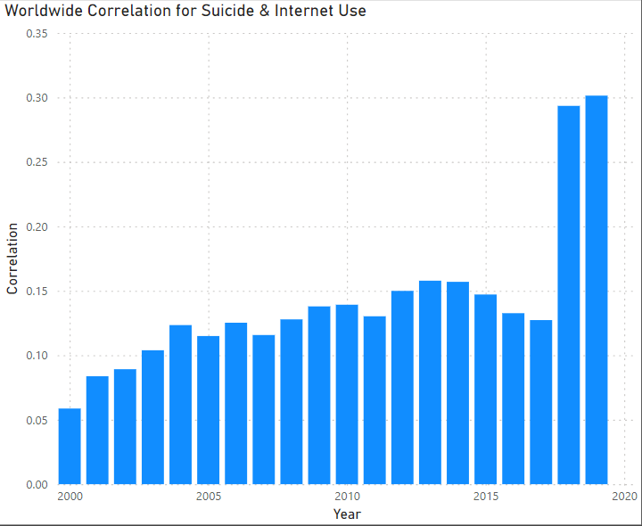
Is there a correlation between internet usage and suicide?
What does this chart reveal?
The data began in 2000 and went until 2019.
There were a total of 265 countries in this dataset.
I wanted to start here and see if there was any correlation at all. The correlation for the entire data frame was a .09.
In 2000 we see a very low positive correlation.
It continued to grow at a slow rate until a large spike in 2018 and 2019.
This does suggest that their may be a slight correlation as .05 through .16 is a very low positive correlation.
However in 2018 and 2019 the .29 and .30 positive correlation is much stronger suggesting there may be something there.

Slide 4
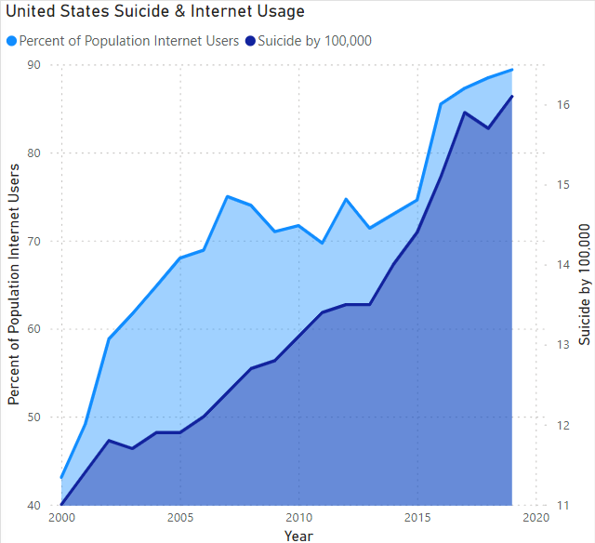

After seeing the correlation for the world. I was curious about how the United States would compare.
As we can see by the visualization, they seem to have some relation.
The percentage of the population of internet users and suicides by 100,000 have a .89 correlation. This strong positive correlation
After seeing this dramatic spike in suicides from 2000-2019. I want to dive into the history of suicides in the United States!
4

Slide 5
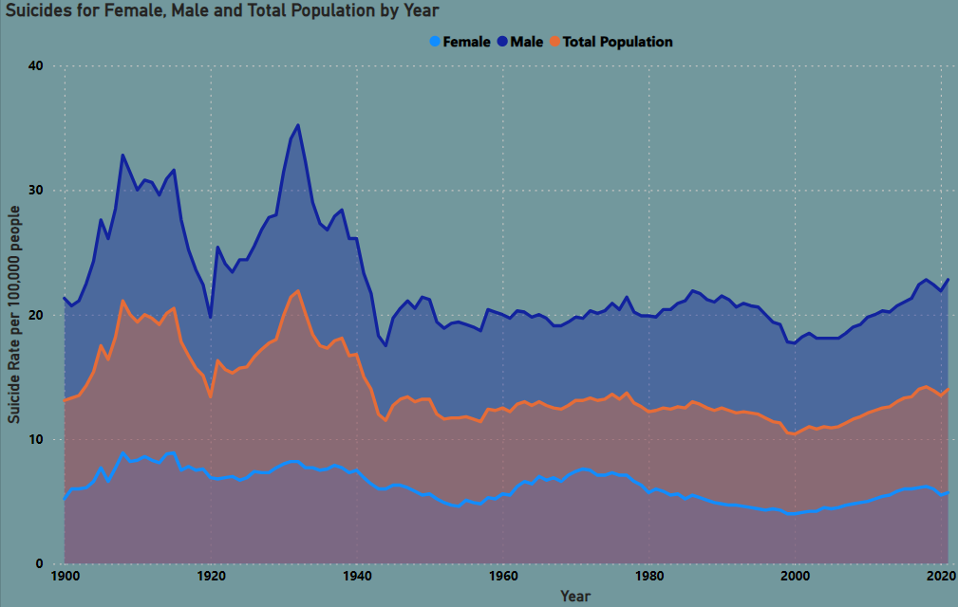
What is the History of suicide in the united states of America
After seeing the dramatic spike from 2000-2019 this was not what I was expecting to see. The suicide rate had reached all time lows in 2000.
We can see that males are significantly more at risk of committing suicide than females. Males are on average 4x more likely to commit suicide.
Lets first dive into age ranges and see if there are any age groups that are more at risk before diving into the timeline and seeing what technological advancements may contribute to this increase.

Slide 6


Slide 7
EFFECTIVE DELIVERY TECHNIQUES
This is a powerful tool in public speaking. It involves varying pitch, tone, and volume to convey emotion, emphasize points, and maintain interest.
Pitch variation
Tone inflection
Volume control
Effective body language enhances your message, making it more impactful and memorable.
Meaningful eye contact
Purposeful gestures
Maintain good posture
Control your expressions

Slide 8
NAVIGATING Q&A SESSIONS
Know your material in advance
Anticipate common questions
Rehearse your responses
Maintaining composure during the Q&A session is essential for projecting confidence and authority. Consider the following tips for staying composed:
Stay calm
Actively listen
Pause and reflect
Maintain eye contact

Slide 9

SPEAKING IMPACT
Your ability to communicate effectively will leave a lasting impact on your audience
Effectively communicating involves not only delivering a message but also resonating with the experiences, values, and emotions of those listening

Slide 10
DYNAMIC DELIVERY
METRIC | MEASUREMENT | TARGET | ACTUAL
Audience attendance | # of attendees | 150 | 120
Engagement duration | Minutes | 60 | 75
Q&A interaction | # of questions | 10 | 15
Positive feedback | Percentage (%) | 90 | 95
Rate of information retention | Percentage (%) | 80 | 85
Learn to infuse energy into your delivery to leave a lasting impression
One of the goals of effective communication is to motivate your audience

Slide 11
FINAL TIPS & TAKEAWAYS
Consistent rehearsal
Strengthen your familiarity
Refine delivery style
Pacing, tone, and emphasis
Timing and transitions
Aim for seamless, professional delivery
Practice audience
Enlist colleagues to listen & provide feedback
Seek feedback
Reflect on performance
Explore new techniques
Set personal goals
Iterate and adapt

Slide 12
SPEAKING ENGAGEMENT METRICS
IMPACT FACTOR | MEASUREMENT | TARGET | ACHIEVED
Audience interaction | Percentage (%) | 85 | 88
Knowledge retention | Percentage (%) | 75 | 80
Post-presentation surveys | Average rating | 4.2 | 4.5
Referral rate | Percentage (%) | 10 | 12
Collaboration opportunities | # of opportunities | 8 | 10

Slide 13
THANK YOU
Mirjam Nilsson​
206-555-0146
mirjam@contoso.com
www.contoso.com

