Slide 1


Suicides correlation to internet Usage and Technology.
A dive into technologies impact on our mental Health

Slide 2





Agenda
Analyze Suicide trends
Analyze Internet Usage
Find trends if any are to be found
Dive Deeper into what may have an impact
Conclusions

Slide 3
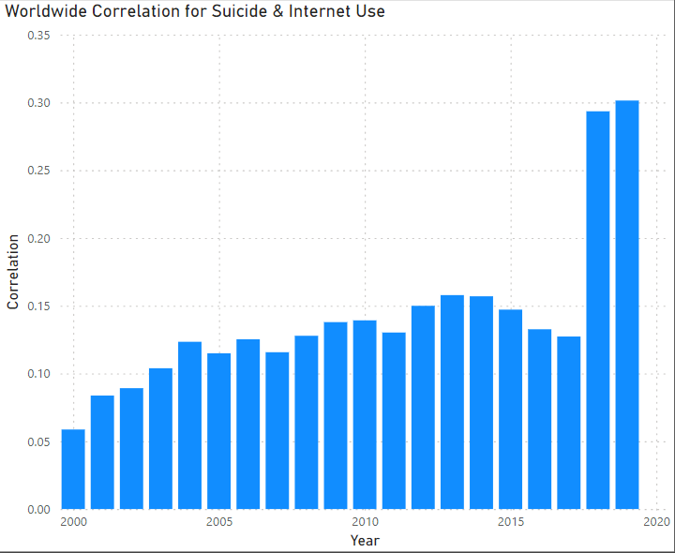
Is there a correlation between internet usage and suicide?
What does this chart reveal?
The data began in 2000 and went until 2019.
There were a total of 265 countries in this dataset.
I wanted to start here and see if there was any correlation at all. The correlation for the entire data frame was a .09.
In 2000 we see a very low positive correlation.
It continued to grow at a slow rate until a large spike in 2018 and 2019.
This does suggest that their may be a slight correlation as .05 through .16 is a very low positive correlation.
However in 2018 and 2019 the .29 and .30 positive correlation is much stronger suggesting there may be something there.

Slide 4
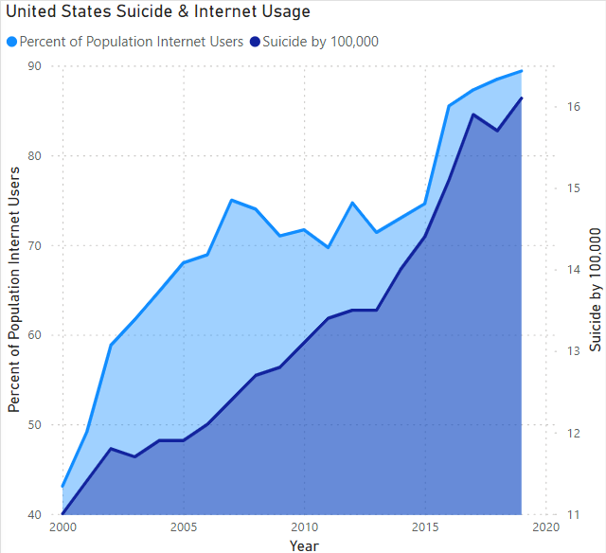

After seeing the correlation for the world. I was curious about how the United States would compare.
As we can see by the visualization, they seem to have some relation.
The percentage of the population of internet users and suicides by 100,000 have a .89 correlation. This strong positive correlation
After seeing this dramatic spike in suicides from 2000-2019. I want to dive into the history of suicides in the United States!
4

Slide 5
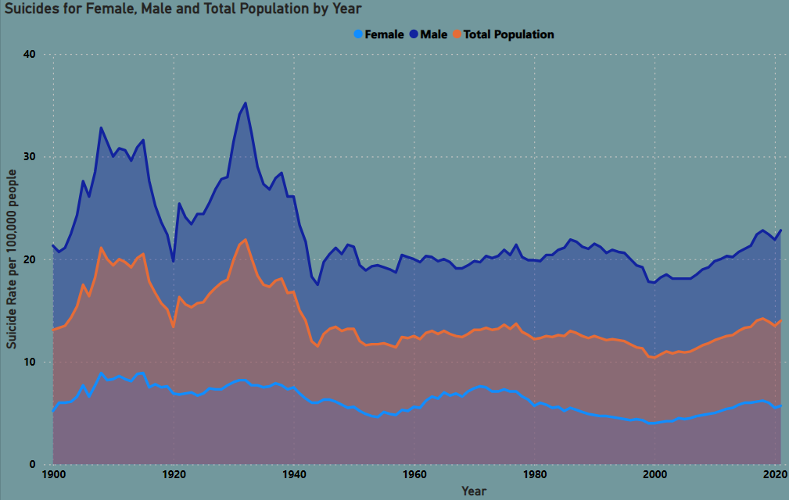
What is the History of suicide in the united states of America
After seeing the dramatic spike from 2000-2019 this was not what I was expecting to see. The suicide rate had reached all time lows in 2000.
We can see that males are significantly more at risk of committing suicide than females. Males are on average 4x more likely to commit suicide.
Lets first dive into age ranges and see if there are any age groups that are more at risk before diving into the timeline and seeing what technological advancements may contribute to this increase.

Slide 6
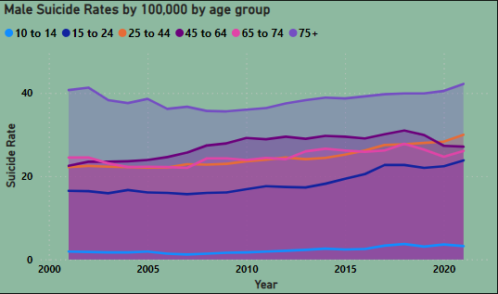
Lets analyze male suicides by age group.
Here we see the different age categories. Lets look at percent change for each category from 2001 to 2021.
10 to 14 increase 68%
15 to 24 increase 44%
25 to 44 increase 35%
45 to 64 increase 20%
64 to 74 increase 6%
75 + increase 3%
We are seeing increase in suicides across all age groups. However the younger age groups are increasing at a much larger rate.

Slide 7
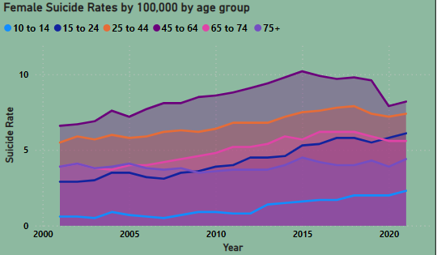
Now let us dive into female suicides by age group
Here we see the different age categories. Lets look at percent change for each category from 2001 to 2021.
10 to 14 increase 283%
15 to 24 increase 110%
25 to 44 increase 34%
45 to 64 increase 24%
64 to 74 increase 43%
75 + increase 12%
We are seeing increase in suicides across all age groups. However the younger age groups are increasing at a much larger rate.
7

Slide 8
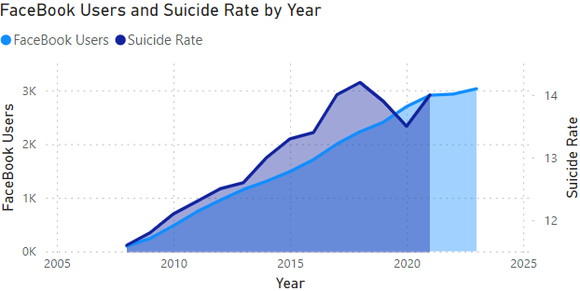
Lets look at Facebook data on users in millions by over the years.
Facebook was founded in 2004 by Mark Zuckerberg.
The company went public in September 2006.
The data set I found is from 2008 until 2023. It has historical data on the user count in millions.
The data sets time lines are off a little. However this timeline does reveal an interesting trend. The total populations suicide rate in the U.S. compared to worldwide FaceBook users. I was unable to find a dataset for just the United States FaceBook users. Lets see how the individual age groups compare to the rise of Facebook!
8

Slide 9
Lets start with the youngest age group. The 10 to 14 year old category.
9

Slide 10
THANK YOU
Mirjam Nilsson​
206-555-0146
mirjam@contoso.com
www.contoso.com

