Slide 1


Suicides correlation to internet Usage and Social Media.
1
A dive into technologies impact on our mental Health

Slide 2





Who am i? Russell Bracey Data Analyst
2
Motivation
My motivation for doing The topic of suicides Correlation to internet usage and social media is multifaceted. As someone who has had a family member commit suicide. I always have been Curious about the history of suicide and what can contribute to that decision.
Social Media is a relatively new phenomenon. I have always wondered if this way of communicating And socializing is influencing our Mental Health.

Slide 3

Agenda
3
Find correlation between suicide and internet usage across all countries.
Find correlation for the United States between internet usage and suicide.
Look into the history of suicide in the United States.
Look at historic suicide rates by age categories.
Find correlations between Social Media platforms and suicide rates in the United States.
Conclusion

Slide 4
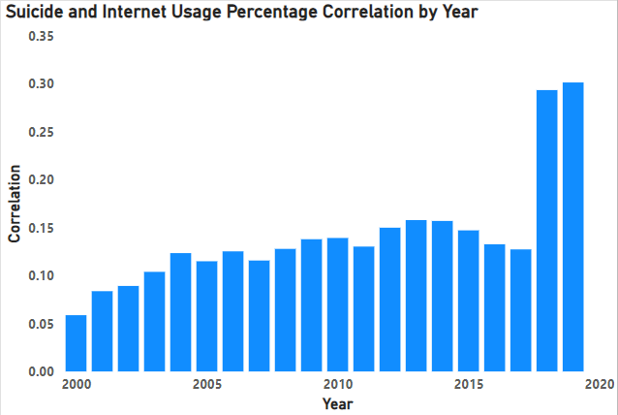
Is there a correlation between internet usage and suicide?
What does this chart reveal?
The data began in 2000 and went until 2019.
There were a total of 265 countries in this dataset.
I wanted to start here and see if there was any correlation at all. The correlation for the entire data frame was a .09.
In 2000 we see a very low positive correlation.
It continued to grow at a slow rate until a large spike in 2018 and 2019.
This does suggest that their may be a slight correlation as .05 through .16 is a very low positive correlation.
However in 2018 and 2019 the .29 and .30 positive correlation is much stronger suggesting there may be something there.

Slide 5
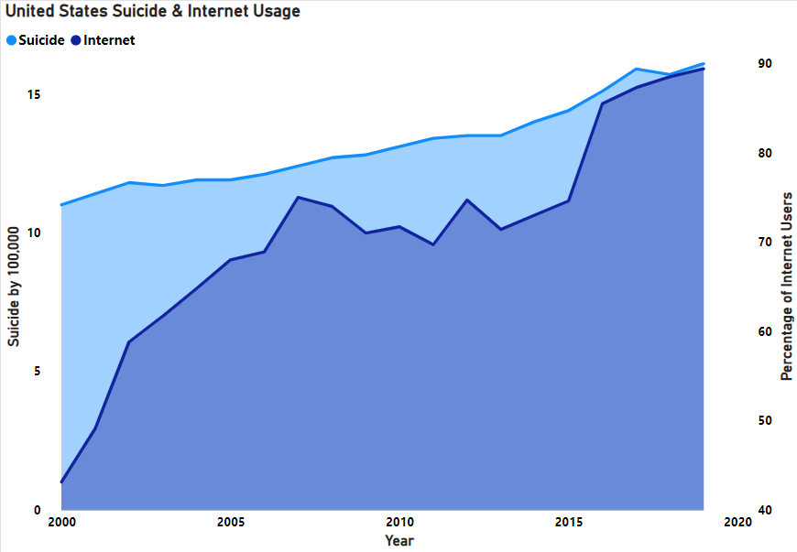
After seeing the correlation for the world. I was curious about how the United States would compare.
As we can see by the visualization, they seem to have some relation.
The percentage of the population of internet users and suicides by 100,000 have a +.89 correlation. This is a strong positive correlation
After seeing this dramatic spike in suicides from 2000-2019. I want to investigate the history of suicides in the United States!
5

Slide 6
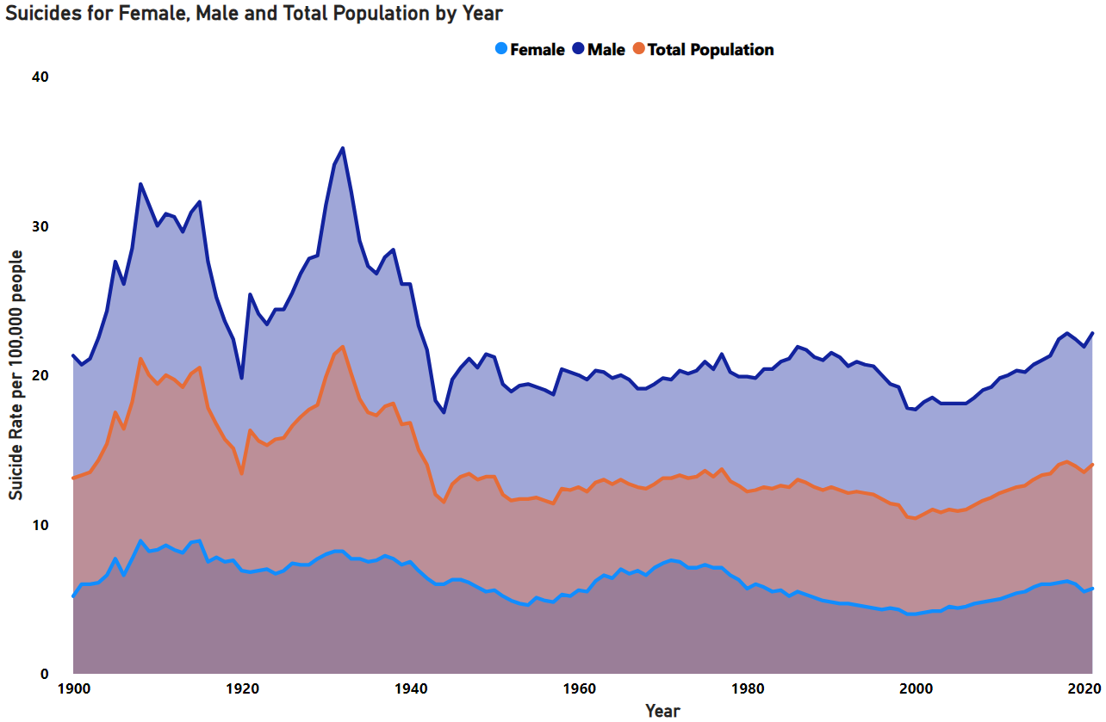
What is the History of suicide in the united states of America
After seeing the dramatic spike from 2000-2019 this was not what I was expecting to see. The suicide rate had reached all time lows in 2000.
We can see that males are significantly more at risk of committing suicide than females. Males are on average 4x more likely to commit suicide.
Let us dive into suicide by age ranges and gender to see if there are any age groups that are more at risk before looking at the timeline and seeing what technological advancements may contribute to this increase.

Slide 7
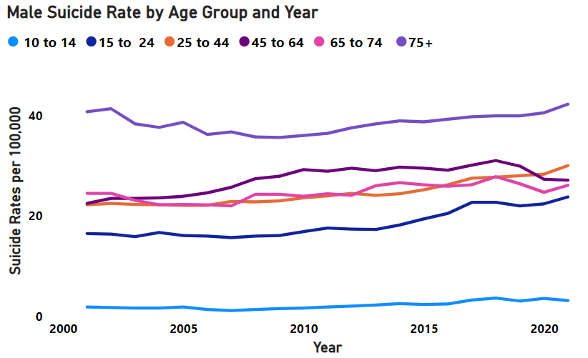
Lets analyze male suicides by age group.
7
Here we see the different age categories. Lets look at percent change for each category from 2001 to 2021.
10 to 14 increase 68%
15 to 24 increase 44%
25 to 44 increase 35%
45 to 64 increase 20%
64 to 74 increase 6%
75 + increase 3%
We are seeing increase in suicides across all age groups. However the younger age groups are increasing at a much larger rate.

Slide 8
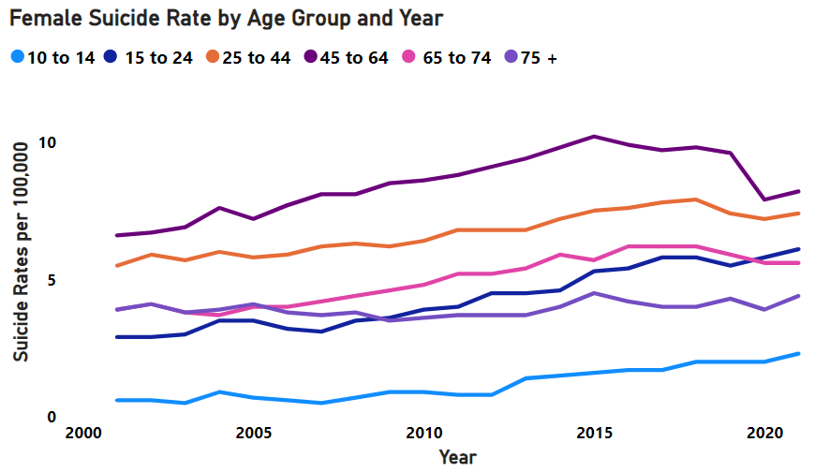
Now let us dive into female suicides by age group
8
Here we see the different age categories. Lets look at percent change for each category from 2001 to 2021.
10 to 14 increase 283%
15 to 24 increase 110%
25 to 44 increase 34%
45 to 64 increase 24%
64 to 74 increase 43%
75 + increase 12%
We are seeing increase in suicides across
all age groups in women as well. Again we see that the youngest category is the category with the largest percent change.
8

Slide 9
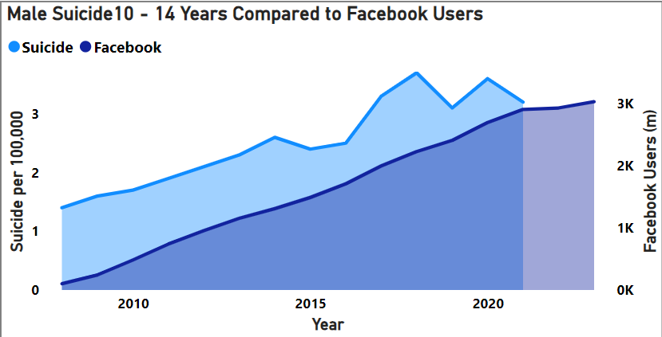
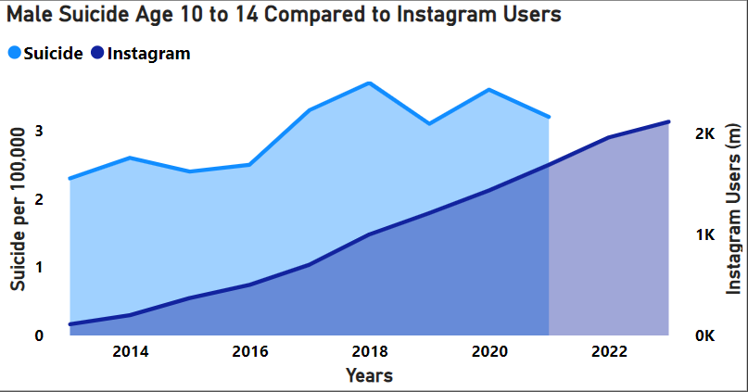
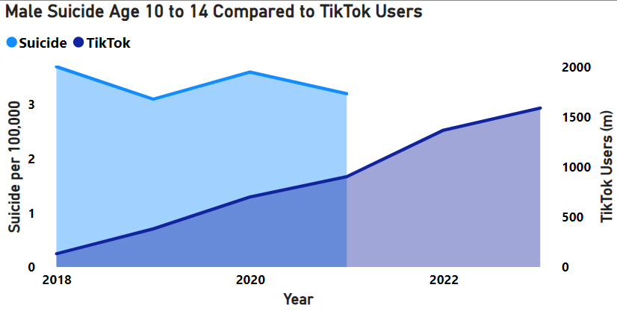
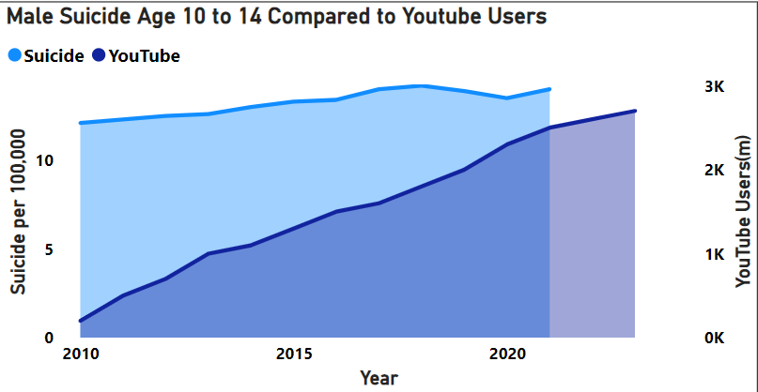
Lets look at the 10 to 14 year old category for the males in different social media platforms.
Correlation:
Between Social Media Platform and Suicide Rates.
Facebook: + .94
Instagram: + .77
TikTok: - .38
Youtube: + .89

Slide 10
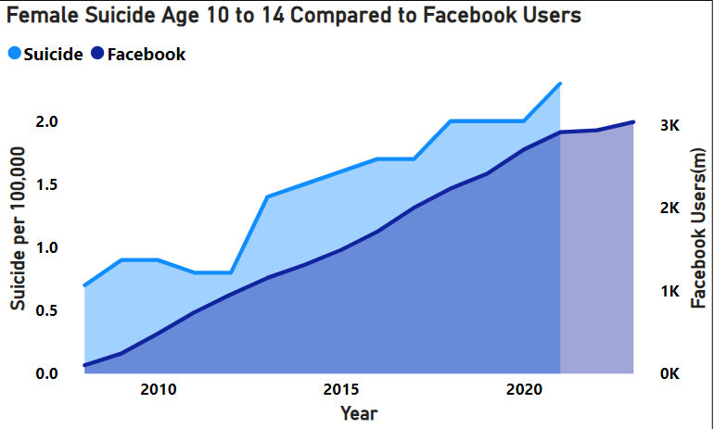
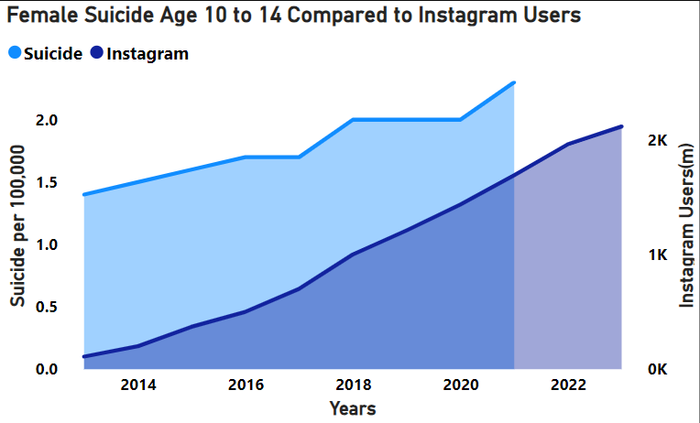
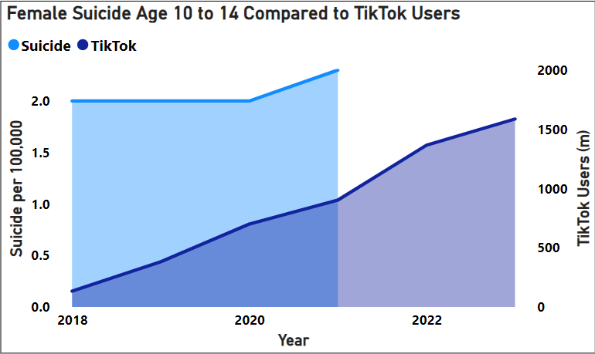
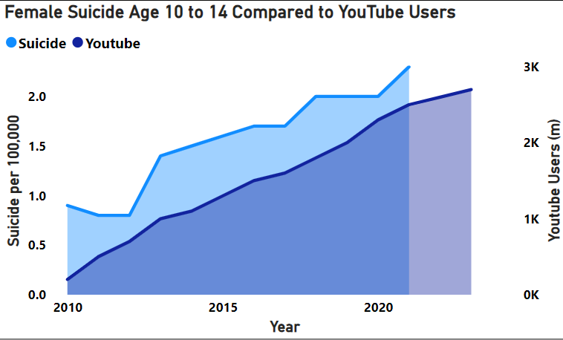
Lets start with the youngest age group. The 10 to 14 year old category for females in different social media platforms.
9
Correlation:
Between Social Media Platform and Suicide Rates.
Facebook: + .95
Instagram: + .97
TikTok: + .73
Youtube: + .95

Slide 11
Conclusion:
11
While worldwide suicidality is trending downward
every year, it is unfortunately on the rise in the
United States.
Suicide rates in 2021 are comparable to the end of WWII.
Although suicide was on the decline in WWII. WWII followed the Great Depression. Which was the highest suicide rates by population the United States has ever seen.
It cannot be said definitively that social media and internet usage are a determining factor in suicidality, though there is a strong correlation, especially in the United States.
My thoughts as to why this may be:
Social media is meant to connect us to others. However, most of the time people are posting only the good parts of their lives. Which can lead others to have a negative viewpoint of their own life. Which could have an impact on suicidality.

