Slide 1
Presentation
张瀚元、刘晨彦

Slide 2
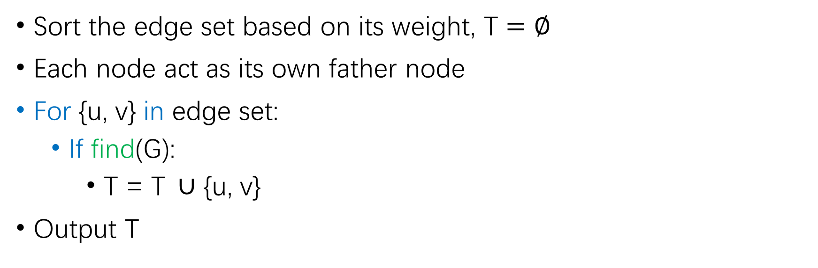
MST: Kruskal algorithm
Overall cost: O(mlogm)
Sort the edge set based on its weight, T $=∅$
Each node act as its own father node
For {u, v} in edge set:
If find(G):
T = T$∪$ {u, v}
Output T
O(mlogm)
O(m)
O(m * logm)
If u, v have same father node:
Return False
Else:
One node’s father node become another node’s father node’s father
Return True
Father_node(u):
If u’s father is it self:
Return u
Else:
Return Father_node(u’father node)
O(logm)

Slide 3

MST: Prim algorithm
|V| = n, |E| = m
X = {s}, s$∈$G , T $=∅$
While |T| < |V| - 1:
Traverse all the edge {u, v} that u $∈$ T, v $∉$T, find edge(u, v) have minimum weight
X = X $∪$ {v}
T = T $∪$ {(u, v)}
Output T
O(n * m)
O(m)
Overall cost: O(mn)

Slide 4
Test set: generated graph
Small graph to check algorithm’s correctness while big graph for it’s performance.
3 edges and 3 nodes: [(0, 1, 3), (1, 2, 3), (0, 2, 2)]:
Kruskal Algorithm:
The edges of the MST: [(0, 2), (0, 1)]
Sum of the weight of MST: 5
Prim Algorithm:
The edges of the MST: [(0, 2), (0, 1)]
Sum of the weight of MST: 5

Slide 5
Test set: generated graph
10 edges and 12 nodes: [(0, 1, 12), (1, 2, 12), (2, 3, 5), (3, 4, 5), (4, 5, 10), (5, 6, 5), (6, 7, 2), (7, 8, 10), (8, 9, 7), (6, 0, 6), (3, 5, 11), (0, 3, 7)]
Kruskal Algorithm:
The edges of the MST: [(6, 7), (2, 3), (3, 4), (5, 6), (6, 0), (8, 9), (0, 3), (7, 8), (0, 1)]
Sum of the weight of MST: 59
Prim Algorithm:
The edges of the MST: [(6, 0), (6, 7), (5, 6), (0, 3), (2, 3), (3, 4), (7, 8), (8, 9), (0, 1)]
Sum of the weight of MST: 59

Slide 6
Test set: generated graph

Slide 7

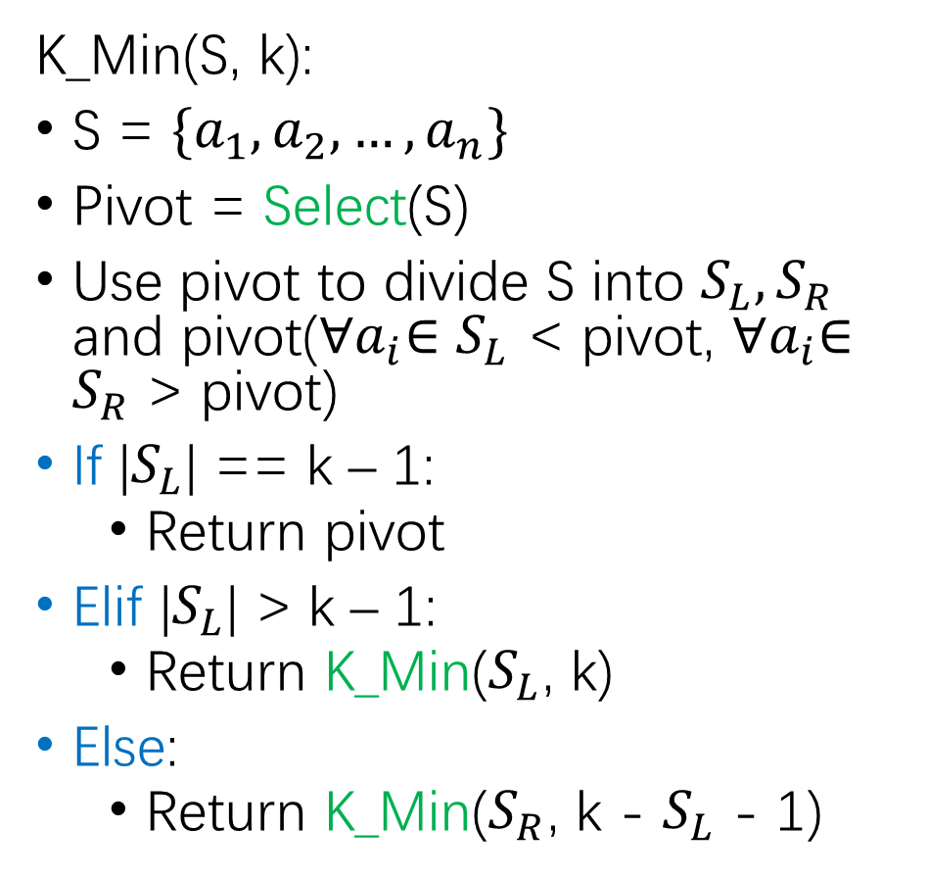

Kth-min algorithm
|S| = n
Select(S):
Divide S into |S|/5 groups
Sort all the groups and find the median
Append these medians to group S’
If |S’| > 1:
Return Select(S’)
Else:
Return S’[0]
T(n) = T$\left(\frac{3n}{4}\right)$+ O(n) = O(n)
T(n) = T$\left(\frac{n}{5}\right)$+ O(n) = O(n)
K_Min(S, k):
S = $\{a_{1},a_{2},…, a_{n}\}$
Pivot = Select(S)
Use pivot to divide S into $S_{L}, S_{R}$ and pivot(${∀a}_{i}∈S_{L}$ < pivot, ${∀a}_{i}∈S_{R}$ > pivot)
If |$S_{L}$| == k – 1:
Return pivot
Elif |$S_{L}$| > k – 1:
Return K_Min($S_{L}$, k)
Else:
Return K_Min($S_{R}$, k - $S_{L}$ - 1)
Overall cost: O(n)

Slide 8

Test set: generated number and kth
Generate a list with 10~400 numbers and a kth $∈$ [1,length of list]

