Slide 1

CSS / CSS 3
WITH MANNY PALOU

Slide 2
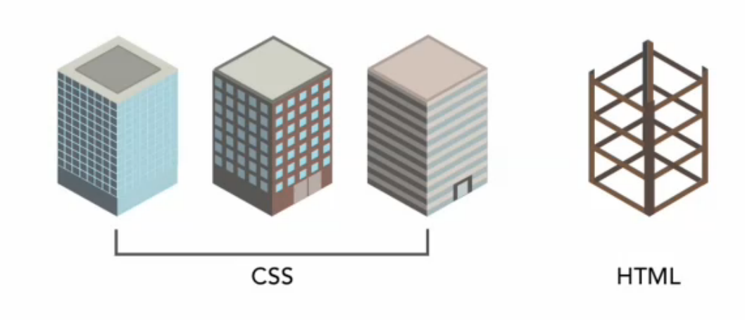
WTF IS CSS?
IF HTML IS THE FOUNDATION OF A BUILDING,
CSS IS THE FACADE OR ‘SKIN’ OF THAT BUILDING

Slide 3
CSS
Stylesheets are a set of formatting rules
Commonly contained in external stylesheets
Styles are applied to pages in the order in which they are found, from external to local styles
“Cascade” comes from the rules of specificity found within CSS

Slide 4
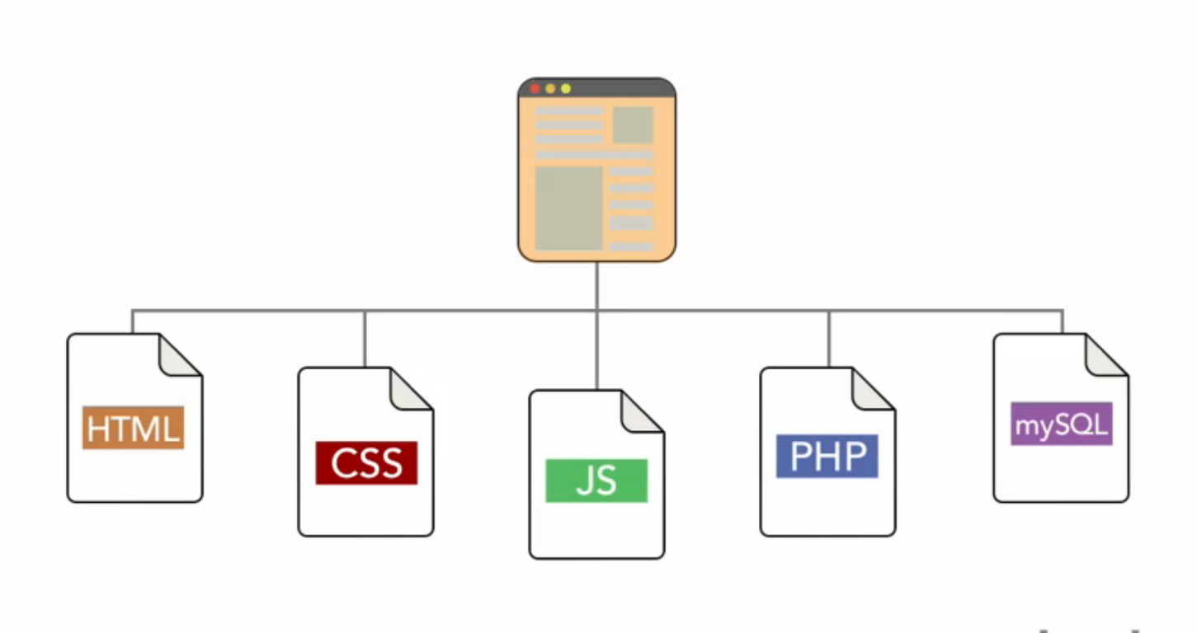
CSS’ ROLE IN WEB

Slide 5
BENEFITS OF CSS
Can change entire website feel by swapping CSS
Allows for consistent styling across entire website
Seperates content from aesthetic, making your content more portable
Allows for different looks across different platforms

Slide 6
INCLUDING CSS
Externally:
<link rel=”stylesheet” type=”text/css” href=”css/styles.css”>
Inline: (should never really do this)
<style>
.myClass { font-size:12px; }
</style>

Slide 7
SYNTAX
p {
font-family: Helvetica, Arial, Sans-Serif;
font-size: 12px;
}
  selector
declaration
property
value

Slide 8
WHITESPACE
DOESNT MATTER
body {
background-color: #ffffff;
margin: 0;
}
body { background-color:#ffffff; margin:0; }
DOES MATTER
body #header {
background-color: #ffffff;
margin: 0;
}
body#header {
background-color:#ffffff;
margin:0;
}

Slide 9
INHERITANCE
body {
font-size:24px;
margin: 0;
}
h1 { font-size:2em; }
<body>
  Hello World
  <h1> This is the header </h1>
</body>

Slide 10
SPECIFICTY
In External CSS:
body {
font-size:24px;
}
In <head> CSS:
body { font-size:16px; }
Inline CSS:
<body style=”font-size:12px;”>

Slide 11
BASIC SELECTOR TYPES
FOR TARGETING MULTIPLE ELEMENTS ACROSS ENTIRE SITE TO TARGETING A SINGLE ELEMENT ON A SINGLE PAGE
• Global Selectors = Based on HTML Elements
body, html, p, h1 table, div, a, br, hr, header, footer, img
• Class Selectors = Based on Class Names
.myClassName {} , .myClassName.Manny {}
• Global Selectors = Based on HTML Elements
body, html, p, h1 table, div, a, br, hr, header, footer, img
• Global Selectors = Based on HTML Elements
body, html, p, h1 table, div, a, br, hr, header, footer, img

Slide 12
BASIC SELECTOR TYPES
FOR TARGETING MULTIPLE ELEMENTS ACROSS ENTIRE SITE TO TARGETING A SINGLE ELEMENT ON A SINGLE PAGE
• Global Selectors = Based on HTML Elements
body, html, p, h1 table, div, a, br, hr, header, footer, img
• Class Selectors = Based on Class Names
.myClassName {} .myClassName.Manny {}
• ID Selectors = Based on ID Name
#myIdName {} #myIdName.Manny {}

Slide 13
DESCENDING SELECTOR TYPES
CASCADING IN EFFECT, TARGET ELEMENTS BASED ON SPECIFICITY
• Within Containers:
#div1 h2 { font-size:2em; }
.Manny .favColor { color:#e3e3e3; }
• Div that also has class:
#myDiv.Manny { background-image:url(‘manny.jpg’); }
• Multiple Classes:
.myDiv.Manny.blue { color:blue; }

Slide 14
GROUPING SELECTORS
h1 { font-size:1.2em; }
#myDiv h2 { font-size:1.2em; }
h3.blue { font-size:1.2em; }
______________________________________
h1, #myDiv h2, h3.blue { font-size:1.2em; }

Slide 15
USING SEMANTIC CSS/HTML
Use class names that make sense and have meaning, while being as globally applicable as possible
Use camelCase or seperate with-hyphens but be consistent
Use consistent HTML structure
Use global classes for things that repeat often
Don’t think of CSS when initially structuring HTML

Slide 16
ASSIGNMENT!!!
• Include CSS file to your website
• Start modifying divs, paragraphs, and anything else you want by using their selector (adding IDs and Classnames as you see fit), specifying a property you want to modify, and giving it a new value

Slide 17
COMMON PROPERTIES
color
text-align
text-decoration
text-transformation
line-height
letter-spacing
font-family
font-size
font-style
font-weight
background-color
background-image
background-repeat
background-position
list-style-type
list-style-position
margin
padding
border
position
float
clear
        top
        left
        width
        height
        z-index
        overflow
        display
        cursor
        visibility

Slide 18
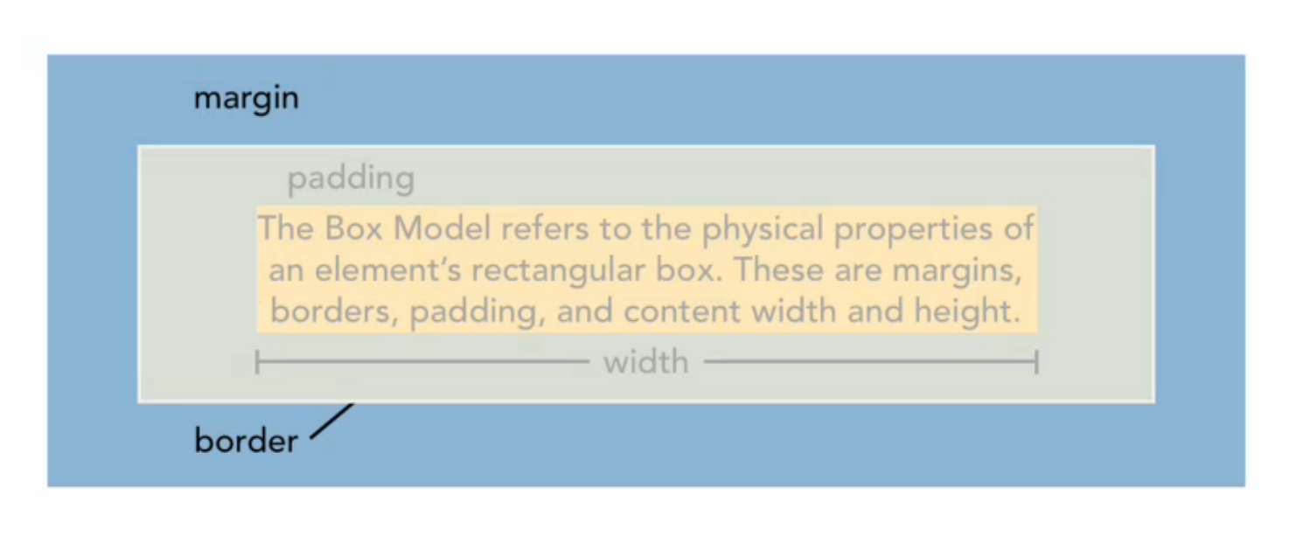
CSS BOX MODEL

Slide 19
COMMON UNITS OF MEASUREMENT
h1 { font size: <length>; }
Absolute size = in , cm, mm, pt, pc
Relative size = em, px, vw, vh, vm, rem;
Percentage = 50%;
Inherit = takes value from parent element

Slide 20
ELEMENT POSITIONING
Normal Flow = What happens when you do nothing to control
page layout, takes what is there and stacks elements ontop of another as block level elements
Element Positioning:
#myDiv{ position: static | relative | absolute | fixed | inherit ; }
relative - can have offsets while statics cant
absolute - ignores content flow and looks for parent positioning
fixed - floats on top of all content out of flow, never moves
inherit - takes value from parent element
stacking is remedied with z-index property

Slide 21
WORKING WITH FONTS
Import font with @font-face property
use a @font-face generator online for speed
.otf & .ttf are best standard

Slide 22
margin & padding
margin-left: 10px;
margin-right:10px;
margin-top:10px;
margin-bottom:10px;
margin: 10px;
padding-left: 10px;
padding-right:10px;
padding-top:10px;
padding-bottom:10px;
padding:10px;
padding-left: 14px;
padding-right:11px;
padding-top:1px;
padding-bottom:100px;
padding: 1px 11px 100px 14px;
margin-left: 12px;
margin-right:13px;
margin-top:11px;
margin-bottom:15px;
margin: 11px 12px 15px 12px;

