Slide 1

FRONT END DEVELOPMENT
with Manny Palou

Slide 2

ABOUT MANNY
- 22 YEAR OLD
- BACKGROUND IN NEW MEDIA ART
- FRONT END DESIGNER & DEVELOPER
- NOT A TEACHER

Slide 3
ABOUT THIS CLASS
Monday
- Intro to Web Design & Front End Development
- HTML / HTML5
Tuesday
- CSS / CSS 3
- Responsive Web Design
Wednesday
- Javascript / jQuery
- Frameworks & Libraries
Thursday
- Hackathon, build web app / website in 6 hours
- Snacks, DJ, Best project wins all expense paid lunch & drinks with Manny at Mighty Quinns’ BBQ

Slide 4
SO? Wtf is front end development?

Slide 5
FRONT END DEVELOPMENT IS..
      - MANAGING THE CLIENT SIDE EXPERIENCE OF THE END USER
      - MAINTAINING ASSETS ACROSS PLATFORMS
- CROSS BROWSER COMPATIBILITY
- MODULARITY, SIMPLIFICATION & REFACTORING
- TESTING
- RESPONSIVE
- CONSTANTLY EVOLVING
- THE FASHION OF THE WEB
http://rmurphey.com/blog/2012/04/12/a-baseline-for-front-end-developers/

Slide 6
THINGS TO KNOW
• GIT VERSION CONTROL
• THE COMMAND LINE
• TEMPLATING
• IN-BROWSER DEV. TOOLS
• TESTING FRAMEWORKS
• AUTOMATION
• CODE QUALITY

Slide 7
SOFTWARE
• GIT
• Terminal
• VI
• IN-BROWSER DEV. TOOLS
• Sublime Text 2
• JS Lint http://www.jslint.com/
• CSS Lint http://csslint.net/
• Xcode
• Homebrew
• MAMP

Slide 8
HTML

Slide 9
  <h1> WHAT IS HTML?</h1>
<ul>
    <li> HYPERTEXT MARKUP LANGUAGE </li>
    <li> HYPERLINKS MAKE THE WEB GO ROUND</li>
    <li> CONTROLS THE ORDER FLOW OF WEB</li>
    <li> HOLDS THE VISUAL CONTENT</li>
    <li> BY DEFAULT HAVE NO STYLE</li>
    </ul>

Slide 10
WHAT IS HTML?
    • HYPERTEXT MARKUP LANGUAGE
    • HYPERLINKS MAKE THE WEB GO ROUND
    • CONTROLS THE ORDER FLOW OF WEB
    • HOLDS THE VISUAL CONTENT
    • BY DEFAULT HAVE NO STYLE

Slide 11
BASICS OF AN HTML PAGE
• <!DOCTYPE html> = Tells the browser what version of HTML to expect & that it is standards compliant
• <HTML> = wraps everything in HTML tag, can set language
• <head> = top of of the “tree”, things that apply to entire document; scripts, css, meta tags, titles, etc
• <body> = wraps all the content meant to be displayed/read

Slide 12
<head>
• The “table of contents” of the document, also specifies order of when things get loaded and where they load from
<title></title> = Gives page title, shows up in browser bar
<meta> = Set things like character set, device width, etc
<link> = Link to external stylesheets
<script> = Link to or embed script files

Slide 13
<BODY>
• Content tags & Containers such as
<h1><h2><h3><h4><h5><h6><h7>... = Headlines varying in size
<p></p> = Paragraph text, starts a new line for text
<br /><hr /> = white space line breaks & horizontal rules
<a></a> = Hyperlink container
<div></div> = Container ‘block’, multiple <divs> make up most HTML pages.
<img /> = displays an image

Slide 14
<a></a>
<a> tags are hyperlinks, they lead to other pages, other websites or even link to other sections within the same page
<a href=”otherpage.html”>This would link to another page on your site</a>
<a href=”http://www.google.com”>This would link to Google
</a>
<a href=”#anchor”>This would link to a div in your page with the ID of “anchor” </a>
<a href=”/images/someimage.jpg”>This would link to an image inside your ‘images’ folder</a>

Slide 15
<img />
Standalone tags that point to an image and then display it.
<img src=”myimage.jpg” /> = would show an image in that same directory named ‘myimage.jpg’
<img src=”http://www.google.com/logo.png”> = would ‘hotlink’ to another website and show specified image
<img width=”250px” src=”myimage.jpg”> = Would show that image but proportionately constrain to 250px wide.

Slide 16
HTML ATTRIBUTES
href = link src attribute
id = unique ID, can only have 1 on a single element
class = can specify multiple classes
style = inline CSS style
alt = Alternative text in case an image can’t be displayed
rel =Specifies the relationship of the target object to the link object
...+ a lot more, check
https://developer.mozilla.org/en-US/docs/Web/HTML/Attributes

Slide 17
MORE HTML FORMATTING
• Phrase Listings:
<em>Emphasize</em> = Emphasize
<strong>Strong</strong> = Strong
<dfn>Define a term</dfn> = Define a Term
<code>Show Code</code> = Show Code
<sample>Sample</sample> = Sample
<kbd>Keyboard</kbd> = Keyboard
<var> Variables </kbd> = Variables

Slide 18
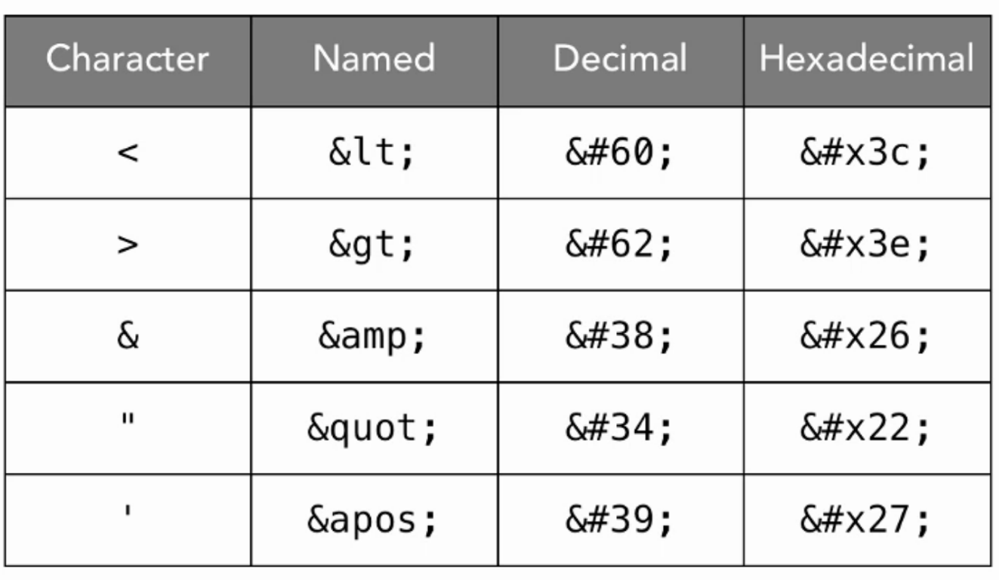
CHARACTER REFERENCES

Slide 19
FONT MARKUP ELEMENTS
<b></b> = Bold
<i></i> = Italic
<u></u> = Underline
<sub></sub> = Subscript
<sup></sup> = ^{Superscript}
<small></small> = Small
<s></s> = Strikethrough
<mark></mark> = HTML5 HIGHLIGHT

Slide 20
<pre></pre>
shows content
      the exact way
typed out without
being
renderered
by
the
browser
at all.
Also good for displaying code as nothing is rendered inside <pre> tags.

Slide 21
HTML LISTS
<ul>
<li> Unordered list </li>
<li> lists are displayed with bullets, squares, discs, or without decoration</li>
</ul>
<ol>
<li> Ordered List</li>
<li> created with numbers, 1..2..3..etc
</ol>
<dl>
  <dt>HTML</dt>
    <dd>Hyper Text Markup Language</dd>
    <dt>5</dt>
    <dd>The number after 4.</dd>
</dl>

Slide 22
ASSIGNMENT!!!
• CREATE AN HTML DOCUMENT
• INCLUDE TITLE OF PAGE
• INCLUDE META TAGS TO SET CHARSET OF DOCUMENT
• INCLUDE AN UNORDERED LIST AT TOP INSIDE DIV ID OF “HEADER” WHICH WILL SERVE AS YOUR TABLE OF CONTENTS, MAKE THESE ANCHOR TAGS TO OTHER DIVS ON YOUR SITE
• MAKE AT LEAST 5 DIVS ON YOUR SITE, SPACE THEM OUT WITH <br /> tags.
• MAKE ONE DIV A JOKE, THAT LINKS TO AN IMAGE IN THAT DIRECTORY IN A NEW WINDOW
• ADD FOOTER TO YOUR WEBSITE
* remember img tags are <img /> and link tags are <a></a>

Slide 23
HTML(5)

Slide 24
HTML 4 CONTENT MODELS
Block Level:
div, form, h1, h2, h3, h4, h5, h6, li, ol, p, pre, table, ul
Inline:
a, span, em, img, input, strong

Slide 25
HTML 5 CONTENT MODELS
More sophisticated & semantic document structures
Metadata = Content that sets up presentation, in <head>
base, command, noscript, link, meta, style, title
Embedded = content that imports other resources into document
audio, canvas, embed, iframe, img, math, object, svg, video
Interactive = Any content specifically intended for user interaction
a, audio, button, img, iframe, input, keygen, menu, object, select
Heading = Header of a section
h1, h2, h3, h4, h5, h6, hgroup
Phrasing = Text of the document
audio, button, q, strong, var, i, small, kbd, canvas, code,
Flow = Majority of contents in HTML5, would be in flow of doc.
br, h1, pre, p, ol, object, table, textarea, video, nav, details
Sectioning = Defines scopes of headings and footers
article, aside, nav, section

Slide 26
HTML 5 STRUCTURAL ELEMENTS
More semantic than using <div> tags, can help easily identify common components of a website while making them more machine-readable & “app friendly”
<header> </header> = Implies the header or ‘top bar’
<footer> </footer> = Implies footer section of websites
<nav></nav> = Implies a navigation element such as sidemenu

Slide 27
HTML 5 OUTLINE ALGORITHM
• Sectioning and heading content are used to define the outline
• Body is established as outline root
• Items are added to the outline as they are discovered
• Initital headings content is used to name sections

Slide 28
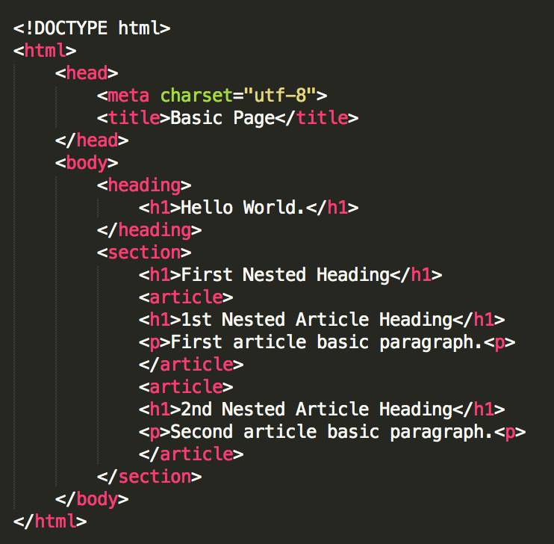
PARSING HEADINGS

Slide 29
Hello World.
1. First Nested Heading
a. 1st Nested Article Heading
b. 2nd Nester Article Heading

Slide 30
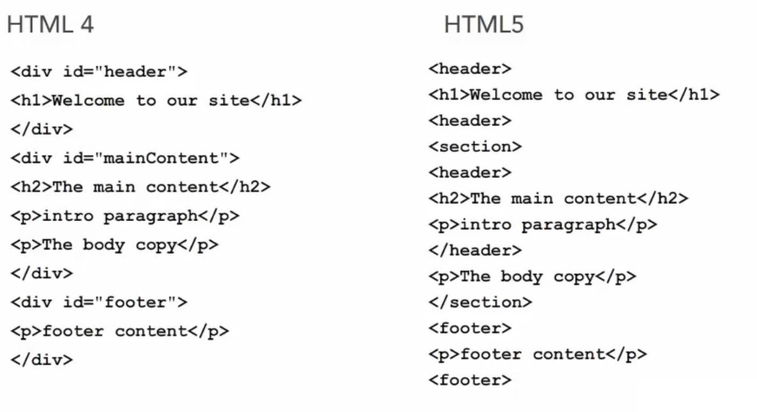
LESS IS MORE

Slide 31
HTML 4 DOCTYPE
<!DOCTYPE HTML PUBLIC "-//W3C//DTD HTML 4.01//EN" "http://www.w3.org/TR/html4/strict.dtd">
HTML 5 DOCTYPE
<!DOCTYPE html>

Slide 32
HTML 4 CHARSET
<meta http-equiv='Content-Type' content='text/html; charset=utf-8'>
HTML 5 CHARSET
<meta charset='utf-8'>

Slide 33
HTML 5 OUTLINER TOOL
http://gsnedders.html5.org/outliner/

Slide 34
ASSIGNMENT!!!
Go back to the website you made for yourself before, this time
restructuring your content using semantic HTML5.
When finished, go to the HTML5 Outliner, input your website and make sure your outline is what you expected.

Slide 35
FORMS IN HTML5
denoted with <form></form>
<form id=”exampleForm” method=”post” action=”#”>
• method:
The HTTP method that the browser uses to submit the form. Possible values are:
post: Corresponds to the HTTP POST method ; the data from the form is included in the body of the form and is sent to the server.
get: Corresponds to the HTTP GET method; the data from the form are appended to the action attribute URI, with a '?' as a separator, and the resulting URI is sent to the server.
action = The URI of a program that processes the information submitted via the form.

Slide 36
FORMS IN HTML5
input types tell what the machine to expect when user inputs information
<!-- Simple form which will send a GET request -->
<form action="">
<label for="GET-name">Name:</label>
<input id="GET-name" type="text" name="name">
<input type="submit" value="Save">
</form>
<!-- Simple form which will send a POST request -->
<form action="" method="post">
<label for="POST-name">Name:</label>
<input id="POST-name" type="text" name="name">
<input type="submit" value="Save">
</form>
<!-- Form with fieldset, legend, and label -->
<form action="" method="post">
<fieldset>
<legend>Title</legend>
<input type="radio" name="radio" id="radio"> <label for="radio">Click me</label>
</fieldset>
</form>

Slide 37
FORM FUNCTIONALITY
tabindex = Order of which a user tabs through, set in intervals of 10
label = shows label of that form input
name = sets name of form, for machine
autofocus = boolean (true/false) to default focus on this input
placeholder = default text before user starts typing
required = boolean value to determine if input is required

Slide 38
FORM FUNCTIONALITY
number = input type that lets user input a number
min = minimum value for input type
value = default value for an input type
date = input type for selecting a date

Slide 39
ASSIGNMENT!!!
In one of the sections of your website, add a questionaire
that uses form to mine data from the user (which you will later sell to advertising companies)
Ask any relevant questions you want, but use at least 3 different input types such as text, date, email, or numbers.

Slide 40
HTML(5) API LIBRARIES

Slide 41
<CANVAS>
New HTML5 structural element
Uses Canvas API to draw vector graphics inside browser
To define a Canvas:
<canvas id=”myCanvas” width=”600” height=200”>
Your browser does not support Canvas. LOL.
</canvas>
Draw inside of the canvas using javascript with canvas API
http://html5demos.com/canvas

Slide 42
<VIDEO>
New HTML5 structural element
<video src=”myVideo.mp4” width=”420” height=”300” />
http://html5demos.com/video

Slide 43
DRAP & DROP API
Allows you to easily create a drag and drop UI
Native to HTML5 construct
Works by setting objects as draggable to a drag target
Can transfer data between objects using JavaScript
http://html5demos.com/drag

Slide 44
OFFLINE WEB API
Instructs browser or device to store a version of the application in the user’s cache
This is achieved by setting up a cache manifest for your files
<html manifest=”cache.manifest”>
CACHE MANIFEST
# this is a comment
index.htm
_css/main.css
_scripts/contact.js
http://html5demos.com/offline

Slide 45
GEOLOCATION API
Can get a user’s geolocation based on internet source
paired with Google Maps or open source libraries like geo.js
http://html5demos.com/geo

Slide 46
WEB STORAGE API
Easier to create robust applications without putting stress on server
Storing data locally is faster & can create more seamless experience such as not having to log in, etc
Stores data in key / value pairs
Session storage = single session, single window
Local Storage = data across multiple windows that exists for longer than one session
Assign storage types to elements in your page markup
http://html5demos.com/storage

Slide 47
WEB SOCKET API
• DESIGNED TO MAKE A SINGLE, BIDIRECTIONAL CONNECTION BETWEEN CLIENT & SERVER
• BROWSER NATIVE, UNLIKE AJAX OR COMET, MAKING THEM LIGHTWEIGHT AND EASY TO IMPLEMENT
• WORK BY OPENING HTTP REQUEST TO SERVER AND MAINTAINING CONSISTENT WEB SOCKET CONNECTION
• ANY CONNECTION CAN SUPPORT STREAMING
• ONLY SINGLE CONNECTION REQURIED FOR UPLOADING/DOWNLOADING
http://html5demos.com/web-socket

Slide 48
ASSIGNMENT!!!
Pick any of the APIs discussed and incorporate it into your existing site.

