Slide 1

Fake News Defender
Group 10
Fadi Russell Walter

Slide 2
Fake News Numbers
From Kaggle Fake News Dataset:
-In one Month, from 10/25/2016 to 11/25/2016.
-12,999 Fake News posts.
- 244 websites as sources of Fake News.

Slide 3
Fake News Impact
-In 2013, AP Twitter account tweeted “President Barack Obama is injured in an explosion at The White House”.
-The impact? stock market lost $130 billion in stocks values.
- AP twitter account had been hacked and suspended.
-$130 Billions recovered.

Slide 4
Fake News Impact
-On 11/12/2016, Pepsi CEO Indra Nooyi told Donald Trump supporters to "take their business elsewhere." It was Fake News.
- The truth? She says that some of her employees are worried after the President Trump victory.
-But people took over SM and threatening #boycottPepsi and #Pepsiboycott

Slide 5
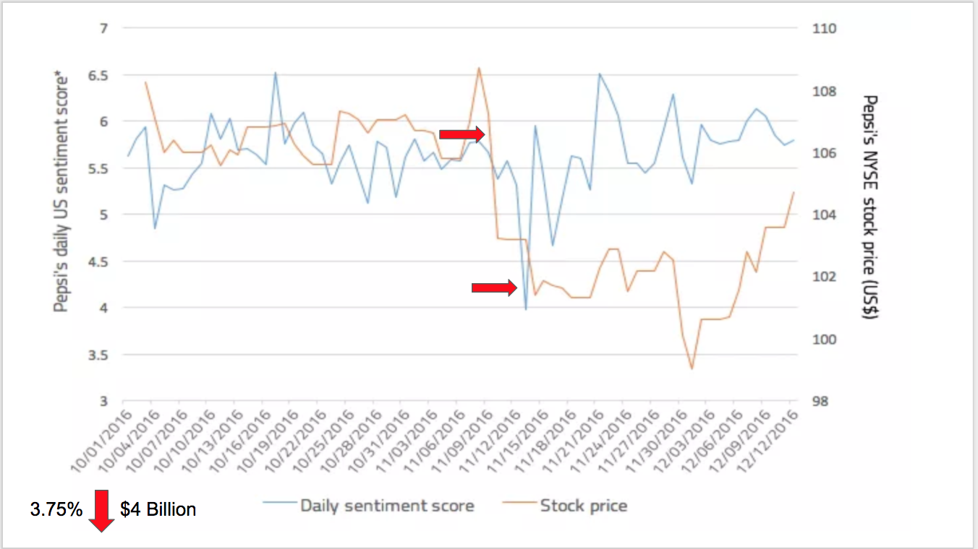
The Impact on PEPSI

Slide 6
How can we turn this into a business?
Immediately detect fake news articles pertaining to any interested company being shared on social media
Identify them as false to all readers
Prevent viral fake news from causing impacts like those seen with Pepsi

Slide 7
Social Media Hubs
Reddit and Twitter
Each has over 250 million users
High traffic provides avenue for propagation of fake news
Reddit and Twitter APIs both enable automatically generated responses

Slide 8
Utilization of automatic responses
Reddit bot!
Implemented with Praw package for Reddit API
Searches through submissions. If submission mentions our customer’s keyword and links to a known fake news source, the bot replies warning readers of the site’s fraudulent nature
Twitter bot!
Implemented with Tweepy package for Twitter API.
Streams Tweets, filtering on our client’s keyword. If Tweet contains keyword and a link to a known fake news source, the bot replies to the user and let them know of the site’s fraudulent nature

Slide 9
What is OpenSources?
Established by Dr. Melissa Zimdars of Merrimack College
Curated list of websites that are frequent sources of misleading or false news stories
Used as the reference for our bots

Slide 10
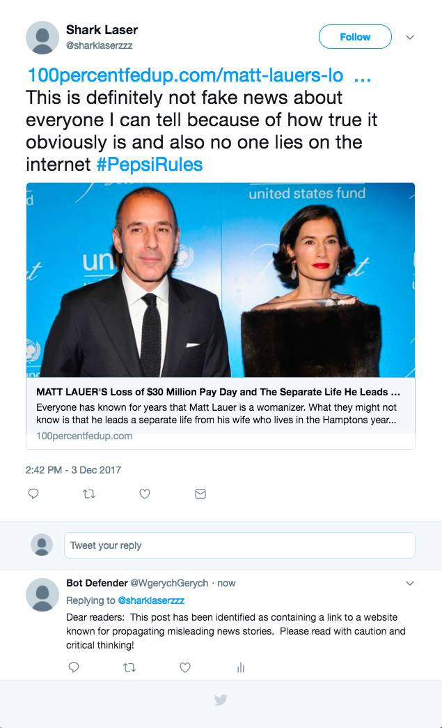
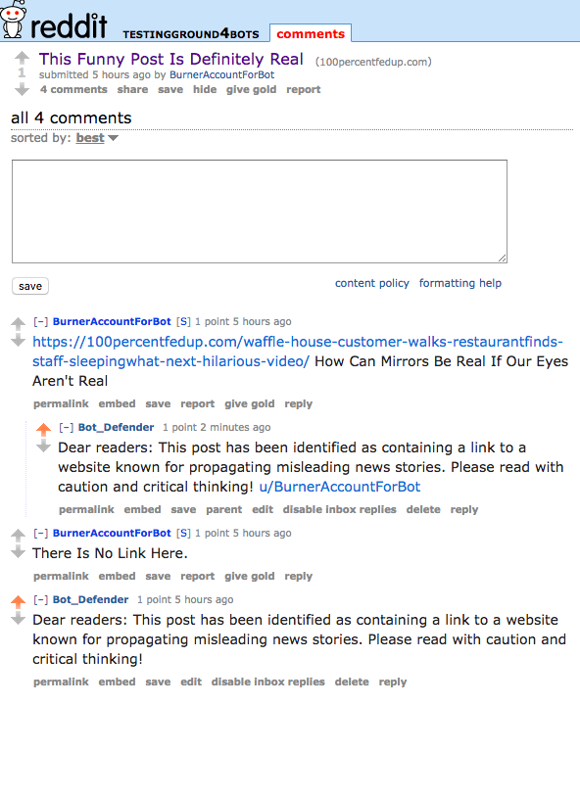
Replying to Fake News

Slide 11
What if it's from a new source?
Reddit and Twitter bots can obtain text from posted links
Use BeautifulSoup HTML parser to extract text from unclassified article
Given the text as input, we need to be able to classify new documents
Performed using an Artificial Neural Network

Slide 12
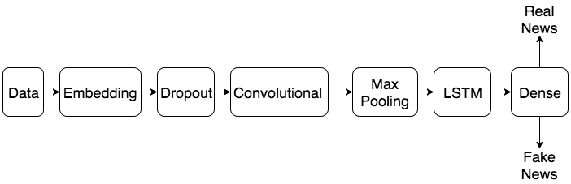
How does that work, then?
Keras
Neural Network library
We use it to create a CNN+LSTM Neural Network
88% accurate
Our Neural Network:

Slide 13
Embedding Layer
-Takes words as input
-Transforms them into high-dimensional vectors
Example: Few → (0.1, 0.5, -0.7, 0.4, 0.6, …..) Couple → (0.1, 0.3, -0.6, 0.4, 0.5, …..) Sing → (0.7, 0.1, 0.9, -0.5, -0.2, …)

Slide 14
Embedding Layer (cont'd)
-The mapping function is trained to achieve a certain task (in this case, part of the neural network that classifies documents) -The vectors change as the mapping function learn -As the mapping function learns, similar words end up with similar vectors

Slide 15
Embedding layers in practice
Few People

Slide 16
Embedding layers in practice
Few People
Some People

Slide 17
Embedding layers in practice
Few People
Some People
Lizard People

Slide 18
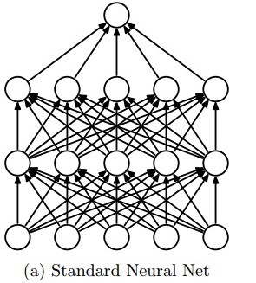
Dropout

Slide 19
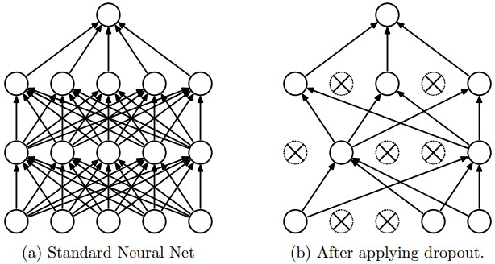
Dropout
http://blog.christianperone.com/wp-content/uploads/2015/08/dropout.jpeg

Slide 20
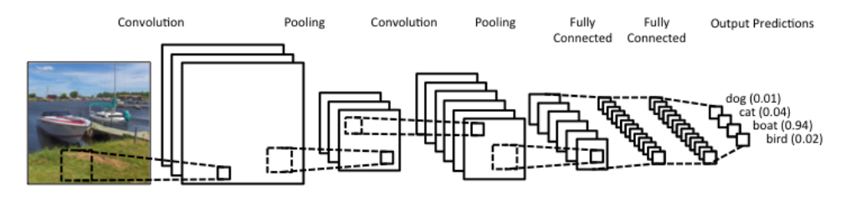
Convolutional Layer and Max Pooling Layer
http://www.wildml.com/2015/11/understanding-convolutional-neural-networks-for-nlp/

Slide 21
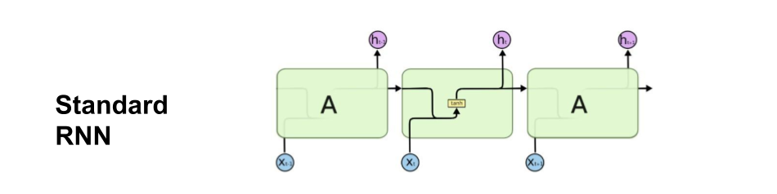
Recurrent Neural Network - Long Short-term Memory
https://blog.altoros.com/wp-content/uploads/2017/01/deep-learning-using-tensorflow-and-long-short-term-memory.png

Slide 22
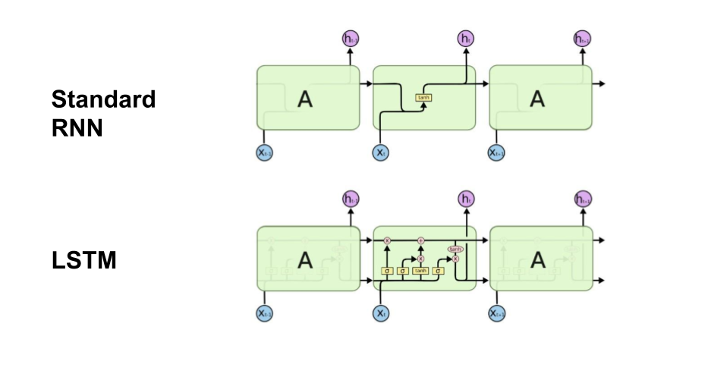
Recurrent Neural Network - Long Short-term Memory
https://blog.altoros.com/wp-content/uploads/2017/01/deep-learning-using-tensorflow-and-long-short-term-memory.png

Slide 23
Dense Layer
Interprets output from RNN-LSTM layer as a value between 0 and 1
These values are used to delineate between fake news and real news

Slide 24
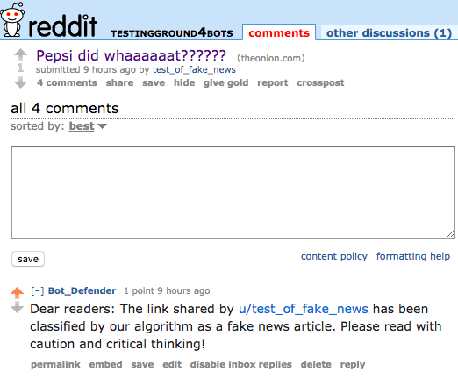
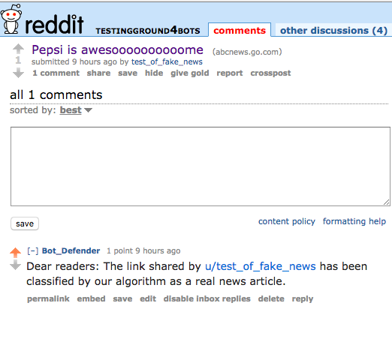
Automatic Classification

Slide 25
Business specifics
No direct competitors, so pricing was somewhat generalized
Companies do exist that focus on social media, but usually oriented around keeping organizations apprised of general sentiment

Slide 26
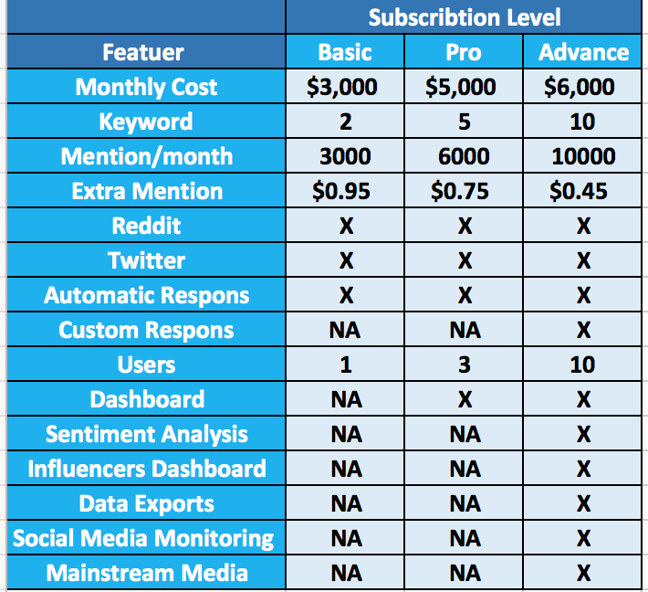

Slide 27
Questions?

