Slide 1


Slide 2
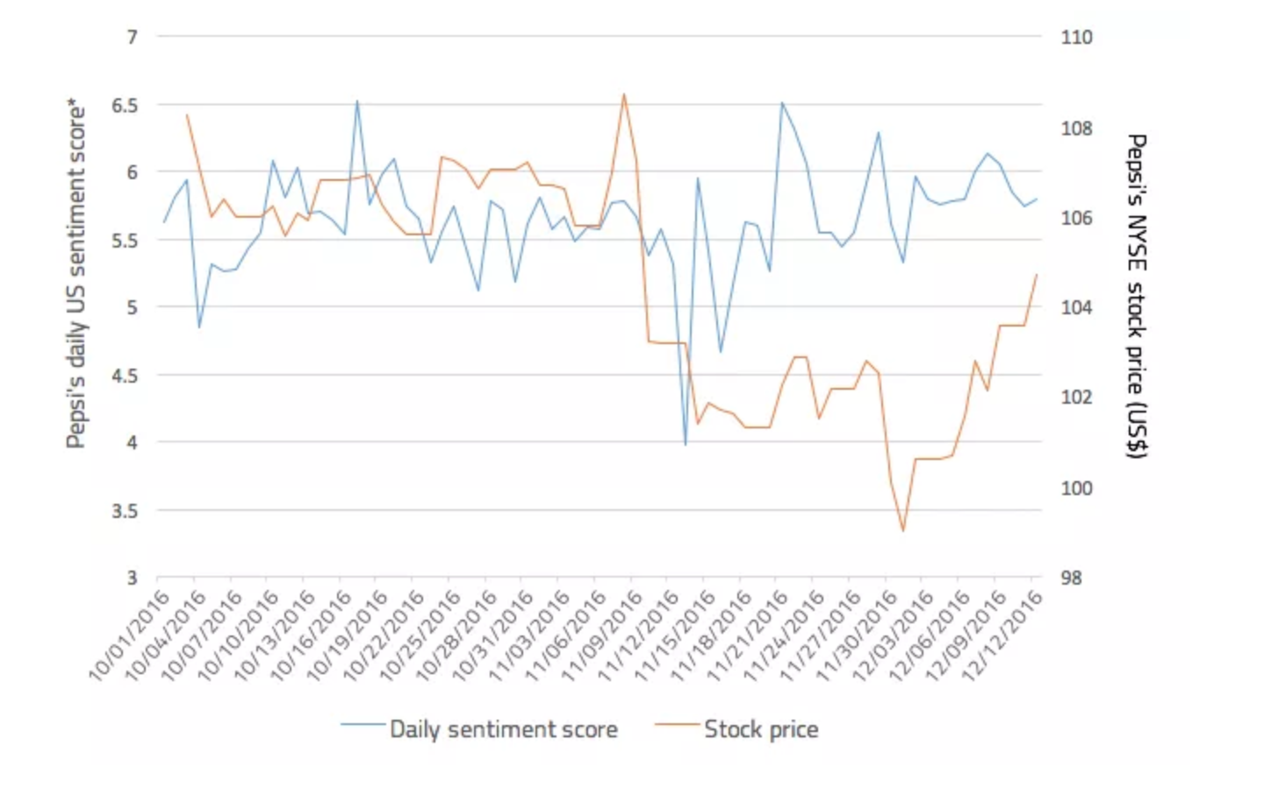
3.75% $4 Billion

Slide 3

Defender
Our Services is
Pro Acting to protect our customers against Fake News on the internet and SM platforms.
Developed Bots that can detect Fake News on Twitter & Reddit.
The faster companies combat Fake News, the better result for mitigating Fake News Impact.

Slide 4
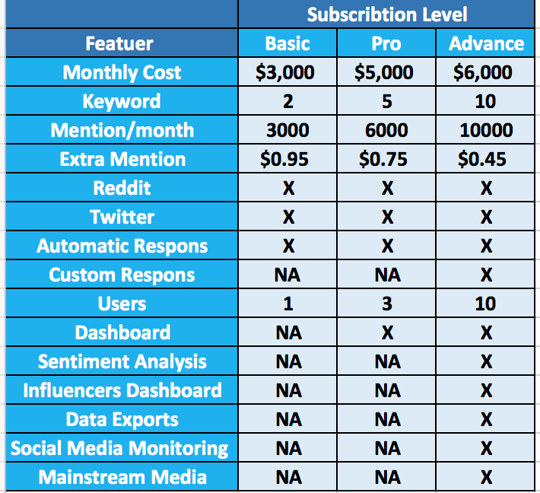

Slide 5
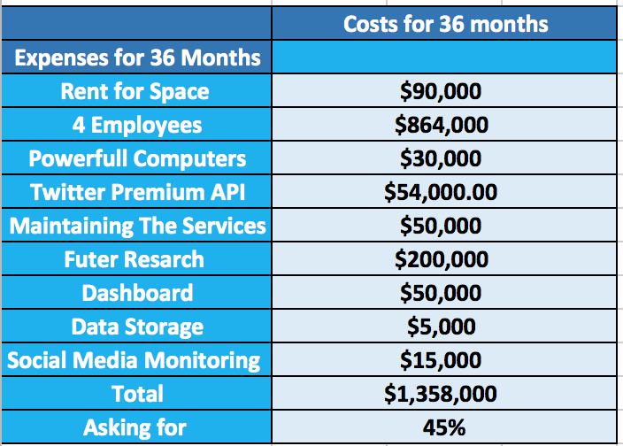
Our Finance

