Slide 1
NYC Apartment Rent Prediction & Analysis
Russell McGrath, Sumita Trivedi, Sharmila Sainani, Alexandra Zelcer, & Tony Joy

Slide 2
Project Overview
Creation of a web-based tool that allows users to enter NYC apartment feature requirements and have the application return the predicted monthly rent of an apartment with those features using ML learning models.
Additionally, the website will provide insights and analysis into NYC rent trends.

Slide 3
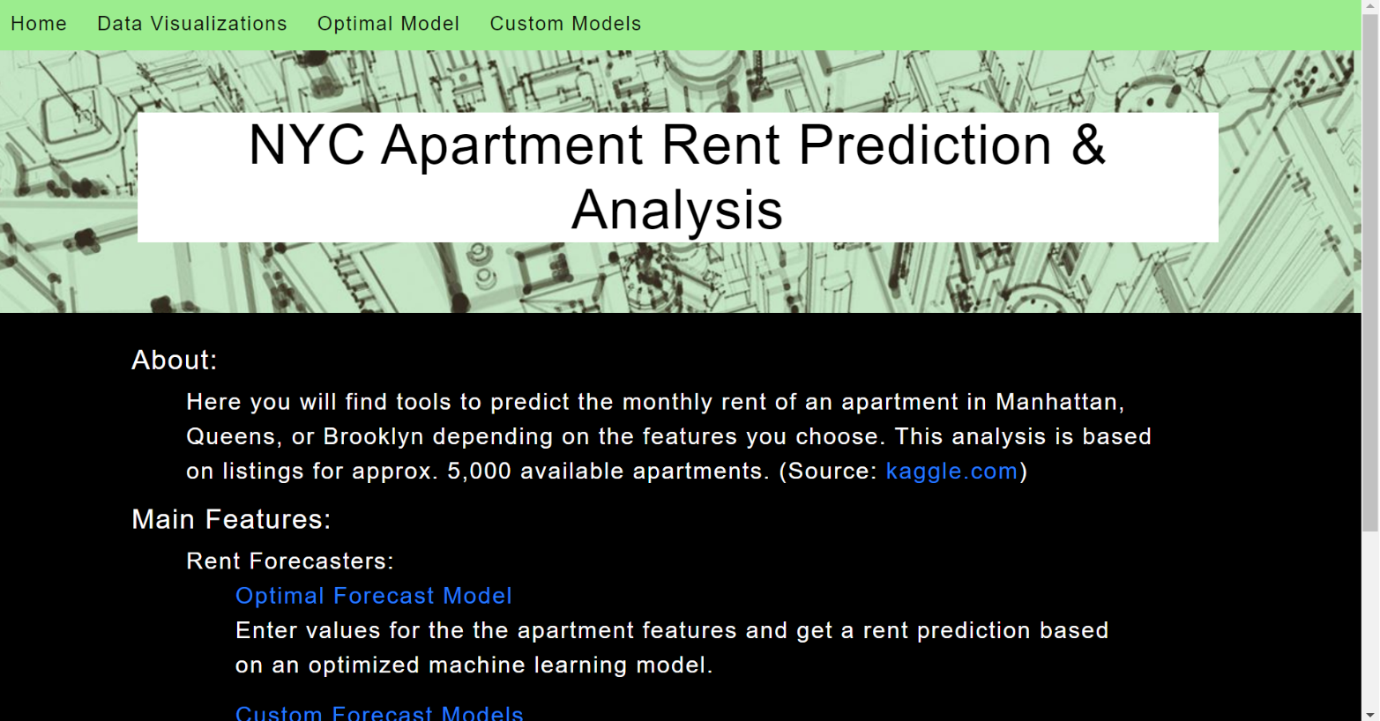
Website Design
HTML/CSS implemented to display:
Homepage
Data Visualizations
Optimal Model
Custom Models
Highlights:
Easily Accessible Navigation Menu Bar
Description of features

Slide 4
Visualizations
Sharmila

Slide 5
Tableau/HTML Integration
Sharmila

Slide 6
App Server
Russ and sumita

Slide 7
Optimized Modeling
Sumita

Slide 8
User Customized Model
Russ

Slide 9
AWS Deployment
Sharmila

Slide 10
Heroku Deployment
Russ

Slide 11
Issues Encountered

Slide 12
Future Developments
All

Slide 13
Title and Content Layout with Chart

Slide 14
Title and Content Layout with Table
First bullet point here
Second bullet point here
Third bullet point here
Class | Group 1 | Group 2
Class 1 | 82 | 95
Class 2 | 76 | 88
Class 3 | 84 | 90

Slide 15
Two Content Layout with SmartArt
First bullet point here
Second bullet point here
Third bullet point here
Step 1 Title
Step 2 Title
Step 3 Title
Step 4 Title

Slide 16
Add a Slide Title - 1

Slide 17
Add a Slide Title - 2

Slide 18
Add a Slide Title - 3

Slide 20
Add a Slide Title - 4

Slide 21
Add a Slide Title - 5

