Slide 1
NYC Apartment Rent Prediction & Analysis
Alexandra Zelcer, Russell McGrath, Sharmila Sainani, Sumita Trivedi, & Tony Joy

Slide 2
Project Overview
Creation of a web-based tool that allows users to enter NYC apartment feature requirements and have the application return the predicted monthly rent of an apartment with those features using ML learning models.
Additionally, the website will provide insights and analysis into NYC rent trends.

Slide 3
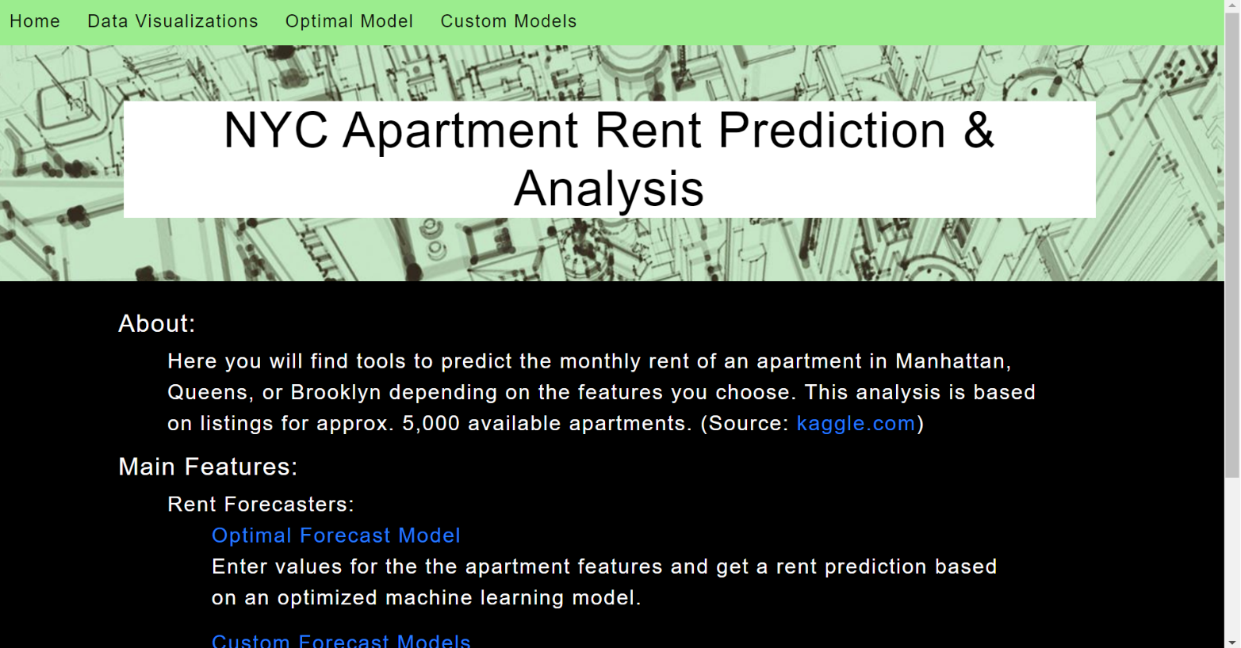
Website Design
HTML/CSS implemented to display:
Homepage
Data Visualizations
Optimal Model
Custom Models
Highlights:
Easily Accessible Navigation Menu Bar
Description of features

Slide 4
Tableau Visualizations

Slide 5
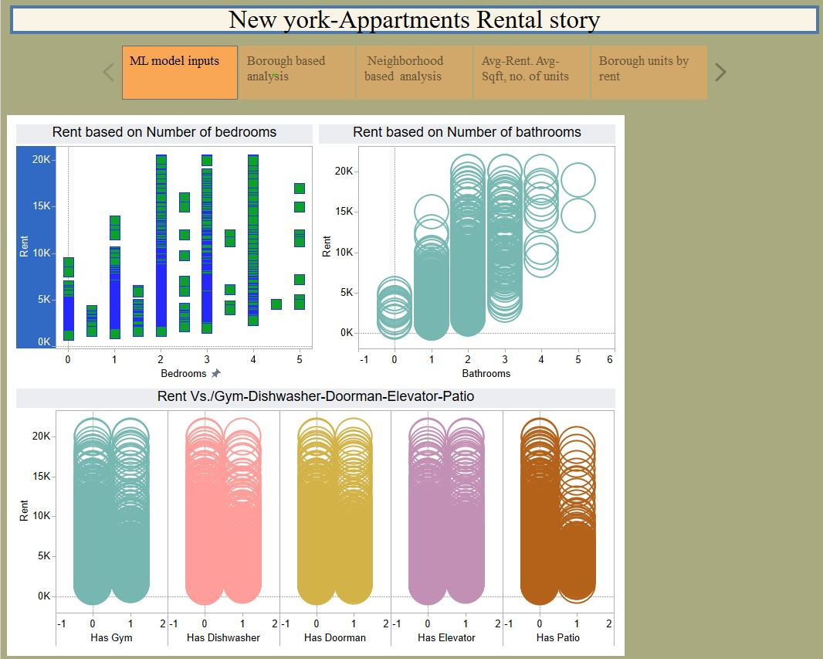
ML model Inputs
Analysis of some of ML model inputs
Rent vs bedrooms
Rent vs bathrooms
Rent based on gym, dishwasher, doorman, elevator and patio

Slide 6
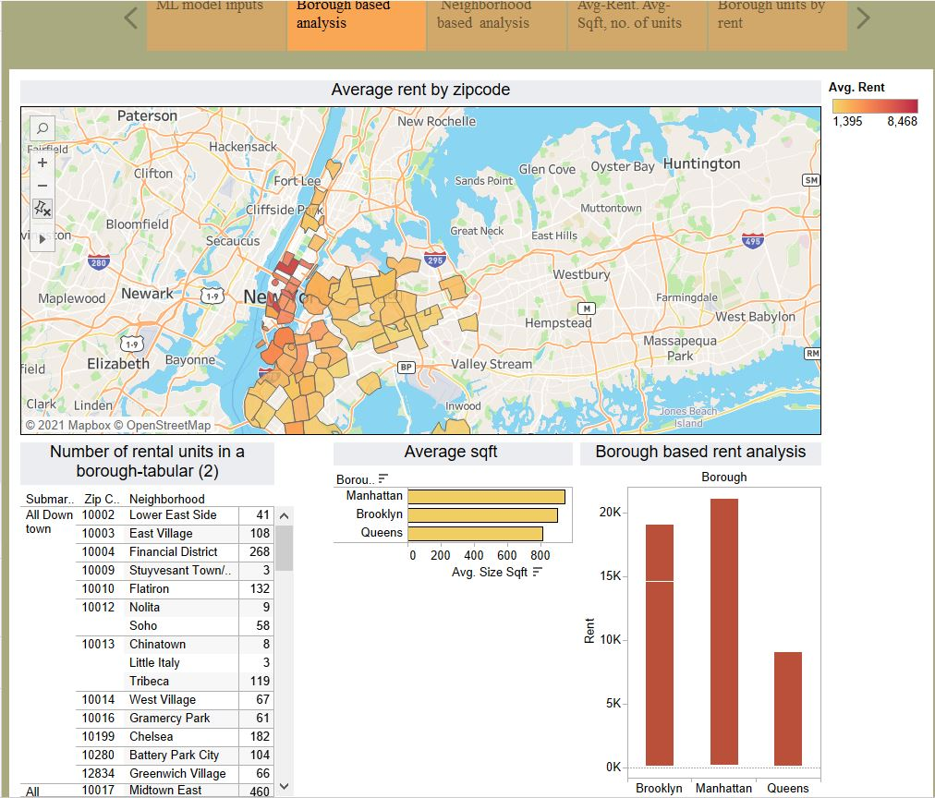
Borough based analysis
Average square footage by borough
Number of rental units available in neighborhood
Borough based rent range

Slide 7
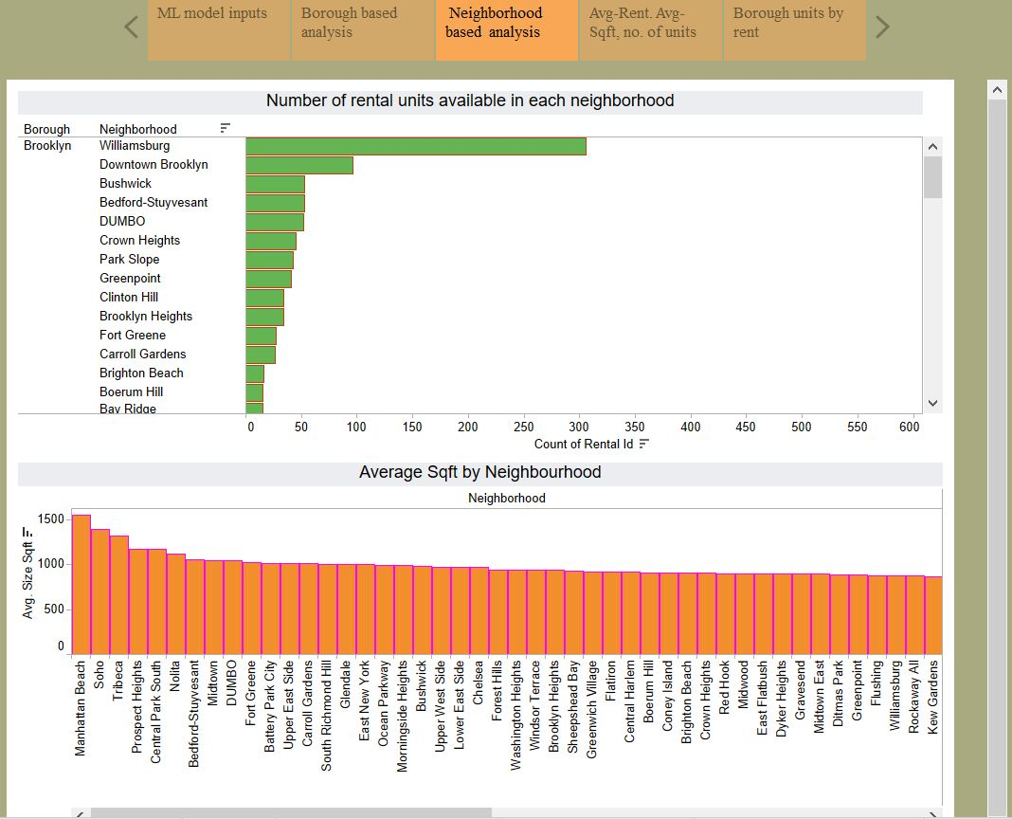
Neighborhood analysis
Number of rental units available in a given neighborhood
Average Sqft. In that selected neighborhood

Slide 8
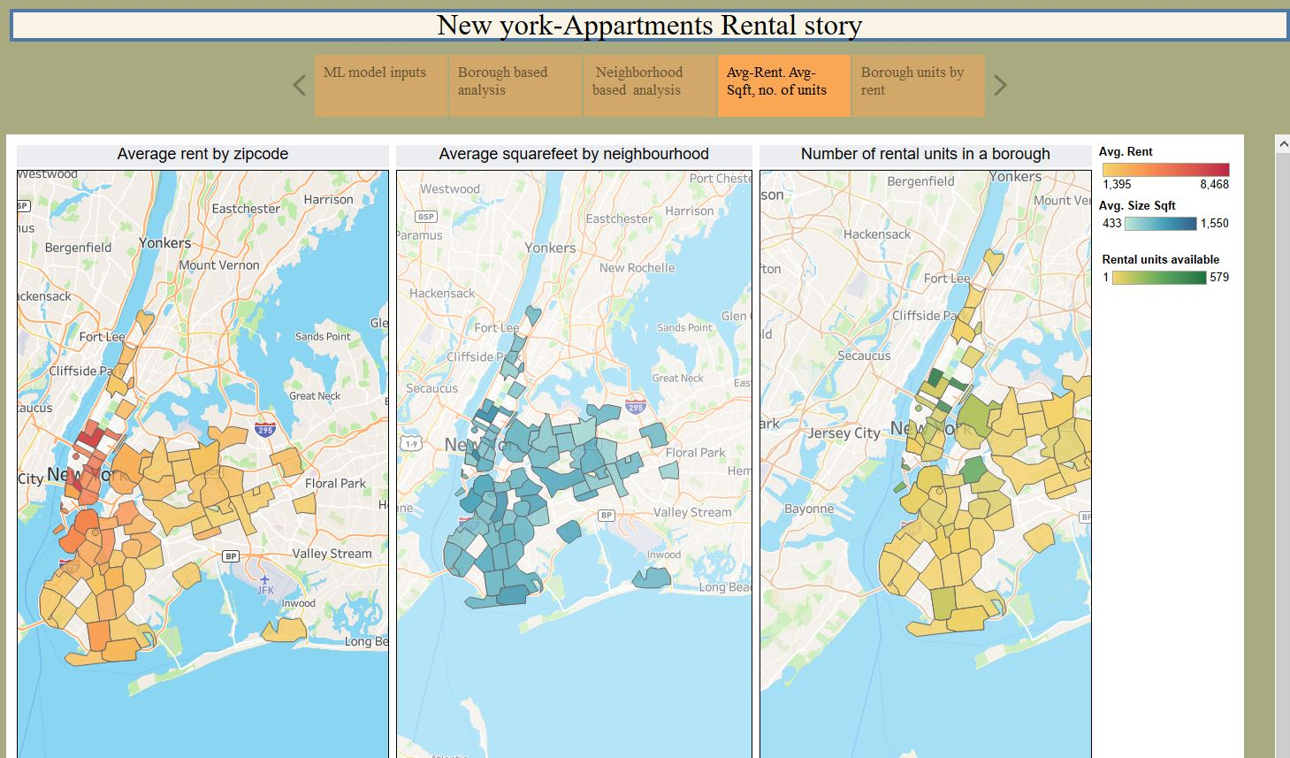
Average rent and Sqft. analysis
Average Rent by zip code
Average square feet by zip code
Rental units available by zip code

Slide 9
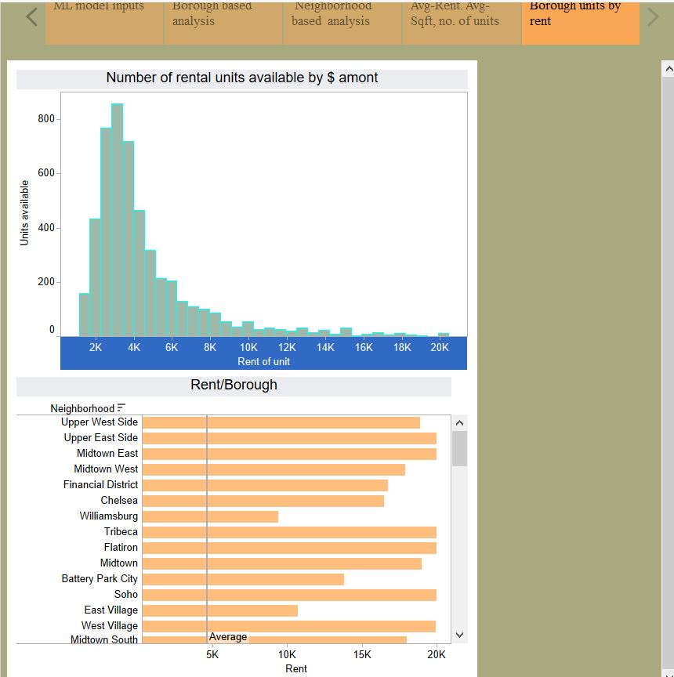
Borough units rent range
Number of units available in the price range in the selected neighborhood

Slide 10
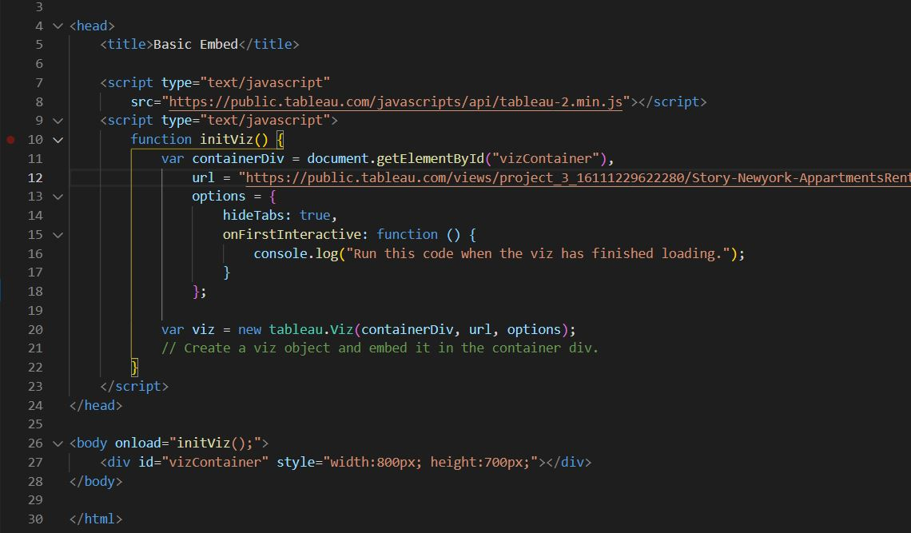
Tableau/HTML Integration
Modifying the HTML code given in Tableau web by adding the public tableau link in the URL
And incorporating the tableau html with the index. html

Slide 11
Machine Learning Model Optimization

Slide 12
Optimized Modeling - Feature Selection
Correlation of features with target
Target | Feature | Correlation | Absolute Correlation
rent | rent | 1 | 1
rent | size_sqft | 0.808783506 | 0.808783506
rent | bathrooms | 0.733644386 | 0.733644386
rent | bedrooms | 0.531199605 | 0.531199605
rent | floor | 0.27235111 | 0.27235111
rent | building_age_yrs | -0.122301768 | 0.122301768
rent | has_elevator | 0.120822476 | 0.120822476
rent | has_doorman | 0.099105765 | 0.099105765
rent | has_dishwasher | 0.096631286 | 0.096631286
rent | has_washer_dryer | 0.096135793 | 0.096135793
rent | has_gym | 0.093736869 | 0.093736869
rent | no_fee | -0.091768666 | 0.091768666
rent | has_roofdeck | 0.081285812 | 0.081285812
rent | has_patio | 0.058259675 | 0.058259675
rent | min_to_subway | 0.003652178 | 0.003652178

Slide 13
Optimized Modeling - Applying Algorithms
Split data into train-test in 80:20 ratio
Create x_train, x_test, y_train, y_test and scale data using StandardScaler
Run modeling algorithms and compare results on Test data
Models | Mean Square Error - Test Data | R square | Comment
Linear Regression | 0.226113395 | 0.786538043
Lasso | 0.231648322 | 0.783183172
Ridge | 0.228063947 | 0.786538054
Elasticnet | 0.229526386 | 0.785169248
Xgboost Regressor | 0.185860706 | 0.826039194 | Best Model
Deep Learning | 0.493411504

Slide 14
Optimized Modeling - Deployment
Save XGBModel, XGB_modelcolumns, X_scaler, y_scaler as pickle files
Create front end for user to input values
“Predict Rent” button valls app.py
Takes the user input values, transforms values into floats, runs the X_scaler to scale the data and predicts the scaled rent.
Apply y_scaler to inverse transforms the prediction and gives the predicted rent in $
Demo - html page

Slide 15
Application Server

Slide 16
App Server – Optimized Model
Flask Server
Import ML Files
Machine Learning Files (.pkl)
Scrape & Package user_input
XGBModel.pkl
Scale user_input
X_scaler.pkl
y_scaler.pkl
Render results endpoint
Get prediction
/optimal Endpoint
/predict Endpoint
- Enter Values
<displays results>
User DOM

Slide 17
App Server – Optimized Model
Flask Server
Import ML Files
Machine Learning Files (.pkl)
Scrape & Package user_input
XGBModel.pkl
Scale user_input
X_scaler.pkl
y_scaler.pkl
Render results endpoint
Get prediction
/optimal Endpoint
/predict Endpoint
- Enter Values
<displays results>
User DOM

Slide 18
Issues Encountered
Zip code data has been added to the original data (as the building address specifications were missing)---incomplete dataset
Heroku Deployment:
500mb “slug size” limit – Had to remove neural network model from final app since TensorFlow library takes up almost 400mb.
30sec timeout limit – Complex

Slide 19
On-Demand Custom Models

Slide 20
App Server – Custom Modeler
create_models Function (.py)
Data Source
(csv)
Import Source Data
“Dummify”
- Source Data
- User Input
Flask Server
Scrape & Package user_input
- Select Features
Train/Test Split Data
Unpack results & render results endpoint
Scale Source Data
- Create Model
- Fit Model (train data)
- Score Model (test data)
x5
Scale User Input Data
/custom Endpoint
/custom_results
- Model.predict(scaled data)
- Inverse scale prediction
x5
- Select Features
- Enter Values
<displays results>
Package Scores and Predictions into variable
User DOM

Slide 21
App Deployment Architecture

Slide 22
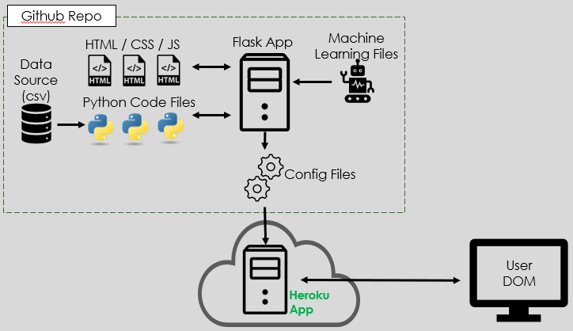
App Deployment Architecture

Slide 23
Future Developments
Work with live data
Build a data base
Incorporate schedulers
Implement AWS hosting
Performance optimization

