Slide 1
Project 1 Team 1
Members:
Russell McGrath
Sharmila Sainani
Tony Joy

Slide 2
Central Hypothesis
How can one use data to inform their decision on which US college to attend?

Slide 3
Questions to be answered…
Is going to an in-state school a good deal?
What is the relationship between SAT scores and tuition cost?
How does school size affect future earnings?

Slide 4
Data Source
Department of Education College Scorecard
https://collegescorecard.ed.gov/data/documentation/
From the data documentation:
The College Scorecard project is designed to increase transparency, putting the power in the hands of students and families to compare how well individual postsecondary institutions are preparing their students to be successful. This project provides data to help students and families compare college costs and outcomes as they weigh the tradeoffs of different colleges, accounting for their own needs and educational goals.

Slide 5
Question 1 – Are In-State Schools a Good Deal?
What do we mean by a “good deal”?
How well does tuition cost correlate to future earning potential?

Slide 6
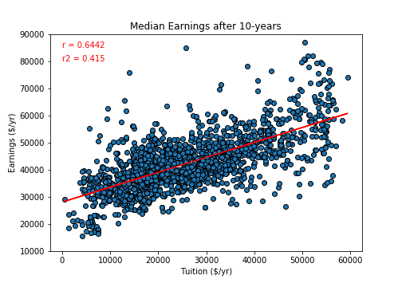
Future Earnings as a Function of Tuition
Number of schools: 1705
Schools that:
Are primarily 4-year programs
Are not online-only
Have more than 100 students
Amongst alumni who:
Completed an undergraduate program 10 years prior
Not currently enrolled in the institution
Are currently employed
Tuition data: 2018
Earnings data: 2007 graduates

Slide 7
Future Earnings as a Function of Tuition
Conclusion:
There is a moderate (positive) correlation between tuition costs and future earnings.
This is reflected by the r-value of 0.64, as well as seen visually in the figure.

Slide 8
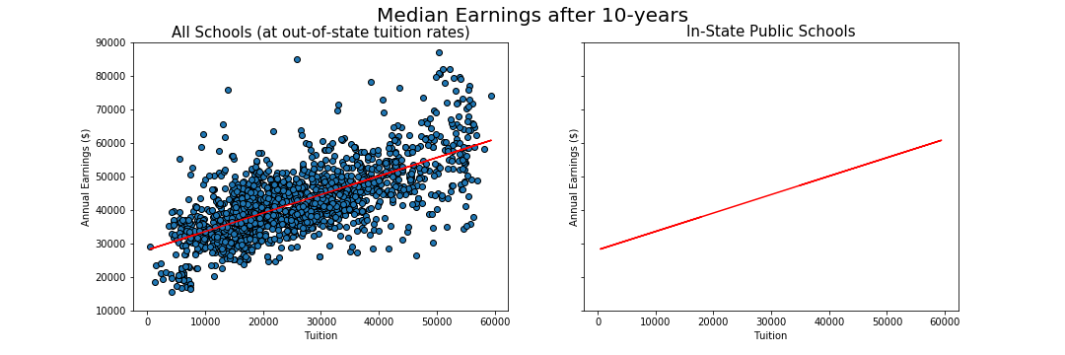
Future Earnings as a Function of Tuition

Slide 9
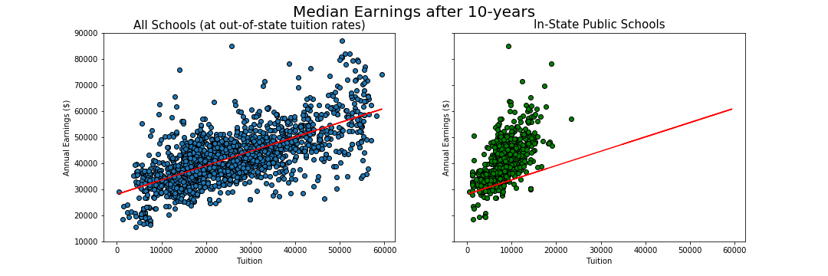
Future Earnings as a Function of Tuition
Conclusion: In-state public schools consistently outperform private and out-of-state schools in tuition to future earnings ratio.

Slide 10
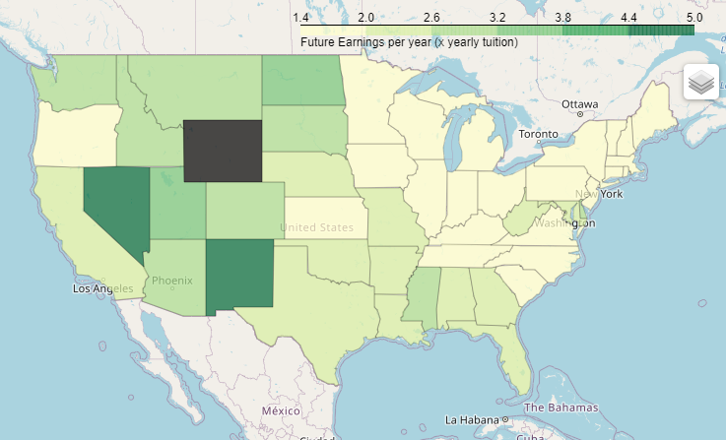
Which states have the best bang-for-the-buck state schools?
Top 5 states:
State | Avg Tuition ($/year) | Median earnings 10 years later ($/year) | Earnings (x in-state tuition)
WY | $5,400 | $47,900 | 8.87
AK | $7,443 | $37,500 | 5.04
NM | $7,317 | $36,278 | 4.96
NV | $8,938 | $40,214 | 4.5
ND | $9,456 | $35,350 | 3.74

Slide 11
Question 2 – SAT and Tuition Relation
How does your SAT score relate to cost of tuition based on school type.
Can getting a good SAT score help you with your tuition making it a good deal?
How well does SAT score correlate to future tuition cost ?

Slide 12
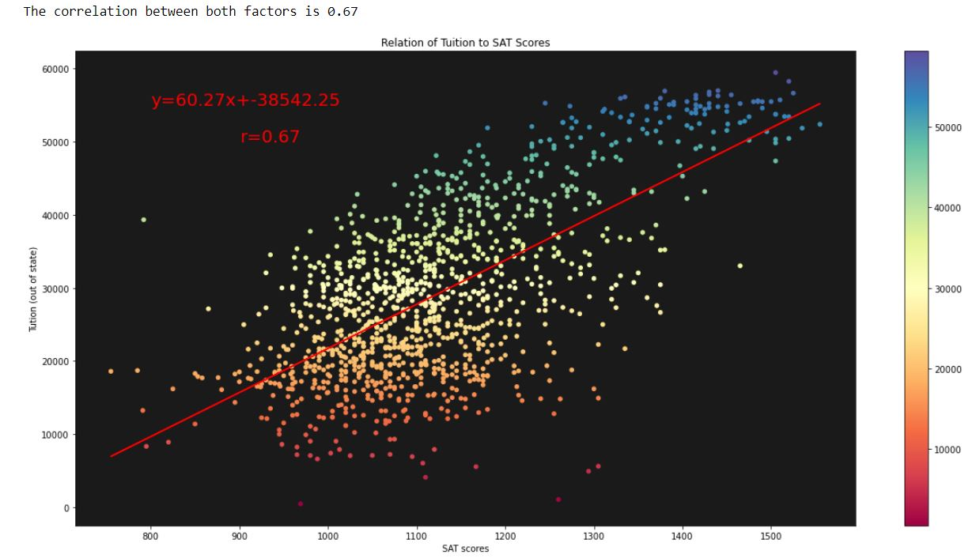
SAT Scores as a Function of Tuition out
Number of schools: 1212
Schools that:
Are primarily 4-year programs
Are not online-only
Have more than 100 students
SAT score:
Total SAT scores of math and reading
Tuition data: 2018
SAT Scores data:2018

Slide 13
SAT Scores as a Function of Tuition out
Number of schools: 1212
Conclusion:
As the correlation is 0.67 the SAT scores are moderately corelated to the out of state tuition
Pearson correlation coefficient
Pearson’s r = 0.67
Regression Equation: Y

Slide 14
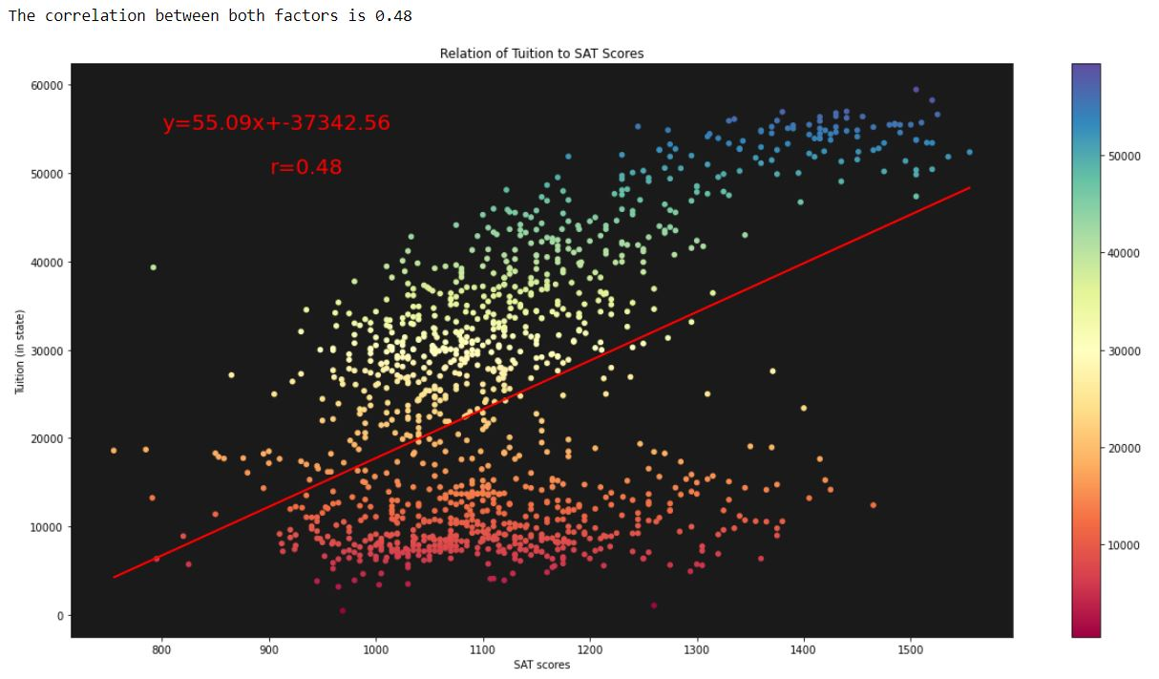
SAT Scores as a Function of Tuition in
Number of schools: 1212
Schools that:
Are primarily 4-year programs
Are not online-only
Have more than 100 students
SAT score:
Total SAT scores of math and reading
Tuition data: 2018
SAT Scores data:2018

Slide 15
SAT Scores as a Function of Tuition in
Number of schools: 1212
Conclusion:
As the correlation is 0.48 the SAT scores are weakly corelated to the in state tuition
Pearson correlation coefficient
Pearson’s r = 0.48
Regression Equation: Y

Slide 16
Question 3 – How does school size affect future earnings?
Why does the size of the school matter?
Is there a benefit from going to a school with less students?

Slide 17
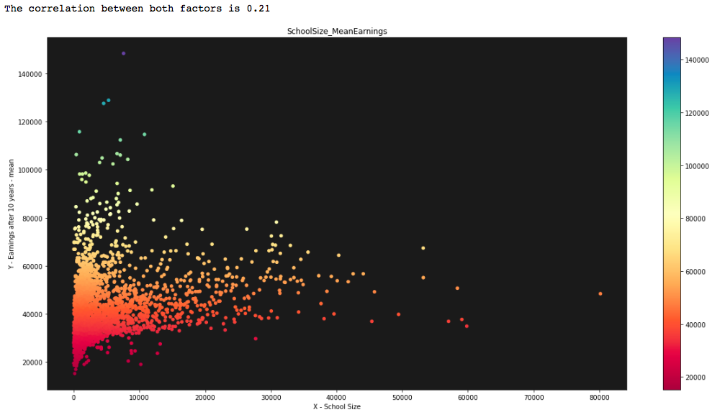
Future Earnings as a Function of School Size
2703 Schools in total
School size:
Amount of students that attended that school for the school year of 2018
Earnings after 10 years
Mean yearly salary of alumnis 10 years after they attended the given university

Slide 18
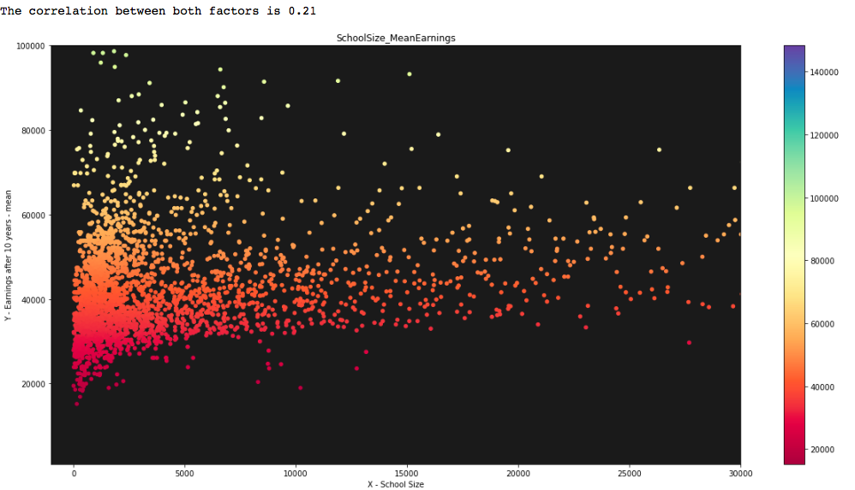
Limiting the Axis
Limitation:
X-axis: -1000 - 30000
Y-axis: 1000 – 10000
Correlation value remains the same
Conclusion:
Weak positive correlation between the amount of students and the future earnings

Slide 19
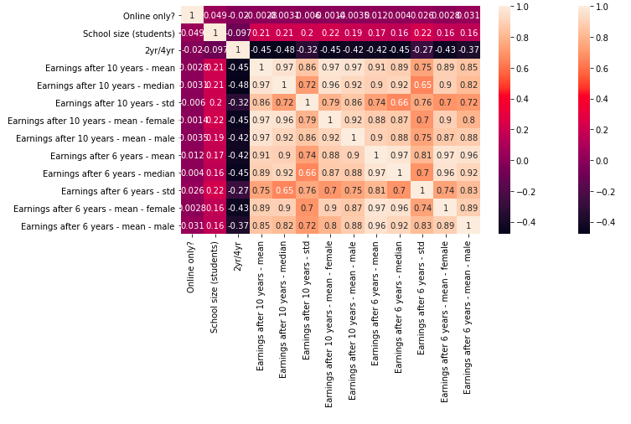
Heat Map
Comparing correlation value between various different variables.
Conclusion:
The size of the school does not have a strong impact on any other variable.
Mean earnings does not have a strong impact with the categories not related to earnings

Slide 20
Shortcomings, Caveats and Other factors
School regions – some regions have higher pay than others
Not weighted averages
Tuition and SAT data is from 2018
Salaries are from students who graduated in 2007
SAT scoring has changed a number of times over the past 10 years

Slide 21
Other factors- Issues encountered
We encountered the following:
API response came in at only 20 records per call
Column wrapping/ called the column names and changed the names
The filtered data frame was being returned empty/so deleted the column which had all Nan values (total tuition fee)
Needed to learn how to add a colorbar to a plot
Importing issues that required multiple libraries; numpy, pandas, scipy, and seaborn to be reinstalled.

Slide 22
If we had more time…
Gender analysis
Program level analysis
Outlier analysis
Google maps representations

Slide 23
Thanks for your time!
Questions?

