Slide 1



Self-Hosting AI
Own your models, your data, and your costs
through the lens of self-enablement
Neal Russell | Nov 11, 2026
Created with AI assistance
Notes:
Why and how to run AI on your own hardware, built around a home lab:
This slide deck contains seven sections: the case for self-hosting, GPU hardware, Ollama, the surrounding container ecosystem, token reduction, one live demo of a use case in action, two offline real use cases, and backup slides.

Slide 2

Why self-host?
A demo kick-off, then four reasons
01
Notes:
Section 1: Contains the demo kick-off, then the reasons for self-hosting (subscription fatigue, token control, data sovereignty, and cost governance).

Slide 3






Demo kick-off: the "Expense Assistant"
Copy receipt photos into Nextcloud
  Receipt photos: IMG_####.jpg
Processing takes ~3 minutes per receipt
We circle back in Section 7
~30
minutes per 1 week of receipts
Phone photos
Nextcloud
Windmill flow
Local vision AI
Organized output
IMG_####.jpg
Upload folder
Queue + scripts
Ollama on my GPU
Folders, receipts, XLSX, PDF, DOCX
Notes:
The "Expense Assistant" is an automation that turns uploaded receipts into a submission-ready expense report. It works like this:
You upload receipt(s) -> Automation happens -> You make edits (if needed)
That's it.
Most times, your expense report is done for you after your last meal in the airport as you walk to the gate to board your plane to go home.
This automation is accomplished via automatic Nextcloud webhooks triggered by file uploads. These webhooks, in turn, trigger Windmill flows. Windmill then runs flows that will add each receipt photo (e.g. IMG_####.jpg) to a queue and process each one, one at a time, using a local vision model running on Ollama. This vision model is instructed to return JSON only, and to populate specific key:value pairs using information about the receipt. There's more to it, but that's the basic "magic."
Timing: about 3 minutes per receipt, which works out to roughly 30 minutes for a week of receipts. That is why the demo is being started now and reviewed, live, in Section 7 (use case two).
Output: Receipts are renamed into date of expense, category, description, and original file extension (e.g. YYYY-MM-DD - Meals - Lunch.jpg). These receipt files are then organized into folders based on the week they were incurred. Then all the follow on files are recreated: an XLSX expense spreadsheet, and a PDF and a DOCX both of which contain the receipts in the same order as the spreadsheet. For onboarding and future reference, a README.md is created.
Links:
https://nextcloud.com
https://www.windmill.dev
https://ollama.com/library/qwen3-vl

Slide 4




Why self-host? Four reasons
Why I started this journey
A pain point for customers now
My home-lab case
The enterprise lens
Subscription fatigue
Token control
Data sovereignty
Cost governance
Too many monthly fees stacking up
Quotas and token bills you can’t predict
Privacy, security, and ownership issues
Difficulty in controlling and forecasting AI spend
Notes:
Four pains points:
Subscription fatigue: recurring fees keep stacking up, across everyday life and now across AI tools as well.
Token control: hosted AI limits usage through quotas (subscription) or bills it per token (API), and both are hard to predict, and both can be reduced by using a lower price, on-prem option.
Data sovereignty: using commercial AI means handing data to a provider whose terms, retention and training practices vary, which raises privacy, security and ownership questions.
Cost governance: organizations struggle to control and forecast their AI spend.

Slide 5





Subscription fatigue
Housing
Utilities
Car
Streaming
Apps
Rent or mortgage
Electric, gas, water, etc.
Payments, insurance
Netflix, Hulu, YouTube TV, sports, etc.
Passwords, office, AI, etc.
We used to buy things once and own them
Now subscriptions keep spreading to replace that model
  Vendors are continually pushing this boundary with features built into products, like car seat heaters
AI is one more subscription on the pile
  One AI subscription can cover chat, coding, agents, etc., but it's still one more subscription
Notes:
Housing and utilities were always recurring. What changed is that things we used to buy once, like movies, music, and software, moved to subscriptions through app stores and streaming platforms. Now vendors are pushing the same model platforms that historically didn’t have that type of pricing. Two car examples:
Example 1: BMW
BMW offered heated seats through its ConnectedDrive program as a monthly subscription (about $18 per month in the UK, Germany and South Korea; the heated steering wheel was about $12 per month). Think about how egregious this is. The manufacturer incurred the cost of designing, manufacturing, and installing the hardware in the car, then charged the buyer cost+margin for this hardware in the price of the car itself, then locked the ability to use the hardware that the buyer now owns behind a paywall with a subscription fee. After the backlash, BMW dropped the heated-seat subscription in 2023 and sells it as a factory option, but still sells other features by subscription and defends the model ("If you use it, we have to pay for it").
Sources:
https://www.techspot.com/news/111208-bmw-admits-heated-seat-subscriptions-mistake-but-commits.html
https://tech.slashdot.org/story/23/09/07/1545202/bmw-drops-controversial-heated-seats-subscription-to-refocus-on-software-services
Example 2: Toyota
Toyota tied key-fob remote start to its Remote Connect subscription in 2021. Toyota later called the requirement "unintentional" and said it was reviewing the plan; a follow-up report said remote start might not require a subscription after all.
Sources:
https://www.thedrive.com/tech/43636/toyota-reviewing-key-fob-remote-start-subscription-plan-after-massive-blowback
https://www.motor1.com/news/556893/toyota-remote-start-subscription/
These examples aren’t the only two examples. And please don’t take away the message of “ERR MAH GERSH! BMW bad! Toyota bad!” That’s not the message. The message is these are two companies out of the subset of all companies. All companies are incentivized to monetize their products and services in the most optimal way. So these two companies aren’t the only companies that will ever do this. These are just the start of all companies doing this, but in these two cases, they did it to a degree where they faced a backlash. They pushed beyond the current measure of public acceptance for subscription services.
Let’s talk about the “movement” of “the current measure of public acceptance for subscription services.” When the iPhone first came out (2007), I personally would never have paid for additional functionality for a phone I had just purchased, even with a renamed presentation (an app). I wouldn’t pay $1.99, nor $0.99, not even $0.49, and a subscription? Forget that. Now today, my own acceptance of this construct has moved. I now have purchased an app or two, a password manager being the most notable. I don’t believe I’m alone in my change in position over time. I believe we are all experiencing this to some degree. This is the needle of public perception for one-time vs subscription purchases, and it is moving over time. All companies are going to continue to monitor this movement and test the waters to seek out, in one form or another, that sweet sweet subscription income. This isn’t tinfoil-hat territory. This is the new reality. We’re here now.
At the AI level, the same pattern stacks on top: subscriptions or API access to Anthropic Claude, OpenAI ChatGPT, Google Gemini, Microsoft Copilot and others. Subscription usage counts against a quota, and API usage goes straight onto a bill. One AI subscription can cover chat, coding, automation and agent features, so the point is not the number of AI tools, but that AI is one more recurring line item on top of everything else. With API token billing, the cost can also climb quickly and unpredictably, which is the token-control problem on the next slide.
A self-hosted setup concentrates cost into compute (a GPU, a host machine, electricity) that all of these tools share: the same GPU serves chat, coding help, automation, document Q&A and agents. Local models are generally weaker than the best cloud models, so the saving applies to everyday, repetitive, low-stakes tasks they handle well. When considering AI use, whether self-hosted or subscription, use the right tool for the job. We'll come back to this in the enterprise slides.

Slide 6

Token control
Hosted AI is metered by quota or by token
Local tokens cost electricity
  You pay in time, not dollars
Agents and long context burn tokens fast
  You can control it, or you can self-host it
Commercial
Local
Metered
Flat
Quotas and per-token bills
Hardware plus power, no per-token bill
Notes:
Two hosted-AI mechanisms make usage hard to predict:
Subscriptions: limited by quota (some plans use rolling usage windows), so hitting the limit can act like a temporary outage.
APIs per token billing: heavy workloads can produce a surprise at the end of the billing cycle.
Chat is cheap; agentic workflows and large documents are not, because each step can resend a large context (see Section 5).
Before you decide to self-host, know that you do have some control over token use. Both subscription and API use can be managed to a degree at the provider level. Context size is the biggest driver, because as it grows (think a single chat getting long), the token use grows. Context caching helps avoid reprocessing it. Practical context-management techniques (/clear, /compact, a HANDOFF.md file) are covered in Section 5, in the notes for the context-cache slide.
More info here:
https://old.reddit.com/r/ClaudeAI/comments/1xakl7o/how_do_you_guys_manage_the_5hour_limit_on_pro/
https://medium.com/@r3dtuxedo/where-did-my-claude-usage-go-auditing-your-agents-hidden-token-tax-95d6ab17b8b6
Self-hosting sidesteps all of this for the workloads run on-prem: there is no quota and no per-token bill, only hardware and electricity. The trade-off moves from dollars to time, since local generation can be slower on modest hardware. That is also why token reduction still matters locally: fewer tokens means faster responses.

Slide 7

Data sovereignty
Once your data goes into a commercial AI, you lose control of it
  Privacy: sensitive personal data
  Security: passwords, keys, and tokens
Ownership does not transfer just because you posted it
  You (or the customer) still own it, and may hold copyright or trademark
Posting customer data makes you a third party at risk
  The receiver may believe it owns the data; only a court can settle it
Your network
(or the customer's)
Who owns it?
Your data
(or the customer's)
Commercial AI
Terms of service may claim rights
Ownership, copyright, trademark
Notes:
Privacy is a concern across the internet, and it applies to AI as well. With local models, prompts, documents, logs and embeddings stay on the local network: no third party receives them, and retention, access control and logging stay under your control. In this lab, sensitive material goes into Open Notebook notebooks that use only local models, while less sensitive material can use a hosted model. This matters for work-adjacent data such as contracts, customer questions, financial receipts and server logs.
With hosted services, terms differ by provider and by plan tier, so the safe generalization is "some providers," not all.
Examples:
Anthropic: consumer plans (Free, Pro, Max) can be used for training when the setting is on, with 5-year retention (30 days if not allowed); commercial plans (Team, Enterprise, API) are not trained on by default, with 30-day standard retention.
Source:
https://code.claude.com/docs/en/data-usage
GitHub Copilot: from April 24, 2026, interaction data from Copilot Free, Pro and Pro+ is used for training by default unless the user opts out, covering things like inputs, accepted outputs and code context; Business and Enterprise are excluded; retention up to five years; affiliates including Microsoft may use the data.
Source:
https://thenewstack.io/github-copilot-interaction-data/
Meta: announced it would use posts and chatbot interactions on Facebook, Instagram, Threads and WhatsApp to train generative AI. There was no opt-out for users in the US; users in the EU and UK could object.
Source:
https://www.technologyreview.com/2024/06/14/1093789/how-to-opt-out-of-meta-ai-training/
Wider data collection: an FTC staff report (September 2024) found that large social media and video streaming companies engaged in "vast surveillance" of users.
Source:
https://ftc.gov/news-events/news/press-releases/2024/09/ftc-staff-report-finds-large-social-media-video-streaming-companies-have-engaged-vast-surveillance
The enterprise implication: pasting customer information into a personal or consumer-tier account can create security and customer-rights problems. Check each provider's current terms; they change.
Current sentiment (links):
Pew Research, June 2026: 71% of U.S. adults think increased AI use will make their personal information less secure, and 59% have little or no confidence in U.S. companies to develop and use AI responsibly.
https://www.pewresearch.org/internet/2026/06/17/americans-and-ai-2026-chatbots-smart-devices-and-views-on-impact/
F-Secure consumer AI survey, April 2026 (not reviewed):
https://www.f-secure.com/en/partners/illuminate-research/consumer-ai-survey-april-2026
IBM Cost of a Data Breach 2025, via VentureBeat: shadow AI linked to costlier breaches, most affected firms lacked AI access controls (not reviewed): https://venturebeat.com/business/ibm-shadow-ai-breaches-cost-670k-more-97-of-firms-lack-controls
Employees pasting sensitive data into AI tools, vendor report (not reviewed, vendor-sourced): https://www.unseensecurity.ai/shadow-ai-report
For DoD customers:
There is an Impact Level 5 (IL5) enterprise AI platform for unclassified and Controlled Unclassified Information (CUI) work. It offers multiple providers: ChatGPT, Gemini, and Grok. It is available to authorized DoD users using your CAC at this URL:
https://genai.mil
Reported by Military Times, which describes ChatGPT Mil as accredited for CUI at IL5. The platform's own notices state that CUI and PII are authorized, but PHI is not.
NOTE: This is definitely NOT ‘self-hosted’. However, it is relevant to data sovereignty with respect to keeping CUI at IL5 in IL5.
Source:
https://www.militarytimes.com/industry/techwatch/2026/08/31/the-militarys-chatgpt-is-now-live-via-the-pentagons-genai-platform/

Slide 8
Cost governance: the enterprise AI bill
AI spend scales with usage, not headcount
  Forecasting and attribution are the gaps
Overruns are the norm, not the exception
  Gartner: 50%+ of GenAI projects overrun budget through 2028
That gap is a way for us to grow an AI practice
  Assess spend, add controls, pilot offloading
93%
of surveyed organizations exceeded their AI budgets (McKinsey, May 2026)
20%
of CFOs use advanced AI-specific cost controls (Deloitte, Q3 2026)
#1
skill FinOps teams say they need: AI cost management (FinOps Foundation, 2026)
Survey and analyst data; sources in speaker notes.
Notes:
The enterprise lens: cost governance (the difficulty of controlling and forecasting AI spend)
This is the one most likely to connect us with a customer.
Why it is hard:
Spend now scales with usage and agent activity rather than headcount, so it is hard to forecast, and several large organizations have publicly pulled back.
Reported examples:
Uber: reported to have used its 2026 AI coding budget by April, then capped employees at $1,500 per month per tool.
AT&T: limiting some employees' GitHub Copilot access (reported by The Information).
Meta: reported to be reining in staff spend on Anthropic and other AI tools.
Walmart: capped use of its in-house AI agent.
Source:
https://thenextweb.com/news/tokenminimizing-companies-cap-employee-ai-spending
Survey and analyst evidence:
McKinsey Enterprise AI FinOps survey (May 2026): 93% of respondents report exceeding their AI budgets. Roughly 20-30% of AI spend is often unaccounted for because it is fragmented across vendors and business units. Only 20-25% of companies have mature AI FinOps practices. Token usage for the same task can vary by up to 30 times.
Source:
https://www.mckinsey.com/capabilities/quantumblack/our-insights/the-cost-of-intelligence-how-cios-can-manage-ai-demand-at-scale
Deloitte CFO Signals Survey, Q3 2026 (200 CFOs at North American organizations with at least $1 billion in revenue, published October 21, 2026): Only 20% use advanced AI-specific controls such as token-level attribution or AI gateways. 53% review AI usage costs retrospectively. 40% cite a lack of AI cost governance, processes or policies; most organizations would need several business days or longer to pause AI use if costs exceeded approved limits.
Source:
https://www.deloitte.com/us/en/insights/topics/business-strategy-growth/3q-2026-cfo-signals-survey.html
Gartner: at least 50% of GenAI projects will overrun their budgeted costs through 2028, attributed to poor architectural choices and lack of operational know-how. Inference is expected to be at least 70% of a model's lifetime cost, and agents add pressure because one task can trigger several model calls. (Reported by Campus Technology, a secondary source.)
Source:
https://campustechnology.com/articles/2026/06/22/gartner-half-of-gen-ai-projects-could-exceed-budget-by-2028.aspx
FinOps Foundation, State of FinOps 2026: 98% of respondents now manage AI spend (up from 63% in 2025 and 31% in 2024). "FinOps for AI" is the top forward-looking priority. AI cost management is the number one skillset teams say they need to develop. The main challenges are visibility into AI costs, allocating costs to business units, and determining AI value.
Source:
https://data.finops.org/
Mavvrik with Benchmarkit (396 enterprises, fieldwork April-May 2026, released July 29, 2026): 40% required board-level escalation after AI cost surprises. 25% delayed or cancelled an AI initiative. 11% forecast AI costs within 10% (down from 15% in 2025). 39% saw coding-tool costs above expected levels.
Source:
https://www.wboc.com/online_features/press_releases/ai-bill-shock-hits-the-boardroom-40-of-companies-escalated-surprise-ai-costs-1-in/article_96bcba22-8751-5f95-8070-c438f3f66945.html
Why bills rise even as per-token prices fall:
agents send thousands of background tokens with every prompt
models generate hidden reasoning tokens
unattended agents spawn sub-agents and retry
and usage-based pricing replaces per-seat pricing
Also reported: Ramp's AI Index (June 2026) puts the top 1% of AI-adopting companies at roughly $7,500 per employee per month, and GitHub Copilot moved to token-based billing in June 2026.
Source: https://www.unite.ai/ai-token-costs-enterprise-budgeting-agentic-spending/
The opportunity for an IT services practice (speculative, to be refined as we learn what customers actually buy). Possible entry points:
- Assess spend: find where AI spend goes, which workflows drive it, and what is unaccounted for.
- Add controls: put a gateway in front of the models with budgets, per-task attribution and policy, so spend is visible and forecastable.
- Pilot offloading: pick one repetitive, high-volume workflow, run it on a local model and compare quality and cost.
The next two slides cover the architecture and the selection criteria behind these. McKinsey recommends the same levers: routing each task to the lowest-cost model that meets the quality bar, and a central gateway or control plane for visibility, attribution and token budgets.
Be clear about what the evidence shows:
These sources document the pain and a skills gap (the FinOps report names AI cost management as the top skill teams need). None of them says customers are buying consulting for this; that connection is our inference.
The home lab is how consultants build the hands-on knowledge to have this conversation credibly.

Slide 9


Hybrid AI architecture: route work by task
Self-hosted tier (on-prem)
Classification and routing
Data extraction to JSON
Embeddings, search, short summaries
Sensitive or regulated data
AI router
AI request
escalate when confidence is low
rules or small classifier
Commercial tier (off-prem)
Multi-step planning and agents
Hard code and debugging
Long-context synthesis
Review of cheaper model output
Notes:
Hybrid AI architecture: put an AI router in front of the models. The AI router decides, per request, whether the self-hosted tier or an off-prem commercial model handles the work.
Routing approaches:
- Rule-based: routing by task type, context length or quality threshold. The simplest place to start.
- Complexity-based: a lightweight classifier (which can itself be local) scores each request before routing.
- Two-stage advisor: a local model drafts and a commercial model reviews, instead of generating from scratch.
Supporting techniques:
- Escalate to the commercial tier when confidence in the local result is low, with confidence built from a check such as a second AI model reviewing the first model's output, and keep a fallback path if the local tier fails
- Compress context locally before any commercial call
- Use semantic caching
- Set token budgets per workflow
Example use cases:
- Self-hosted tier: classification, structured extraction, embeddings, short summaries and sensitive data
- Commercial tier: multi-step planning, difficult code, long-context synthesis and final validation
Real-world example: Goldman Sachs is reported to run a central model gateway that classifies requests by task type and routes each to the most cost-effective model, from open source to frontier (commercial).
Source: https://www.unite.ai/ai-token-costs-enterprise-budgeting-agentic-spending/
Implementation: From an automation point of view, Ollama exposes an OpenAI-compatible endpoint. To reroute between on-prem or off-prem then becomes a simple base-URL change for OpenAI-compatible endpoints. Also, open source tools, such as the LiteLLM gateway, provide a single proxy with routing and per-key budgets.
An AI gateway:
An AI gateway (not articulated in the slide) can be placed in front of the AI router, so every request passes through it before it is routed. The gateway can implement guardrails, cost controls, security controls, or apply policies before prompts reach the AI router. In practice, some tools, such as LiteLLM, combine the gateway and router functions in one product.
Use cases for the AI gateway:
- One gateway for all models, so authentication, logging, and budgets live in one place; the logs can be monitored, and relevant snippets can be parsed out to increase AI usage visibility
- A token budget per workflow (a cap that stops, slows or alerts, protecting against runaway agent loops; on the commercial tier it is real money, on the self-hosted tier it is effectively a limit on GPU time)
- Cost visible per task, by tagging each request with the workflow that made it
- A policy that redacts or blocks sensitive data before a request can reach the commercial tier (see the data sovereignty slide)
Why it matters:
The Mavvrik survey (a vendor summarizing its own report, so treat it as indicative) found 15% of organizations running agentic workloads cannot attribute agent-related costs at any level, and only 11% forecast AI spending within 10%, down from 15% in 2025.
Source:
- https://www.wboc.com/online_features/press_releases/ai-bill-shock-hits-the-boardroom-40-of-companies-escalated-surprise-ai-costs-1-in/article_96bcba22-8751-5f95-8070-c438f3f66945.html
Savings: sources claim 5-10x lower cost on workloads dominated by classification, embedding or transcription, and a 7B local model can cost far less per token on narrow tasks. For specifics, see the MindStudio article:
- https://mindstudio.ai/blog/hybrid-ai-architecture-local-models-cloud-frontier
Sources:
- https://mindstudio.ai/blog/hybrid-ai-architecture-local-models-cloud-frontier
- https://www.unite.ai/ai-token-costs-enterprise-budgeting-agentic-spending/
- https://docs.ollama.com/openai
- https://docs.litellm.ai/

Slide 10



What to offload first
High volume
Repetitive, structured
Many requests with low inferencing
Same (or similar) shape every time
Sensitive data
Small model is enough
Should not leave the network
Quality bar is already met
In this deck: Expense Assistant, Open Notebook Q&A, CrowdSec audit
Notes:
Criteria for deciding what to self-host:
Treat these as a decision checklist, not a documented best practice or a description of what the industry does now.
- High volume: many requests that each need little inference, where per-token cost adds up fastest. There is no standard threshold; break-even depends on GPU cost, utilization and the staff time to run it.
- Repetitive and structured: same (or similar) input and output shape each time.
- Sensitive data: material that may need to stay on the network regardless of cost. This is a policy choice, not an industry rule: many enterprises send sensitive data to commercial tiers under contract terms or private cloud endpoints (see the data sovereignty notes).
- A small model is enough: if the use case can be handled by a small model, then use a small model. Gartner predicts that by 2027 organizations will use small, task-specific models at least three times more than general-purpose LLMs, citing better accuracy on domain-specific tasks plus faster, cheaper operation (a prediction, not a measurement).
Source:
- https://www.gartner.com/en/newsroom/press-releases/2025-04-09-gartner-predicts-by-2027-organizations-will-use-small-task-specific-ai-models-three-times-more-than-general-purpose-large-language-models
Examples in this deck, all repetitive and run on a 12 GB GPU: the Expense Assistant (receipt extraction), Open Notebook (document Q&A with citations) and the CrowdSec audit (log reconciliation).
Starting point for a customer: pick one repetitive, high-volume workflow, measure its current token spend, run a sample through a local model and compare quality and cost.
Evidence for routing: the RouteLLM paper (LMSYS) reports cost reductions of over 85% on MT Bench, 45% on MMLU and 35% on GSM8K versus GPT-4 alone while keeping 95% of GPT-4 performance. These results come from academic benchmarks with a strong model (GPT-4 Turbo) and a weaker one (Mixtral 8x7B), so they support routing by difficulty rather than on-prem versus commercial specifically.
Source:
- https://lmsys.org/blog/2024-07-01-routellm/
Caveats a customer might raise to self-hosting:
- latency
- availability
- operations burden of running models
- the quality gap between open models and the best commercial ones
Bottom line: test before committing.
For DoD customers:
There is an Impact Level 5 (IL5) enterprise AI platform for unclassified work. It offers multiple providers: ChatGPT, Gemini and Grok. It is available to authorized DoD users at this URL:
- https://genai.mil
Reported by Military Times, which describes ChatGPT Mil as accredited for Controlled Unclassified Information (CUI) at IL5. The platform's own notices state that CUI and PII are authorized, but PHI is not.
NOTE: This is definitely NOT ‘self-hosted’. However, it seems relevant and doesn’t fit anywhere else in this slide deck.
Source:
- https://www.militarytimes.com/industry/techwatch/2026/08/31/the-militarys-chatgpt-is-now-live-via-the-pentagons-genai-platform/

Slide 11

The hardware
GPUs under $1,000 with 10 GB+ of VRAM
02
Notes:
Section 2 covers GPU hardware under one rule: price under $1,000 and at least 10 GB of VRAM.

Slide 12
Rule: $1,000 +/- with 10 GB+ VRAM
VRAM decides which models load
Memory bandwidth decides how fast they run
24 GB
~32B models (tight fit)
16 GB
~14B models with room for context
12 GB
~8B models with room for context
Rough model-size guide
Notes:
VRAM is the limiting resource: the model weights plus the context cache must fit in GPU memory, or the model will not load or will spill into much slower system RAM.
Rough guide:
- 12 GB: models up to about 13B parameters.
- 16 GB: 14B-class models with usable context.
- 24 GB: about 32B-class models, a tight fit once context grows.
These are estimates. Actual memory use depends on quantization, context length (both prompt and response).
Why bandwidth matters: VRAM decides whether a model loads; memory bandwidth decides how fast it generates. Producing each token means reading essentially all of the model's weights out of VRAM, so generation speed is limited by how quickly the card can move data, not just by how much it can hold. Two cards with the same VRAM can differ several-fold in tokens per second. A rough ceiling is bandwidth divided by the model's size in memory: an 8B model at 4-bit is about 5 GB, so a 288 GB/s card tops out near 55 tokens/s and a 936 GB/s card near 185 tokens/s. This is my back-of-the-envelope arithmetic, not a benchmark; real speeds are lower and depend on the runtime, context length and quantization.
Explainer:
https://apxml.com/courses/llm-model-sizes-hardware/chapter-3-model-size-hardware-connection/memory-bandwidth
Enterprise note: this budget cap is a home-lab constraint. Customer deployments would use data-center GPUs or on-demand cloud GPU instances sized to the workload.
Sources:
https://corelab.tech/llmgpu/
https://localairigs.com/guides/best-gpu-for-local-ai-under-1000

Slide 13
My card: NVIDIA RTX A2000 12 GB
Single slot, 70 W, no extra power cable
12 GB runs 8-14B models well
Lives in my QNAP NAS (NAS01)
RTX A2000
12 GB GDDR6
12 GB
70 W
1 slot
VRAM
power
height
Notes:
NVIDIA RTX A2000 12 GB: a workstation card with a 70 W power limit, powered from the PCIe slot with no extra cable, and a single-slot cooler. That suits a NAS chassis (QNAP NAS01 here) with limited space and power.
What 12 GB handles: 8B-class models comfortably, 12-14B models with modest context, and the qwen3-vl:8b vision model used for receipts. It does not fit 32B-class (or higher) models.
Being straight about this card: it meets the rule on price, VRAM and power, but at 288 GB/s it is mid-to-low on speed. Cards such as the RTX 3090, RX 7900 XTX and RTX 5070 Ti have roughly 3x the bandwidth and would generate noticeably faster, at 300+ W and with an extra power cable. The demos later in the deck run on the A2000 card, so response times you see are more of a “floor” of performance, not a ceiling for self-hosting.
A faster card (RTX 4070 Ti Super) was considered and passed over; larger unified-memory platforms expected in 2027 are the longer-term upgrade path:
AMD Strix Halo (out today: 128GB unified memory – 92GB allocatable to VRAM)
AMD Gorgon Halo (coming out soon (evolutionary upgrade): 192GB unified memory – 160GB allocatable to VRAM)
AMD Medusa Halo (coming out 2028 (revolutionary upgrade): 256GB unified memory – 224GB allocatable to VRAM)
Specs: https://www.nvidia.com/en-us/design-visualization/rtx-a2000/

Slide 14
GPUs with slot power only
VRAM (GB)
GPU | VRAM | Bandwidth | TDP | Price new/used
RTX A2000 | 12 GB | 288 GB/s | 70 W | $600/$499
RTX 2000 Ada | 16 GB | 224 GB/s | 70 W | $625†/—
RTX 4000 SFF Ada | 20 GB | 280 GB/s | 70 W | $1,490/—
RTX PRO 2000 Blackwell | 16 GB | 288 GB/s | 70 W | ~$1,380†/—
RTX PRO 4000 Blackwell SFF | 24 GB | 432 GB/s | 70 W | $3,470/—
Approximate prices, early Nov 2026; verify before buying.
† Launch price or unverified listing average; confirm before buying.
Red = over the $1,000 budget.
Notes:
Cards that meet the 10 GB+ VRAM rule and run on slot power alone: no extra power cable, 70 W each. That is what lets a card fit a NAS or small-form-factor chassis with limited power and cooling. Red in the table means over the $1,000 budget. Prices are approximate, early November 2026, and several of these are workstation cards with little used-market data.
Why does TDP matter? You’re going to pay once for the hardware, but you're going to pay monthly (power) to use that hardware. Running a hair dryer (1000W) 24/7 is going to be far more impactful to your monthly utility bill than running a lightbulb intermittently.
- RTX A2000, 12 GB, 288 GB/s. $600 new on Amazon, $499 used on eBay (presenter's check). The card used in this lab: chosen for fit and power, not speed.
- RTX 2000 Ada, 16 GB, 224 GB/s. Launch price was $625; I did not find a verified current price. Slightly lower bandwidth than the A2000 despite newer silicon, because of its narrower 128-bit bus.
- RTX 4000 SFF Ada, 20 GB, 280 GB/s. About $1,490 new at a major US reseller (list $1,999). The most VRAM here per dollar, but well over the cap.
- RTX PRO 2000 Blackwell, 16 GB, 288 GB/s. About $1,380: a lowest-average of eBay listings, with condition not stated, so treat it as indicative only. Same bandwidth as the A2000 with 4 GB more VRAM.
- RTX PRO 4000 Blackwell SFF, 24 GB, 432 GB/s. About $3,470 new from a reseller that requires export paperwork. The 70 W slot-powered edition. Do not confuse it with the standard RTX PRO 4000 Blackwell (140 W, 16-pin connector, 672 GB/s), which needs an extra cable and is on neither slide.
Takeaway: slot-powered cards trade speed for fit. None here exceeds 432 GB/s, versus roughly 900 GB/s on the high-TDP cards, and only the A2000 is under the $1,000 budget.
† = launch price or unverified listing average.
Sources:
Bandwidth and TDP:
https://getdeploying.com/gpus/nvidia-rtx-2000-ada-vs-nvidia-rtx-4000-sff-ada
https://technical.city/en/video/RTX-PRO-2000-Blackwell-vs-Arc-Pro-B50
https://hmc-tech.com/gpus/nvidia-rtx-pro-4000-blackwell-vs-nvidia-rtx-pro-4000-blackwell-sff
https://www.tomshardware.com/pc-components/gpus/nvidias-new-pro-gpu-costs-less-than-dollar650-rtx-2000-ada-generation-arrives-with-2816-cuda-cores-and-16gb-ecc-vram
Prices:
https://cdw.com/product/nvidia-rtx-4000-sff-ada-generation-graphics-card-rtx-4000-ada-20-gb/7400847
https://gpupoet.com/gpu/learn/price/november-2026/nvidia-rtx-pro-2000-blackwell
https://cloudninjas.com/products/nvidia-rtx-pro-4000-blackwell-sff-24gb-gpu

Slide 15
GPUs with extra power cable
VRAM (GB)
GPU | VRAM | Bandwidth | TDP | Price new/used
RTX 3090 | 24 GB | 936 GB/s | 350 W | —/$1,060-1,200*
RX 7900 XTX | 24 GB | 960 GB/s | 355 W | $1,500+/$970-1,300
RTX 5070 Ti | 16 GB | 896 GB/s | 300 W | $1,210/$900-1,030
RTX 4060 Ti | 16 GB | 288 GB/s | 165 W | —/$779*
RTX 5060 Ti | 16 GB | 448 GB/s | 180 W | $875/$600
Approximate prices, early Nov 2026; verify before buying.
* Used only (no new listing found).
Red = over the $1,000 budget.
Notes:
Cards that meet the rule (10 GB+ of VRAM) and what each trades off. Prices below are approximate for early November 2026 and have moved sharply this year, so treat them as a snapshot, not a quote. Red in the table means over the $1,000 budget.
These cards need an extra power cable and PSU headroom (165-355 W).
- RTX 3090, 24 GB, 936 GB/s, 350 W. Used only now (discontinued): roughly $1,060-1,200. Median used price was about $700 in December 2025 and has climbed about 70%, so it no longer fits the $1,000 cap. Most VRAM and bandwidth per dollar from NVIDIA, but large and power-hungry.
- RX 7900 XTX, 24 GB, 960 GB/s, 355 W. New about $1,500+; used about $970-1,300. Highest bandwidth on the list. AMD software support is the trade-off; best on Linux.
- RTX 5070 Ti, 16 GB, 896 GB/s, 300 W. New about $1,210 (launch price $749); used about $900-1,030. Fastest 16 GB card here.
- RTX 4060 Ti 16 GB, 288 GB/s, 165 W. No new listing found; used $779 (Amazon, presenter's check; eBay medians were closer to $650). Cheap 16 GB, but its narrow memory bus gives it the same bandwidth as the A2000.
- RTX 5060 Ti 16 GB, 448 GB/s, 180 W. New about $875 (launch price $429); used about $600.
Prices marked * are used only. Price sources and dates vary; used prices in particular differ between "sold" medians and asking prices.
Sources:
Bandwidth and TDP:
https://technical.city/en/video/GeForce-RTX-4060-Ti-16-GB-vs-RTX-A2000-12-GB
https://getdeploying.com/gpus/nvidia-a2000-vs-nvidia-rtx-5070-ti
https://gpuprix.com/de/compare/geforce-rtx-3090-vs-radeon-rx-7900-xtx
https://gpuprix.com/de/compare/geforce-rtx-3090-vs-geforce-rtx-5060-ti-16gb
Prices:
https://gpupoet.com/gpu/market-report/gpu-market-report-october-2026
https://bestvaluegpu.com/history/new-and-used-rtx-3090-price-history-and-specs/
https://www.getpcparts.com/market-prices/gpu-graphics-cards
https://gpudojo.com/rx-7900-xtx | https://videocardprices.com/card/amd-radeon-rx-7900-xtx/
https://resaleprices.com/gpu/nvidia-rtx-4060-ti-16gb
Buyer's guides:
https://corelab.tech/llmgpu/
https://localairigs.com/guides/best-gpu-for-local-ai-under-1000

Slide 16
Beyond discrete GPUs: AMD unified memory
CPU and GPU share one large memory pool
Capacity is the strength; bandwidth is the limit
Roadmap: more memory, (Gorgon) then faster memory (Medusa)
Strix Halo
128 GB unified, ~96 GB as VRAM
256 GB/s; available now
Gorgon Halo
192 GB unified, 160 GB as VRAM
Refresh of Strix Halo; announced
Medusa Halo
Rumored: LPDDR6, ~460 GB/s
Unconfirmed; expected 2027-28
Figures from AMD announcements and press reports; Medusa Halo is a leak, not a spec
Notes:
A different route to running large models: AMD's "Halo" APUs put the CPU and a sizeable integrated GPU on one chip, sharing a single pool of fast system memory. Part of that pool can be assigned to the GPU, so a 128-192 GB machine can load models that no card under $1,000 can hold. The trade-off is the speed of that memory: it is much slower than the GDDR on a discrete GPU, so small models usually run faster on a graphics card.
Strix Halo (Ryzen AI Max+ 395, available now): 128 GB of LPDDR5X on a 256-bit bus, about 256 GB/s on paper (one community test measured roughly 215 GB/s), with up to about 96 GB assignable to the GPU. Community tests show roughly 100 tokens/s on a 30B mixture-of-experts model and about 55 tokens/s on a 120B model, because only a few billion parameters are active per token. A discrete RTX 5090 was reported at about 186 tokens/s on an 8B model versus 80-90 on Strix Halo. Mini PCs run roughly $1,500-2,000 (June 2026); Linux software support is the rougher part. Power is about 60-120 W under load.
Gorgon Halo (Ryzen AI Max 400, announced): a modest refresh of Strix Halo (Zen 5, RDNA 3.5, up to 40 GPU compute units, a clock bump on the top chip). The change that matters here is memory: up to 192 GB unified, of which up to 160 GB can be used as VRAM. AMD said partner systems start in Q3 2026; the top chip is branded "Pro", so a consumer version is unconfirmed. AMD did not state a bandwidth figure in the coverage I reviewed.
Medusa Halo (rumored): leaks point to Zen 6, RDNA 5 and LPDDR6 memory. If the leaked 256-bit bus and 14,400 MT/s hold, that is about 460 GB/s, roughly 80% more than Strix Halo; a 384-bit bus would give about 690 GB/s. Nothing is confirmed by AMD, and timing is reported as 2027-28.
Enterprise angle: this is the "large model, small box" option for teams that want a 70B+ or large mixture-of-experts model on-prem without building a multi-GPU server. It is a bandwidth-for-capacity trade, so size the workload first.
Sources:
https://www.tomshardware.com/pc-components/cpus/amd-ryzen-ai-max-400-gorgon-halo-packs-up-to-192gb-of-unified-memory-refreshed-apu-uses-zen-5-and-rdna-3-5-and-can-clock-up-to-5-2-ghz
https://videocardz.com/newz/amd-confirms-ryzen-ai-max-400-gorgon-halo-will-support-up-to-192gb-memory-and-160gb-vram
https://www.tomshardware.com/pc-components/cpus/amds-future-medusa-halo-apus-could-use-lpddr6-ram-new-leak-suggests-ryzen-ai-max-500-series-could-have-80-percent-more-memory-bandwidth
https://dev.to/jovan_chan_9500711396d4e6/amd-ryzen-ai-max-395-strix-halo-for-local-llms-in-2026-128gb-unified-memory-100-ts-on-30b-2875

Slide 17

Ollama
The engine that serves the models
03
Notes:
Section 3: Ollama, the model server that everything else in the talk connects to.

Slide 18


What is Ollama?
Runs open models locally with one command
Serves a simple HTTP API on port 11434
Handles download, quantization, and GPU offload
Your app
Ollama API
GPU
WebUI, n8n, agents
:11434
Model in VRAM
Notes:
Ollama downloads open-weight models, applies a quantization, loads them onto the GPU and serves them over an HTTP API (default port 11434). Applications talk to the API rather than to model files, so models can be swapped without changing the applications.
It also provides an OpenAI-compatible endpoint, which many tools support out of the box.
Links:
https://ollama.com
https://docs.ollama.com
https://github.com/ollama/ollama

Slide 19

The Ollama website and library
ollama.com/library is the model catalog
Size tags set the VRAM you need
Pick by task: vision, chat, embeddings
Vision
qwen3-vl:8b
Chat
gemma4:12b
Embeddings
nomic-embed-text
Notes:
ollama.com/library is the model catalog. Each model lists size tags (for example 8b or 12b) and quantization variants; the tag largely determines VRAM needs.
Models used in this lab, by task:
Vision: qwen3-vl:8b, reads receipt images.
Chat: gemma4:12b, answers questions in Open Notebook.
Embeddings: nomic-embed-text, converts documents to vectors for search.
Picking a small model that fits the task usually works better on a 12 GB card than a larger general model.
Links:
https://ollama.com/library
https://ollama.com/library/qwen3-vl
https://ollama.com/library/nomic-embed-text

Slide 20


Running Ollama in a container
Official ollama/ollama image
GPU passed through by the NVIDIA Container Toolkit
A volume keeps downloaded models
Volume: models
Container: ollama
NVIDIA Container Toolkit
Host: GPU driver + RTX A2000
Notes:
Ollama ships an official image (ollama/ollama). Running it in a container keeps the host clean and makes upgrades and rollbacks simple: pull a new tag, restart, or pin the old tag.
The stack, bottom to top: host GPU driver; NVIDIA Container Toolkit, which exposes the GPU to containers; the Ollama container; and a volume for downloaded models, so upgrades do not re-download them.
Links:
https://hub.docker.com/r/ollama/ollama
https://docs.ollama.com/docker

Slide 21
Example Ollama container config
services:
ollama:
image: ollama/ollama:latest
ports:
- "11434:11434"
volumes:
- ./ollama:/root/.ollama
deploy:
resources:
reservations:
devices:
- driver: nvidia
count: all
capabilities: [gpu]
restart: unless-stopped
Port 11434
Publishes the API
Models volume
Survives upgrades
GPU reservation
Hands the card to the container
Example config: replace with your preferences
Full compose.yaml files: github.com/RussellNS/self-host
Notes:
PLACEHOLDER: the compose file shown is a generic example. Replace it with the actual compose file from NAS01 (image tag, ports, volumes, and any environment variables such as OLLAMA_KEEP_ALIVE or OLLAMA_NUM_PARALLEL that are actually set).
What each block does:
ports: publishes the API on 11434.
volumes: persists downloaded models.
deploy.resources.reservations.devices: reserves the NVIDIA GPU for the container.
restart: unless-stopped: restarts the container after reboots or crashes.
Other containers (OpenClaw, Open WebUI, Windmill, Open Notebook) reach Ollama at its hostname on port 11434.
Reference:
https://docs.ollama.com/docker
Link:
- https://github.com/RussellNS/self-host

Slide 22

The ecosystem
Other containers that build on Ollama
04
Notes:
Section 4: the containers that build on Ollama, grouped by role.

Slide 23




The ecosystem around Ollama
Access
Local knowledge
Open WebUI
Open Notebook
IDE
Ollama
Agents
VS Code
the model API
OpenClaw, Hermes
Orchestration
Something else
n8n, Windmill
To be added
Notes:
Ollama is the shared model API. Around it sit five categories: access (chat UI), IDE integration, orchestration, local knowledge (document Q&A) and agents. A sixth slot is left open for additions.
Each later slide in this section covers one category.

Slide 24

Self-enablement: steel sharpens steel
Build it in your own lab
  Start from my sanitized compose files
  Adapt them to your environment
Bring back what you learn
  Extend these use cases
  Add new ones
  Fix my mistakes
There’s no ego in my work
  All modifications for any reason are welcome
Compose files for every stack
https://github.com/RussellNS/self-host
Notes:
Steel sharpens steel: each person's lab, and each person's mistakes (especially mine), make the group's use cases better.
Build it in your own lab: scan the QR code or use the link, and start from the sanitized compose files. The repo has one folder per stack (Nextcloud, Ollama with Open-WebUI, VS Code, n8n, Windmill, Open Notebook, OpenClaw, Hermes Agent, etc.), each with a compose.yaml and an .env.example. Secrets are ${VARIABLES} you set yourself, and domains, IP addresses and paths are placeholders. They are a snapshot of my home lab, shared as-is, so adapt them to your own hardware and network.
Bring back what you learn: I do not have all the answers, and the use cases later in the talk are only the ones I have had time to try. Extend these use cases, add new ones, and fix my mistakes. There is no ego in my work: all modifications for any reason are welcome. Mention how and where to share back (to be decided).
Why a link instead of YAML on a slide: a real compose file is 40-80 lines, too small to read in a room. The slides show what each stack does and why; the repo has the files. The same link is at the bottom of each stack slide that follows, so there is no need to write it down.
Link:
https://github.com/RussellNS/self-host

Slide 25
Access: Open WebUI
A chat interface for your Ollama models
Multiple users, models, and saved history
Runs in the browser, no client install
Summarize this contract
Here are the three key points...
Full compose.yaml files: github.com/RussellNS/self-host
Notes:
Open WebUI is a self-hosted web chat interface that connects to Ollama (and to OpenAI-compatible endpoints). It provides user accounts, saved conversations, a model selector, and built-in document upload/RAG features. It runs in the browser, so users need no client install.
Links:
https://github.com/open-webui/open-webui
https://docs.openwebui.com
https://github.com/RussellNS/self-host

Slide 26
IDE: VS Code with local AI
VS Code runs in a container, in the browser
AI extensions point at Ollama
Code stays on your network
Local AI chat
Full compose.yaml files: github.com/RussellNS/self-host
Notes:
VS Code runs here in a container and is used from a browser; it is also the development environment for the Windmill scripts. AI extensions can use Ollama as the model provider, so completions and chat are served locally and code stays on the network. Continue is one extension with Ollama support.
A 7B coding model is not comparable to the best hosted coding models; its value is privacy and low latency for boilerplate and explanations.
Links:
https://continue.dev
https://docs.ollama.com
- https://github.com/RussellNS/self-host

Slide 27
Orchestration: n8n and Windmill
Triggers, APIs, and models wired together
n8n: visual workflow builder
Windmill: code-first, runs my expense pipeline
Nodemation (n8n)
Trigger
AI node
Action
Windmill
Webhook
Script
Flow
Full compose.yaml files: github.com/RussellNS/self-host
Notes:
Orchestration tools provide the triggers, queues and glue that turn a model into a workflow.
- Nodemation (n8n): visual, node-based workflow builder with many prebuilt app integrations and AI nodes.
- Windmill: code-first (Python, TypeScript and others); scripts are chained into flows with resources, schedules, webhooks and a DEV/PROD workspace model. The Expense Assistant runs on Windmill.
Links:
https://n8n.io
https://www.windmill.dev
- https://github.com/RussellNS/self-host

Slide 28

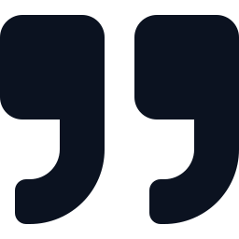
AI with local info: Open Notebook
Ask questions about your own documents
Answers cite the source document
Local embeddings and chat model keep it private
Documents
Embeddings
Answer
PDFs, notes
nomic-embed-text
gemma4:12b + citation
Full compose.yaml files: github.com/RussellNS/self-host
Notes:
Open Notebook is a self-hosted tool for asking questions about your own documents. Sources are chunked and embedded, a search finds relevant passages, and a chat model answers with citations back to the source documents.
Setup in this lab: separate notebooks by sensitivity. Sensitive content uses only local models (nomic-embed-text for embeddings, gemma4:12b for chat); general material can use a hosted model. Concurrent ingestion tasks are limited to 2, because very large PDFs can strain the ingestion database.
Link:
- https://github.com/lfnovo/open-notebook
- https://github.com/RussellNS/self-host

Slide 29


Agents: AI orchestrating AI
A model in a loop that picks tools and acts
OpenClaw: agent gateway on local models
Hermes Agent: a second framework to compare
Agent
Tools
Data
Sub-agent
Full compose.yaml files: github.com/RussellNS/self-host
Notes:
An agent is a model run in a loop: it chooses a tool, reads the result, and decides the next step until the task is done. Frameworks add tool definitions, memory and sandboxing.
OpenClaw runs here as a gateway container on NAS01 using local Ollama models. Hermes Agent (from Nous Research) is a second agent framework used for comparison on the same task in Section 8 (use case three).
Agents stress local models the most: tool calling needs reliable structured output, and long contexts need VRAM and time. That is the link to Section 5.

Slide 30

Token reduction
Context and context caching
05
Notes:
Section 5: how to reduce the number of tokens a model has to process, and how caching avoids reprocessing them.

Slide 31
Context: what the model reads
Context = everything sent on every turn
It grows with history, files, and tool output
Bigger context means slower answers and more VRAM
System prompt
Tool definitions
Conversation history
Files and tool output
New question
One context window, resent every turn
Notes:
The model keeps no memory between requests. Every request carries the full context: system prompt, tool definitions, conversation history, files or tool output, and the new question. Agent frameworks often have long system prompts and tool lists, and history grows each turn.
Costs of large context: slower time to first token, more VRAM for the KV cache, and (for hosted models) more billed tokens. On a 12 GB GPU, context size competes with model size for the same memory.
Reference: https://docs.ollama.com/faq (context length settings)

Slide 32
Context cache: reuse the prefix
Reuse the unchanged start of the prompt
Stable prefix means a cache hit
Changing early content invalidates the rest
Turn 1
All processed
Turn 2
Cached
New
Turn 3
Cached
New
Blue = reused, amber = computed
Notes:
Prompt (prefix) caching reuses computation for the part of the prompt that is identical to the previous request, so only the new tail is processed. The practical rule is to put stable content first (instructions, tool definitions) and changing content last. Any change early in the prompt invalidates the cache from that point on.
For local servers the model generally needs to stay loaded for its cache to help; Ollama's keep-alive setting controls how long it stays in memory.
Reference: https://docs.ollama.com/faq
Managing context in hosted tools (Claude Code examples):
- /clear: discards the conversation and starts with empty context. Use between unrelated tasks, since every later turn otherwise carries the old history.
- /compact: replaces the history with a summary to free space. Cheaper than carrying everything, but the rewritten start of the context means one cache miss afterward, and detail can be lost.
- /clear plus HANDOFF.md: before clearing, write the current state, decisions and next steps into a file, then start fresh and have the new session read it. Carries only what matters instead of the full history.
Prompt caches expire after a limited time (for Anthropic's API the default has been documented as about five minutes, refreshed on use; confirm in current docs), so long pauses can force the context to be reprocessed.
Official docs:
https://code.claude.com/docs
Community references:
https://old.reddit.com/r/ClaudeAI/comments/1xakl7o/how_do_you_guys_manage_the_5hour_limit_on_pro/
https://medium.com/@r3dtuxedo/where-did-my-claude-usage-go-auditing-your-agents-hidden-token-tax-95d6ab17b8b6

Slide 33
Why this matters for OpenClaw
Observed: agents resend large context every turn
Local models pay in time, not dollars
Trim the prompt and keep the start stable
Notes:
Observation, not a benchmark: with local models behind OpenClaw, slowdowns tracked how much context each turn carried more than the difficulty of the request. The chart is illustrative of the pattern (context growing each turn); the bars are not measured values.
Mitigations that follow from the previous two slides: trim what is sent each turn, keep the start of the prompt stable so the cache applies, and choose a model and context size that fit in VRAM.

Slide 34

Use case one
Open Notebook answers product questions
06
Notes:
Section 6, use case one: Open Notebook answering questions about product documentation loaded into it. The next slide covers it.

Slide 35

Use case: Open Notebook Q&A
Product docs loaded
Customer question
Notebook searches
Quote + citation
Already in the notebook
Copy and paste it in
Local embeddings + chat
Document name, page number and/or URL
Live demo
Open Notebook: customer question -> quote docs (with source, page, link)
Notes:
Scenario: product documentation is already loaded into an Open Notebook notebook. A customer question or concern is pasted in, the notebook searches the documents, and the answer returns one or more quotes with the document name and page number (or URL if applicable).
The citation is what makes the answer checkable; it points back to the source rather than asking for trust in the model.
Link:
- https://github.com/lfnovo/open-notebook

Slide 36
Use case two
The Expense Assistant, start to finish
07
Notes:
Section 7, use case two: the Expense Assistant. We return to the demo started in Section 1: a recap, how receipts get uploaded from the phone, and the results the pipeline produced.

Slide 37
Demo return: the "Expense Assistant"
Here’s the “Expense Assistant” in action
Copy receipt photos into Nextcloud
  Receipt photos: IMG_####.jpg
Processing takes ~3 minutes per receipt
~30
minutes per 1 week of receipts
Phone photos
Nextcloud
Windmill flow
Local vision AI
Organized output
IMG_####.jpg
Upload folder
Queue + scripts
Ollama on my GPU
Folders, receipts, XLSX, PDF, DOCX
Notes:
We're back at the Expense Assistant, the batch started in Section 1. By now it has made significant progress working through the receipts in the background.
To recap:
receipt photos land in Nextcloud -> a Nextcloud webhook triggers Windmill -> Windmill adds each webhook to a queue -> (in parallel) Windmill processes the queue, one at a time with a local vision model on Ollama
The results become a submission ready expense report.
Timing: about 3 minutes per receipt, roughly 30 minutes for a week of receipts, all unattended.
Links:
https://nextcloud.com
https://www.windmill.dev
https://ollama.com/library/qwen3-vl

Slide 38



Output from the “Expense Assistant”
README.md
Renamed image files
The explanation the pipeline wrote
IMG_####.jpg became date, category, description
Spreadsheet
PDF
DOCX
Expenses entered
Receipts, same order
Receipts, same order
One order, three files
Notes:
Review the results of the batch started in Section 1:
- README.md: generated explanation of what the pipeline did.
- Image files: IMG_####.jpg originals are now filed in folders and renamed by expense date, category and description.
- XLSX: expenses entered as rows.
- PDF and DOCX: the receipts, in the same order as the spreadsheet.
Pipeline details are in the final backup slide.
Hand-off: the automation works as designed, but the receipt guidance has changed since I built it. Next: update the automation, then test with a fresh receipt.

Slide 39
Update the automation: Claude in VS Code
New expense guidance isn’t in the automation yet
  One small item, picked live
Claude in VS Code edits the Windmill script
  I ask in plain language
  Claude makes the change
  Review the diff
  Promote: VS Code -> Windmill
Same pipeline, one change, one test receipt
Claude
Windmill
DEV
PROD
VS Code with Claude
Windmill workspaces
1 Describe the change
2 Review the diff
3 Test in DEV, promote
Notes:
The expense guidance has changed as of October 1st. The automation has not been updated. In this slide, we’re going to update it together:. Earlier in the talk VS Code used a local model. Here a commercial model edits the code, not the data. This is commercial AI updating a pipeline for local AI to use. The receipts and the vision model stay on my hardware; only the script text goes to the commercial tier.
Pick one small item at the time of the demo (for instance, Name or Date).
The setup: VS Code is the same container from the ecosystem section, and it is where the Windmill scripts are edited. Here the side pane is the Claude extension instead of a local model. Windmill has separate DEV and PROD workspaces and the 'wmill' CLI moves scripts between them, so the change is tested in DEV before it reaches PROD.
The process, left to right in the three boxes:
1. Describe the change in plain language. Tell Claude which script to change and what the new rule is. Useful constraints: keep the change small, follow the script's existing header and logging style, update the change log, and keep the file ASCII-only (Windmill's scanner rejects non-ASCII characters).
2. Review the diff. This is the human step: read exactly what changed before accepting it. Claude proposes, you decide.
3. Test in DEV, then promote to PROD.
Links:
https://code.claude.com/docs/en/vscode
https://www.windmill.dev/docs/advanced/cli/sync
https://www.windmill.dev

Slide 40
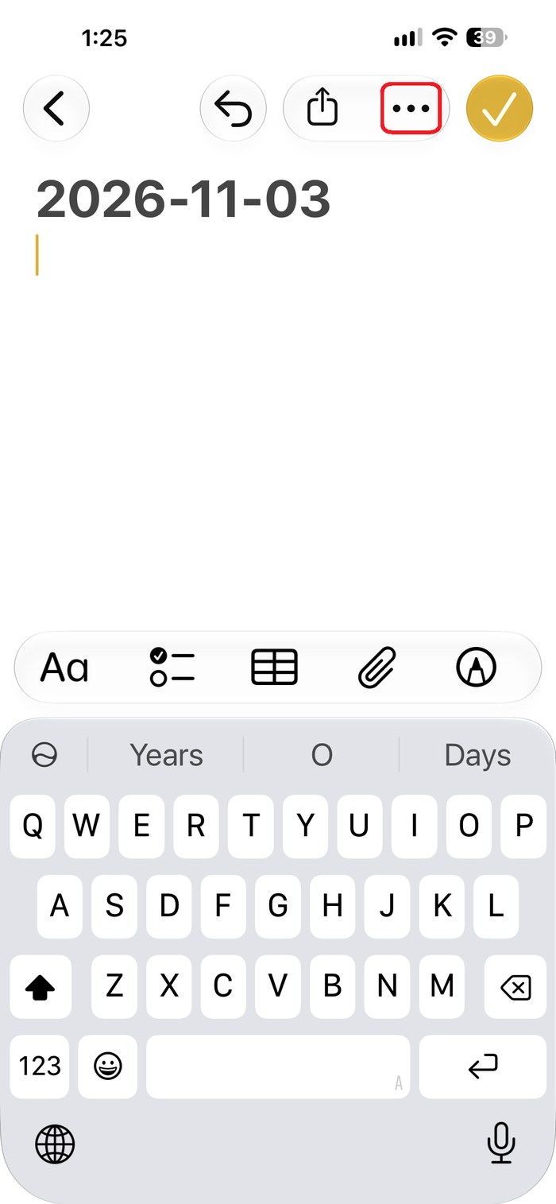
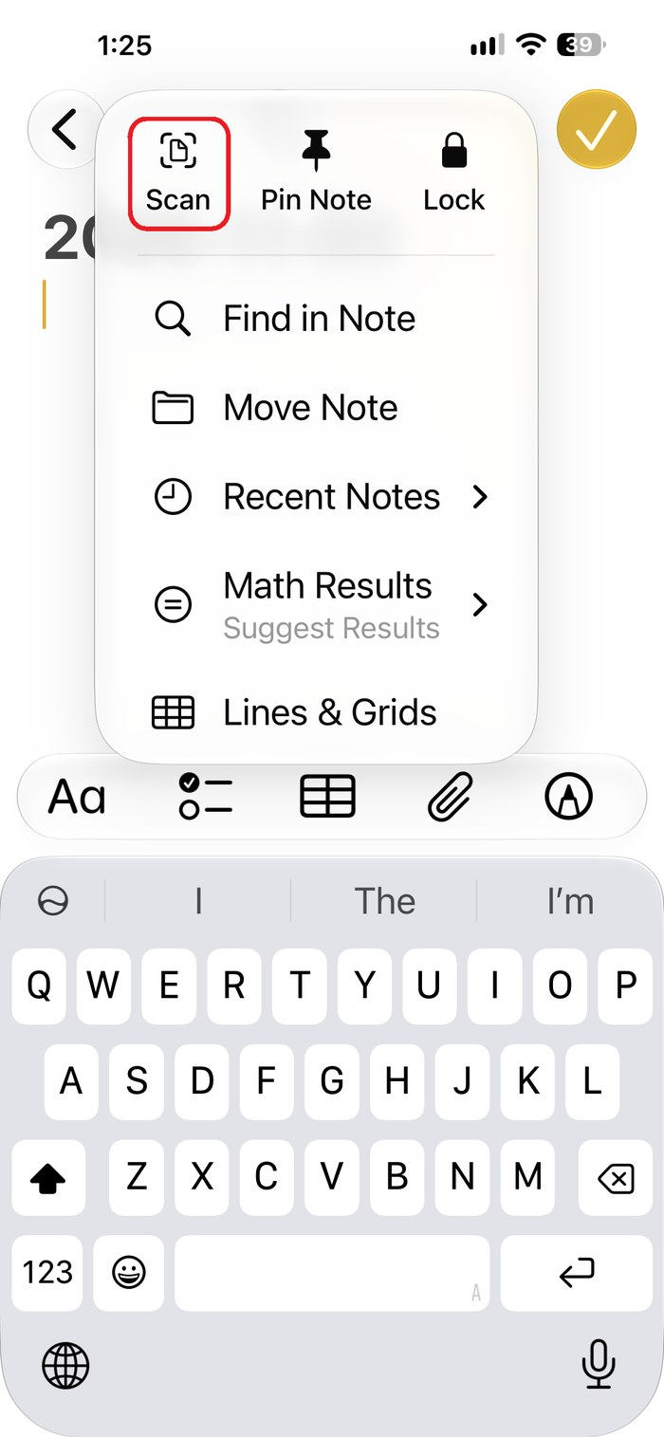
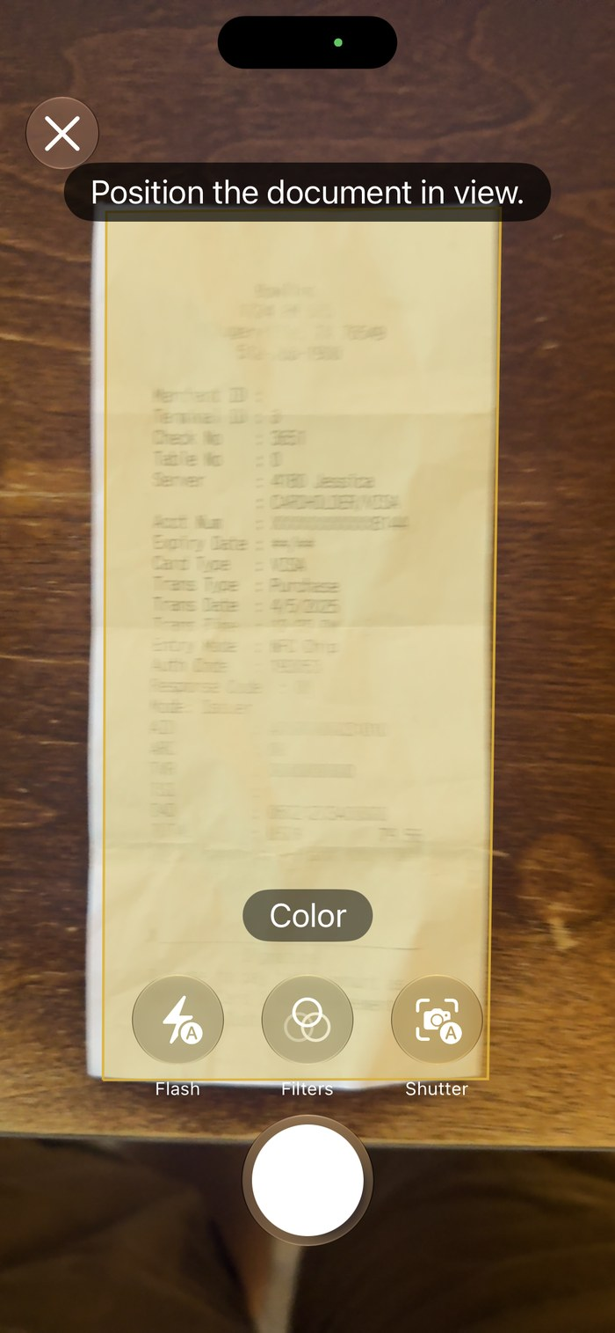
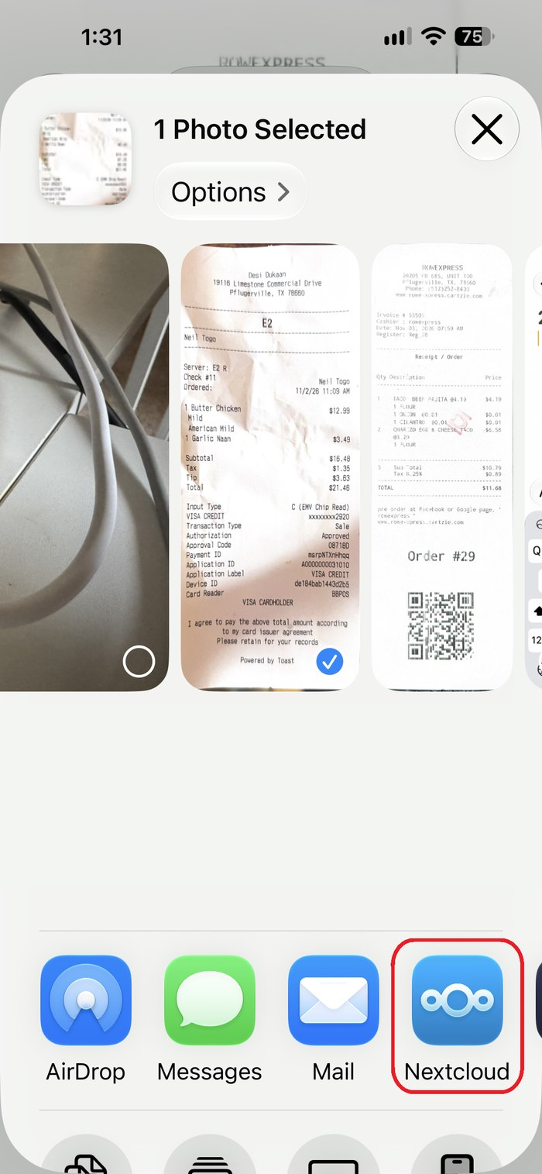
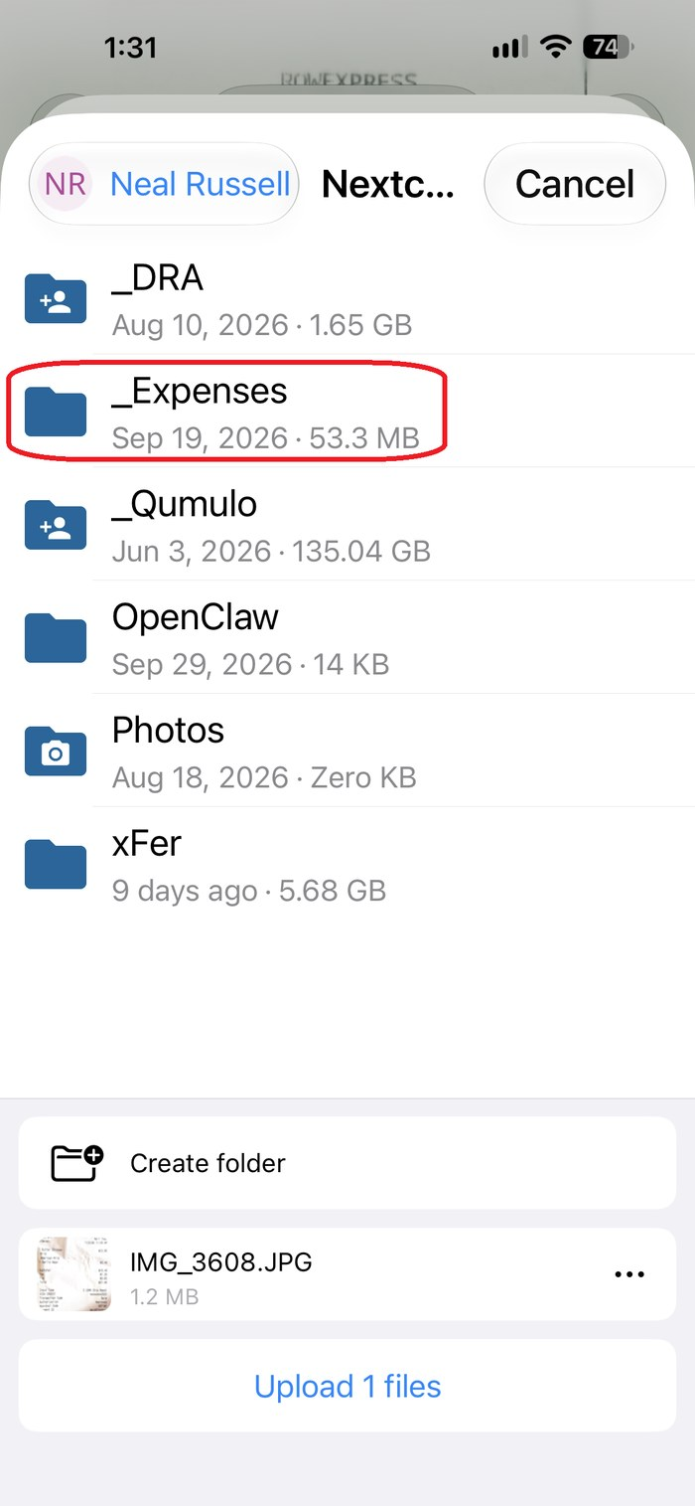
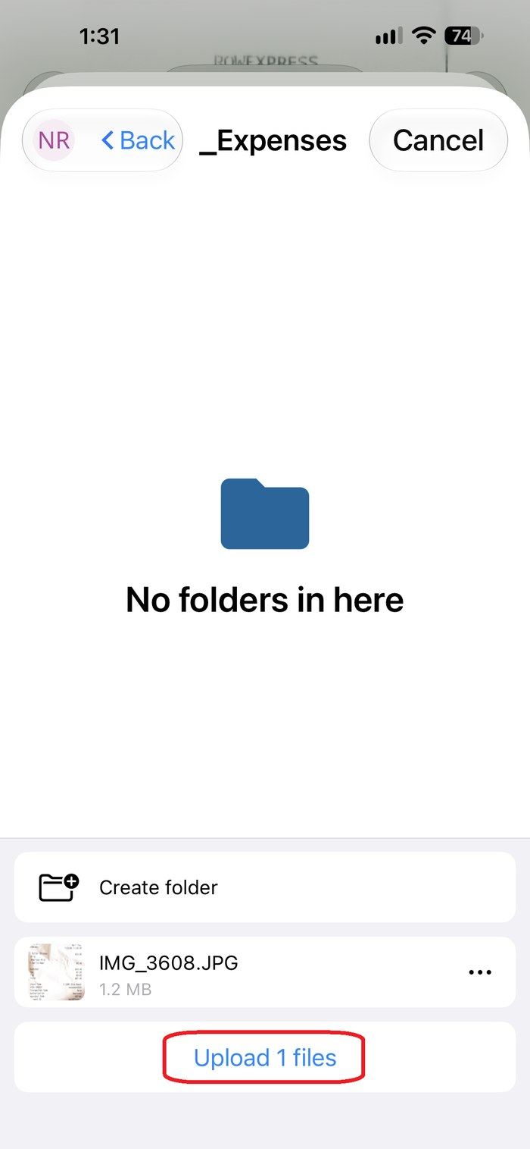
Demo: upload receipts from your phone
1
2
3
4
5
6
Open a note, tap the ••• menu
Tap Scan
Scan the receipt
Share to Nextcloud
Choose the _Expenses folder
Tap Upload
Notes:
Now test the change from the previous slide with one fresh receipt. The steps are the same ones used to start the batch in Section 1: getting a receipt from the phone into the Nextcloud upload folder, which kicks off the Expense Assistant. It takes about a minute per receipt.
Walk through the six screens:
1. Open Notes on the iPhone, start a new note, and tap the ••• menu (top right).
2. Choose Scan. iOS offers "Scan Documents" here, which is faster and cleaner than snapping a photo and cropping it.
3. Hold the phone over the receipt. The scanner finds the edges, flattens the paper and captures it automatically (or tap the shutter). Keep it as a color scan so the vision model sees the original text.
4. Save the scan to Photos, select it, and in the share sheet choose the Nextcloud app. The file is saved as a standard IMG_####.jpg (here IMG_3608.JPG, about 1.2 MB), which is the name the pipeline expects.
5. Pick the destination: the _Expenses folder in my Nextcloud. This folder is the trigger point for the whole automation.
6. Tap Upload. As soon as the file lands, Nextcloud fires a webhook to Windmill, which queues the receipt for the local vision model.
What to say: nothing else is required from the user. No form, no categories, no typing. The phone is only the capture device; everything after step 6 happens on my own hardware, which is the self-hosting point. Processing a single receipt takes roughly 3 minutes in the background. Once it finishes, we review the new spreadsheet to confirm the guidance item is in.
If you show it live instead: have the receipt and the note ready, and consider uploading two or three receipts so the queue has something to show.
Links:
- Nextcloud clients (iOS app): https://nextcloud.com/install/#install-clients
- Nextcloud: https://nextcloud.com
- Windmill: https://www.windmill.dev

Slide 41
Review the new spreadsheet
Open the new spreadsheet
  The fresh receipt is now a row
The new item shows in that row
  Earlier rows predate the change
Same pipeline, new rule applied
  Diff reviewed, output verified
Date
Category
Description
Amount
New item
…
…
Earlier receipt
…
–
…
…
Earlier receipt
…
–
…
…
Fresh receipt
…
Applied
Expenses spreadsheet (XLSX)
1 Open the XLSX
2 Find the new row
3 Check the new item
Live: open the spreadsheet in Nextcloud
Notes:
We're back from the live receipt test. Switch to the desktop (minimize the PPTX), open Nextcloud in the browser, and open the expenses spreadsheet that the single receipt just updated. If the processing isn't finished yet (about 3 minutes per receipt), keep talking through the change from the previous slide and check again.
What to look for, in the order of the three boxes:
1. Open the spreadsheet. The mock on the slide is conceptual: the real column names and layout are whatever the pipeline writes.
2. Find the new row. It is the most recent entry. Compare it with the receipt image that was filed in the same run; the PDF and DOCX list receipts in the same order as the rows, so the match is easy to show.
3. Check the new item. This is the one small guidance change chosen earlier, so name it out loud and show the cell. If you let the group pick the item, ask them whether the value looks right.
Why earlier rows don't have it: they were processed before the change. The pipeline applies a rule when it processes a receipt, so old rows are not rewritten. That is the expected behavior, and it is a useful point for consultants: a rule change affects new work, and backfilling old records is a separate decision.
If the item is missing or wrong, that is the best possible demo moment. The loop is short: go back to the VS Code slide's workflow, ask Claude to adjust the script, review the diff, test in DEV, and run one receipt again. A single receipt keeps each iteration to about 3 minutes.
The point to land: a commercial model changed the code, the diff was reviewed by a person, and the proof is in the output, not in the model's say-so. Only the script text went to the commercial tier; the receipts, the vision model and the spreadsheet all stayed on local hardware. For enterprise customers, the same pattern applies: small reviewed changes, tested in DEV before PROD, verified against real output.
Caution: the vision model can misread a receipt, so spot-check the amount against the image rather than trusting the row blindly.
Links:
https://nextcloud.com
https://www.windmill.dev
https://code.claude.com/docs/en/vscode

Slide 42
Use case three
A CrowdSec audit, reconciled by agents
08
Notes:
Section 8, use case three: a CrowdSec audit. Five logs reconciled by agents, with two real configuration findings at the end.

Slide 43

Is CrowdSec actually working?
Fail2ban: local logs, local bans
CrowdSec: same idea plus a shared community blocklist
Think of it as the Pi-hole of IDS/IPS
Fail2ban
CrowdSec
Local only
Local + community
Live: show the CrowdSec Web UI
Notes:
CrowdSec is an open-source, log-driven intrusion detection and prevention tool. Agents read logs, parsers normalize them, scenarios detect malicious patterns, and decisions (such as a temporary ban) are enforced by bouncers.
Comparison with Fail2ban: both react to patterns in local logs. CrowdSec additionally shares detections with a community and pulls a curated blocklist back, which is why it is described here as the Pi-hole of IDS/IPS: shared lists plus local enforcement.
Links: https://www.crowdsec.net | https://docs.crowdsec.net | https://github.com/fail2ban/fail2ban | https://pi-hole.net

Slide 44

The infrastructure
Raspberry Pi 4B
QNAP NAS
External Nginx (Nginx logs)
Nextcloud (Nginx + app logs)
CrowdSec LAPI
Mealie (Nginx + app logs)
VS Code (Nginx logs)
Notes:
Two hosts:
- Raspberry Pi 4B: the external Nginx reverse proxy and the CrowdSec Local API (LAPI), which stores alerts and decisions.
- QNAP NAS: Nextcloud, Mealie and VS Code, each with its own Nginx in front; Nextcloud and Mealie also write an application log.
The per-app CrowdSec/Nginx pairing on the NAS is why many log sources exist for one request.

Slide 45

One request, many logs
Nextcloud Nginx
App log
External Nginx
Mealie Nginx
App log
2-3 logs per path
User
VS Code Nginx
No app log
Notes:
Request path: user, external Nginx (on the Pi), the app's own Nginx (on the NAS), then the application. Each hop writes its own log, so one request leaves two to three log entries across two machines.
VS Code has Nginx logs only. It has no application log, which is a technical limitation.

Slide 46

Audit: five logs to reconcile
CrowdSec LAPI
External Nginx
Nextcloud
Alerts and decisions
What arrived
Nginx + app log
Is CrowdSec working?
Mealie
VS Code
Nginx + app log
Nginx only
(technical limit)
Manual reconciliation across all five is slow and error-prone.
Notes:
The audit compares five sources: the CrowdSec LAPI (decisions), the external Nginx log (what arrived), and the Nginx and application logs for Nextcloud and Mealie, plus the Nginx log for VS Code.
For each ban, the question is whether traffic from that address actually stopped. Matching timestamps and IP addresses across five sources by hand is slow, which makes it a good candidate for an agent.
The overall question: is CrowdSec working?

Slide 47
Live: reconciliation by agents
OpenClaw
Hermes Agent
Agent gateway on local Ollama models
Second framework, same task
Same audit, two agents
Switch to each agent and show the reconciliation, then explain the findings.
Notes:
Live comparison: the same reconciliation task run by OpenClaw and by Hermes Agent, each reading the five log sources and reporting whether banned addresses were actually blocked.
Things worth comparing: runtime, whether the agent keeps its place across large logs, and differences between the two answers.

Slide 48



Finding 1: Cloudflare whitelist
Traffic arrives proxied through Cloudflare
A ban is issued, but the traffic is still whitelisted
Root cause: external Nginx configuration
Attacker
Cloudflare
External Nginx
App
Proxied
Whitelisted
Ban ignored
Notes:
Traffic arrives through Cloudflare's proxy, so the source address Nginx sees is a Cloudflare address unless real-IP handling is configured. A ban decision was made, but the traffic was still allowed through a whitelist, so the ban had no effect.
Root cause: external Nginx configuration, not CrowdSec itself.
Related documentation:
- https://developers.cloudflare.com/support/troubleshooting/restoring-visitor-ips/restoring-original-visitor-ips/
- https://nginx.org/en/docs/http/ngx_http_realip_module.html

Slide 49
Finding 2: CrowdSec config issue
Bouncer runs on the Pi's bare OS (IP/MAC-1)
External Nginx runs in Docker (IP/MAC-2)
Bans apply to IP/MAC-1, not enforced for IP/MAC-2
Raspberry Pi 4B
Bouncer on bare OS (IP/MAC-1)
IP/MAC-1: bans applied here
Nginx in Docker container (IP/MAC-2)
IP/MAC-2: traffic arrives here, ban not enforced
Notes:
The CrowdSec bouncer runs on the Raspberry Pi's bare OS, which has one IP/MAC address (call it 1). The external Nginx reverse proxy runs in a Docker container on the same Pi, with a different IP/MAC address (2). Ban decisions were applied for address 1 but not enforced for address 2, so the bouncer was blocking at a point the traffic never passes.
Key point: a decision only matters where a bouncer enforces it.
Links: https://docs.crowdsec.net/u/bouncers/intro | https://docs.crowdsec.net/u/bouncers/nginx

Slide 50
Summary
What to take away
09
Notes:
Section 9, summary: the takeaways, then questions.

Slide 51


Takeaways
Use it where it pays
Modest hardware goes far
Boring jobs win
Subscriptions, tokens, or data sensitivity
Pick models by task, manage context
Receipts and log audits are ideal
Notes:
Summary:
- Self-hosting pays off where subscriptions, token cost or data sensitivity matter.
- Modest hardware goes far when models are chosen by task and context is managed.
- Repetitive jobs such as receipt processing and log audits are the best fit; the CrowdSec audit surfaced two real configuration problems.

Slide 52
Questions?
Backup slides follow
Notes:
Backup slides follow: extended GPU list, CrowdSec components and the expense pipeline design, and the disconnection idea (the price of delegating code to AI).

Slide 53

Backup slides
Deeper detail and detours worth keeping
10
Notes:
Section 10: backup slides. Not part of the main talk; kept for questions and detours.

Slide 54
Disconnection: the price of delegation
Delegation is the benefit. Disconnection is the price.
Delegate more: more time saved
Syntax suggestion
“How do I format this date?”
Specific function
“Take this webhook payload, return this exact JSON”
Logic
“Parse the webhook and decide what to do”
Whole script
“Take a webhook, act on remote systems, report success or failure”
Disconnection: none
Disconnection: low
Disconnection: moderate
Disconnection: high
Break-even: investigating costs as much as writing it
Disconnection: I can’t predict what a change will affect
  I must investigate before even a small edit
Break-even: investigating costs as much as writing it
  Only writing it myself reconnects me
Related ideas: comprehension debt (Osmani), programming as theory building (Naur), out-of-the-loop problem (Bainbridge)
Notes:
This is the question underneath the live demo ("how much should I let AI write?").
What I noticed: when I write code myself I am completely in tune with it: the formatting, the functions, the logic. When AI writes it, I can still follow every line, but there is a gap between me and the code. I call that gap "disconnection." I am not claiming this is an established term.
The dial, left to right:
- Syntax suggestion: almost no disconnection.
- Specific function: low. If I give it a webhook payload in a known format and ask for an exact JSON output, I can check the result against an example.
- Logic: moderate. The AI is now making decisions I would normally make: variable name and content structure, looping structure, task order, logic structure, function creation, etc.
- Whole script: high. A script that takes a webhook, acts on remote systems and reports success or failure cannot be verified by reading it.
Size is a rough proxy. The underlying variable is how many decisions the AI made that I did not. A long script specified function by function would disconnect me less than a short, vague request. My confidence holds while the ask is specific and fades as it moves away from specifics.
The line on the banner is the point of the slide. If I specify every step (the pseudo-code, every loop, every function), I am effectively writing it myself, and I would not go to AI for that. The speed-up and the disconnection come from the same thing: handing over decisions. Delegation is the benefit; disconnection is the price.
What disconnection is: not being able to predict what a change to the code will affect. The symptom is that, to make even a small change, I have to investigate the code first to be sure I am not breaking something else.
Break-even (my own rule of thumb, not a published measure): There’s an inflection point around “if coming up to speed on the code, or troubleshooting it, takes as long as writing it would have.” At this point, the delegation to AI in helping code may still be worth it, but you’re more beholden to AI for updates and troubleshooting. This is judged after the fact and varies by person and task, so the amber marker is approximate.
What fixes it, in my experience: authorship. Rewriting a section or a function myself brings the connection back. Rereading and understanding the code, while beneficial, doesn’t do as much to generate connection. This is one person's observation, not a study, and it is a diagnosis, not a policy (see the next slide).
How the related ideas compare:
- Comprehension debt (Addy Osmani, March 2026): "the growing gap between how much code exists in your system and how much of it any human being genuinely understands." That is the accumulated, system-level version. Disconnection is the in-the-moment version, and repeated disconnection plausibly builds up into comprehension debt.
- Programming as theory building (Peter Naur, 1985): the real product of programming is the programmer's mental model, and the code is a by-product. Disconnection is what it feels like to lack that model: I can read the code but cannot predict what a change would do.
- Out-of-the-loop problem (Bainbridge, "Ironies of Automation", 1983; Endsley and Kiris, 1995): operators who monitor instead of act lose awareness, more so as automation does more of the work. This is from my background knowledge and I have not checked the original papers, so verify before quoting.
- Anthropic study, "How AI Impacts Skill Formation": in a randomized trial of 52 engineers learning a new library, the AI-assisted group scored about 17% lower on a comprehension quiz, mostly on debugging, and passive delegation hurt more than asking questions. Cited here as reported by Osmani; I have not opened the paper. The participants were learning a library, not fluent coders in a familiar language.
Links:
https://addyosmani.com/blog/comprehension-debt/
https://seangoedecke.com/programming-with-ai-agents-as-theory-building/
https://www.thoughtworks.com/radar/techniques/complacency-with-ai-generated-code
https://arxiv.org/abs/2601.20245

Slide 55
Disconnection at team scale
Can your team predict the blast radius of a change to AI-written code?
Handoffs already disconnect people
  Process handoffs, breakages, attrition
AI magnifies it
  Even the author may never have been connected
Make code handoff-ready
  Modular functions
  Docstrings with example input and output
  Verbose inline comments
Author
with AI help
handoff
Next owner
inherits the script
One script, modular functions
Parse webhook
in: webhook JSON
out: clean dict
Update remote system
in: clean dict
out: status code
Report result
in: status code
out: success or failure message
A change stays inside one function
Notes:
Audience: consultants advising enterprise customers. The previous slide is my personal view; this one is for the customer conversation.
A team of developers can usually answer the banner question quickly. If they cannot, that is disconnection at team scale: they can read the code but cannot predict what a change will affect.
Handoffs already cause this. Code passes between people through planned process handoffs, when something breaks, and as people leave. The new owner gets the same feeling described on the previous slide. AI magnifies it, because the author may never have been fully connected to the code either, so the handoff is from someone who was not in tune to someone who is not in tune. Two further points: fluent developers feel the warning signs of “disconnection," but newer developers may not. Newer developers may not because they have less of a baseline to compare against, and velocity and test-coverage metrics do not show it (Osmani makes this point about comprehension debt).
Why not just rewrite it: a new person feeling disconnected from a script is not a reason to rewrite it, and no team can rewrite every script it inherits. Rewriting a section is a diagnosis I use on myself (previous slide), not a policy to recommend. The aim is code that is handoff-ready.
Three mitigating practices, and why each helps:
- Modular functions: A change is contained to the function it touches, so the blast radius shrinks and the new owner can work one function at a time. That is what the highlighted box shows.
- Docstrings with example input and output values: They make behaviour checkable against an example without tracing every line. The boxes on the slide show the idea: each function states what goes in and what comes out.
- Verbose inline comments: ideally with example values, explain the why behind the logic.
Make these part of the acceptance standard for AI-written code: ask for them in the prompt and check for them in review.
A related point on change logs and version numbers: they tell you which version is current and why it changed, which stops an older script overwriting a newer one. That is valuable, but it does not restore understanding, so do not count it as a fix for disconnection.
These are the practices I lean on in my own scripts (the Windmill scripts behind the Expense Assistant): a header block, step-by-step logging, functions with docstrings, and inline comments with example values.
Link:
https://addyosmani.com/blog/comprehension-debt/

Slide 56


Backup index: what belongs here
Discussion detours
Deeper dives
Anything else relevant
Good discussions we pivoted away from
More depth than the live talk needs
Added as the material grows
Notes:
Holding area for three kinds of slides: topics that were discussed and then set aside, deeper dives than the live talk needs, and anything else relevant. New backup slides go after this index.

