Slide 1
SYLTHARAE-PRO / TECHNICAL SYSTEM BRIEFING
Information intelligence
across mixed file collections
A code- and documentation-grounded examination of architecture, workflows, operations, security, and adoption considerations.
Repository snapshot • 2.2.0 • 2026-10-16
Research basis: checked-out repository at aa2b865a24c429e242a457a60d2aef84661389b2

Slide 2
SYSTEM
Executive summary
What it is
What stands out
A Python / Flask and PostgreSQL information-intelligence application for ingesting, extracting, indexing, analyzing, preserving, and connecting mixed file collections.
Broad ingestion and forensic readers sit alongside search, detection, geo enrichment, analyst categorization, monitoring, reporting, jobs, and a browser UI.
Operating model
Adoption lens
One Flask application and one process per database. Slow tasks run as bounded worker threads and persist job state/events in PostgreSQL.
Evaluate the supported formats and workflow fit, PostgreSQL operations, file retention/backup, security configuration, and AGPL obligations before production use.
Evidence: README.md; docs/ARCHITECTURE.md; pyproject.toml; run_web.py
02

Slide 3
NAVIGATION
Agenda & evidence policy
01 / Orient
02 / Understand
Purpose, users, technical profile, value boundaries.
Architecture, repository, request path, ingestion, search, detection, reporting.
03 / Operate
04 / Evaluate
Prerequisites, configuration, installation paths, example flows, troubleshooting.
Security, quality, deployment, use cases, limitations, evidence index.
Evidence labels
Implemented = source/test-backed. Documented = stated in repository documentation. Code-derived walkthroughs are not claimed as runtime-tested. Proposed = recommendation only.
Evidence: docs/ARCHITECTURE.md; see appendix source index
03

Slide 4
SYSTEM
Project at a glance
Runtime & framework
Persistence
Python >=3.10 (version metadata declares 3.10–3.12); Flask >=3,<4; server-rendered Jinja UI plus JSON APIs.
PostgreSQL via psycopg2; migrations are authoritative. Filesystem holds ingested bytes and runtime data.
Interfaces
Optional capabilities
Browser UI; numerous route modules; CLI entry point; import utility. Verify the specific workflows before relying on an individual command.
PDF, Office, OCR, ebook, audio, media, PST readers and Waitress via extras; system binaries/language packs may also be needed.
Evidence: pyproject.toml; version.py; docs/ARCHITECTURE.md
04

Slide 5
SYSTEM
Purpose, context & intended users
Problem addressed
Core workflow
Mixed-format collections are difficult to search and connect when content remains trapped in files, archives, scans, mail, media, and databases.
Bring files into a managed collection; extract text and metadata; resolve content identity and occurrences; search and analyze; preserve traceable results.
Likely operators
Scope caution
Analysts, investigators, knowledge workers, collection administrators, and technical operators—roles inferred from UI domains and data model, not a published persona study.
The repository supports a general-purpose information intelligence workflow; it does not document a verified deployment sector, customer, or outcome.
Evidence: README.md; docs/DOMAIN_MODEL.md; docs/ARCHITECTURE.md
05

Slide 6
EXECUTIVE
Value proposition: evidence vs inference
Demonstrated characteristics
Operational implication
Content hash/context/path identity; durable job history; migration-led schema; registries for interface, user actions, and screen contracts; versioned detection/reporting records.
These choices can improve traceability, resumability, schema discipline, and consistency—provided operators configure and maintain the supporting database/filesystem.
Differentiating design
Not established
A single application combines collection ingestion/search with downstream signal, rules/scenarios, geo, and reporting modules; this is a repository observation, not a comparative market claim.
No verified benchmarks, customer adoption, quantified productivity, scale guarantees, compliance certification, or production-readiness attestation found in the inspected evidence.
Evidence: docs/ARCHITECTURE.md; see appendix source index
06

Slide 7
ARCHITECTURE
High-level system architecture
Browser
Nginx / proxy
WSGI / Flask
Routes + services
PostgreSQL
UI / API client
TLS, limits
single process
HTTP → domain
state / search
Pipeline
Readers
Jobs
read · extract · store
format handlers
thread pool + events
Boundary: browser → HTTP/proxy → single Flask process → PostgreSQL + filesystem. Background work is threaded in-process.
Evidence: docs/ARCHITECTURE.md
07

Slide 8
SYSTEM
Repository anatomy
Application surface
Domain & processing
apps/web (app, serving, deployment); Api/routes (HTTP endpoints); templates + static (UI); apps/cli and run_cli.py.
services/ (ingestion, jobs, detection, reporting, geo, retention, monitoring); pipeline/ (reader and progress workflow); reader_file/ (format readers).
Foundation
Operations & proof
core/ (security, search, registries, analytics, OCR, safety, reporting); database/ (bootstrap, migrations, query/data services); concurrency/.
settings/, .env.example, install.py, scripts/, deploy/, offline-bundle/, docs/, tests/ (unit, integration, security, JS).
Evidence: repository tree; docs/ARCHITECTURE.md
08

Slide 9
SYSTEM
Component responsibilities & boundaries
Routes
Services / core
Parse and validate HTTP input, enforce endpoint authorization, call services, shape status/JSON/page responses.
Orchestrate domain work and own invariants; route-independent domain logic. Services coordinate ingestion, jobs, detection, reports, geo, and retention.
Pipeline / readers
Database / UI
Read → extract → store. Reader registry dispatches format handlers; storage pipeline writes extracted content, identity, provenance and progress.
Migrations and repositories own PostgreSQL state. Jinja/JavaScript presents pages and calls APIs; interface/action/experience registries describe portions of the UI contract.
Evidence: docs/ARCHITECTURE.md; core/interfaces; core/experience
09

Slide 10
WORKFLOWS
Request lifecycle: browser to response
1
2
3
4
5
Request
Gates
Route
Service
Response
Browser sends HTTP(S) request through proxy.
Setup state, session/authentication, authorization, rate limiting and lockout checks.
Route validates fields and invokes a service; query values are parameterized.
Domain logic reads/writes PostgreSQL or creates a long-running job.
Rendered page or JSON; failures mapped to status and message, not traceback body.
Code-derived: docs/ARCHITECTURE.md; apps/web/app.py; Api/routes/*
10

Slide 11
WORKFLOWS
Ingestion: input to durable searchable content
1
2
3
4
5
Select input
Queue work
Read & extract
Identity + store
Follow up
Upload or server path (server paths require configured ingestion roots).
Ingestion route creates a persisted job; job manager records lifecycle and events.
Integrated reader dispatches formats; text, metadata, OCR or archive extraction as available.
Hash bytes; combine hash with source/side context; attach path occurrences; deduplicate with database unique constraints.
Progress ledger supports resume; detection hooks may run; job events are persisted and shown to UI.
Code-derived: docs/ARCHITECTURE.md; services/ingesting; pipeline; database/services/dedup_service.py
11

Slide 12
WORKFLOWS
Search: query to paginated result
1
2
3
4
5
Query
Resolve words
Candidate set
Filter & rank
Return page
User submits text and any filters.
Tokenizer and word resolution use indexed word keys.
Inverted word-to-content association table identifies candidates.
Apply source/side/date/category constraints; retrieve content and create snippets/ranking.
Cursor pagination; response reports exact/timed/skip count mode so total precision is explicit.
Code-derived: docs/ARCHITECTURE.md; core/search; docs/search/PERFORMANCE_ARCHITECTURE.md
12

Slide 13
WORKFLOWS
Signals, rules, scenarios & reports
1
2
3
4
5
Detect
Enrich
Evaluate
Notify
Report
Versioned detector run writes content signals and provenance.
Place/geo mentions can resolve through gazetteer and map-related services.
Monitoring rule engine and scenario engine persist evaluations/outcomes.
Alerts/notifications follow qualifying evaluations.
Definition registry creates report run, datasets, analyses and immutable artifacts with checksums.
Code-derived: docs/ARCHITECTURE.md; services/detection; services/monitoring; services/reporting
13

Slide 14
SYSTEM
Data model & information handling
Identity layers
Content representation
hashes = bytes; hash_contexts = bytes in source + side; paths = occurrences. Same content at multiple locations is represented once with multiple occurrences.
contents stores search representation; contents_raw stores verbatim extracted text. Original file bytes are retained in the application storage model.
Provenance & lifecycle
Data movement caution
Detection runs and signals retain detector provenance; job_events preserve activity; reporting and selected analyst history are append-only/trigger protected.
Database backups must include contents_raw; file bytes/runtime data also need filesystem backup. A database-only backup is incomplete for restoring originals.
Evidence: docs/ARCHITECTURE.md; docs/DATABASE.md; database/migrations/
14

Slide 15
SYSTEM
Jobs, concurrency & recoverability
Lifecycle
Execution
QUEUED → RUNNING, with PAUSED/CANCELLING and terminal COMPLETED, COMPLETED_WITH_WARNINGS, CANCELLED, FAILED states.
Bounded worker threads inside the single application process; max concurrent jobs configured through settings.
Events & progress
Failure semantics
JobRepository persists event stream; throttling samples high-frequency events. Browser pages can reload and recover history from PostgreSQL.
Cancellation is cooperative. A job stuck CANCELLING remains visibly unresolved; process loss and multi-process deployment require careful evaluation because workers are in-process.
Evidence: docs/ARCHITECTURE.md; services/jobs/manager.py; job_state.py
15

Slide 16
SYSTEM
Search and analytical capabilities
Full-text discovery
Analytics & narrative
PostgreSQL-backed word index/inverted associations, filters, snippets, ranking and cursor pagination; query cost/total-count mode is surfaced.
core/analytics provides kinds, measures, profiles, thresholds and narrative modules; route/service inventory includes analytics and exports.
Information linking
Limits to claims
Detection signals, identifiers, temporal and place intelligence, relationships, analyst categories and lineage enable cross-record exploration.
No benchmark performance numbers asserted here. Dataset size, query mix, hardware, Postgres configuration, OCR load and count mode affect real outcomes.
Evidence: docs/ARCHITECTURE.md; core/search; core/analytics; docs/perf/
16

Slide 17
SYSTEM
Reader ecosystem & extraction caveats
Format breadth
OCR selection
Repository includes handlers for office, PDF, email/mailboxes, archives, images/OCR, ebook, audio/video, databases, diagrams and structured data; exact support depends on handler and installed extras.
Tesseract preferred, then RapidOCR. Missing engines/language packs produce retryable unavailable-engine status rather than silent text success.
Archives & safety
Operational consequence
Archive safety and nested extraction controls exist; encrypted or unsupported formats may require external tools/credentials and can fail.
Inventory actual formats and language needs; run OCR self-check; assess hostile-file exposure, resource costs, retention, and extraction fidelity before broad ingestion.
Evidence: pyproject.toml; docs/CONFIGURATION.md; core/ocr; core/archive_safety.py
17

Slide 18
SYSTEM
Configuration model & key settings
Precedence
Core runtime
OS environment → .env → data/settings.json → config.example.json → dataclass defaults. Restart after editing .env.
FLASK_ENV, FLASK_DEBUG, FLASK_HOST/PORT, WSGI_SERVER, WAITRESS_THREADS, FLASK_SECRET_KEY, SOURCE_CODE_URL.
Database & admin
Data & trust
DB_HOST/PORT/NAME/USER/PASSWORD; APP_ADMIN_USERNAME/PASSWORD for first admin; password minimum 12.
INGESTION_ROOTS confines server-path reads; TRUSTED_PROXY_COUNT must match proxy topology; APP_DATA_DIR defines runtime storage.
Evidence: docs/CONFIGURATION.md; .env.example; apps/web/deployment.py
18

Slide 19
OPERATIONS
Install & first-start sequence (documented path)
1
2
3
4
5
Obtain source
Prepare Python
Prepare PostgreSQL
Configure safely
Launch & initialize
Clone/download the repository and select a reviewed version. This briefing examines the checked-out snapshot; no release tag was found.
Create isolated Python 3.10–3.12 environment; install base and required optional extras for intended formats.
Provision DB and credentials; set environment / .env. Ensure application can create or upgrade schema per deployment policy.
Set strong persistent secret, production mode, proxy count, ingestion roots, storage paths and backup policy.
Run python run_web.py; setup gate routes uninitialized instance to wizard. Verify service/DB, admin login and readiness before adding data.
Documented/code-derived; exact production steps in docs/OPERATIONS.md; no live server test performed
19

Slide 20
OPERATIONS
Practical commands & optional extras
Install base
Install feature sets
python -m pip install -e . (from repository root, in a virtual environment). Package name is file-analysis; Python >=3.10.
pip install -e ".[pdf,office,ocr,ebook,audio,media,server]" — choose only needed extras; PST extra has native build prerequisites.
Run web
Readiness & tests
python run_web.py | optional console script: file-analysis-web. Defaults Flask dev server; Waitress opt-in via WSGI_SERVER=waitress.
python verify_readiness.py; python -m pytest tests/unit -q (integration/security suites and requirements described in docs/TESTING.md). Commands are repository-documented; startup and ingestion were exercised, but the listed test suites were not run.
Evidence: pyproject.toml; docs/OPERATIONS.md; docs/TESTING.md; run_web.py
20

Slide 21
OPERATIONS
Deployment topology & operational constraints
Supported shape
Single-process rule
systemd service + nginx reverse proxy in deploy/. Nginx TLS/static/request limits; app receives trusted proxy headers only when configured.
Exactly one application process per database. Multi-worker Gunicorn/uWSGI is not supported because jobs run as in-process threads.
Data & backups
Upgrade discipline
Back up PostgreSQL plus filesystem data (especially originals/runtime files). Restore-test database and file consistency.
database.bootstrap/migration runner owns schema changes; migrations each transact and record schema_migrations. Historical database/SYLTHARAE.sql is not deploy authority.
Evidence: docs/ARCHITECTURE.md; docs/OPERATIONS.md; docs/DATABASE.md; deploy/
21

Slide 22
OPERATIONS
Troubleshooting decision tree
Cannot start
First-run redirects
Check apps/web/deployment.py startup findings; invalid production debug setting is refused. Validate DB connection, env precedence, secret and WSGI option.
Expected setup gate before schema/accounts are initialized. Complete wizard; do not bypass partially initialized state.
Server-path ingest fails
Scan has no text
INGESTION_ROOTS empty disables server path ingestion; use upload or add approved absolute root. Check path safety/permissions.
Run python tools/ci/ocr_selfcheck.py; verify Tesseract binary and eng/heb/ara packs, or RapidOCR availability. Retry after installing dependency.
Jobs stall / overloaded
Inspect persisted job status/events; ensure single process; review thread capacity, database availability and resource limits; cancellation is cooperative.
Evidence: docs/CONFIGURATION.md; docs/ARCHITECTURE.md; docs/OPERATIONS.md
22

Slide 23
SECURITY
Security controls evidenced in repository
Identity & access
Web protections
Authentication/session management, authorization decorators, lockouts and rate limits; endpoint and interface security tests exist.
CSRF via Flask-WTF; security headers/CSP; deployment validation; proxy trust explicitly configured; session/secure cookie settings vary by environment.
Data access
Audit & integrity
Parameterized SQL is policy; path safety confines server reads; archive safety and upload constraints mitigate unsafe inputs.
Audit logging; immutable/trigger-protected selected history; checksums for report artifacts. Controls require configuration and do not establish overall security certification.
Evidence: docs/SECURITY.md; core/security; tests/security; core/path_safety.py
23

Slide 24
SECURITY
Security boundaries & risk considerations
Trust boundaries
Secrets
Browser/proxy ↔ Flask; app ↔ PostgreSQL; app ↔ filesystem; uploaded documents and optional decoders are untrusted inputs.
Never commit .env; provision stable FLASK_SECRET_KEY and DB credentials using an enterprise secret store. Auto-generation is fallback, not secret lifecycle management.
Proxy hazards
Residual validation
Set TRUSTED_PROXY_COUNT only for the actual trusted chain; a wrong value can corrupt client IP attribution and rate-limit/lockout behavior.
Repository controls/tests are evidence, not an independent penetration test. Review dependency advisories, deployment hardening, threat model, privacy, retention and access boundaries.
Evidence: docs/SECURITY.md; docs/CONFIGURATION.md; .env.example
24

Slide 25
QUALITY
Quality, testing & observability
Automated checks
Observable work
pytest unit, integration (disposable PostgreSQL), security, JS smoke tests; Ruff and Bandit are declared dev tools.
Job status/event history, application logs, performance monitoring, health/readiness routes, error monitoring/recovery modules.
Evidence distinction
Operational gap
Presence of test files and CI/config does not prove all tests passed in this snapshot. Test execution was not performed for this briefing.
No quantified capacity guarantees or SLOs established. Run representative load, restore, upgrade, failure and security exercises on target infrastructure.
Evidence: docs/TESTING.md; pyproject.toml; docs/OPERATIONS.md
25

Slide 26
SYSTEM
Distinctive architectural choices & trade-offs
Registries/contracts
Database-led integrity
Interface, action, and experience contract registries support generated documentation and tests to detect drift.
Migrations are authoritative; deduplication uses unique constraints; foreign-key/deletion semantics and append-only records encode invariants.
Resumable work
Trade-offs
Progress ledger and persistent job events favor visibility/recovery over request-bound processing.
Single process simplifies shared in-memory coordination but caps horizontal scaling of workers; PostgreSQL and filesystem form a coupled recovery boundary.
Evidence: docs/ARCHITECTURE.md; tests/unit; database/migrations
26

Slide 27
APPLICATIONS
Enterprise evaluation scenarios (hypothetical)
Casework collection
Records discovery
Ingest a controlled evidence set → preserve source/side/path identity → search and detect signals. Validate provenance, chain-of-custody needs, access segregation and retention.
Index mixed office/email/archive material and use search/filter/export. Validate supported formats, language/OCR quality, legal hold and data minimization.
Situation monitoring
Knowledge repository
Evaluate signals against rules/scenarios; surface notifications and build reports. Validate false-positive handling, detector versions, analyst review and alert delivery.
Use source/side organization, category, lineage and reports to connect distributed files. Validate data ownership, usability, backup/recovery and concurrency limits.
Hypothetical scenarios derived from documented capabilities; no customer deployments asserted
27

Slide 28
APPLICATIONS
Use-case validation plan
1 / Fixture set
2 / Functional outcomes
Build representative, legally approved files across formats, languages, corruptions, duplicates and archive nesting; define expected extraction and provenance.
Verify ingestion → search → categorization/detection → rule/report → export, including permission checks and failure cases.
3 / Operations
4 / Governance
Benchmark realistic query/ingestion mix; test job cancellation/restart, database outage, disk pressure, backup and restore.
Threat-model uploads/decoders; verify retention, audit access, secrets, AGPL obligations, privacy, data residency and operator controls.
Evidence: docs/ARCHITECTURE.md; see appendix source index
28

Slide 29
ASSESSMENT
Limitations, risks & open questions
Scale & resilience
Format fidelity
Single-process threaded jobs limit horizontal worker scaling; no HA architecture or capacity guarantee established. What workload envelope is acceptable?
Reader support is dependency- and version-sensitive; OCR quality, language packs, malformed/encrypted media behavior need corpus validation.
Deployment verification
Governance
No startup, install, functional smoke, or suite run performed for this deliverable. Verify supported OS, PostgreSQL versions, service upgrades and rollback on target.
Clarify access model/tenant isolation, retention/legal hold, privacy classification, source custody, AGPL compliance and incident response for intended deployment.
Evidence: docs/OPERATIONS.md; docs/CONFIGURATION.md; pyproject.toml; assessment items are open questions
29

Slide 30
ASSESSMENT
Prioritized improvement roadmap (recommendations)
P0 / Adoption gate
P1 / Resilience
Run reproducible install→ingest→search→backup/restore acceptance on target OS/DB; document supported versions and workload thresholds.
If scale demands it, externalize job execution and define durable queue semantics; add multi-process-safe coordination and idempotent retry tests.
P1 / Security
P2 / Operability
Independent threat model and penetration test; dependency/SBOM policy; secret manager integration; retention and authorization review.
Add baseline dashboards/SLOs, capacity and OCR corpus benchmarks, tested upgrade/rollback playbooks, and verified admin/operator runbooks.
Recommendations, not current capabilities
30

Slide 31
CLOSE
Conclusion: what to carry forward
Verified strengths
Material constraints
Broad file-centric pipeline; persisted jobs and provenance; PostgreSQL migrations and identity model; search, detection, geo, reporting; explicit security/registry/testing machinery.
Single-process worker model, coupled DB/filesystem recovery, optional native/OCR dependencies, and workload-specific behavior require validation.
Decision posture
Next actions
Promising candidate for a controlled technical evaluation; this evidence alone is insufficient to declare production-ready, secure, scalable, or compliant.
Select workload and formats → provision isolated test environment → execute validation plan → review security/licensing → approve operational architecture.
Evidence: docs/ARCHITECTURE.md; see appendix source index
31

Slide 32
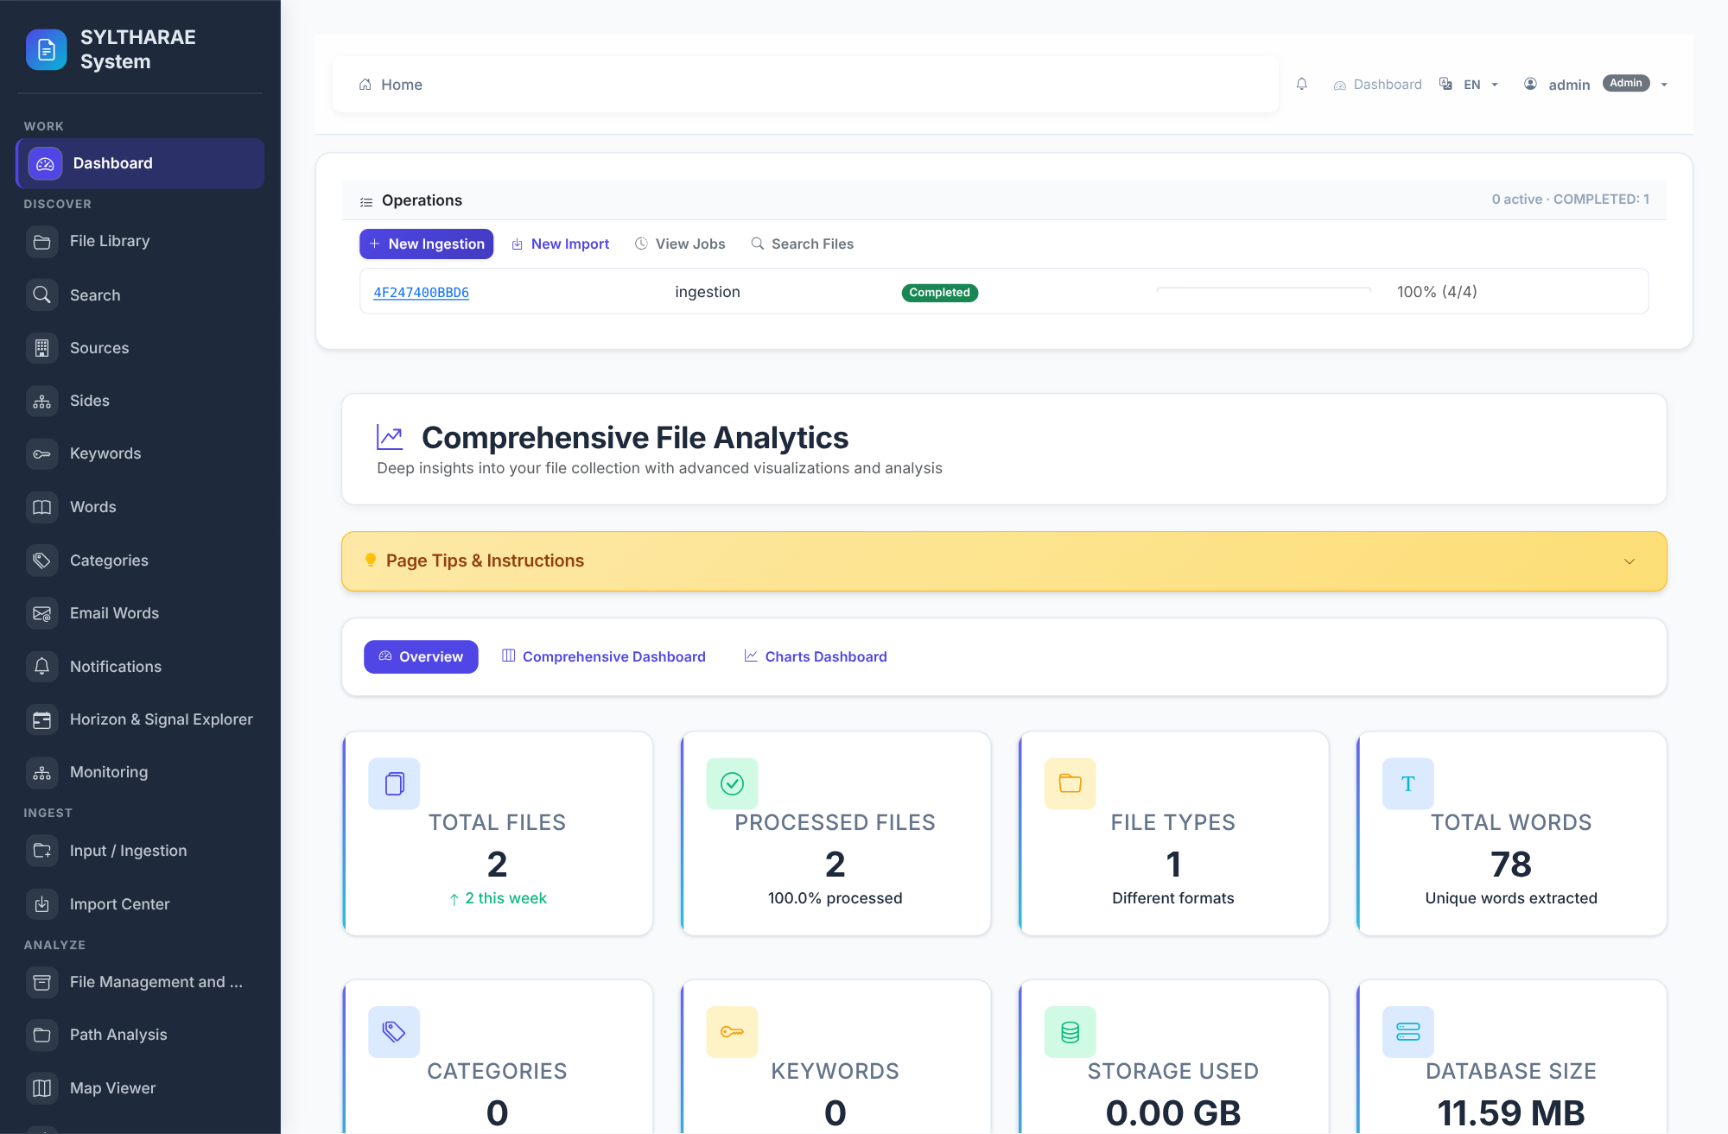
PRODUCT TOUR
A live look at the SYLTHARAE application
LIVE PRODUCT CAPTURE
REAL UI • SAMPLE INSTANCE
1
Operations widget surfaces new ingestion, imports, jobs and search entry points; here it reports the completed demo intake.
2
The dashboard provides overview/comprehensive/charts navigation; actual demo data comes from a synthetic two-file batch.
3
The shared shell includes breadcrumbs, account context, notifications and a registry-backed navigation menu.
4
Capture from the running application at 1600 × 1050 CSS viewport. Database and app were local sandbox services; user is a temporary demo admin.
Authentic capture from running Flask app; source: templates/base.html; templates/Analysis/dashboard.html; docs/INTERFACE_REGISTRY.md
32

Slide 33
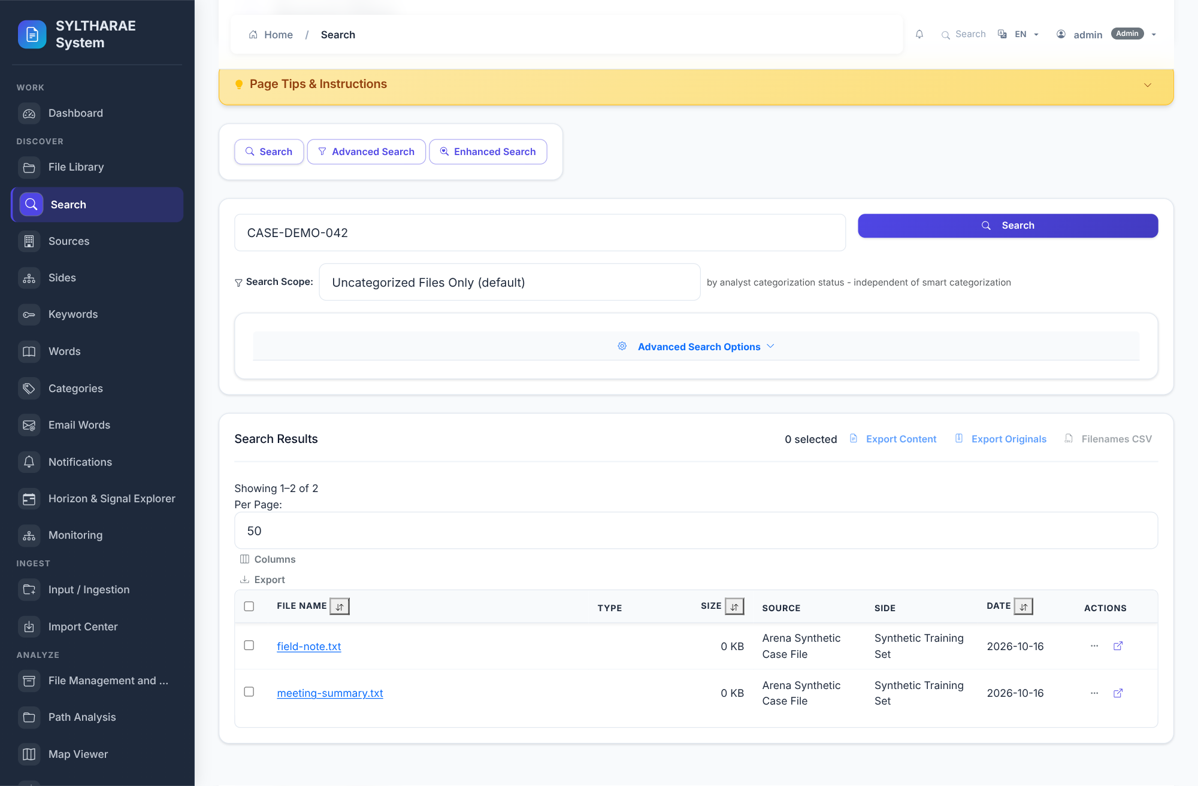
PRODUCT TOUR
Search Files
LIVE PRODUCT CAPTURE
AUTHENTIC • NOT A MOCKUP
1
The screenshot shows two real demo records for query CASE-DEMO-042.
2
Visible controls include standard, advanced and enhanced search views, query, scope, export actions and result table.
3
Each row exposes filename, type, source, side, date and record actions; result count is 2 in this test collection.
4
Observed live result. The sample data is synthetic; implementation: Api/routes/search.py; core/search; Api/services/search_service.py.
Authentic live search capture; synthetic demo corpus; templates/Search/search.html
33

Slide 34
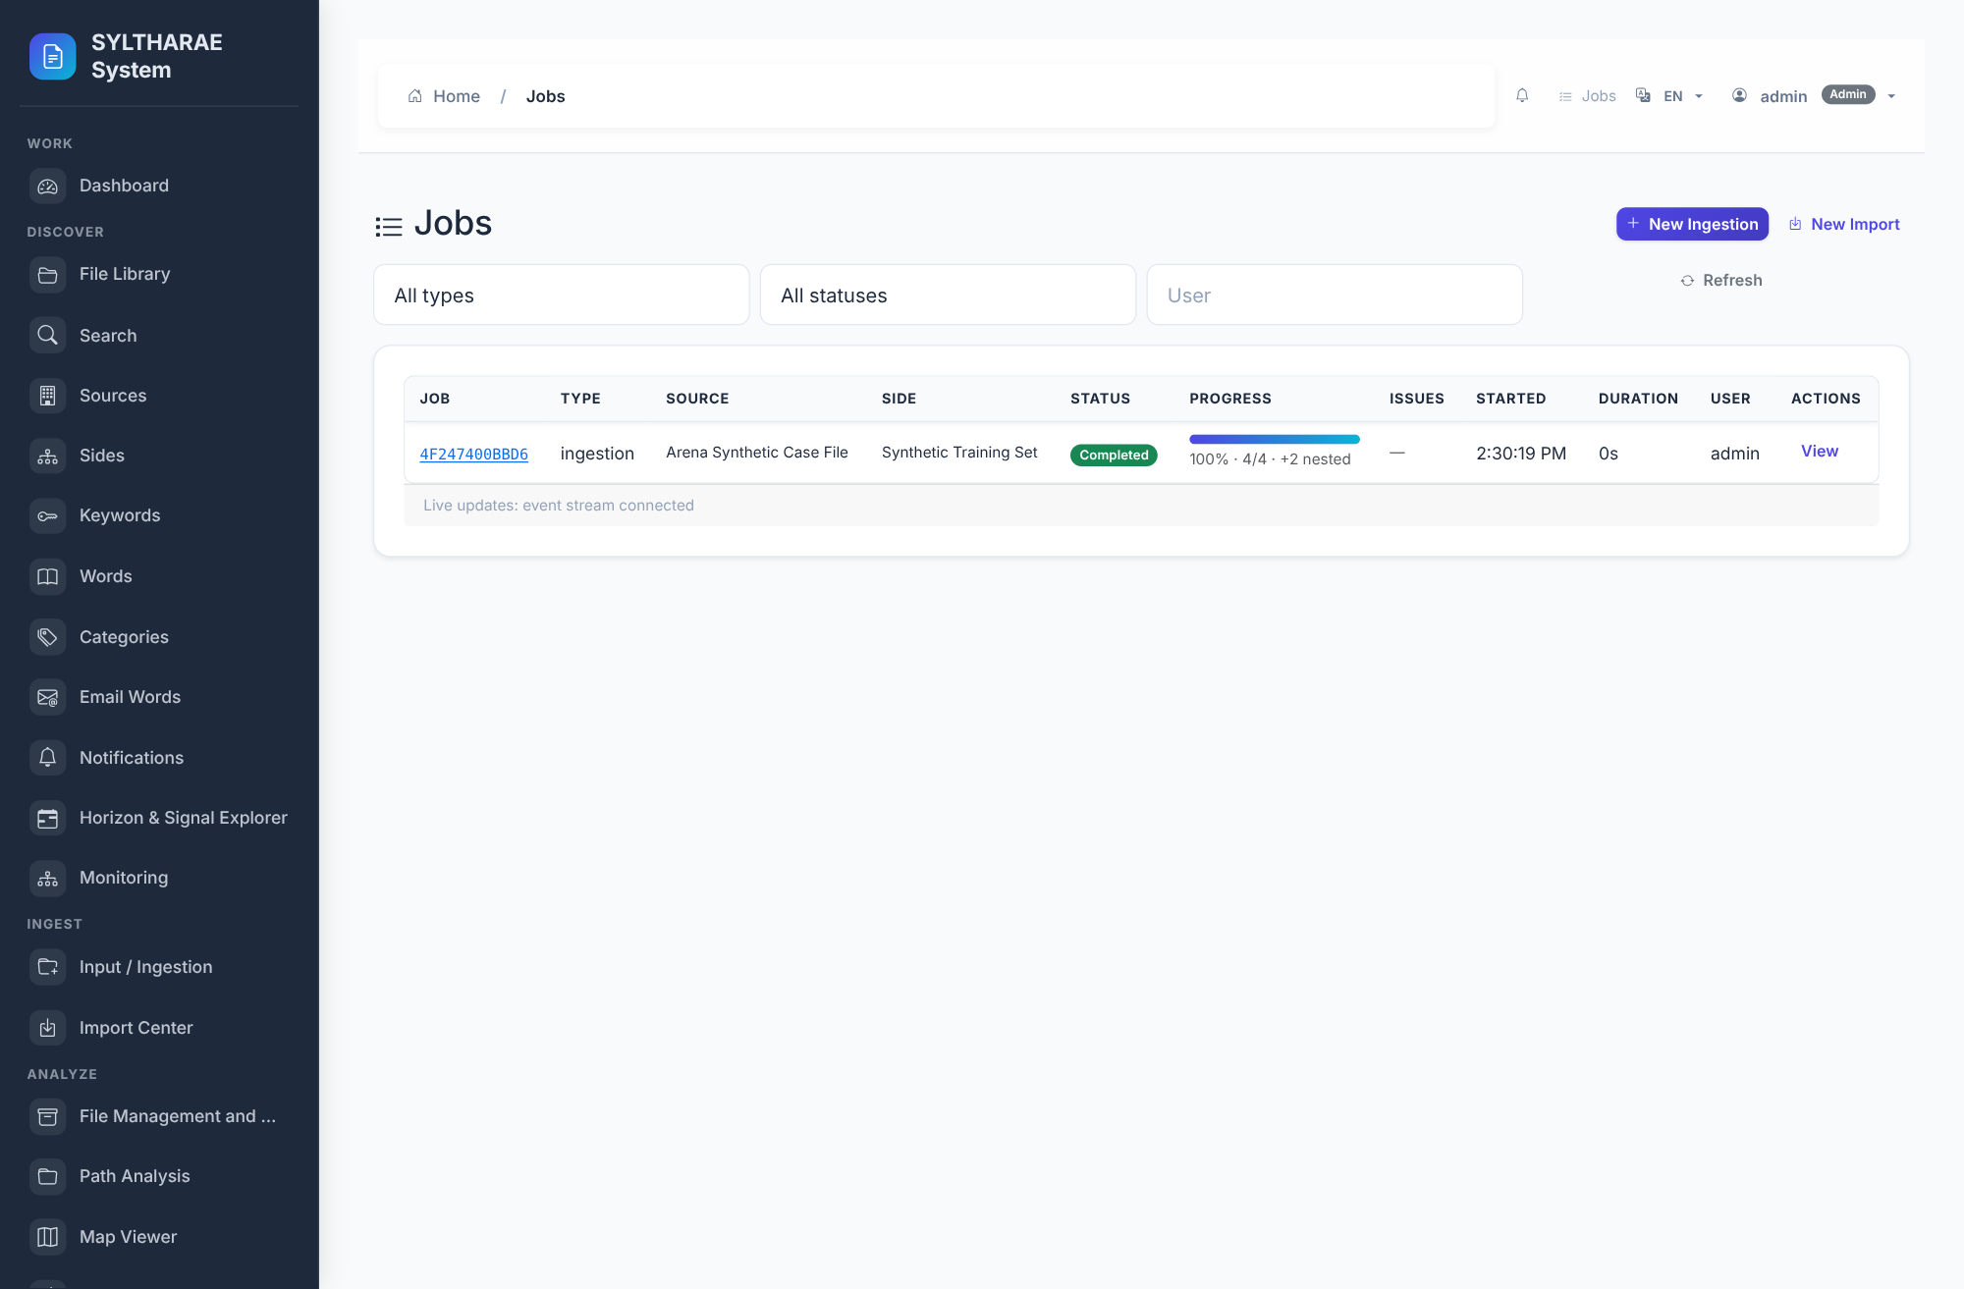
PRODUCT TOUR
Operations • Jobs
LIVE PRODUCT CAPTURE
AUTHENTIC • NOT A MOCKUP
1
This is the actual Jobs interface from the running demo instance.
2
The completed job is available in detail, with a separate list view in the gallery.
3
The job table and lifecycle actions are provided by the application—not a mock screen.
4
See the dedicated ingestion and completion sequence for test-data context.
Authentic local application screen capture; templates/Operations/jobs.html; synthetic demo data
34

Slide 35
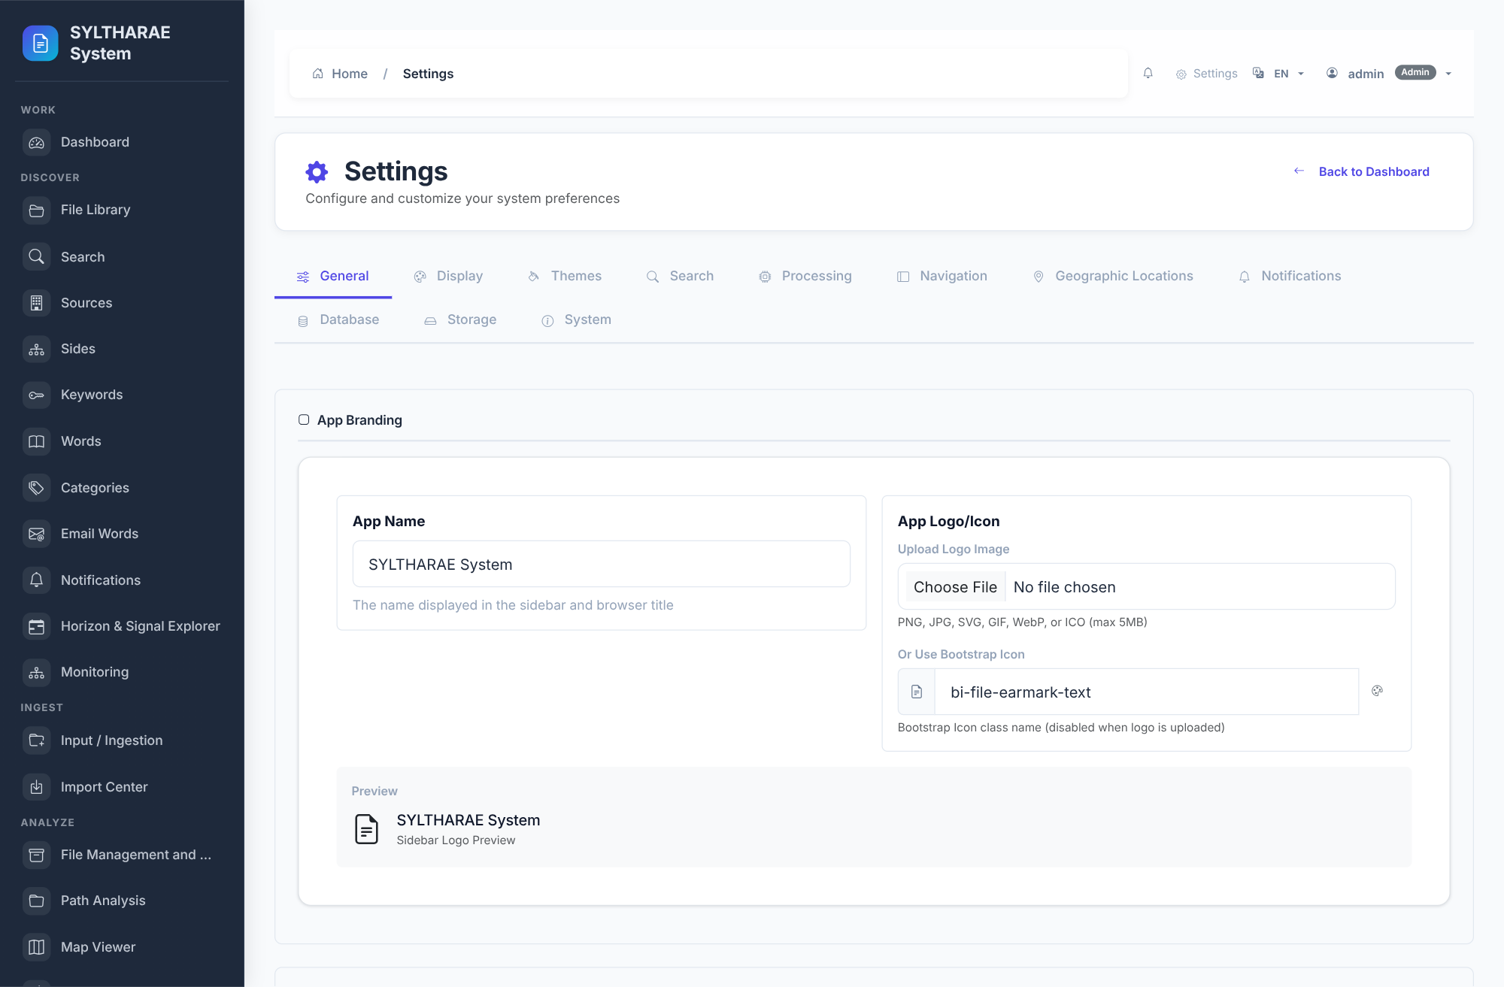
PRODUCT TOUR
Settings
LIVE PRODUCT CAPTURE
AUTHENTIC • NOT A MOCKUP
1
The screenshot shows the actual Settings page and its tabs: General, Display, Themes, Search, Processing, Navigation, Geographic Locations, Notifications, Database, Storage, System.
2
The General tab displays branding settings; tab-specific values vary by active panel.
3
Environment variables outrank .env and persisted settings; processing controls mostly reside in settings store.
4
The screen is an authentic capture from the local instance; see docs/CONFIGURATION.md for precedence and supported names.
Authentic live capture from Settings • templates/Settings/settings.html
35

Slide 36
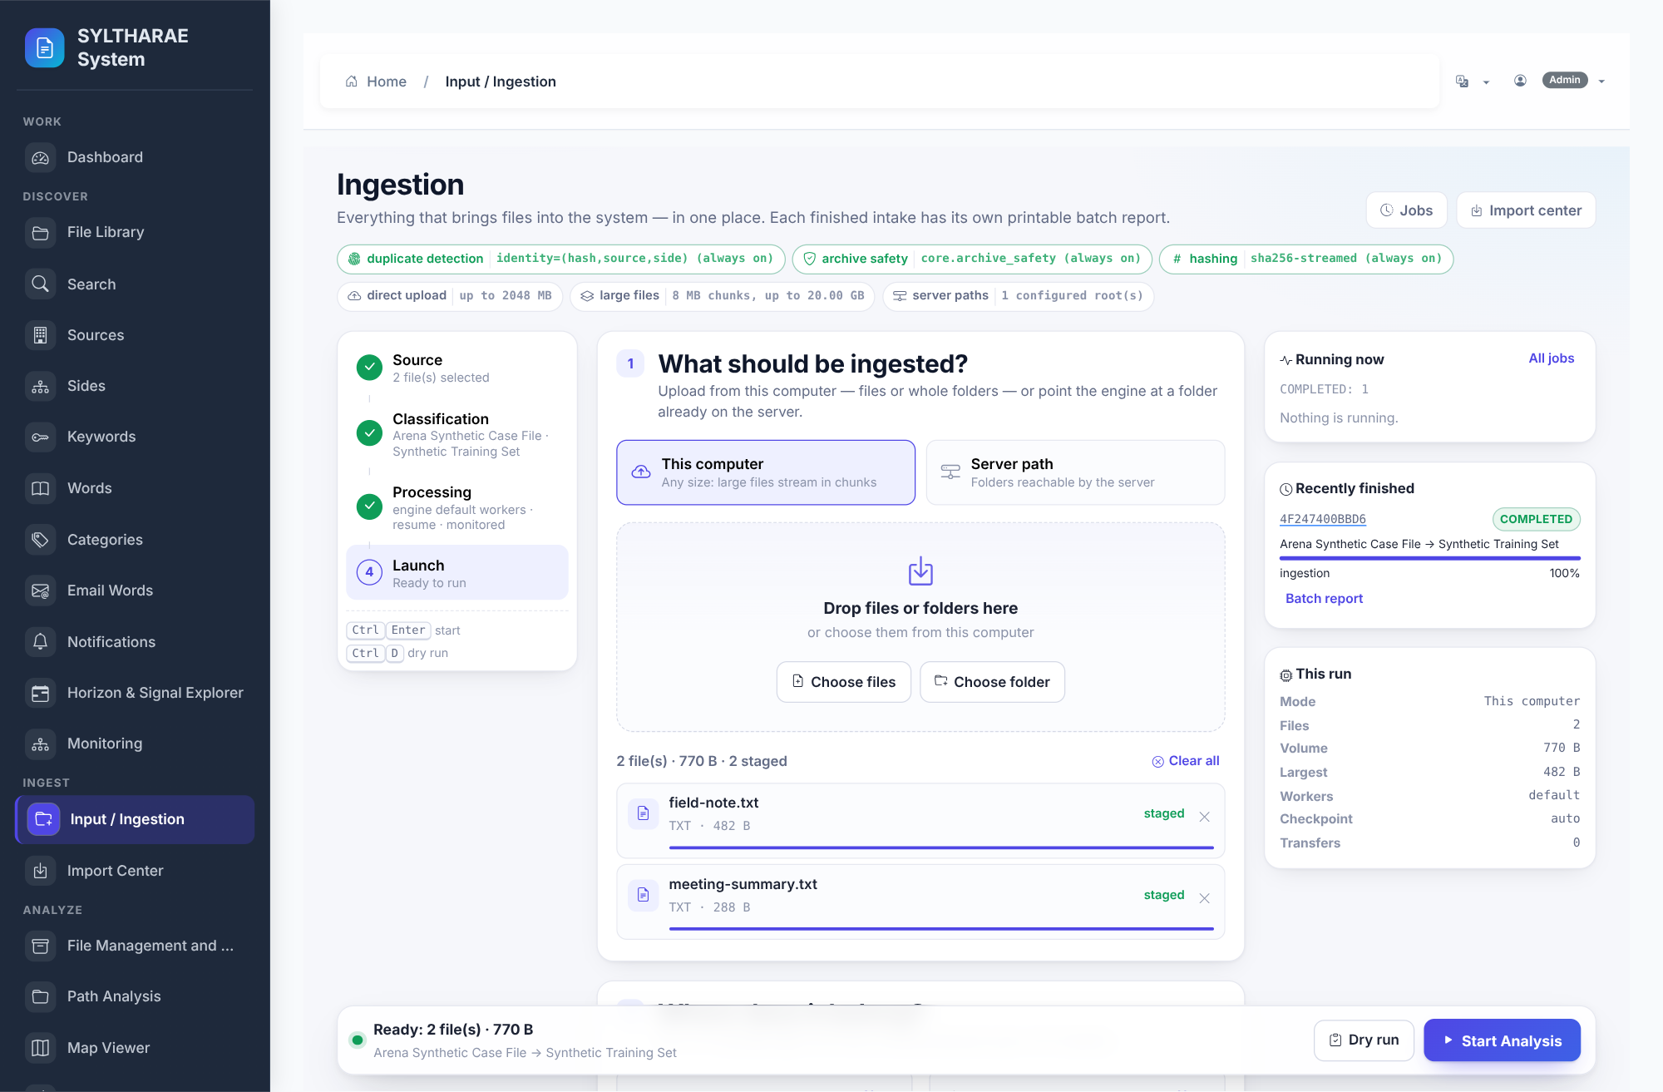
PRODUCT TOUR
Ingestion studio: preflight before write
LIVE PRODUCT CAPTURE
REAL UI • SAMPLE INSTANCE
1
The four-step intake flow binds files, source/side, processing options and launch review.
2
Synthetic demo batch: 2 uploaded text files; selected source “Arena Synthetic Case File” and side “Synthetic Training Set”.
3
Actual preflight returned 2 discovered, 2 to read, 0 unreadable, 770 B. Dry-run does not write ingested content.
4
Backend: Api/routes/operations_api.py, services/ingesting, pipeline reader, progress ledger. A later confirmed run completed successfully.
Authentic preflight capture from local running app; synthetic data only; 2026-10-16
36

Slide 37
PRODUCT TOUR
Search result: content enters discovery
LIVE PRODUCT CAPTURE
REAL UI • SAMPLE INSTANCE
1
Query CASE-DEMO-042 returned two actual demo records in the result table.
2
Table exposes file name, type, size, source, side, date and record actions; export controls are visible above.
3
The ingested examples are synthetic training files, not customer or operational records.
4
Capture shows app response after actual ingestion; search route and repository implementation: Api/routes/search.py; core/search; Api/services/search_service.py.
Authentic live result screenshot, synthetic sample corpus, 2026-10-16
37

Slide 38
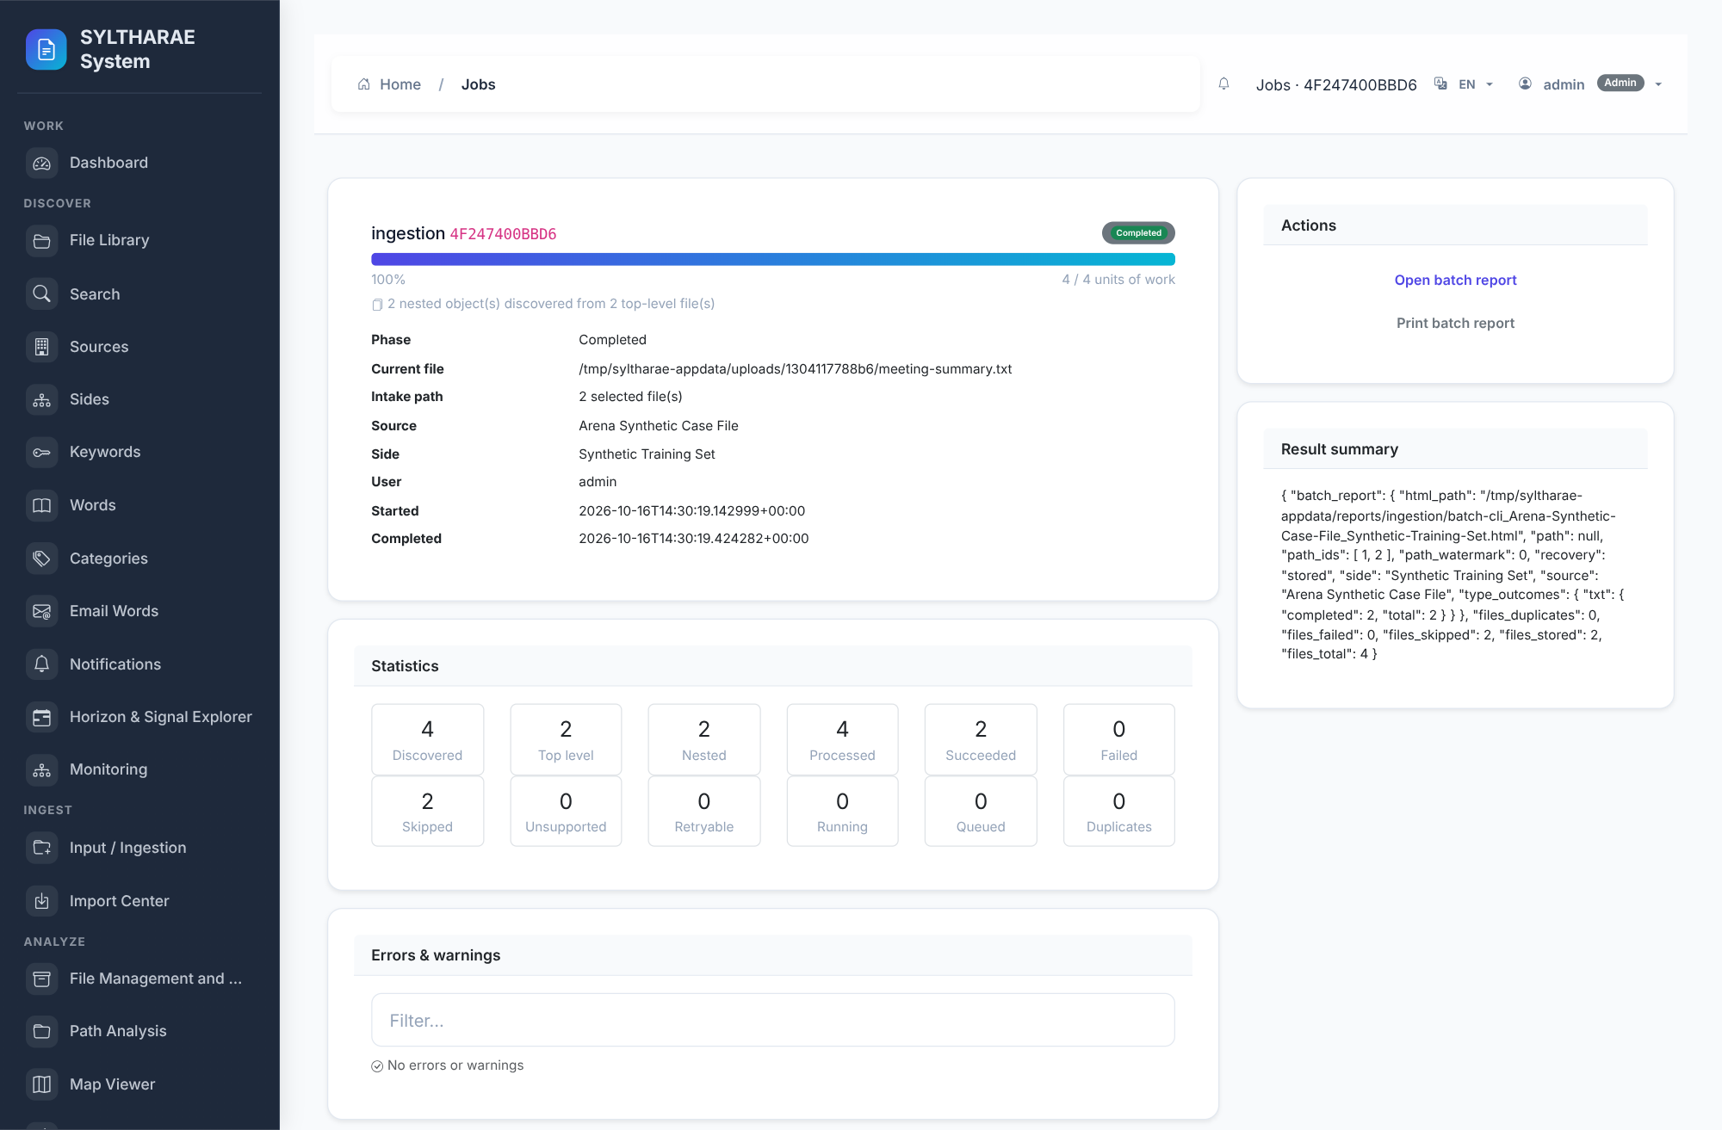
PRODUCT TOUR
Completed ingestion job: persisted outcome
LIVE PRODUCT CAPTURE
REAL UI • SAMPLE INSTANCE
1
Actual job reached COMPLETED at 100%; work ledger reports 4 of 4 units complete.
2
Job detail shows source, side, intake path, user, start/completion timestamps and current file.
3
Observed processing used two synthetic text files and one local PostgreSQL development cluster.
4
Job ID in the screenshot is local demo data. State/event implementation: services/jobs/job_state.py; services/jobs/manager.py; services/jobs/repository.py.
Authentic live capture from completed local ingestion job; synthetic dataset
38

Slide 39
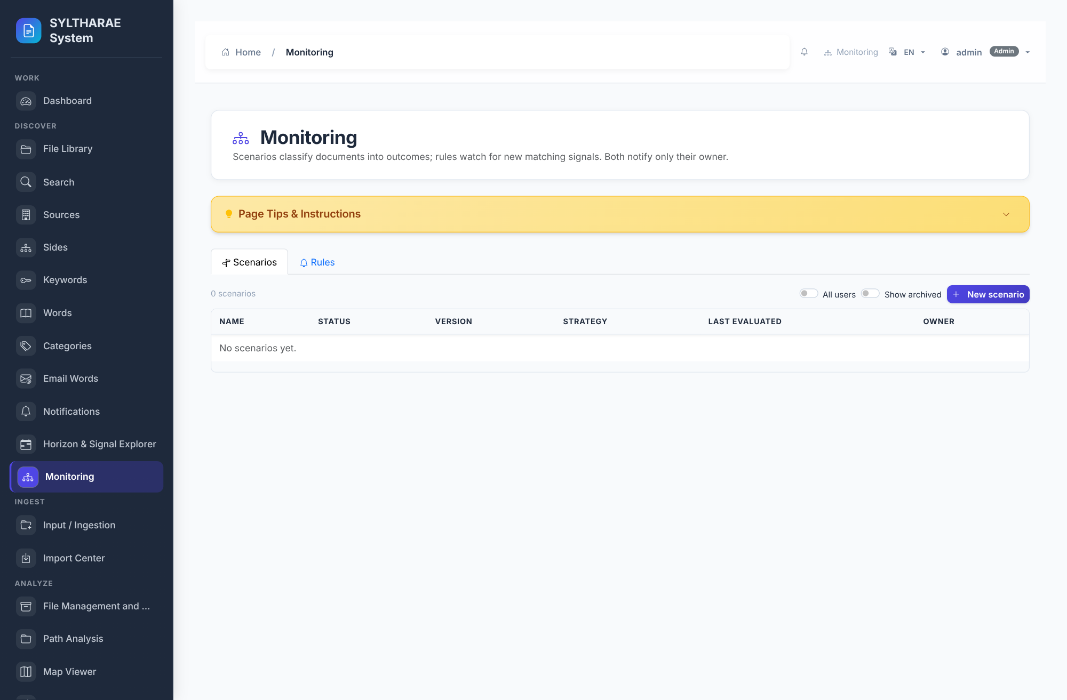
PRODUCT TOUR
Operations, monitoring & analytics interfaces
LIVE PRODUCT CAPTURE
REAL UI • SAMPLE INSTANCE
1
This capture is the running Monitoring interface; dashboards for reports, signals, maps and analytics are separately implemented screens.
2
Empty/low-data state is a real UI state; the demo intake has no configured monitoring rules or geographic detections.
3
Feature interfaces: Signals, Detection, Map Viewer, Reports, Notifications and Schedules; screenshots are included in the companion gallery.
4
Interface source references: templates/Monitoring/monitoring.html; templates/Signals/*; templates/map/map_viewer.html; templates/Reports/*.
Authentic live Monitoring page capture; empty-state context is real for demo database
39

Slide 40
PRODUCT TOUR
Front-end implementation map
Shell & navigation
Search & collection
templates/base.html; templates/components/sidebar_nav.html; core/interfaces/*; static/css/styles.css; static/js/modules/core/navigation-swap.js
templates/Search/*; templates/file/*; templates/components/search_input.html, file_library_table.html, filter_bar.html, unified_pagination.html
Operational screens
Configuration & reports
templates/Operations/*; templates/Monitoring/*; templates/Signals/*; templates/Notifications/*; static/js/pages/jobs-page.js
templates/Settings/*; templates/Reports/*; templates/map/map_viewer.html; templates/auth/*; static/css/Settings.css; static/css/reports.css
Repository paths inspected; see deliverables/interface_inventory.md
40

Slide 41
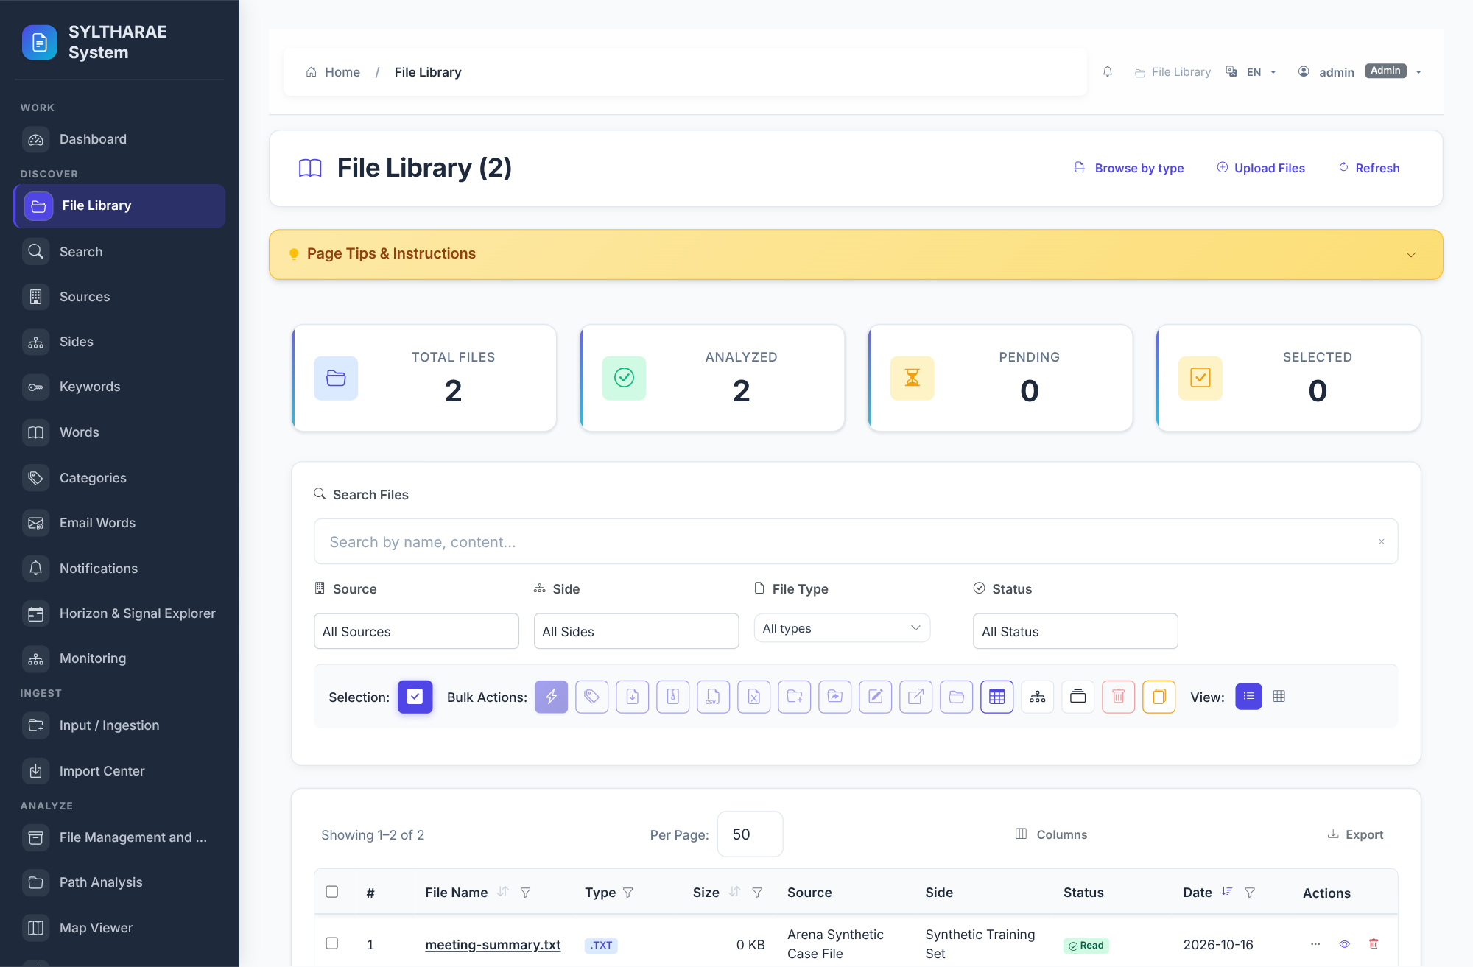
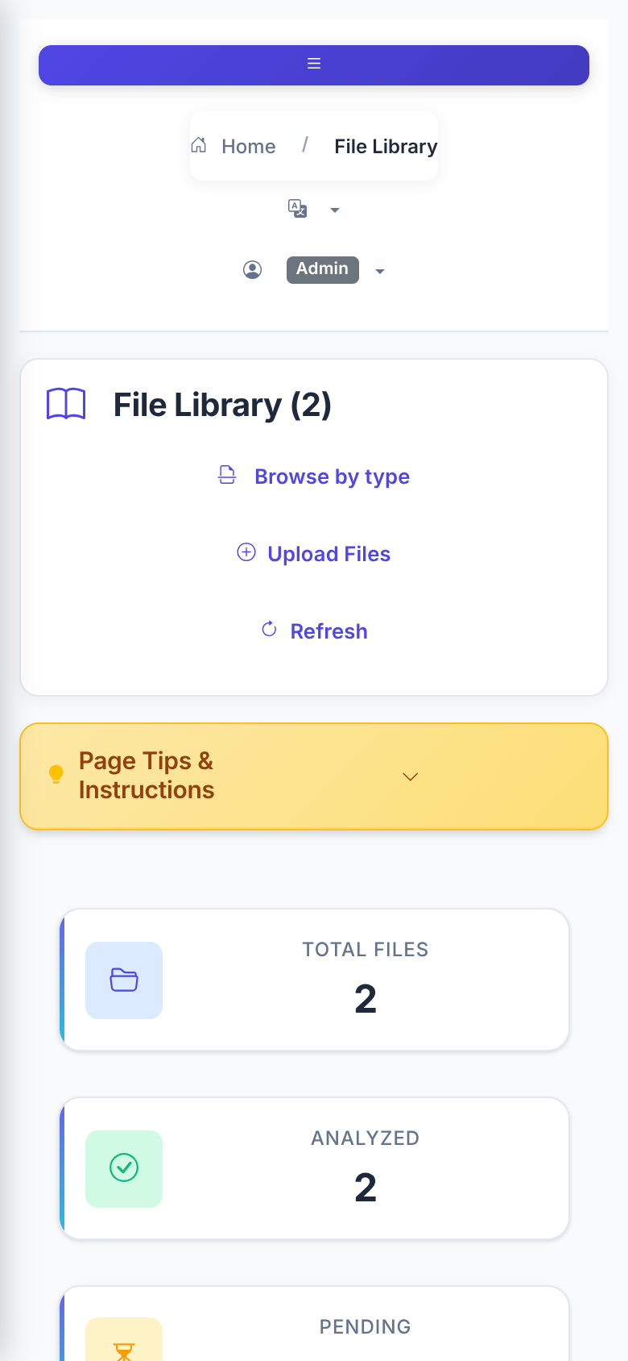
PRODUCT TOUR
Responsive interface: real desktop and mobile captures
OBSERVED
The same File Library route served at two actual viewport sizes. The narrow layout exposes the menu control and responsive page shell.\n\nScreenshots are real rendered app pages; content reflects the demonstration database. This is a visual spot-check, not exhaustive breakpoint/accessibility testing.
Source: templates/base.html • templates/file/files_list.html • static/css/responsive-fixes.css • static/js/responsive-fixes.js
Authentic screenshots from /files at desktop 1600×1050 and mobile 390×844 CSS viewport; captured 2026-10-16
41

Slide 42
APPENDIX
Appendix A — Feature inventory (1/2)
Collection & extraction
Search & navigation
Upload/server-path ingestion; readers and OCR; archive traversal; metadata/text extraction; progress/resume; duplicates. Files: services/ingesting, pipeline/, reader_file/, core/ocr.
Tokenization, word/inverted index, filtering, snippets, cursor pagination, saved searches/history, file navigation/preview. Files: core/search, Api/services/search*, Api/routes/search.py.
Content identity & lineage
Analyst enrichment
Hash/context/path model; deduplication; provenance, path revisions, lineage and original-file access. Files: database/services/dedup_service.py; database/migrations; Api/services/lineage_service.py.
Categories, identifiers, temporal/place signals, gazetteer/geo, maps, translations. Files: services/detection, services/geo, core/detection, services/map* and Api/routes.
Feature matrix companion: deliverables/feature_matrix.csv
42

Slide 43
APPENDIX
Appendix A — Feature inventory (2/2)
Jobs & operations
Monitoring & reporting
Persistent jobs/events, pause/cancel, schedules, retention, health/performance/error monitoring, notifications. Files: services/jobs, services/retention, core/monitoring, Api/routes.
Rules/scenarios, evaluations/outcomes, report registry/runs/datasets/analyses/artifacts, exports. Files: services/monitoring, services/reporting, core/reporting.
Access & experience
Import/export & tooling
Authentication, authorization, audit, CSRF, rate limits, UI registries/contracts, localization, preferences. Files: core/security, core/experience, core/interfaces, translations/.
Import/export services, CLI/import utilities, setup/installer/readiness, deployment templates, offline bundle. Files: apps/, install.py, verify_readiness.py, deploy/, offline-bundle/.
Companion feature matrix maps capability groups to evidence and slide coverage
43

Slide 44
APPENDIX
Appendix B — Configuration quick reference
Required to connect
Production web
DB_HOST, DB_PORT, DB_NAME, DB_USER, DB_PASSWORD (or equivalent service-injected values). Confirm account/db provisioning and PostgreSQL access.
FLASK_ENV=production; FLASK_DEBUG=false; stable FLASK_SECRET_KEY; WSGI_SERVER=waitress (install server extra); proxy count and bind host intentionally set.
Ingestion / OCR
Runtime data
INGESTION_ROOTS for server paths; TESSERACT_CMD/TESSDATA_PREFIX as needed; install OCR extras and language packs; run OCR self-check.
APP_DATA_DIR for logs/uploads/cache/checkpoints/settings; plan filesystem capacity, permissions and backup alongside PostgreSQL.
Evidence: docs/CONFIGURATION.md; .env.example
44

Slide 45
APPENDIX
Appendix C — Dependencies & external prerequisites
Core Python
Optional Python sets
Flask, Flask-Babel, Flask-Limiter, Flask-WTF, Flask-Compress, psycopg2-binary, dotenv, psutil, PyYAML and reader-related packages.
pdf: PyMuPDF/pypdf; office: python-docx/openpyxl/python-pptx/xlrd/odfpy; OCR: pytesseract/Pillow/RapidOCR/OpenCV headless; ebook/audio/media/PST/server extras.
Infrastructure
Supply chain
PostgreSQL; filesystem storage; optional nginx/systemd; optional Waitress. Tesseract binary and traineddata; PST requires native C dependencies on many hosts.
Version constraints are ranges rather than a single lockfile in pyproject; inspect requirements.txt/THIRD_PARTY_NOTICES.md and establish organization-specific pinning/scanning.
Evidence: pyproject.toml; requirements.txt; THIRD_PARTY_NOTICES.md; deploy/
45

Slide 46
APPENDIX
Appendix D — Quality evidence & research limits
Repository snapshot
History/release limits
Checked out commit aa2b865a24c429e242a457a60d2aef84661389b2; project version 2.2.0; version.py build date 2026-09-26.
Local history available only as a single shallow/base commit; no tags listed in checkout. Release history not independently reviewed.
Executed in sandbox
Not executed
Installed Python extras; started bundled PostgreSQL; applied all 39 migrations; completed setup; captured live UI; ingested two synthetic files, ran preflight, confirmed job completion, and searched results.
The repository test suites, OCR self-check, full-format matrix, load test, backup/restore and independent security review were not performed. No production readiness is implied.
External audit limits
No customer validation, compliance evidence, independent security review, benchmark, or production support SLA established.
Repository metadata and inspection performed 2026-10-16
46

Slide 47
APPENDIX
Appendix E — Glossary & sources
Hash / context / path
Signal / rule / scenario
Content digest / digest in source+side / concrete location occurrence.
Detector-produced observation / condition evaluated over signals / modeled multi-condition situation.
Job / event
Primary source set
Durable work lifecycle state / progress or activity record emitted during that lifecycle.
README.md; docs/ARCHITECTURE.md, CONFIGURATION.md, DATABASE.md, OPERATIONS.md, SECURITY.md, TESTING.md; pyproject.toml; .env.example; run_web.py; database/migrations; services/jobs; pipeline/.
Stable source URLs: https://github.com/RussellTCrivello/SYLTHARAE-Pro/tree/aa2b865a24c429e242a457a60d2aef84661389b2
47

Slide 48
APPENDIX
Appendix F — Interface index (1–6 of 34)
Dashboard / WORK
File Library / DISCOVER
ID: dashboard • endpoint: index
ID: file_library • endpoint: files.files_list
Source: templates/Analysis/dashboard.html\nRole: work workflow; see interface registry for role, visibility, dependencies and shortcut.
Source: templates/file/files_list.html\nRole: discover workflow; see interface registry for role, visibility, dependencies and shortcut.
Search / DISCOVER
Sources / DISCOVER
ID: search • endpoint: search_page
ID: sources • endpoint: sources_list
Source: templates/Search/search.html\nRole: discover workflow; see interface registry for role, visibility, dependencies and shortcut.
Source: templates/Sources/sources_list.html\nRole: discover workflow; see interface registry for role, visibility, dependencies and shortcut.
Sides / DISCOVER
Keywords / DISCOVER
ID: sides • endpoint: sides_list
ID: keywords • endpoint: keywords_list
Source: templates/Side/sides_list.html\nRole: discover workflow; see interface registry for role, visibility, dependencies and shortcut.
Source: templates/Keyword/keywords_list.html\nRole: discover workflow; see interface registry for role, visibility, dependencies and shortcut.
Registry: docs/INTERFACE_REGISTRY.md; purpose is summarized by domain and template source
48

Slide 49
APPENDIX
Appendix F — Interface index (7–12 of 34)
Words / DISCOVER
Categories / DISCOVER
ID: words • endpoint: words_list
ID: categories • endpoint: categories_list
Source: templates/Word/Word_list.html\nRole: discover workflow; see interface registry for role, visibility, dependencies and shortcut.
Source: templates/Category/categories_list.html\nRole: discover workflow; see interface registry for role, visibility, dependencies and shortcut.
Email Words / DISCOVER
Notifications / DISCOVER
ID: email_words • endpoint: email_words
ID: notifications • endpoint: notifications_page
Source: templates/email_words/email_words.html\nRole: discover workflow; see interface registry for role, visibility, dependencies and shortcut.
Source: templates/Notifications/notifications.html\nRole: discover workflow; see interface registry for role, visibility, dependencies and shortcut.
Horizon & Signal Explorer / DISCOVER
Monitoring / DISCOVER
ID: signal_horizon • endpoint: signals_page
ID: monitoring • endpoint: monitoring_page
Source: templates/Signals/signals.html\nRole: discover workflow; see interface registry for role, visibility, dependencies and shortcut.
Source: templates/Monitoring/monitoring.html\nRole: discover workflow; see interface registry for role, visibility, dependencies and shortcut.
Registry: docs/INTERFACE_REGISTRY.md; purpose is summarized by domain and template source
49

Slide 50
APPENDIX
Appendix F — Interface index (13–18 of 34)
Input / Ingestion / INGEST
Import Center / INGEST
ID: input_ingestion • endpoint: operations_input_page
ID: import_center • endpoint: operations_import_page
Source: templates/Operations/input.html\nRole: ingest workflow; see interface registry for role, visibility, dependencies and shortcut.
Source: templates/Operations/import_center.html\nRole: ingest workflow; see interface registry for role, visibility, dependencies and shortcut.
File Management and Analysis / ANALYZE
Path Analysis / ANALYZE
ID: archives • endpoint: archives_page
ID: path_analysis • endpoint: path_analysis_page
Source: templates/file/File_Management_Analysis_System.html\nRole: analyze workflow; see interface registry for role, visibility, dependencies and shortcut.
Source: templates/Analysis/path_analysis.html\nRole: analyze workflow; see interface registry for role, visibility, dependencies and shortcut.
Map Viewer / ANALYZE
Batch Analysis / ANALYZE
ID: map_viewer • endpoint: map_viewer_page
ID: batch_analysis • endpoint: analysis_batch
Source: templates/map/map_viewer.html\nRole: analyze workflow; see interface registry for role, visibility, dependencies and shortcut.
Source: templates/Analysis/analysis_batch.html\nRole: analyze workflow; see interface registry for role, visibility, dependencies and shortcut.
Registry: docs/INTERFACE_REGISTRY.md; purpose is summarized by domain and template source
50

Slide 51
APPENDIX
Appendix F — Interface index (19–24 of 34)
Analyst Categories / CLASSIFY
Classification / CLASSIFY
ID: analyst_categorization • endpoint: analyst_categorization_page
ID: classification • endpoint: file_classification_page
Source: templates/Analyst/analyst_categorization.html\nRole: classify workflow; see interface registry for role, visibility, dependencies and shortcut.
Source: templates/Analysis/file_classification.html\nRole: classify workflow; see interface registry for role, visibility, dependencies and shortcut.
Comprehensive Dashboard / REPORT
Reports / REPORT
ID: comprehensive_dashboard • endpoint: comprehensive_dashboard
ID: reports • endpoint: reports_page
Source: templates/Analysis/comprehensive_dashboard.html\nRole: report workflow; see interface registry for role, visibility, dependencies and shortcut.
Source: templates/Reports/reports.html\nRole: report workflow; see interface registry for role, visibility, dependencies and shortcut.
Reports Dashboard / REPORT
Schedules / REPORT
ID: reports_dashboard • endpoint: reports_dashboard_page
ID: schedules • endpoint: schedules_page
Source: templates/Reports/dashboard.html\nRole: report workflow; see interface registry for role, visibility, dependencies and shortcut.
Source: templates/Scheduling/schedules.html\nRole: report workflow; see interface registry for role, visibility, dependencies and shortcut.
Registry: docs/INTERFACE_REGISTRY.md; purpose is summarized by domain and template source
51

Slide 52
APPENDIX
Appendix F — Interface index (25–30 of 34)
Charts Dashboard / REPORT
Detection / OPERATE
ID: charts_dashboard • endpoint: charts_dashboard
ID: detection • endpoint: detection_page
Source: templates/Analysis/charts_dashboard.html\nRole: report workflow; see interface registry for role, visibility, dependencies and shortcut.
Source: templates/Signals/detection.html\nRole: operate workflow; see interface registry for role, visibility, dependencies and shortcut.
Jobs / OPERATE
Import/Export / OPERATE
ID: jobs • endpoint: operations_jobs_page
ID: import_export_console • endpoint: import_export_page
Source: templates/Operations/jobs.html\nRole: operate workflow; see interface registry for role, visibility, dependencies and shortcut.
Source: templates/ImportExport/import_export.html\nRole: operate workflow; see interface registry for role, visibility, dependencies and shortcut.
Retention / ADMINISTRATION
User Management / ADMINISTRATION
ID: retention • endpoint: retention_page
ID: users • endpoint: users_page
Source: templates/Retention/retention.html\nRole: administration workflow; see interface registry for role, visibility, dependencies and shortcut.
Source: templates/auth/users.html\nRole: administration workflow; see interface registry for role, visibility, dependencies and shortcut.
Registry: docs/INTERFACE_REGISTRY.md; purpose is summarized by domain and template source
52

Slide 53
APPENDIX
Appendix F — Interface index (31–34 of 34)
Audit Log / ADMINISTRATION
Settings / SETTINGS
ID: audit_log • endpoint: audit_page
ID: settings • endpoint: settings_page_direct
Source: templates/auth/audit.html\nRole: administration workflow; see interface registry for role, visibility, dependencies and shortcut.
Source: templates/Settings/settings.html\nRole: settings workflow; see interface registry for role, visibility, dependencies and shortcut.
Translation Management / SETTINGS
Concurrency Monitor / INTERNAL
ID: translation_manager • endpoint: translations.translation_management_page
ID: concurrency_monitor • endpoint: concurrency.dashboard
Source: templates/Settings/translation_manager.html\nRole: settings workflow; see interface registry for role, visibility, dependencies and shortcut.
Source: templates/concurrency/dashboard.html\nRole: internal workflow; see interface registry for role, visibility, dependencies and shortcut.
Registry: docs/INTERFACE_REGISTRY.md; purpose is summarized by domain and template source
53

Slide 54

PRODUCT TOUR
Interface reference — Dashboard
LIVE PRODUCT CAPTURE
REAL UI • SAMPLE INSTANCE
1
Work interface • canonical route: index.
2
Collection overview, analytics navigation and operations summary.
3
Implementation reference: templates/Analysis/dashboard.html. Capture shows the actual running application state; data/empty states are from the synthetic demo instance.
Authentic live screen capture • interface ID dashboard • templates/Analysis/dashboard.html
54

Slide 55
PRODUCT TOUR
Interface reference — File Library
LIVE PRODUCT CAPTURE
REAL UI • SAMPLE INSTANCE
1
Discover interface • canonical route: files.files_list.
2
Browse indexed records, filter, select and open file actions.
3
Implementation reference: templates/file/files_list.html. Capture shows the actual running application state; data/empty states are from the synthetic demo instance.
Authentic live screen capture • interface ID file_library • templates/file/files_list.html
55

Slide 56
PRODUCT TOUR
Interface reference — Search
LIVE PRODUCT CAPTURE
REAL UI • SAMPLE INSTANCE
1
Discover interface • canonical route: search_page.
2
Query content; inspect results; use search modes, pagination and exports.
3
Implementation reference: templates/Search/search.html. Capture shows the actual running application state; data/empty states are from the synthetic demo instance.
Authentic live screen capture • interface ID search • templates/Search/search.html
56

Slide 57
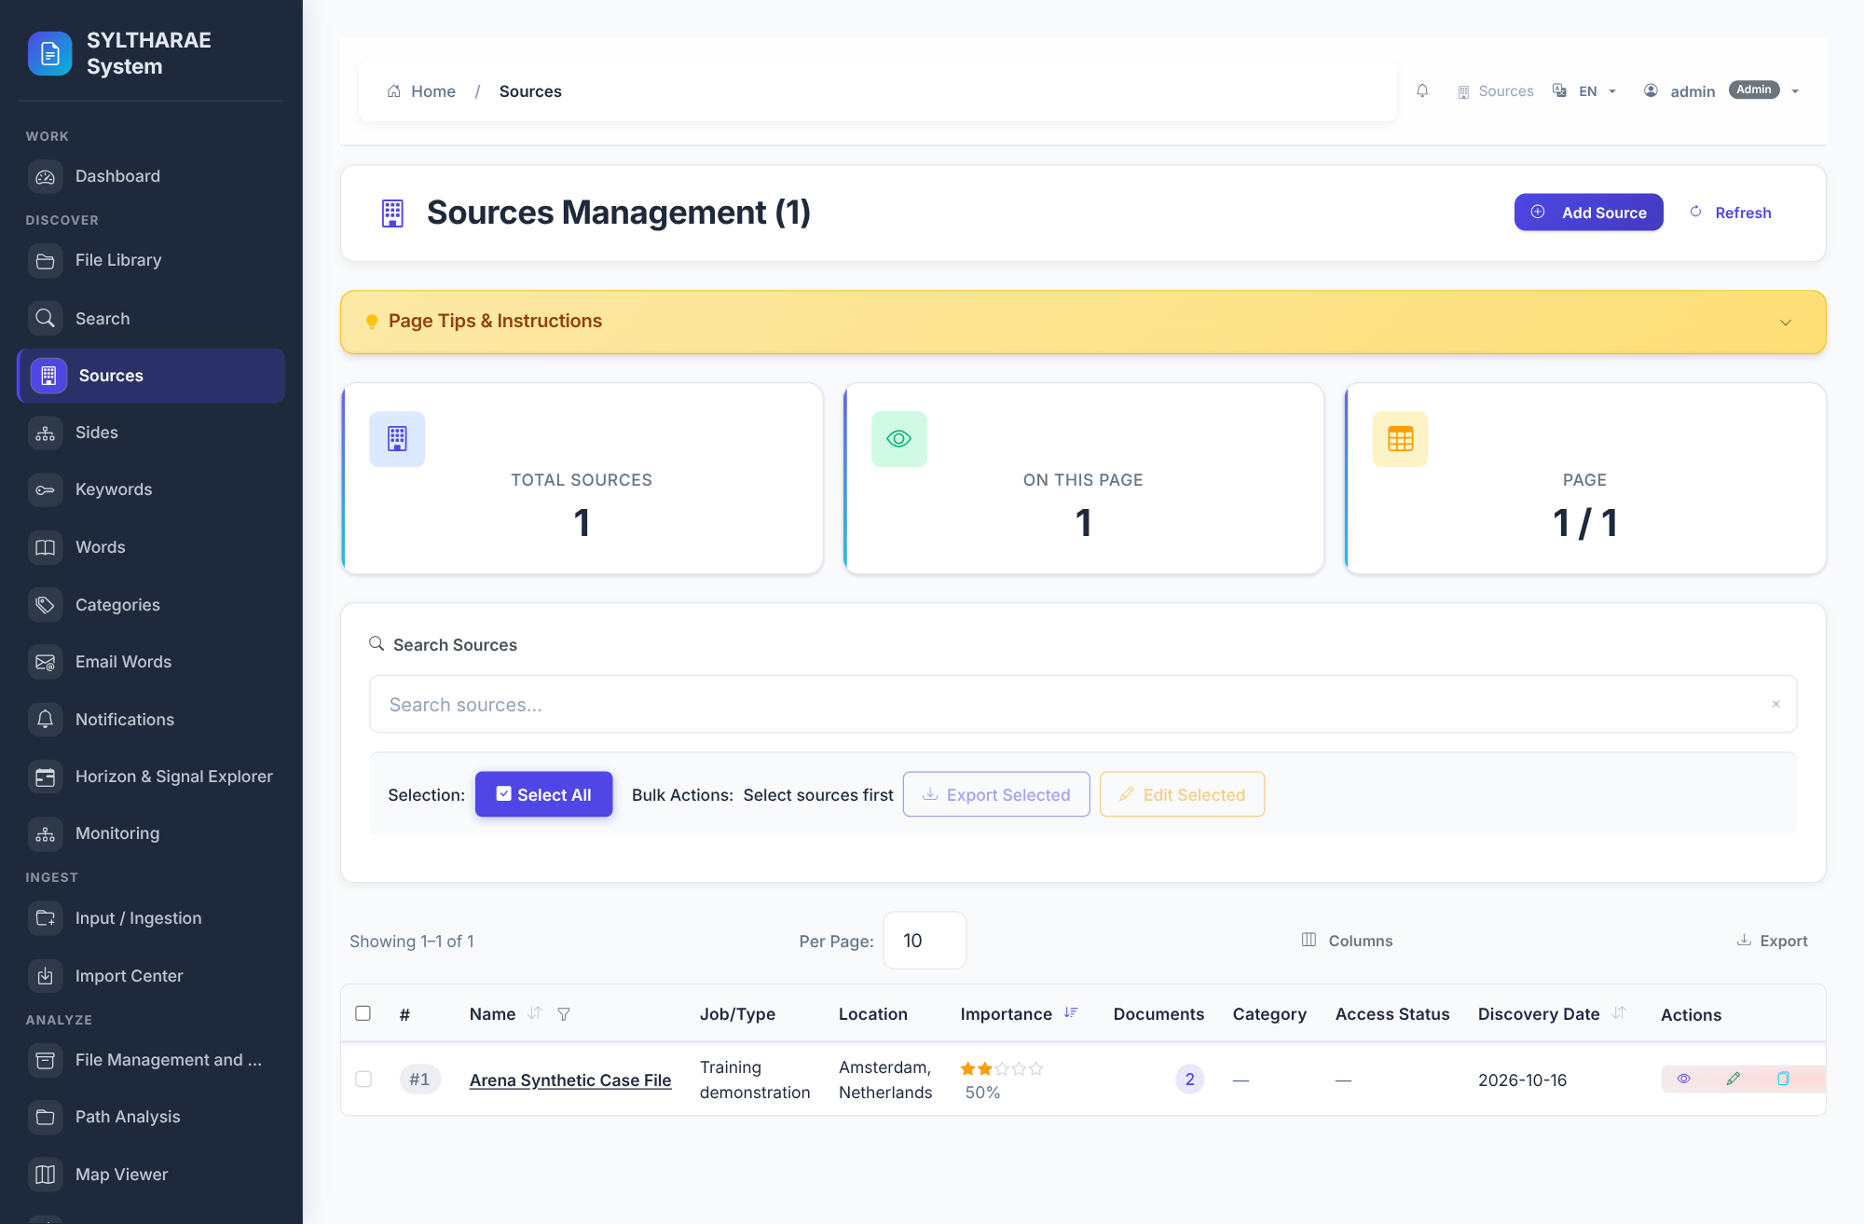
PRODUCT TOUR
Interface reference — Sources
LIVE PRODUCT CAPTURE
REAL UI • SAMPLE INSTANCE
1
Discover interface • canonical route: sources_list.
2
Manage source entities associated with ingested records.
3
Implementation reference: templates/Sources/sources_list.html. Capture shows the actual running application state; data/empty states are from the synthetic demo instance.
Authentic live screen capture • interface ID sources • templates/Sources/sources_list.html
57

Slide 58
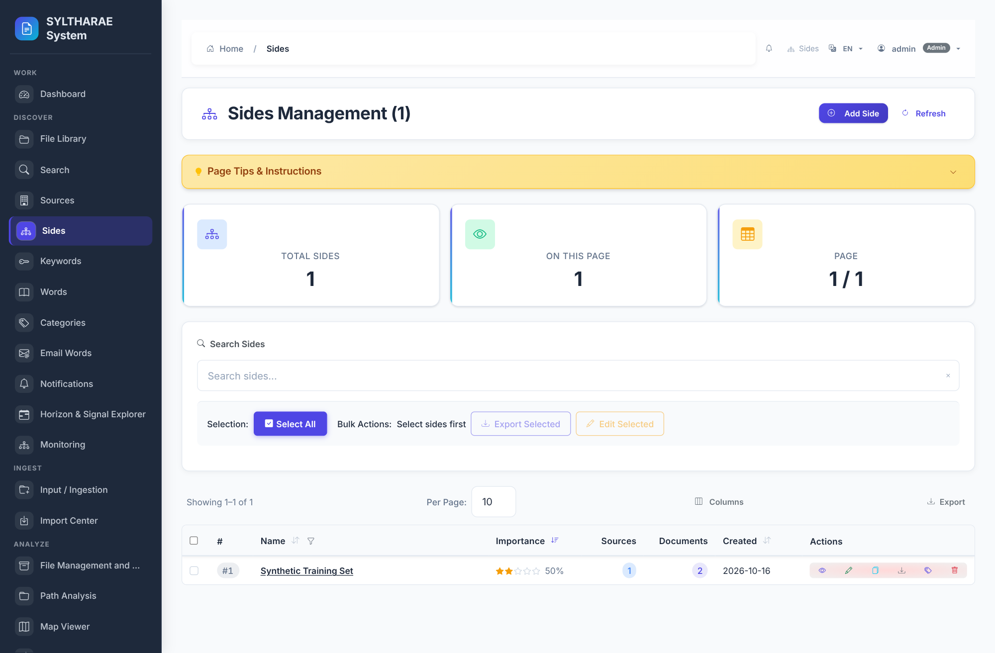
PRODUCT TOUR
Interface reference — Sides
LIVE PRODUCT CAPTURE
REAL UI • SAMPLE INSTANCE
1
Discover interface • canonical route: sides_list.
2
Manage side/collection context paired with sources.
3
Implementation reference: templates/Side/sides_list.html. Capture shows the actual running application state; data/empty states are from the synthetic demo instance.
Authentic live screen capture • interface ID sides • templates/Side/sides_list.html
58

Slide 59
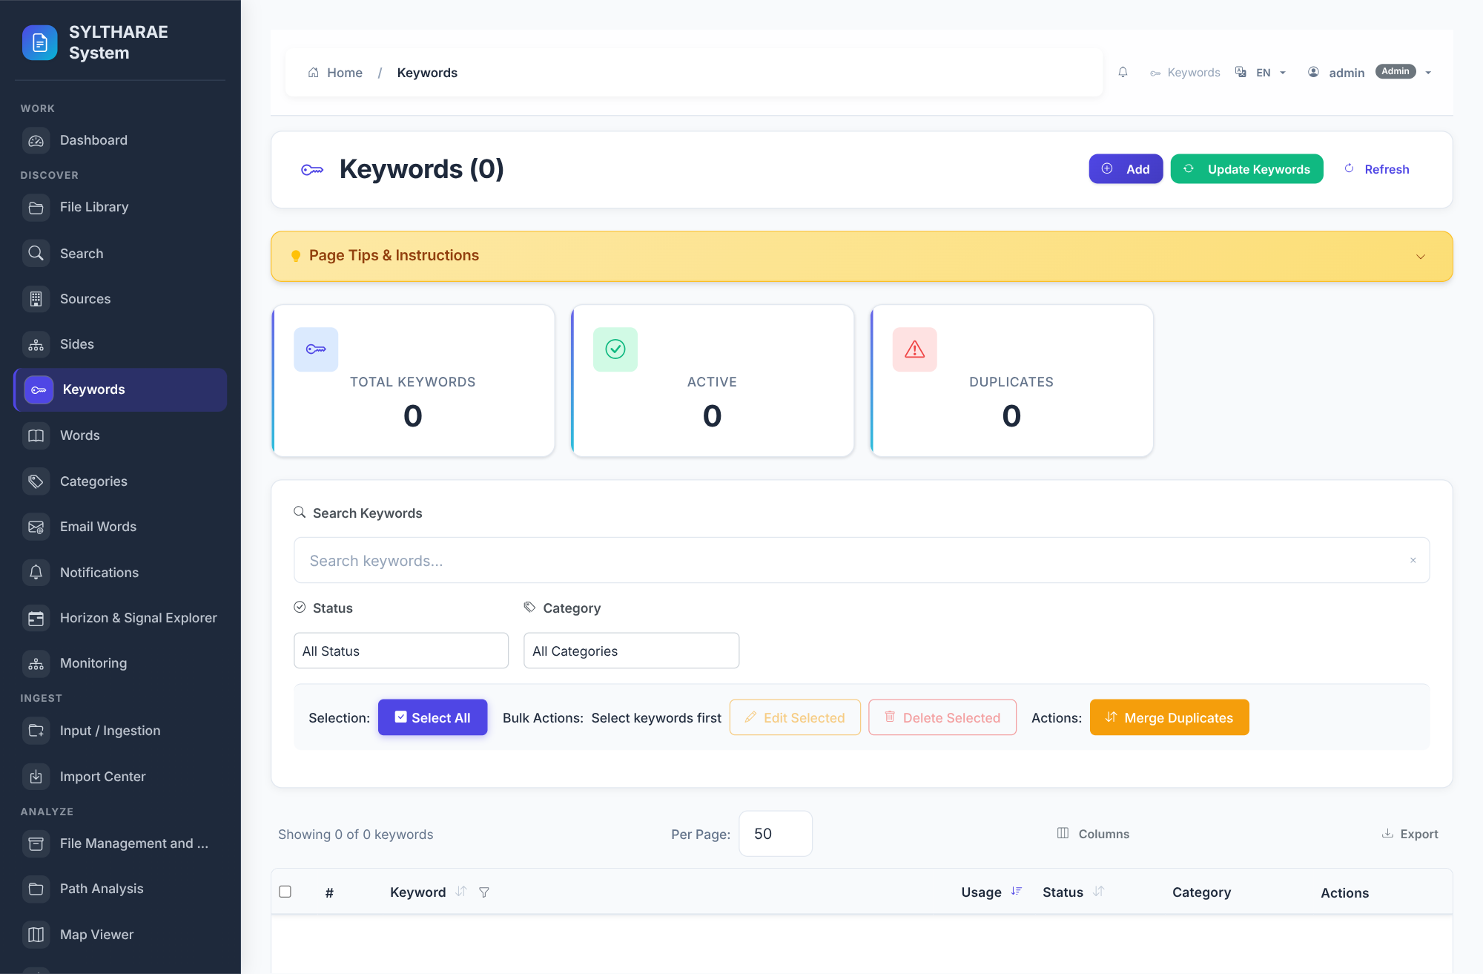
PRODUCT TOUR
Interface reference — Keywords
LIVE PRODUCT CAPTURE
REAL UI • SAMPLE INSTANCE
1
Discover interface • canonical route: keywords_list.
2
Review and maintain keyword vocabulary and relationships.
3
Implementation reference: templates/Keyword/keywords_list.html. Capture shows the actual running application state; data/empty states are from the synthetic demo instance.
Authentic live screen capture • interface ID keywords • templates/Keyword/keywords_list.html
59

Slide 60
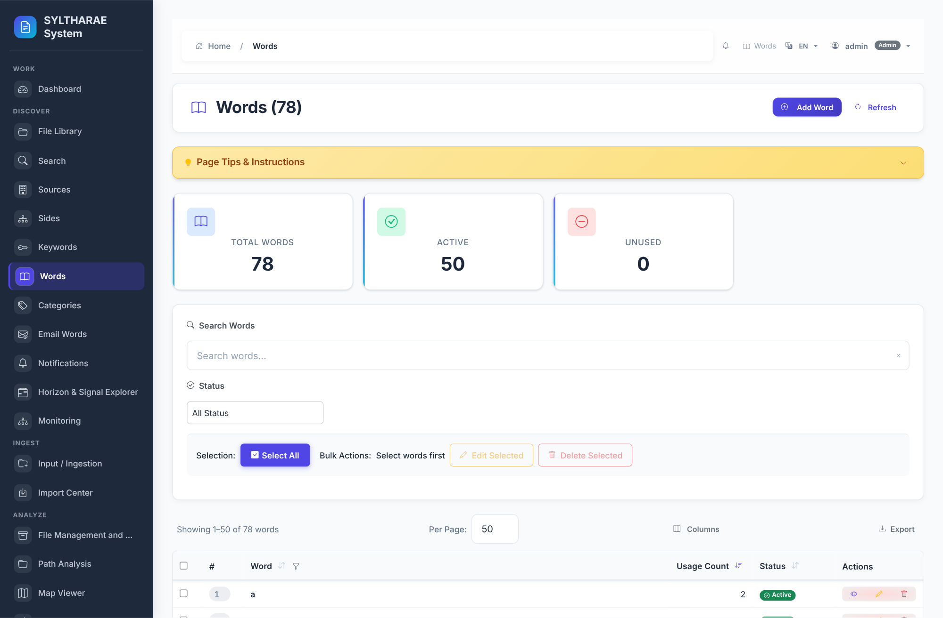
PRODUCT TOUR
Interface reference — Words
LIVE PRODUCT CAPTURE
REAL UI • SAMPLE INSTANCE
1
Discover interface • canonical route: words_list.
2
Explore indexed word vocabulary and associations.
3
Implementation reference: templates/Word/Word_list.html. Capture shows the actual running application state; data/empty states are from the synthetic demo instance.
Authentic live screen capture • interface ID words • templates/Word/Word_list.html
60

Slide 61
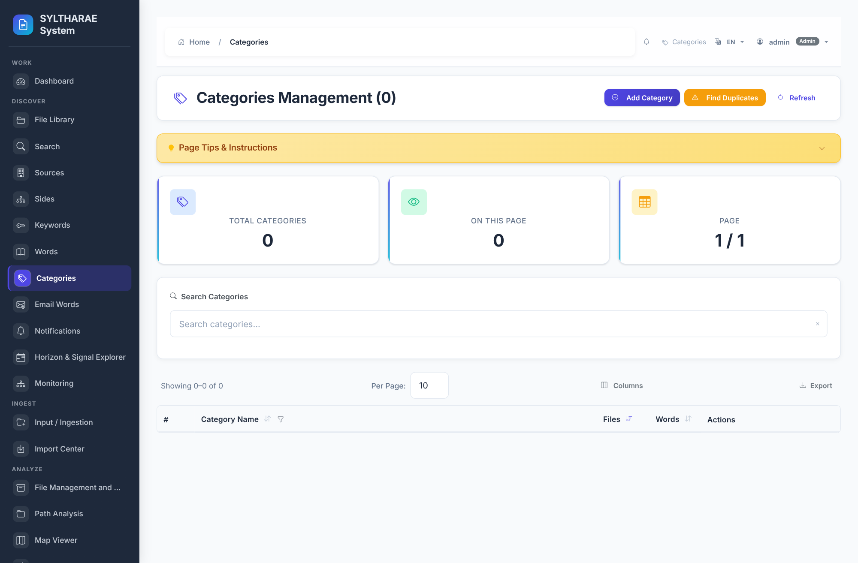
PRODUCT TOUR
Interface reference — Categories
LIVE PRODUCT CAPTURE
REAL UI • SAMPLE INSTANCE
1
Discover interface • canonical route: categories_list.
2
Manage classification categories and their content relationships.
3
Implementation reference: templates/Category/categories_list.html. Capture shows the actual running application state; data/empty states are from the synthetic demo instance.
Authentic live screen capture • interface ID categories • templates/Category/categories_list.html
61

Slide 62
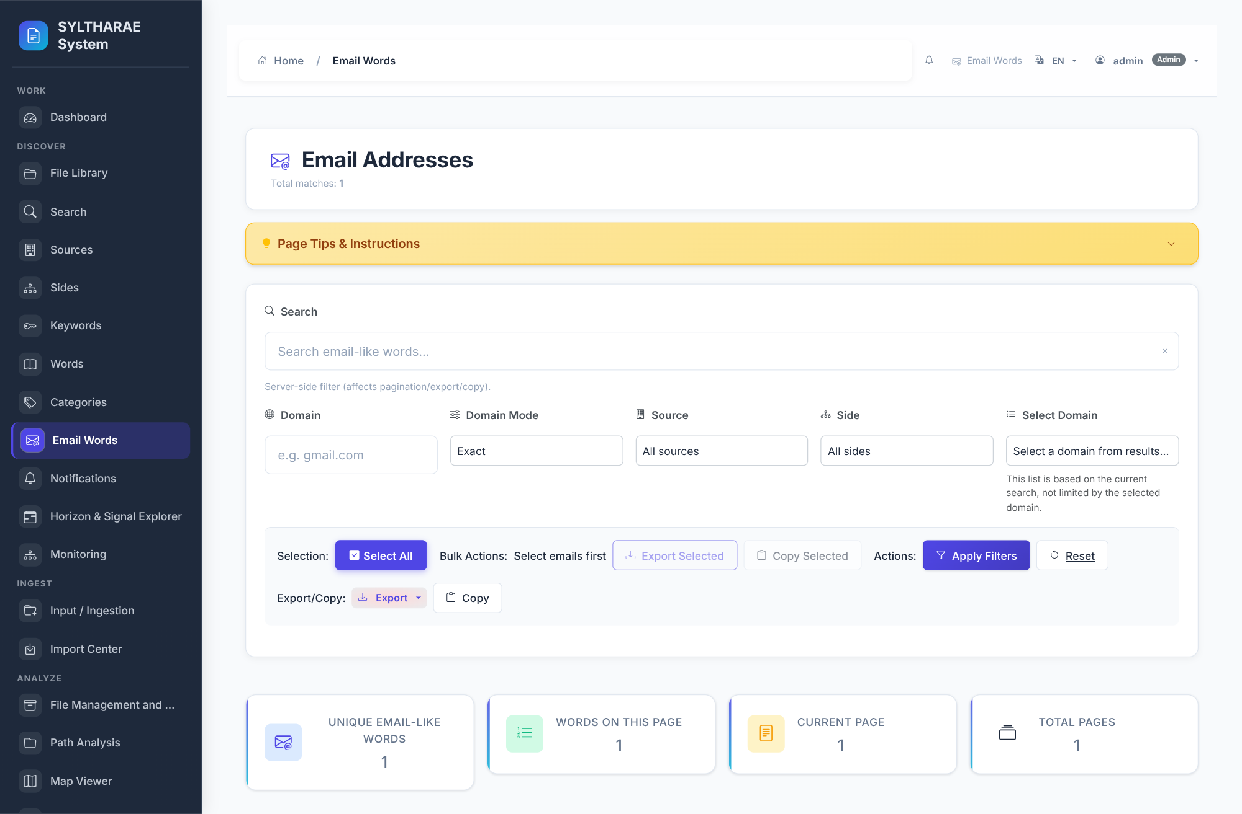
PRODUCT TOUR
Interface reference — Email Words
LIVE PRODUCT CAPTURE
REAL UI • SAMPLE INSTANCE
1
Discover interface • canonical route: email_words.
2
Explore extracted email-like terms.
3
Implementation reference: templates/email_words/email_words.html. Capture shows the actual running application state; data/empty states are from the synthetic demo instance.
Authentic live screen capture • interface ID email_words • templates/email_words/email_words.html
62

Slide 63
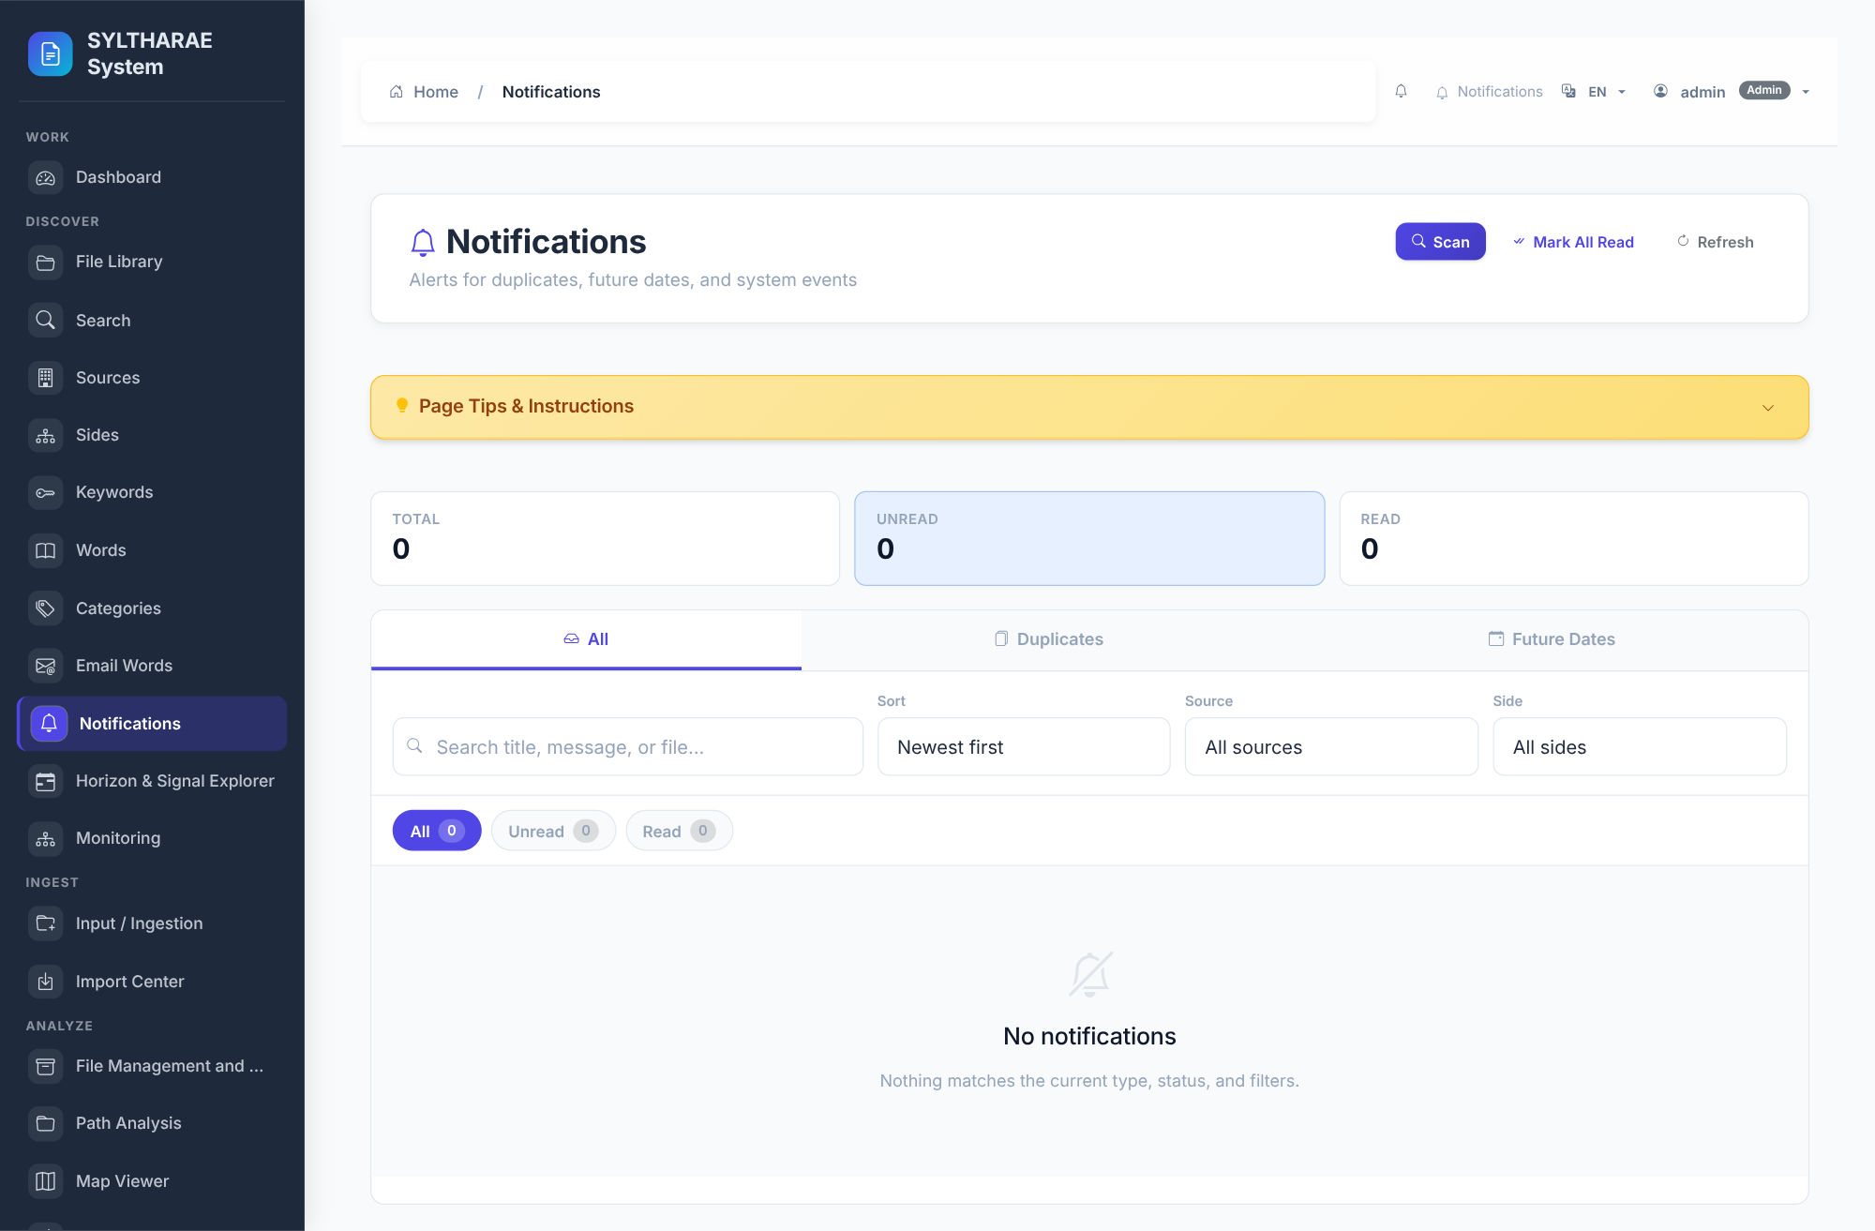
PRODUCT TOUR
Interface reference — Notifications
LIVE PRODUCT CAPTURE
REAL UI • SAMPLE INSTANCE
1
Discover interface • canonical route: notifications_page.
2
Review alert and notification records.
3
Implementation reference: templates/Notifications/notifications.html. Capture shows the actual running application state; data/empty states are from the synthetic demo instance.
Authentic live screen capture • interface ID notifications • templates/Notifications/notifications.html
63

Slide 64
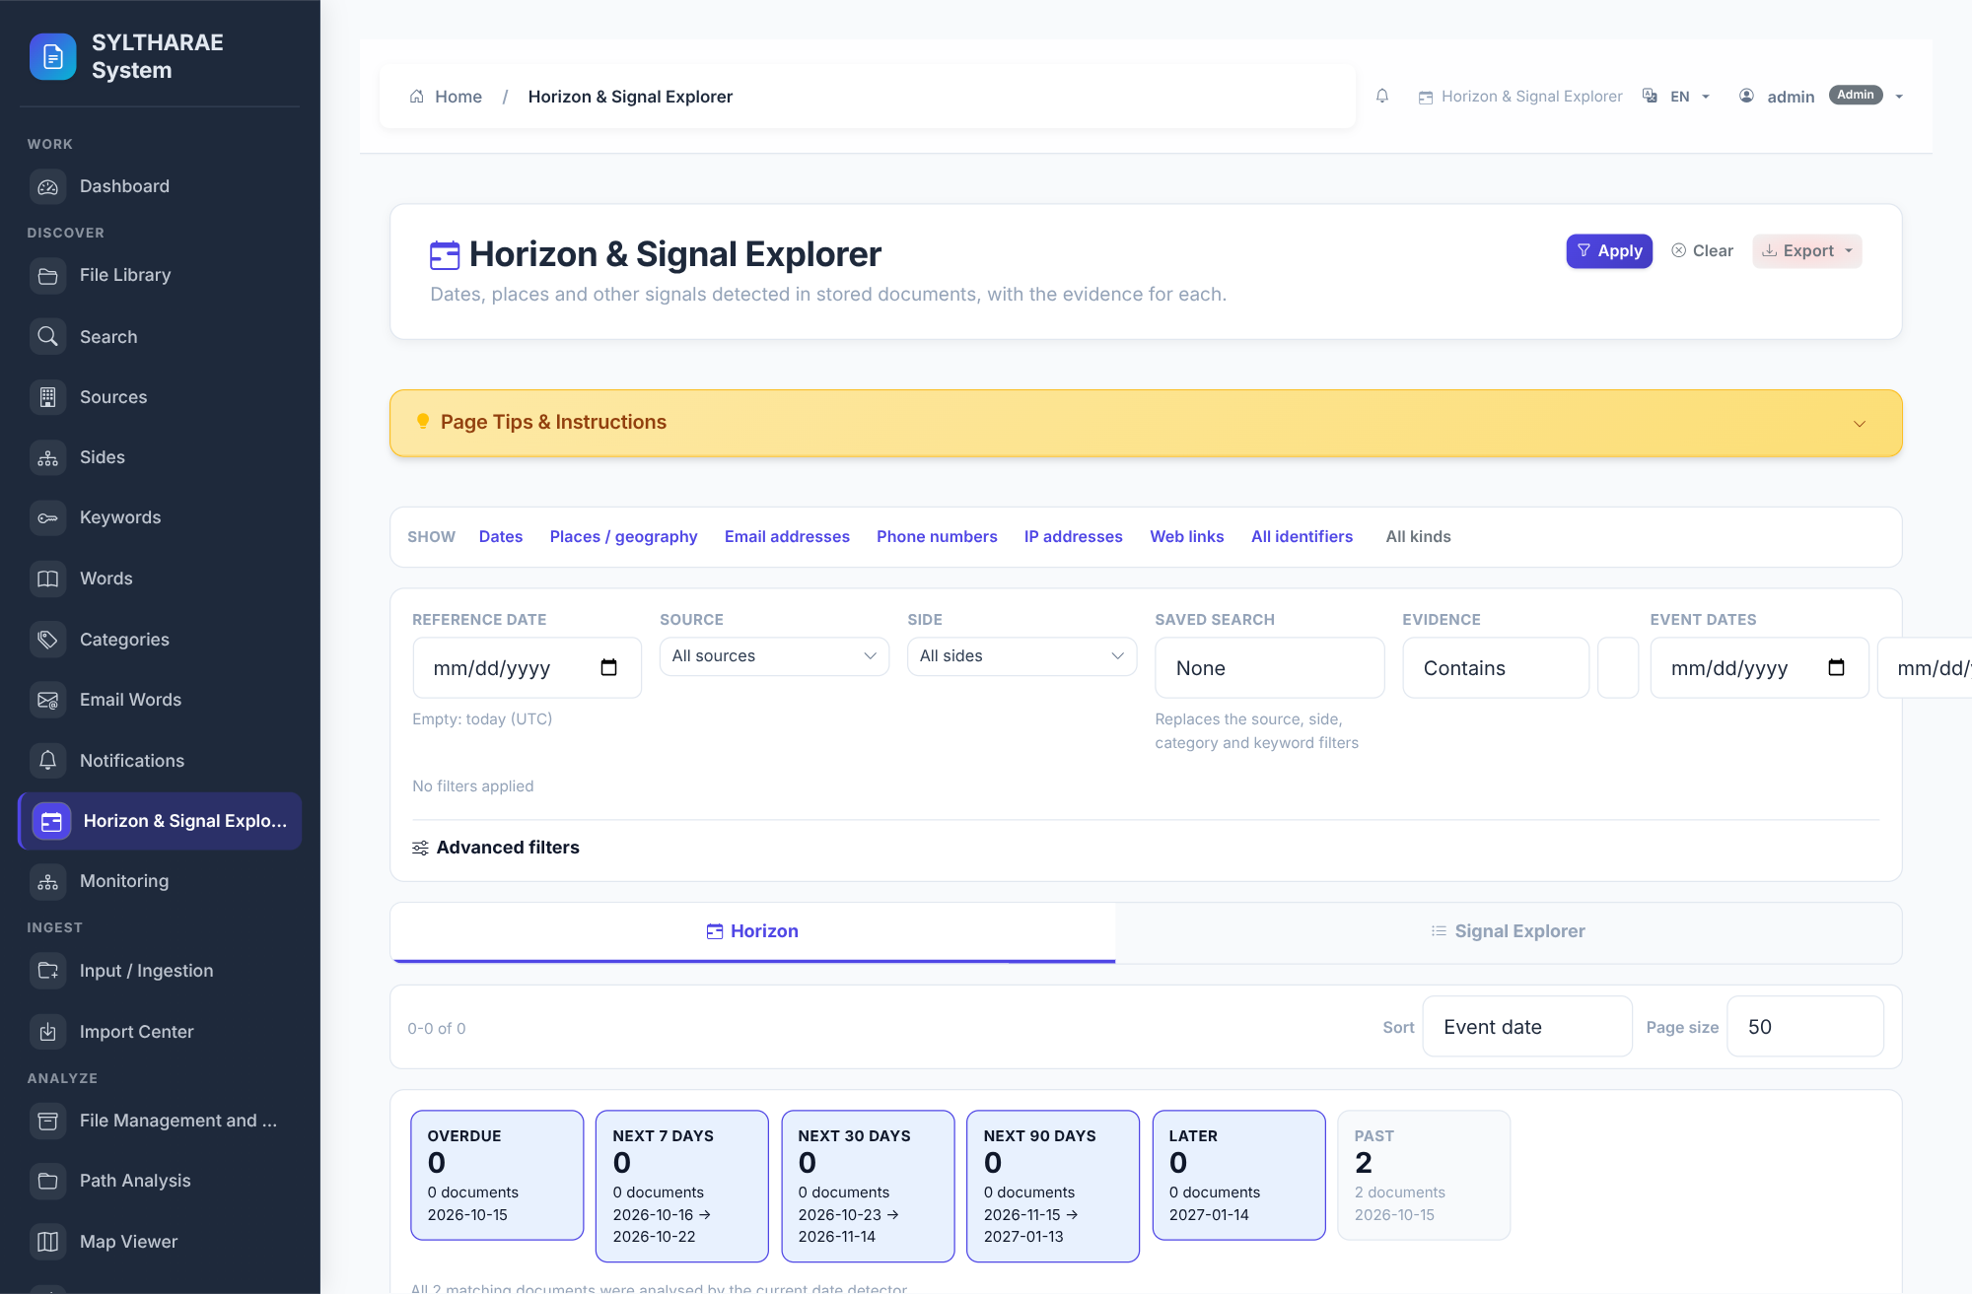
PRODUCT TOUR
Interface reference — Horizon & Signal Explorer
LIVE PRODUCT CAPTURE
REAL UI • SAMPLE INSTANCE
1
Discover interface • canonical route: signals_page.
2
Explore detected signals across time/horizon.
3
Implementation reference: templates/Signals/signals.html. Capture shows the actual running application state; data/empty states are from the synthetic demo instance.
Authentic live screen capture • interface ID signal_horizon • templates/Signals/signals.html
64

Slide 65
PRODUCT TOUR
Interface reference — Monitoring
LIVE PRODUCT CAPTURE
REAL UI • SAMPLE INSTANCE
1
Discover interface • canonical route: monitoring_page.
2
Manage or review monitoring rules and evaluations.
3
Implementation reference: templates/Monitoring/monitoring.html. Capture shows the actual running application state; data/empty states are from the synthetic demo instance.
Authentic live screen capture • interface ID monitoring • templates/Monitoring/monitoring.html
65

Slide 66
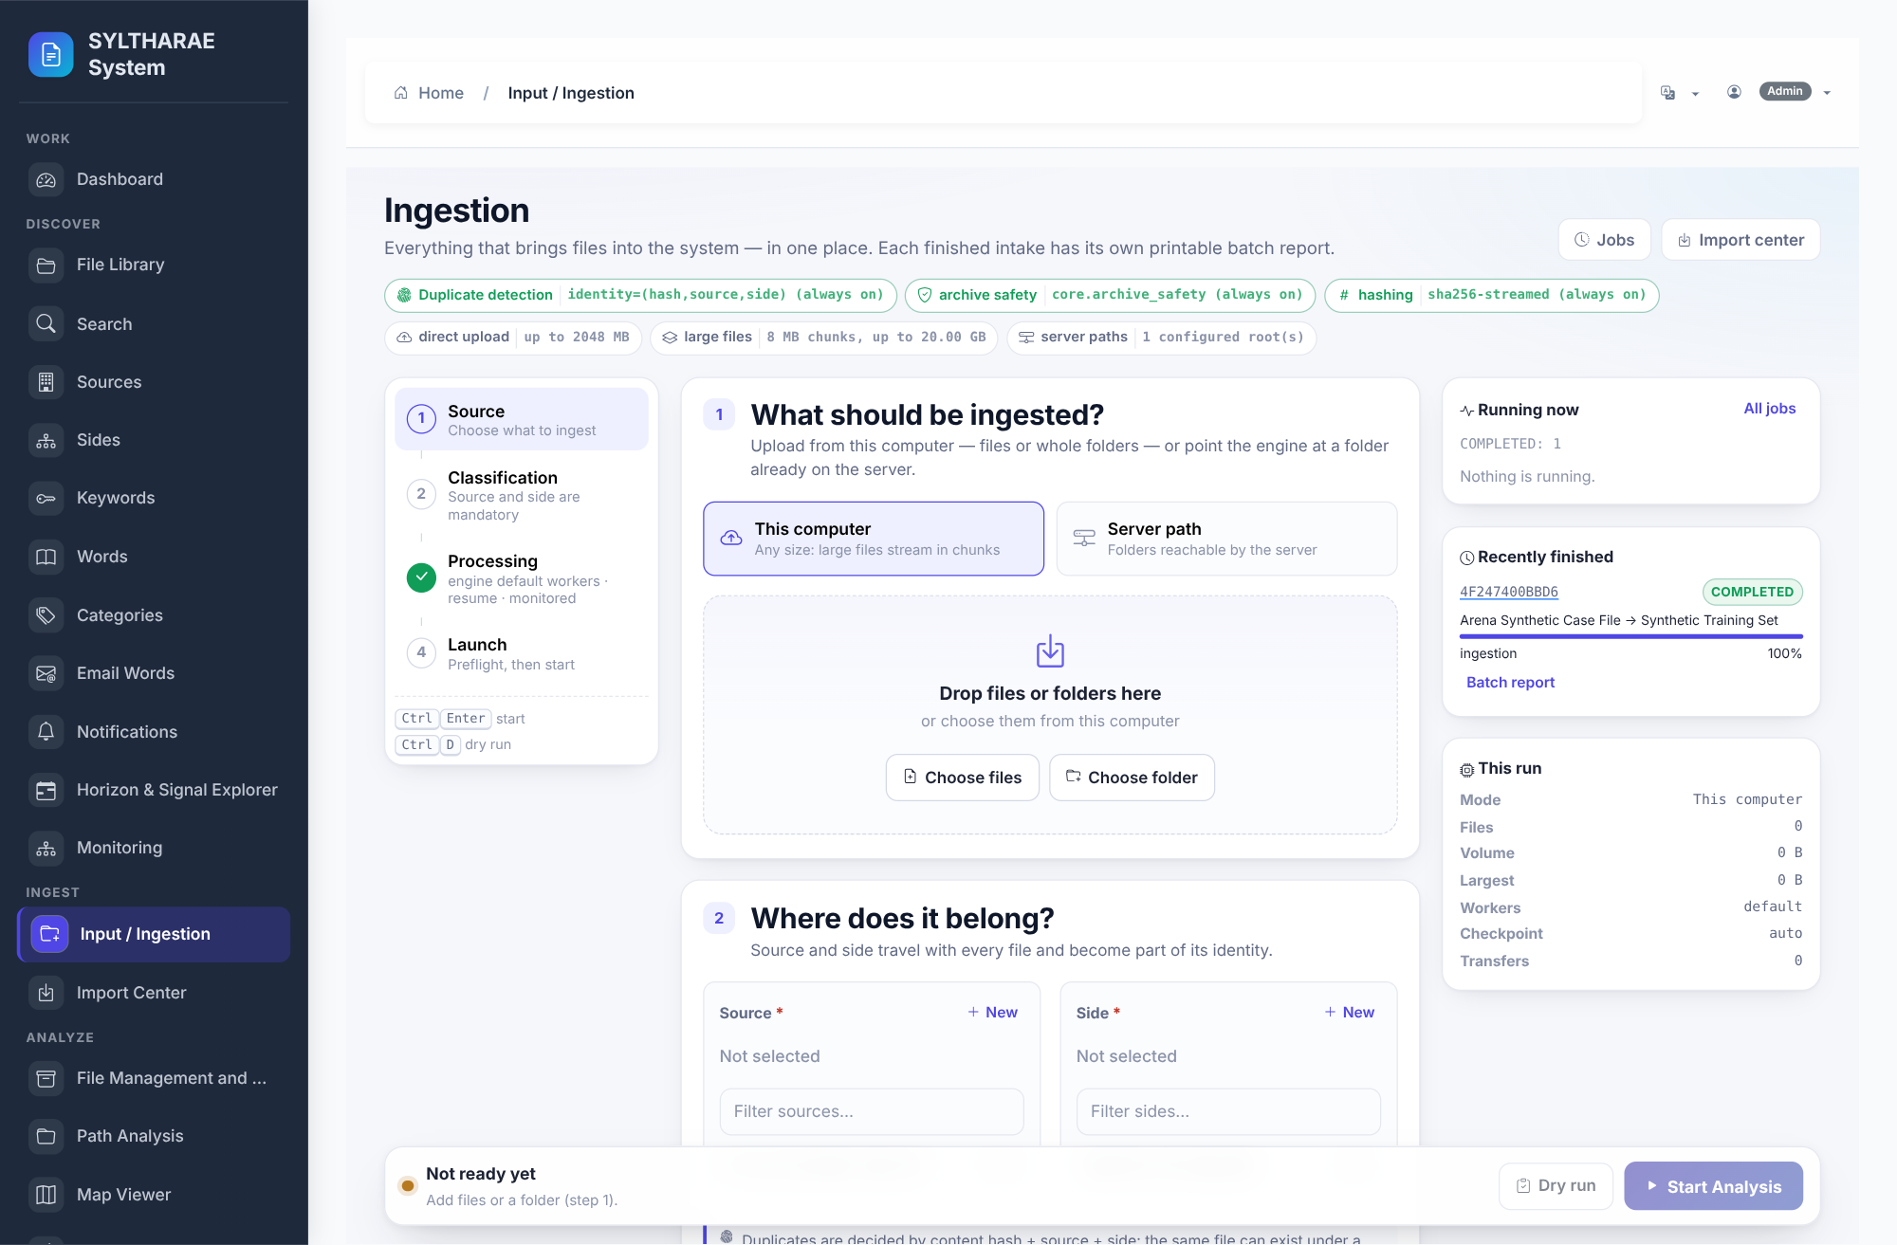
PRODUCT TOUR
Interface reference — Input / Ingestion
LIVE PRODUCT CAPTURE
REAL UI • SAMPLE INSTANCE
1
Ingest interface • canonical route: operations_input_page.
2
Upload or select input; classify source/side; configure processing; run preflight.
3
Implementation reference: templates/Operations/input.html. Capture shows the actual running application state; data/empty states are from the synthetic demo instance.
Authentic live screen capture • interface ID input_ingestion • templates/Operations/input.html
66

Slide 67
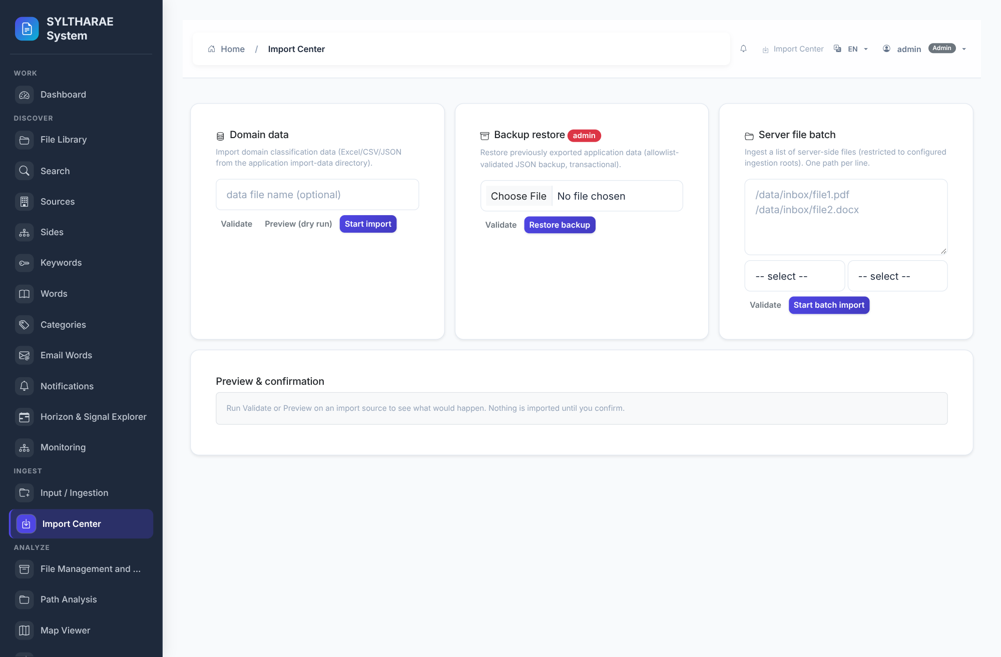
PRODUCT TOUR
Interface reference — Import Center
LIVE PRODUCT CAPTURE
REAL UI • SAMPLE INSTANCE
1
Ingest interface • canonical route: operations_import_page.
2
Import domain or backup data through an operations screen.
3
Implementation reference: templates/Operations/import_center.html. Capture shows the actual running application state; data/empty states are from the synthetic demo instance.
Authentic live screen capture • interface ID import_center • templates/Operations/import_center.html
67

Slide 68
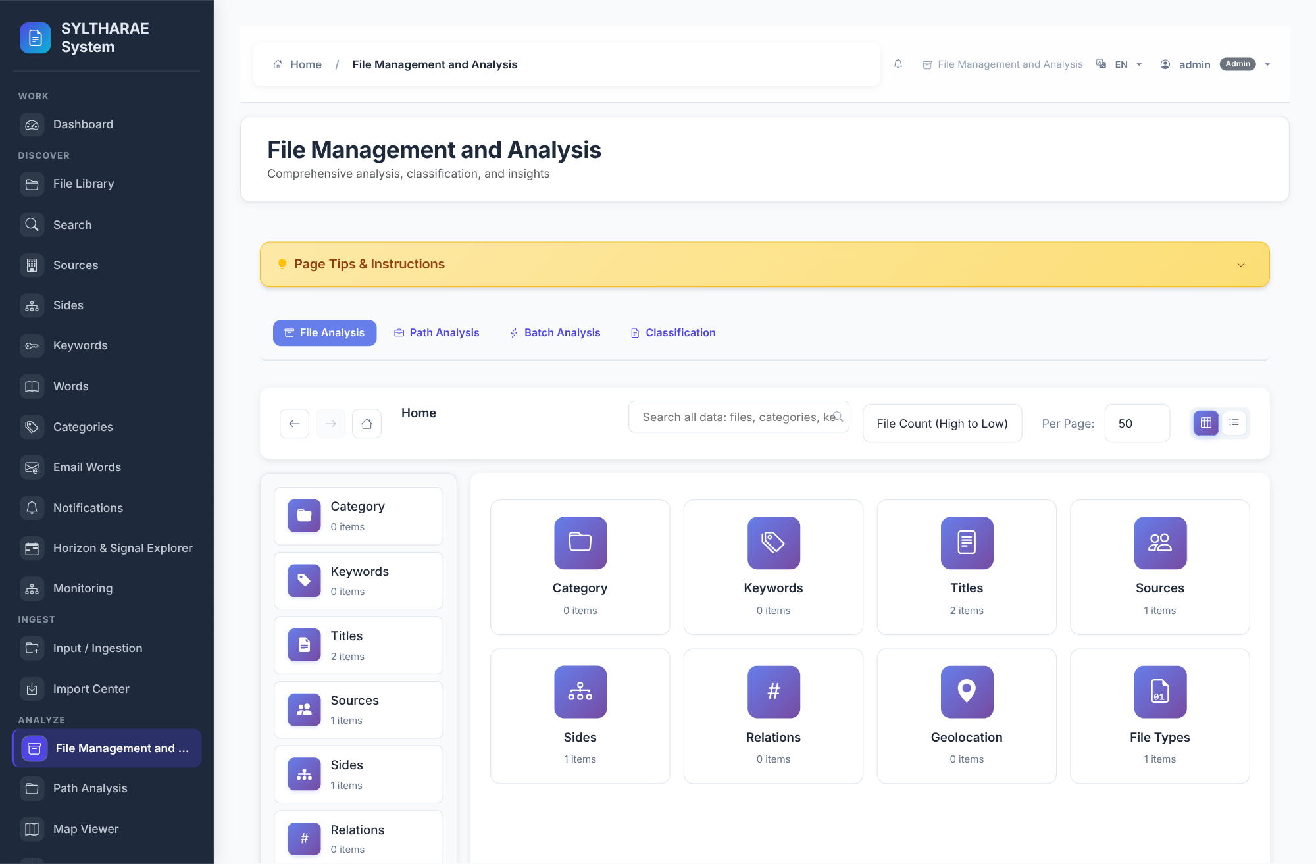
PRODUCT TOUR
Interface reference — File Management and Analysis
LIVE PRODUCT CAPTURE
REAL UI • SAMPLE INSTANCE
1
Analyze interface • canonical route: archives_page.
2
File management and analysis workspace.
3
Implementation reference: templates/file/File_Management_Analysis_System.html. Capture shows the actual running application state; data/empty states are from the synthetic demo instance.
Authentic live screen capture • interface ID archives • templates/file/File_Management_Analysis_System.html
68

Slide 69
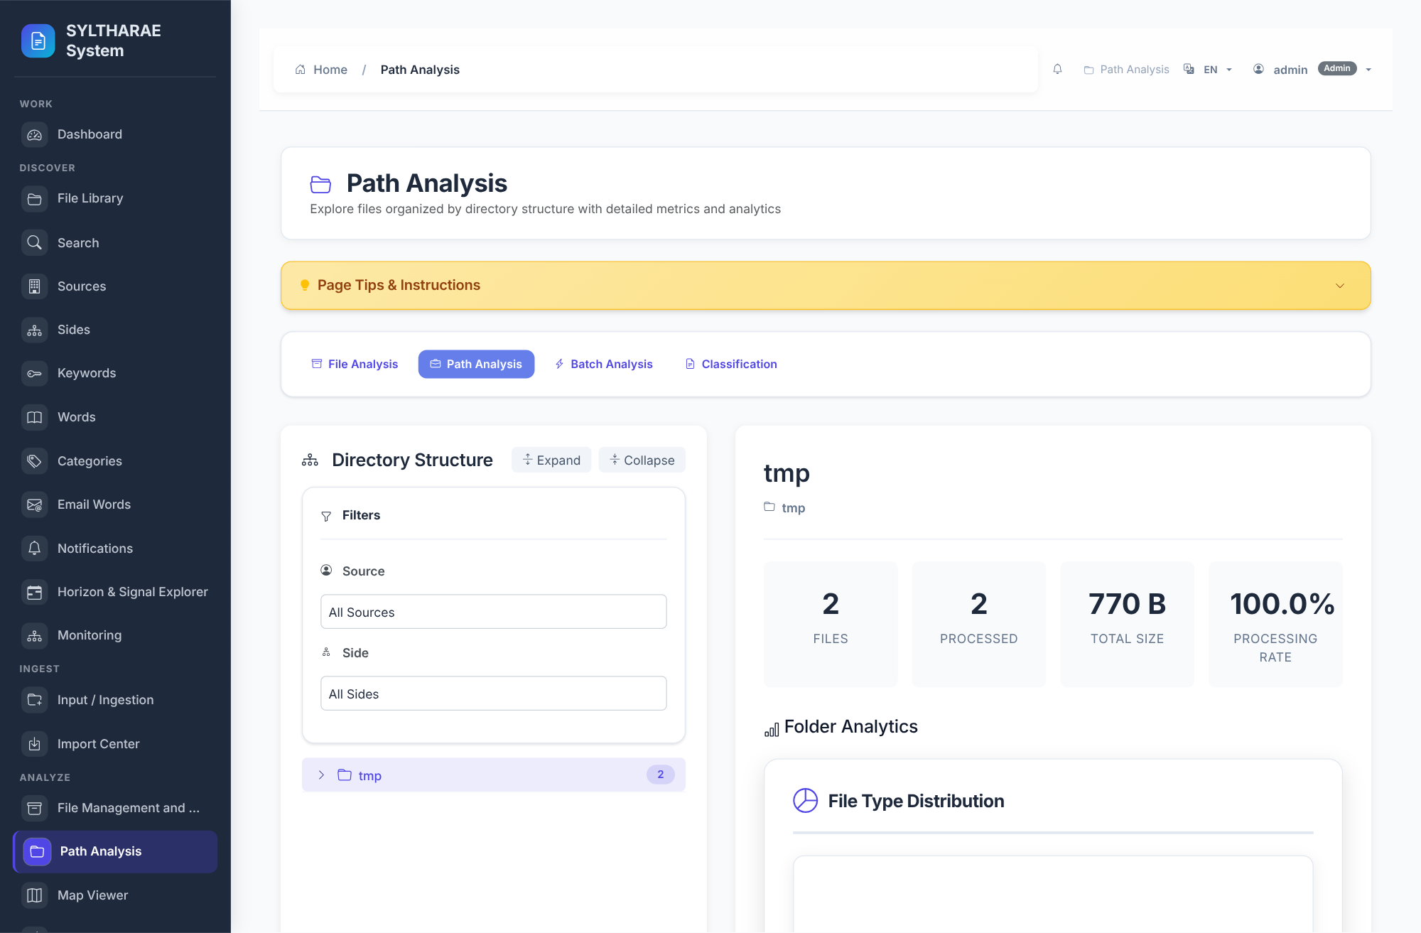
PRODUCT TOUR
Interface reference — Path Analysis
LIVE PRODUCT CAPTURE
REAL UI • SAMPLE INSTANCE
1
Analyze interface • canonical route: path_analysis_page.
2
Analyze directory/path relationships.
3
Implementation reference: templates/Analysis/path_analysis.html. Capture shows the actual running application state; data/empty states are from the synthetic demo instance.
Authentic live screen capture • interface ID path_analysis • templates/Analysis/path_analysis.html
69

Slide 70
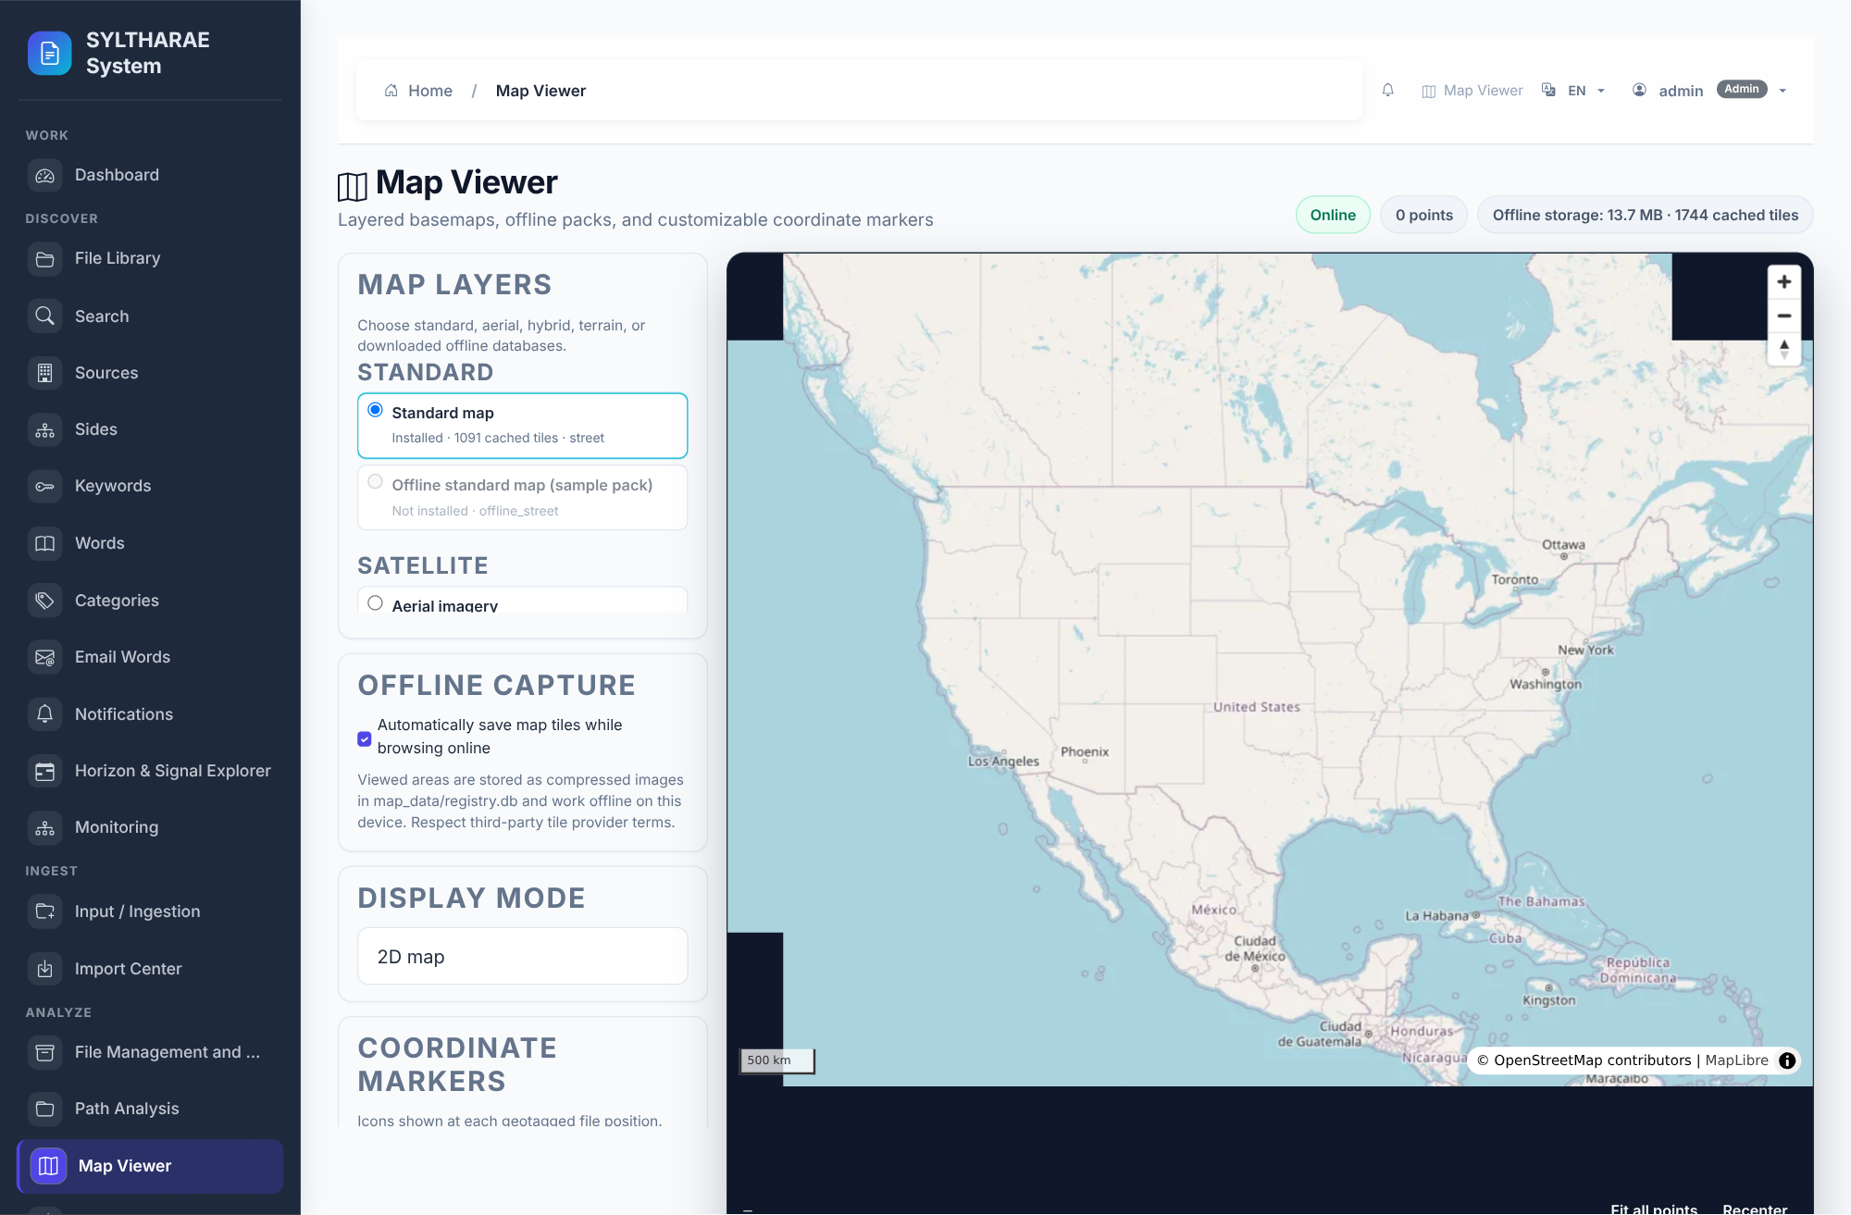
PRODUCT TOUR
Interface reference — Map Viewer
LIVE PRODUCT CAPTURE
REAL UI • SAMPLE INSTANCE
1
Analyze interface • canonical route: map_viewer_page.
2
Geographic exploration of place-related data.
3
Implementation reference: templates/map/map_viewer.html. Capture shows the actual running application state; data/empty states are from the synthetic demo instance.
Authentic live screen capture • interface ID map_viewer • templates/map/map_viewer.html
70

Slide 71
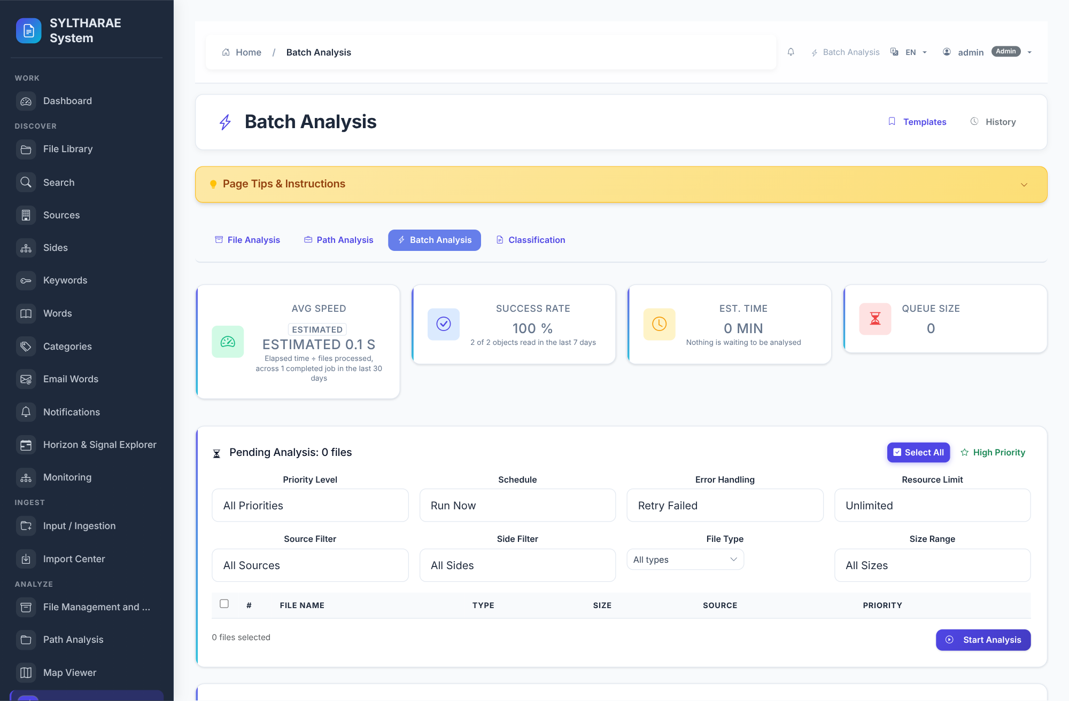
PRODUCT TOUR
Interface reference — Batch Analysis
LIVE PRODUCT CAPTURE
REAL UI • SAMPLE INSTANCE
1
Analyze interface • canonical route: analysis_batch.
2
Submit and inspect batch analysis operations.
3
Implementation reference: templates/Analysis/analysis_batch.html. Capture shows the actual running application state; data/empty states are from the synthetic demo instance.
Authentic live screen capture • interface ID batch_analysis • templates/Analysis/analysis_batch.html
71

Slide 72
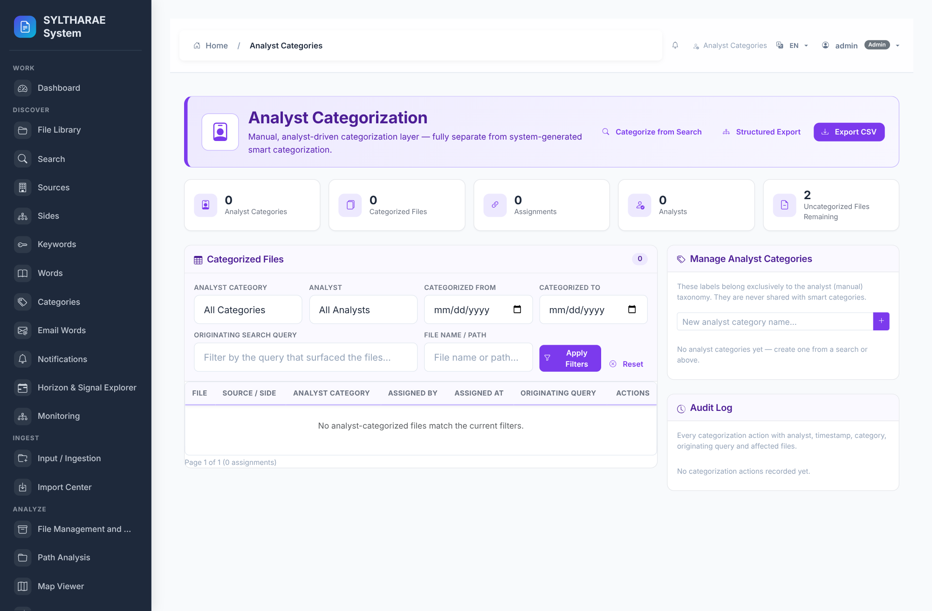
PRODUCT TOUR
Interface reference — Analyst Categories
LIVE PRODUCT CAPTURE
REAL UI • SAMPLE INSTANCE
1
Classify interface • canonical route: analyst_categorization_page.
2
Assign analyst categories to records.
3
Implementation reference: templates/Analyst/analyst_categorization.html. Capture shows the actual running application state; data/empty states are from the synthetic demo instance.
Authentic live screen capture • interface ID analyst_categorization • templates/Analyst/analyst_categorization.html
72

Slide 73
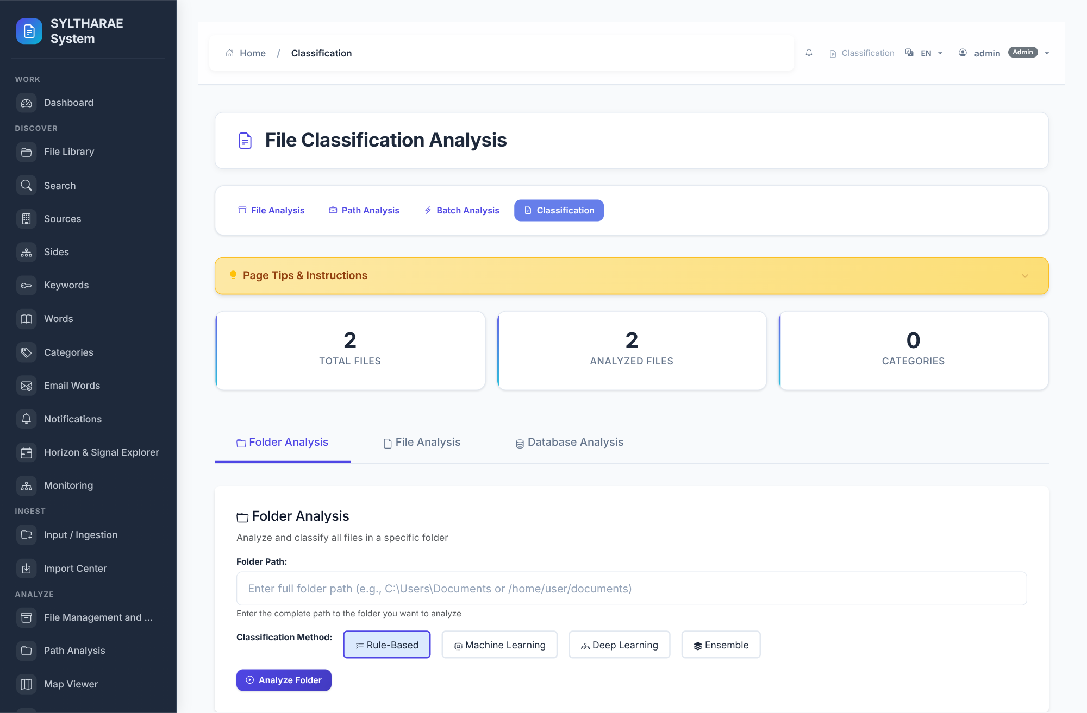
PRODUCT TOUR
Interface reference — Classification
LIVE PRODUCT CAPTURE
REAL UI • SAMPLE INSTANCE
1
Classify interface • canonical route: file_classification_page.
2
Review file classification work.
3
Implementation reference: templates/Analysis/file_classification.html. Capture shows the actual running application state; data/empty states are from the synthetic demo instance.
Authentic live screen capture • interface ID classification • templates/Analysis/file_classification.html
73

Slide 74
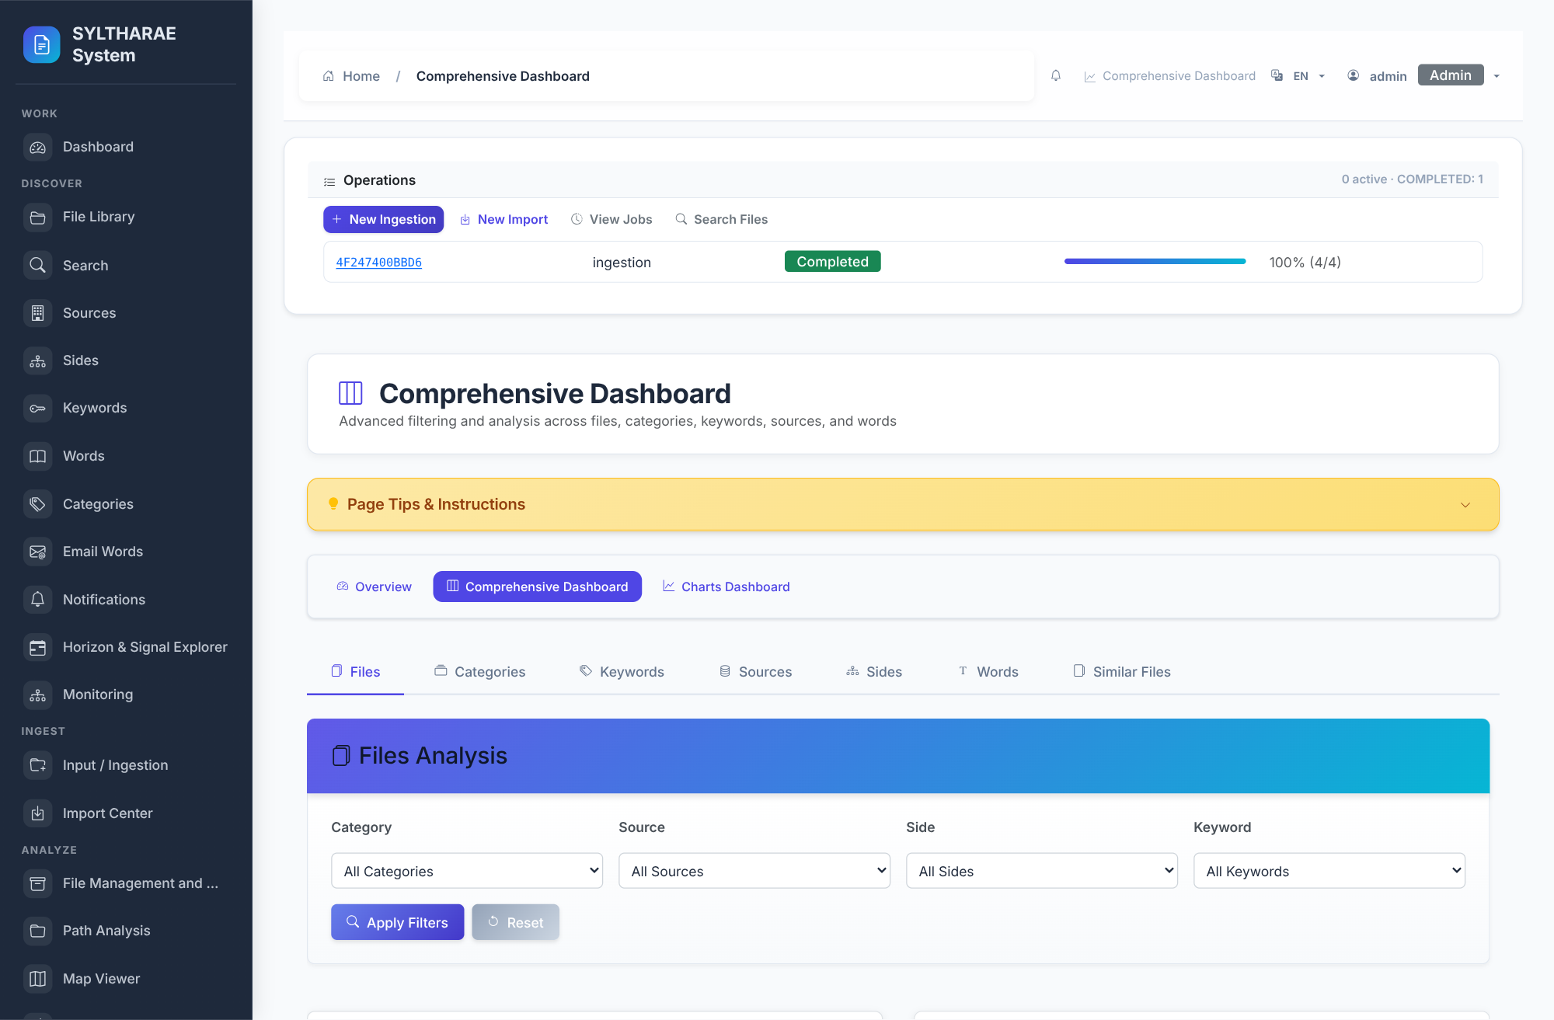
PRODUCT TOUR
Interface reference — Comprehensive Dashboard
LIVE PRODUCT CAPTURE
REAL UI • SAMPLE INSTANCE
1
Report interface • canonical route: comprehensive_dashboard.
2
Switchable analytical dashboard views.
3
Implementation reference: templates/Analysis/comprehensive_dashboard.html. Capture shows the actual running application state; data/empty states are from the synthetic demo instance.
Authentic live screen capture • interface ID comprehensive_dashboard • templates/Analysis/comprehensive_dashboard.html
74

Slide 75
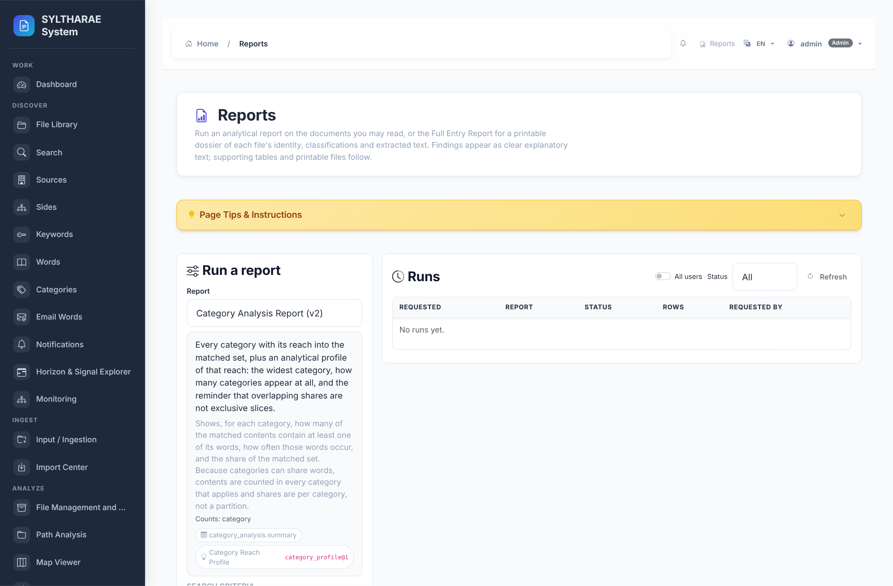
PRODUCT TOUR
Interface reference — Reports
LIVE PRODUCT CAPTURE
REAL UI • SAMPLE INSTANCE
1
Report interface • canonical route: reports_page.
2
Browse and run report definitions.
3
Implementation reference: templates/Reports/reports.html. Capture shows the actual running application state; data/empty states are from the synthetic demo instance.
Authentic live screen capture • interface ID reports • templates/Reports/reports.html
75

Slide 76
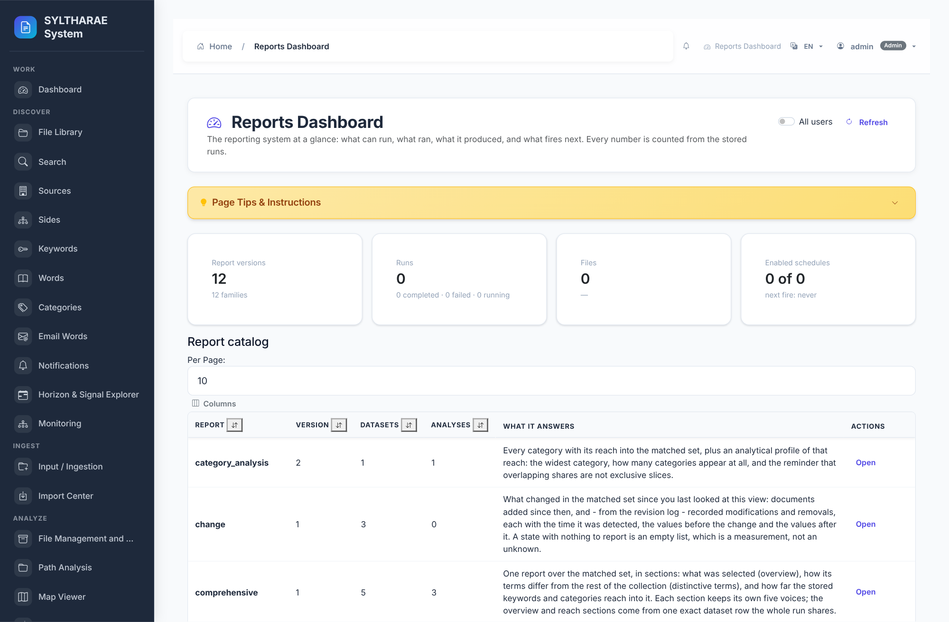
PRODUCT TOUR
Interface reference — Reports Dashboard
LIVE PRODUCT CAPTURE
REAL UI • SAMPLE INSTANCE
1
Report interface • canonical route: reports_dashboard_page.
2
View report-oriented dashboard summaries.
3
Implementation reference: templates/Reports/dashboard.html. Capture shows the actual running application state; data/empty states are from the synthetic demo instance.
Authentic live screen capture • interface ID reports_dashboard • templates/Reports/dashboard.html
76

Slide 77
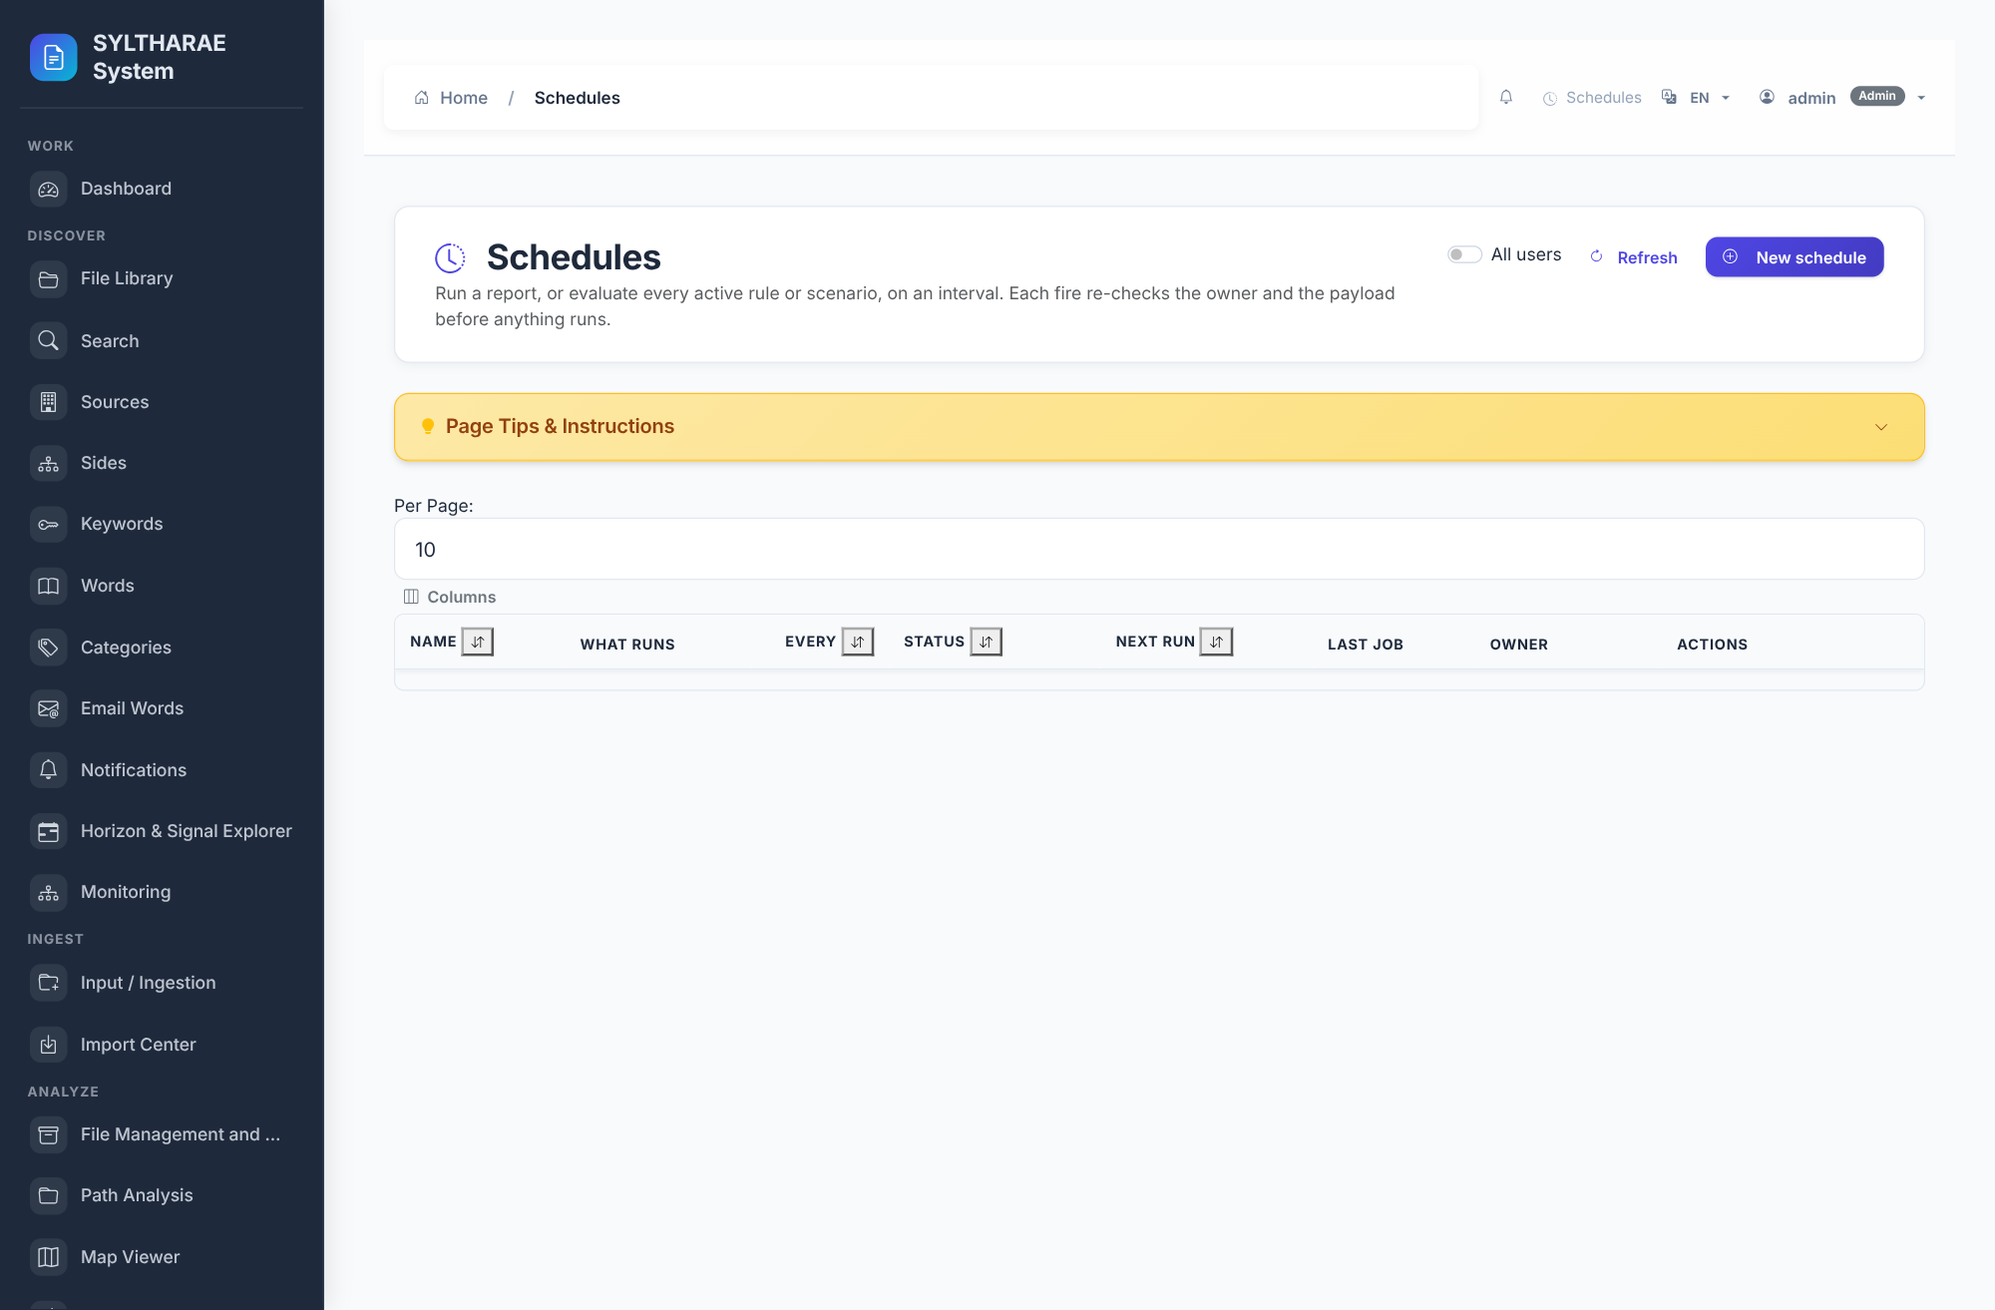
PRODUCT TOUR
Interface reference — Schedules
LIVE PRODUCT CAPTURE
REAL UI • SAMPLE INSTANCE
1
Report interface • canonical route: schedules_page.
2
Manage scheduled report or operation runs.
3
Implementation reference: templates/Scheduling/schedules.html. Capture shows the actual running application state; data/empty states are from the synthetic demo instance.
Authentic live screen capture • interface ID schedules • templates/Scheduling/schedules.html
77

Slide 78
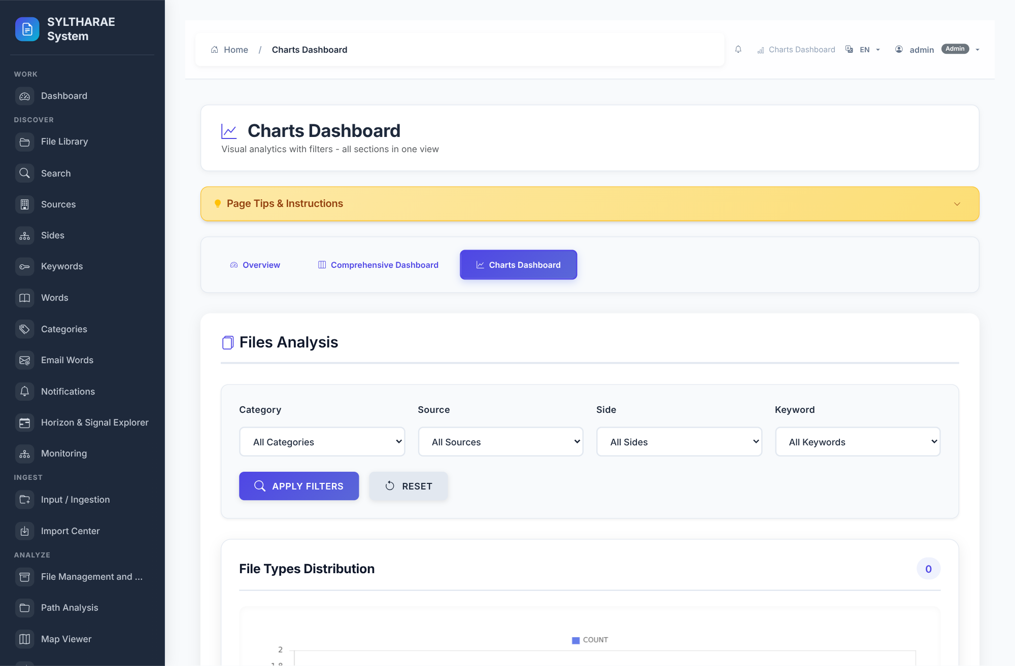
PRODUCT TOUR
Interface reference — Charts Dashboard
LIVE PRODUCT CAPTURE
REAL UI • SAMPLE INSTANCE
1
Report interface • canonical route: charts_dashboard.
2
Chart-centric analytical view.
3
Implementation reference: templates/Analysis/charts_dashboard.html. Capture shows the actual running application state; data/empty states are from the synthetic demo instance.
Authentic live screen capture • interface ID charts_dashboard • templates/Analysis/charts_dashboard.html
78

Slide 79
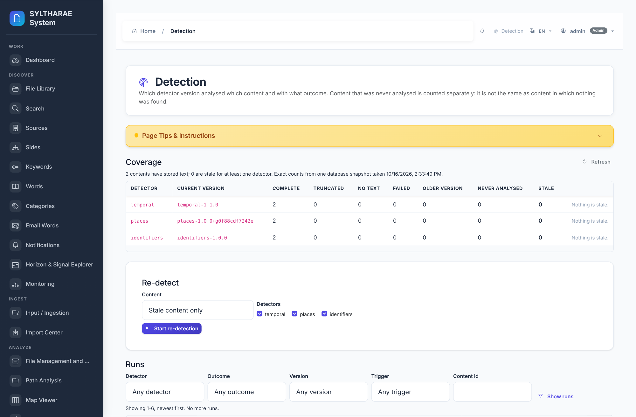
PRODUCT TOUR
Interface reference — Detection
LIVE PRODUCT CAPTURE
REAL UI • SAMPLE INSTANCE
1
Operate interface • canonical route: detection_page.
2
Configure or invoke signal detection workflows.
3
Implementation reference: templates/Signals/detection.html. Capture shows the actual running application state; data/empty states are from the synthetic demo instance.
Authentic live screen capture • interface ID detection • templates/Signals/detection.html
79

Slide 80
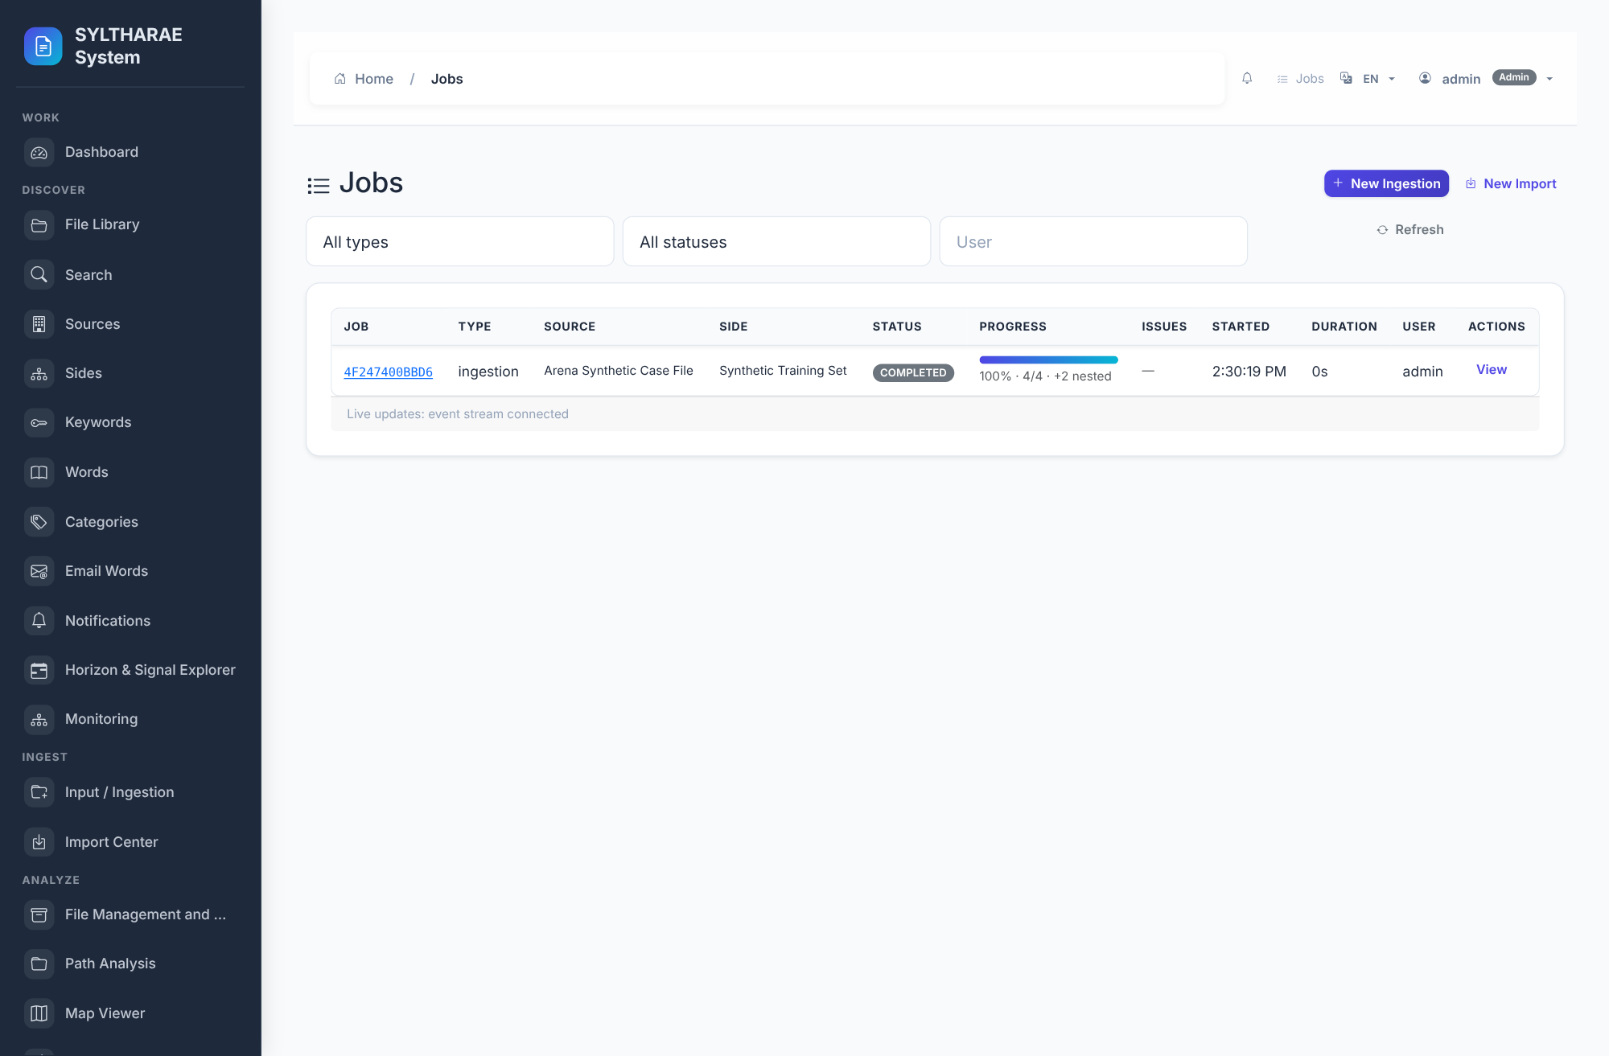
PRODUCT TOUR
Interface reference — Jobs
LIVE PRODUCT CAPTURE
REAL UI • SAMPLE INSTANCE
1
Operate interface • canonical route: operations_jobs_page.
2
Review durable background jobs and lifecycle status.
3
Implementation reference: templates/Operations/jobs.html. Capture shows the actual running application state; data/empty states are from the synthetic demo instance.
Authentic live screen capture • interface ID jobs • templates/Operations/jobs.html
80

Slide 81
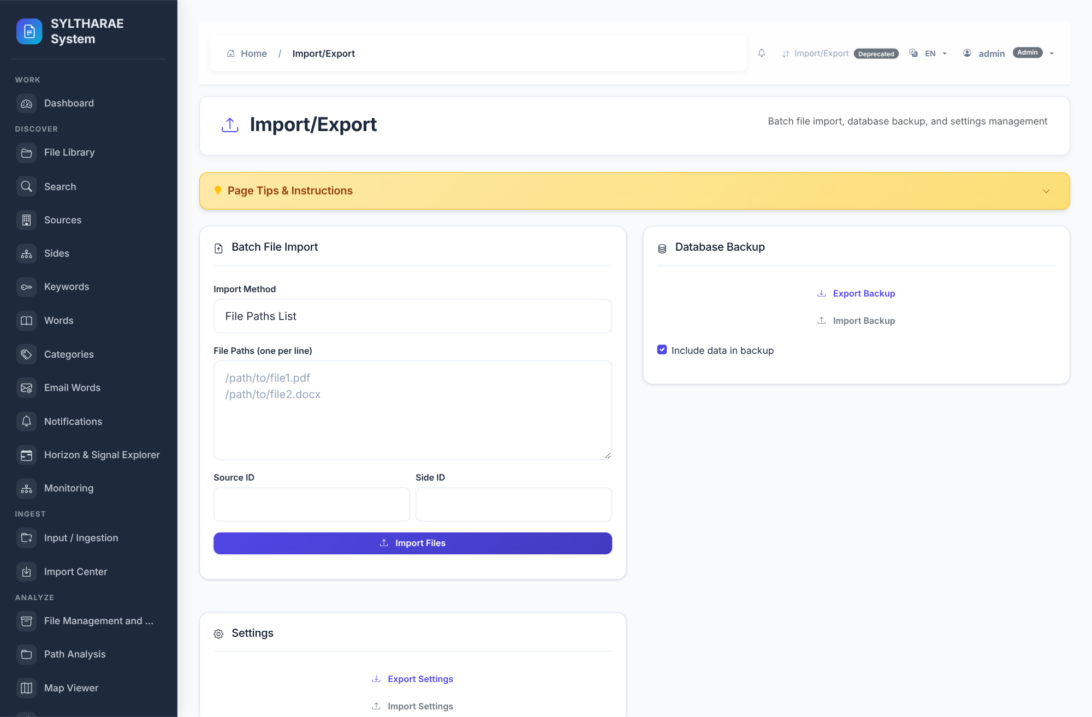
PRODUCT TOUR
Interface reference — Import/Export
LIVE PRODUCT CAPTURE
REAL UI • SAMPLE INSTANCE
1
Operate interface • canonical route: import_export_page.
2
Administrator-facing structured import/export surfaces.
3
Implementation reference: templates/ImportExport/import_export.html. Capture shows the actual running application state; data/empty states are from the synthetic demo instance.
Authentic live screen capture • interface ID import_export_console • templates/ImportExport/import_export.html
81

Slide 82
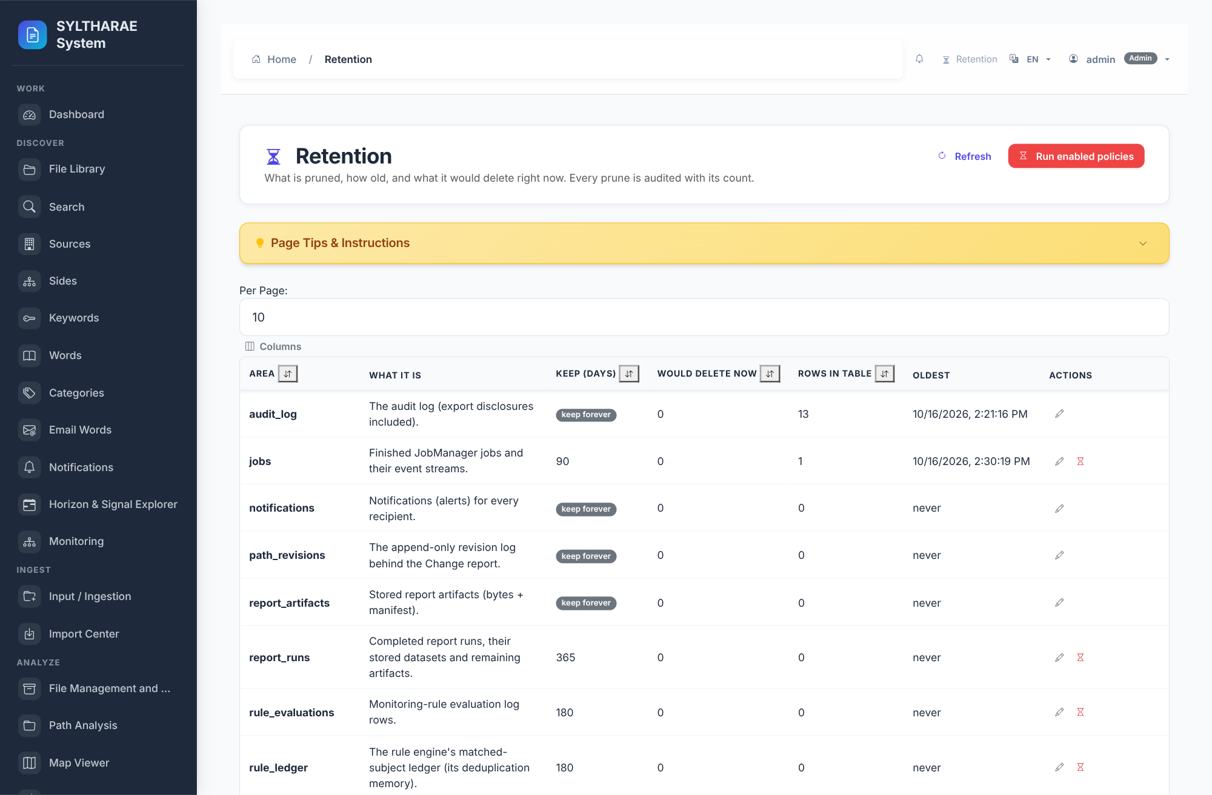
PRODUCT TOUR
Interface reference — Retention
LIVE PRODUCT CAPTURE
REAL UI • SAMPLE INSTANCE
1
Administration interface • canonical route: retention_page.
2
Review retention policy and schedule operations.
3
Implementation reference: templates/Retention/retention.html. Capture shows the actual running application state; data/empty states are from the synthetic demo instance.
Authentic live screen capture • interface ID retention • templates/Retention/retention.html
82

Slide 83
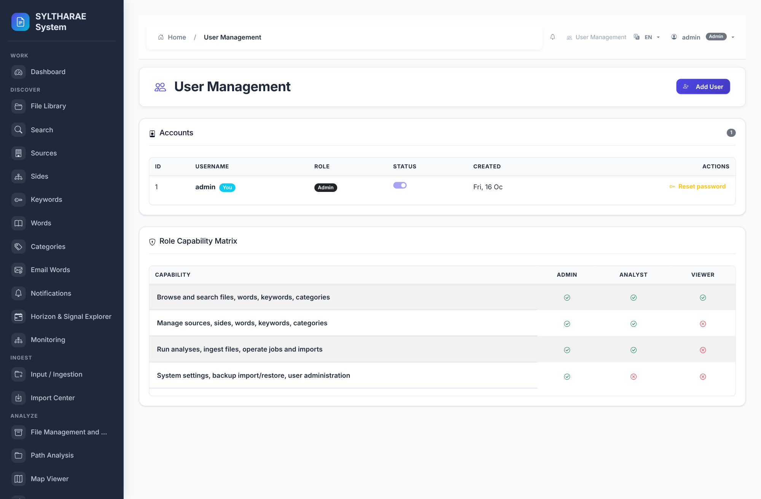
PRODUCT TOUR
Interface reference — User Management
LIVE PRODUCT CAPTURE
REAL UI • SAMPLE INSTANCE
1
Administration interface • canonical route: users_page.
2
Manage user accounts and roles.
3
Implementation reference: templates/auth/users.html. Capture shows the actual running application state; data/empty states are from the synthetic demo instance.
Authentic live screen capture • interface ID users • templates/auth/users.html
83

Slide 84
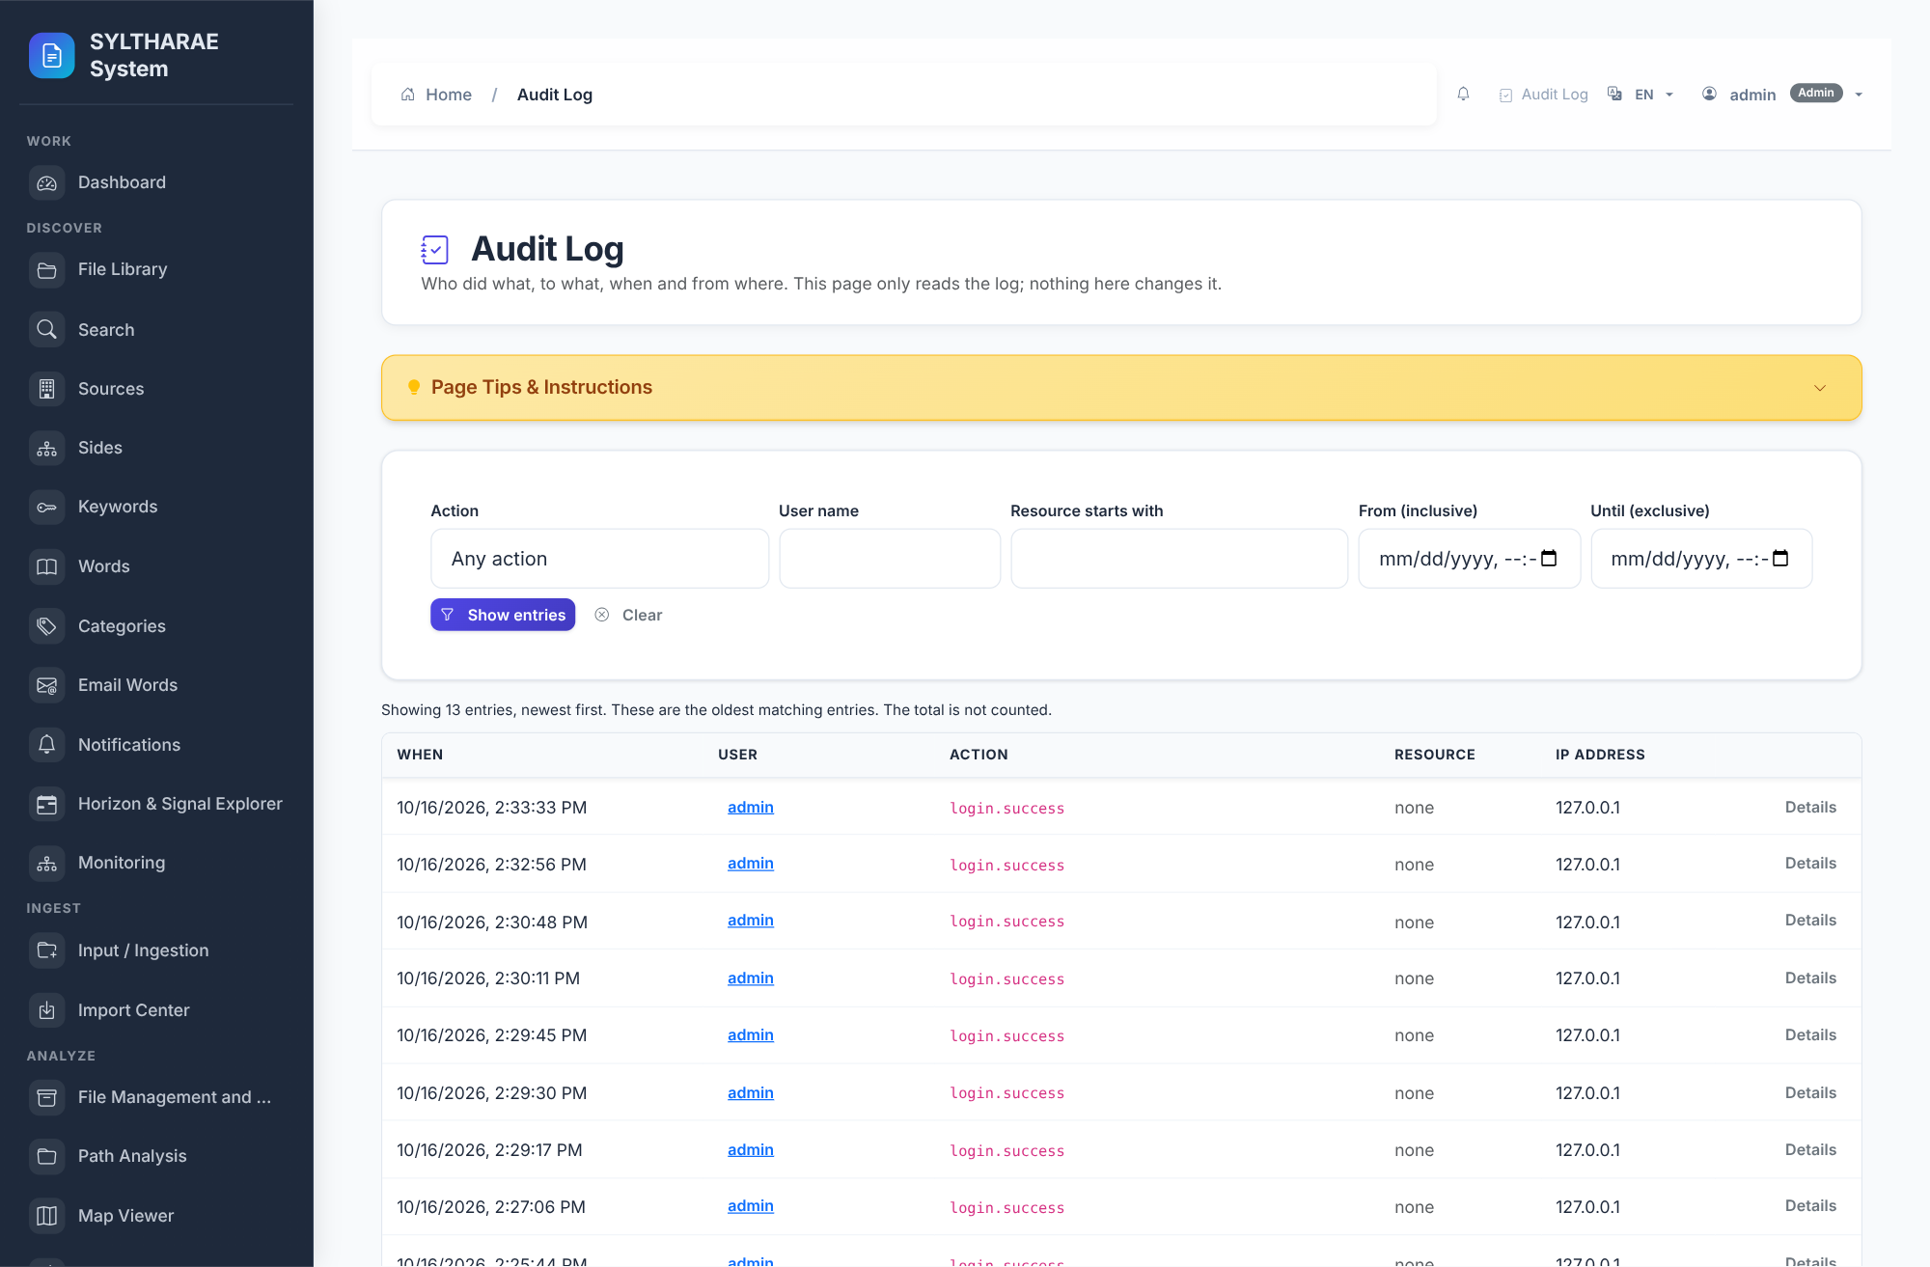
PRODUCT TOUR
Interface reference — Audit Log
LIVE PRODUCT CAPTURE
REAL UI • SAMPLE INSTANCE
1
Administration interface • canonical route: audit_page.
2
Review audited actions.
3
Implementation reference: templates/auth/audit.html. Capture shows the actual running application state; data/empty states are from the synthetic demo instance.
Authentic live screen capture • interface ID audit_log • templates/auth/audit.html
84

Slide 85
PRODUCT TOUR
Interface reference — Settings
LIVE PRODUCT CAPTURE
REAL UI • SAMPLE INSTANCE
1
Settings interface • canonical route: settings_page_direct.
2
Configure application, theme, processing, database and storage preferences.
3
Implementation reference: templates/Settings/settings.html. Capture shows the actual running application state; data/empty states are from the synthetic demo instance.
Authentic live screen capture • interface ID settings • templates/Settings/settings.html
85

Slide 86
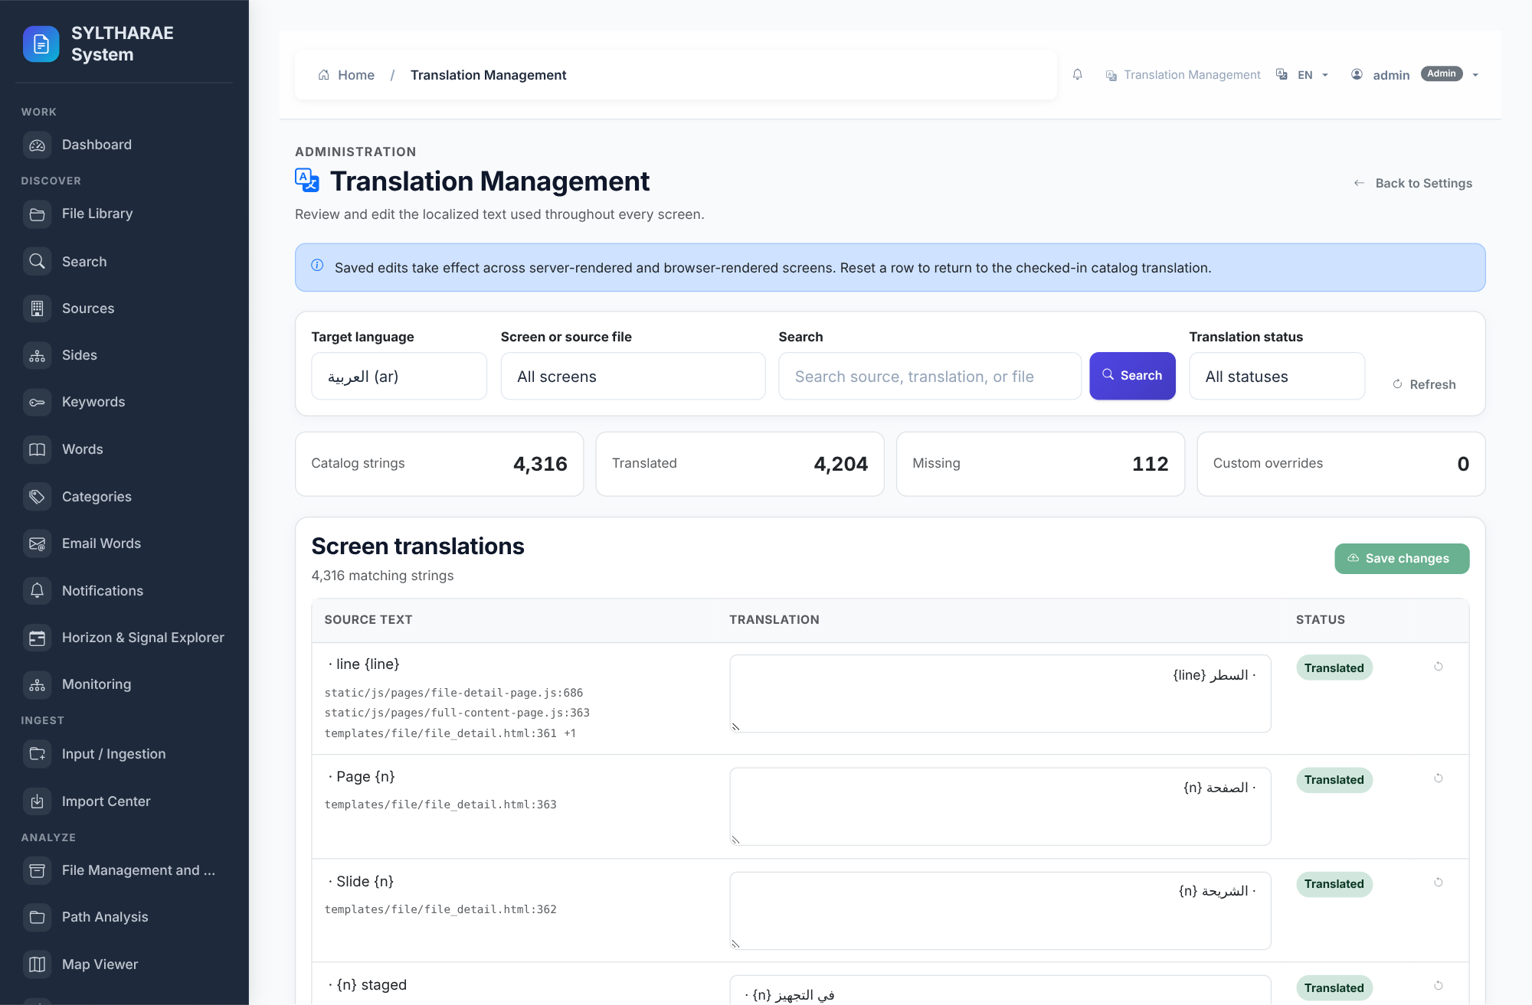
PRODUCT TOUR
Interface reference — Translation Management
LIVE PRODUCT CAPTURE
REAL UI • SAMPLE INSTANCE
1
Settings interface • canonical route: translations.translation_management_page.
2
Maintain translated UI catalog surfaces.
3
Implementation reference: templates/Settings/translation_manager.html. Capture shows the actual running application state; data/empty states are from the synthetic demo instance.
Authentic live screen capture • interface ID translation_manager • templates/Settings/translation_manager.html
86

Slide 87
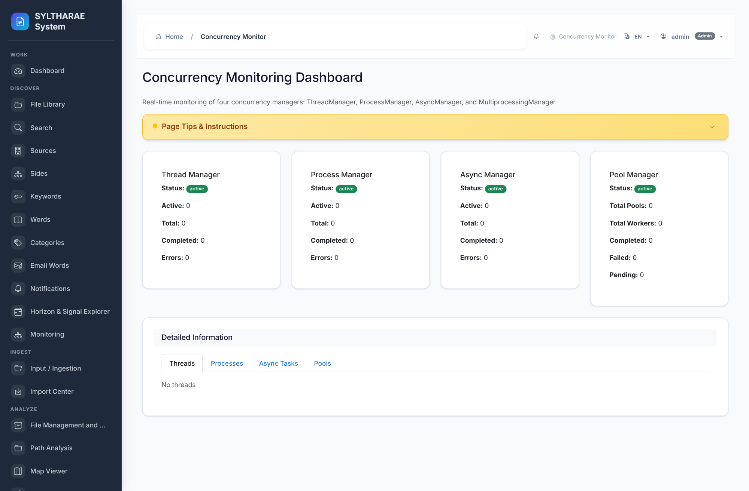
PRODUCT TOUR
Interface reference — Concurrency Monitor
LIVE PRODUCT CAPTURE
REAL UI • SAMPLE INSTANCE
1
Internal interface • canonical route: concurrency.dashboard.
2
Observe thread/job/resource concurrency state.
3
Implementation reference: templates/concurrency/dashboard.html. Capture shows the actual running application state; data/empty states are from the synthetic demo instance.
Authentic live screen capture • interface ID concurrency_monitor • templates/concurrency/dashboard.html
87

Slide 88
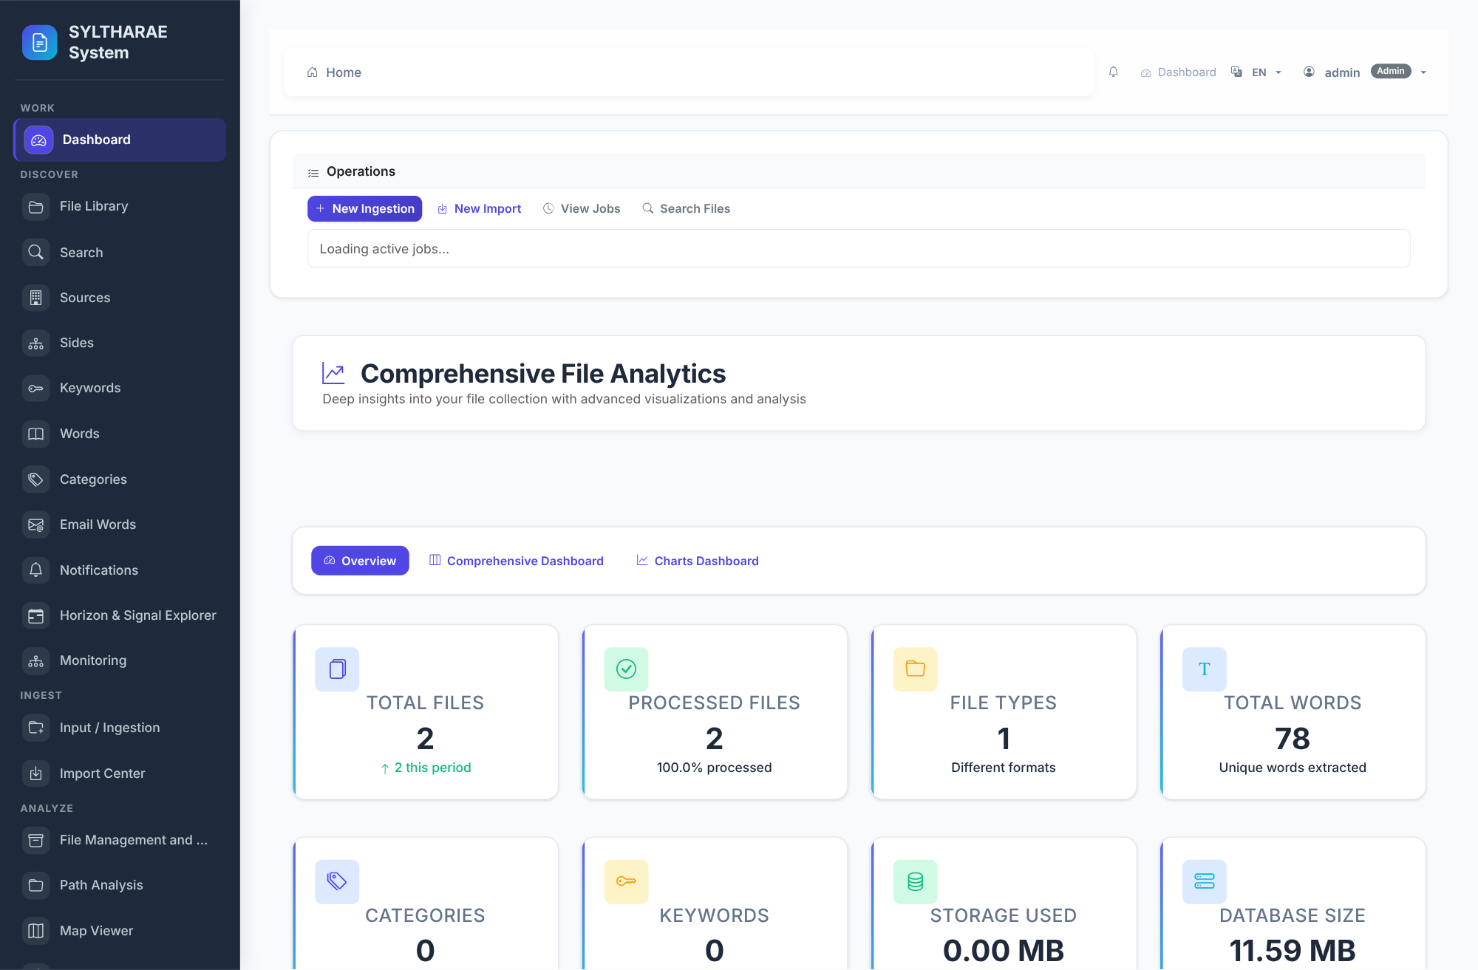
PRODUCT TOUR
Interface reference — Authentication — sign in
LIVE PRODUCT CAPTURE
REAL UI • SAMPLE INSTANCE
1
Operational/secondary interface captured from the live local application.
2
Sign-in form and localized session entry.
3
Source: templates/auth/login.html. Screenshot is authentic; content is the synthetic demo record or the actual setup/login state.
Authentic live screen capture • templates/auth/login.html
88

Slide 89
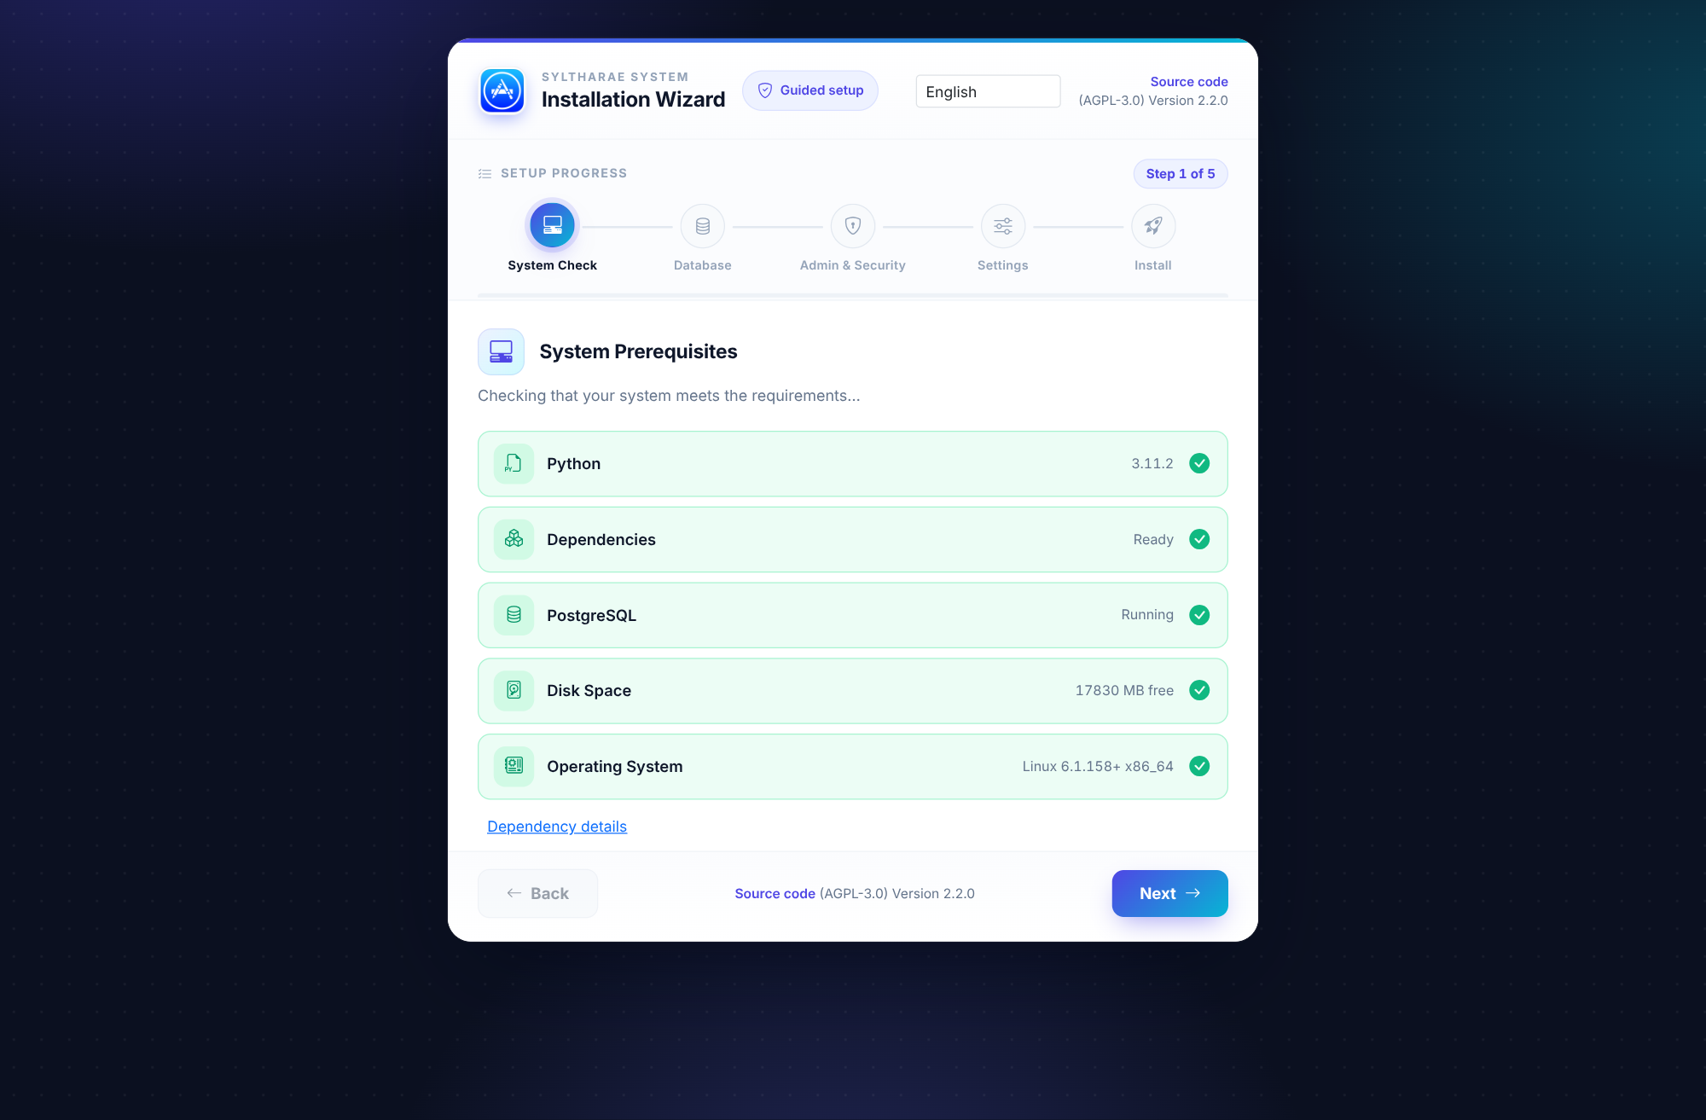
PRODUCT TOUR
Interface reference — First-run setup wizard
LIVE PRODUCT CAPTURE
REAL UI • SAMPLE INSTANCE
1
Operational/secondary interface captured from the live local application.
2
Five-step first-run setup: system check, database, admin/security, settings, install.
3
Source: templates/Setup/install_wizard.html. Screenshot is authentic; content is the synthetic demo record or the actual setup/login state.
Authentic live screen capture • templates/Setup/install_wizard.html
89

Slide 90
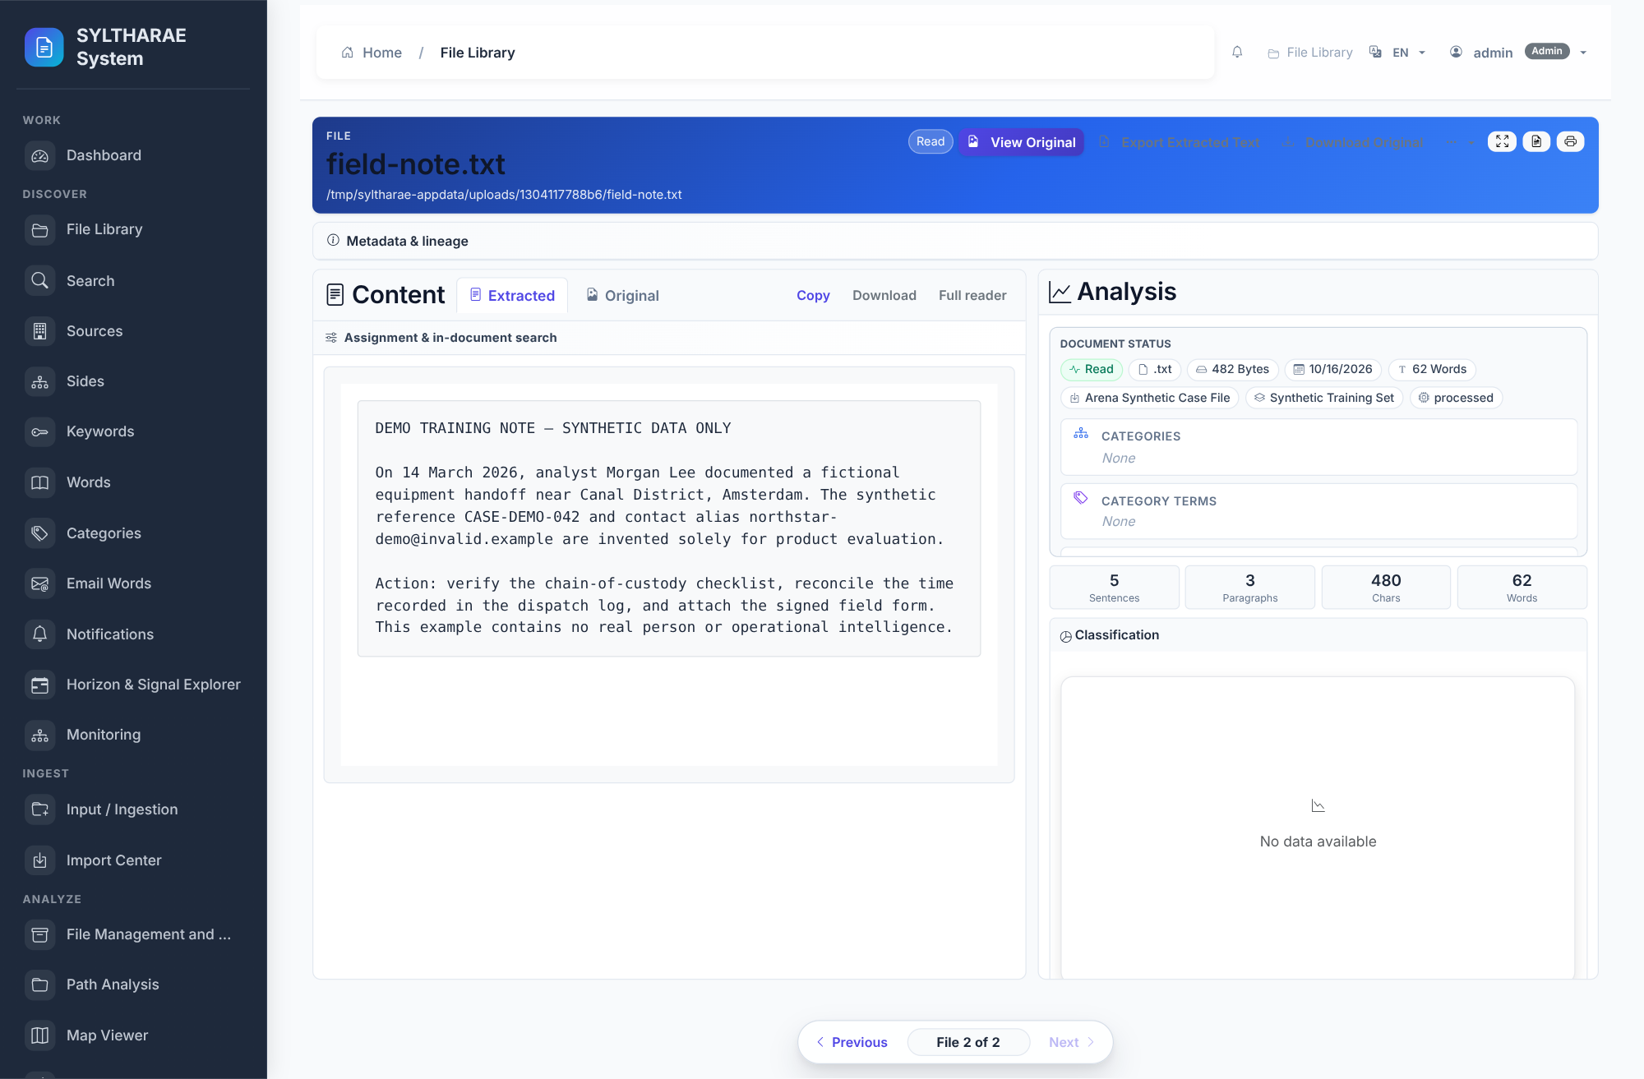
PRODUCT TOUR
Interface reference — File detail & extracted metadata
LIVE PRODUCT CAPTURE
REAL UI • SAMPLE INSTANCE
1
Operational/secondary interface captured from the live local application.
2
Record-level details, provenance, actions and extracted metadata.
3
Source: templates/file/file_detail.html. Screenshot is authentic; content is the synthetic demo record or the actual setup/login state.
Authentic live screen capture • templates/file/file_detail.html
90

Slide 91
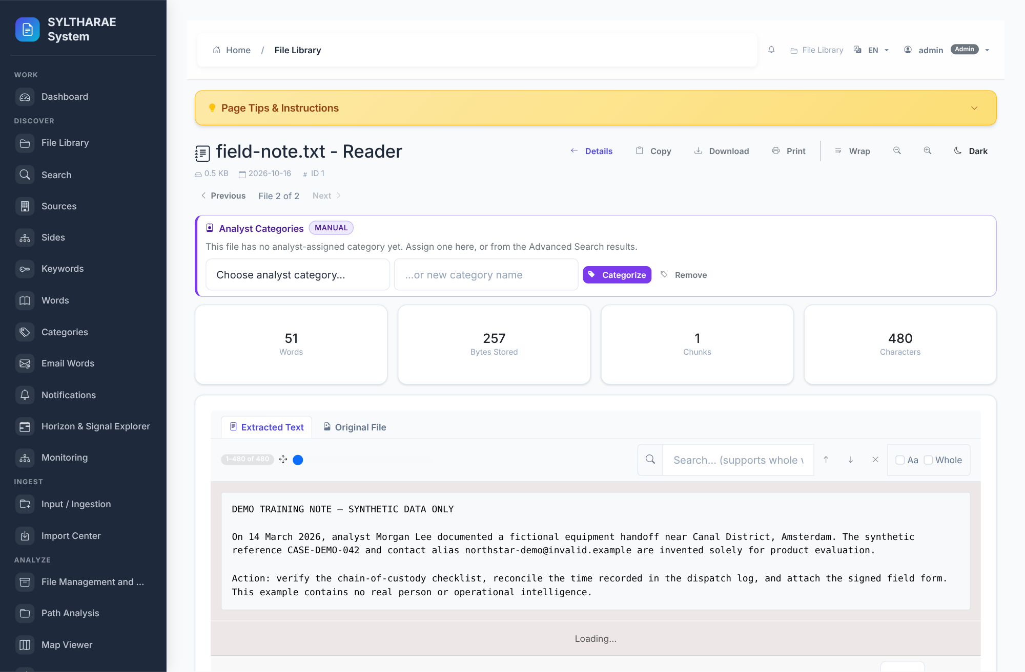
PRODUCT TOUR
Interface reference — Full-text reader
LIVE PRODUCT CAPTURE
REAL UI • SAMPLE INSTANCE
1
Operational/secondary interface captured from the live local application.
2
Read extracted full content associated with an indexed file.
3
Source: templates/file/full_content.html. Screenshot is authentic; content is the synthetic demo record or the actual setup/login state.
Authentic live screen capture • templates/file/full_content.html
91

