Slide 1
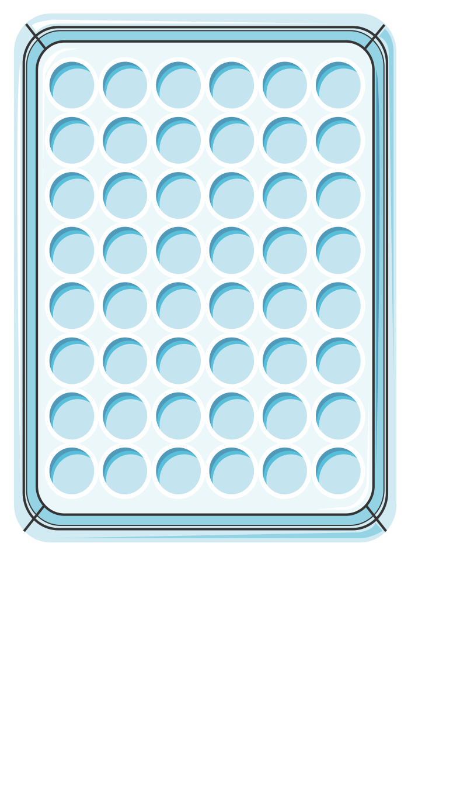
Gentamicin
0
0.25 0.5 1 2 4
0/0
0.125/0.0312
0.25/0.0625
Ceftazidime/avibactam (mg/L)
0.5/0.125
1/0.25
2/0.5
4/1
8/2

