Slide 1

Pharmacology of Systemic Antifungal Therapy
Russell E. Lewis, Pharm.D., FCCP Associate Professor of Infectious Diseases Department of Molecular Medicine, University of Padua

Slide 2
russelledward.lewis@unipd.it https://lewis-id-lab.github.io

Slide 3
Scope and objectives
This lecture covers the systemically administered antifungal agents: the four established classes and the investigational agents now in late-phase development.
By the end you should be able to:
Map each class to its molecular target and explain why the eukaryotic nature of fungi constrains target choice.
State the spectrum of each agent in terms of MIC/MEC distributions rather than species lists alone.
Predict exposure at the site of infection from ADME properties — including CSF, vitreous, urine and lung.
Select the correct PK/PD index for each class and the target magnitude that drives efficacy.
Recognise the toxicities and interactions that limit each agent, and know when therapeutic drug monitoring changes management.
Place rezafungin, ibrexafungerp, fosmanogepix, olorofim and opelconazole in the current therapeutic landscape.
Organising principle. Spectrum tells you whether a drug can work; pharmacokinetics tells you where it can work; pharmacodynamics tells you how much you need. All three must hold for a patient to be cured.

Slide 4
Part 1 · The clinical problem

Slide 5
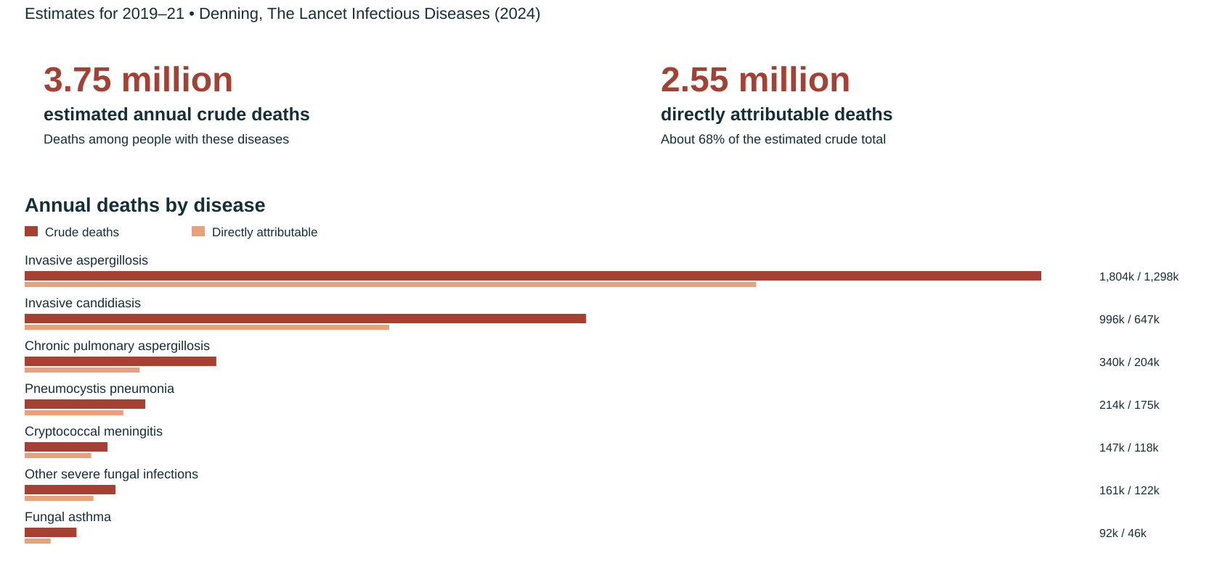
The high mortality burden of fungal diseases

Slide 6
(Denning, 2024)

Slide 7
WHO fungal priority pathogens list (2022)
Priority | Pathogens | Why they are listed
Critical | Cryptococcus neoformans, Candida auris, Aspergillus fumigatus, Candida albicans | High mortality, rising resistance, diagnostic gaps, inadequate treatment options
High | Nakaseomyces glabratus (C. glabrata), Histoplasma spp., eumycetoma agents, Mucorales, Fusarium spp., Candida tropicalis, Candida parapsilosis | Resistance, limited access to therapy, high burden in specific regions
Medium | Scedosporium spp., Lomentospora prolificans, Coccidioides spp., Pichia kudriavzevii (C. krusei), Cryptococcus gattii, Talaromyces marneffei, Pneumocystis jirovecii, Paracoccidioides spp. | Intrinsic multiresistance or geographically concentrated burden

Slide 8
The list is a research and development agenda, not a treatment guideline. Its practical message for pharmacology: the pathogens with the worst outcomes are precisely those for which our existing classes have either no activity (L. prolificans, Fusarium) or unreliable activity (C. auris, azole-resistant A. fumigatus) (Fisher et al., 2022; Gow et al., 2022).

Slide 9
Why is it difficult to develop new antifungals?

Slide 10
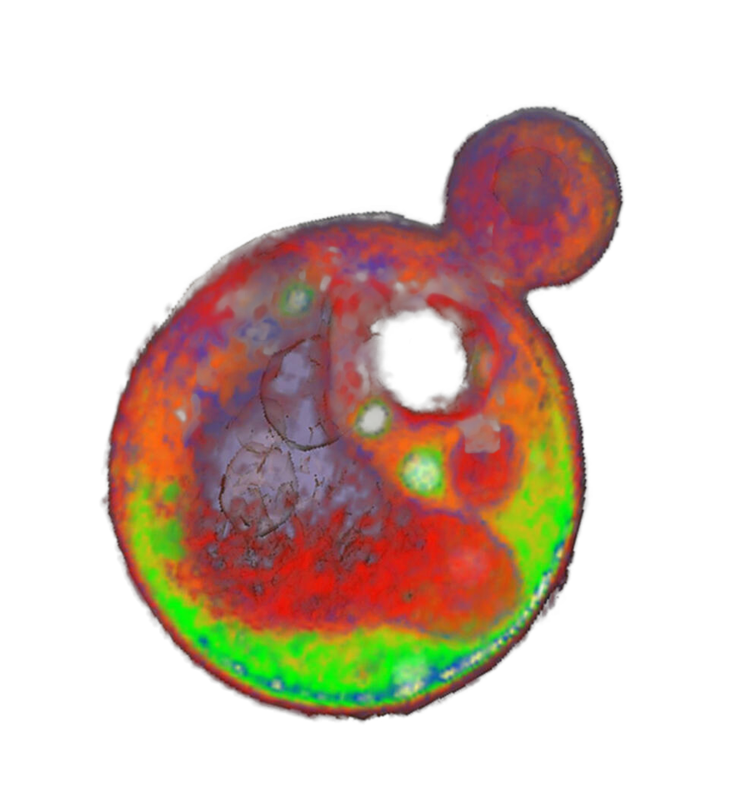
Target scarcity. Fungi are eukaryotes. Pathways that are essential are usually conserved with the human host; selectivity must come from fungus-specific enzymes (Erg11, Fks1/2, Gwt1, fungal DHODH) or fungus-specific sterols and cell wall polymers.
Static versus cidal. Only the polyenes are reliably fungicidal against yeasts and moulds; azoles are fungistatic against yeasts and fungicidal against moulds; echinocandins are the reverse.
Sanctuary sites. CNS, eye, urine and necrotic/abscessed tissue are poorly served by the large, highly protein-bound molecules that otherwise behave well.
Trial design. Mortality endpoints in heterogeneous, critically ill populations require large samples; the rarest and most resistant infections are studied in single-arm salvage trials.
Source: https://www.nigms.nih.gov/image-gallery

Slide 11
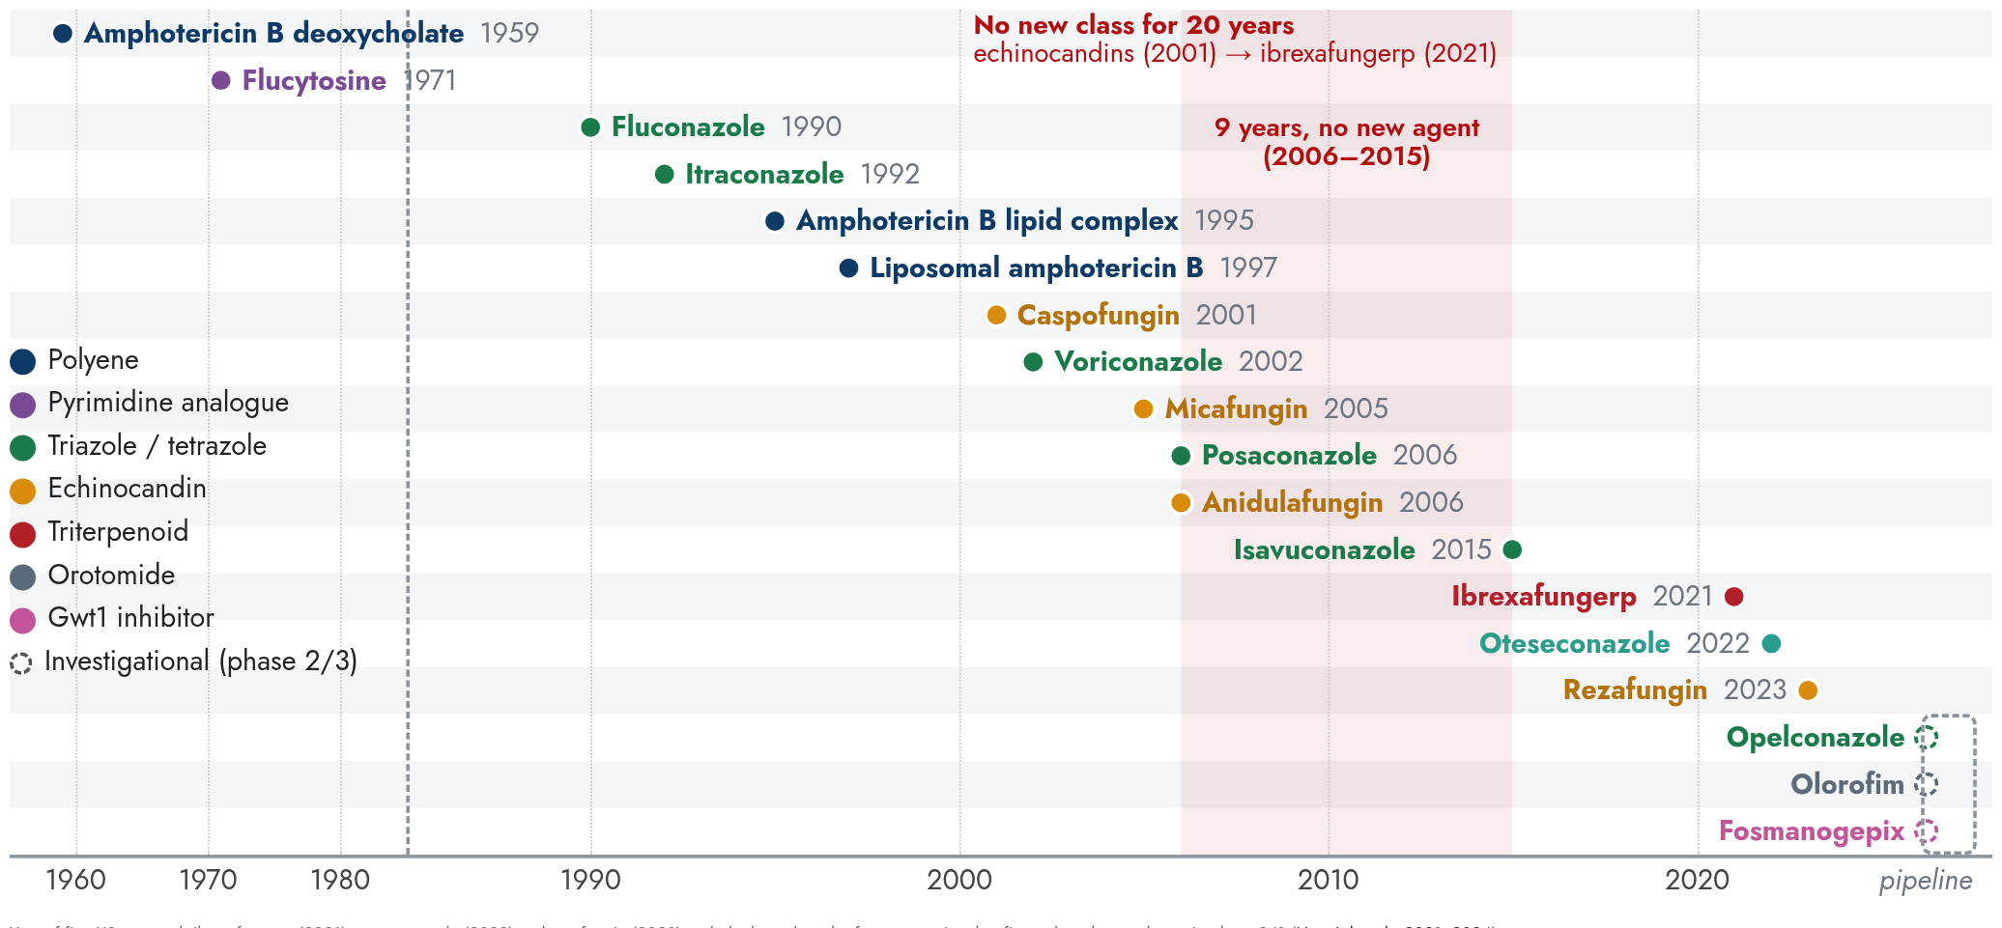
Six decades of systemic antifungal approvals

Slide 12
Year of first US approval. Ibrexafungerp (2021), oteseconazole (2022) and rezafungin (2023) ended a long drought; fosmanogepix, olorofim and opelconazole are in phase 2/3 (Hoenigl et al., 2021, 2024).

Slide 13
Four established targets, three new ones
Target | Molecular site | Agents | Effect on the cell
Ergosterol itself | Membrane ergosterol — extraction into an extramembranous “sterol sponge” | Amphotericin B (deoxycholate, ABLC, liposomal) | Sterol depletion, permeability loss, oxidative injury; fungicidal (Anderson et al., 2014; Gray et al., 2012)
Ergosterol synthesis | Lanosterol 14α-demethylase (Erg11 / Cyp51A) | Triazoles, tetrazole (oteseconazole), inhaled opelconazole | Ergosterol depletion plus accumulation of toxic 14α-methyl sterols; fungistatic vs yeasts, fungicidal vs moulds
Cell wall β-1,3-glucan | β-1,3-D-glucan synthase (Fks1 / Fks2) | Echinocandins, rezafungin; triterpenoid ibrexafungerp at a distinct site | Loss of wall integrity and lysis; fungicidal vs Candida, fungistatic vs Aspergillus
Pyrimidine salvage | Cytosine deaminase (Fca1) → 5-FU → RNA miscoding and thymidylate synthase inhibition | Flucytosine | Fungistatic; requires partner drug
GPI-anchor maturation | Gwt1 inositol acyltransferase | Fosmanogepix (prodrug of manogepix) | Mannoproteins fail to anchor to the wall; loss of adhesion, biofilm and germ-tube formation
Pyrimidine de novo synthesis | Fungal dihydroorotate dehydrogenase (DHODH) | Olorofim (orotomide) | Pyrimidine starvation; fungicidal vs moulds, no yeast activity (Oliver et al., 2016)
Iron uptake | Sit1 siderophore transporter | ATI-2307, VL-2397 class | Fungus-specific transporter-mediated entry

Slide 14
Fungi are eukaryotes: every one of these targets exists because it is absent or structurally divergent in humans.

Slide 15
The pharmacodynamic framework
Class | PK/PD index | Driver of effect | Implication for dosing
Polyenes | C_{max}/MIC, AUC/MIC | Concentration-dependent killing, long post-antifungal effect | Large intermittent doses; single 10 mg/kg liposomal dose is rational
Triazoles | AUC_{0–24}/MIC | Exposure-dependent, saturable | Total daily exposure matters, not peak; loading doses needed
Echinocandins | C_{max}/MIC, AUC/MIC, (MEC for moulds) | Concentration-dependent with prolonged persistence in tissue | Front-loading works; weekly rezafungin exploits this
Flucytosine | %T > MIC | Time-dependent, fungistatic | Divided dosing; never monotherapy
Olorofim | AUC/MIC (MEC) | Exposure-dependent | Twice-daily oral dosing to a minimum concentration target

Slide 16
Why the index matters. The AUC/MIC ratio predicted efficacy across Candida, Cryptococcus and Aspergillus models for the azoles, whereas amphotericin B killing is best described by the ratio of peak concentration to MIC (Andes, 2003). Echinocandin targets differ by species — the free-drug AUC/MIC needed for stasis is substantially higher for C. parapsilosis than for C. albicans (Andes et al., 2010).
MIC is not interchangeable across methods. EUCAST and CLSI values diverge for several agents; rezafungin required 0.002% Tween 20 in the medium to stop non-specific binding to plastics from inflating MICs (Hoenigl et al., 2024). Against moulds, echinocandins and manogepix are read as a minimum effective concentration (MEC) — the lowest concentration producing short, stubby, aberrantly branched hyphae — not an MIC.

Slide 17
Part 2 · Established agents

Slide 18
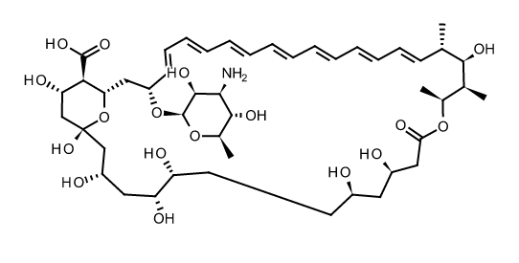
Polyenes · amphotericin B

Slide 19
Amphotericin B is an amphipathic heptaene macrolide: a lactone ring with seven conjugated double bonds (lipophilic face) opposite a polyol face (hydrophilic), plus a mycosamine sugar. It is zwitterionic and poorly water-soluble, hence the deoxycholate or lipid carriers needed for IV infusion.

Slide 20
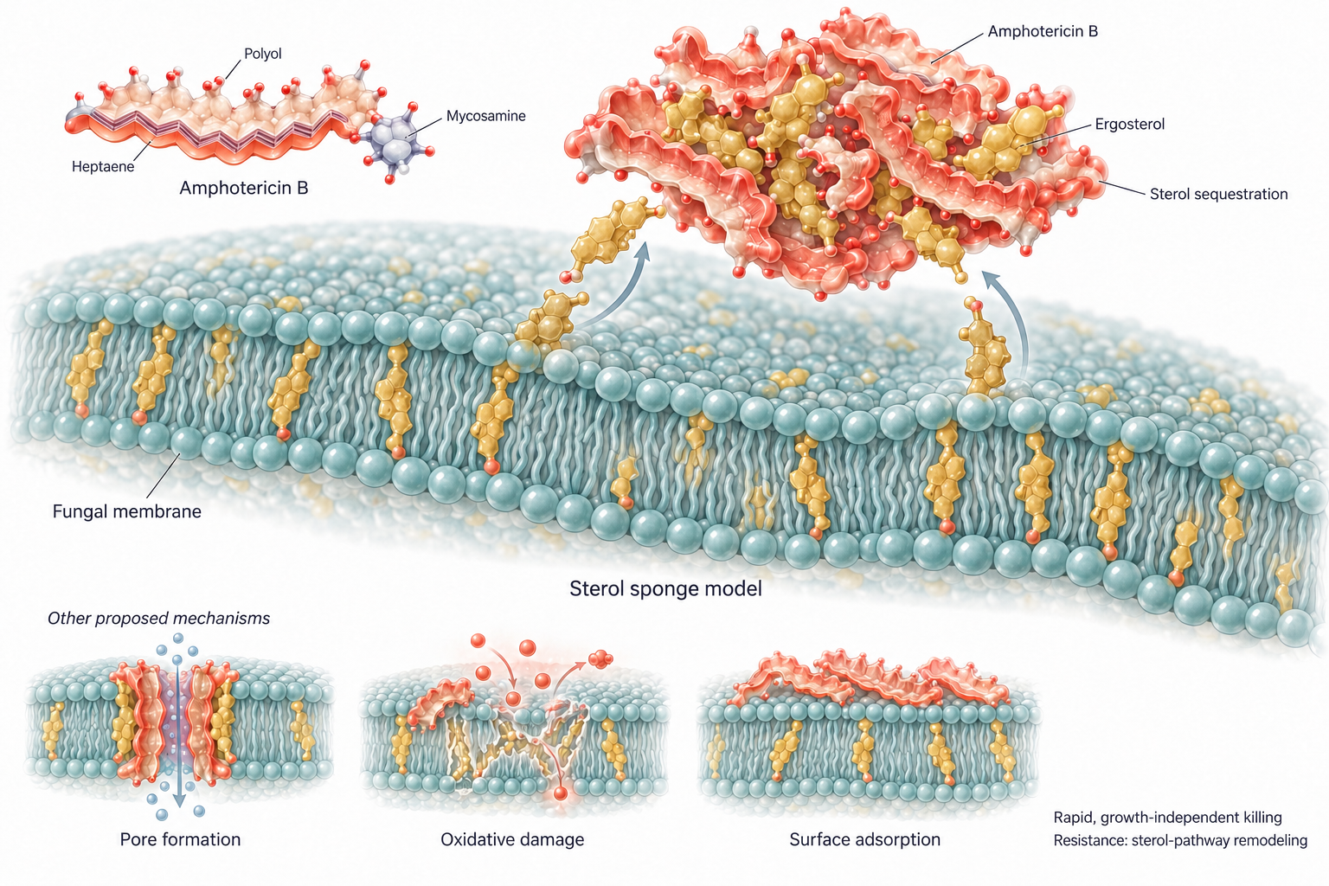
Polyenes · mechanism of action

Slide 21
One drug, four formulations. The active moiety is identical; formulation changes distribution and toxicity, never spectrum:
amphotericin B deoxycholate (AMBD, 1959)
amphotericin B colloidal dispersion (ABCD)-no longer available
amphotericin B lipid complex (ABLC)
liposomal amphotericin B (L-AmB)-most frequently used

Slide 22
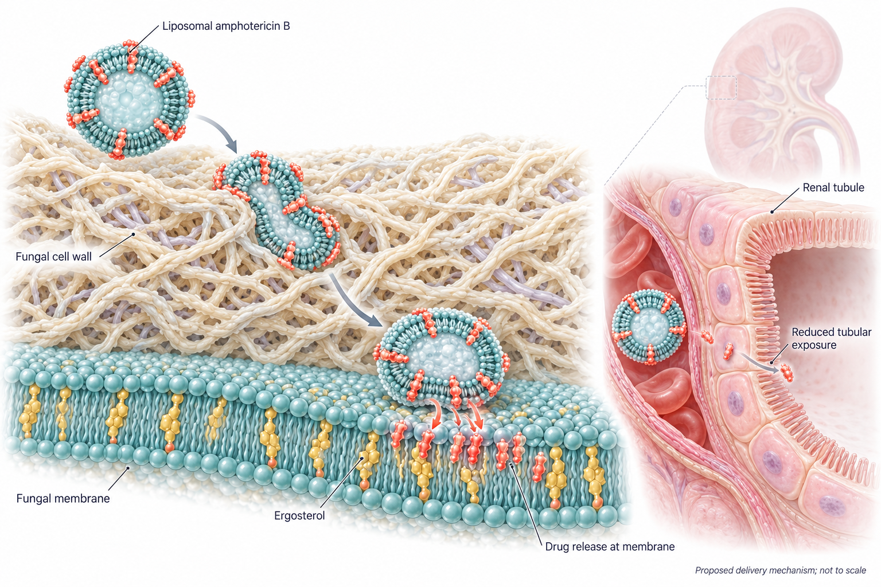
How does the liposomal formulation change the pharmacology of amphotericin B?

Slide 23
Liposomal amphotericin B traverses the fungal cell wall and releases amphotericin B at the ergosterol-containing cell membrane, disrupting membrane function. Liposomal encapsulation limits renal tubular exposure to amphotericin B, reducing nephrotoxicity compared with the conventional deoxycholate formulation.

Slide 24
Polyenes · microbiology and spectrum
Organism | Typical MIC₉₀ (mg/L) | Comment
C. albicans, C. tropicalis, C. parapsilosis | 0.25–1 | Wild-type; EUCAST/CLSI susceptible ≤1
N. glabratus (C. glabrata) | 0.5–1 | Reliably active; MICs slightly higher than C. albicans
C. auris | 1–>2 | Amphotericin B resistance in ~30–40% of isolates
C. lusitaniae | variable, often >1 | Classic intrinsic/inducible resistance
Cryptococcus neoformans | 0.25–1 | Backbone of induction therapy
A. fumigatus | 0.5–2 | Active; A. terreus, A. lentulus, A. calidoustus intrinsically resistant
Mucorales | 0.25–1 | Drug of choice for first-line therapy
Fusarium spp. | 1–>8 | Variable; F. solani complex least susceptible
Scedosporium / L. prolificans | >8 | Intrinsically resistant

Slide 25
Where amphotericin B fails in vitro. Primary resistance clusters in A. terreus, A. calidoustus, A. lentulus, Scedosporium, Trichosporon, and — among yeasts — C. lusitaniae and C. auris. Acquired resistance in normally susceptible species is rare and usually accompanied by reduced growth and virulence, reflecting the cost of rebuilding the sterol pathway (ERG2, ERG3 lesions, alternative sterols, sphingolipid modulation).

Slide 26
Polyenes · ADME
Parameter | Amphotericin B deoxycholate | Liposomal amphotericin B
Absorption | Not orally bioavailable; IV only | IV only (oral encochleated formulation investigational)
Protein binding | >95%, principally to β-lipoprotein | High; drug remains liposome-associated in circulation
C_{max} | 0.5–2.0 mg/L at conventional doses, falling to a 0.2–0.5 mg/L plateau | Markedly higher C_{max} and AUC at equal mg/kg — up to ~10-fold (Groll et al., 2019)
Distribution | Leaves plasma rapidly, binds cholesterol-containing membranes; stored in liver and other organs; localises to endothelium, including activated endothelium at infection sites | Preferential uptake by the reticuloendothelial system; high liver/spleen concentrations
Metabolism / elimination | Degraded in situ; only a small fraction excreted in urine or bile | Similar; negligible renal clearance of active drug
Half-life | Initial ~24 h; terminal β-phase ~15 days; detectable in serum up to 7 weeks after the last dose | Prolonged; supports intermittent high-dose strategies
Organ dysfunction | Blood levels unaffected by renal or hepatic failure; not removed by haemodialysis | No dose adjustment for renal replacement therapy

Slide 27
Formulation pharmacokinetics compiled from refs (Bellmann and Smuszkiewicz, 2017; Groll et al., 2019; Hamill, 2013).

Slide 28
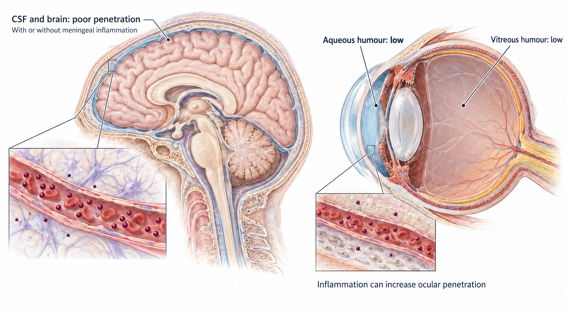
Polyenes · penetration into privileged sites

Slide 29
Note
The cryptococcal paradox. Amphotericin B achieves minimal CSF concentrations yet produces the fastest rate of CSF sterilisation of any agent. Explanations include cidal activity at low concentrations and the long tissue residence of drug. CSF and brain-to-plasma ratios in rabbits are similarly low (≤0.3) for deoxycholate, lipid-complex and liposomal formulations, and inflammation does not appear to raise them, so formulation does not rescue CNS exposure (Felton et al., 2014). Whole-tissue homogenates also overestimate the biologically available drug (lipid-bound versus free drug), and cryptococcal disease is multifocal. The practical lesson: plasma or CSF concentration is a poor surrogate for polyene effect.
Outside the CNS, polyenes reach high concentrations in liver, spleen, kidney and bone marrow, and are low in bronchial secretions and skeletal muscle (Felton et al., 2014).

Slide 30
Polyenes · pharmacodynamics
Concentration-dependent killing. Time–kill and murine models show that effect is best described by C_{max}/MIC; onset is rapid and unrelated to growth rate (Andes, 2003).
Prolonged post-antifungal effect, consistent with drug remaining bound to membrane sterols after free concentrations fall.
Together these properties have been used to justify large, infrequent dosing of the liposomal formulation in select situations.
Clinical proof of the PD logic. In AMBITION-cm, a single 10 mg/kg dose of liposomal amphotericin B plus 14 days of flucytosine and fluconazole was non-inferior to 7 days of daily amphotericin B deoxycholate for HIV-associated cryptococcal meningitis, with less toxicity (Jarvis et al., 2022).
More is not always better. In AmBiLoad, liposomal amphotericin B 10 mg/kg/day for invasive mould disease produced no efficacy benefit over 3 mg/kg/day but more nephrotoxicity and hypokalaemia (Cornely et al., 2007a). Front-loading works for a single sterilising dose, not as a chronic daily strategy.

Slide 31
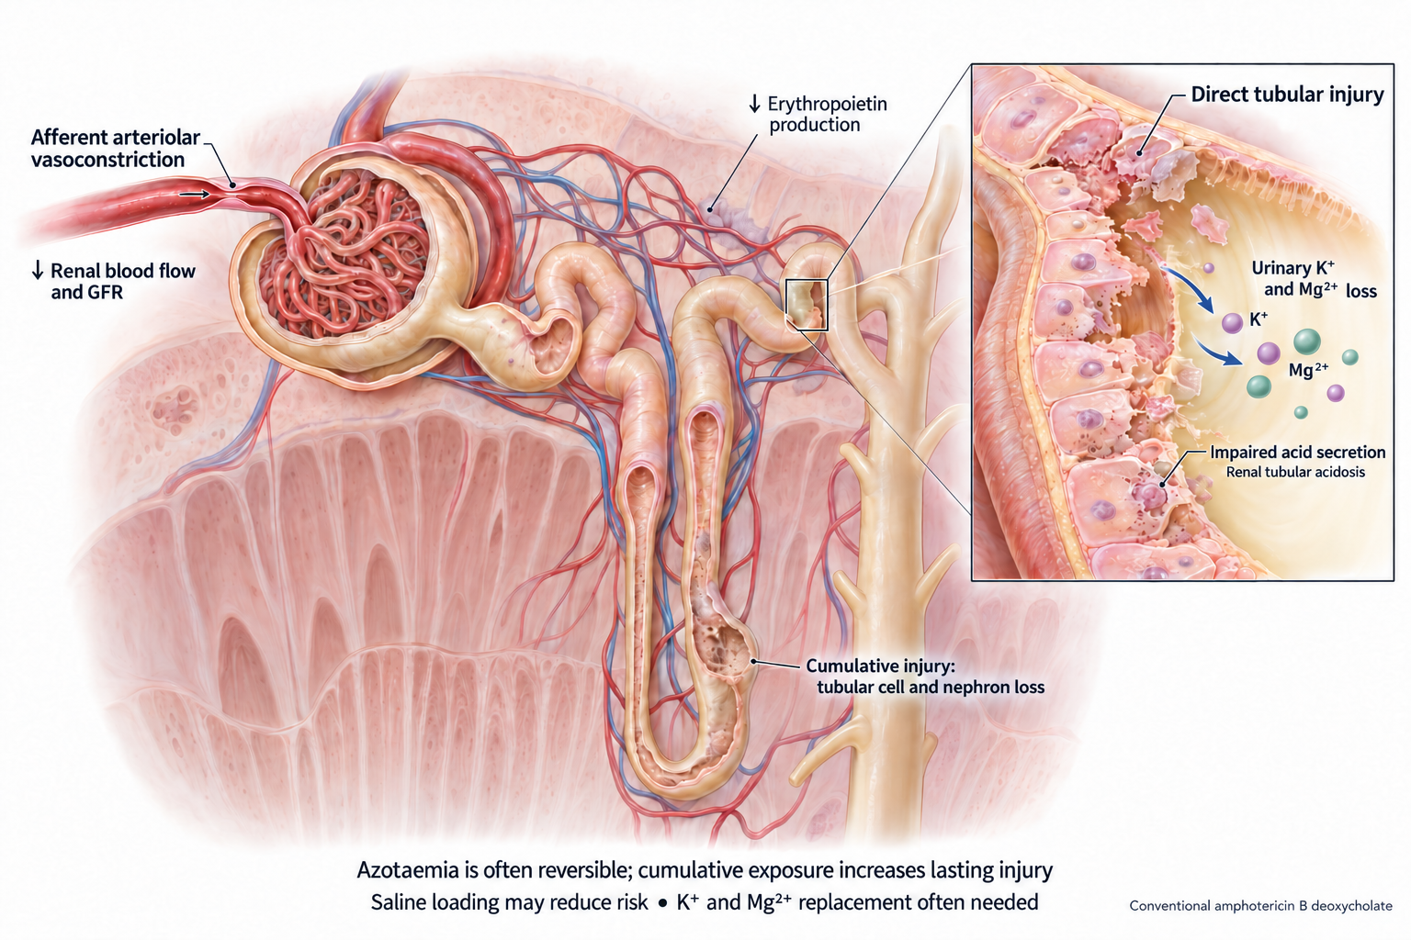
Polyene toxicity · Dose-limiting nephrotoxicity

Slide 32
Polyene · infusion-related reactions

Slide 33
Direct (cytokine) reaction
Classically with amphotericin B deoxycholate
Mechanism: deoxycholate-AMB stimulates innate immune cells via TLR/CD14 signalling (mainly TLR2/TLR1; TLR4 contribution reported), releasing TNF-α, IL-1β, IL-6 and IL-8 (Razonable et al., 2005; Sau et al., 2003).
Onset: chills, fever and tachypnoea 30–45 min into the first infusions; peak at 15–30 min; settle over 2–4 h.
Course: milder with successive doses; less common in young children and in patients on corticosteroids.
Mitigation: paracetamol premedication, hydrocortisone 25–50 mg in the infusion, meperidine for established rigors.
CARPA
Complement activation-related pseudoallergy, seen with liposomal AMB
Mechanism: liposomes activate complement; the anaphylatoxins C3a and C5a trigger mast cell and basophil degranulation (Szebeni, 2005). Not IgE-mediated, so no prior sensitisation is needed (Thompson et al., 2025).
Onset: within minutes of starting the infusion; C3a and SC5b-9 are already raised at 5 min (Thompson et al., 2025).
Features: chest and back pain, flushing, dyspnoea, haemodynamic change, sometimes fever (Roden et al., 2003; Thompson et al., 2025).
Management: pause or stop the infusion, give antihistamine ± steroid, and consider restarting more slowly; premedication and rate reduction are practical, but controlled evidence is limited (Nham et al., 2025; Thompson et al., 2025).

Slide 34
Different mechanism, different fix. Antipyretic and steroid premedication targets the cytokine reaction; CARPA is complement-driven, so management centres on pausing or slowing the infusion and treating symptoms.

Slide 35
Polyenes · other adverse effects
Normocytic normochromic anaemia (haematocrit rarely <20–25%), nausea, anorexia, phlebitis.
Rare: thrombocytopenia, arrhythmia, hepatic transaminase elevation, encephalopathy, seizures.
Lipid formulations reduce but do not abolish nephrotoxicity and infusion reactions.
Virtually no CYP-mediated drug interactions — but additive nephrotoxicity with calcineurin inhibitors and aminoglycosides.
TDM has no established role. Routine measurement of serum, urine or CSF amphotericin B concentrations does not aid management; monitoring is of renal function, potassium and magnesium.

Slide 36
Polyenes · clinical use
Indication | Role
Mucormycosis | First-line therapy, liposomal formulation, high dose (Cornely et al., 2019)
Cryptococcal meningitis | Induction backbone with flucytosine; single-dose 10 mg/kg L-AmB regimen in resource-limited settings (Jarvis et al., 2022; Molloy et al., 2018)
Invasive candidiasis | Alternative to echinocandins; preferred where CNS, ocular or urinary involvement is suspected (Pappas et al., 2015)
Invasive aspergillosis | Second-line, or first-line when azole resistance is likely or azoles cannot be used (Patterson et al., 2016; Ullmann et al., 2018)
Endemic mycoses | Severe/disseminated disease induction, followed by oral triazole step-down
Empirical therapy in persistent neutropenic fever | Historical standard; largely replaced by pre-emptive, diagnostic-driven strategies

Slide 37
Choose the lipid formulation for essentially all systemic indications in high-income settings. Deoxycholate retains a role where cost dominates and renal monitoring is feasible — and the single-dose liposomal regimen now offers a toxicity-sparing alternative in exactly those settings (Jarvis et al., 2022).

Slide 38
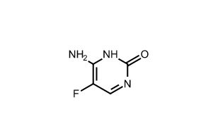
5-Flucytosine (5-FC, Flucytosine)

Slide 39
Flucytosine (5-fluorocytosine) is a small, water-soluble fluorinated pyrimidine analogue of cytosine (molecular weight about 129), with a fluorine at C-5 of the pyrimidine ring. It is a prodrug with no intrinsic activity: fungal cytosine deaminase converts it to 5-fluorouracil, an enzyme that mammalian cells largely lack.

Slide 40
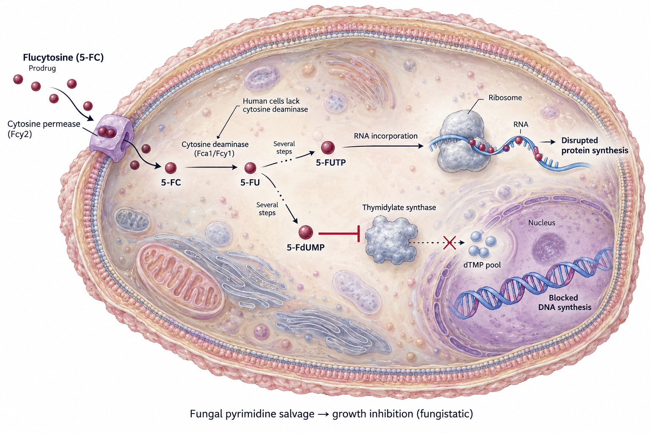
Flucytosine · mechanism of action

Slide 41
Resistance is easy and fast — never use alone.
FUR1 C301T → R101C in uracil phosphoribosyltransferase (impaired quaternary structure)
Homozygous FCA1 G28D in cytosine deaminase
In Cryptococcus: MBS1, UXS1 and URA6 lesions beyond the salvage pathway
In A. fumigatus: pH-dependent resistance — the CBC and PacC regulators downregulate the purine–cytosine permease orthologue fcyB

Slide 42
Flucytosine · microbiology and spectrum
Organism | Typical MIC₉₀ (mg/L) | Clinical relevance
C. albicans | 0.12–0.5 | Highly susceptible; wild-type
N. glabratus (C. glabrata) | 0.12–0.5 | Susceptible
C. tropicalis, C. parapsilosis | 0.12–1 | Susceptible
P. kudriavzevii (C. krusei) | 1–32 | Reduced susceptibility
Cryptococcus neoformans / gattii | 2–8 | Key indication — synergy with amphotericin B
Aspergillus spp. | >32 (pH-dependent) | Not clinically useful
Mucorales, Fusarium, Scedosporium | >64 | No activity

Slide 43
Spectrum is essentially yeasts only, and the indication is driven by synergy rather than by potency: amphotericin B permeabilises the membrane and increases flucytosine entry, while flucytosine accelerates sterilisation of the CSF.

Slide 44
Flucytosine · ADME
Parameter | Value
Oral bioavailability | Excellent: 78–89% absorbed in healthy volunteers; peak 30–40 mg/L within 2 h of a 2 g dose
Effect of food / antacids | Absorption delayed (not reduced) by food or aluminium hydroxide
Bioavailability in disease | Falls to 40–76% in renal failure and ~45% in late-stage HIV infection
Volume of distribution | ~0.6 L/kg — approximates total body water, independent of renal function
Protein binding | <4% — effectively unbound drug
Metabolism | No conventional hepatic metabolism. About 4% of an oral dose is deaminated to 5-FU by intestinal bacterial flora — enough to reach 5-FU exposures associated with cytotoxicity
Elimination | Renal, unchanged, by glomerular filtration with little tubular handling; up to 95% recovered in urine within 24 h
Dialysis | Clearance by haemodialysis is nearly indistinguishable from creatinine clearance — dose after dialysis

Slide 45
Parameters as tabulated in the primary chapter source and the standard pharmacology review (Vermes et al., 2000).
Renal function is the entire dosing story. A small, hydrophilic, unbound, renally cleared drug with a narrow therapeutic index: every dose must be adjusted to creatinine clearance, and concentrations must be measured.

Slide 46
Flucytosine · penetration and pharmacodynamics

Slide 47
Penetration — the best of any antifungal
CSF: 60–90% of the simultaneous serum concentration.
Peritoneal fluid: ~65–100% of serum in limited human data (Felton et al., 2014).
Also penetrates aqueous and vitreous (~40–100% of serum), bronchial secretions (~75% in dogs) and synovial fluid (~40–80%) (Felton et al., 2014).
Urine: up to 95% of the dose appears as active drug — Effective for Candida cystitis and renal parenchymal disease.
Pharmacodynamics
Fungistatic in time–kill and murine models.
Substantial post-antifungal effect: 2–4 h in vitro, 3.3–15.1 h in vivo; the effect increases with concentrations up to ~4× MIC.
The index that best predicts efficacy is %T > MIC, supporting conventional divided dosing (100 mg/kg/day in four divided doses).

Slide 48
A time-dependent, fungistatic agent with near-complete oral absorption, free drug distribution into every compartment of interest, and renal elimination — pharmacologically close to ideal, and limited almost entirely by toxicity and resistance, not by exposure.

Slide 49
Flucytosine · toxicity and therapeutic drug monitoring

Slide 50
Toxicity is largely 5-FU toxicity
Dose-related myelosuppression — neutropenia and thrombocytopenia; the principal risk, and the reason for monitoring.
Hepatotoxicity: transaminase elevation, usually reversible.
Gastrointestinal: nausea, vomiting, diarrhoea; severe enterocolitis is described.
Risk rises steeply with accumulation in renal impairment and with intestinal conversion to 5-FU.
TDM is mandatory, not optional
 | Target
Peak (2 h post-dose) | 30–80 mg/L
Concentration to avoid | >100 mg/L — strongly associated with marrow and hepatic toxicity
Sampling | At steady state (~day 3–4) and after every dose change or change in renal function
Fifteen years of UK monitoring experience confirm that a substantial proportion of patients fall outside the target range on standard weight-based dosing, chiefly because of unrecognised renal impairment (Ashbee et al., 2013; Pasqualotto et al., 2007).

Slide 51
Flucytosine · clinical use
Indication | Regimen and evidence
Cryptococcal meningitis — induction | With amphotericin B. In the ACTA trial, one week of amphotericin B deoxycholate plus flucytosine was as effective as two weeks and less toxic; oral fluconazole plus flucytosine was an effective all-oral alternative where amphotericin B is unavailable (Molloy et al., 2018)
 | Adding flucytosine to amphotericin B improves the rate of CSF sterilisation and survival compared with amphotericin B alone (Loyse et al., 2013)
 | Now also the partner for single-dose 10 mg/kg liposomal amphotericin B (Jarvis et al., 2022)
Candida CNS infection, endophthalmitis | Added to amphotericin B for sanctuary-site penetration (Pappas et al., 2015)
Candida urinary tract infection | Option for fluconazole-resistant Candida cystitis — short courses only, because resistance emerges rapidly
Chromoblastomycosis, selected rare moulds | Adjunctive, historical

Slide 52
Access, not evidence, is the limiting factor. Flucytosine is unavailable or unaffordable in much of the region carrying the greatest cryptococcal burden — a major contributor to global cryptococcal mortality (Ikuta et al., 2024; Molloy et al., 2018).

Slide 53
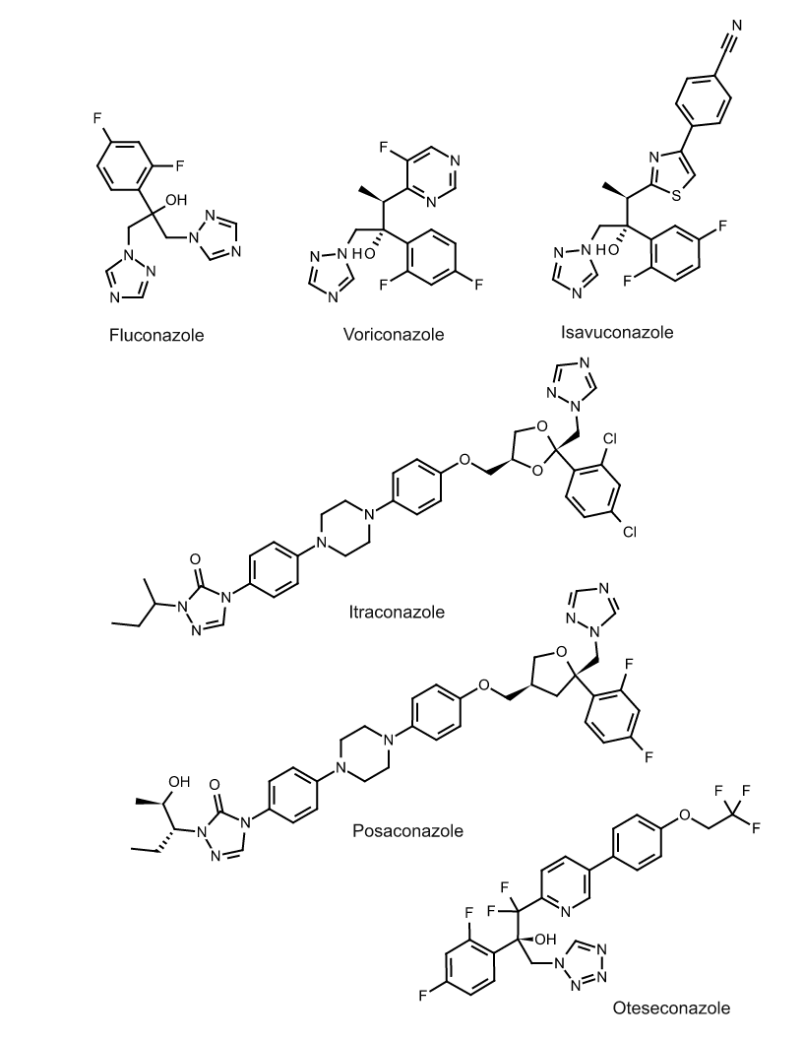
Azoles
Azole ring: a five-membered N-containing heterocycle linked to the rest of the molecule through a ring nitrogen (N-1).
Imidazoles (two N; e.g. ketoconazole, miconazole, clotrimazole) are largely topical or limited by toxicity and interactions.
Triazoles (three N; fluconazole, itraconazole, voriconazole, posaconazole, isavuconazole) are the systemic agents, with greater CYP selectivity for the fungal enzyme.
Tetrazoles (four N; oteseconazole) replace the triazole with a tetrazole metal-binding group, designed for weaker binding to human CYPs and so greater fungal CYP51 selectivity. It is very long-lived (half-life of months) and approved for recurrent vulvovaginal candidiasis, not systemic infection.
Pharmacophore: the unsubstituted ring N (N-4 in triazoles, N-3 in imidazoles) binds the haem iron of fungal CYP51 (Erg11).
Side chain: a halogenated (fluoro/chlorophenyl) group and a lipophilic tail drive potency, spectrum, solubility, and CYP interactions. Short-tailed agents (fluconazole, voriconazole) are smaller and more water-soluble; long-tailed agents (itraconazole, posaconazole) are larger and lipophilic.

Slide 54
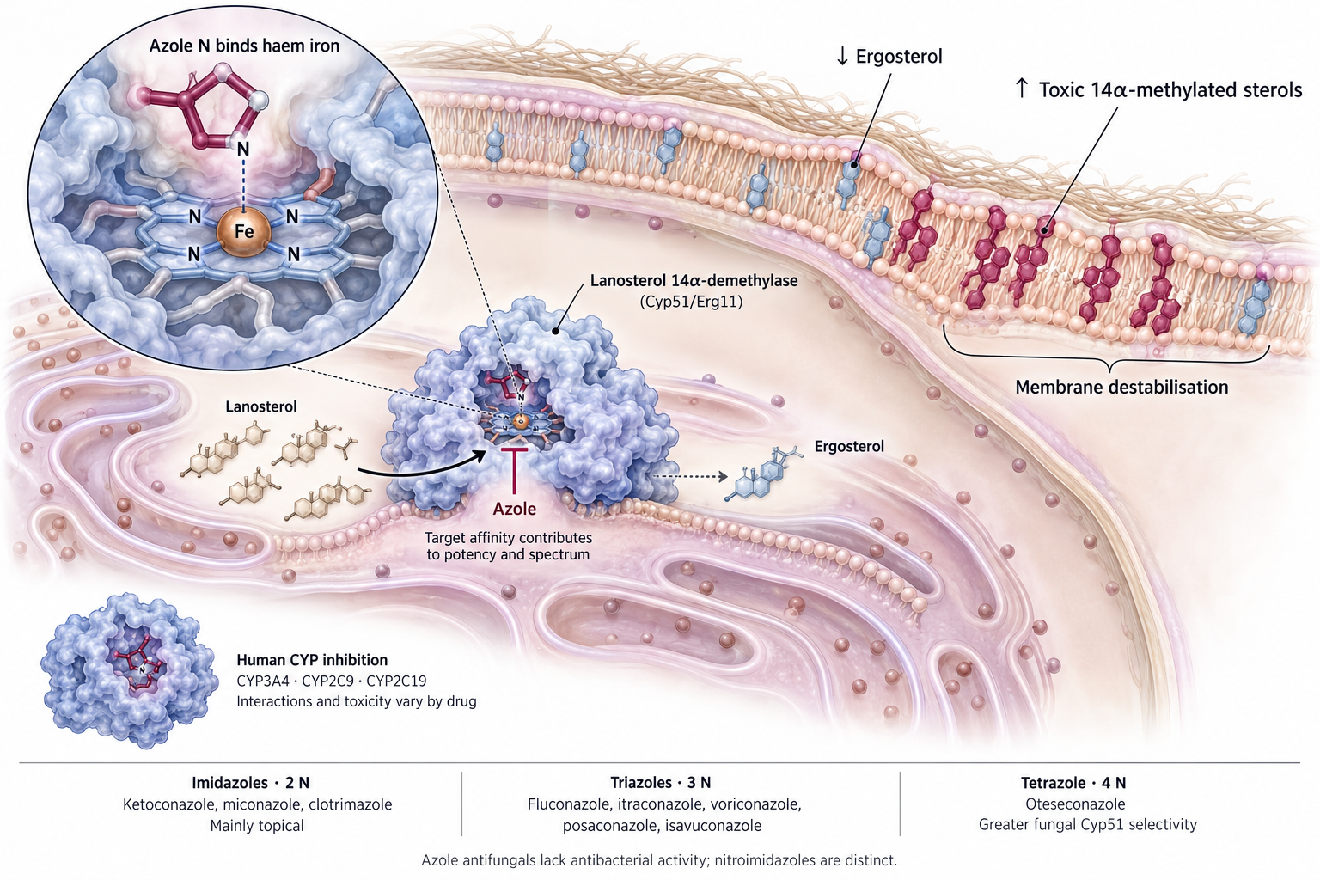
Azoles · mechanism of action

Slide 55
Fungistatic against yeasts, fungicidal against moulds. This asymmetry explains why azoles work as step-down and prophylaxis in candidiasis, but can be curative monotherapy in aspergillosis.
The tetrazole scaffold of oteseconazole replaces the triazole iron-binding group to gain selectivity for fungal Cyp51 over human CYP enzymes — fewer interactions, fewer off-target effects.

Slide 56
Triazoles · comparative spectrum and MICs
Organism | Fluconazole | Itraconazole | Voriconazole | Posaconazole | Isavuconazole
C. albicans (MIC₉₀, mg/L) | 0.25–1 | 0.06–0.25 | 0.015–0.06 | 0.03–0.06 | 0.015–0.06
N. glabratus (C. glabrata) | 8–32 | 0.5–2 | 0.25–1 | 0.5–2 | 0.5–2
C. parapsilosis | 0.5–2 | 0.12–0.5 | 0.03–0.12 | 0.06–0.25 | 0.03–0.12
P. kudriavzevii (C. krusei) | 32–64 (intrinsic R) | 0.25–1 | 0.12–0.5 | 0.12–0.5 | 0.12–0.5
C. auris | 32–>64 (~90% R) | variable | 0.5–>8 | 0.06–1 | 0.12–1
Cryptococcus neoformans | 2–8 | 0.12–0.5 | 0.03–0.12 | 0.06–0.25 | 0.03–0.12
A. fumigatus (MEC/MIC) | >64 (no activity) | 0.5–1 | 0.5–1 | 0.03–0.25 | 0.5–2
Mucorales | >64 | >8 | >8 (intrinsic R) | 0.5–2 | 1–4
Fusarium spp. | >64 | >8 | 2–>8 | 2–>8 | 4–>8
L. prolificans | >64 | >8 | >8 | >8 | >8

Slide 57
Representative wild-type MIC₉₀ ranges compiled from surveillance data summarised in refs (Hoenigl et al., 2024; Perlin, 2015; Verweij et al., 2015). Use local EUCAST/CLSI breakpoints for interpretation — method, medium and endpoint all shift the number.
Three intrinsic resistances to memorise: fluconazole has no mould activity; voriconazole has no Mucorales activity (a distinctive Cyp51 sequence); L. prolificans is resistant to every licensed agent.

Slide 58
Triazoles · resistance mechanisms

Slide 59
In Candida
Overexpression of ERG11 plus efflux via MDR1, CDR1, CDR2 is the dominant mechanism in C. albicans; point substitutions are less common.
N. glabratus: efflux (Cdr1, Cdr2); resistance can sometimes be overcome by higher exposure, but an alternative class is recommended for invasive disease. A mismatch-repair “mutator” phenotype facilitates multiclass resistance.
P. kudriavzevii: intrinsic fluconazole resistance from ERG11 sequence.
C. parapsilosis: emerging fluconazole resistance, mostly Y132F in Erg11.
C. auris: largely fluconazole-resistant via ERG11 mutations, variable for other azoles.
Cross-resistance with amphotericin B occurs via ERG2/ERG3 lesions.
In Cryptococcus
Mostly heteroresistance: unstable, transient adaptation from duplication of chromosome 1, which carries ERG11 and the efflux pump AFR1 — not classical point mutation.
Up to 12% of isolates show reduced fluconazole susceptibility; MICs rose between 2007 and 2017.
In Aspergillus fumigatus
Point mutations in CYP51A — pattern determines which azoles are lost.
Environmental, fungicide-driven resistance: a 34-bp tandem repeat in the cyp51A promoter with L98H (TR₃₄/L98H) gives pan-azole resistance; TR₄₆/Y121F/T289A gives high-level voriconazole resistance (Snelders et al., 2008; Verweij et al., 2015).
Non-cyp51A mechanisms and cryptic species (A. lentulus, A. tubingensis, A. calidoustus) add further resistance — always identify to species and test.

Slide 60
Triazoles · comparative ADME
Compiled from refs (Bellmann and Smuszkiewicz, 2017; Brüggemann et al., 2009; Jenks et al., 2018); fluconazole parameters and renal dose adjustments as per the primary chapter source.

Slide 61
Triazoles · penetration into privileged sites
Site | Fluconazole | Voriconazole | Posaconazole | Isavuconazole | Itraconazole
CSF | 50–100% of plasma (brain tissue 0.7–2.4×) | 22–100% of plasma; brain tissue similar to or above plasma | Very low in CSF (<1%); brain tissue better, higher with meningeal inflammation | Very low in CSF (CSF/plasma ~0.01–0.04 in volunteers and rabbits (n.d.d; n.d.c)); brain tissue 0.4–1.8× plasma in rabbits, rats and one human abscess (n.d.c; n.d.b) | Very low (CSF/plasma <0.002–0.12)
Vitreous / aqueous | Good (~40–100% of serum) | Good (~40–100% of serum) — agent of choice for fungal endophthalmitis with susceptible organisms | Limited data; aqueous 0.6 and vitreous 0.2 of plasma in one inflamed eye | No published data found | Negligible in uninflamed eyes
Urine (active drug) | High — 80% unchanged; the only triazole reliably active in urine | <2% unchanged | Minimal | Minimal | Minimal
Epithelial lining fluid / lung | Good | High | Good; high alveolar macrophage concentrations | Moderate in healthy volunteers; ELF below serum in lung-transplant patients (n.d.d; n.d.a) | Moderate
Saliva / mucosa | Excellent (≈ plasma) | Good (25% of plasma on day 1, 88% at steady state) | No published concentration data; clinically effective | No data found | Variable, generally below plasma; esophageal tissue ~3× plasma

Slide 62
Two site-specific rules. For Candida urinary tract disease, fluconazole (or flucytosine, or amphotericin B) — not an echinocandin, posaconazole or isavuconazole. For CNS or ocular candidiasis or aspergillosis, fluconazole or voriconazole have the distribution; posaconazole and isavuconazole have brain tissue penetration but low CSF concentrations.

Slide 63
Triazoles · pharmacodynamics and TDM targets

Slide 64
The index is AUC_{0–24}/MIC, validated across Candida, Cryptococcus and Aspergillus models (Andes, 2003).
Because exposure is the driver, loading doses are needed for every agent with a long half-life, and trough concentration is used as a practical surrogate for AUC.
TDM is indicated where exposure is unpredictable — which, for this class, means most agents most of the time.
Agent | Trough target | When to measure
Fluconazole | Not routinely defined | High-dose coccidioidomycosis, renal dysfunction or augmented clearance, CVVHD, morbid obesity
Itraconazole | >0.5–1 mg/L (itraconazole; some add hydroxy-metabolite) | All patients — absorption is erratic
Voriconazole | 1–5.5 mg/L: >1–2 for efficacy, <5.5 to avoid neurotoxicity | All patients, day 4–7, after any dose change
Posaconazole | ≥0.7 mg/L prophylaxis; ≥1.0–1.25 mg/L treatment | Always for suspension always; tablet/IV if absorption or response in doubt or suspected toxicites
Isavuconazole | Not routinely required | Obesity, low body weight, ECMO, poor response, significant interactions. suspected toxicity

Slide 65
Voriconazole TDM changes outcomes. Observational and randomised data show that dose adjustment to a target trough increases response and reduces drug discontinuation for toxicity (Ashbee et al., 2013; Hamada and Yagi, 2024; Park et al., 2012; Pascual et al., 2008; Troke et al., 2011).

Slide 66
Triazoles · drug interactions

Slide 67
Mechanism. All triazoles inhibit CYP3A4; fluconazole and voriconazole additionally inhibit CYP2C9 and CYP2C19. Itraconazole has the largest interaction burden; fluconazole and isavuconazole the smallest (Brüggemann et al., 2009).
Azole concentration raised by other drugs: clarithromycin, erythromycin, indinavir, ritonavir (itraconazole).
Azole concentration reduced by other drugs — usually an absolute contraindication: rifampicin, rifabutin, phenobarbital, phenytoin, carbamazepine, long-acting barbiturates, St John’s wort, efavirenz. Antacids, H₂-blockers and PPIs reduce itraconazole capsules and posaconazole suspension (not the tablet).
Clinically critical substrate interactions
Substrate | Consequence
Tacrolimus, cyclosporin, sirolimus | Large exposure increases; pre-emptive dose reduction and TDM. Voriconazole’s effect on tacrolimus is greater with oral than IV administration
Venetoclax, ibrutinib, midostaurin, ruxolitinib, glasdegib | Major exposure increases; dose reduction per label and/or careful monitoring
Vinca alkaloids | Neurotoxicity — avoid
Statins (CYP3A4-dependent) | Myopathy risk
QT-prolonging agents (pimozide, quinidine, dofetilide, terfenadine, cisapride) | Contraindicated
Warfarin | INR rise, especially fluconazole and voriconazole (CYP2C9)
Isavuconazole shortens the QT interval — the opposite of the class effect — and is contraindicated in familial short QT syndrome.

Slide 68
Triazoles · adverse effects by agent
Agent | Characteristic toxicities
Fluconazole | Generally benign: headache, alopecia, xerosis, cheilitis — all reversible. Hepatotoxicity and QTc prolongation possible with any triazole. Neurotoxicity reported at very high doses (2000 mg/day). Teratogen — FDA category D; high-dose first-trimester exposure linked to skeletal and cardiac defects
Itraconazole | Negative inotropy — contraindicated in heart failure; oedema, hypertension, hypokalaemia; GI intolerance with the oral solution
Voriconazole | Transient visual disturbance (~30%; reversible dysfunction of retinal ON-bipolar cells); hepatotoxicity; encephalopathy and hallucinations (concentration-dependent); phototoxicity progressing to cutaneous squamous cell carcinoma with chronic use; fluoride excess and periostitis; alopecia and nail changes
Posaconazole | Generally well tolerated; pseudohyperaldosteronism (hypertension, hypokalaemia) through 11β-hydroxylase inhibition; hepatotoxicity
Isavuconazole | Best-tolerated of the mould-active triazoles; GI upset, hepatotoxicity, infusion reactions; QT shortening
Oteseconazole | Headache (7.4%) and nausea (3.6%); only 1 of 580 women in phase 3 discontinued for an adverse event. Ocular abnormalities in rat offspring at ~3.5× clinical exposure — contraindicated in pregnancy and in women of reproductive potential

Slide 69
The chronic-voriconazole triad — photosensitivity, periostitis with fluoride excess, and squamous cell carcinoma — is the main reason long-term mould prophylaxis and treatment has shifted toward posaconazole and isavuconazole.

Slide 70
Triazoles · clinical use
Agent | Established role
Fluconazole | Invasive candidiasis (susceptible isolates) and step-down; Candida UTI; cryptococcal consolidation (400–800 mg/day ≥8 weeks) and maintenance (200–400 mg/day); coccidioidomycosis; neonatal prophylaxis (3–6 mg/kg twice weekly in infants <1000 g)
Itraconazole | Agent of choice for blastomycosis, histoplasmosis, paracoccidioidomycosis and non-meningeal coccidioidomycosis; ABPA; onychomycosis
Voriconazole | First-line invasive aspergillosis — superior to amphotericin B deoxycholate in the pivotal trial (Herbrecht et al., 2002); Scedosporium apiospermum; Candida endophthalmitis
Posaconazole | Prophylaxis in AML/MDS neutropenia and in severe GVHD (Cornely et al., 2007b; Ullmann et al., 2007); non-inferior to voriconazole for first-line invasive aspergillosis with better tolerability (Maertens et al., 2021); salvage therapy for mucormycosis
Isavuconazole | Non-inferior to voriconazole for invasive mould disease with fewer hepatic, ocular and skin adverse events (SECURE) (Maertens et al., 2015); mucormycosis (VITAL) (Marty et al., 2016); no TDM, no renal-vehicle problem, linear kinetics
Oteseconazole | Recurrent vulvovaginal candidiasis — 6.7% and 3.9% of treated women had a recurrence through week 48 versus 42.8% and 39.4% on placebo in the VIOLET trials (Sobel et al., 2022)

Slide 71
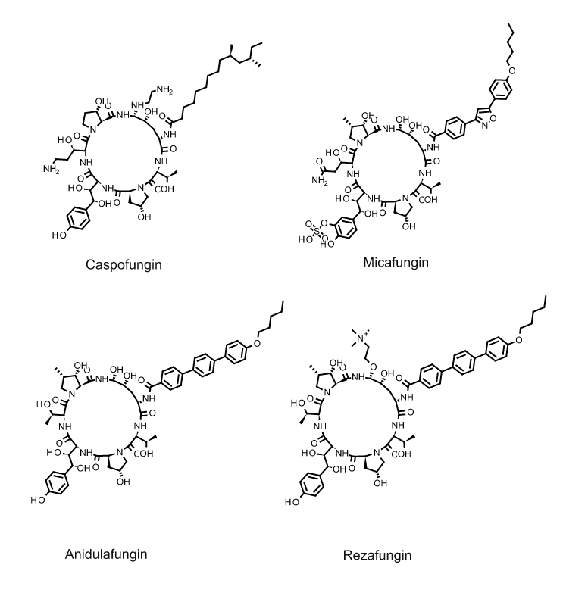
Echinocandins

Slide 72
Echinocandins are semisynthetic lipopeptides: a cyclic hexapeptide core of hydroxylated amino acids carrying an N-linked lipid side chain. The core is shared across the class, and the side chain differs. Caspofungin, micafungin and anidulafungin are each derived from a different fungal fermentation product. Their large, polar structure explains the lack of oral absorption and the need for intravenous dosing.

Slide 73
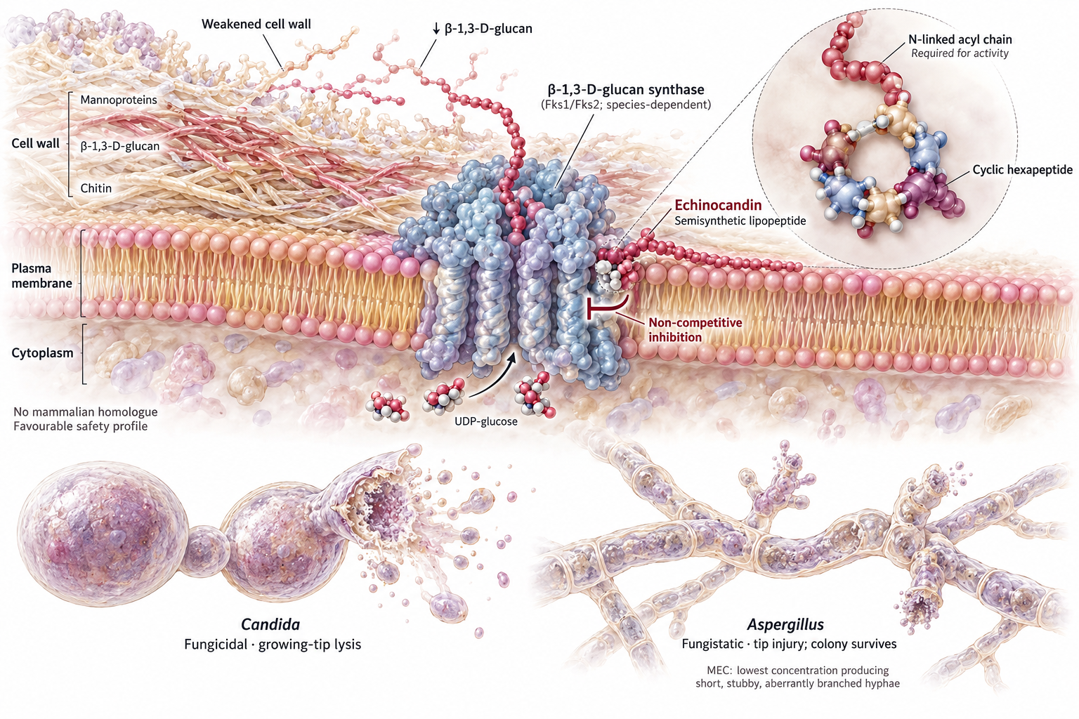
Echinocandins · mechanism of action

Slide 74
β-1,3-glucan is also the analyte in the serum (1→3)-β-D-glucan assay. Echinocandin exposure does not reliably lower the assay result, and a rising BDG on echinocandin therapy should not be read as a pharmacodynamic readout.

Slide 75
Echinocandins · microbiology and spectrum
Organism | Typical MIC₉₀ / MEC₉₀ (mg/L) | Comment
C. albicans | 0.015–0.06 | Fungicidal; wild-type
N. glabratus (C. glabrata) | 0.03–0.12 | First-line despite azole resistance; FKS resistance up to ~10% at high-risk centres
C. tropicalis | 0.03–0.12 | Susceptible
C. parapsilosis | 0.5–2 | Intrinsically elevated MIC — naturally occurring Fks1 P660A substitution (Garcia-Effron et al., 2008)
P. kudriavzevii (C. krusei) | 0.03–0.12 | Susceptible — important given intrinsic fluconazole resistance
C. auris | 0.06–0.25 | Active; resistance ~3–5%
Aspergillus spp. (MEC) | 0.015–0.06 | Active in vitro; not monotherapy
Cryptococcus spp. | >16 | No activity — glucan synthase not essential in the same way
Mucorales, Fusarium, Scedosporium | >16 | No activity

Slide 76
The two spectrum gaps that cause harm: Cryptococcus (no activity at all) and C. parapsilosis (elevated MICs — reconsider the echinocandin if the isolate is C. parapsilosis and the patient is not improving). Caspofungin, anidulafungin, micafungin and rezafungin differ substantially in pharmacokinetics but have similar spectra, and guidelines treat the first three as interchangeable for invasive candidiasis.

Slide 77
Echinocandins · ADME
Values as tabulated in the primary chapter source; rezafungin half-life and clearance confirmed in phase 1 studies (Sandison et al., 2017).

Slide 78
Echinocandins · distribution and the sanctuary-site problem
Echinocandins distribute well into liver, spleen, lung and kidney in animals (strongest for anidulafungin and caspofungin; micafungin liver exposure is closer to plasma), where they accumulate and form tissue reservoirs from which active drug slowly returns to the circulation. Tissue persistence correlates with continued antifungal activity after plasma concentrations fall below the MIC.
High molecular weight and ≥96% protein binding limit entry into urine, CSF, brain, prostate and ocular fluid. Brain concentrations are ~10% of plasma C_{max} for anidulafungin (rabbit) and caspofungin (rodent); human CSF data are sparse (caspofungin undetectable in one patient; micafungin CSF/plasma 0.002–0.54) (Felton et al., 2014).
Despite low urinary concentrations, echinocandins have sterilised azole-resistant candiduria in case reports and work in experimental renal candidiasis — because they accumulate in renal parenchyma even though they do not appear in urine.
A single dose of rezafungin achieved higher concentrations in intra-abdominal abscesses and liver at 48–72 h than daily micafungin in a murine model; clinical significance is unknown.
Do not use an echinocandin as sole therapy for:
Candida meningitis or any CNS candidiasis
Candida endophthalmitis or chorioretinitis
symptomatic Candida cystitis (urinary drug is negligible)
cryptococcosis (no activity)
“Poor urinary concentration” and “ineffective in renal infection” are different statements. Parenchymal kidney infection responds; luminal bladder infection does not.

Slide 79
Echinocandins · pharmacodynamics
Concentration-dependent killing with a prolonged post-antifungal effect; efficacy tracks C_{max}/MIC (or, equivalently in most models, AUC/MIC) (Andes et al., 2010).
PD targets are species-specific: the free-drug AUC/MIC required for stasis is far higher for C. parapsilosis than for C. albicans or N. glabratus — pharmacodynamics, not just the MIC, explains the C. parapsilosis caveat (Andes et al., 2010).
Front-loading is pharmacologically sound, and is the design principle behind rezafungin: population PK/PD modelling showed rezafungin attained stasis targets against all tested N. glabratus isolates from recent surveillance, where caspofungin, micafungin and anidulafungin failed at approved doses (Hoenigl et al., 2024).
The paradoxical (Eagle) effect. Growth resumes at concentrations well above the MIC in vitro for C. albicans and others, mediated by cell-wall integrity and calcineurin signalling with compensatory chitin synthesis (Wiederhold et al., 2005). It is a reproducible laboratory phenomenon whose clinical relevance remains unproven — but it is the reason simply escalating the dose is not a reliable answer to echinocandin failure.

Slide 80
Echinocandins · resistance
Resistance is conferred by mutations in FKS1 and FKS2 hot-spot regions (HS1, HS2), which reduce the sensitivity of glucan synthase to the drug by orders of magnitude (Perlin, 2015).
Rates: uncommon overall, but may approach 10% among N. glabratus at high-risk centres and is 3–5% in C. auris. Prior echinocandin exposure is the dominant risk factor.
C. parapsilosis carries a naturally occurring P660A substitution in Fks1 — an intrinsic, not acquired, mechanism (Garcia-Effron et al., 2008).
N. glabratus can accumulate azole and echinocandin resistance, facilitated by a mismatch-repair defect (mutator) phenotype prevalent in clinical isolates.
FKS mutations predict failure better than MIC alone. An isolate with a hot-spot mutation may test as intermediate yet fail clinically. Where echinocandin failure occurs in N. glabratus or C. auris, sequence FKS, do not simply increase the dose.
Rezafungin resistance is also FKS-mediated and requires higher concentrations against HS1 mutants, exactly as for the older agents. Whether weekly dosing with prolonged sub-MIC tails in colonising flora will select or suppress resistance is a genuine open question.

Slide 81
Echinocandins · safety and interactions

Slide 82
Adverse effects — the class is remarkably safe
Infusion-related histamine-mediated reactions (flushing, rash), usually rate-dependent.
Transient transaminase elevation; clinically significant hepatotoxicity is rare.
Fever, headache, phlebitis; hypokalaemia in trial populations is usually attributable to the underlying illness.
No renal dose adjustment for any agent; no nephrotoxicity.
Caspofungin requires dose reduction in moderate hepatic impairment; the others do not.
Drug interactions — minimal and agent-specific
Interacting drug | Effect
Tacrolimus | Caspofungin reduces tacrolimus AUC and peak by ~20%; no effect with anidulafungin, micafungin or rezafungin
Ciclosporin | Caspofungin AUC increases ~35%; anidulafungin AUC increases 22%; ciclosporin clearance falls 16% with micafungin; no effect with rezafungin
Sirolimus | Sirolimus AUC increases 21% with micafungin
Nifedipine | AUC increases 18% with micafungin
Rifampicin | Reduces caspofungin steady-state concentrations — increase caspofungin to 70 mg/day
Voriconazole | No significant interaction
Rezafungin showed no meaningful effect on probe substrates for CYP3A4, CYP2B6, CYP1A2, CYP2C8, P-gp, OATP, BCRP or OCT/MATE transporters.

Slide 83
Echinocandins · clinical use
Indication | Evidence
Candidaemia and invasive candidiasis — first line | Caspofungin non-inferior (and better tolerated) than amphotericin B deoxycholate (Mora-Duarte et al., 2002); anidulafungin non-inferior to fluconazole (Reboli et al., 2007); micafungin non-inferior to liposomal amphotericin B (Kuse et al., 2007) and equivalent to caspofungin (Pappas et al., 2007)
Empirical therapy in neutropenic fever | Caspofungin and micafungin are established options
Prophylaxis | Micafungin in HSCT; echinocandins where azole interactions are prohibitive
Invasive aspergillosis | Not monotherapy. Salvage or combination use only (Patterson et al., 2016)
Oesophageal candidiasis | Effective, but relapse is higher than with fluconazole; reserve for azole-resistant disease

Slide 84
Why echinocandins became first-line for candidaemia: fungicidal activity, retained activity against azole-resistant N. glabratus and P. kudriavzevii, an excellent safety profile, and almost no drug interactions — accepting the trade-off of IV-only administration and no sanctuary-site penetration (Pappas et al., 2015).

Slide 85
Part 3 · Agents recently approved or in late-phase development

Slide 86
What the established classes cannot do
Gap | Clinical consequence
No oral agent active against azole-resistant moulds | Prolonged IV therapy, or no therapy at all, for TR₃₄/L98H A. fumigatus
No agent active against L. prolificans | Near-uniform resistance to every licensed drug; mortality >70%
Echinocandins cannot reach CNS, eye or urine | Class cannot be used for the sanctuary-site syndromes it would otherwise suit
Azole interaction burden | Unmanageable in patients on venetoclax, vinca alkaloids, or complex transplant regimens
Only IV options for the fungicidal classes | No step-down for C. auris, echinocandin-resistant N. glabratus, or long-course mould disease
Polyene toxicity | Limits duration of induction therapy exactly where it is most needed
No new target since 2001 | Resistance to each class remains unopposed by a mechanistically distinct partner

Slide 87
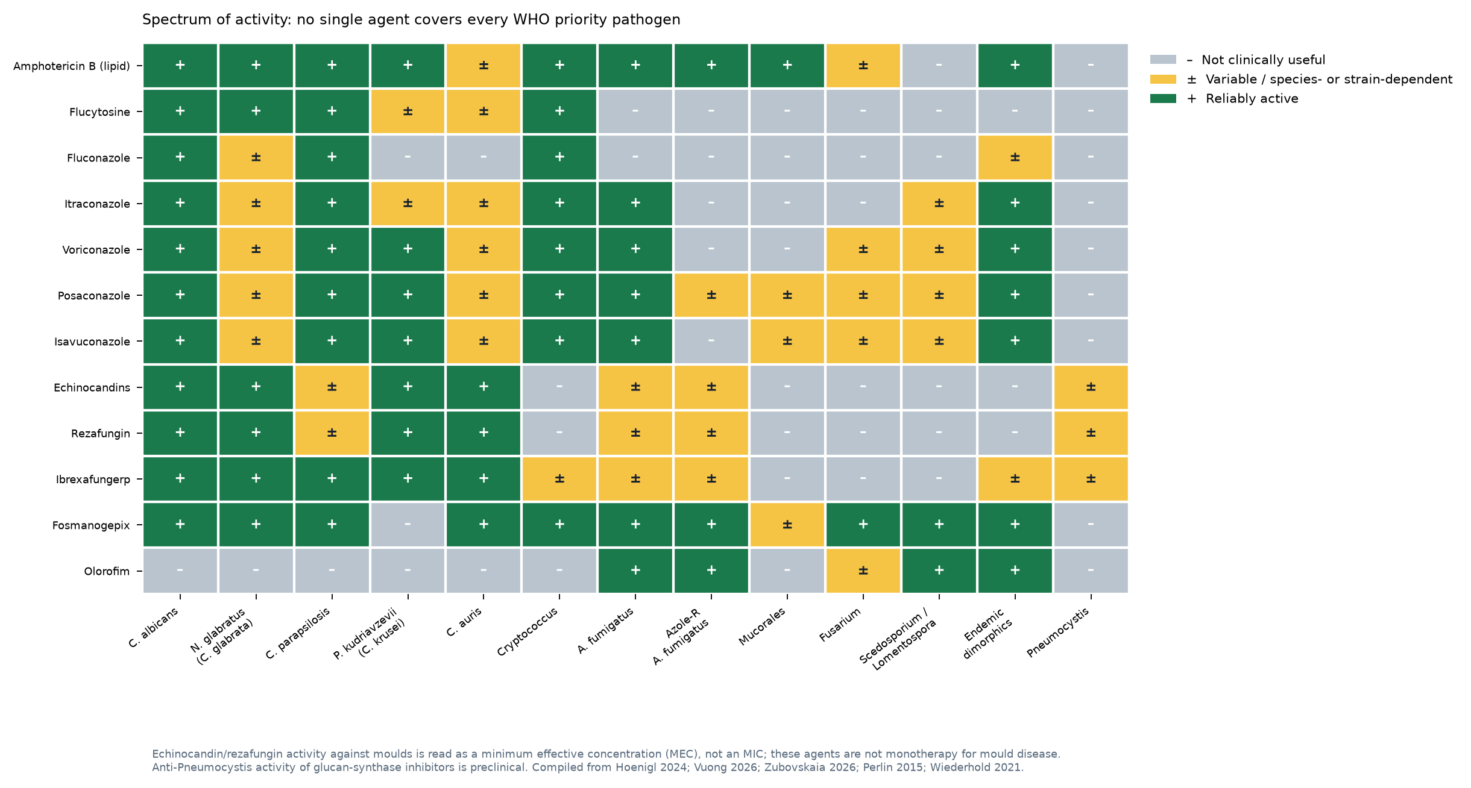
Spectrum comparison

Slide 88
The five agents that changed the picture
Agent | Class / target | Route | Status
Rezafungin | Echinocandin, Fks1/2 — long-acting | IV weekly | Approved (EU/UK invasive candidiasis; US for limited/no alternatives)
Ibrexafungerp | Triterpenoid, glucan synthase at a distinct site | Oral | Approved for VVC/rVVC; phase 3 for invasive disease
Fosmanogepix | Gwt1 inhibitor (GPI-anchor maturation) | IV and oral | Phase 3
Olorofim | Orotomide, fungal DHODH | Oral | Phase 3 (OASIS); breakthrough therapy designation
Opelconazole | Inhaled triazole (Cyp51) | Inhaled | Phase 2/3

Slide 89
Note what these agents have in common: oral or long-interval administration, activity against resistant organisms, and in two cases genuinely new targets. Those are precisely the gaps in the table above (Hoenigl et al., 2021, 2024; Stover et al., 2023; Vuong et al., 2026; Zubovskaia and Vazquez, 2026).

Slide 90
Rezafungin · a once-weekly echinocandin
Mechanism and chemistry
Structural analogue of anidulafungin sharing its lipid side chain. The C5 ornithine hemiaminal is replaced by a choline aminal ether, which blocks the non-enzymatic ring-opening that degrades anidulafungin.
Target and spectrum are unchanged: β-1,3-D-glucan synthase, fungicidal against Candida.
The chemistry is the pharmacology: greater chemical stability produces a half-life >130 h and front-loaded exposure.
Microbiology
Spectrum essentially identical to the older echinocandins, including C. auris and azole-resistant N. glabratus; no activity against Cryptococcus or Mucorales.
At vaginal pH 4, MICs (including C. parapsilosis) sit below achievable intravaginal concentrations.
A methodological caution with real consequences. EUCAST and CLSI rezafungin MICs diverge notably because rezafungin binds non-specifically to plastics — microtitre plates, pipette tips, reservoirs. Adding 0.002% Tween 20 to the medium normalises MICs across plate types and laboratories while preserving wild-type/non-wild-type separation (Hoenigl et al., 2024).
Resistance remains FKS-mediated. In vitro the spontaneous mutation frequency conferring reduced susceptibility is low (1.35 × 10⁻⁸ to 3.86 × 10⁻⁹) and ~20 serial passages are needed to select resistance.

Slide 91
Rezafungin · pharmacokinetics and pharmacodynamics
Parameter | Value
Half-life | ~80 h after the first dose; ~150 h after the second or third — linear kinetics
C_{max} (single dose) | 19.2 mg/L
Steady-state AUC_{0–24} | 827 mg·h/L
Protein binding | 97%
Metabolism | Minimal — most circulating and excreted drug is unchanged
Elimination | 75% faeces, 25% urine; plasma clearance 3.1 mL/min
Dose adjustment | None for renal or hepatic impairment
Population PK | Three-compartment model; no covariate (body surface area, albumin, disease state, age, sex, race, creatinine clearance) produced clinically meaningful change — one regimen for all adults
Regimen: 400 mg IV in week 1, then 200 mg IV once weekly.

Slide 92
PK/PD rationale. Front-loaded C_{max}/MIC with a very long terminal phase. Population PK/PD modelling showed rezafungin reached the stasis target for all N. glabratus isolates from 2018–2020 surveillance, whereas caspofungin, micafungin and anidulafungin failed to do so at approved doses (Hoenigl et al., 2024).
Tissue penetration. A single rezafungin dose produced higher concentrations in intra-abdominal abscesses and liver at 48 and 72 h than daily micafungin in a murine model. CSF, vitreous and urinary penetration remain low, as for the class.

Slide 93
Rezafungin · clinical evidence
Trial | Design | Result
STRIVE (phase 2) | Rezafungin 400 mg weekly, or 400 mg then 200 mg weekly, vs caspofungin | Day-14 overall cure 60.5% / 76.1% / 67.2%. The 400/200 mg regimen gave the highest cure and lowest 30-day mortality; candidaemia cleared more rapidly
ReSTORE (phase 3, NCT03667690) | Double-blind, double-dummy vs caspofungin; 199 adults with candidaemia and/or invasive candidiasis; non-inferiority margin 20% | Global cure at day 14: 59.1% vs 60.6%; 30-day all-cause mortality 23.6% vs 21.2% — non-inferior on both the EMA and FDA primary endpoints (Thompson et al., 2022)
Pooled STRIVE + ReSTORE | Mycological response at day 14 by species | C. albicans 67% vs 67%; N. glabratus 84% vs 63% (between-group difference 21.4, 95% CI 1.9–40.8); C. tropicalis 74% vs 64%; C. parapsilosis 79% vs 70%
 | Subgroup mortality | Favoured rezafungin in patients ≥65 years (−17.6%, 95% CI −32.5 to −2.8) and CrCl <60 mL/min (−18.2%, −33.1 to −3.2)
ReSPECT (phase 3) | Double-blind, 2:1 randomisation; rezafungin 400 mg then 200 mg weekly (n = 402) vs daily fluconazole or posaconazole plus co-trimoxazole after engraftment (n = 200) in allogeneic HSCT recipients | Fungal-free survival at day 90: 60.7% vs 59.0% (difference 1.6%, 95% CI −6.2 to 9.3) — met non-inferiority. Proven/probable IFD 3.5% vs 4.5% (Aspergillus 2.0% vs 3.0%; Candida 1.2% vs 1.0%); death 4.5% vs 5.5%. Adverse events leading to discontinuation 9.3% vs 14.7%; no new safety signals. Press-release data, IDWeek 2026; not yet approved for this indication (Mundipharma, 2026)
RADIANT (phase 2) | Topical gel/ointment for vulvovaginal candidiasis | Inferior to oral fluconazole — programme discontinued

Slide 94
Rezafungin · safety and place in therapy
Safety
In ReSTORE, treatment-emergent adverse events occurred in 91% of rezafungin and 85% of caspofungin recipients — in a population with high baseline illness: pyrexia 14% vs 5%, hypokalaemia 13% vs 9%, pneumonia 10% vs 3%, anaemia 9% in both.
Grade ≥3 events 49% vs 51%; serious adverse events 55% vs 49%; discontinuation for an adverse event 9% in both arms. Treatment-related serious events were rare (one infusion reaction, one urticaria).
No QT prolongation at single doses up to 1400 mg.
Label precautions: infusion-related reactions, photosensitivity, hepatic reactions.
No clinically significant drug interactions across CYP and transporter probe substrates.
Where it fits. Once-weekly IV dosing converts candidaemia from a reason to keep a central line and a hospital bed into an outpatient-manageable disease. In the ECMM Candida III cohort, 16% of candidaemia patients required prolonged hospitalisation and a further 4% received outpatient parenteral therapy — so roughly one in five is a candidate on logistics alone. Rezafungin also appears to be a safe and effective alternative to triazole-prophylaxis in patients undergoing allo-HSCT.
Unresolved. Whether prolonged sub-MIC tails in colonising flora select FKS mutants is unknown, as is whether higher front-loaded exposure helps against isolates that already carry hot-spot mutations. Dose adjustment was not needed for mycological cure in the small number of resistant isolates in the trials.

Slide 95
Ibrexafungerp · the first oral glucan synthase inhibitor
Mechanism
First agent of the triterpenoid class (formerly SCY-078). Inhibits β-1,3-D-glucan synthesis, as the echinocandins do, but binds a distinct site on the catalytic subunit with only partial overlap.
The practical consequence is limited cross-resistance: most echinocandin-resistant FKS mutants — particularly N. glabratus and C. auris — remain susceptible (Ghannoum et al., 2020).
Cross-resistance is confined to a small number of substitutions at the initial phenylalanine codon: F641S (C. albicans Fks1), F659del and F659L (N. glabratus Fks2). Thirteen other alterations outside that codon did not confer cross-resistance.
Microbiology
Broad anti-Candida activity including C. auris; activity against Aspergillus (MEC endpoint); some activity against Pneumocystis in murine models; no Mucorales or Fusarium activity.
EUCAST testing shows a partial inhibition (trailing) pattern in ~10% of C. parapsilosis, ~2% of C. tropicalis and ~1% of C. dubliniensis, which complicates MIC reading.

Slide 96
Ibrexafungerp pharmacokinetics
PK parameter | Value
Oral bioavailability | ~36%
Food effect | AUC increased ~40% — give with food
Protein binding | 99.7%
Half-life | ~20 h (reported range 20–30 h)
Linearity | Linear, 10–1600 mg single dose

Slide 97
Tissue:blood AUC ratios (animal): spleen 54×, liver 50×, lung 31×, bone marrow 25×, kidney 20×, skin 12–18×, vaginal tissue 9×, skeletal muscle 4×.
High tissue distribution with low CSF penetration — the profile of a tissue-directed oral step-down agent, not a CNS drug.

Slide 98
Ibrexafungerp · clinical evidence
Trial | Result
VANISH-303 (acute VVC, US) | Clinical cure 50.5% vs 28.6% placebo (RR 1.70, 95% CI 1.2–2.5); mycological eradication 49.5% vs 19.4% (Sobel et al., 2021)
VANISH-306 (US/Bulgaria) | Clinical cure RR 1.35 (95% CI 1.06–1.73); superior on all secondary endpoints
DOVE (dose-finding) | 300 mg twice for one day selected — higher doses added GI toxicity without efficacy
FURI (phase 3, open-label, refractory/intolerant IFD) | 113 patients: clinical benefit in 83%, complete or partial response 58%, stable disease 24%. Among 10 with invasive pulmonary aspergillosis, 4 (40%) responded
FURI intra-abdominal subgroup | 17 patients, 71% with prior echinocandin failure: complete/partial response 53%, stable disease 41%
CARES (C. auris) | Open-label single-arm, as add-on or monotherapy
MARIO (phase 3) | Oral ibrexafungerp as step-down after IV echinocandin for invasive candidiasis
SCYNERGIA | Combination with voriconazole in invasive aspergillosis — terminated for slow enrolment

Slide 99
Ibrexafungerp · Safety
Safety
Predominantly gastrointestinal: abdominal pain, nausea, diarrhoea; also dizziness and headache. Events are generally mild–moderate and self-limiting (~1 day).
In the VVC programme, treatment-related adverse events occurred in 46.7% versus 25% with fluconazole, but without excess discontinuation.
Animal studies indicate potential fetal harm: contraindicated in pregnancy; contraception is required during treatment and for 4 days afterwards.
Interactions — a CYP3A4 substrate that is itself a modest perpetrator:
Inhibitor of CYP2C8; weak inhibitor of CYP2C9 and CYP2D6
Weak inducer of CYP2B6; moderate inducer of CYP1A2, CYP2C19 and CYP3A4
Substrate exposure changes: tacrolimus AUC ×1.4, dabigatran ×1.4, pravastatin ×2.8
Place in therapy: approved for VVC and recurrent VVC (300 mg twice daily for one day); the real prize is oral step-down for invasive candidiasis and salvage therapy for echinocandin-resistant N. glabratus and C. auris (Azie et al., 2020; Ordaya et al., 2023).

Slide 100
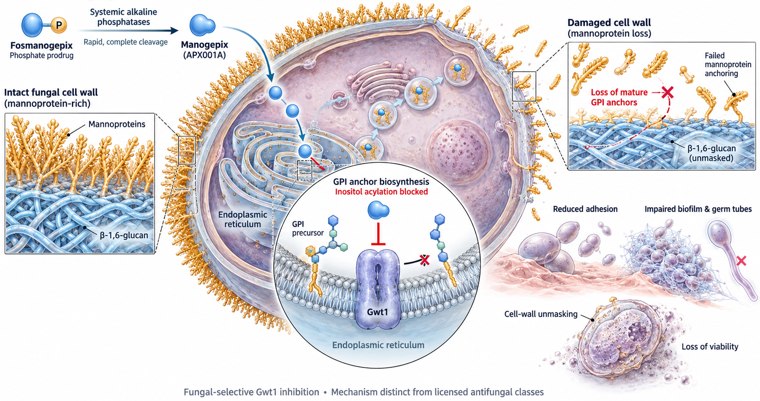
Fosmanogepix · inhibiting GPI-anchor maturation

Slide 101
Fosmanogepix · Spectrum
Microbiology
Very broad: Candida (including C. auris), Cryptococcus, Aspergillus (including azole-resistant), Fusarium, Scedosporium and Lomentospora, endemic dimorphic fungi; variable against Mucorales.
Notable gap: P. kudriavzevii (C. krusei) has reduced susceptibility and was excluded from the candidaemia trials.
Mould activity is read as an MEC; MECs against endemic dimorphic fungi are very low (<0.008 mg/L).
Why it matters for privileged sites. In a rabbit model of haematogenous Candida meningoencephalitis, manogepix meninges-, cerebrum- and spinal cord-to-plasma ratios were approximately 1:1, with a significant fall in C. albicans tissue burden. Ocular penetration was lower: liquid-to-plasma ratios were 0.19–0.52 (aqueous), 0.09–0.12 (vitreous) and 0.02–0.04 (choroid). Radiolabelled drug distributed widely in rats and monkeys — including lung, brain, eye and uveal tract (Petraitiene et al., 2021).
Resistance is already characterised: target alteration V163A in Gwt1 (N. glabratus; V162A in C. albicans) and efflux induction — a ZCF29 gain-of-function activating CDR1/SNQ2 in C. albicans, and MDR1 activation in C. parapsilosis.

Slide 102
Fosmanogepix · pharmacology and clinical evidence
Pharmacology
Available intravenously and orally — the key practical advantage.
Phase 1 programme: single IV doses 10–350 mg and multiple doses 50–600 mg daily for 14 days; oral tablet doses 100–500 mg with food-effect assessment.
PD target: against wild-type and CYP51A-mutant A. fumigatus, the free-drug AUC/MEC associated with a 1-log kill was ~89 (total AUC/MEC ~5258) (Alkhazraji et al., 2020; Zhao et al., 2018).
No clinically relevant drug interactions reported to date; dedicated CYP interaction studies completed but unpublished.
Typical trial regimen
1000 mg IV twice daily on day 1 → 600 mg IV daily → 600 mg IV or 700–800 mg orally once daily.

Slide 103
Fosmanogepix · Clinical evidence
Trial | Result
Candidaemia (phase 2, NCT03604705) | 16/20 (80%) met treatment success (clearance of Candida without additional antifungal and survival at day 42); blood cultures negative after a mean of 2.4 days; day-30 survival 85%; efficacy seen in amphotericin B- and anidulafungin-resistant isolates (Vazquez et al., 2023)
APEX — C. auris candidaemia (NCT04148287) | 8/9 (89%) cleared C. auris from blood
AEGIS — invasive mould disease (phase 2) | 20 patients: 40% successful response; all-cause mortality at day 42 25% (80% CI 12.7–41.5), meeting the predefined target of <45%. Discontinued for toxicity in 7 (33%), usually nausea and anorexia
Fusarium solani meningitis outbreak (2023) | Used under compassionate access when isolates tested resistant to all licensed agents; recommended as part of triple therapy
Phase 3 | Candidaemia/invasive candidiasis programme planned (~450 participants)

Slide 104
Read the AEGIS numbers carefully. A 40% global response in salvage mould disease is encouraging, but a 33% toxicity-driven discontinuation rate — mainly gastrointestinal — is the signal to watch, and dose splitting resolved it in only 3 of 5 patients.

Slide 105
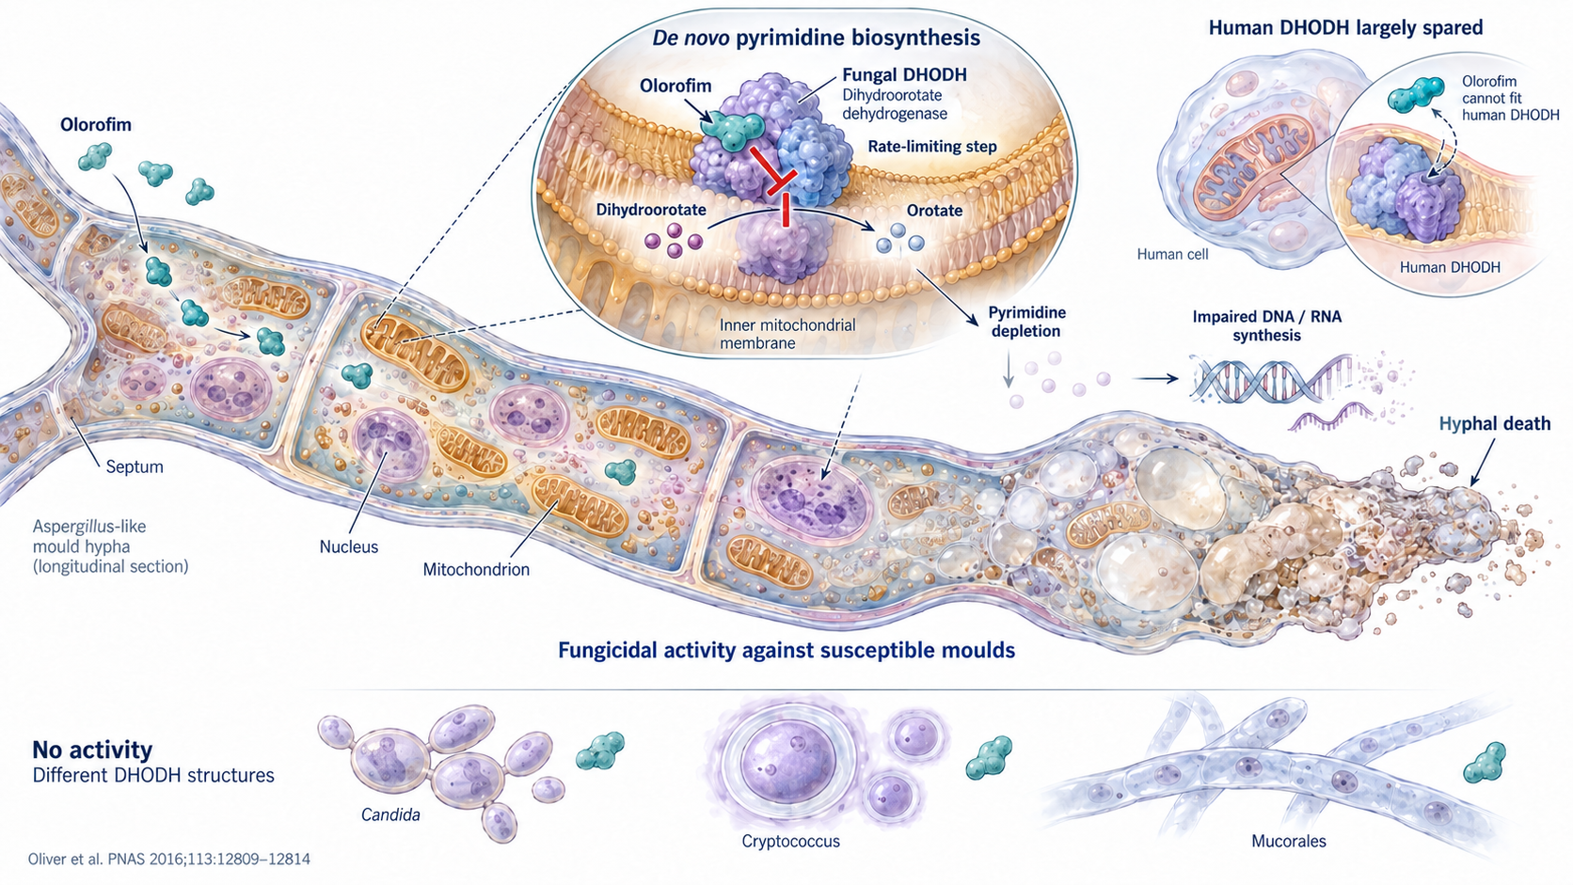
Olorofim · a new target for mould disease

Slide 106
Olorofim · microbiology
Microbiology
Potent against Aspergillus spp. irrespective of azole susceptibility, including TR₃₄/L98H isolates.
Active against the organisms with no other options: Lomentospora prolificans, Scedosporium spp., Coccidioides spp., Microascus/Scopulariopsis, and other rare moulds; variable against Fusarium (Su et al., 2021; Vanbiervliet et al., 2024).
No in vitro cross-resistance with any licensed class.

Slide 107
Olorofim · pharmacokinetics
PK parameter | Value
Formulation | Oral only (IV in development)
Oral bioavailability | ~45%
Solubility / binding | Poorly water-soluble; highly protein bound
Metabolism | Multiple CYP450 enzymes including CYP3A4
Perpetrator risk | Weak CYP3A4 inhibitor — low interaction potential
PD index | AUC/MEC; target C_{min} ≥0.1–0.2 mg/L

Slide 108
Dosing as studied: initially weight-based (180–300 mg loading, then 120–240 mg/day in divided doses); simplified from patient 59 onward to 150 mg twice on day 1, then 90 mg twice daily.
Population PK modelling showed that weight-based dosing and routine TDM could be dropped without materially changing plasma concentrations — C_{min} consistently exceeded the PD target in both the TDM and fixed-dose groups.

Slide 109
Olorofim · FORMULA-OLS phase 2b
Design. Single-arm, open-label, 22 centres in 11 countries. Patients ≥16 years with proven IFD or probable invasive pulmonary aspergillosis and few or no treatment options: 203 treated, 202 with committee-adjudicated IFD (Maertens et al., 2025).
Population — this is a salvage cohort, not a first-line trial
  Aspergillus spp. 101 (22 azole-resistant), Coccidioides spp. 41, L. prolificans 26, Scedosporium spp. 22, other 12
  Reason for enrolment: failure of available therapy 54%, resistance to all licensed agents 25%, intolerance 14%
  95% had received prior antifungal therapy (median 2 agents); median 75 days from diagnosis to first dose
Sites: lung/sinonasal 62%, CNS 24%, bone/joint 17%, disseminated 25%

Slide 110
Olorofim · FORMULA-OLS phase 2b
Endpoint | Day 42 | Day 84
Global response success | 28.7% (95% CI 22.6–35.5) | 27.2% (21.2–33.9)
Success with stable disease counted as success | 75.2% (68.7–81.0) | 63.4% (56.3–70.0)
Clinical response | 59.9% (52.8–66.7) | 54.0% (46.8–61.0)
All-cause mortality | 11.9% (7.8–17.2) | 16.3% (11.5–22.2)
Outcomes

Slide 111
By pathogen (global response, day 42): L. prolificans 42.3%, Scedosporium 36.4%, Aspergillus 34.7%, other susceptible moulds 33.3%, Coccidioides 0%.
Interpreting a 28.7% global response. The composite requires improvement in clinical, radiological and mycological components; stable disease counts as failure. In extrapulmonary coccidioidomycosis mycological eradication is not achievable at all — yet 75.6% of those 41 patients had a complete or partial clinical response. All-cause mortality of 11.9% at day 42 in a cohort that had already failed everything is the number that matters most.

Slide 112
Olorofim · OASIS phase 3
Endpoint (ITT) | Olorofim | L-AmB + SOC | Difference (95% CI)
Day-42 all-cause mortality (primary; non-inferiority margin 20%) | 23.8% (36/151) | 24.3% (18/74) | −0.5% (−13.1 to 10.8)
Day-84 all-cause mortality | 32.5% (49/151) | 29.7% (22/74) | 2.7% (−10.6 to 15.0)
Global response, day 42 / day 84 | 26.5% / 30.5% | 31.1% / 28.4% | not reported
≥1 drug-related adverse event | 35.8% | 63.9% | —
Renal adverse events | 1.3% | 22.2% | —
Design. Randomised (2:1), adjudicator-blinded, olorofim vs liposomal amphotericin B 3 mg/kg then standard of care, up to 84 days. 225 adults (151 vs 74) with proven invasive aspergillosis or probable pulmonary disease in whom a mould-active azole was inappropriate
  (resistance, intolerance, interactions, breakthrough or failure); about 79% haematological malignancy or HSCT (F2G and Shionogi, 2026).

Slide 113
Non-inferior on mortality, with less renal toxicity. Oral olorofim met the primary endpoint, with fewer drug-related and renal adverse events; liver injury was similar (4.6% vs 4.2%). These are press-release data, with no efficacy advantage shown; the drug remains investigational.

Slide 114
Olorofim · safety, interactions and place in therapy

Slide 115
Safety
Hepatic. Medically significant liver-enzyme elevations at least possibly attributable to olorofim in 20/203 (10%), adjudicated by an independent hepatic advisory committee. Managed by dose reduction or pause in 14 (7%) and permanent discontinuation in 6 (3%). All events resolved; no liver failure and no hepatic deaths. Events clustered in the first 12 weeks.
Gastrointestinal intolerance in 10%, predominantly mild or moderate and self-limiting.
Adverse events of special interest also included neurological symptoms, hypotension, vertigo, syncope and dry eye.
Well tolerated with >2 years of continuous therapy in the extended-treatment phase (114 patients, mean 361 days).
Interactions
Fluconazole (moderate CYP3A4/2C9 inhibitor) increased olorofim AUC_{0–72} by 1.5–1.6× without a significant C_{max} change.
As a weak CYP3A4 inhibitor, olorofim required calcineurin-inhibitor dose reduction within 14 days in 9/18 (50%) patients on ciclosporin (median 50% reduction) and 8/46 (17%) on tacrolimus (median 29%). No change was needed for tyrosine kinase inhibitors or venetoclax.
Resistance
The only mechanism described so far is target alteration: substitutions at the G119 codon of the DHODH gene (pyrE) — G119A, G119V, G119S, G119C confirmed in recombinant enzyme — plus one H116P isolate.
Place in therapy. An oral, fungicidal, mechanistically novel agent for azole-resistant aspergillosis, L. prolificans, Scedosporium and refractory coccidioidomycosis — with CNS activity. The phase 3 OASIS trial compares oral olorofim with liposomal amphotericin B followed by standard of care in invasive aspergillosis, with day-42 all-cause mortality as the primary endpoint.

Slide 116
Opelconazole · triazole optimized for lung delivery

Slide 117
PC945 is a triazole engineered for inhalation: it inhibits lanosterol 14α-demethylase like the rest of the class, but is formulated as a nebulised suspension with a particle size of ~1–4 µm designed for retention in lung and lower airways.
The pharmacological argument is exposure at the site of infection with negligible systemic exposure:
  plasma C_{max} 0.951 ng/mL after 5 mg once daily for 7 days
  C_{max} 0.322 ng/mL at t_{max} 4–5 h after a single 14 mg inhaled dose
  oral bioavailability of the swallowed fraction <0.7%
Typical dose studied: 14.8 mg twice daily; dose-linear from 1.4–28 mg.
Because expected steady-state systemic C_{max} is ≤0.01 µM, inhibitory drug interactions are considered improbable — the single biggest practical advantage over the oral triazoles (Cass et al., 2021).
Microbiology
Potent against A. fumigatus and A. terreus (MIC 0.063–0.078 mg/L); ~2.5-fold more potent than voriconazole against 96 clinical A. fumigatus isolates.
Markedly less active against A. flavus and A. niger (MIC 6–>8 mg/L).
Covers Candida (including C. auris), Cryptococcus and Trichophyton rubrum; no Mucorales activity (MIC >8 mg/L).
The critical caveat. Opelconazole lacks activity against A. fumigatus carrying TR₃₄/L98H or TR₄₆/Y121F/T289A (MIC >16 mg/L). An inhaled azole does not solve environmental azole resistance.
Evidence so far: phase 1/2a safety; a compassionate-use series with clinical benefit in 8 of 9 last-resort patients; and OPERA-S, a phase 2 prophylaxis study in lung transplant recipients where immunosuppressant discontinuation was 8% versus 27% with standard of care.

Slide 118
Other agents worth knowing
Agent | Target / class | Status and distinguishing feature
Oral encochleated amphotericin B (MAT2203) | Amphotericin B in a nanocochleate of lipid bilayers and calcium ions | Protects the drug through the gut and delivers it intracellularly to macrophages. C_{max} 59.2 ng/mL — an order of magnitude below liposomal amphotericin B (22,900 ng/mL) and deoxycholate (1400 ng/mL) — yet effective in murine cryptococcal meningoencephalitis with fluorescent particles reaching the brain (Aigner and Lass-Flörl, 2020; Lu et al., 2019). EnACT phase 2 in 80 Ugandan adults with HIV-associated cryptococcal meningitis. Topical/VVC programme was inferior to fluconazole
ATI-2307 | Aromatic diamidine; dissipates the fungal mitochondrial membrane potential (pentamidine-like) | Active against Candida and Cryptococcus, variable against Aspergillus; improved survival in neutropenic A. fumigatus mice
VL-2397 / ASP2397 | Siderophore resembling ferrichrome (aluminium rather than iron chelate), taken up by the Sit1 transporter, which humans lack | First-in-class fungal-specific uptake; active against Aspergillus, Fusarium solani and N. glabratus; phase 1 completed with infusion-site reactions the main adverse event
Mandimycin | Novel polyene macrolide targeting membrane phospholipids rather than ergosterol | In vitro and in vivo activity against multidrug-resistant C. auris, Cryptococcus, A. fumigatus, Mucorales and dimorphic fungi; no human studies
Miltefosine | Alkylphosphocholine, approved for leishmaniasis | Broad in vitro antifungal activity (dermatophytes, Cryptococcus, Candida, Sporothrix, endemic fungi); fungistatic with antibiofilm activity against Mucorales. GI toxicity and teratogenicity limit use; clinical antifungal data lacking
APX2039 / APX2096 | Gwt1 inhibitors of the fosmanogepix family | Optimised for cryptococcal meningitis; APX2020/APX2097 for coccidioidomycosis

Slide 119
Two themes: reformulation to reach a compartment (inhaled opelconazole, oral encochleated amphotericin B, inhaled voriconazole), and new chemistry against new targets (Gwt1, DHODH, Sit1, mitochondrial potential, phospholipids).

Slide 120
Part 4 · Putting it together

Slide 121
Classes at a glance

Slide 122
Pharmacokinetics compared

Slide 123
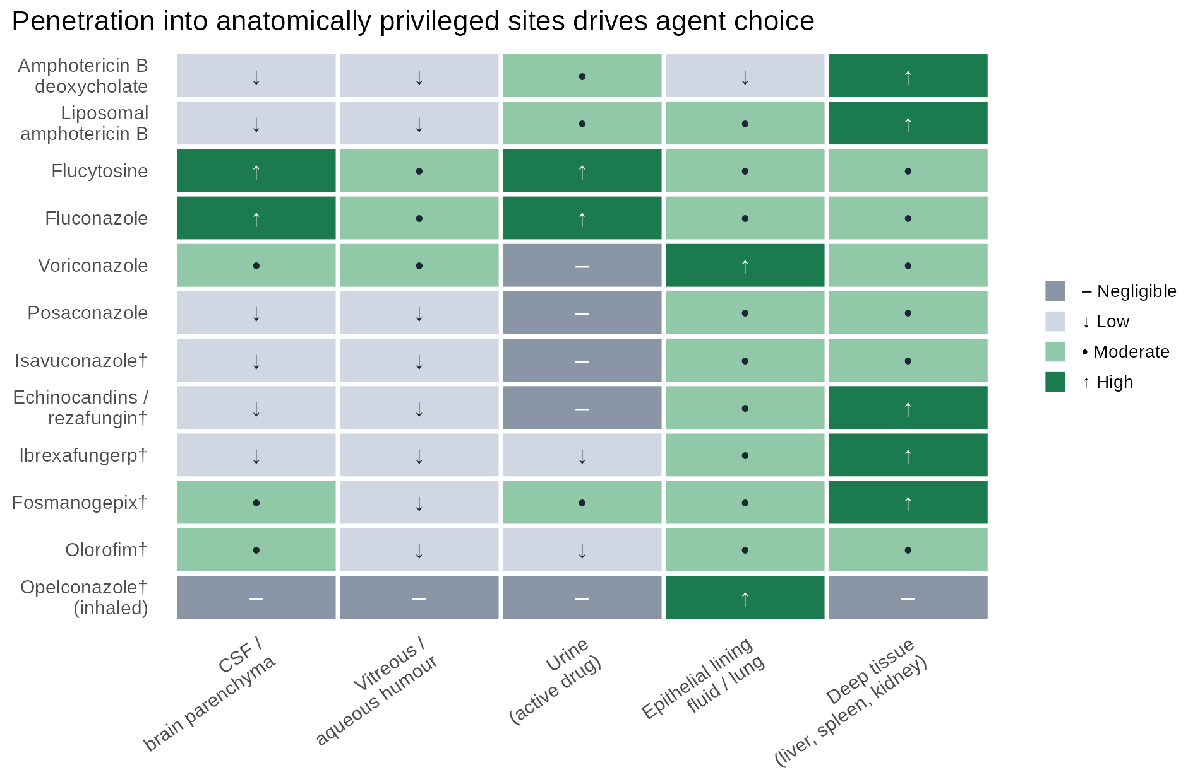
Reaching the infection: privileged sites

Slide 124
Licensed agents scored against the tissue- and fluid-to-plasma ratios in Felton et al. (Felton et al., 2014); † not covered by that review (manogepix brain-to-plasma ratio ~1:1 but vitreous 0.09–0.12 in rabbits; opelconazole lung-retained, dose-dependent plasma C_{max} ~0.3–1 ng/mL at low doses and ≤0.01 µM at clinical steady state) (Hoenigl et al., 2021).
Clinical translation. CNS candidiasis → amphotericin B + flucytosine, or fluconazole. Candida endophthalmitis → amphotericin B ± flucytosine, or voriconazole/fluconazole. Candida cystitis → fluconazole, flucytosine or amphotericin B deoxycholate. Never an echinocandin alone for any of the three.

Slide 125
Choosing by syndrome
Syndrome | First-line | Key alternatives | Pharmacological reason
Candidaemia, non-neutropenic | Echinocandin | Fluconazole step-down when susceptible; rezafungin for weekly outpatient therapy | Fungicidal, safe, covers azole-resistant species
Candidaemia with eye or CNS involvement | Liposomal amphotericin B ± flucytosine | Fluconazole or voriconazole if susceptible | Echinocandins do not reach these sites
C. auris | Echinocandin | Ibrexafungerp, fosmanogepix (investigational) | 90% azole-resistant; 30–40% amphotericin B-resistant
Echinocandin-resistant N. glabratus | Ibrexafungerp (distinct binding site) | High-dose amphotericin B | Most FKS mutants retain ibrexafungerp susceptibility
Invasive aspergillosis | Voriconazole or isavuconazole | Posaconazole; L-AmB; olorofim if resistant | Mould-active azole with good lung exposure
Azole-resistant aspergillosis | L-AmB ± echinocandin | Olorofim (oral, fungicidal) | No cross-resistance with the azole target
Mucormycosis | Liposomal amphotericin B + surgery | Isavuconazole, posaconazole | Only polyenes and two azoles have activity
Cryptococcal meningitis | Amphotericin B + flucytosine induction | Single-dose 10 mg/kg L-AmB + flucytosine/fluconazole | Flucytosine penetration + polyene cidality
L. prolificans / Scedosporium | No licensed effective option | Olorofim, fosmanogepix | Intrinsic pan-resistance
Chronic/allergic pulmonary aspergillosis | Itraconazole or voriconazole | Opelconazole (inhaled, investigational) | Long courses; interaction burden favours local delivery

Slide 126
Therapeutic drug monitoring · consolidated
Agent | Target | Rationale | Practical notes
Flucytosine | Peak 30–80 mg/L; avoid >100 mg/L | Narrow therapeutic index; myelosuppression is exposure-related | Sample 2 h post-dose at steady state; repeat with any change in renal function (Pasqualotto et al., 2007)
Voriconazole | Trough 1–5.5 mg/L | Non-linear kinetics, CYP2C19 polymorphism, concentration-dependent neurotoxicity and hepatotoxicity | Day 4–7 and after every dose change; TDM improves response and reduces discontinuation (Park et al., 2012; Pascual et al., 2008)
Itraconazole | Trough >0.5–1 mg/L | Erratic, formulation- and food-dependent absorption | Measure in every patient on treatment
Posaconazole | ≥0.7 mg/L prophylaxis; ≥1.0–1.25 mg/L treatment | Suspension absorption saturable and pH-dependent | Tablet/IV usually adequate; still check in GI disease, mucositis, diarrhoea
Isavuconazole | Not routinely required | Linear kinetics, predictable exposure | Consider in obesity, ECMO, renal replacement, poor response
Fluconazole | Not routinely defined | High, predictable bioavailability | Consider at high dose (coccidioidomycosis), renal dysfunction, morbid obesity
Echinocandins / rezafungin | Not indicated | Predictable exposure, wide therapeutic index, no concentration–toxicity relationship | —
Amphotericin B | Not indicated | Concentrations do not predict effect or toxicity | Monitor creatinine, potassium, magnesium instead
Olorofim | C_{min} ≥0.1–0.2 mg/L (optional) | PD target-driven; fixed dosing achieved the target without TDM in phase 2b | May be dropped with the simplified fixed-dose regimen

Slide 127
When TDM earns its place: non-linear kinetics (voriconazole), erratic absorption (itraconazole, posaconazole suspension), a narrow therapeutic index (flucytosine), or a concentration-defined toxicity (voriconazole neurotoxicity). Otherwise it is a cost without a decision (Ashbee et al., 2013; Hamada and Yagi, 2024).
Interpretation needs the MIC. A voriconazole trough of 1.5 mg/L is comfortable against an A. fumigatus with an MIC of 0.25 mg/L and inadequate against one with an MIC of 2 mg/L. TDM without susceptibility testing is half an answer.

Slide 128
Ten things to carry away
Spectrum, exposure and potency must all align. Cure fails if any one of the three is missing, and the commonest reason for failure is a drug that cannot reach the compartment.
Formulation changes distribution and toxicity, never spectrum — amphotericin B is one drug in four wrappers.
Amphotericin B works in cryptococcal meningitis despite poor CSF penetration. Plasma and CSF concentrations are poor surrogates for polyene effect.
Flucytosine is pharmacokinetically close to ideal and clinically constrained by toxicity, resistance and access. Always a partner, always monitored.
For the triazoles, exposure is the variable to control — AUC/MIC drives efficacy, so loading doses, formulation choice and TDM are not optional extras.
The azole interaction burden is a therapeutic constraint in its own right, and the main driver behind inhaled and non-azole alternatives.
Echinocandins are the safest class and the most anatomically restricted. Not for CNS, eye, urine, or Cryptococcus; reconsider in C. parapsilosis.
Resistance mechanisms are now the organising framework: CYP51A with TR₃₄/L98H for azoles, FKS hot spots for glucan synthase inhibitors, FUR1/FCA1 for flucytosine, G119 for olorofim and Gwt1 V163A for fosmanogepix.
The new agents fill specific gaps, not all of them — weekly IV (rezafungin), oral glucan synthase inhibition with retained activity against FKS mutants (ibrexafungerp), broad oral and IV coverage with CNS and ocular penetration (fosmanogepix), oral fungicidal activity against pan-resistant moulds (olorofim), and lung-targeted delivery without systemic exposure (opelconazole).
No new agent covers everything. Olorofim has no yeast or Mucorales activity; opelconazole fails against TR₃₄/L98H; ibrexafungerp has limited mould data; fosmanogepix spares C. krusei. Combination and sequencing strategies will matter more, not less.

Slide 129
Where the field is going

Slide 130
Questions the phase 3 programmes will answer
Does olorofim reduce day-42 mortality versus liposomal amphotericin B in invasive aspergillosis (OASIS)?
Can rezafungin prevent invasive aspergillosis as prophylaxis in allogeneic HSCT (ReSPECT)?
Is oral ibrexafungerp adequate step-down after echinocandin induction (MARIO)?
Does fosmanogepix hold up in a randomised candidaemia trial, and is the 33% gastrointestinal discontinuation rate manageable?
Questions that remain open
Will weekly echinocandin exposure select FKS resistance in colonising flora?
Can pharmacodynamic targets be defined for sanctuary-site disease, where no plasma measurement reflects the compartment?
Will any agent reach the populations carrying most of the burden? Flucytosine access remains the clearest example of a solved pharmacological problem and an unsolved delivery problem (Ikuta et al., 2024).
Does agricultural stewardship get addressed before environmental pan-azole resistance becomes the norm (Fisher et al., 2022; Verweij et al., 2015)?

Slide 131
Three first-in-class approvals since 2021, after two decades with none. The pharmacology to use them well is the same pharmacology that governs the older agents: know the target, know where the drug goes, and know how much you need once it gets there.

Slide 132
References
Bronchopulmonary penetration of isavuconazole in lung transplant recipients. n.d.a.
Isavuconazole brain penetration in cerebral aspergillosis. n.d.b.
Pharmacodynamics of isavuconazole in a rabbit model of cryptococcal meningoencephalitis. n.d.c. https://doi.org/10.1128/aac.00546-19.
Pharmacokinetics of isavuconazole at different target sites in healthy volunteers after single and multiple intravenous infusions. n.d.d.
Aigner M, Lass-Flörl C. Encochleated amphotericin B: Is the oral availability of amphotericin B finally reached? J Fungi (Basel) 2020;6:66. https://doi.org/10.3390/jof6020066.
Alkhazraji S, Gebremariam T, Alqarihi A, Gu Y, Mamouei Z, Singh S, Wiederhold NP, Shaw KJ, Ibrahim AS. Fosmanogepix (APX001) is effective in the treatment of immunocompromised mice infected with invasive pulmonary scedosporiosis or disseminated fusariosis. Antimicrob Agents Chemother 2020;64. https://doi.org/10.1128/AAC.01735-19.
Anderson TM, Clay MC, Cioffi AG, Diaz KA, Hisao GS, Tuttle MD, Nieuwkoop AJ, Comellas G, Maryum N, Wang S, Uno BE, Wildeman EL, Gonen T, Rienstra CM, Burke MD. Amphotericin forms an extramembranous and fungicidal sterol sponge. Nat Chem Biol 2014;10:400–406. https://doi.org/10.1038/nchembio.1496.
Andes D. In vivo pharmacodynamics of antifungal drugs in treatment of candidiasis. Antimicrob Agents Chemother 2003;47:1179–1186. https://doi.org/10.1128/AAC.47.4.1179-1186.2003.
Andes D, Diekema DJ, Pfaller MA, Bohrmuller J, Marchillo K, Lepak A. In vivo comparison of the pharmacodynamic targets for echinocandin drugs against Candida species. Antimicrob Agents Chemother 2010;54:2497–2506. https://doi.org/10.1128/AAC.01584-09.
Ashbee HR, Barnes RA, Johnson EM, Richardson MD, Gorton R, Hope WW. Therapeutic drug monitoring (TDM) of antifungal agents: Guidelines from the British Society for Medical Mycology. J Antimicrob Chemother 2013;69:1162–1176. https://doi.org/10.1093/jac/dkt508.
Azie N, Angulo D, Dehn B, Sobel JD. Oral ibrexafungerp: An investigational agent for the treatment of vulvovaginal candidiasis. Expert Opin Investig Drugs 2020;29:893–900. https://doi.org/10.1080/13543784.2020.1791820.
Bellmann R, Smuszkiewicz P. Pharmacokinetics of antifungal drugs: Practical implications for optimized treatment of patients. Infection 2017;45:737–779. https://doi.org/10.1007/s15010-017-1042-z.
Brüggemann RJ, Alffenaar JW, Blijlevens NM, Billaud EM, Kosterink JG, Verweij PE, Burger DM. Clinical relevance of the pharmacokinetic interactions of azole antifungal drugs with other coadministered agents. Clin Infect Dis 2009;48:1441–1458. https://doi.org/10.1086/598327.
Cass L, Murray A, Davis A, Woodward K, Albayaty M, Ito K, Strong P, Ayrton J, Brindley C, Prosser J, Murray J, French E, Haywood P, Wallis C, Rapeport G. Safety and nonclinical and clinical pharmacokinetics of PC945, a novel inhaled triazole antifungal agent. Pharmacol Res Perspect 2021;9. https://doi.org/10.1002/prp2.690.
Cornely OA, Alastruey-Izquierdo A, Arenz D, Chen SCA, Dannaoui E, Hochhegger B, Hoenigl M, Jensen HE, Lagrou K, Lewis RE, Mellinghoff SC, Mer M, Pana ZD, Seidel D, Sheppard DC, Wahba R, Akova M, Alanio A, Al-Hatmi AMS, Arikan-Akdagli S, Badali H, Ben-Ami R, Bonifaz A, Bretagne S, Castagnola E, Chayakulkeeree M, Colombo AL, Corzo-León DE, Drgona L, Groll AH, Guinea J, Heussel CP, Ibrahim AS, Kanj SS, Klimko N, Lackner M, Lamoth F, Lanternier F, Lass-Floerl C, Lee DG, Lehrnbecher T, Lmimouni BE, Mares M, Maschmeyer G, Meis JF, Meletiadis J, Morrissey CO, Nucci M, Oladele R, Pagano L, Pasqualotto A, Patel A, Racil Z, Richardson M, Roilides E, Ruhnke M, Seyedmousavi S, Sidharthan N, Singh N, Sinko J, Skiada A, Slavin M, Soman R, Spellberg B, Steinbach W, Tan BH, Ullmann AJ, Vehreschild JJ, Vehreschild MJGT, Walsh TJ, White PL, Wiederhold NP, Zaoutis T, Chakrabarti A. Global guideline for the diagnosis and management of mucormycosis: An initiative of the European Confederation of Medical Mycology in cooperation with the Mycoses Study Group Education and Research Consortium. Lancet Infect Dis 2019;19:e405–e421. https://doi.org/10.1016/S1473-3099(19)30312-3.
Cornely OA, Maertens J, Bresnik M, Ebrahimi R, Ullmann AJ, Bouza E, Heussel CP, Lortholary O, Rieger C, Boehme A, Aoun M, Horst HA, Thiebaut A, Ruhnke M, Reichert D, Vianelli N, Krause SW, Olavarria E, Herbrecht R. Liposomal amphotericin B as initial therapy for invasive mold infection: A randomized trial comparing a high-loading dose regimen with standard dosing (AmBiLoad trial). Clin Infect Dis 2007a;44:1289–1297. https://doi.org/10.1086/514341.
Cornely OA, Maertens J, Winston DJ, Perfect J, Ullmann AJ, Walsh TJ, Helfgott D, Holowiecki J, Stockelberg D, Goh YT, Petrini M, Hardalo C, Suresh R, Angulo-Gonzalez D. Posaconazole vs. Fluconazole or itraconazole prophylaxis in patients with neutropenia. N Engl J Med 2007b;356:348–359. https://doi.org/10.1056/NEJMoa061094.
Denning DW. Global incidence and mortality of severe fungal disease. The Lancet Infectious Diseases 2024;24:e428–e438. https://doi.org/10.1016/S1473-3099(23)00692-8.
F2G and Shionogi. F2G and shionogi report data from global phase 3 OASIS study evaluating investigational oral olorofim versus AmBisome followed by standard of care in invasive aspergillosis. 2026.
Felton T, Troke PF, Hope WW. Tissue penetration of antifungal agents. Clinical Microbiology Reviews 2014;27:68–88. https://doi.org/10.1128/CMR.00046-13.
Fisher MC, Alastruey-Izquierdo A, Berman J, Bicanic T, Bignell EM, Bowyer P, Bromley M, Brüggemann R, Garber G, Cornely OA, Gurr SJ, Harrison TS, Kuijper E, Rhodes J, Sheppard DC, Warris A, White PL, Xu J, Zwaan B, Verweij PE. Tackling the emerging threat of antifungal resistance to human health. Nat Rev Microbiol 2022;20:557–571. https://doi.org/10.1038/s41579-022-00720-1.
Garcia-Effron G, Katiyar SK, Park S, Edlind TD, Perlin DS. A naturally occurring proline-to-alanine amino acid change in Fks1p in Candida parapsilosis, Candida orthopsilosis, and Candida metapsilosis accounts for reduced echinocandin susceptibility. Antimicrob Agents Chemother 2008;52:2305–2312. https://doi.org/10.1128/AAC.00262-08.
Ghannoum M, Arendrup MC, Chaturvedi VP, Lockhart SR, McCormick TS, Chaturvedi S, Berkow EL, Juneja D, Tarai B, Azie N, Angulo D, Walsh TJ. Ibrexafungerp: A novel oral triterpenoid antifungal in development for the treatment of Candida auris infections. Antibiotics (Basel) 2020;9:539. https://doi.org/10.3390/antibiotics9090539.
Gow NAR, Johnson C, Berman J, Coste AT, Cuomo CA, Perlin DS, Bicanic T, Harrison TS, Wiederhold N, Bromley M, Chiller T, Edgar K. The importance of antimicrobial resistance in medical mycology. Nat Commun 2022;13. https://doi.org/10.1038/s41467-022-32249-5.
Gray KC, Palacios DS, Dailey I, Endo MM, Uno BE, Wilcock BC, Burke MD. Amphotericin primarily kills yeast by simply binding ergosterol. Proc Natl Acad Sci U S A 2012;109:2234–2239. https://doi.org/10.1073/pnas.1117280109.
Groll AH, Rijnders BJA, Walsh TJ, Adler-Moore J, Lewis RE, Brüggemann RJM. Clinical pharmacokinetics, pharmacodynamics, safety and efficacy of liposomal amphotericin B. Clin Infect Dis 2019;68:S260–S274. https://doi.org/10.1093/cid/ciz076.
Hamada Y, Yagi Y. Therapeutic drug monitoring of azole antifungal agents. J Infect Chemother 2024;31:102535. https://doi.org/10.1016/j.jiac.2024.10.003.
Hamill RJ. Amphotericin B formulations: A comparative review of efficacy and toxicity. Drugs 2013;73:919–934. https://doi.org/10.1007/s40265-013-0069-4.
Herbrecht R, Denning DW, Patterson TF, Bennett JE, Greene RE, Oestmann JW, Kern WV, Marr KA, Ribaud P, Lortholary O, Sylvester R, Rubin RH, Wingard JR, Stark P, Durand C, Caillot D, Thiel E, Chandrasekar PH, Hodges MR, Schlamm HT, Troke PF, Pauw B de. Voriconazole versus amphotericin B for primary therapy of invasive aspergillosis. N Engl J Med 2002;347:408–415. https://doi.org/10.1056/NEJMoa020191.
Hoenigl M, Arastehfar A, Arendrup MC, Brüggemann R, Carvalho A, Chiller T, Chen S, Egger M, Feys S, Gangneux J-P, Gold JAW, Groll AH, Heylen J, Jenks JD, Krause R, Lagrou K, Lamoth F, Prattes J, Sedik S, Wauters J, Wiederhold NP, Thompson GR. Novel antifungals and treatment approaches to tackle resistance and improve outcomes of invasive fungal disease. Clin Microbiol Rev 2024;37. https://doi.org/10.1128/cmr.00074-23.
Hoenigl M, Sprute R, Egger M, Arastehfar A, Cornely OA, Krause R, Lass-Flörl C, Prattes J, Spec A, Thompson GR, Wiederhold N, Jenks JD. The antifungal pipeline: Fosmanogepix, ibrexafungerp, olorofim, opelconazole, and rezafungin. Drugs 2021;81:1703–1729. https://doi.org/10.1007/s40265-021-01611-0.
Ikuta KS, Meštrović T, Naghavi M. Global incidence and mortality of severe fungal disease. Lancet Infect Dis 2024;24:e268. https://doi.org/10.1016/S1473-3099(24)00102-6.
Jarvis JN, Lawrence DS, Meya DB, Kagimu E, Kasibante J, Mpoza E, Rutakingirwa MK, Ssebambulidde K, Tugume L, Rhein J, Boulware DR, Mwandumba HC, Moyo M, Mzinganjira H, Kanyama C, Hosseinipour MC, Chawinga C, Meintjes G, Schutz C, Comins K, Singh A, Muzoora C, Jjunju S, Nuwagira E, Mosepele M, Leeme T, Siamisang K, Ndhlovu CE, Hlupeni A, Mutata C, Widenfelt E van, Chen T, Wang D, Hope W, Boyer-Chammard T, Loyse A, Molloy SF, Youssouf N, Lortholary O, Lalloo DG, Jaffar S, Harrison TS. Single-dose liposomal amphotericin B treatment for cryptococcal meningitis. N Engl J Med 2022;386:1109–1120. https://doi.org/10.1056/NEJMoa2111904.
Jenks JD, Salzer HJ, Prattes J, Krause R, Buchheidt D, Hoenigl M. Spotlight on isavuconazole in the treatment of invasive aspergillosis and mucormycosis: Design, development, and place in therapy. Drug Des Devel Ther 2018;Volume 12:1033–1044. https://doi.org/10.2147/DDDT.S145545.
Kuse ER, Chetchotisakd P, Cunha CA da, Ruhnke M, Barrios C, Raghunadharao D, Sekhon JS, Freire A, Ramasubramanian V, Demeyer I, Nucci M, Leelarasamee A, Jacobs F, Decruyenaere J, Pittet D, Ullmann AJ, Ostrosky-Zeichner L, Lortholary O, Koblinger S, Diekmann-Berndt H, Cornely OA. Micafungin versus liposomal amphotericin B for candidaemia and invasive candidosis: A phase III randomised double-blind trial. Lancet 2007;369:1519–1527. https://doi.org/10.1016/S0140-6736(07)60605-9.
Loyse A, Bicanic T, Jarvis JN. Combination antifungal therapy for cryptococcal meningitis. N Engl J Med 2013;368:2522–2523. https://doi.org/10.1056/NEJMc1305981.
Lu R, Hollingsworth C, Qiu J, Wang A, Hughes E, Xin X, Konrath KM, Elsegeiny W, Park YD, Atakulu L, Craft JC, Tramont EC, Mannino R, Williamson PR. Efficacy of oral encochleated amphotericin B in a mouse model of cryptococcal meningoencephalitis. mBio 2019;10. https://doi.org/10.1128/mBio.00724-19.
Maertens JA, Raad II, Marr KA, Patterson TF, Kontoyiannis DP, Cornely OA, Bow EJ, Rahav G, Neofytos D, Aoun M, Baddley JW, Giladi M, Heinz WJ, Herbrecht R, Hope W, Karthaus M, Lee DG, Lortholary O, Morrison VA, Oren I, Selleslag D, Shoham S, Thompson GR, Lee M, Maher RM, Schmitt-Hoffmann AH, Zeiher B, Ullmann AJ. Isavuconazole versus voriconazole for primary treatment of invasive mould disease caused by Aspergillus and other filamentous fungi (SECURE): A phase 3, randomised-controlled, non-inferiority trial. Lancet 2015;387:760–769. https://doi.org/10.1016/S0140-6736(15)01159-9.
Maertens JA, Rahav G, Lee DG, Ponce-de-León A, Ramírez Sánchez IC, Klimko N, Sonet A, Haider S, Diego Vélez J, Raad I, Koh LP, Karthaus M, Zhou J, Ben-Ami R, Motyl MR, Han S, Grandhi A, Waskin H. Posaconazole versus voriconazole for primary treatment of invasive aspergillosis: A phase 3, randomised, controlled, non-inferiority trial. Lancet 2021;397:499–509. https://doi.org/10.1016/S0140-6736(21)00219-1.
Maertens JA, Thompson GR, Spec A, Donovan FM, Hammond SP, Bruns AHW, Rahav G, Shoham S, Johnson R, Rijnders B, Schaenman J, Hoenigl M, Morrissey CO, Mehta SR, Heath CH, Koehler P, Paterson DL, Slavin MA, Fortún J, Nguyen MH, Patterson TF, Uspenskaya O, Van de Veerdonk FL, Verweij PE, Aoun M, Georgala A, Alexander BD, Chayakulkeeree M, Mehra V, Miceli MH, Sikka MK, Solé A, Walsh TJ, Aguado JM, Holland SM, Moussa M, Rautemaa-Richardson R, Bazaz R, Schwartz S, Walsh SR, Plate M, Yehudai-Ofir D, Brüggemann RJ, Cornely OA, Ostrosky-Zeichner L, Vazquez JA, White PL, Cornelissen K, Ross GG, Fitton L, Dane A, Zinzi D, Rex JH, Chen SC. Olorofim for the treatment of invasive fungal diseases in patients with few or no therapeutic options: A single-arm, open-label, phase 2b study. Lancet Infect Dis 2025;25:1177–1188. https://doi.org/10.1016/S1473-3099(25)00224-5.
Marty FM, Ostrosky-Zeichner L, Cornely OA, Mullane KM, Perfect JR, Thompson GR, Alangaden GJ, Brown JM, Fredricks DN, Heinz WJ, Herbrecht R, Klimko N, Klyasova G, Maertens JA, Melinkeri SR, Oren I, Pappas PG, Ráčil Z, Rahav G, Santos R, Schwartz S, Vehreschild JJ, Young JH, Chetchotisakd P, Jaruratanasirikul S, Kanj SS, Engelhardt M, Kaufhold A, Ito M, Lee M, Sasse C, Maher RM, Zeiher B, Vehreschild MJGT. Isavuconazole treatment for mucormycosis: A single-arm open-label trial and case-control analysis. Lancet Infect Dis 2016;16:828–837. https://doi.org/10.1016/S1473-3099(16)00071-2.
Molloy SF, Kanyama C, Heyderman RS, Loyse A, Kouanfack C, Chanda D, Mfinanga S, Temfack E, Lakhi S, Lesikari S, Chan AK, Stone N, Kalata N, Karunaharan N, Gaskell K, Peirse M, Ellis J, Chawinga C, Lontsi S, Ndong JG, Bright P, Lupiya D, Chen T, Bradley J, Adams J, Horst C van der, Oosterhout JJ van, Sini V, Mapoure YN, Mwaba P, Bicanic T, Lalloo DG, Wang D, Hosseinipour MC, Lortholary O, Jaffar S, Harrison TS. Antifungal combinations for treatment of cryptococcal meningitis in Africa. N Engl J Med 2018;378:1004–1017. https://doi.org/10.1056/NEJMoa1710922.
Mora-Duarte J, Betts R, Rotstein C, Colombo AL, Thompson-Moya L, Smietana J, Lupinacci R, Sable C, Kartsonis N, Perfect J. Comparison of caspofungin and amphotericin B for invasive candidiasis. N Engl J Med 2002;347:2020–2029. https://doi.org/10.1056/NEJMoa021585.
Mundipharma. Mundipharma announces further phase 3 ReSPECT results presented as a late-breaking oral presentation at IDWeek 2026. 2026.
Nham A, Hamza H, Donnelley MA, Thompson GR. Amphotericin-associated infusion reactions. Curr Fungal Infect Rep 2025;19:14. https://doi.org/10.1007/s12281-025-00512-z.
Oliver JD, Sibley GEM, Beckmann N, Dobb KS, Slater MJ, McEntee L, Pré S du, Livermore J, Bromley MJ, Wiederhold NP, Hope WW, Kennedy AJ, Law D, Birch M. F901318 represents a novel class of antifungal drug that inhibits dihydroorotate dehydrogenase. Proc Natl Acad Sci U S A 2016;113:12809–12814. https://doi.org/10.1073/pnas.1608304113.
Ordaya EE, Clement J, Vergidis P. The role of novel antifungals in the management of candidiasis: A clinical perspective. Mycopathologia 2023;188:937–948. https://doi.org/10.1007/s11046-023-00759-5.
Pappas PG, Kauffman CA, Andes DR, Clancy CJ, Marr KA, Ostrosky-Zeichner L, Reboli AC, Schuster MG, Vazquez JA, Walsh TJ, Zaoutis TE, Sobel JD. Clinical practice guideline for the management of candidiasis: 2016 update by the Infectious Diseases Society of America. Clin Infect Dis 2015;62:e1–e50. https://doi.org/10.1093/cid/civ933.
Pappas PG, Rotstein CM, Betts RF, Nucci M, Talwar D, De Waele JJ, Vazquez JA, Dupont BF, Horn DL, Ostrosky-Zeichner L, Reboli AC, Suh B, Digumarti R, Wu C, Kovanda LL, Arnold LJ, Buell DN. Micafungin versus caspofungin for treatment of candidemia and other forms of invasive candidiasis. Clin Infect Dis 2007;45:883–893. https://doi.org/10.1086/520980.
Park WB, Kim NH, Kim KH, Lee SH, Nam WS, Yoon SH, Song KH, Choe PG, Kim NJ, Jang IJ, Oh MD, Yu KS. The effect of therapeutic drug monitoring on safety and efficacy of voriconazole in invasive fungal infections: A randomized controlled trial. Clin Infect Dis 2012;55:1080–1087. https://doi.org/10.1093/cid/cis599.
Pascual A, Calandra T, Bolay S, Buclin T, Bille J, Marchetti O. Voriconazole therapeutic drug monitoring in patients with invasive mycoses improves efficacy and safety outcomes. Clin Infect Dis 2008;46:201–211. https://doi.org/10.1086/524669.
Pasqualotto AC, Howard SJ, Moore CB, Denning DW. Flucytosine therapeutic monitoring: 15 years experience from the UK. J Antimicrob Chemother 2007;59:791–793. https://doi.org/10.1093/jac/dkl550.
Patterson TF, Thompson GR, Denning DW, Fishman JA, Hadley S, Herbrecht R, Kontoyiannis DP, Marr KA, Morrison VA, Nguyen MH, Segal BH, Steinbach WJ, Stevens DA, Walsh TJ, Wingard JR, Young JA, Bennett JE. Practice guidelines for the diagnosis and management of aspergillosis: 2016 update by the Infectious Diseases Society of America. Clin Infect Dis 2016;63:e1–e60. https://doi.org/10.1093/cid/ciw326.
Perlin DS. Mechanisms of echinocandin antifungal drug resistance. Ann N Y Acad Sci 2015;1354:1–11. https://doi.org/10.1111/nyas.12831.
Petraitiene R, Petraitis V, Maung BBW, Mansbach RS, Hodges MR, Finkelman MA, Shaw KJ, Walsh TJ. Efficacy and pharmacokinetics of fosmanogepix (APX001) in the treatment of endophthalmitis and hematogenous meningoencephalitis in nonneutropenic rabbits. Antimicrob Agents Chemother 2021;65. https://doi.org/10.1128/AAC.01795-20.
Razonable RR, Henault M, Lee LN, Laethem C, Johnston PA, Watson HL, Paya CV. Secretion of proinflammatory cytokines and chemokines during amphotericin b exposure is mediated by coactivation of toll-like receptors 1 and 2. Antimicrob Agents Chemother 2005;49:1617–1621.
Reboli AC, Rotstein C, Pappas PG, Chapman SW, Kett DH, Kumar D, Betts R, Wible M, Goldstein BP, Schranz J, Krause DS, Walsh TJ. Anidulafungin versus fluconazole for invasive candidiasis. N Engl J Med 2007;356:2472–2482. https://doi.org/10.1056/NEJMoa066906.
Roden MM, Nelson LD, Knudsen TA, others. Triad of acute infusion-related reactions associated with liposomal amphotericin b: Analysis of clinical and epidemiological characteristics. Clin Infect Dis 2003;36:1213–1220. https://doi.org/10.1086/374553.
Sandison T, Ong V, Lee J, Thye D. Safety and pharmacokinetics of CD101 IV, a novel echinocandin, in healthy adults. Antimicrob Agents Chemother 2017;61. https://doi.org/10.1128/AAC.01627-16.
Sau K, Mambula SS, Latz E, Henneke P, Golenbock DT, Levitz SM. The antifungal drug amphotericin b promotes inflammatory cytokine release by a toll-like receptor- and CD14-dependent mechanism. J Biol Chem 2003;278:37561–37568. https://doi.org/10.1074/jbc.M306137200.
Snelders E, Lee HA van der, Kuijpers J, Rijs AJ, Varga J, Samson RA, Mellado E, Donders AR, Melchers WJ, Verweij PE. Emergence of azole resistance in Aspergillus fumigatus and spread of a single resistance mechanism. PLoS Med 2008;5:e219. https://doi.org/10.1371/journal.pmed.0050219.
Sobel JD, Donders G, Degenhardt T, Person K, Curelop S, Ghannoum M, Brand SR. Efficacy and safety of oteseconazole in recurrent vulvovaginal candidiasis. NEJM Evid 2022;1. https://doi.org/10.1056/EVIDoa2100055.
Sobel R, Nyirjesy P, Ghannoum MA, Delchev DA, Azie NE, Angulo D, Harriott IA, Borroto-Esoda K, Sobel JD. Efficacy and safety of oral ibrexafungerp for the treatment of acute vulvovaginal candidiasis: A global phase 3, randomised, placebo-controlled superiority study (VANISH 306). BJOG 2021;129:412–420. https://doi.org/10.1111/1471-0528.16972.
Stover KR, Hawkins BK, Keck JM, Barber KE, Cretella DA. Antifungal resistance, combinations and pipeline: Oh my! Drugs Context 2023;12:1–23. https://doi.org/10.7573/dic.2023-7-1.
Su H, Zhu M, Tsui CK, Lee H van der, Tehupeiory-Kooreman M, Zoll J, Engel T, Li L, Zhu J, Lu Z, Zhang Q, Verweij PE, Deng S. Potency of olorofim (F901318) compared to contemporary antifungal agents against clinical isolates, and review of azole resistance phenotype and genotype epidemiology in China. Antimicrob Agents Chemother 2021;65. https://doi.org/10.1128/AAC.02546-20.
Szebeni J. Complement activation-related pseudoallergy: A new class of drug-induced acute immune toxicity. Toxicology 2005;216:106–121. https://doi.org/10.1016/j.tox.2005.07.023.
Thompson GR, Sani GM, Donnelley MA, others. Liposomal amphotericin b and complement activation-related pseudoallergy (CARPA). Antimicrob Agents Chemother 2025;69:e0169224. https://doi.org/10.1128/aac.01692-24.
Thompson GR, Soriano A, Cornely OA, Kullberg BJ, Kollef M, Vazquez J, Honore PM, Bassetti M, Pullman J, Chayakulkeeree M, Poromanski I, Dignani C, Das AF, Sandison T, Pappas PG. Rezafungin versus caspofungin for treatment of candidaemia and invasive candidiasis (ReSTORE): A multicentre, double-blind, double-dummy, randomised phase 3 trial. Lancet 2022;401:49–59. https://doi.org/10.1016/S0140-6736(22)02324-8.
Troke PF, Hockey HP, Hope WW. Observational study of the clinical efficacy of voriconazole and its relationship to plasma concentrations in patients. Antimicrob Agents Chemother 2011;55:4782–4788. https://doi.org/10.1128/AAC.01083-10.
Ullmann AJ, Aguado JM, Arikan-Akdagli S, Denning DW, Groll AH, Lagrou K, Lass-Flörl C, Lewis RE, Munoz P, Verweij PE, Warris A, Ader F, Akova M, Arendrup MC, Barnes RA, Beigelman-Aubry C, Blot S, Bouza E, Brüggemann RJM, Buchheidt D, Cadranel J, Castagnola E, Chakrabarti A, Cuenca-Estrella M, Dimopoulos G, Fortun J, Gangneux JP, Garbino J, Heinz WJ, Herbrecht R, Heussel CP, Kibbler CC, Klimko N, Kullberg BJ, Lange C, Lehrnbecher T, Löffler J, Lortholary O, Maertens J, Marchetti O, Meis JF, Pagano L, Ribaud P, Richardson M, Roilides E, Ruhnke M, Sanguinetti M, Sheppard DC, Sinkó J, Skiada A, Vehreschild MJGT, Viscoli C, Cornely OA. Diagnosis and management of Aspergillus diseases: Executive summary of the 2017 ESCMID-ECMM-ERS guideline. Clin Microbiol Infect 2018;24:e1–e38. https://doi.org/10.1016/j.cmi.2018.01.002.
Ullmann AJ, Lipton JH, Vesole DH, Chandrasekar P, Langston A, Tarantolo SR, Greinix H, Morais de Azevedo W, Reddy V, Boparai N, Pedicone L, Patino H, Durrant S. Posaconazole or fluconazole for prophylaxis in severe graft-versus-host disease. N Engl J Med 2007;356:335–347. https://doi.org/10.1056/NEJMoa061098.
Vanbiervliet Y, Van Nieuwenhuyse T, Aerts R, Lagrou K, Spriet I, Maertens J. Review of the novel antifungal drug olorofim (F901318). BMC Infect Dis 2024;24. https://doi.org/10.1186/s12879-024-10143-3.
Vazquez JA, Pappas PG, Boffard K, Paruk F, Bien PA, Tawadrous M, Ople E, Wedel P, Oborska I, Hodges MR. Clinical efficacy and safety of a novel antifungal, fosmanogepix, in patients with candidemia caused by Candida auris: Results from a phase 2 trial. Antimicrob Agents Chemother 2023;67. https://doi.org/10.1128/aac.01419-22.
Vermes A, Guchelaar HJ, Dankert J. Flucytosine: A review of its pharmacology, clinical indications, pharmacokinetics, toxicity and drug interactions. J Antimicrob Chemother 2000;46:171–179. https://doi.org/10.1093/jac/46.2.171.
Verweij PE, Chowdhary A, Melchers WJ, Meis JF. Azole resistance in Aspergillus fumigatus: Can we retain the clinical use of mold-active antifungal azoles? Clin Infect Dis 2015;62:362–368. https://doi.org/10.1093/cid/civ885.
Vuong NN, McClung DR, Aitken SL, Rausch CR. New antifungals for the treatment of invasive mould disease. Clin Microbiol Infect 2026;32:1418–1424. https://doi.org/10.1016/j.cmi.2026.03.035.
Wiederhold NP, Kontoyiannis DP, Prince RA, Lewis RE. Attenuation of the activity of caspofungin at high concentrations against candida albicans: Possible role of cell wall integrity and calcineurin pathways. Antimicrob Agents Chemother 2005;49:5146–5148. https://doi.org/10.1128/AAC.49.12.5146-5148.2005.
Zhao M, Lepak AJ, VanScoy B, Bader JC, Marchillo K, Vanhecker J, Ambrose PG, Andes DR. Pharmacokinetics and pharmacodynamics of APX001 against Candida spp. In a neutropenic disseminated candidiasis mouse model. Antimicrob Agents Chemother 2018;62. https://doi.org/10.1128/AAC.02542-17.
Zubovskaia A, Vazquez JA. The upcoming antifungal drugs in clinical development for the treatment of invasive candidiasis. Infect Drug Resist 2026;Volume 19:1–21. https://doi.org/10.2147/IDR.S547511.

