Slide 1

Process Mining of
Smart Home
Sensor Events
The Aruba study
Data preparation, comparative experiments
and an interactive dashboard
ARUBA / PROCESS MINING
01
Notes:
This presentation reports an exploratory process-mining project using CASAS Aruba sensor data. It covers the full experimental path, including unsuccessful runs, model comparison and dashboard delivery. The work supports exploration and methodological findings. It does not establish predictive accuracy or validated activity recognition.
Project sources: PROJECT_DOCUMENTATION_EN.md (27 October 2026), data/experiments/comparison_20261023T213310299553Z/comparison_results.json and the associated manifest, evaluation metadata and PNML exports. Historical experiment evidence is documented in the English report. All scores describe this project, not external benchmarks.
Design assets: AI-generated conceptual backgrounds created with the built-in image-generation tool for this presentation. The house illustration is decorative and does not represent a verified Aruba floor plan. Quantitative charts, tables and dashboard screenshots retain project evidence.

Slide 2

Project objective
Can process discovery describe recurring
behaviour in the Aruba sensor log?
Analytical task
Practical outcome
Convert raw sensor records into a structured event log and compare discovered Petri nets.
Inspect models, metrics and observed transitions in a Streamlit application.
The project evaluates the quality and limits of the resulting representation.
ARUBA / PROCESS MINING
02
Notes:
The objective is to examine whether sensor event sequences can support interpretable process models of recurring behaviour. The dashboard makes the discovered structures and measured trade-offs inspectable. The initial data representation uses mapped sensor zones, not human-labelled activities. Any next-zone or anomaly interpretation through Gemini remains exploratory.
Project sources: PROJECT_DOCUMENTATION_EN.md (27 October 2026), data/experiments/comparison_20261023T213310299553Z/comparison_results.json and the associated manifest, evaluation metadata and PNML exports. Historical experiment evidence is documented in the English report. All scores describe this project, not external benchmarks.
Design assets: AI-generated conceptual backgrounds created with the built-in image-generation tool for this presentation. The house illustration is decorative and does not represent a verified Aruba floor plan. Quantitative charts, tables and dashboard screenshots retain project evidence.

Slide 3
System workflow
01
02
Raw CASAS TXT records undergo timestamp parsing, sensor mapping and case construction.
PM4Py discovers Petri nets with Inductive, Heuristic and Alpha Miner.
03
04
Colab evaluates candidate configurations and saves consistent experiment packages.
Streamlit displays the evidence and supplies selected context to Google Gemini.
ARUBA / PROCESS MINING
03
Notes:
Preprocessing creates the common event log. PM4Py discovers the process models and performs conformance evaluation. Colab provides a runtime with more resources and persistent backups. The local Streamlit dashboard loads completed experiment packages. Google Gemini is an optional explanatory layer using an API key. Gemini does not discover or train the Petri nets.
Project sources: PROJECT_DOCUMENTATION_EN.md (27 October 2026), data/experiments/comparison_20261023T213310299553Z/comparison_results.json and the associated manifest, evaluation metadata and PNML exports. Historical experiment evidence is documented in the English report. All scores describe this project, not external benchmarks.
Design assets: AI-generated conceptual backgrounds created with the built-in image-generation tool for this presentation. The house illustration is decorative and does not represent a verified Aruba floor plan. Quantitative charts, tables and dashboard screenshots retain project evidence.

Slide 4
Dataset windows and coverage
Property | Initial window | Larger window
Calendar interval | 1–28 Nov 2011 | 1 Jan–31 Mar 2012
Compressed events | 65,783 | 329,885
Cases | 109 | 322
Distinct complete traces | 108 | 320
Mapped zones | 12 | 12
Coverage caveat
The larger window contains 82 observed days out of 91. A nine-day gap remains in the raw data.
ARUBA / PROCESS MINING
04
Notes:
The first run used 1–28 November 2011. The larger run used 1 January–31 March 2012 according to parsed timestamps, regardless of a misleading raw-file name. The larger window covers 82 of 91 calendar days. There are no records from 20 through 28 March, and this gap is already present in the raw input. Counts refer to the compressed event log. Case identifiers combine a date with one of four periods.
Project sources: PROJECT_DOCUMENTATION_EN.md (27 October 2026), data/experiments/comparison_20261023T213310299553Z/comparison_results.json and the associated manifest, evaluation metadata and PNML exports. Historical experiment evidence is documented in the English report. All scores describe this project, not external benchmarks.
Design assets: AI-generated conceptual backgrounds created with the built-in image-generation tool for this presentation. The house illustration is decorative and does not represent a verified Aruba floor plan. Quantitative charts, tables and dashboard screenshots retain project evidence.

Slide 5
Preprocessing of the raw TXT dataset
01
02
Parse timestamps and keep mapped motion and door sensor records.
Map sensor identifiers to the project’s 12 conventional zone labels.
03
04
Assign each event to a date and time-period case.
Compress consecutive records with the same zone inside each case.
ON/OFF and OPEN/CLOSE records remain part of the representation.
ARUBA / PROCESS MINING
05
Notes:
The Colab pipeline reads the raw TXT file line by line, parses timestamps, filters to mapped motion and door sensors, and maps sensors to conventional zone labels. Temperature and unmapped records are excluded. It checks chronological order. Within each date-period case, consecutive identical zones are compressed. ON/OFF and OPEN/CLOSE states remain represented. The prepared CSV is reused by every candidate to ensure that changes to models do not change the input data. Streaming preprocessing does not remove the memory cost of later discovery and replay.
Project sources: PROJECT_DOCUMENTATION_EN.md (27 October 2026), data/experiments/comparison_20261023T213310299553Z/comparison_results.json and the associated manifest, evaluation metadata and PNML exports. Historical experiment evidence is documented in the English report. All scores describe this project, not external benchmarks.
Design assets: AI-generated conceptual backgrounds created with the built-in image-generation tool for this presentation. The house illustration is decorative and does not represent a verified Aruba floor plan. Quantitative charts, tables and dashboard screenshots retain project evidence.

Slide 6
Case construction and its implications
One case = one date + one time period
Night 00–06 Morning 06–12 Afternoon 12–19 Evening 19–24
Long and highly variable traces
A modelling limitation
The larger log has 884 events per case at the median, with up to 4,759 events.
Fixed time blocks can split routines and combine unrelated sequences within one case.
320 of 322 full traces are distinct. Case design deserves further investigation.
ARUBA / PROCESS MINING
06
Notes:
A case spans one date and one time period. Night runs 00:00–06:00, morning 06:00–12:00, afternoon 12:00–19:00 and evening 19:00–24:00. Thus periods have different lengths. In the larger log, the median case contains 884 events and the maximum 4,759. There are 320 distinct full traces among 322 cases. This is evidence of highly variable long sequences, not 320 verified human routines. Fixed periods can split a routine at a boundary and merge unrelated actions into one case.
Project sources: PROJECT_DOCUMENTATION_EN.md (27 October 2026), data/experiments/comparison_20261023T213310299553Z/comparison_results.json and the associated manifest, evaluation metadata and PNML exports. Historical experiment evidence is documented in the English report. All scores describe this project, not external benchmarks.
Design assets: AI-generated conceptual backgrounds created with the built-in image-generation tool for this presentation. The house illustration is decorative and does not represent a verified Aruba floor plan. Quantitative charts, tables and dashboard screenshots retain project evidence.

Slide 7
Evaluation measures
Measure | Interpretation
Fitness | How well the model can replay the observed traces
Precision | How strongly the model restricts additional behaviour
Harmonic mean (F1) | 2 × fitness × precision / (fitness + precision)
Perfectly fitting traces | Share of cases that replay without deviations
Evaluation scope
Discovery and evaluation share the source log. The results measure in-sample conformance.
ARUBA / PROCESS MINING
07
Notes:
Fitness uses token-based replay to measure how well the net reproduces the evaluated traces. Precision evaluates how much additional behaviour the net permits. Fitness is an aggregate measure and differs from the proportion of perfectly fitting traces. F1 in the comparison is the harmonic mean of fitness and precision, not classification F1 or predictive accuracy. All three lie between zero and one. The evaluation uses cases sampled from the same log that discovery used, so it is an in-sample conformance assessment.
Project sources: PROJECT_DOCUMENTATION_EN.md (27 October 2026), data/experiments/comparison_20261023T213310299553Z/comparison_results.json and the associated manifest, evaluation metadata and PNML exports. Historical experiment evidence is documented in the English report. All scores describe this project, not external benchmarks.
Design assets: AI-generated conceptual backgrounds created with the built-in image-generation tool for this presentation. The house illustration is decorative and does not represent a verified Aruba floor plan. Quantitative charts, tables and dashboard screenshots retain project evidence.

Slide 8
First experiment: four weeks
Candidate | Fitness | Precision | F1
Inductive, noise 0.20 | 0.9978 | 0.1549 | 0.2681
Heuristic, dependency 0.50 | 0.0035 | 0.5355 | 0.0069
Alpha Miner | 0.0229 | 0.6637 | 0.0444
Initial observation
Inductive reproduces much of the log, but low precision suggests a permissive model.
ARUBA / PROCESS MINING
08
Notes:
The initial November 2011 experiment evaluated 50 sampled cases with seed 42. Inductive Miner with noise threshold 0.20 performed much better in aggregate fitness than Alpha and the initial Heuristic configuration. Nevertheless its precision was only 0.154879. Only five of fifty traces fitted perfectly, despite fitness near one. The initial Inductive net omitted two log labels, with ten represented out of twelve. These early observations motivated a larger data window and a broader comparison.
Project sources: PROJECT_DOCUMENTATION_EN.md (27 October 2026), data/experiments/comparison_20261023T213310299553Z/comparison_results.json and the associated manifest, evaluation metadata and PNML exports. Historical experiment evidence is documented in the English report. All scores describe this project, not external benchmarks.
Design assets: AI-generated conceptual backgrounds created with the built-in image-generation tool for this presentation. The house illustration is decorative and does not represent a verified Aruba floor plan. Quantitative charts, tables and dashboard screenshots retain project evidence.

Slide 9
A larger window did not improve the balance
Reference: Inductive Miner, noise 0.20. The evaluated samples differ: 50 cases and 20 cases.
More data alone did not resolve the permissive behaviour of the reference model.
ARUBA / PROCESS MINING
09
Notes:
This historical comparison contrasts the same reference Inductive threshold on different date windows. The initial run evaluated 50 cases, and the later run evaluated 20. Fitness increased from 0.997812 to 0.999858, precision fell from 0.154879 to 0.083982 and the harmonic mean fell from 0.268138 to 0.154949. Since both the date window and evaluation sample changed, these observations do not isolate the causal effect of dataset size.
Project sources: PROJECT_DOCUMENTATION_EN.md (27 October 2026), data/experiments/comparison_20261023T213310299553Z/comparison_results.json and the associated manifest, evaluation metadata and PNML exports. Historical experiment evidence is documented in the English report. All scores describe this project, not external benchmarks.
Design assets: AI-generated conceptual backgrounds created with the built-in image-generation tool for this presentation. The house illustration is decorative and does not represent a verified Aruba floor plan. Quantitative charts, tables and dashboard screenshots retain project evidence.

Slide 10
Colab execution and resource limits
Initial constrained run
Successful comparison
A 10 GiB worker limit stopped the first two Inductive candidates with memory_limit.
Removing the worker RAM cap allowed all seven candidates to finish within 5,400 seconds each.
Approximately 96 minutes
Combined worker time, excluding preprocessing and backup overhead
Drive checkpoints preserved intermediate results. Peak RAM remains unmeasured.
ARUBA / PROCESS MINING
10
Notes:
Local memory saturation prompted the move to Colab. The first supplied capped benchmark output shows memory_limit for the first two Inductive configurations at a worker cap of 10 GiB and a per-model timeout of 5,400 seconds. The retained evidence does not establish the exact failure phase. The successful run set MAX_MODEL_RAM_GB=None and retained the 5,400-second limit per candidate. All seven candidates finished. The disabled cap also disabled RSS monitoring, so recorded peak_worker_gb=0 means unmeasured memory. Total worker time was about 96 minutes, excluding preprocessing and backup overhead. Persistent Drive checkpoints preserved outputs before the optional final packaging cell.
Project sources: PROJECT_DOCUMENTATION_EN.md (27 October 2026), data/experiments/comparison_20261023T213310299553Z/comparison_results.json and the associated manifest, evaluation metadata and PNML exports. Historical experiment evidence is documented in the English report. All scores describe this project, not external benchmarks.
Design assets: AI-generated conceptual backgrounds created with the built-in image-generation tool for this presentation. The house illustration is decorative and does not represent a verified Aruba floor plan. Quantitative charts, tables and dashboard screenshots retain project evidence.

Slide 11
Controlled comparison of seven candidates
Algorithm | Configurations | Purpose
Inductive Miner | Noise 0.00, 0.10, 0.20 | Assess noise filtering
Heuristic Miner | Dependency 0.10, 0.30, 0.50 | Assess dependency filtering
Alpha Miner | One classical configuration | Provide a structural baseline
Common evaluation protocol
The same 20 cases, 21,069 events and random seed 42 for every candidate.
All candidates use the same prepared log for discovery.
ARUBA / PROCESS MINING
11
Notes:
The benchmark preprocesses once, then uses a common CSV for all seven candidates. Inductive Miner has three noise thresholds and Heuristic Miner three dependency thresholds. The classical Alpha implementation in this benchmark has one configuration because no analogous threshold sweep was defined. It is a baseline, not a claim to exhaust every Alpha variant. The supervisor fixes a sample of 20 cases using seed 42, containing 21,069 events. Every candidate uses that same sample for conformance and the order diagnostic. The discovered nets use all 322 cases. There is no chronological holdout in this benchmark.
Project sources: PROJECT_DOCUMENTATION_EN.md (27 October 2026), data/experiments/comparison_20261023T213310299553Z/comparison_results.json and the associated manifest, evaluation metadata and PNML exports. Historical experiment evidence is documented in the English report. All scores describe this project, not external benchmarks.
Design assets: AI-generated conceptual backgrounds created with the built-in image-generation tool for this presentation. The house illustration is decorative and does not represent a verified Aruba floor plan. Quantitative charts, tables and dashboard screenshots retain project evidence.

Slide 12
Benchmark results
Candidate | Fitness | Precision | F1 | Perfect traces
Heuristic, dependency 0.30 | 0.9578 | 0.1740 | 0.2945 | 10%
Heuristic, dependency 0.50 | 0.9578 | 0.1740 | 0.2945 | 10%
Heuristic, dependency 0.10 | 0.9929 | 0.1430 | 0.2500 | 15%
Inductive, noise 0.00 | 1.0000 | 0.0840 | 0.1550 | 100%
Inductive, noise 0.20 | 0.9999 | 0.0840 | 0.1549 | 95%
Inductive, noise 0.10 | 0.9999 | 0.0840 | 0.1549 | 95%
Alpha Miner | 0.0033 | 0.6015 | 0.0066 | 0%
Heuristic 0.30 and 0.50 tie at F1 = 0.2945. Their marked labelled nets are isomorphic.
ARUBA / PROCESS MINING
12
Notes:
All seven candidates completed. Values shown are rounded from the retained comparison JSON, not recomputed for this deck. Heuristic dependency 0.30 and 0.50 tie exactly on the stored scores, and the marked labelled nets are isomorphic. Inductive noise 0.00 has a very small F1 advantage over 0.10 and 0.20. Alpha has the highest precision of the candidates but cannot replay the observed log meaningfully. A near-zero fitness prevents its high precision from supporting a good combined result. Runtime and structural detail are available in speaker notes and the documentation.
Project sources: PROJECT_DOCUMENTATION_EN.md (27 October 2026), data/experiments/comparison_20261023T213310299553Z/comparison_results.json and the associated manifest, evaluation metadata and PNML exports. Historical experiment evidence is documented in the English report. All scores describe this project, not external benchmarks.
Design assets: AI-generated conceptual backgrounds created with the built-in image-generation tool for this presentation. The house illustration is decorative and does not represent a verified Aruba floor plan. Quantitative charts, tables and dashboard screenshots retain project evidence.

Slide 13
Four quality measures across seven configurations
Inductive 0.00 has the highest simplicity (0.626).
Alpha scores highest on replay generalization (0.913), yet its fitness is only 0.003.
ARUBA / PROCESS MINING
13
Notes:
All seven saved models use the original 20 evaluation cases (21,069 events). Fitness and precision come from the October benchmark. The November supplement measures arc-degree simplicity and token-replay generalization. Heuristic 0.30 and 0.50 tie on all four dimensions. Source: data/experiments/comparison_20261023T213310299553Z/quality_metrics.json.

Slide 14
Order sensitivity remains limited
Candidate | Original fitness | Shuffled fitness | Original − shuffled
Inductive, noise 0.20 | 0.999858 | 0.999858 | 0.000000
Heuristic, dependency 0.30 | 0.957796 | 0.960813 | −0.003017
Heuristic, dependency 0.10 | 0.992856 | 0.978780 | +0.014076
Diagnostic interpretation
Aggregate fitness remains high after order changes. One shuffled sample cannot establish robust routine recognition.
ARUBA / PROCESS MINING
14
Notes:
The negative control shuffles the order of zone labels within the same sampled cases while preserving label frequencies, timestamps and case membership. It uses one permutation with seed 42, not a repeated permutation test. The table compares original and shuffled aggregate fitness. Inductive reference fitness is unchanged. Heuristic 0.30 fitness rises slightly after shuffling, while Heuristic 0.10 drops by 0.014076. The proportion of perfectly fitting traces does fall for Heuristic candidates, but the aggregate score still gives weak evidence of order sensitivity. Without labelled anomalies or future-day testing, these observations do not establish reliable routine recognition.
Project sources: PROJECT_DOCUMENTATION_EN.md (27 October 2026), data/experiments/comparison_20261023T213310299553Z/comparison_results.json and the associated manifest, evaluation metadata and PNML exports. Historical experiment evidence is documented in the English report. All scores describe this project, not external benchmarks.
Design assets: AI-generated conceptual backgrounds created with the built-in image-generation tool for this presentation. The house illustration is decorative and does not represent a verified Aruba floor plan. Quantitative charts, tables and dashboard screenshots retain project evidence.

Slide 15
Why Heuristic 0.30 is the dashboard default
0.2945
A meaningful trade-off
Fitness falls to 0.9578 and precision rises to 0.1740 relative to the Inductive reference.
Best harmonic mean, shared with dependency 0.50
Model complexity
Trace-level behaviour
The selected net contains 93 transitions, including 81 silent transitions.
Only 2 of the 20 evaluation traces fit perfectly. Aggregate fitness does not show this distinction.
ARUBA / PROCESS MINING
15
Notes:
The dashboard defaults to Heuristic dependency 0.30 because it is one of the tied F1 leaders. Dependency 0.50 is equally supported on this benchmark. The Heuristic 0.30 net has 26 places, 93 transitions including 81 silent transitions, and 188 arcs. The Inductive reference has 36 places, 41 transitions including 29 silent transitions, and 104 arcs. Higher F1 does not imply a simpler net. Only 2/20 Heuristic 0.30 traces fit perfectly compared with 19/20 for the reference Inductive net. The dashboard keeps all seven options to expose these different properties.
Project sources: PROJECT_DOCUMENTATION_EN.md (27 October 2026), data/experiments/comparison_20261023T213310299553Z/comparison_results.json and the associated manifest, evaluation metadata and PNML exports. Historical experiment evidence is documented in the English report. All scores describe this project, not external benchmarks.
Design assets: AI-generated conceptual backgrounds created with the built-in image-generation tool for this presentation. The house illustration is decorative and does not represent a verified Aruba floor plan. Quantitative charts, tables and dashboard screenshots retain project evidence.

Slide 16
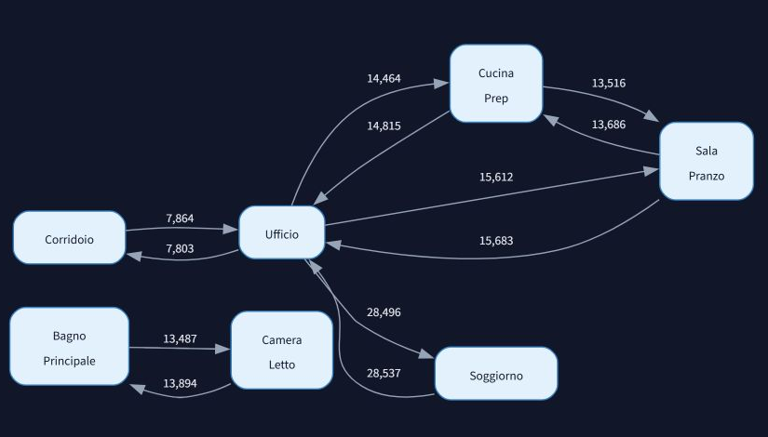
Observed transitions and process structure
12 most frequent flows
57.0% of within-case transitions
The DFG summarises observed adjacency. The Petri net describes permitted behaviour.
The simplified DFG complements the dense Petri net without replacing it.
ARUBA / PROCESS MINING
16
Notes:
This directly-follows graph is a real dashboard view derived from the larger event log. It shows the twelve highest-frequency flows. Those flows account for 187,857 of 329,563 within-case transitions, approximately 57.0%, and represent twelve of 123 distinct flows. It omits cross-case links. It describes observed adjacency, not the behaviour allowed by the selected Petri net. Zone labels are project conventions rather than verified semantic activity labels. The full Petri net remains available in the application but is dense and difficult to read in a projected presentation. Source image: audit/en_screenshots/S3_dfg.png, cropped to retain the complete displayed graph.
Project sources: PROJECT_DOCUMENTATION_EN.md (27 October 2026), data/experiments/comparison_20261023T213310299553Z/comparison_results.json and the associated manifest, evaluation metadata and PNML exports. Historical experiment evidence is documented in the English report. All scores describe this project, not external benchmarks.
Design assets: AI-generated conceptual backgrounds created with the built-in image-generation tool for this presentation. The house illustration is decorative and does not represent a verified Aruba floor plan. Quantitative charts, tables and dashboard screenshots retain project evidence.

Slide 17
Event distributions require careful interpretation
Compressed events by mapped zone
Events per calendar hour by period
These measures describe compressed sensor records. Room occupancy remains unmeasured.
Calendar-hour normalisation accounts for period length, but retains the internal coverage gap.
ARUBA / PROCESS MINING
17
Notes:
The left chart uses compressed zone event counts for the five most frequent labels plus all remaining labels. Ufficio 84,837, Soggiorno 54,109, Cucina_Prep 43,638, Sala_Pranzo 39,124 and Bagno_Principale 28,682 sum to 250,390, with 79,495 remaining events. The English labels are translations of the project’s conventional zone names. The right chart divides period totals by calendar hours intersecting the date window, accounting for unequal period lengths and partial boundary days. The rates are approximately 197.37, 43.14, 193.61 and 173.53. This denominator includes the internal nine-day gap and does not correct missing coverage. Event counts include sensor state changes and do not measure time spent in rooms.
Project sources: PROJECT_DOCUMENTATION_EN.md (27 October 2026), data/experiments/comparison_20261023T213310299553Z/comparison_results.json and the associated manifest, evaluation metadata and PNML exports. Historical experiment evidence is documented in the English report. All scores describe this project, not external benchmarks.
Design assets: AI-generated conceptual backgrounds created with the built-in image-generation tool for this presentation. The house illustration is decorative and does not represent a verified Aruba floor plan. Quantitative charts, tables and dashboard screenshots retain project evidence.

Slide 18
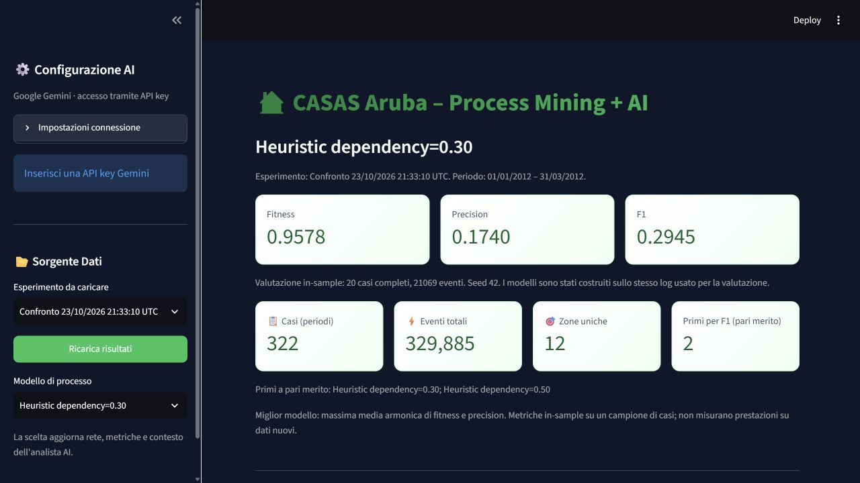
Interactive model selection in the website
A consistent experiment package
The selection updates the net and metrics.
All seven candidates remain available for inspection.
ARUBA / PROCESS MINING
18
Notes:
Actual Streamlit screenshot: audit/en_screenshots/S1_overview.png. The application supports experiment selection and a separate model selector. It loads the event log, models and metrics as a consistent package. Changing the selected model updates the Petri net, displayed metrics and context passed to Gemini, while invalidating previous chat and reports to avoid stale interpretations. The event log and observed DFG remain common across candidates in the same experiment. The interface is in Italian, while this presentation describes its functions in English.
Project sources: PROJECT_DOCUMENTATION_EN.md (27 October 2026), data/experiments/comparison_20261023T213310299553Z/comparison_results.json and the associated manifest, evaluation metadata and PNML exports. Historical experiment evidence is documented in the English report. All scores describe this project, not external benchmarks.
Design assets: AI-generated conceptual backgrounds created with the built-in image-generation tool for this presentation. The house illustration is decorative and does not represent a verified Aruba floor plan. Quantitative charts, tables and dashboard screenshots retain project evidence.

Slide 19
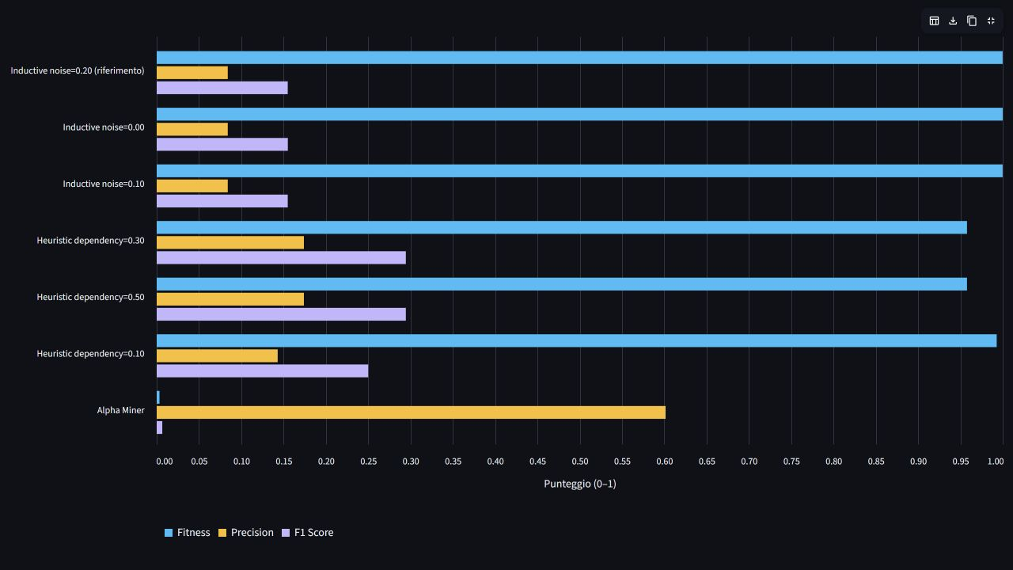
Configuration comparison in the website
Common scale
Separate bars keep the three scores comparable.
The table and order diagnostic provide the numerical detail.
ARUBA / PROCESS MINING
19
Notes:
Actual Streamlit screenshot: audit/en_screenshots/S6_metric_chart.png. The comparison shows separate fitness, precision and F1 bars with a common zero-to-one scale. The website also provides a numeric results table and original-versus-shuffled diagnostics. Values and selected models derive from the installed comparison archive. The visualisation avoids the earlier stacked-metric issue. The screenshot retains the actual Italian interface and names.
Project sources: PROJECT_DOCUMENTATION_EN.md (27 October 2026), data/experiments/comparison_20261023T213310299553Z/comparison_results.json and the associated manifest, evaluation metadata and PNML exports. Historical experiment evidence is documented in the English report. All scores describe this project, not external benchmarks.
Design assets: AI-generated conceptual backgrounds created with the built-in image-generation tool for this presentation. The house illustration is decorative and does not represent a verified Aruba floor plan. Quantitative charts, tables and dashboard screenshots retain project evidence.

Slide 20
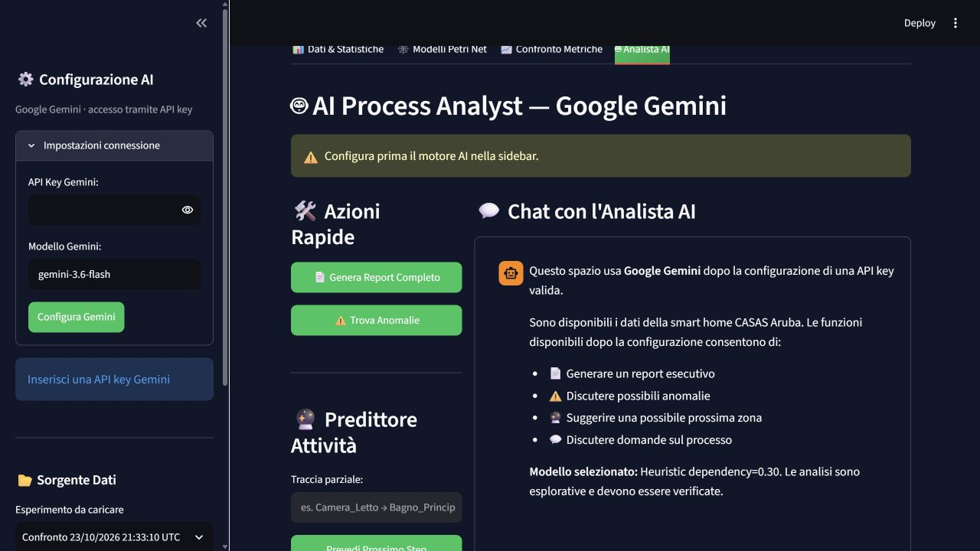
Google Gemini as an explanatory layer
Role of the integration
Explain selected evidence using the current experiment context.
The application does not train Gemini on this dataset.
The integration is implemented. Real API response quality remains unverified.
ARUBA / PROCESS MINING
20
Notes:
Actual screenshot: audit/en_screenshots/S7_ai_configuration.png. The application uses Google Gemini through an API key, with no local LLM deployment in the delivered implementation. The explanatory context includes complete sampled cases within a 20,000-row budget, selected-model statistics and metrics, a compact DFG summary and abbreviated trace variants. The row budget is not a token budget and does not guarantee representativeness. The initial greeting is static application text. No real Gemini response has been verified in the project evidence, and client tests use mocks. Therefore the slide presents the implemented integration and its intended role, not demonstrated answer quality or predictive performance.
Project sources: PROJECT_DOCUMENTATION_EN.md (27 October 2026), data/experiments/comparison_20261023T213310299553Z/comparison_results.json and the associated manifest, evaluation metadata and PNML exports. Historical experiment evidence is documented in the English report. All scores describe this project, not external benchmarks.
Design assets: AI-generated conceptual backgrounds created with the built-in image-generation tool for this presentation. The house illustration is decorative and does not represent a verified Aruba floor plan. Quantitative charts, tables and dashboard screenshots retain project evidence.

Slide 21
What the evidence supports
Established in this project
Still unverified
Seven completed candidates on a common log. Heuristic improves the measured balance over the Inductive reference.
Generalisation to future days, semantic activity labels and the accuracy of anomaly or next-zone explanations.
The strongest methodological finding
A high aggregate fitness score alone gives insufficient evidence that a model captures routine order.
ARUBA / PROCESS MINING
21
Notes:
The project supports a reproducible comparison on a common log and sampled case set, together with an operational dashboard for inspecting outputs. It shows that tuning and changing algorithms alter the trade-off between fitness and precision. It does not yet demonstrate generalisation to unseen days, validated human-activity semantics, anomaly detection accuracy or reliable next-zone prediction. The larger window includes a documented data gap, and the physical interpretation of the zone mapping requires confirmation. The order diagnostic provides a warning about permissiveness rather than a formal hypothesis test.
Project sources: PROJECT_DOCUMENTATION_EN.md (27 October 2026), data/experiments/comparison_20261023T213310299553Z/comparison_results.json and the associated manifest, evaluation metadata and PNML exports. Historical experiment evidence is documented in the English report. All scores describe this project, not external benchmarks.
Design assets: AI-generated conceptual backgrounds created with the built-in image-generation tool for this presentation. The house illustration is decorative and does not represent a verified Aruba floor plan. Quantitative charts, tables and dashboard screenshots retain project evidence.

Slide 22
Priorities for the next experiment
01
02
Verify raw-data coverage and the physical meaning of the zone mapping.
Compare shorter or inactivity-based cases and explicit sensor-state policies.
03
04
Use a chronological discovery, validation and test split for model selection.
Repeat order controls and evaluate anomaly claims against labelled evidence.
A stronger representation and evaluation design take priority over another larger window.
ARUBA / PROCESS MINING
22
Notes:
These are proposed next steps, not results already obtained. First verify provenance, coverage and the sensor-to-zone mapping. Then compare case definitions such as shorter sessions or inactivity-delimited traces while explicitly considering how state filtering changes meaning. Separate earlier discovery days from later validation and test days. Tune on validation data and report only final performance on a held-out chronological test. Repeat order permutations and introduce justified negative controls or labelled anomalies. Evaluate model complexity and interpretation separately. Extending the time window becomes useful after these representation and validation choices are controlled.
Project sources: PROJECT_DOCUMENTATION_EN.md (27 October 2026), data/experiments/comparison_20261023T213310299553Z/comparison_results.json and the associated manifest, evaluation metadata and PNML exports. Historical experiment evidence is documented in the English report. All scores describe this project, not external benchmarks.
Design assets: AI-generated conceptual backgrounds created with the built-in image-generation tool for this presentation. The house illustration is decorative and does not represent a verified Aruba floor plan. Quantitative charts, tables and dashboard screenshots retain project evidence.

Slide 23
Conclusions
A working experimental system
Raw TXT preprocessing, recoverable Colab experiments and an interactive dashboard with seven model configurations.
An improved result with clear limits
Heuristic reaches F1 = 0.2945. Low precision and limited order sensitivity motivate a stronger case design and independent evaluation.
ARUBA / PROCESS MINING
23
Notes:
The final project delivers raw-data preprocessing, Colab experiments with recoverable outputs, seven selectable process models and a dashboard with an optional Gemini integration. The best observed harmonic mean is 0.2945, shared by Heuristic dependency 0.30 and 0.50. Precision of those leaders remains 0.1740 and generalisation is unverified. A professional assessment should recognise the working experimental system and the measured improvement while retaining these substantive limitations. The next contribution should address case construction and independent evaluation rather than frame parameter tuning alone as a solved modelling task.
Project sources: PROJECT_DOCUMENTATION_EN.md (27 October 2026), data/experiments/comparison_20261023T213310299553Z/comparison_results.json and the associated manifest, evaluation metadata and PNML exports. Historical experiment evidence is documented in the English report. All scores describe this project, not external benchmarks.
Design assets: AI-generated conceptual backgrounds created with the built-in image-generation tool for this presentation. The house illustration is decorative and does not represent a verified Aruba floor plan. Quantitative charts, tables and dashboard screenshots retain project evidence.

