Slide 1

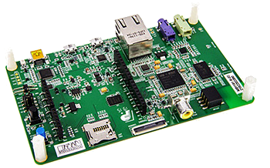
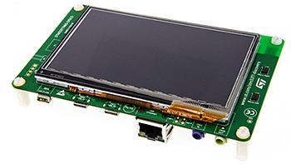
Praktikum:
Sichere Softwareentwicklung
für Mikrocontroller in vernetzten Energiesystemen

Slide 2
Game Specification
Genre: Shoot ‘Em Up
Countdown
Score
Optional Microphone: Shout “Peng” to Shoot
Different Targets
Two Game Modes

Slide 3


Targets*
Evil:
+50
Hero:
-70
*similarities to real characters are purely coincidental.

Slide 4

Targets*
Evil:
+50 +100
Hero:
-70
*similarities to real characters are purely coincidental.

Slide 5
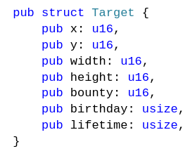
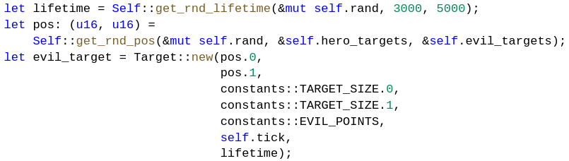
Targets

Slide 6
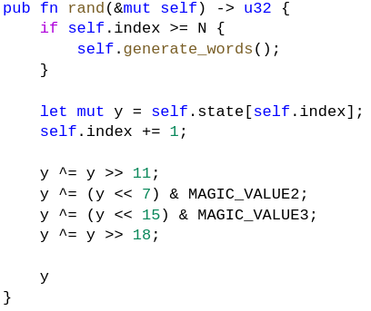
Randomizer
Mersenne-Twister
Seeded with HW-Random-Register

Slide 7
Renderer-Pipeline
picture.png
picture.dump
include_bytes(dump)
render([pixel])
For() {
render_pixel(x,y)
}

Slide 8
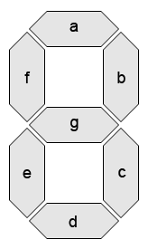
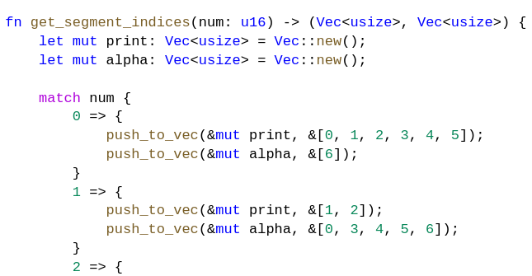
Seven Segments
Factory-Methods:
  new_vertical(x, y, size)
  new_horizontal(x, y, size)
Binary → BCD → match

Slide 9






Additional Game Features
Two different Game Modes
  Hunt the
  Hunt the
Click to Start Game & Play Again
Mute Button
Highscore of Game Instance

Slide 10
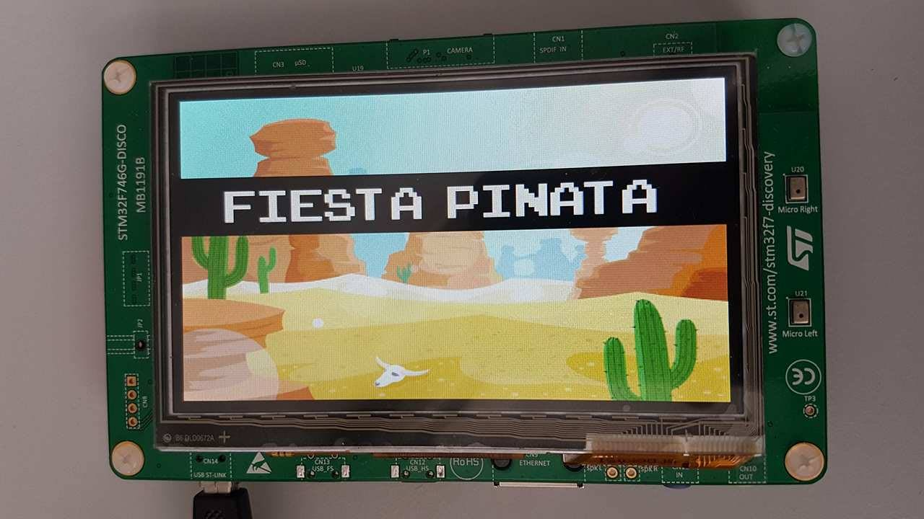
Game Demo

Slide 11
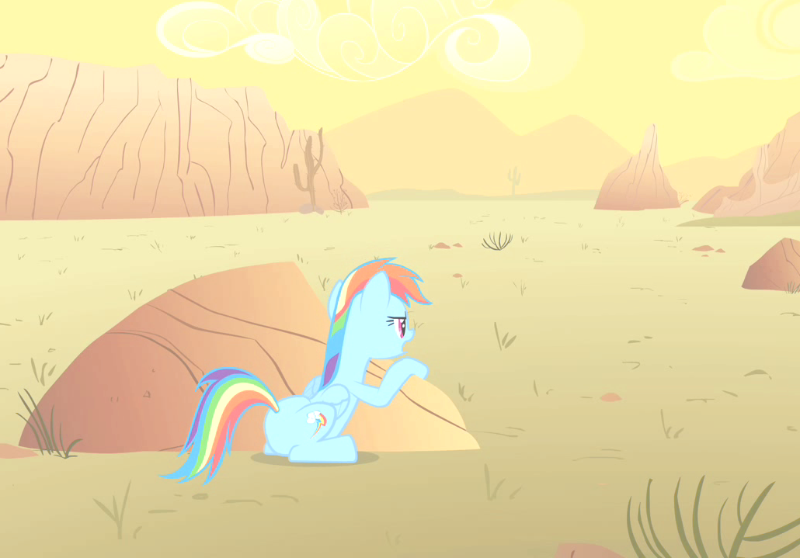
Danke für eure Aufmerksamkeit!

