Slide 1
Grokking VCF files
Stephen Duke
Rust UG @ Wellcome Sanger
sd32@sanger.ac.uk

Slide 2
Contents
Current version and link to spec
Major structure of file
Meta Information
Header
Interpreting Rows

Slide 3
Current Version and Link to Useful Stuff
Version 4.4
This is a great video which describes VFC files
The actual spec can be found here

Slide 4
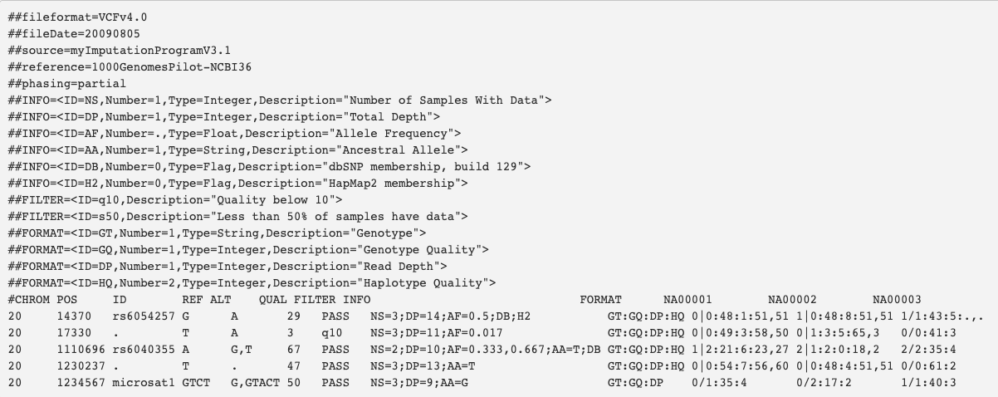
Meta Data - File Description
Header
Data Rows
Macro structure of a VCF file

Slide 5
Meta Information
Lines start with ‘##’
Can be structured or unstructured
Data types permitted in VCF files
Integer
Float
Flag
Character
String

Slide 6
Meta Information - Unstructured
Key value pairs
Format: ##key=value
Constraints:
Values cannot start with ‘<’
Must use ‘=’
Required keys:
##fileformat: VCF version (must be first line)

Slide 7
Meta Information - Structured
Value is a list of more key value pairs
Format:
##key=<key=value, key=value,...>
Constraints:
Must be enclosed in ‘<’ , ‘>’
Required fields
ID is required which must be unique for that ##key
Other fields are optional and can be user defined

Slide 8
Meta Information - Structured >> ##INFO
Number describes the number of values expected
Flags are 0
. (dot) means variable

Slide 9
Meta Information - Structured >> ##FILTER
Describes any quality control information for that variant

Slide 10
Meta Information - Structured >> ##FORMAT
Describes the columns which are recorded for each sample

Slide 11
Meta Information - Structured >> ##ALT
Describes any symbolic alternative alleles
None shown here ->
Example
##ALT=<ID=DEL, Description=”Special deletion”>

Slide 12
Header
Starts with a single ‘#’
Site space
8 required columns
Sample space
Format + 0:n columns

Slide 13
Header - 8 Site Columns (Mandatory)
Column | Description | Required | Data type
CHROM | Chromosome (entries must be contiguous) | Yes | String
POS | Position (1 indexed, numerically increasing, duplication permitted) | Yes | Integer
ID | If variant is known then variant ID from databases (multiple) | No | String
REF | Reference base (multiple permitted) | Yes | String
ALT | Alternate base (variants). List of non-ref alleles | No | String
QUAL | Quality score for variant in ALT. | No | Float
FILTER | Filter status. (PASS if all passed else list of filters failed) | No | String
INFO | Additional information. (List of key=value pairs) | No | String

Slide 14
Header - 8 Sample Columns
Column | Description | Required | Data type
FORMAT | Columns describing the genotype fields | Yes | String
Genotype Fields | The same types of data must be present for all samples and in the same order. | Yes | Integer

Slide 15
Rows
Describes a variant at a precise genomic location which may or may not be present in a sample

Slide 16
Rows - Variant Interpretation
REF
ALT
Ref | a | t | c | - | g | a
1 | a | t | g | - | g | a
2 | a | t | - | - | g | a
3 | a | t | - | - | - | a
4 | a | t | c | a | g | a
1
C
G
Subst.
2
TC
T
Del.
3
TCG
T
Del.
4
C
CA
Ins.
What are the different allele that we have??
{TCG, TGG, TG, T, TCAG}

Slide 17
Rows - Variant Interpretation
{TCG, TGG, TG, T, TCAG}
How is this represented as a row in a VCF file?
#CHROM
POS
ID
REF
ALT
QUAL
FILTER
INFO
20
165
.
TCG
TGG, TG, T, TCAG
.
.
.
Ref | a | t | c | - | g | a
1 | a | t | g | - | g | a
2 | a | t | - | - | g | a
3 | a | t | - | - | - | a
4 | a | t | c | a | g | a

Slide 18
Rows - Sample Interpretation (GT only)

Slide 19
Insights for implementation
The spec provides a good description of what is valid
The spec provides indications for backwards compatibility

