Slide 1




Face detection with opencv-rust
@Payne325
Alexander Payne
Payne325
PaynoInsano
Notes:
I'm Alex, for those of you that don't know me, I'm Software Engineer at Esri and my background is in the Geographic, Engineering and Game development software.
Today I'm going to be talking about a little side project I've been working on which I programmed in Rust and which utilises face detection from a live webcam feed.

Slide 2
What I set out to do
Had beginner level experience with Rust already
Wanted a project that had aims beyond “Learn Rust language features X, Y & Z”
Some experience with Computer Vision and Deep Learning with Python
Goal: Game with real-time face tracking to move the player
Notes:
I've dipped my toe into rust a few times, I've started the rust book, used it in a couple of game jams and used my personal programming kata (text based game) to understand basic I/O. I wanted to make a proof of concept for a computer game that was a bit silly, something I could work on slowly on the side and hopefully a somewhat novel idea.
I thought I'd use Rust to see how feasible it would be to run with such a project. I wasn't sure what I'd end up learning, but was excited to find out. The intention really was to pick a project where the key aim wasn't necessarily to learn Rust, but to see what I picked up along the way
What I ended up learning was a little bit about rust language features, and a fair bit about the maturity of computer vision support in the rust crate realm.
My aim was to make a "Space Invaders" style game that used head tracking to move the player character left and right. I've done a little bit of work with computer vision with Python in the past so I had a rough idea of how such a game would work in mind before starting.

Slide 3
Why OpenCV?
Piston – A modular game engine written in Rust
  Has some image processing functionality available
  Still in development
  No plan to venture into serious computer vision
cv-rs – A hand crafted binding to the OpenCV Cpp Library
  Incomplete implementation
  Commit history suggests project was abandoned
opencv-rust – auto-generated bindings
  Requires user to install OpenCV manually
  Untested
  Full support for OpenCV functions and modular compilation
Notes:
I already had prior experience with OpenCV with python, and I knew the underlying library with performant and had multiple ways of doing what I wanted. I was interested in whether there was a rust crate for opencv available, but I also wanted to get an idea of any other applications that I might be able to use. After a bit of digging I arrived at three real options.
- Piston (a modular game engine written in rust) had some imageproc functions, but at the time it was still in development and the roadmap didn't look like it was planning to venture into more serious computer vision. It didn't have quite what I needed and it looks unlikely it ever will.
- cv-rs - a hand crafted binding to the OpenCV CPP library. Incomplete, and based on commit history the project had been abandoned.
- opencv-rust - automatically generated bindings, requires opencv to be preinstalled, untested.
- but it did offer almost full support for opencv functions and the ability to control which components of the library are compiled within the toml.

Slide 4
Developer Environment
Acquire the OpenCV library
  Windows: Recommended via package manager
  Linux: Recommended Compile from Source
Set the necessary system variables
  opencv-rust crate documentation didn't cover all the variables I needed
  Issue history suggests other developers have had different setup problems
  Setup process seems fragile
Requires installation of the libclang-dev or llvm package
Notes:
The first step was to download and install the library. For Windows this was recommended via a package manager, I used Chocolately. For Linux it's recommended for installation via the repository release or to compile from source.
Next I had to set a number of system variables. Most of these were documented but I ran into a few issues with certain system variables missing from the documentation. A number of issues in the repo suggested that this was not an uncommon problem. In fact there were a number of reported problems in the repo that I thankfully didn't see, but the build process certainly seems fragile on both Windows and Linux.
I couldn't help compare the process to that of opencv for python where you cna just install and setup everything via pip in one command.
Final step is to install the libclang-dev or llvm package depending on your OS. The crate depends on these for building.

Slide 5
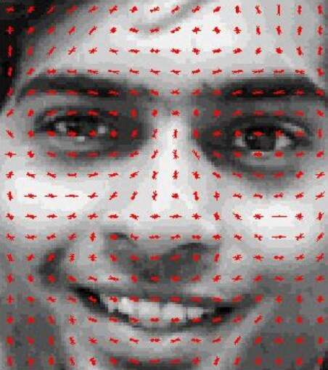
Approaches for Face Detection
Detect Facial Landmarks using H.O.G.s
Feature descriptors derived from distribution of intensity gradients within the image
Descriptors passed to a suitable ML model
Dlib is common choice for Python, Rust bindings exist
Notes:
- Detect Facial landmarks using HOGs (Histogram of Oriented Gradients)
- The idea is that feature descriptors can be extracted from an image, and these descriptors are derived from the distribution in intensity gradients within the image.
- The intensity gradient being a directional change in color intensity for a neighbourhood of pixels in an image. A descriptor is a concatenation of these.
- Descriptors are passed through some machine learned model to find the key facial landmarks (using H.O.Gs is fairly agnostic with regards to the model type)
- I believe that Support-Vector Machines were the first model used when H.O.G. facial detection although I've lost the link to whever I read that, so citation needed.
- Dlib has provided this functionality for many years and is known to work
- Unoffical rust libraries exist, but this just provides bindings, user has to install dlib
- I had just come through the opencv set up at this point, so was eager to find a solution that didn't involve more libraries.

Slide 6
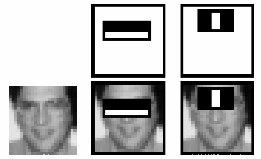
Approaches for Face Detection
Haar-feature classifier
Haar-feature is a predefined kernel used to detect lines and edges of contrasting intensity
Haar-feature classifier groups these into 'stages' and applies them to windows of the image
Windows passing all stages contain a facial landmark
Notes:
- Describe Haar-Feature classifier approach
- I discovered this after implementing my chosen approach, so did not consider this at the time.
- A predefined kernel/small matrix called a Haar-feature is applied across an image to detect the liklihood that some facial feature is within a particular subsection/window of the image.
- Haar-features are used to detect lines and edges where a face would contrast locally between a darker and lighter areas. E.g. eyes vs bridge of the nose.
- A Haar-feature classifier is a program constructed to group Haar-features in terms of priority into different stages and apply each stage to a window. If a stage fails, i.e. if it doesnt detect its desired haar-features, then the window is no longer considered for further evaluation. A window that passes all stages contains a facial landmark of some sort.
- This is very fast, but from my reading it only works well for faces facing directly front.
- OpenCV provides Haar-cascade Detection via its interface and even provides a weights file within its release files.
- If I revist this project, I'd like to experiment with a Harr-feature based implementation of the face tracker.

Slide 7
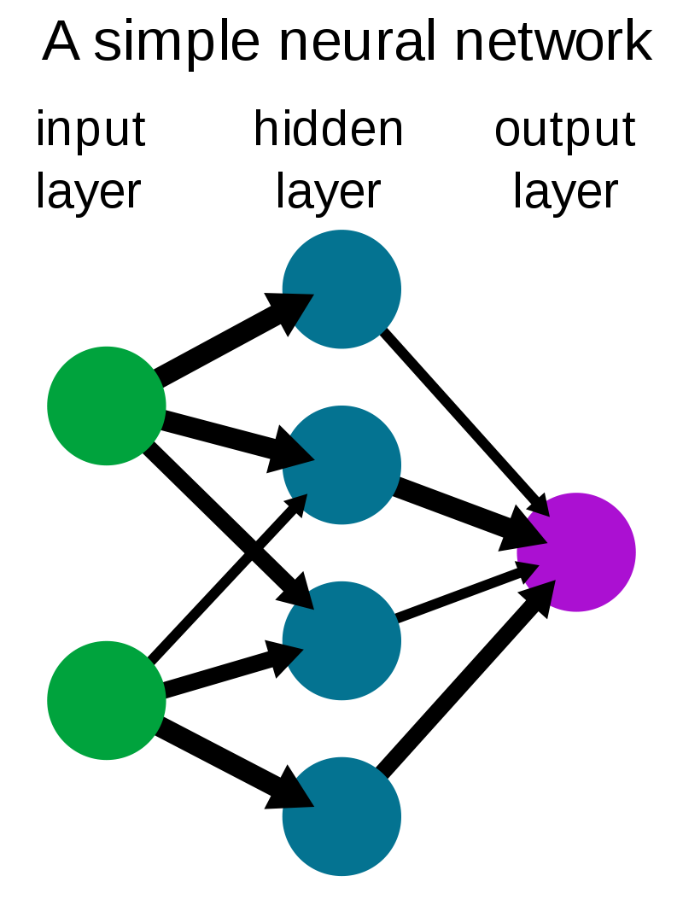
Approaches for Face Detection
Pass image through a Neural Network
Network of layers which uses weights to manipulate input data
During training, the layer weights are adjusted to provide the desired output.
To detect a face, we can feed in pixel data and get image location
Notes:
- Describe DNN approach
- I'll admit to some bias for this approach, I had used it before with Python when first experimenting with OpenCV a few years ago
- For those that don't know, a neural network is a network of layers, each of which uses a series of weights to manipulate some given input data.
- When training a Neural Net, the result (in our case a classification) is determined as right or wrong, and that information is fed back into the model to adjust the weights at each layer.
- For face detection, we can feed in the pixel data of an image and have the model return an area supposedly containing the face.
- OpenCV has a Deep Neural Network (DNN) Module, with an interface for loading a caffe model and weights.
- It also hides the necessary model and weights for face detection in the source, which is now widely known online.
- This approach is very fast and doesn't require the user to be directly front facing.
- This approach avoids the need to determine/define any facial landmark descriptors, but we can only obtain a bounding box around the face instead of precise detection of the face
- Acceptable for our purposes
- Picked NN because
- prior experience
- had the model and weights to hand
- believed it would be mroe performant when running (best option for a game).

Slide 8
Implementation: How it works
Obtains an image frame from the camera
Preprocess image
  Change size to that expected by the NN
  Convert to OpenCV's blob type
Blob provided as input data to the NN and forward pass is triggered
Output matrix is retrieved from the NN
Extract normalised bounding box position from matrix
Multiply normalised BB by original image width and height
Notes:
- Runs in a loop, starts by obtaining an image/frame from the camera
- Currently the program just grabs the first registered camera device, but could be extended to allow for other options.
- The image is then pre-processed into the size expected by the Neural net and converted to a 'blob'
- The image blob is passed to the Neural net as input data and a forward pass of the model is triggered. Meaning the image data is passed through the layers
- The output is returned in the form of a matrix, which we can extract normalised positions within the image to determine a bounding box containing the face.
- Simply multiply those normalised positions by the orginal frame width and height to obtain the position in the original image.
- Some of these points seem like they are quite complicated to do, and it can seem like I've glossed over them here, however each bullet point really only corresponds to one or two opencv functions, the library does a good job of extracting the complicated stuff across all available interfaces.

Slide 9
Implementation: Successes
I was able to write a face detection program with Rust
The resulting implementation performs well
Was prompted to enforce error handling with matches
Wealth of documentation online was applicable due to one-to-one mapping of methods
Feasible to port Python/C++ OpenCV application to Rust
Notes:
It works! I was able to write a face detection program with Rust and it works quite well.
- Many of the crate's functions returned values wrapped in Rust's result type, which prompted me to write matches, causing the code to end up looking a bit like try/catch blocks.
- The C++ opencv lib is known to work well and is quite safe, so the rust binding to it is also performant.
- For the most part, the functions were a one-to-one mapping with the C++ implementation, made navigating documentation much easier
- Overall I'd say its extremely feasible to port an OpenCV based application from Python/CPP to Rust.

Slide 10
Implementation: Problems I encountered
Interface is not entirely consistent across Python/C++/Rust
OpenCV has specific types (converted to traits) for output from functions.
Resultant code was very coupled to the neural net model used.
Rust's syntax made these problems very obvious
Notes:
However it wasn't all fun and games, in addition to the difficulty I encountered with the crate set up I also found a few problems during development.
- Although it was mostly pretty good, the interface was not entirely consistent across the Rust/CPP/Python versions. Particular example, giving an empty string when requesting a layer means all in cpp/python, in rusty it means none. This was not documented.
- OpenCV's interface has specific types for Input/Output to and from functions, which the auto generated bindings for Rust made somewhat overly complicated when converting these types to traits by obscuring the underlying type.
- For example, the OutputVector trait was used for vector and collection of vectors, meaning it got very confusing figuring out how many dimensions I had to deal with in my data source.
- I also found that end result was a program very coupled to the design of the neural network, which resulted in
- Necessary casting of output data
- Had to hard code the indices for extracting positional info from resultant matrix.
- It's worth noting that these are not necessarily failings of Rust, as these problems would exist wih Rust/CPP/Python. The Rust syntax did make these problems very obvious to see.

Slide 11
Integration into the game
Packaged Face detection into a crate f-trak
Game runs f-trak in a separate thread
Game retrieves bounding box data via channels (rust-book chapter 16.2)
Bounding box mapped to game coordinate system
Player X position set to the X position of scaled bounding box centre point

Slide 12
Integration into the game
Packaged Face detection into a crate f-trak
Game runs f-trak in a separate thread
Game retrieves bounding box data via channels (rust-book chapter 16.2)
Bounding box mapped to game coordinate system
Player X position set to the X position of scaled bounding box centre point
Notes:
- Created a crate for f-trak to simplify development for myself
- I could abstract/turn off f-trak in my game on the fly for debugging purposes
- Admitedly, it's mainly because I had never published a rust crate before and I was curious.
- The process is well documented and very quick and Chris has given a talk about this before so I won't go into details.
- The Game runs f-trak's function in a separate thread and utilises channels to receive the bounding box containing a face (rust-book chapter 16.2)
- The Game maps this bounding box to game coordinate system with simple scaling function to convert from camera width/height to game window width/height
- The Player's X position is set to the X position of scaled bounding box centre point, and a game character is drawn on screen.

Slide 13
Let's see it running!

Slide 14

Questions
References available in accompanying notes
Notes:
Thanks for watching/listening/reading.
I've uploaded these slides and some notes to my github, where you can also find the f-trak and bongosero projects as well.
The notes also contain references to the various articles I read and borrowed images from for this presentation.

