Slide 1
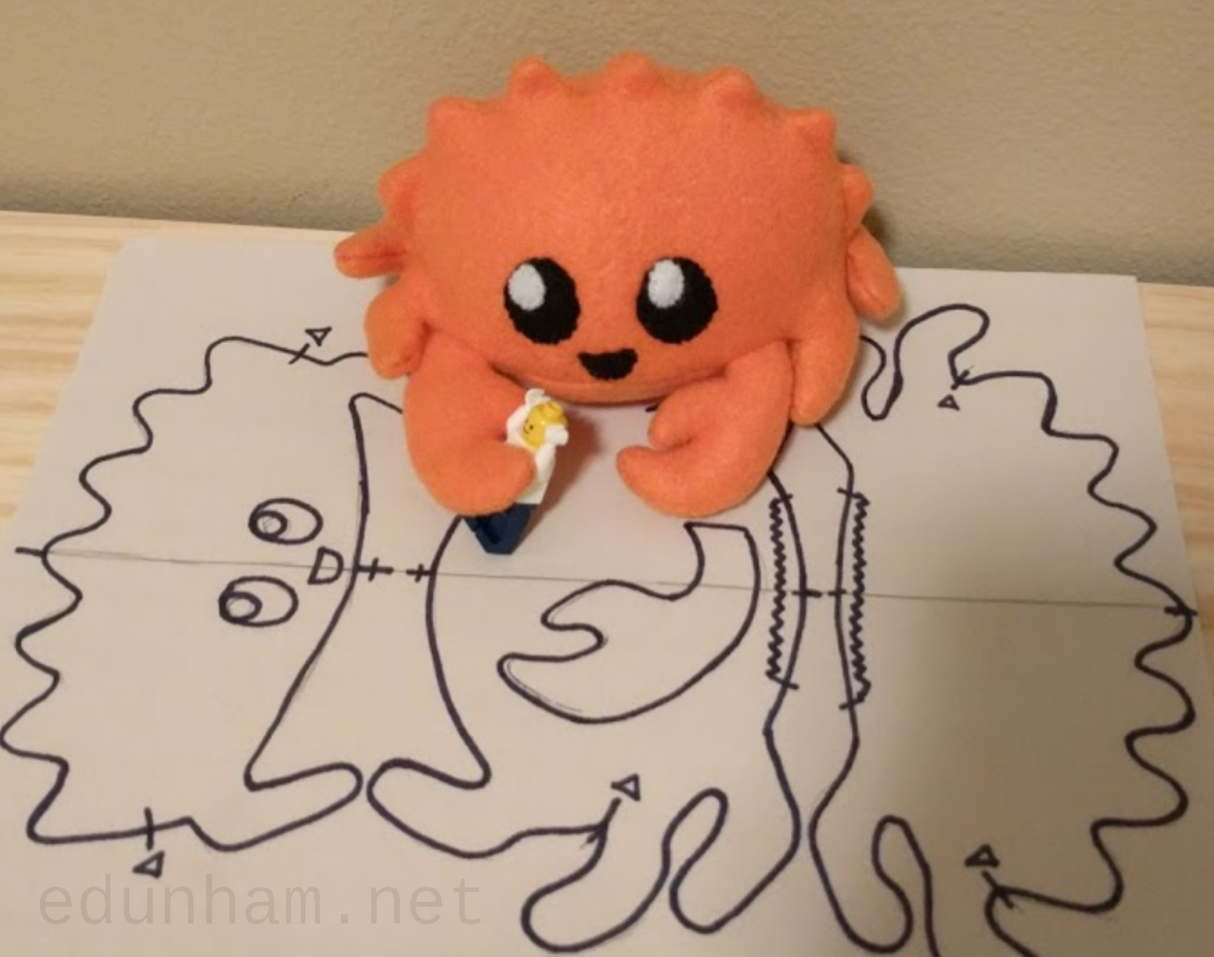


Slide 2



We are a community of Rust Developers in Kenya whose mission is to share and collaborate in across software and hardware disciplines.
Our Community

Slide 3

Problem Statement
Growing adoption of Rust in critical systems requires robust developer support.
Developers face hurdles in mastering Rust’s advanced features (e.g., ownership, lifetimes).
Lack of accessible troubleshooting at key events limits productivity and innovation.

Slide 4



01
Deliver hands-on workshops and mentorship programs to teach Rust best practices.
EDUCATE
02
What We Do
Collaborate on open source community projects to build libraries our members can integrate into their commercial and open source projects.
COLLABORATE
03
Partner with institutions and projects to offer Rust courses and technical support in their events.
PARTNERSHIPS

Slide 5
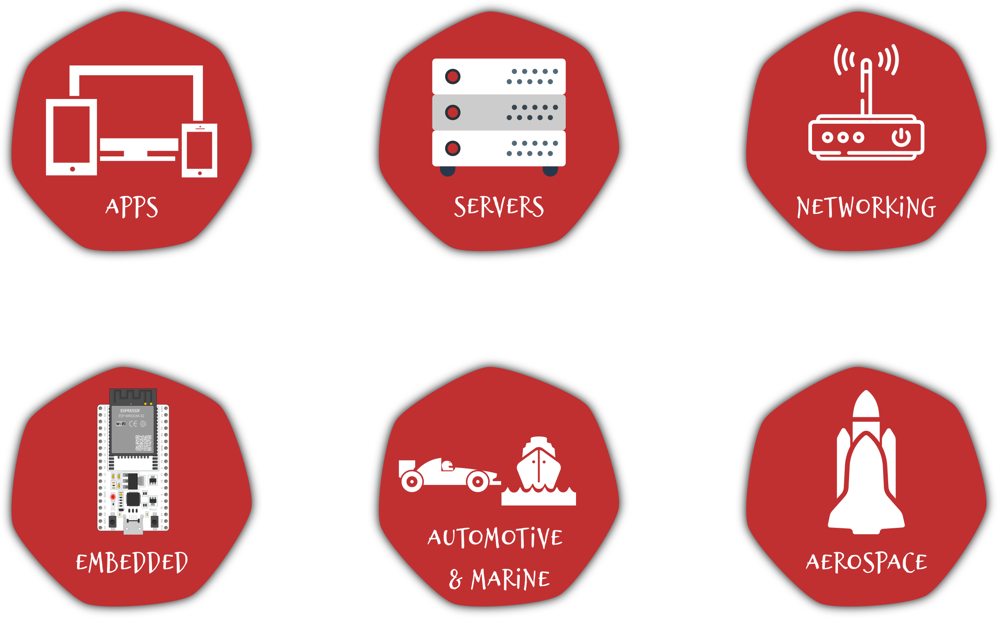
Scope
Rust can be used to build any software and hardware system, our mission is to ensure our community can use Rust no matter the task.

Slide 6




WE BUILD TOGETHER
@RustaceansKenya
RustaceansKenya
Email

