Slide 1

SIS3: Generative Model for Text Generation
Character-level language modelling on Shakespeare
Exercise title: SIS3
Students name:
Khalimov Rustam, Kaliyev Alpamys, Baimyrza Nurlybek, Kuat Adilet
Date: April 23, 2026

Slide 2
Problem Overview
Text Generation Task
Dataset & Baseline
Character-level text generation predicts the next character in a sequence, with the goal of building coherent prose one character at a time.
Tiny Shakespeare provides a compact but expressive corpus for training. We use an LSTM baseline as the reference model for generating text.

Slide 3

Baseline Architecture
Architecture
Hyperparameters
Baseline Performance
Embedding → stacked LSTM → dropout → dense softmax
Adam optimizer, learning rate 0.001, batch size 64, cross-entropy loss
Val. Loss 1.94
Perplexity 6.96
Each sequence predicts the next character — the model learns the probability distribution of character transitions.
These results also highlight the model's limitations on long-range structure and coherent generation.

Slide 4

Modification 1: Attention Mechanism
Stacked LSTM
Dense Softmax
Embedding
Attention
Attention layer inserted before the final dense layer to focus on relevant positions and capture long-range dependencies.
Results
1.82
6.17
Val. Loss
Perplexity
vs 1.94 baseline
vs 6.96 baseline

Slide 5
Model Modifications
Three targeted modifications — each addressing a specific weakness of the baseline
Attention Mechanism
1
Focus on relevant positions in the sequence
GRU + Optimised Dropout
2
Lighter architecture, faster training
Deep LSTM + Regularisation
3
Hierarchical patterns, highest capacity

Slide 6
4.1 — Attention Mechanism
Design Choice
Attention layer inserted before the final dense layer — weights each timestep's contribution to the next-character prediction
Motivation
Not all positions contribute equally; attending to the most relevant context captures long-range dependencies that vanilla LSTM misses
Outcome
1.82
6.17
Val. Loss
Perplexity
More coherent sentences · fewer abrupt transitions · better long-range structure

Slide 7

Modification 2: GRU with Optimised Dropout
What was changed
LSTM layers were replaced with GRU units, reducing the number of parameters in the model.
Why it helps
This led to faster convergence and lower compute requirements during training.
Performance metrics
Val. Loss: 1.87
Perplexity: 6.49
Key advantage
Significant training time reduction.
Comparison note: Compared with the baseline, this modification improves efficiency while maintaining strong validation performance.
Val. Loss: 1.87
Faster
Perplexity ≈ 6.49
Significant training time reduction

Slide 8

Modification 3: Deep LSTM with Regularisation
What was changed
Additional LSTM layers + stronger regularisation (L2 + recurrent dropout).
Why it helps
Deeper hierarchy captures more abstract patterns in the character sequence.
Richer Representations
Deep LSTM + Recurrent Dropout
Deep LSTM + L2
3-layer LSTM
2-layer LSTM
Best-in-class results
1.80
6.05
Val. Loss
Perplexity

Slide 9
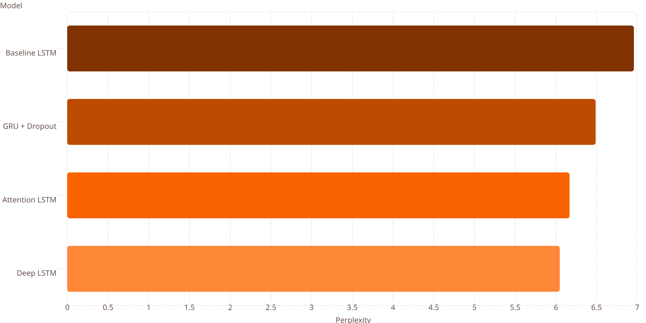
Comparative Analysis
Key Trade-offs
6.96
Architecture choice depends on performance goals, available compute, and time constraints — no single winner.
6.49
6.17
6.05
Deep LSTM
Attention
GRU
Highest accuracy · highest cost
Strong coherence · moderate cost
Resource-efficient · solid performance

Slide 10
Conclusions & Insights
Deep LSTM
Trade-offs
Best overall results — perplexity 6.05 and the most natural, consistent prose
Better performance came with higher complexity and compute requirements
Lessons Learned
Future Improvements
Attention and Deep LSTM were both effective; GRU remained a strong option under resource constraints
Very long sequences still need more advanced architectures for stronger context retention

