Slide 1
Developing Web Applications with CI/CD Pipelines
Using Jenkins, Git, Docker, and Terraform to streamline your development workflow.
DR
Team Members:
2200033105- Sai Raghavendra
2200031490- Tarish
2200032535- Rambabu
2200032740- Nikhil Vardhan Reddy

Slide 2
Introduction to CI/CD
What is CI/CD?
Why CI/CD?
CI (Continuous Integration) automates code testing and integration. Reduces integration issues by 80%.
Faster release cycles accelerate time to market by 20-50%. Higher code quality through automated testing reduces bug rates by 15%.
CD (Continuous Deployment) automates application deployment. Deployment frequency increased by 500%.
Automated testing and deployment decrease manual effort by 30%.

Slide 3
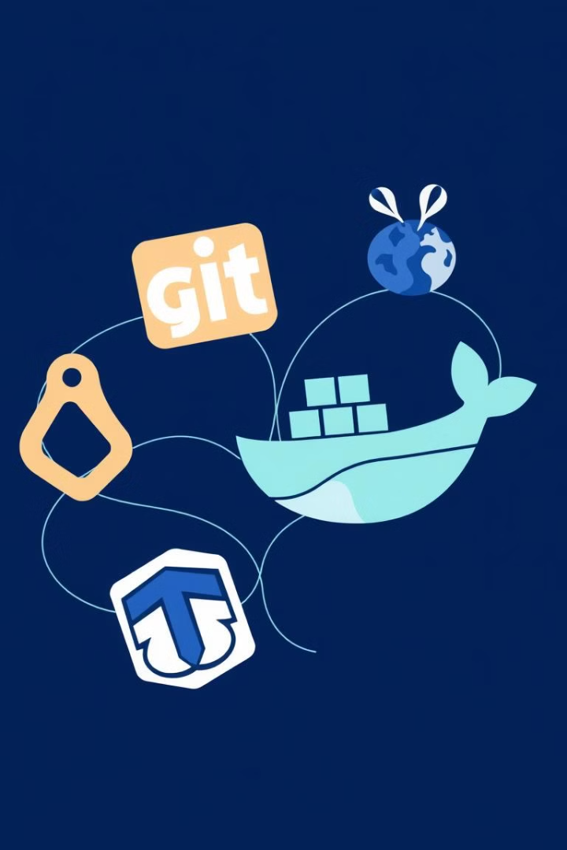




Technologies Used in CI/CD
Git: Source code management used by 90% of developers. A version control system for tracking changes.
Jenkins: Automation server. Open-source server for CI/CD. Supports building, testing, and deploying applications.
Docker: Containerization platform. Creates lightweight, portable, and executable containers
Terraform: Infrastructure as Code tool. Enables infrastructure provisioning and management across cloud providers.

Slide 4
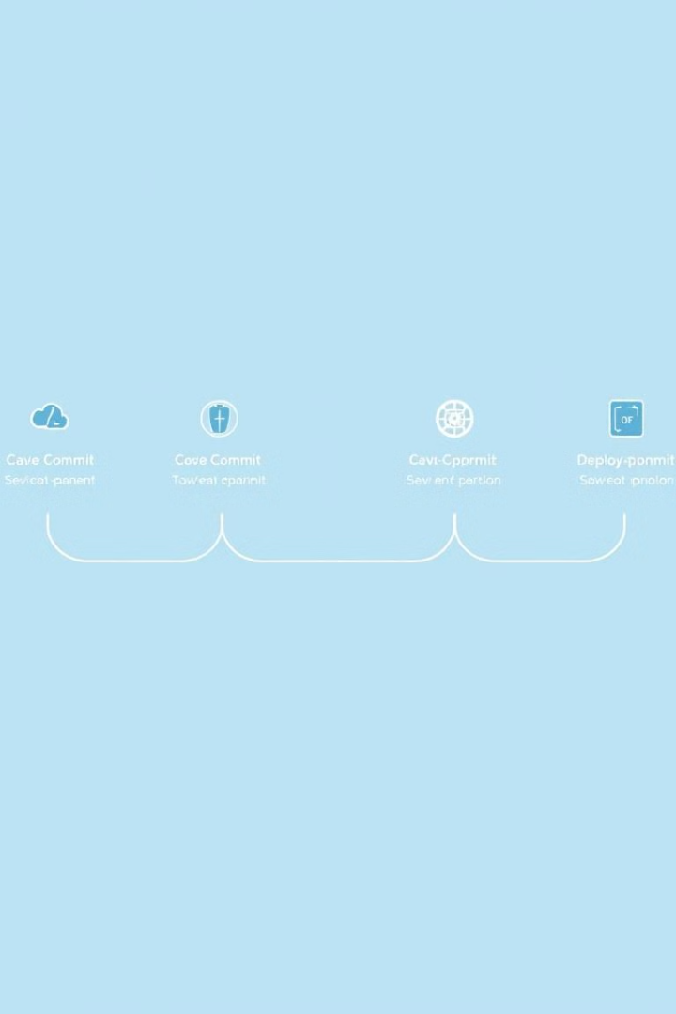




Setting Up the CI/CD Pipeline
Code Commit
Triggered by Git commit.
Build
Compiles code, runs static analysis.
Test
Executes unit, integration, and end-to-end tests.
Deploy
Deploys to staging/production environments.

Slide 5
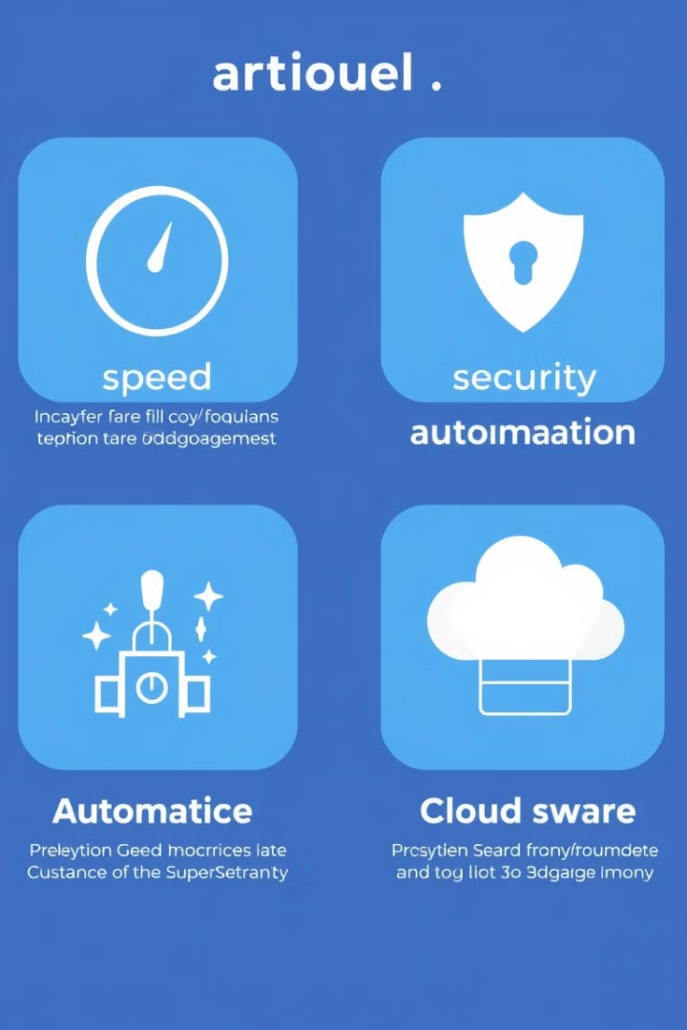
Benefits of Using CI/CD
Faster Delivery
Accelerates software release cycles.
Improved Code
Enhances quality and security.
Automated Deployments
Reduces manual errors.
Scalable Infrastructure
Portable and efficient.

Slide 6

Conclusion and Benefits of CI/CD
1
Key Technologies
2
Faster Time to Market
Leverage Git, Jenkins, Docker, and Terraform.
Accelerate release cycles by 40%.
3
Improved Quality
4
Increased Automation
Reduce bugs and errors by 20%.
Save 30% of developer time by automating repetitive tasks.
Streamline workflows and minimize deployment issues. Now, are there any questions?

Slide 7


