Slide 2
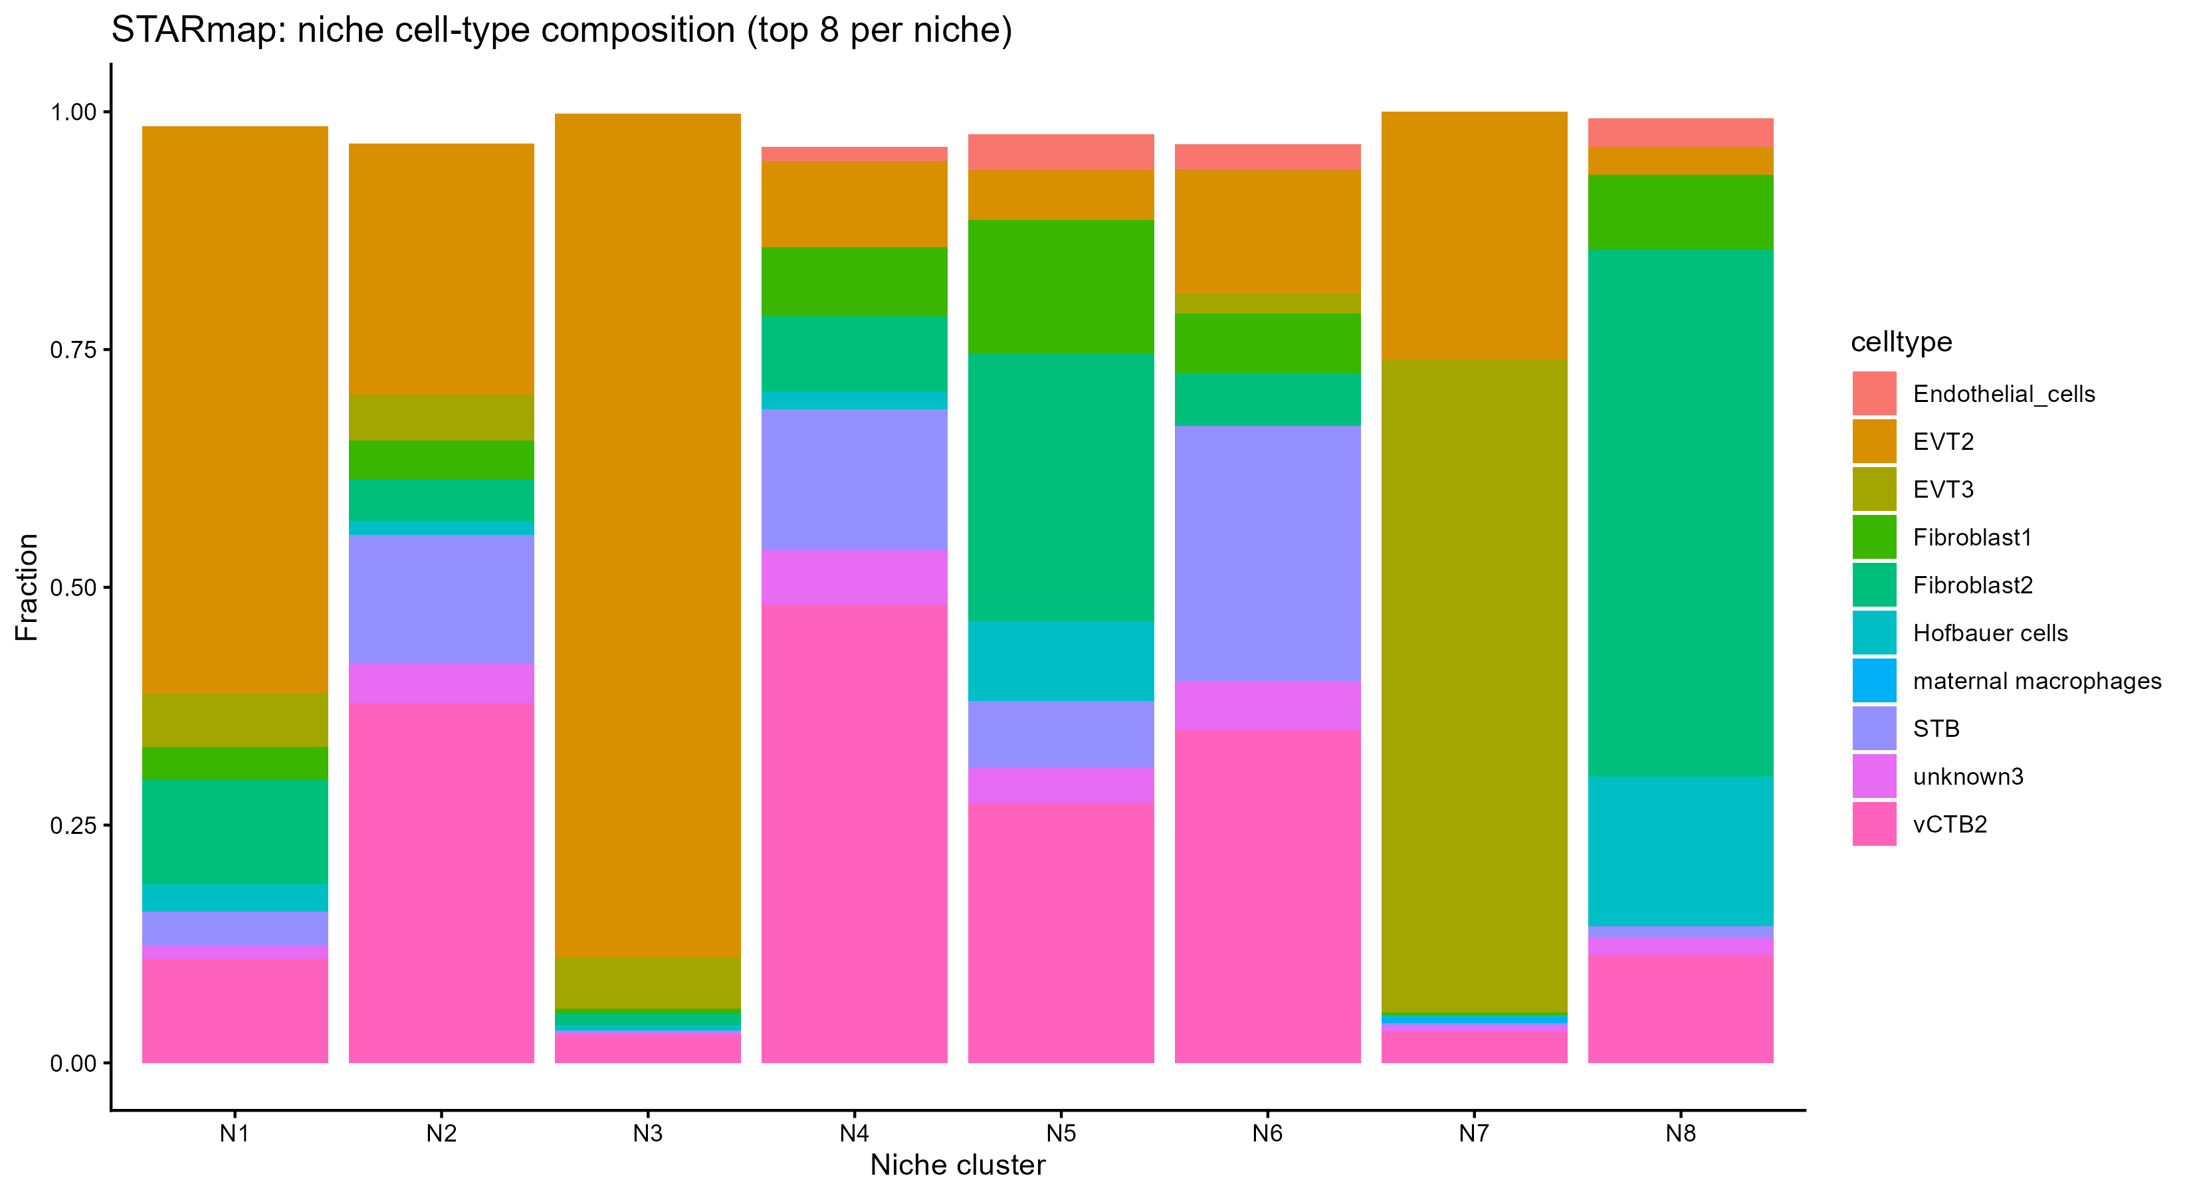
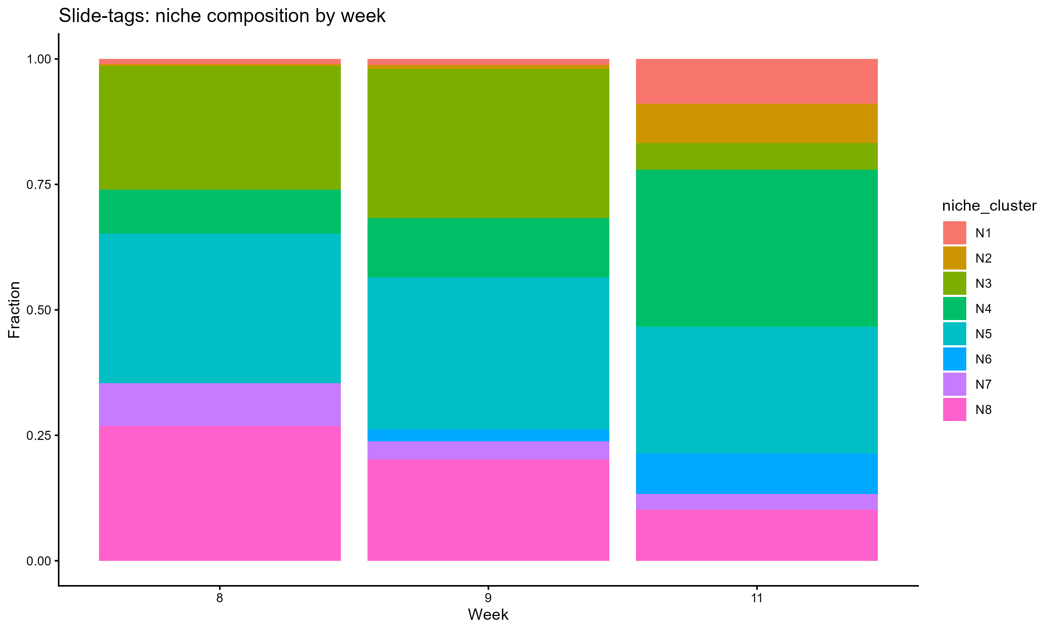
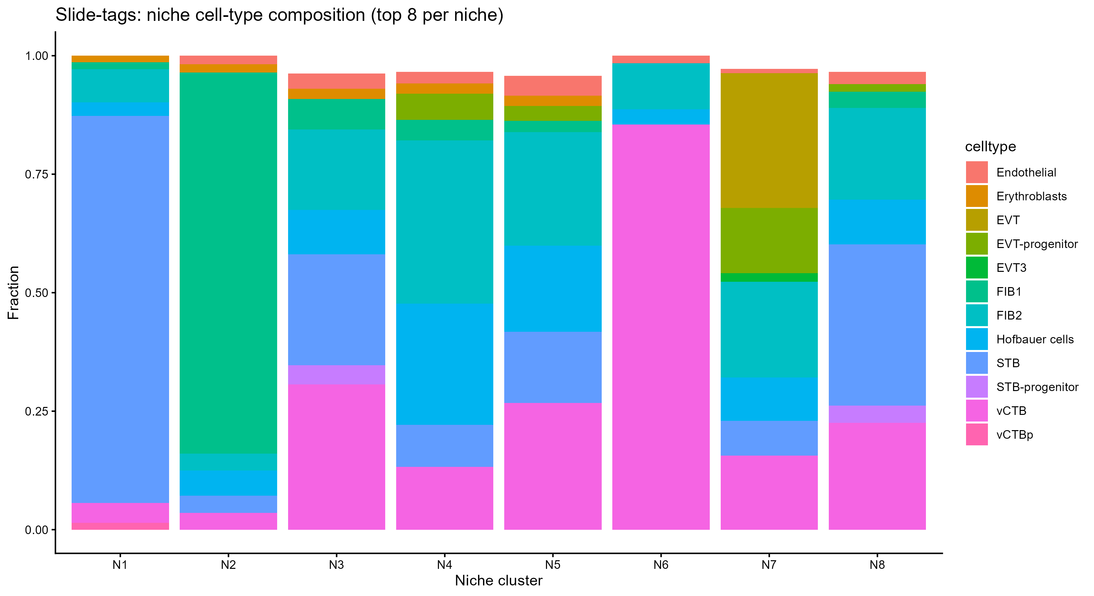
See significant reduction in the N8 cluster, and an increasing the N3 , n8 mainly fibroblast 2
An appearance of N3
N1 Growth
Increase in N6

