Slide 1
Nomad company
Members: Daulet Zh. Alikhan Zh. Rustem My.

Slide 2
About our company
Nomad is a road cargo system designed to provide efficient and reliable transportation of goods. The system incorporates modern technology to ensure timely delivery and optimum utilization of resources. Nomad is an ideal choice for businesses looking for a dependable cargo transportation solution.

Slide 3



Members
Developing Frontend Backend
Design
Database

Slide 4
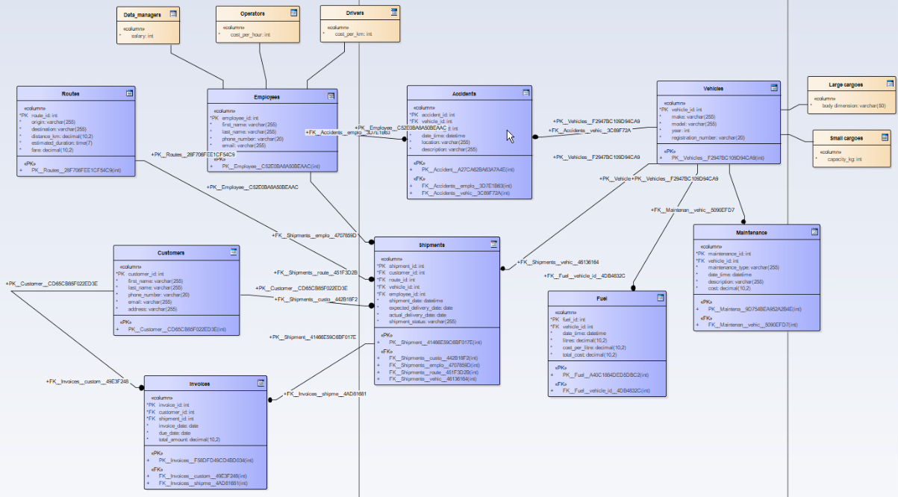
Logical model

Slide 5
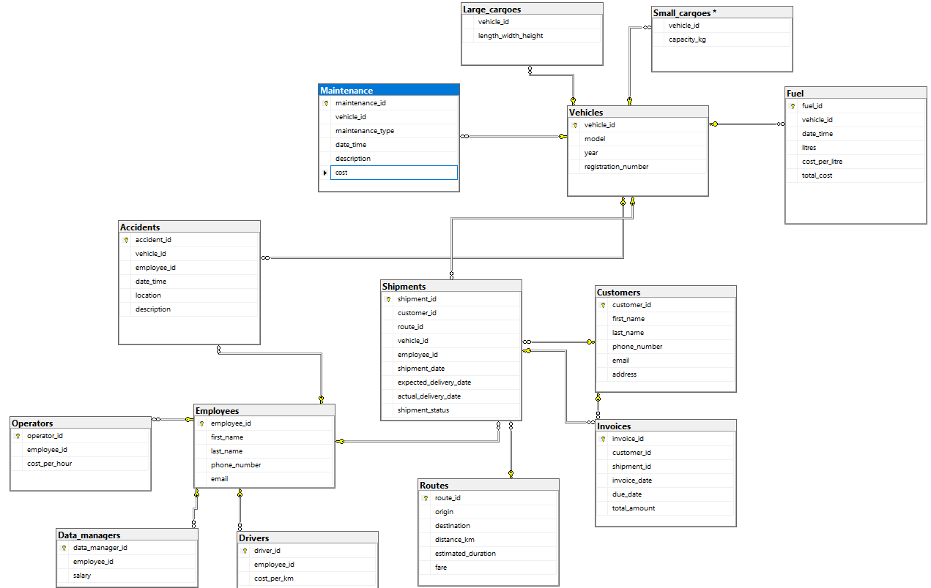
Physical model

Slide 6
Functions
Admin Panel
Data editing
Output data to the application Grid view
Bind tables separate fields with a table in the form of a grid
Calculated fields (examples: Client's Age, Orders Amount, etc.)
Data search (examples: by Name, Address, Phone, etc.)
Data sorting
Data filter (Cascade rows by binding tables)

Slide 7
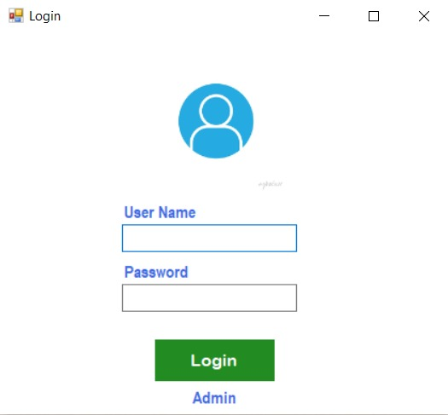
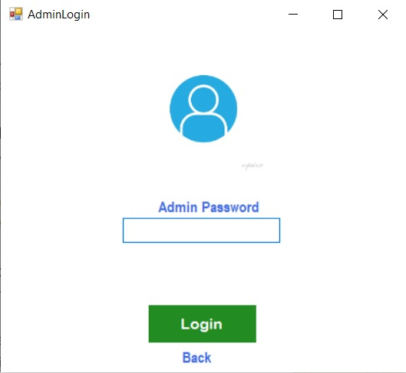
Functionality of website
Login page
Admin page

Slide 8
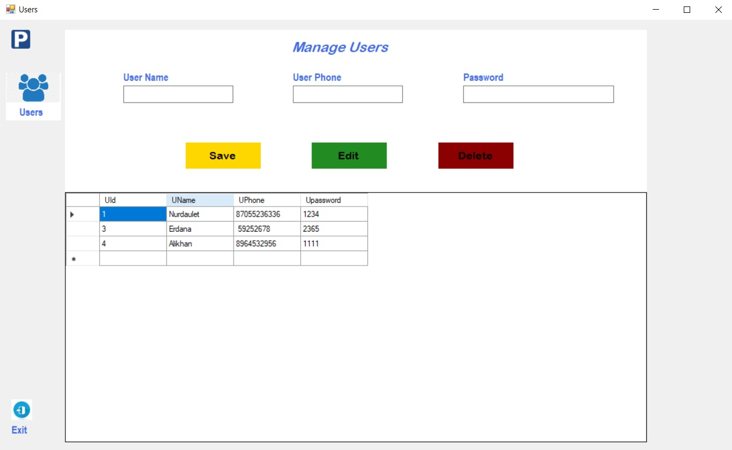
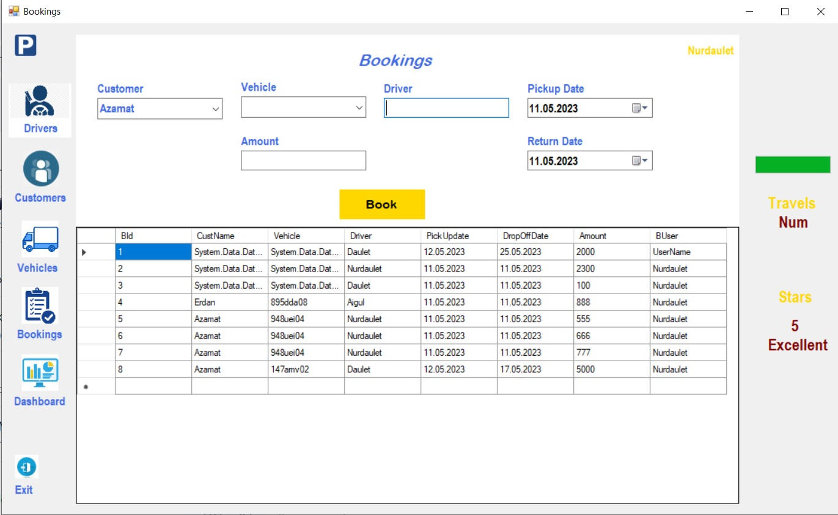
Functionality of website
Manage users
Booking

Slide 9
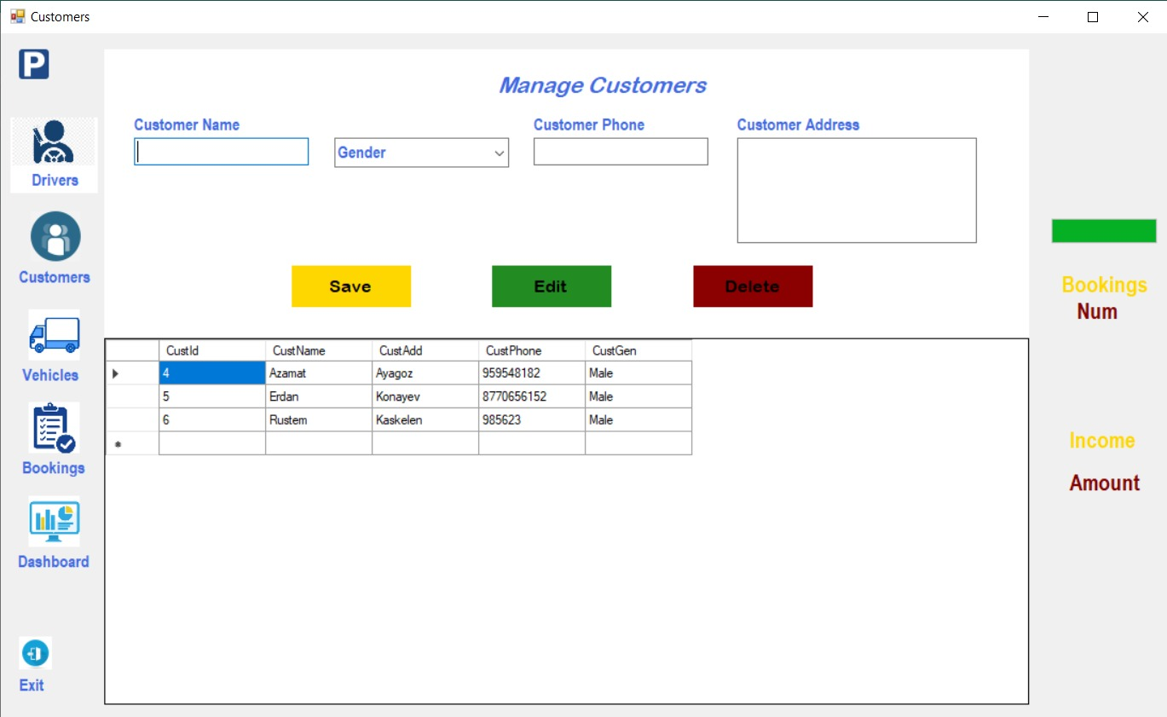
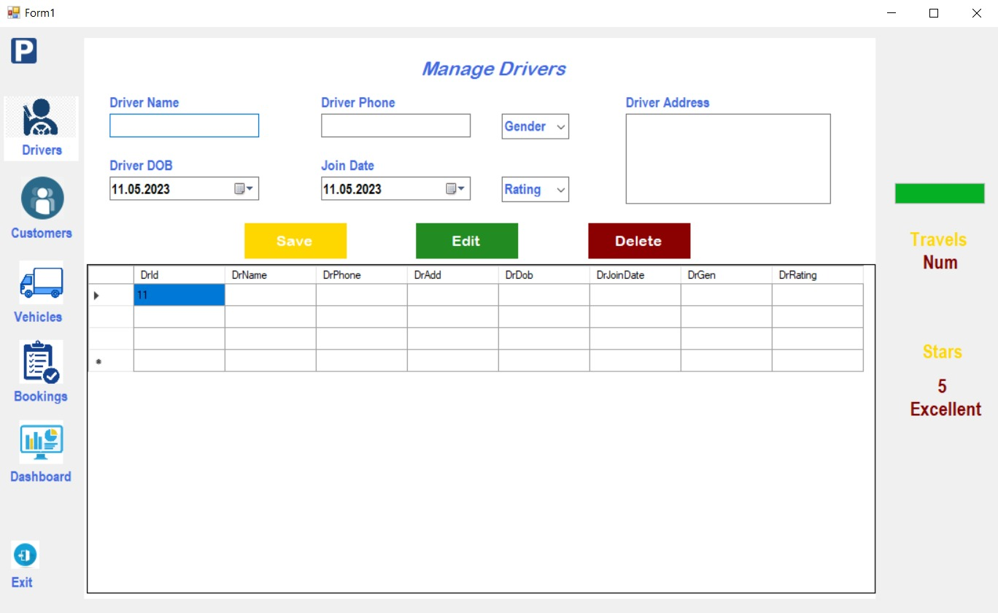
Functionality of website
Manage drivers
Manage Customers

Slide 10
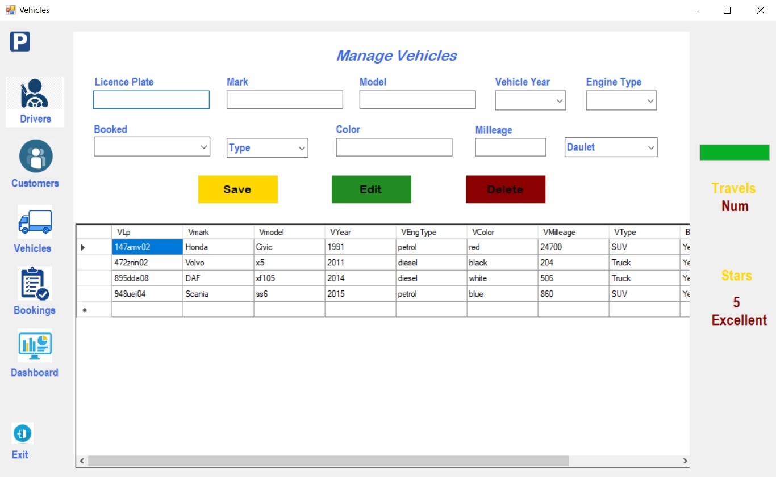
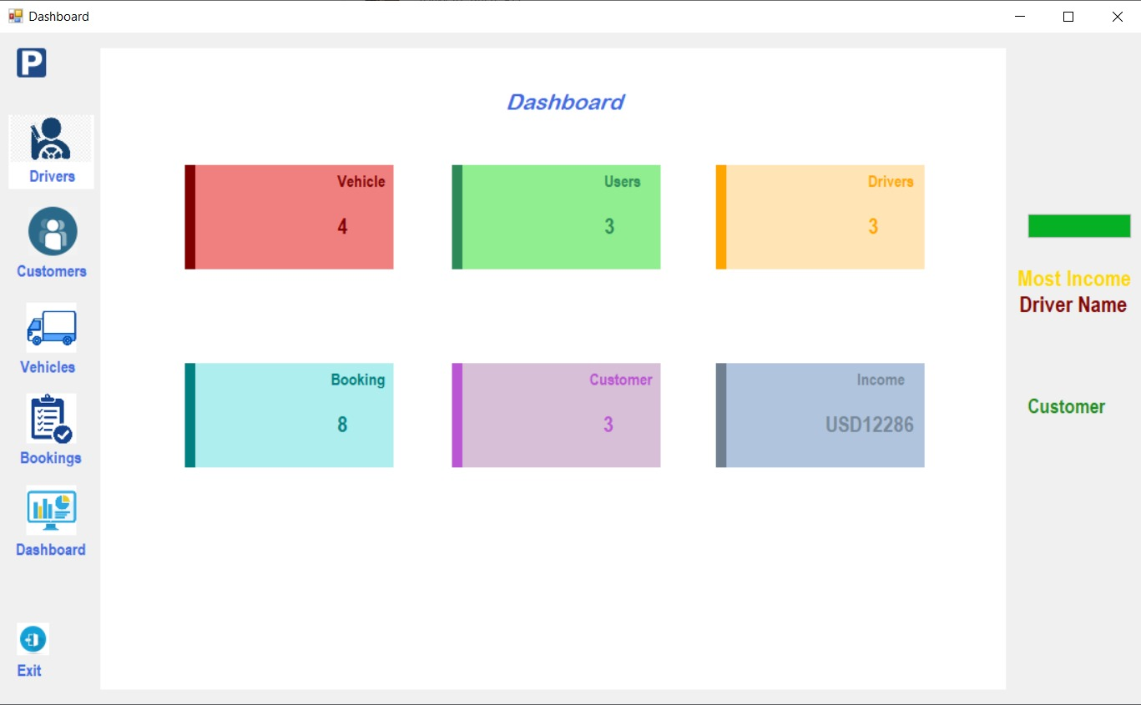
Functionality of website
Manage Vehicle
Dashboard

Slide 11
The end!

