Slide 1

K
PROJECT
Final Review 2026
Katalyze
PRESENTED BY
GUIDED BY
Arunoday A K
Achutharaj R
Lokesh D
Abhay Rohit M
CB.SC.U4AIE23106
CB.SC.U4AIE23108
CB.SC.U4AIE23123
CB.SC.U4AIE23173
Dr. Palmani Duraisamy
Assistant Professor (Sr. Gd.)
School of Artificial Intelligence
KATALYZE
An Autonomous Testing Agent for Functional Bugs in Web Applications
Notes:
1

Slide 2
K
PROJECT
Final Review 2026
Katalyze
INTRODUCTION
Examples of functional bugs
Web Application Testing & Functional Bugs
Incorrect calculations
Cart totals or prices are updated incorrectly.
Web applications are tested to ensure that their features, workflows, and user interactions behave as intended. Web testing involves systematically evaluating an application's functionality, validating outputs, and checking whether user actions produce the expected results.
Functional bugs occur when an application feature does not behave according to its intended requirements. These defects can affect individual operations or emerge across sequences of user interactions.
Validation failures
Invalid inputs are accepted, or valid inputs are rejected.
Data inconsistency
User changes are not saved or are lost after reloading.
Workflow errors
A sequence of actions produces an unexpected outcome.
Functional bugs may not crash an application or generate visible errors, making their detection an important aspect of reliable web application testing.
Notes:
2

Slide 3
K
PROJECT
Final Review 2026
Katalyze
PROBLEM STATEMENT
01
02
03
Scripted testing: Traditional web application testing relies heavily on predefined test cases and manually scripted workflows, limiting its ability to explore unexpected sequences of user interactions.
Silent failures: Functional bugs can emerge only after multiple dependent actions and may produce incorrect outputs or inconsistent application states without triggering crashes or visible errors. Conventional error detection methods may fail to identify them.
The need: An autonomous testing system that can systematically explore web application workflows, identify potential functional faults, and verify that detected faults are genuine and reproducible.
Notes:
3

Slide 4
K
PROJECT
Final Review 2026
Katalyze
PROJECT OBJECTIVES
01
02
03
Autonomous Web Exploration
Structured State Exploration
Test-Directed Exploration
Develop a testing agent that autonomously explores web applications through sequences of user interactions.
Integrate page-state abstraction and state revisitation to systematically explore workflows and revisit discovered states.
Incorporate test-design operators to explore meaningful interaction sequences and uncover functional faults.
04
05
06
Lightweight Online Learning
Reliable Fault Verification
Empirical Evaluation
Investigate whether Thompson-sampling bandits and count-based curiosity improve exploration effectiveness.
Check reproducibility in fresh browser sessions, compare against a control build, and minimise failing sequences.
Evaluate the approaches against random exploration using verified functional faults and false-positive rates.
Notes:
4

Slide 5
K
PROJECT
Final Review 2026
Katalyze
LITERATURE REVIEW
Paper | Approach and contribution | Limitation | How Katalyze addresses it | What we adopt
Automatic Web Testing Using Curiosity-Driven Reinforcement Learning (WebExplor), ICSE 2021 [1] | Tabular Q-learning with a curiosity reward; an automaton steers the agent back to unexplored states | Console errors as the only oracle; failures never verified; silent functional bugs missed | Verified-fault oracle covering six functional bug classes | The curiosity reward; its six benchmark applications and measures
Deep Reinforcement Learning for Automated Web GUI Testing (WebRLED), 2025 [2] | Deep Q-network with grid action values and a learned discriminator of actionable elements | Same implicit oracle; the learner's share of the gains is not isolated | Controlled comparison of decision strategies on one shared structure | The importance of detecting actionable elements
First Return, Then Explore (Go-Explore), Nature 2021 [3] | Keeps an archive of reached states, returns to promising ones, then explores from there | Designed for games; has no notion of a bug or an oracle | Applied to web testing with exact browser replay and abstract page states | The archive-and-return loop at the heart of our explorer
Understanding Automated Web GUI Testing: An Empirical Study Across Exploration Strategies and State Abstractions, 2026 [4] | Compares model-, RL- and LLM-based web testers under six state abstractions | Code coverage is only weakly linked to revealing failures | Verified faults as the primary measure, coverage reported beside it | A compact state abstraction (our page cells)
The Oracle Problem in Software Testing: A Survey, IEEE TSE 2015 [5] | Surveys how tests decide whether observed behaviour is correct | Implicit oracles (crashes, errors) cannot see wrong results | Specified oracles for seeded faults, verified against control builds | The specified versus implicit oracle distinction
Notes:
5

Slide 6
K
PROJECT
Final Review 2026
Katalyze
RESEARCH GAP
Research Need
An integrated autonomous testing framework that combines structured web exploration with systematic verification of functional faults and controlled evaluation of exploration strategies.
Despite advances in reinforcement learning and autonomous web testing, several limitations remain.
01
02
03
04
Limited exploration structure
Inadequate fault verification
Insufficient evaluation of strategies
Lack of robust fault validation
Existing approaches do not fully address systematic exploration and revisitation of web application states within a unified testing framework.
Many approaches rely on indirect indicators, such as console errors or code coverage, rather than verifying whether functional faults are genuine and reproducible.
The individual benefits of structured exploration, test-design strategies, and lightweight online learning are not clearly isolated.
Detected failures require reproducibility checks, comparison against a fault-free control build, and minimisation of failing interaction sequences.
Notes:
6

Slide 7
K
PROJECT
Final Review 2026
Katalyze
HOW THE LITERATURE CONNECTS
TO OUR CONTRIBUTIONS
LITERATURE LIMITATION
KATALYZE'S RESPONSE
Console errors can miss silent functional bugs
Verify functional faults using a dedicated oracle
Limited systematic state exploration
Archive-and-return exploration with abstract page states
Benefits of learning strategies are unclear
Compare structured exploration with learning-enhanced variants
Code coverage does not establish fault correctness
Use verified faults as the primary evaluation measure
Candidate failures may be false positives
Reproduce, compare against a control build, and minimise failures
Notes:
7

Slide 8






K
PROJECT
Final Review 2026
Katalyze
WHAT ARE FUNCTIONAL BUGS?
Calculation Errors
Constraint Bypasses
State Corruption
The application produces an incorrect numerical result.
The application accepts invalid input or allows an action that a rule should block.
Information entered or selected by the user becomes incorrect in a later screen or state.
Increasing the quantity of a product does not update the cart total correctly.
An order is placed without a required delivery address.
Express delivery is selected, but the confirmation shows standard delivery.
Persistence Failures
Broken Transitions
Crash-Type Faults
Data that should be saved is lost, reverted, or not stored correctly.
An action navigates to the wrong page or state, or fails to navigate when it should.
An interaction triggers an uncaught script error or a failed application request.
After editing a record and reloading the page, the old value returns.
Clicking “Next” in a multi-step form returns to the first step.
Selecting a checklist item causes a JavaScript error.
Notes:
8

Slide 9
K
PROJECT
Final Review 2026
Katalyze
ARCHITECTURE & METHODOLOGY
01
02
03
04
05
06
Application Input & Setup
Browser Automation
Hybrid Exploration Engine
Fault Detection
Fault Verification
Results & Reports
URL / ZIP / Dockerfile repository
Playwright + Chromium
Page Abstraction
Generate state cells
Seeded Oracle
Known fault assertions
Replay ×2
Verified bugs
Validation & sandboxed deployment
Capture page state
Go-Explore Archive
Select & replay states
Generic Triggers
Runtime / state errors
Delta debugging
Reproduction steps & screenshots
Identify forms, links & custom clickables
Coverage
Policy + Operators
Choose & execute tests
LLM-Inferred Rules
Silent functional bugs
Control-build comparison / LLM judgement
Record browser events
HTML / JSON reports
Observe outcome → update archive / learner → repeat
Three parallel checks
Generic failures require additional confirmation when needed
Notes:
9

Slide 10
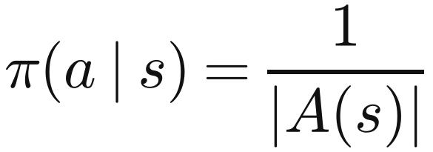
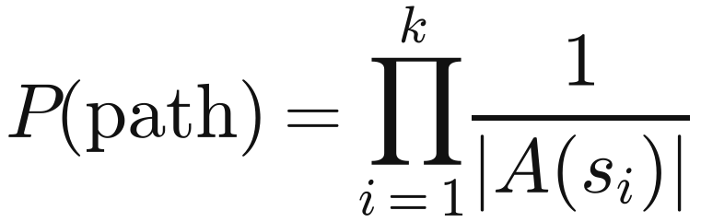
K
PROJECT
Final Review 2026
Katalyze
RANDOM EXPLORATION
Approach 1 of 5 · the baseline every tester has to beat
WHAT IT IS
At every step, pick one of the actions available on the current page uniformly at random. No memory, no structure, no learning.
WHY WE INCLUDE IT
It is the honest yardstick: on applications with shallow faults, chance alone finds a lot, so every other approach must be compared with it.
THE MATHS
A(s): the actions available on page s. Each one is equally likely, whatever happened before.
HOW IT WORKS
List the valid actions on the page: links, buttons, fields, dropdowns
Pick one uniformly at random and execute it in the browser
Repeat until the interaction budget is spent
Every finding passes the same verification as the other approaches
The chance of following one specific k-step path. With 10 actions per page, a fault 4 steps deep is reached with probability 1 in 10,000: why deep faults are rare for random exploration.

Slide 11
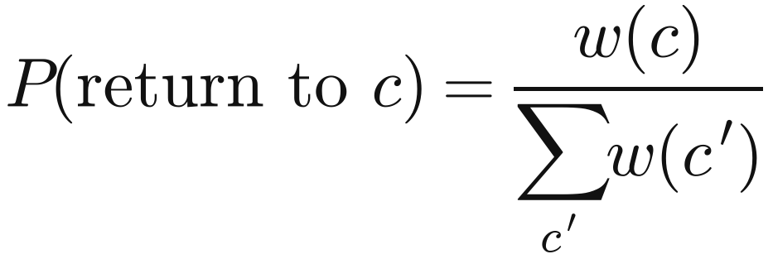
K
PROJECT
Final Review 2026
Katalyze
STRUCTURED EXPLORER
Approach 2 of 5 · remember states, return to them exactly, test deliberately; no learning
WHAT IT IS
Each page becomes an abstract state, a cell. The explorer keeps an archive of cells, picks one by its weight, replays the shortest path back to it, and applies a test operator there.
WHY WE INCLUDE IT
Functional faults sit several steps into a workflow and need a deliberate deviation. This approach isolates what structure alone achieves.
THE MATHS
Cells are chosen in proportion to their weight.
HOW IT WORKS
Abstract the page into a cell: page kind, path, heading, form state
Choose a cell with probability proportional to its weight w(c)
Return to it exactly by replaying its shortest path
Apply an untried test: complete a step, invalid input, edit after review, back or reload and resume, double submit
Add every newly reached cell to the archive
n: visits · u: untried tests · f: failed returns · ρ: room left in the episode · d: depth. Rarely visited, untested, reachable and deep cells are preferred.
Untried pairs first, in random order; once all are tried, any pair is allowed again.

Slide 12


K
PROJECT
Final Review 2026
Katalyze
BANDIT EXPLORER
Approach 3 of 5 · the structured explorer, with Thompson sampling choosing the test
WHAT IT IS
The structured explorer, with a Bayesian bandit choosing which test operator to apply. It learns online, inside the application being tested.
WHY WE INCLUDE IT
A run makes only about 50–135 operator decisions: too few for a neural network, enough for a bandit over a few dozen meaningful keys.
THE MATHS
θ_k: how likely test k is to pay off, kept as a Beta distribution.
After each test, a success adds to α and a failure to β.
HOW IT WORKS
Key k = (page kind, operator, target type), backing off to (operator, target) and (operator)
Sample every candidate's posterior and take the highest draw
Reward r = 1 when the test shows something new (an alert, a new state): the tester's own observation, never the oracle
Update the key's counts after every test
A new key borrows 30% of the evidence of its more general keys (S, F: their successes and failures).
Thompson sampling: the highest sampled θ wins, so uncertain tests still get tried.

Slide 13
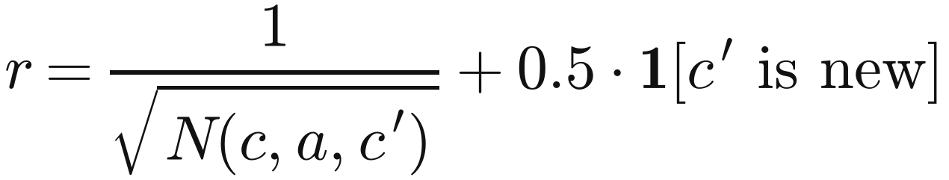
K
PROJECT
Final Review 2026
Katalyze
CURIOSITY RL EXPLORER
Approach 4 of 5 · count-based curiosity Q-learning, the design of WebExplor and WebRLED
WHAT IT IS
The structured explorer, with a tabular Q-learner choosing the free exploration steps between test operators, rewarded for novelty.
WHY WE INCLUDE IT
It is the reinforcement-learning design of the published testers, so it gives a like-for-like RL comparison on their own benchmark.
THE MATHS
N(c, a, c′): how often this transition has been seen. Rare transitions and new cells pay most.
HOW IT WORKS
States are cells; actions are the page's controls
Reward every step for rarely seen transitions and new cells
Choose ε-greedily from Q; untried actions start optimistic
Learn from every transition: about 2,000 updates per run
Q-learning: move Q(c, a) towards the reward plus the discounted value of the best next action.
α: learning rate · γ: discount · ε: chance of a random action. Untried actions start at R_max / (1 − γ).

Slide 14
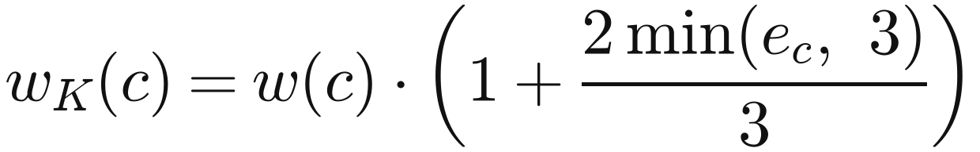
K
PROJECT
Final Review 2026
Katalyze
KATALYZE, TUNED
Approach 5 of 5 · the structured explorer with the options that won tuning; frozen before the benchmark
WHAT IT IS
The structured explorer plus a list-browsing operator, failure feedback and listener-based clickable detection. It is the default agent in the Katalyze app.
WHY WE INCLUDE IT
Tuning on eight full-stack applications kept only what helped. It was frozen and tagged before anyone looked at the benchmark applications.
THE MATHS
e_c: actions at c that were followed by a browser error. A cell's weight grows up to three times.
Listeners are recorded by a script injected before the page's own code, so custom buttons built from plain elements become actions.
HOW IT WORKS
Browse list: sort or filter a list, page forward, open an item on a later page
Failure feedback: more attention to states where errors followed an action
Listener-based clickables: elements that register click handlers (React, Vue, jQuery, Angular)
Rejected in tuning: the bandit (slower on 7 of 8 apps) and heuristic clickables

Slide 15
K
PROJECT
Final Review 2026
Katalyze
WORKFLOW
How Katalyze tests an application, end to end
1 Target
URL, static site, repository with a Dockerfile, or a demo app
2 Intake + sandbox
build and run it in a restricted container
3 Browser
Playwright + Chromium; find forms, links and clickables
Nothing is reported unless it passes verification.
4 EXPLORATION LOOP repeats until the interaction budget is spent
5 Detect a candidate
seeded assertion · generic trigger (script error, failed request, dead link) · LLM-inferred rule
Choose a state
from the archive, in proportion to its weight w(c)
Return exactly
replay the shortest path to that state
6 Verify
replay twice in fresh sessions · control build without the fault · minimise (delta debugging) · LLM judge for rule findings
Observe the page
new states join the archive; the learner is updated
Apply a test
the operator is chosen by the approach (slides on each arm)
7 Report
steps, screenshots; HTML, Markdown, JSON

Slide 16
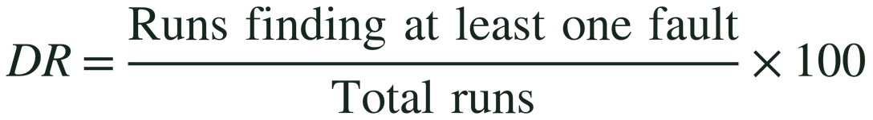
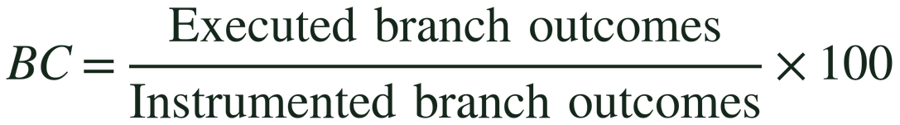
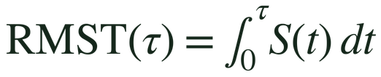
K
PROJECT
Final Review 2026
Katalyze
EVALUATION METRICS &
STATISTICAL METHODOLOGY
METRIC 01 Distinct verified faults
METRIC 02 Fault discovery rate
METRIC 03 Branch coverage
METRIC 04 Time to first verified fault
Interactions to the first verified fault, with runs that find none censored at the budget; summarised by restricted mean survival time (RMST), not by averaging successful runs alone.
Fault-discovery and coverage metrics are reported separately, never combined as though they measure the same thing.
Notes:
10

Slide 17
K
PROJECT
Final Review 2026
Katalyze
RESULTS: OUR EVALUATION
Our evaluation: verified functional faults on seeded applications
Held-out: 8 unseen apps, 24 seeded faults, 40 runs per approach, pre-registered. Tuning: 8 development apps, 41 faults, 24 runs per approach (development data).
Approach | Runs that verified a fault (held-out) | Time to first fault RMST, lower is faster | Distinct faults held-out, of 24 | False positives clean-build controls | Errors per run tuning
Random exploration | 32 / 40 | 978 | 13 | 0 / 8 | 5.38
Structured explorer | 30 / 40 | 737 | 18 | 0 / 8 | 2.88
Bandit explorer | 34 / 40 | 769 | 19 | 0 / 8 | 2.83
Curiosity RL explorer | – | – | – | – | 5.67
SILENT-BUG FINDER (LLM RULES, NO WRITTEN CHECKS)
1 of 9 seeded faults rediscovered on 3 apps; 0 false findings on their clean builds. Post-hoc, tuned on these apps.
RMST: restricted mean time to the first verified fault, in browser interactions (budget 2,000). Bold: best in the column. –: curiosity RL was added after the held-out evaluation, which was frozen and run once.
All held-out speed differences are inconclusive (log-rank p > 0.15): 8 apps give wide intervals.
Notes:
11

Slide 18
K
PROJECT
Final Review 2026
Katalyze
RESULTS: BENCHMARK
WebExplor's six open-source applications: branch coverage (%), one-hour runs
Our approaches: 5 runs per app, same hardware for every run (round 2, listener-based clickables). WebExplor and WebRLED: published averages.
Application | Bandit explorer * | Curiosity RL explorer | WebExplor (published) | WebRLED (published)
Dimeshift | 51.3 | 48.9 | 54.2 | 55.4
Pagekit | 34.8 | 41.0 | 25.8 | 39.8
Splittypie | 34.8 | 47.0 | 36.2 | 44.6
Phoenix | 82.9 | 84.7 | 71.8 | 82.9
Retroboard | 53.9 | 54.0 | 60.2 | 77.4
Petclinic | 42.0 | 46.0 | 85.0 | 85.0
Average, 6 apps | 50.0 | 53.6 | 55.5 | 64.2
Average without Petclinic | 51.5 | 55.1 | 49.6 | 60.0
Console failures per run | 2.1 | 2.3 | 3.1 | 4.1
Bold: the better of our two approaches on that row. * Bandit: post-hoc and untuned, run after round 2. Random exploration (round 1, three runs): 40.3% average. Published numbers come from the papers; WebExplor's code is not public, so the comparison is with published averages on different machines.

Slide 19
K
PROJECT
Final Review 2026
Katalyze
RESULTS: WHAT THEY MEAN
Structure and the action space did the measurable work; learning did not add verified faults
01 Structure finds deep faults
The structured explorers verified 18–19 of 24 held-out faults against 13 for random, including 9 that no random run found. Exact return reaches deep states without luck, and operators make the deliberate deviation a fault needs.
02 Learning did not add faults
The bandit was level with no learner: 19 vs 18 held-out faults, and no faster to the first fault (769 vs 737). A run makes only ~50–135 test decisions; trying every untried test already covers most of them.
03 Curiosity buys coverage
Curiosity RL had our best benchmark coverage (53.6%) and the most errors per run (5.67). Its reward pays for reaching new pages, which is what coverage measures.
04 Curiosity against the papers
Curiosity RL beat both published testers on Pagekit, Splittypie and Phoenix, and WebExplor without Petclinic (55.1% vs 49.6%). WebRLED stays ahead on average (64.2%).
05 Every reported fault is real
0 false positives in 32 clean-build controls. The per-fault control build caught 18 candidates that replay alone would have reported as the wrong fault.
06 Where we fall short
Below WebRLED on average coverage, and below both papers on Dimeshift, Retroboard and Petclinic. The silent-bug finder is early: 1 of 9 seeded faults on its first evaluation.
With these learners and at this scale, structure and the action space mattered more than learning. That is not a claim that RL cannot help.

Slide 20
K
PROJECT
Final Review 2026
Katalyze
CONCLUSION
18 / 24
01
Developed Katalyze, an autonomous web testing system for exploring application workflows and detecting functional faults.
seeded faults verified using structured exploration, compared with 13 using random exploration
02
Integrated structured state exploration, test-design operators, and optional learning-based strategies.
0
03
Implemented a verification pipeline to improve the reproducibility and reliability of reported faults.
false positives recorded across 32 clean-build control runs
Notes:
12

Slide 21




K
PROJECT
Final Review 2026
Katalyze
FUTURE WORK
Primary Direction: Autonomous Security Bug Detection
Extend Katalyze beyond functional testing to identify security vulnerabilities through autonomous browser exploration and security-specific verification mechanisms.
Security-aware exploration
Vulnerability detection
Security verification
Unified testing framework
Explore authentication, authorization, session management, and access-control workflows.
Detect issues such as broken access control, authentication weaknesses, and injection vulnerabilities.
Validate suspected vulnerabilities through safe, controlled reproduction and evidence-based reporting.
Combine functional fault detection and security testing within a single autonomous platform.
Additional Directions
Long-term Vision: Evolve Katalyze from an autonomous functional testing agent into a comprehensive web application testing system capable of detecting and verifying both functional bugs and security vulnerabilities.
  Improve silent functional-bug detection and exploration coverage.
  Evaluate the system on larger, independently developed applications.
  Strengthen sandbox isolation and testing reliability.
Notes:
13

Slide 22
K
PROJECT
Final Review 2026
Katalyze
TEAM CONTRIBUTIONS
The work divided four ways; design decisions and reviews were shared
Arunoday A K
CB.SC.U4AIE23106
EXPLORATION ENGINE
Achutharaj R
CB.SC.U4AIE23108
BUG DETECTION AND VERIFICATION
Lokesh D
CB.SC.U4AIE23123
TEST APPLICATIONS AND EVALUATION
Abhay Rohit M
CB.SC.U4AIE23173
BENCHMARK AND PRODUCT
Page abstraction into cells
Go-Explore archive with exact return
Test-design operators
The five approaches: random, structured, bandit, curiosity RL, Katalyze tuned
Seeded-fault oracle: replay twice, per-fault control builds
Delta-debugging minimisation
Generic triggers for crashes and dead controls
LLM silent-bug finder and its judge
16 seeded full-stack applications with control builds
Pre-registered held-out evaluation
Tuning rounds on the development suite
Statistics: RMST, bootstrap intervals, log-rank tests
WebExplor / WebRLED benchmark with Istanbul coverage
Katalyze web app: intake, sandbox, live run log
Reports: HTML, Markdown, JSON with evidence
Deployment and documentation

Slide 23
K
PROJECT
Final Review 2026
Katalyze
THANK
YOU
Notes:
14

