Slide 1
KEVIN XU INNOVATION CHALLENGE — EQUITECH ALUMNI TRACK
Wayside.
see it, send word.
One WhatsApp number turns anyone who stops on the street into the start of a real aid response — no app to download, no face on file, no database of the people it serves. Just a message that gets answered.
No cameras
No database of the poor
Working demo · 245 tests
Kevin Xu Innovation Challenge · Rustom Dubash · Equitech alum

Slide 2
01 — THE PROBLEM
Everyone walks past, because there's nothing to do
You see a man under a flyover. His foot is wrapped in a bandage that's gone through and darkened again. You stop — for a second, you actually stop. And then: what? 112 is for emergencies, and a soaked bandage doesn't sound like one on the phone. The helpline numbers people forward on WhatsApp ring out or go to voicemail. Handing over cash can, in some cities, turn into a police matter for him, not you. So you do the only thing left: you keep walking. The two minutes you were willing to give evaporate — the same way they do for the next person, every day, in every city.
WHO IT AFFECTS
More than 1.7 million people sleep on India's streets. Injuries go septic, hunger and exposure do their quiet work every winter and monsoon — not dramatically, just steadily, unwitnessed by anyone with the power to act.
WHY CARE NOW
It isn't only their problem — it's the passer-by's too. The one who wanted to do something real, and found no channel built for the two minutes they had.
The gap isn't compassion. It's a channel that answers.
WAYSIDE — 2/13

Slide 3
01 — THE PROBLEM, IN NUMBERS
Two answers already exist. Both fail.
One end of the spectrum watches too much. The other answers too little.
10–15%
23% / 5%
₹0
accuracy of San Jose's camera-AI homeless detection system — shut down in 2025
of UK StreetLink reports led to finding / housing the person — witnesses stop reporting into silence
reaches the person in the moment a witness cares, today
The gap isn't compassion. It's a channel that answers.
WAYSIDE — 3/13

Slide 4
02 — WHY NOW
Why now, why me
DISTRIBUTION
Everyone already has the app
500 million-plus Indians open WhatsApp every day. Reporting can cost exactly one message — the channel they already use is the channel that answers.
THE EDGE
“The sensor isn't a camera.
It's a person who already stopped.”
TECHNOLOGY
AI can finally take the report
LLMs now reliably turn a panicked, code-switched voice note — Hindi, English, Hinglish — into a structured report. Two years ago this took a call centre; today it's a pipeline, for pennies a message.
OPERATIONS
Dispatch patterns are proven
Equitech alum. Built the whole system solo — intake pipeline, control room, responder app, 245 automated tests — before asking anyone for a rupee. Every design choice in it cites a real system that came before and failed, for a specific, documented reason.
GoodSAM showed that offering a case to several nearby responders at once, first-to-accept, gets a yes inside a minute. India Post's DIGIPIN now gives every stretch of pavement its own short address.
REGULATION
Privacy is now the moat
India's DPDP Act makes hoarding personal data a liability, not an asset. A system built to never collect a name, a face, or an address is the version regulators and NGOs trust first.
Nothing here requires new behaviour — only a number worth saving.
WAYSIDE — 4/13

Slide 5
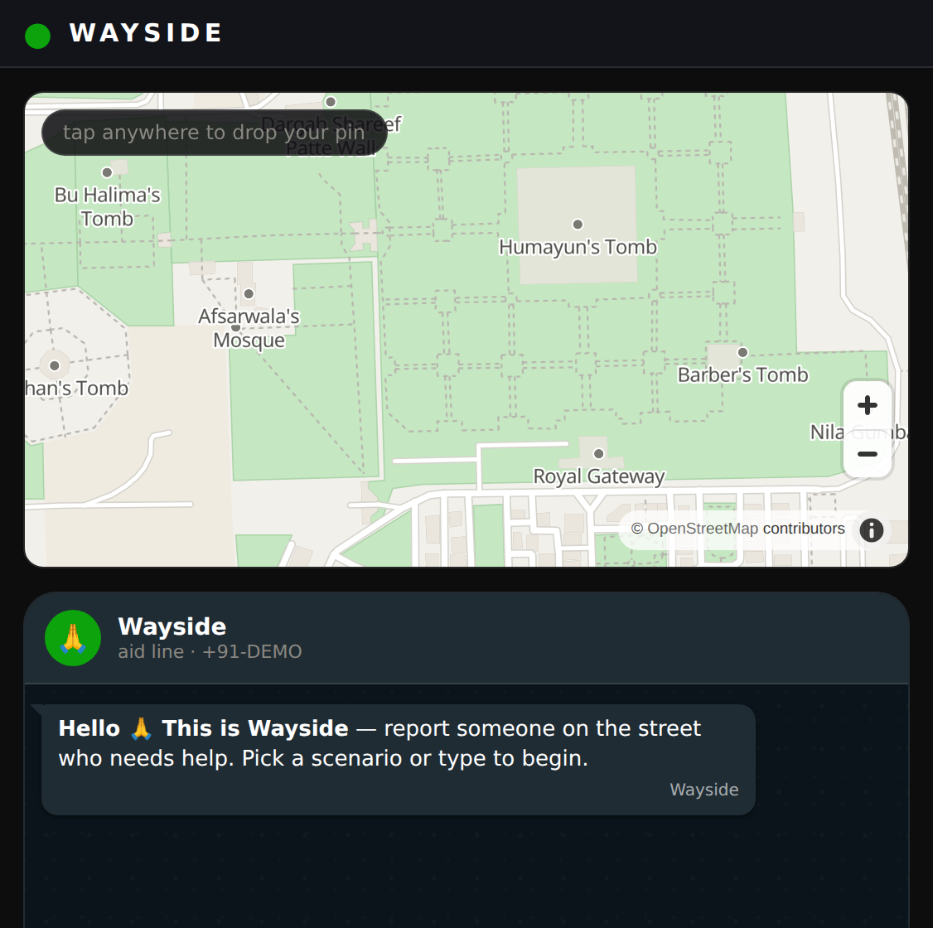
03 — HOW IT WORKS
One message, answered — start to finish
Six steps. Most take under a minute. None of them ask the witness to do anything but send what they'd already send a friend.
1
Witness sends one WhatsApp
Text, a voice note, or a photo — in English, Hinglish, or हिंदी, whatever's natural in the moment.
2
Deterministic 112 gate
Before any model reads the message, a fixed, code-level check looks for real emergencies and redirects them immediately — no AI in the loop for the moment that matters most.
3
AI agent structures the report
the witness's phone — no app to install
The message becomes a location (down to a DIGIPIN), a need, and an urgency level — a kit order is raised automatically: medical, food, or shelter.
WAYSIDE — 5/13

Slide 6
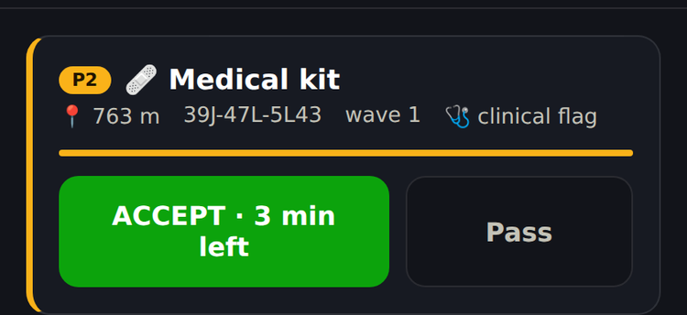
03 — HOW IT WORKS
…and it closes the loop
4
Parallel offers, first accept wins
The order goes out to the nearest trusted responders at once, like a ride-hailing request. Whoever accepts first gets the case; the rest stand down.
5
Kit delivered, outcome recorded
Served, escalated to clinical care, not found, or declined — every outcome is recorded, including a person's right to say no.
the responder's phone — accept, 3 minutes on the clock
6
The witness is told how it ended
“Meena reached him, help was given. Thank you.” Not silence — an answer, which is the whole point.
Value hypothesis: closing the loop turns one-time witnesses into repeat reporters — gratitude is the growth engine.
WAYSIDE — 6/13

Slide 7
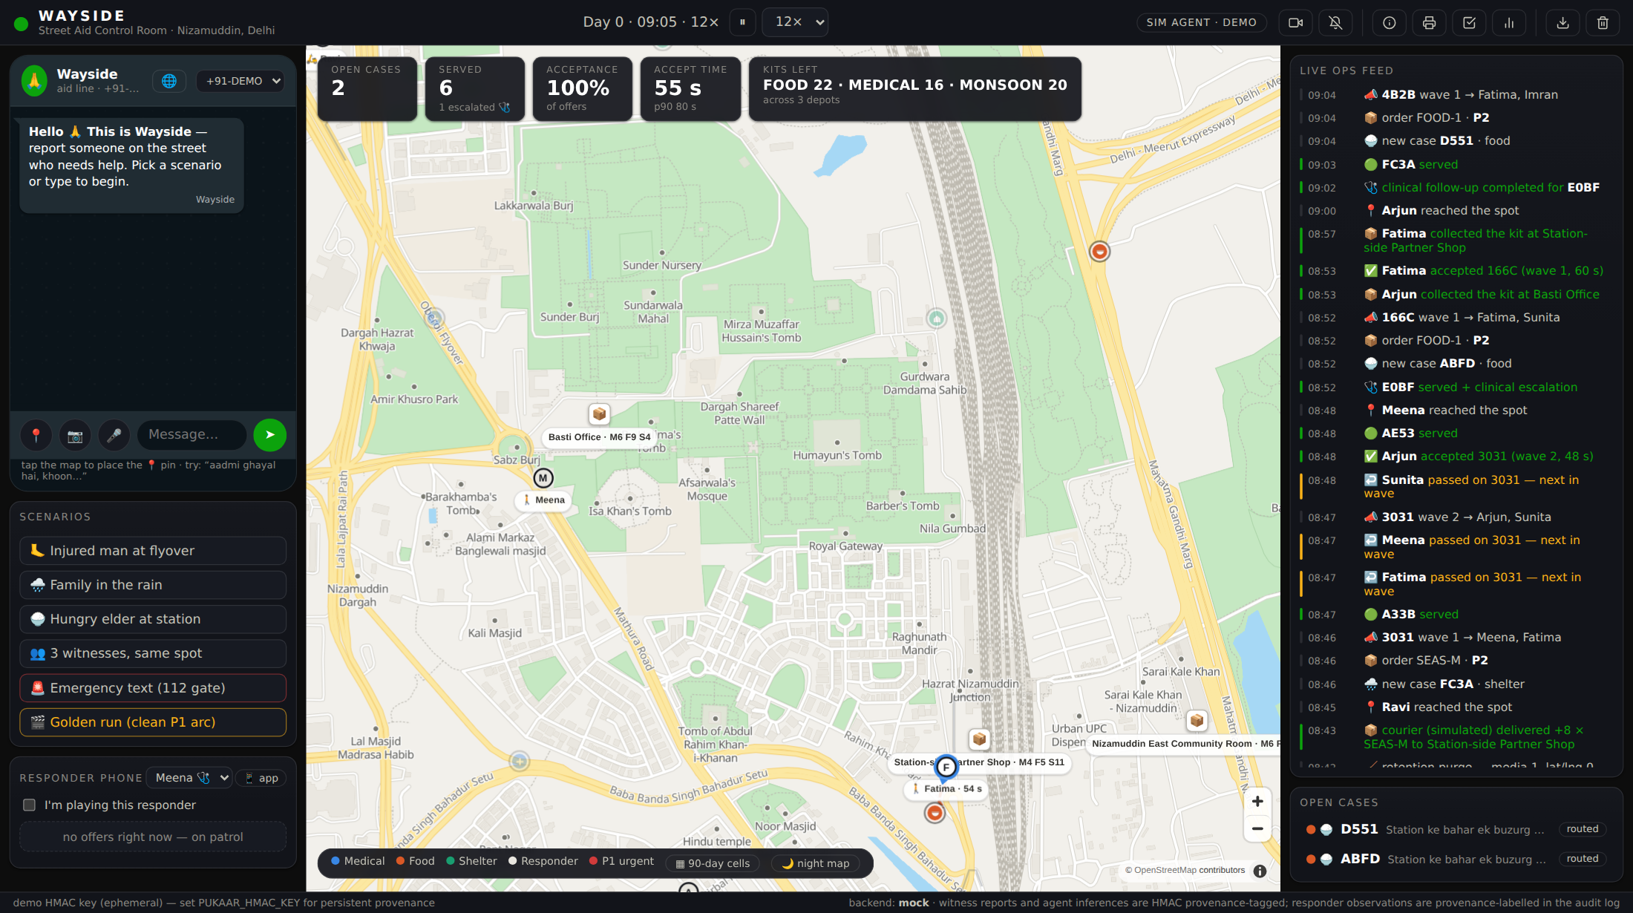
04 — SEE IT RUN
Not a mockup
245 automated tests. Three real surfaces — control room, responder phone, witness phone — running the same loop end to end, offline, with zero paid API calls.
Control room
Live map, dispatch waves, kit stock, kill-criteria dashboard.
Responder app
Offer ping → checklist → outcome, on any phone.
Witness phone
Trilingual chat, photo picker, live progress, a “still there?” check.
the control room, mid-shift — dispatch waves, kit stock, coordinator queue, live ops feed
WAYSIDE — 7/13

Slide 8
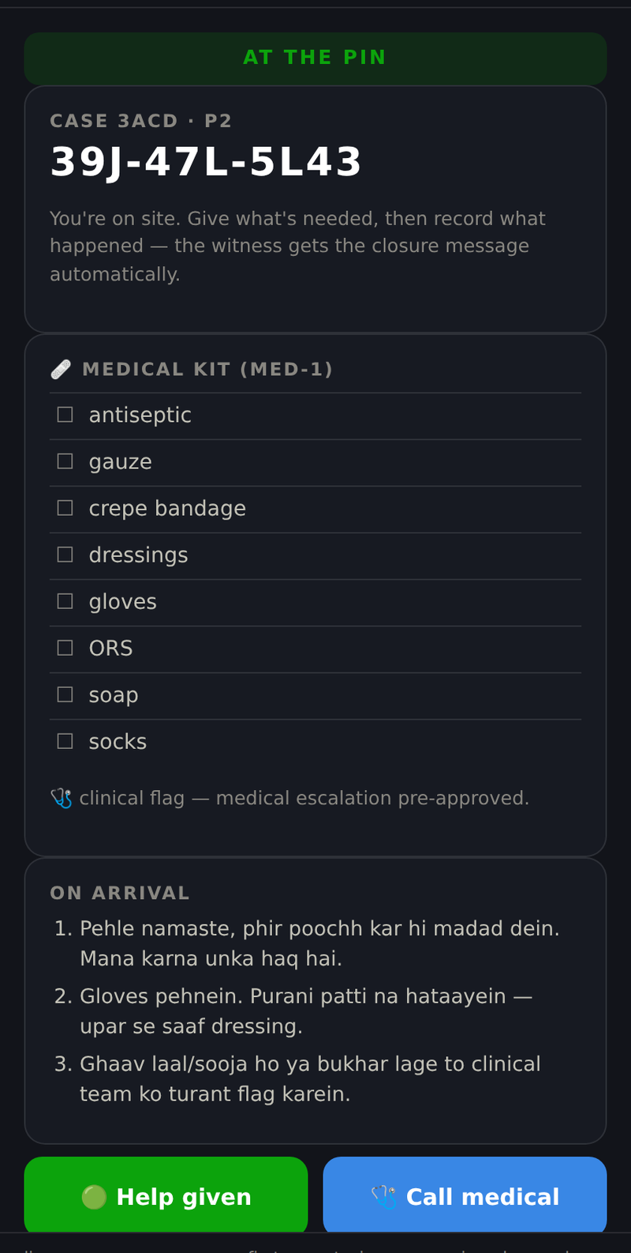
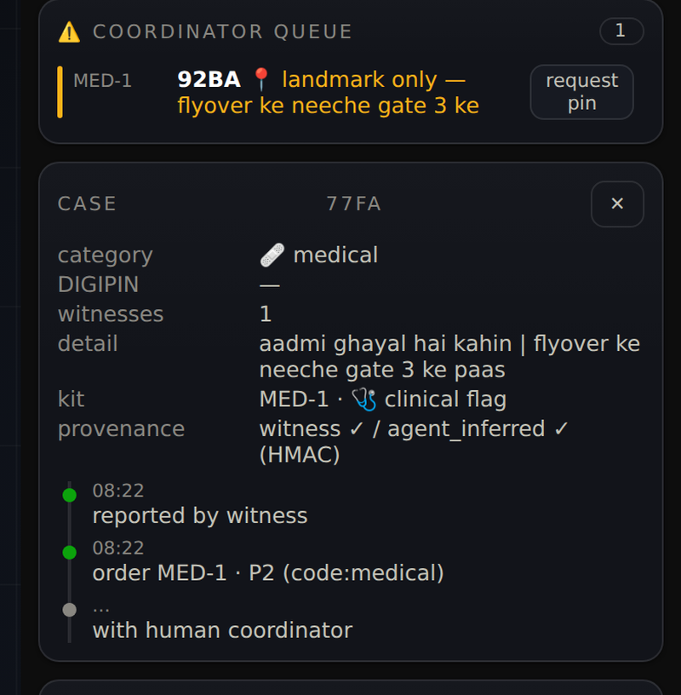
04 — SEE IT RUN
Dignity, and a paper trail
What a responder sees at the pin, and what a coordinator sees behind every case.
ON RECORD
Every case carries a signed trail — who reported it, what the agent inferred, which responder closed it. Witness reports and agent inferences are HMAC-tagged; a responder's observations are labelled as observations, never as fact.
Recorded 2:22 walkthrough and an interactive session replay available on request.
at the pin — greet, ask, don't assume, respect a no
the coordinator's view — full provenance, from report to order to outcome, HMAC-signed
WAYSIDE — 8/13

Slide 9
05 — WHO PAYS
NGOs and CSR budgets, buying verified outcomes
Who buys
Pain solved
NGO street-outreach programs and the CSR funders behind them — India mandates 2% of corporate profit to CSR — plus municipal shelter boards.
Outreach teams find people too late and blind; donors get activity reports, not verified outcomes; data practices now carry DPDP legal risk.
What they get
First customer
A per-zone service: verified need → delivered kit → coded outcome, with provenance-tagged records and privacy by architecture — audit-ready.
One Delhi NGO, one pilot zone — Nizamuddin. Reached through the Equitech network; NGO partner conversations start with this working demo. The pitch is a working demo, not a proposal.
Unit economics to defend in the pilot: ~₹300 kit + delivery ≈ ₹430 per person served — kill line at ₹900.
WAYSIDE — 9/13

Slide 10
06 — WHO IT'S FOR
Three users, and one deliberate non-user
THE WITNESS
THE RESPONDER
THE COORDINATOR
Any passer-by
A vetted NGO field worker
NGO staff
Uses only WhatsApp, nothing to install. Gets progress and closure, so they report again.
Gets the offer ping with kit, distance, and DIGIPIN. One tap records the outcome.
Watches the control room. Handles the edge cases the system refuses to guess at.
The person in need is served — never enrolled.
No name, no photo of a face, no profile is ever stored. Exact locations are wiped once a case closes; after 90 days only coarse heat-cells remain. In a country that still criminalises begging, the strongest protection is that the dangerous database never exists.
Dignity is a design constraint, not a caption.
WAYSIDE — 10/13

Slide 11
07 — ROADMAP
Three months to truth, twelve to scale — or an honest stop
NEXT 3 MONTHS — ONE ZONE, REAL PEOPLE
BY 12 MONTHS — IF THE NUMBERS HOLD
Real WhatsApp number live — transport is built, onboarding is configuration
One NGO partner, 6–10 rostered responders, Nizamuddin pilot zone
Hindi/Hinglish voice-note speech-to-text bake-off (Sarvam vs Whisper)
8-week pilot measured against pre-registered kill criteria
Three zones, two partners — onboarding a partner is config plus a playbook
Voice-first reporting; DPDP audit and a published transparency report
Public dashboard of outcomes — the same one the funders see
Resources needed: pilot grant (kits, responder stipends, WhatsApp + AI costs, DPIA/legal review) · partner introductions · mentorship on NGO ops.
WAYSIDE — 11/13

Slide 12
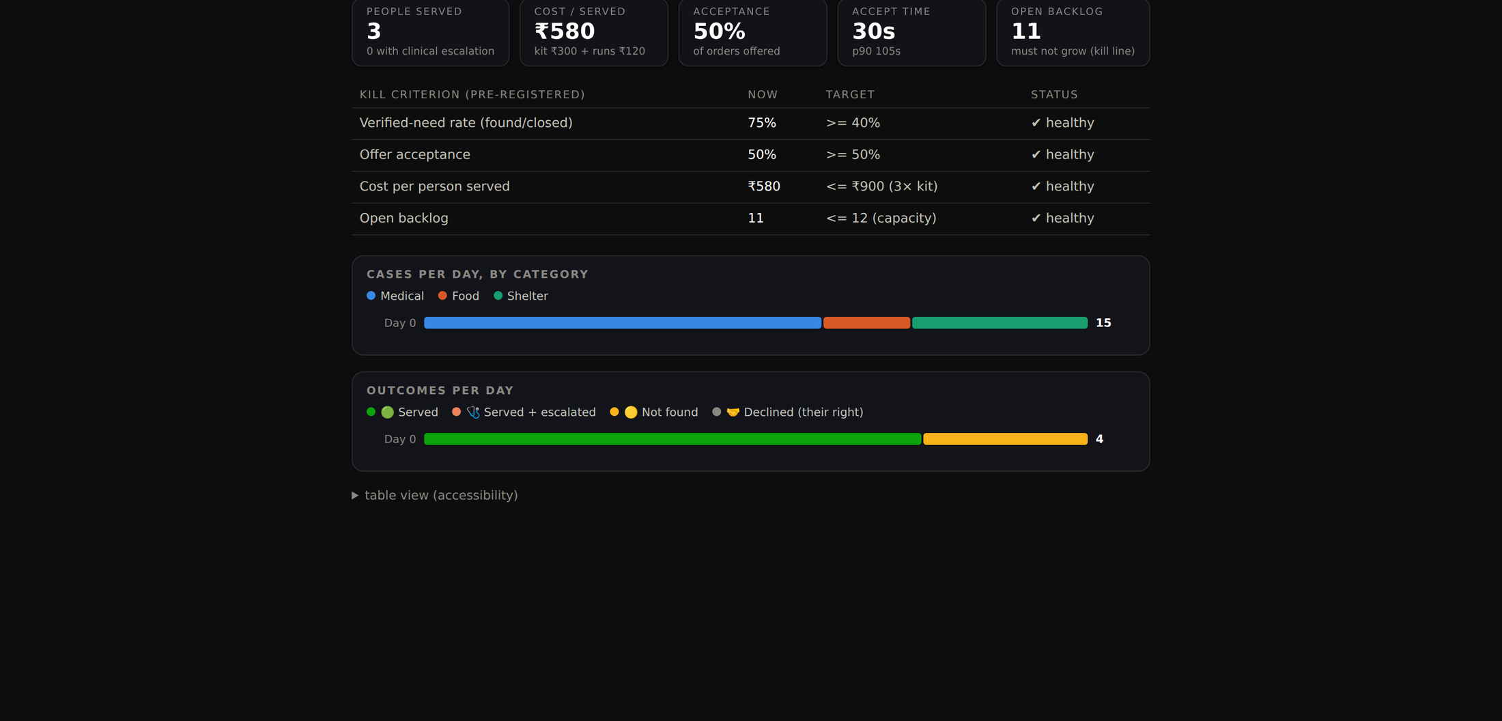
07 — ROADMAP · KILL CRITERIA
Pre-registered, public before the pilot starts
Kill criterion | Now | Target | Status
Verified-need rate (found / closed) | 75% | ≥ 40% | ✓ healthy
Offer acceptance | 50% | ≥ 50% | ✓ healthy
Cost per person served | ₹580 | ≤ ₹900 | ✓ healthy
Open backlog | 11 | ≤ 12 capacity | ✓ healthy
If Wayside stops earning its numbers, its own dashboard says so — and we publish that, and stop.
the same dashboard the funders see — public before the pilot starts
WAYSIDE — 12/13

Slide 13
No cameras. No database of the poor. No one left by the wayside.
The ask: pilot funding for one zone · introductions to Delhi street-outreach NGOs · a mentor who has run field ops.
Rustom Dubash · rustommdubash@gmail.com · working demo, 2:22 video, and full research corpus on request
WAYSIDE — KEVIN XU INNOVATION CHALLENGE

