Slide 1

WELCOME

Slide 2
1. If you see the following import in a file, what is being used for state management in the component?
import React, {useState} from 'react’;
A. stateful components
B. math
C. React Hooks
D. class components
Answer: C

Slide 3
2. If a function component should always render the same way given the same props, what is a simple performance optimization available for it?
Wrap it in the React.memo higher-order component.
B. Implement the useReducer Hook.
C. Implement the useRouter Hook.
D. Implement the shouldComponentUpdate lifecycle method.
Answer: A

Slide 4
4. What is styled-component styling in React?
These styles are written as attributes and are passed to the element.
B. It is a JavaScript library for styling React applications. It removes the mapping between styles and components, and lets you write actual CSS augmented with JavaScript.
It is basically a .css file that is compiled. When compiled, it produces two outputs. One is CSS that is a modified version of input CSS with the renamed class names. The other is a JavaScript object that maps the original CSS name with the renamed name.
It offers a different approach in which no CSS needs to be written to style an application. Instead, It uses utility classes for each CSS property that you can use directly in your HTML or JSX.
Answer: B

Slide 5
5. What is [e.target.id] called in the following code snippet?
handleChange(e) {
this.setState({ [e.target.id]: e.target.value })
}
A. a computed property name
B. a set value
C. a dynamic key
D. a JSX code string
Answer: C

Slide 6
6. What is sent to an Array.map() function?
A. a callback function that is called once for each element in the array
B. the name of another array to iterate over
C. the number of times you want to call the function
D. a string describing what the function should do
Answer: A

Slide 7
7. What do you need to change about this code to get it to run?
class clock extends React.Component {
render() {
return Look at the time: {this.props.time};
}
}
A. Add quotes around the return value
B. Remove this
C. Remove the render method
D. Capitalize clock
Answer: D Explanation: In JSX, lower-case tag names are considered to be HTML tags.

Slide 8
8. How do you invoke setDone only when component mounts, using hooks?
function MyComponent(props) {
const [done, setDone] = useState(false);
return<h1>Done: {done}<h1/>; }
useEffect(() => { setDone(true); });
useEffect(() => { setDone(true); }, []);
useEffect(() => { setDone(true); }, [setDone]);
useEffect(() => { setDone(true); }, [done, setDone]);
Answer: B

Slide 9
9. You have created a new method in a class component called handleClick, but it is not working. Which code is missing?
class Button extends React.Component{
constructor(props) {
super(props);
// Missing line
}
handleClick() {...}
}
this.handleClick.bind(this);
B. props.bind(handleClick);
C. this.handleClick.bind();
D. this.handleClick = this.handleClick.bind(this);
Answer: D

Slide 10
10. What property do you need to add to the Suspense component in order to display a spinner or loading state?
function MyComponent()
{ return (
<Suspense>
<div>
<Message />
</div>
</Suspense>
);
}
lazy B. loading C. fallback D. spinner
Answer: C

Slide 11
11. Using object literal enhancement, you can put values back into an object. When you log person to the console, what is the output?
const name = 'Rachel’;
const age = 31;
const person = { name, age };
console.log(person);
{{name: "Rachel", age: 31}}
B. {name: "Rachel", age: 31}
C. {person: "Rachel", person: 31}}
D. {person: {name: "Rachel", age: 31}}
Answer: B

Slide 12
12. What is setCount?
const [count, setCount] = useState(0);
the initial state value
B. a variable
C. a state object
D. a function to update the state
Answer: D

Slide 13
Interview Questions
1. What is the difference between Element and Component?

Slide 14
Answer:
An Element is a plain object describing what you want to appear on the screen in terms of the DOM nodes or other components. Elements can contain other Elements in their props. Creating a React element is cheap. Once an element is created, it is never mutated. Whereas a component can be declared in several different ways. It can be a class with a render() method. Alternatively, in simple cases, it can be defined as a function

Slide 15
Interview Questions
2. What is the difference between state and props?

Slide 16
Answer:
Both props and state are plain JavaScript objects. While both of them hold information that influences the output of render, they are different in their functionality with respect to component. Props get passed to the component similar to function parameters whereas state is managed within the component similar to variables declared within a function.

Slide 17
Interview Questions
3. What is the difference between Shadow DOM and Virtual DOM?

Slide 18
Answer:
The Shadow DOM is a browser technology designed primarily for scoping variables and CSS in web components. The Virtual DOM is a concept implemented by libraries in JavaScript on top of browser APIs.

Slide 19
Interview Questions
4. What are the lifecycle methods of React?

Slide 20
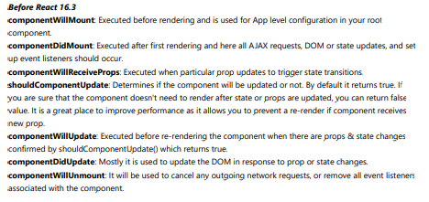
Answer:

Slide 21

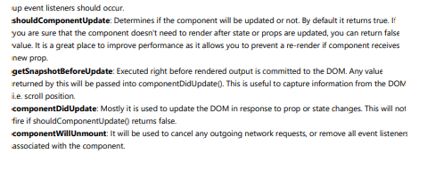

Slide 22
Interview Questions
5. How often does the React useState update? Why?

Slide 23
Answer:
Since developers use useState to enhance performance by creating queues, React doesn’t update changes immediately. Candidates should know that useState doesn’t implement changes to the state object directly; instead, the updates occur asynchronously.

Slide 24
Coding Challenge:
Random User App
Case study/Project :
Case study should be explained to the students during the weekly meeting and has to be completed in one week by the students. Students should work in small teams to complete the case study. RP-03 Task Tracker App

Slide 25

Practice makes perfect.

