Slide 1

Penetration Testing vs Red Teaming, and How to make better reports
Sampson Chandler
Senior Engineer – RSA Security
Handle – Rusty Shackleford (also GitHub)
Twitter - @SecuritySampson

Slide 2
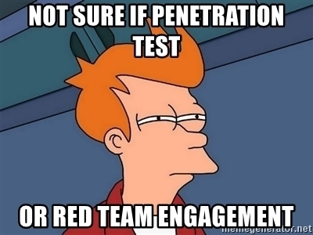

Slide 3

My Infosec Career
Interning in high school
Help Desk
Software Development
Infosec

Slide 4
Overview
Issues We Face
Red Teaming
Reports
Conclusion
Penetration Testing

Slide 5
The Issue – Key Terms
Vulnerability Assessment
Penetration Test
Red Team Engagement
Risk
Vulnerability
Exploit
Notes:
Ask anyone to explain the difference:
Vulnerability vs exploit
Red team vs pen test
Risk vs threat
You will get different answers. If we can’t define these terms then how are others?

Slide 6
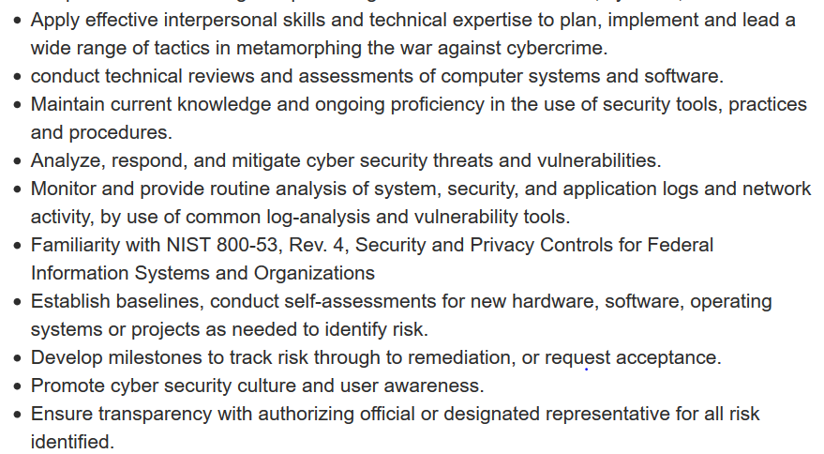
Cyber Security analyst
Notes:
Issue becomes people outside of field not trusting us because of misinformation. Words mean things. Titles should describe a position. A analyst usually does something like monitor logs.

Slide 7
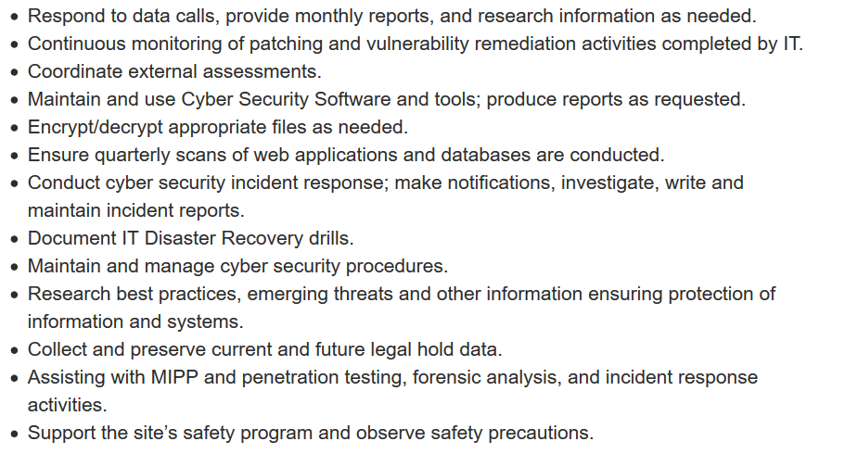
Continued…

Slide 8
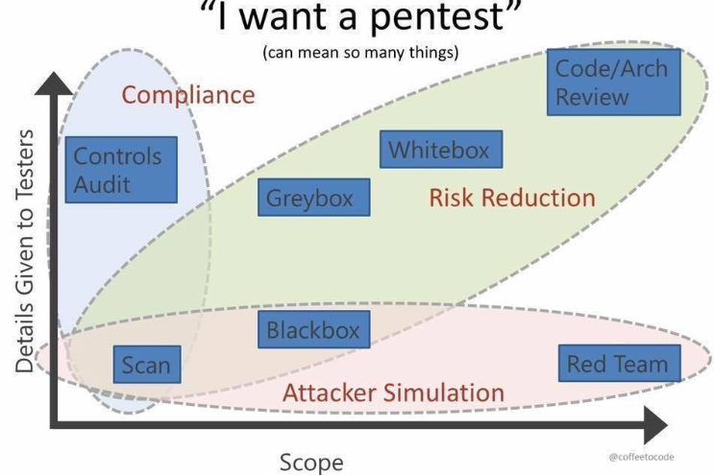
Notes:
What does the customer want?
Source: http://coffeetocode.net/

Slide 9
Penetration Testing
Definition & Goals
Penetration Testing VS Vulnerability Assessment
Different types of penetration testing
Scope and RoE
Deciding which is best for your organization
How each type provides value

Slide 10

Penetration Testing
Goal
Compromise target systems and gain access to information to determine business impact
Formal Definition
"Penetration testing involves modeling the techniques used by real-world computer attackers;
To find vulnerabilities
To exploit those flaws under controlled circumstances
Done in a professional, and safe manner. According to carefully designed scope and Rule of Engagement
Determine business risk and potential impact, all with the goal of helping organizations improve their security practices“ - Ed Skoudis
Notes:
Goal – Compromise target systems and gain access to information to determine business impact
Formal Definition -

Slide 11
Vulnerability assessment
Frequency
At least quarterly
Anytime new equipment or software is added to environment
Reports
Baseline but usually contains false positives
Might have incorrect risk rating
Value
Detects possible vulnerabilities that could be exploited

Slide 12
Penetration testing
Frequency
Annually
Reports
Depends on the type of pen test
Focus
Discovers known (and possibly unknown) exploitable weaknesses in normal business processes
Performed By
Best to use a third party service
Value
Detects possible vulnerabilities that could be exploited, tests the blue team, and business impact

Slide 13
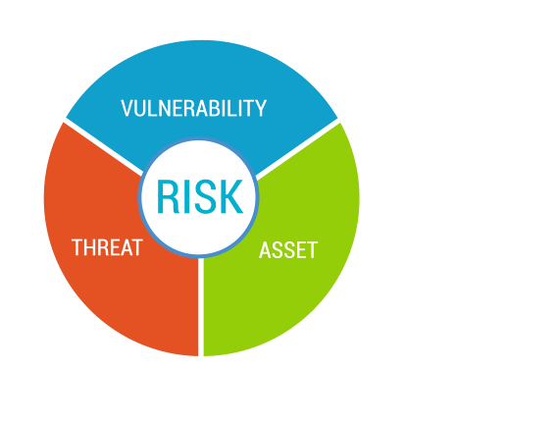
Exploits, Vulnerabilities, threats, and Risk
Notes:
Source: https://www.google.com/url?sa=i&rct=j&q=&esrc=s&source=images&cd=&cad=rja&uact=8&ved=2ahUKEwid5r_4ssPhAhUwVRUIHeU-BtEQjRx6BAgBEAU&url=%2Furl%3Fsa%3Di%26rct%3Dj%26q%3D%26esrc%3Ds%26source%3Dimages%26cd%3D%26ved%3D%26url%3Dhttps%253A%252F%252Fwww.xcellhost.cloud%252Fthreat-management-platform%252Fnetwork-vulnerability-assessment%26psig%3DAOvVaw2tfAQ_1jdblTNy_qSUd68D%26ust%3D1554912586627299&psig=AOvVaw2tfAQ_1jdblTNy_qSUd68D&ust=1554912586627299

Slide 14
Vulnerabilities
A flaw in the measures you take to secure an asset, or anything that exposes your assets to harm.
Threats
Expressed or demonstrated intent to harm an asset or cause it to be come unavailable.
Risk
“the potential for loss, damage or destruction of an asset as a result of a threat exploiting a vulnerability” - Tag

Slide 15
Types of penetration tests
Network Services
Web Application
Client Side
Wireless
Social Engineering

Slide 16
Differences in penetration tests
Black Box
No knowledge of network architecture, or software used.
White Box/Clear Box/Crystal Box
Tester knows the network infrastructure
Gray Box
Simulates real world attack
Access to software source code
determines the vulnerabilities in a system that are exploitable from outside the network
Provide a more focused and efficient assessment of a network’s security than a black-box assessment
Can focus their assessment efforts on the systems with the greatest risk and value from the start, rather than spending time determining this information on their own
penetration testers are able to perform static code analysis,
Notes:
The main trade offs of testing are the accuracy of the test and its speed, efficiency and coverage.
In addition to the dynamic analysis performed in black-box and gray-box testing, white-box testers also are expected to perform static analysis of provided source code

Slide 17
Steps of a pen test
Information Gathering
The stage of reconnaissance against the target.
Threat Modeling
Identifying and categorizing assets, threats, and threats communities.
Vulnerability Analysis
Discovering flaws in systems and applications using a set of tools, both commercially available tools and internally developed.
Exploitation
Simulating a real-world attack to document any vulnerabilities.
Post-Exploitation
Determining the value of compromise, considering data or network sensitivity.
Reporting
Outlining the findings with suggestions for prioritizing fixes. For us, that means walking through the results with you hand-in-hand.

Slide 18
Value of a Pen Test
Determine
Identify
Highlight
Assess
Test
Provide
PrImplement and validate
Meet
Notes:
Determine the feasibility of a particular set of attack vectors
Identify higher-risk vulnerabilities resulting from lower-risk vulnerabilities exploited in a particular way
Highlight vulnerabilities difficult or impossible to detect with automated network or application scanning software
Assess potential business and operational impacts of successful attacks
Test network defense’s ability to successfully detect and respond to the attack
Provide evidence to support increased investments in security personnel and technology
Meet compliance requirements

Slide 19
Value of a pen test
Findings need to be presented in a business sense with data the client will understand.
(For any given risk, decision makers may conclude that, for business purposes, they will accept a given risk identified during a test, rather than mitigate the associated vulnerability. In the end, it’s a business decision)

Slide 20

Defining SCOPe & RoE
Each needs to be defined thoroughly
What are your security concerns?
What is to be tested?
What should be avoided?
Notes:
Stolen sensitive data
Interruption to production
Specific domain names
Network address ranges
Individual hosts
Particular applications

Slide 21
Pros
Identifying possible security holes before an attack can
Identify possible vulnerabilities
Providing information that can help security teams mitigate vulnerabilities and create mechanism for attacks
Cons
Cost
Outages to critical systems
Not receiving valuable information due to limited scope
Legacy systems vital to business

Slide 22
“…one who knows the enemy and knows himself will not be endangered in a hundred engagements.”
Sun Tzu
Originated in the U.S. Military during the 1960s during the height of the Cold War with the Soviet Union
Emerged from game-theory approaches applied to war-gaming and scenario simulations designed to evaluate strategic decisions
From https://www.nuharborsecurity.com/red-teaming-vs-penetration-testing/

Slide 23
Red TEAM
Definition/Goal
Misconceptions
Method & Examples
Does your company need it?
Deciding which is best for your organization
Building a team

Slide 24


Pen test = Pirates
Red team = ninjas
Notes:
Pirates – raid and plunder
Ninjas – stealthy and not noticied

Slide 25

Red Team
Goal-Based adversarial testing process
Identify physical, hardware, software, and human vulnerabilities
Obtain a more realistic understanding of risk for your organization
Help address and fix all identified security weaknesses
Measures how an organization will respond to an attack
Incorporates many elements of an organization’s overall security posture
Notes:
Goal based
Identify all vulns
Obtain a more realistic understanding
Measure orgs response to attack

Slide 26
What is a red team engagement?
"A red team engagement consists of a full scope, multi-layered adversarial attack simulation created to measure how well an organizations staff, networks, applications and physical security controls can withstand a real-life attack"
Notes:
Source: https://www.peerlyst.com/posts/peerlyst-community-ebook-the-red-team-guide-peerlyst?trk=search_page_search_result

Slide 27
What’s the difference?
Supporting the Blue team!
Goals
Length of engagement
Members have a more clearly defined role
Knowledge and experience of team members

Slide 28
Red team Methodology
Reconnaissance
Weaponization
Delivery
Exploitation
Installation
Command and Control
Actions on Objective
Notes:
Reconnaissance, weaponization, delivery, exploitation, installation, command and control, actions on objective

Slide 29
Reconnaissance
OSINT methods and tools
Focused on collecting as much information as possible about the target
Weaponization
Focuses on collecting information about infrastructure, facilities and employees
Crafting custom malicious file payloads
Delivery
the active launch of the operation
Notes:
Reconnaissance –
Weaponization - Prepping RFID cloners
Configuring hardware trojans
Acquiring social engineering costumes
Creating falsified personas/companies
Delivery - carry out the actions on the target(s) intended to reach the Red Team Operation’s goals

Slide 30
Compromise or “break in”
Exploitation
Installation
Cyber or physical
Maintaining persistence is the goal
C&C
The team aims to complete the mission and realize the agreed-upon objectives set by the client
Actions on Objective
Notes:
Exploitation - The goal is to “break in” or compromise servers/apps/networks, bypass physical controls (ie: gates, fences, locks, radar, motion detection, cameras) and exploit target staff through social engineering by face-to-face, email, phone, fax or sms
Installation - Primary goal is to prepare for persistence

Slide 31
So which do I need?
Penetration Test
Vulnerability Assessment
Red Team Engagement
Scan and enumeration
Are you looking to test your systems?
Do you want to know which vulnerabilities exists in those systems and more importantly can those vulnerabilities be exploited?
Do you want to learn more about your organization as a whole?
What if we were attacked? How would we respond?
How quickly can we recover from something like ransomware?
Notes:
Determine what a customer needs and how best to provide it to them

Slide 32
Penetration testing can be limited due to time and scope constraints.
In comparison, Red Team campaigns seek to remove this limitation by providing a service that recreates actual attack scenarios and expose attack surfaces

Slide 33
Reports
Effective Writing
Purpose/Objective & Your Audience
Preparation
Structure & Components
Extra items to set yourself apart
Notes:
Reports are our end product
They are tangible and usually last a very long time

Slide 34
“I can’t”
“I don’t have time”
“They don’t listen”
Communication issue
Notes:
I can’t implement this.
They don’t listen to my recommendations
I don’t have time to change this or that
Are you effectively communicating the why and the benefits?

Slide 35
Reports are the most important part
Definition:
“A report is a statement of the results of an investigation or of any matter on which definite information is required”
They last a while
Others will see them
Bad reports reflect badly on you and our industry
It’s our end product and how we justify our positions
Notes:
Enterprise changes from report recommendations can take a while
Who is your audience

Slide 36
Preparation
Use shared resources
Screenshots, screenshots, screenshots
Notable items
Processes, findings, systems, etc..
And screenshots
Notes:
Notes are incredibly invaluable
So are screenshots

Slide 37
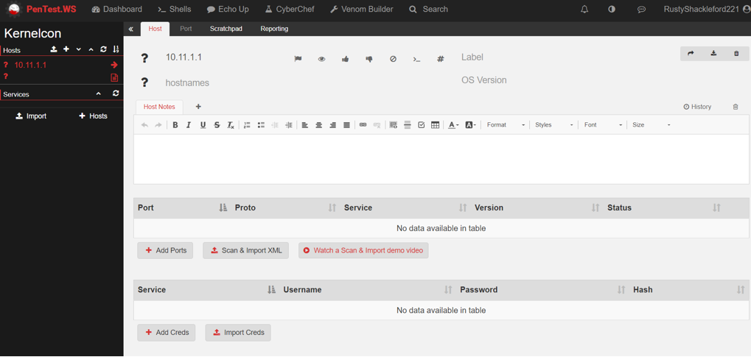
Notes:
Pentest.ws – great website for note taking especially for CTFs
May not want to do it for pen testing due to security but great way to keep track of things
Also see Faraday

Slide 38
Report structure
Executive Summary for Strategic Direction
Scope
Methodology
Attack
Findings
Recommendations
Future Considerations
References
Appendices
Notes:
Not filled out in that order
Scope is usually first or RoE and is well defined
- Orgs and Ips
Scope defined in statement of work
Where you attacked from Internal or external – Useful for blue team when they review
Exclusions – what was exluted? Services, Social Engineer, Any Ips?, C level
Methodology should be the same – keep it short, graph/pics, copy pate from template
Attack – if multiple stages go in technical details
https://www.sans.org/reading-room/whitepapers/bestprac/writing-penetration-testing-report-33343
Executive Summary includes scope of work, project objectives, assumption, and timeline

Slide 39
Findings
Overview – The vulnerability, risk, probability, and impact.
$ amount if possible
Affected Hosts
Use external and internal IPs
Use DNS name AND IP addresses

Slide 40
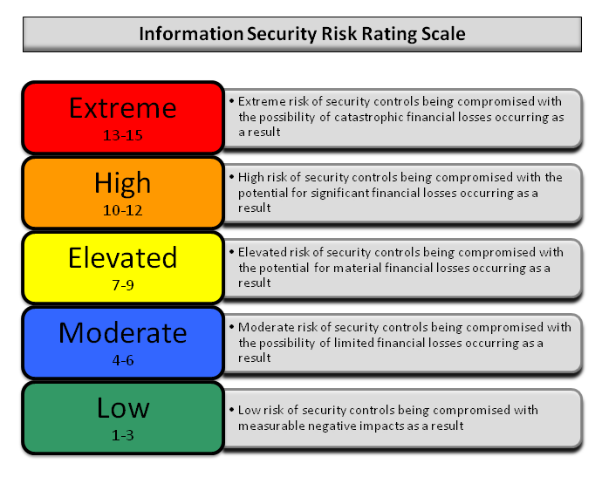
Risk Score
Risk = Impact + Probability
Notes:
Subjective but you are SME and they are paying you
Could go in depth in this but that would be a whole talk
Recommend taking some courses on calculating risk as it can help you communicate more effectively

Slide 41
Recommendations
Protection
How should the organization protect itself
Detection
Create maturity model
Give how to guides instead of step by step instructions
Notes:
Detection is a great one but can be hard to give information on how to detect it. Especially if a new penetration tester with no blue team experience.
Protection is basically remediations but maybe not.
How to guides can be great instead of listing every step by step instruction making your reports super long
Maturity model shows progress and gives goals. Shows what they have improved on since first penetration test. C level execs love graphs and charts showing improvement

Slide 42
Validation & Findings
How to verify
Validation DOES NOT equal explanation
Keep it simple
Tools
Commands
Scripts?
Findings:
Store findings in easily accessible spot
New findings take a while to write up
OneNote, Google Docs, etc..

Slide 43
Executive Summary
Most important part of the report
Write it for someone who is non-technical
Should include:
Time & duration
Scope
Project Objective(s)
Timeline
Method
Brief overview of critical findings
Risk
Recommendations
Appendices/References

Slide 44
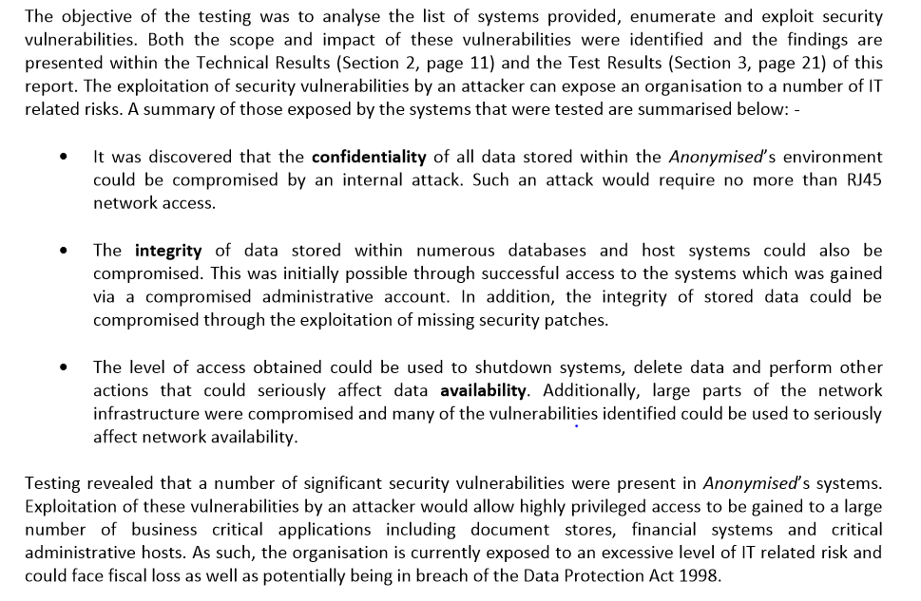
Notes:
Objective = analyse the list of systems provided, enumerate, and exploit security vulnerabilities
Finding are present in technical results
Can expose an org to a number of IT related risks
Summary of those risks
Confidentialy of data
Integrity of data stored
Availability = production down
PwC report - Souce

Slide 45
Extra
Possible threats for org
Tool recommendations
Only recommend, do not talk negatively about a tool
Key metrics and way to track them
Notes:
Threats – what are you hearing about that industry. Financial for example
Tools recommendations –
What are some key metrics we can track that matter to the client and how can we track those over time. Example would be time to response for attack

Slide 46
Take aways
Pen test != Red team engagement
What is your clients goal? Does either of these actually meet that
Having clearly defined objectives and taking good notes will make your job a lot easier
Reports are our end product and last a while. They need to be as good as we can make them. It’s how we justify our positions.
Doing little things will provide substantial value and set you apart
The best IDS/IPS is people
If you are blue team, learn offense. If you are offense, learn defense. It goes a long way

Slide 47
Resources
https://github.com/juliocesarfort/public-pentesting-reports
https://github.com/rustyshackleford221
https://github.com/onlurking/awesome-infosec
https://github.com/yeyintminthuhtut/Awesome-Red-Teaming
https://github.com/bluscreenofjeff/Red-Team-Infrastructure-Wiki
https://github.com/infosecn1nja/Red-Teaming-Toolkit
https://www.peerlyst.com/posts/peerlyst-community-ebook-the-red-team-guide-peerlyst

