Slide 1

SIMULATING POWER GRID CYBER-ATTACKS:
UTILIZING V-I CORRELATION TO DIFFERENTIATE
FDI ATTACKS FROM PHYSICAL FAULTS
SCHOOL OF ELECTRICAL SCIENCES
ODISHA UNIVERSITY OF TECHNOLOGY AND RESEARCH, BHUBANESWAR
Presented By:
Ujjwal Keshri
Reg. No. 23110546
B.Tech (Electrical Engineering)
Guided By:
Prof. A. K. Barisal Professor,
SES
25/4/2026
OUTR, Bhubaneswar

Slide 2
Contents
Introduction
Problem Statement
Research Objectives
Literature Review
System Architecture & Detection Principle
Algorithm Design & Threshold Derivation
MATLAB/Simulink Simulation
Result Analysis
Conclusion
Future Scope
References
25/4/2026
2
OUTR, Bhubaneswar

Slide 3
Introduction
Modern smart grids rely on SCADA systems for real-time monitoring and control of bus voltages, line currents and power flows.
Deep integration of IT with physical infrastructure has introduced cyber-attacks targeting the digital measurement layer.
False Data Injection (FDI) attack: injects crafted erroneous values into SCADA streams — mathematically consistent with power-flow equations, evading conventional Bad Data Detection (BDD).
Critical operational blind spot: traditional relays cannot rapidly distinguish a stealthy cyber-attack from a genuine physical short-circuit.
Misclassification in either direction causes unnecessary outages or catastrophic physical damage.
This project implements detect_fdi() and classify_physical_fault() — two real-time MATLAB functions providing a complete physics-based cyber-physical anomaly detection system for a 5-bus network at 50 µs sample rate.
25/4/2026
3
OUTR, Bhubaneswar

Slide 4
Problem Statement
Modern smart grids are highly vulnerable to FDI cyber-attacks in which malicious actors alter SCADA sensor measurements to deceive grid operators.
Traditional protective relays cannot quickly determine whether a sudden voltage anomaly results from a stealthy cyber-attack or a genuine physical short-circuit.
Misclassifying a cyber-attack as a physical fault → unnecessary, widespread power outages.
Misclassifying a real short-circuit as a digital attack → critical infrastructure exposed to catastrophic physical damage.
Even correctly detecting a physical fault is insufficient — the fault type (symmetrical, unsymmetrical, RPF, intermittent) determines the appropriate relay action.
Existing BDD methods are bypassed by attacks that are mathematically consistent with the network state; ML-based IDS require large training datasets and offline processing.
25/4/2026
4
OUTR, Bhubaneswar

Slide 5
Research Objectives
Model a standard 5-bus transmission network in MATLAB/Simulink and derive normalised per-unit steady-state baselines: V_mean = 0.6872 pu, I_mean = 0.3882 pu, Z_mean = 1.7702 pu.
Implement detect_fdi(): classifies system state as Normal (0), Cyber-Attack (1), or Physical Fault (2) using V-I boundary at 0.6769 pu, five FDI detection modes, weighted scoring counter, and RPF integrator.
Implement classify_physical_fault(): sub-classifies confirmed physical faults into four types (codes 1–4) using rolling one-cycle RMS buffers (400 samples at Ts = 50 µs).
Simulate five FDI attack modes injected exclusively into the SCADA measurement channel: Fake-Short, Fake-Sag, Fake-Swell, Replay Attack, Noise Injection.
Simulate four physical fault types as true physical events on transmission lines: Symmetrical (3-phase), Unsymmetrical (L-G), Reverse Power Flow (RPF), Intermittent.
Validate both functions across all conditions and produce six diagnostic figures including the Cyber Data & Attack Window Overlay (Fig-5.6).
25/4/2026
5
OUTR, Bhubaneswar

Slide 6
Literature Review
Sl. | Authors / Year | Paper Title | Key Contribution
1 | Anwar et al., 2015 (UNSW Australia) | A Data-Driven Approach to Distinguish Cyber-Attacks from Physical Faults in a Smart Grid | Directly motivates my project. Proves that FDI attacks and physical faults produce statistically distinguishable signatures in V-I measurement space. Your V-I correlation boundary (0.6769 pu) is the physics-based, real-time evolution of their offline PCA/SVM classification idea — no training data required.
2 | Abukhousa et al., 2025 (Georgia Tech) | Centralized Dynamic State Estimation Algorithm for Detecting and Distinguishing Faults and Cyber Attacks in Power Systems | Validates my architectural choice of separating detection (flag=0/1/2) from sub-classification (fault_code 1–4). Their DSE + hypothesis testing framework is the centralised, model-dependent counterpart to your lightweight, model-free threshold approach. Their 2.3–9.4 ms response time benchmark is what your 150 µs / 100 µs detection directly outperforms in Table 5.4.
3 | Sridhar et al., 2012 (Iowa State Univ.) | Cyber–Physical System Security for the Electric Power Grid | Provides the threat model foundation for your project. Paper’s classification of SCADA control-loop vulnerabilities (state estimation, AGC, VAR) formally defines why FDI attacks on the voltage measurement channel are dangerous and why real-time relay-level detection — rather than control-centre-level detection — is necessary.
4 | Aman et al., 2012 (Univ. of Malaya) | Modeling and Simulation of Reverse Power Relay for Generator Protection | Directly underpins my Reverse Power Flow fault classification. Their MATLAB/Simulink digital RPR model, power-direction integrator logic, and the V-I phase angle overlap principle are the physical basis for your dir_integral ≤ −0.015 pu·s threshold inside classify_physical_fault().
5 | Rajkumar et al., 2020 (Delft Univ.) | Cyber Attacks on Power System Automation and Protection and Impact Analysis | Establishes the real-world attack context for my simulation. Paper’s demonstration that IEC 61850 GOOSE/SV protocol manipulation causes relay blocking and cascading blackouts is the exact threat scenario your detect_fdi() is designed to catch — specifically the Replay Attack and Noise Injection.
25/4/2026
6
OUTR, Bhubaneswar

Slide 7
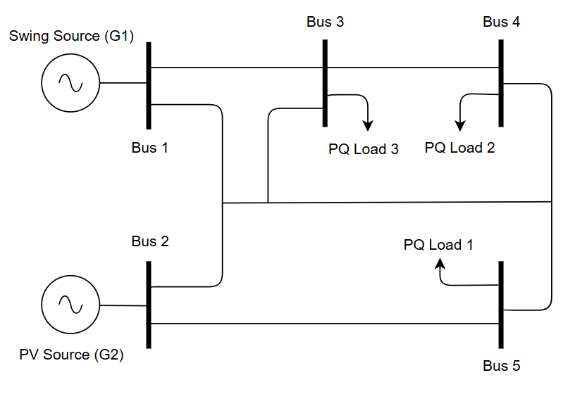
System Architecture & Detection Principle
5-Bus Transmission Network
Standard benchmark: 5 buses, 6 transmission lines
Bus 1 (slack, 1.06 pu, 0°) and Bus 2 (generator, 1.00 pu) supply three load buses (Buses 3–5)
Bus 5 is the primary monitoring and injection bus
All quantities in per-unit on a 100 MVA base
Fixed-step ode4 solver at Ts = 50 µs (20 kHz sample rate)
INSERT IMAGE
INSERT IMAGE
Fig 2.1: SLD of 5-Bus Transmission Network
25/4/2026
7
OUTR, Bhubaneswar

Slide 8
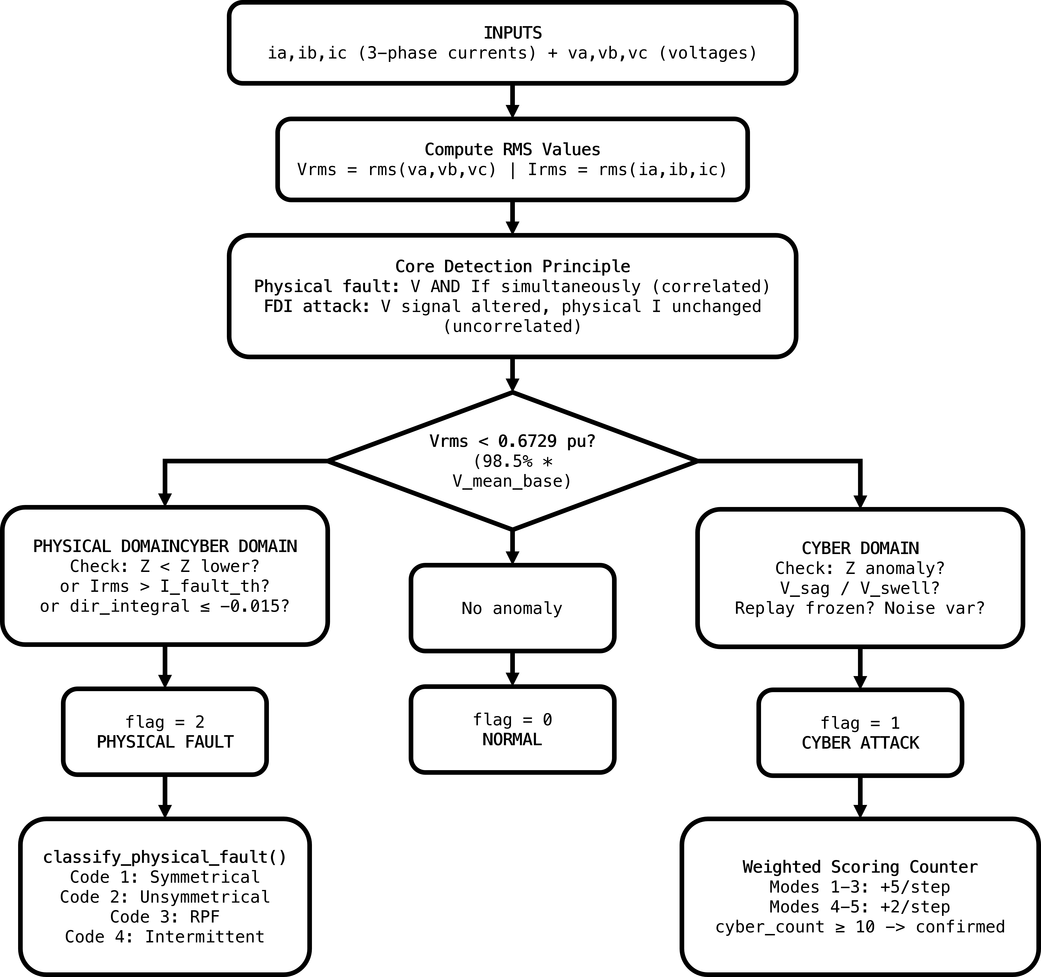
System Architecture & Detection Principle
V-I Correlation Detection Principle
Physical fault: voltage collapses AND current spikes simultaneously → correlated V-I response
FDI attack: only the SCADA voltage signal changes, physical current unchanged → uncorrelated response
Boundary: is_phys_voltage = (Vrms < 0.6769 pu = 98.5% × V_mean_base)
Anomaly while is_cyber_voltage (Vrms ≥ 0.6769) → FDI event
Anomaly while is_phys_voltage (Vrms < 0.6769) → Physical fault
INSERT IMAGE
Fig 2.2: V-I Correlation Logic — Cyber-vs-Physical Boundary Conceptual Diagram
25/4/2026
8
OUTR, Bhubaneswar

Slide 9
FDI Attack Mechanism
An FDI attack targets the SCADA measurement layer — implemented as a Bias Injection block added between the physical voltage measurement output and the detect_fdi() input signal line.
The attack operates exclusively on the signal path with zero connection to the physical power system; therefore, true line currents remain physically unchanged.
Mode 1
Mode 2
Mode 3
Mode 4
Mode 5
Fake-Short
Fake-Sag
Fake-Swell
Replay Attack
Noise Injection
Z < 1.3277 pu AND Irms > 0.5047 pu
Score: +5/step; flag=1 at ≥10
Vrms < 0.6528 pu AND Irms > 0.5×I_mean
Score: +5/step; flag=1 at ≥10
Vrms > 0.7216 pu AND Irms > 0.2717 pu
Score: +5/step; flag=1 at ≥10
delta_v < 1e-3 for > 5 consecutive steps (250 µs)
Score: +2/step; flag=1 at ≥10
mean(noise_var_buf) > 0.001206 (20-sample rolling)
Score: +2/step; flag=1 at ≥10
Weighted Cyber-Event Scoring System
Modes 1–3 (magnitude anomalies): +5 per step; cyber_count ≥ 10 → flag = 1 (100 µs detection, 2 samples)
Modes 4–5 (signal-pattern anomalies): +2 per step; cyber_count ≥ 10 → flag = 1 (250 µs detection, 5 samples)
Natural decay: −5 per step when no cyber condition active; 200-step (10 ms) post-fault holdoff blanking
25/4/2026
9
OUTR, Bhubaneswar

Slide 10
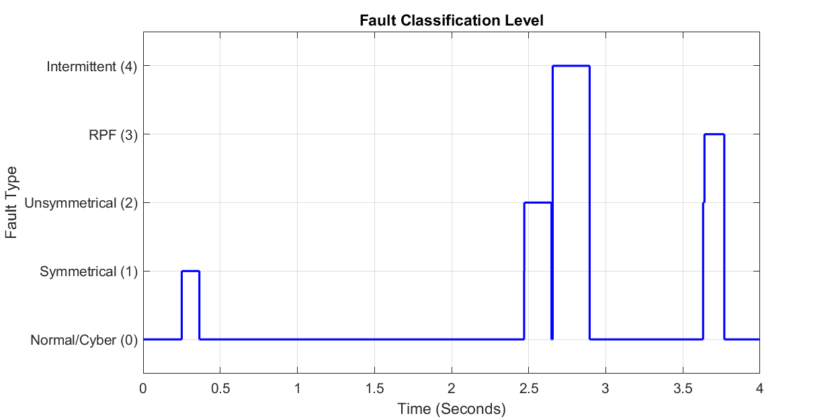
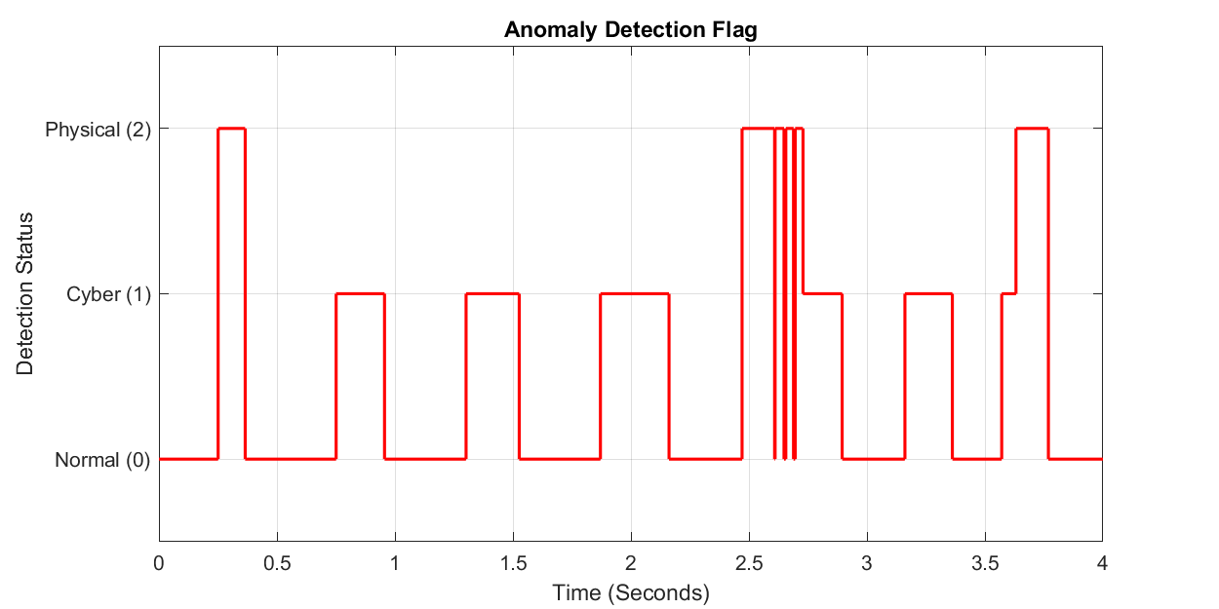
Physical Fault Characteristics & Sub-Classification
Code 1
Code 2
Code 3
Code 4
Symmetrical
(3-Phase Short)
Unsymmetrical
(L-G Fault)
Reverse Power
Flow (RPF)
Intermittent
Fault
Detection Criterion:
Detection Criterion:
Detection Criterion:
Detection Criterion:
Phase RMS unbalance ≤ 15%
of I_avg_rms
Phase RMS unbalance > 15%
of I_avg_rms
dir_integral ≤ −0.015 pu·s
(power direction integrator)
≥ 3 flag=2 transitions
within 200 ms (4000 steps)
Detection: 150 µs (3 samples)
Detection: 150 µs (3 samples)
Detection: 150 µs (3 samples)
Detection: 150 µs (3 samples)
Fig: Fault Classification Waveforms — fault_code output (0–4) and flag output (0=Normal, 1=Cyber, 2=Physical) across all four fault scenarios
25/4/2026
10
OUTR, Bhubaneswar

Slide 11
Baseline Parameters & Threshold Derivation
Per-Unit Baseline Constants
Detection Thresholds
Symbol | Value (pu) | Meaning
V_mean_base | 0.6872 | Normal RMS voltage at Bus 5
I_mean_base | 0.3882 | Normal operating RMS current
Z_mean_base | 1.7702 | Steady-state apparent impedance
V_boundary | 0.6769 | 98.5% of V_mean — cyber/physical separator
Threshold | Value (pu) | Purpose
Z_upper | 2.2128 | High-impedance boundary
Z_lower | 1.3277 | Low-impedance short-circuit boundary
I_fault_th | 0.5047 | Overcurrent threshold (130% of I_mean)
V_sag_th | 0.6528 | Fake voltage sag lower boundary
V_swell_th | 0.7216 | Fake voltage swell upper boundary
Key Timing & Counter Parameters
Parameter | Value | Duration | Effect
Sample Period (Ts) | 50e-6 s | 50 µs | Base time step for all counters
Physical fault confirm | count ≥ 3 | 150 µs | Debounce single-sample transients
Fault latch duration | 250 steps | 12.5 ms | Holds flag=2 after fault clears
Cyber holdoff post-fault | 200 steps | 10 ms | Blanks cyber accumulation after physical event
Replay frozen threshold | count > 5 | 250 µs | Detects frozen/static voltage samples
RMS buffer (classify) | 400 samples | 20 ms | One full 50 Hz cycle for phase unbalance calc
25/4/2026
11
OUTR, Bhubaneswar

Slide 12
MATLAB/Simulink Simulation Setup
Power System Model
Specialized Power Systems toolbox (MATLAB/Simulink)
Three-Phase V-I Measurement blocks at each bus
Three-Phase PI Section Line blocks for transmission lines
Fixed-step ode4 solver at Ts = 50 µs throughout
100 MVA base; nominal frequency 50 Hz
Attack & Fault Injection
FDI attacks: Switch block selects between real voltage measurement and biased version — signal path only, zero physical impact
Physical faults: Three-Phase Fault blocks at t = 0.5 s, duration 0.1 s (L-G and 3-phase bolted)
Intermittent faults: fault block toggled ON/OFF three times within a 200 ms window
Function Block Integration
detect_fdi(): receives ia, ib, ic, va, vb, vc from Bus 5; outputs flag and flag_cyber_raw
classify_physical_fault(): cascaded — activates only when flag = 2; outputs fault_code 0–4
Persistent variables maintain state across 50 µs steps (cyber_count, fault_count, dir_integral, noise_var_buf)
25/4/2026
12
OUTR, Bhubaneswar

Slide 13
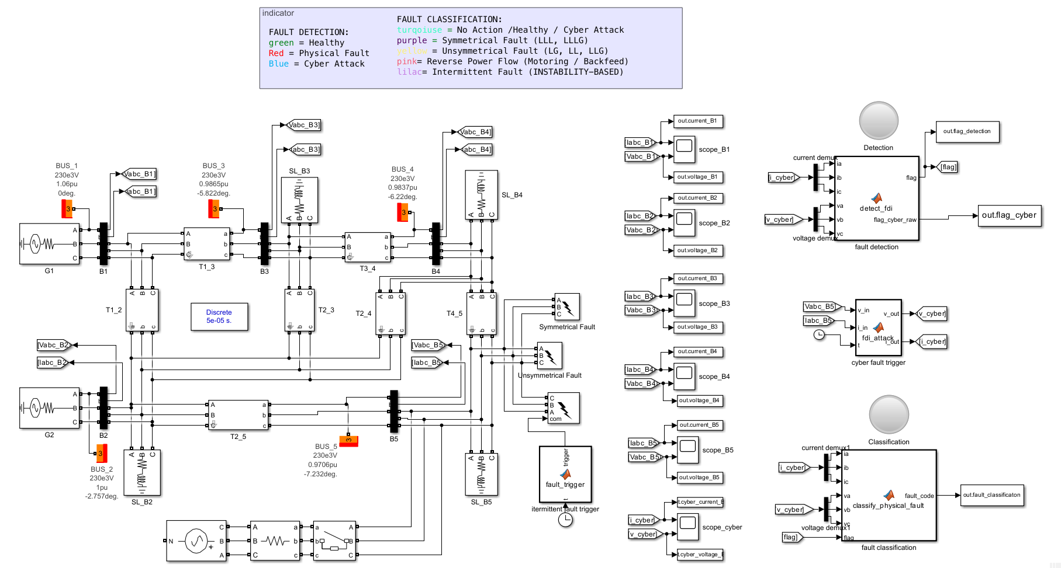
MATLAB/Simulink Simulation Setup
INSERT IMAGE
Fig 4.1: MATLAB/Simulink Model — 5-Bus System with detect_fdi() and classify_physical_fault() Function Blocks
25/4/2026
13
OUTR, Bhubaneswar

Slide 14
Result Analysis — Normal Operation
Simulation run for 1.0 s under normal load. Bus 5 Vrms stays near V_mean_base = 0.6872 pu. Impedance Z remains between Z_lower (1.3277 pu) and Z_upper (2.2128 pu).
Both detect_fdi() outputs hold constant at 0 (Normal). classify_physical_fault() outputs fault_code = 0 throughout.
Bus No. | Voltage Mag (pu) | Angle (°) | Active Load (MW) | Reactive Load (MVAR)
Bus 1 (Slack) | 1.060 | 0.00° | — | —
Bus 2 (Generator) | 1.000 | −4.98° | — | —
Bus 3 (Load) | 0.987 | −12.72° | 94.2 | 19.0
Bus 4 (Load) | 0.984 | −10.33° | 47.8 | −3.9
Bus 5 (Load/Monitor) | 0.972 | −8.78° | 7.6 | 1.6
25/4/2026
14
OUTR, Bhubaneswar

Slide 15

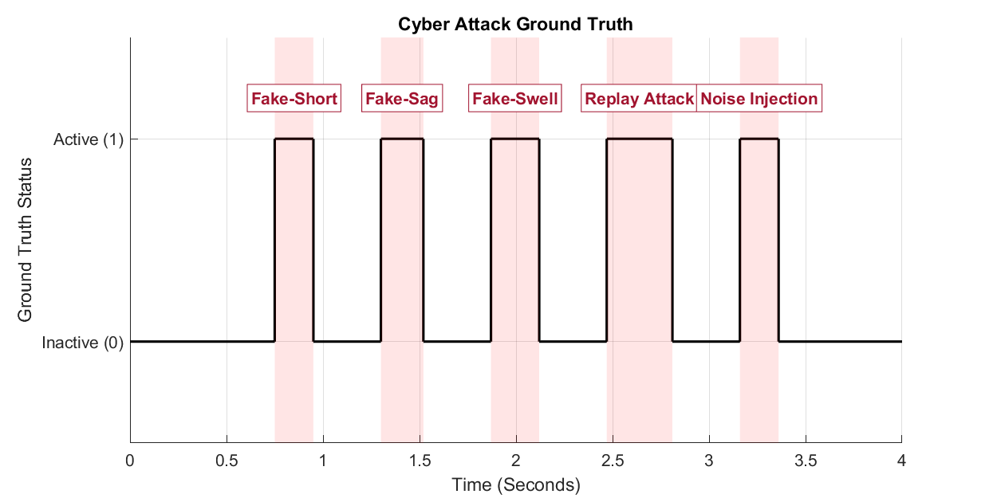
Result Analysis — Normal Operation
INSERT IMAGE
Fig 5.1— Three-Panel Logic Plot: (A) fault_code output (0–4) | (B) flag output (0=Normal, 1=Cyber, 2=Physical) | (C) Cyber Attack Ground Truth Window (injection active signal)
25/4/2026
15
OUTR, Bhubaneswar

Slide 16
Result Analysis — FDI Attack Results (All Five Modes)
FDI attacks applied sequentially to Bus 5 voltage measurements. Physical line currents remain unchanged throughout all attack windows.
detect_fdi() raises flag = 1 within scoring accumulation time. classify_physical_fault() correctly outputs fault_code = 0 throughout all attack windows.
Attack Mode | Condition Triggered | Score Accumulation | flag | fault_code | flag_cyber_raw
Fake-Short | fake_short (Z < 1.3277, is_cyber_V) | +5/step → ≥10 in 2 steps | 1 | 0 | 1
Fake-Sag | fake_sag (Vrms < 0.6528, is_cyber_V) | +5/step → ≥10 in 2 steps | 1 | 0 | 1
Fake-Swell | fake_swell (Vrms > 0.7216, is_cyber_V) | +5/step → ≥10 in 2 steps | 1 | 0 | 1
Replay Attack | frozen_count > 5 (250 µs frozen) | +2/step → ≥10 in 5 steps | 1 | 0 | 1
Noise Injection | mean(noise_buf) > 0.001206 | +2/step → ≥10 in 5 steps | 1 | 0 | 1
Physical faults applied at t = 0.5 s. True bus voltage collapses (is_phys_voltage becomes true) and fault current surges.
detect_fdi() raises flag = 2 within 3 samples (150 µs). classify_physical_fault() outputs the correct sub-code for each fault type.
Fault Type | is_phys_voltage | Detection Time | flag | fault_code | Relay Action
Symmetrical (3-Phase Short) | True (Vrms << 0.6769) | 150 µs (3 samples) | 2 | 1 — Symmetrical | CB Trip
Unsymmetrical (L-G Fault) | True | 150 µs (3 samples) | 2 | 2 — Unsymmetrical | CB Trip
Reverse Power Flow (RPF) | Varies | dir_integral ≤ −0.015 | 2 | 3 — RPF | CB Trip
Intermittent Fault | True | 3 transitions / 200 ms | 2 | 4 — Intermittent | CB Trip
25/4/2026
16
OUTR, Bhubaneswar

Slide 17
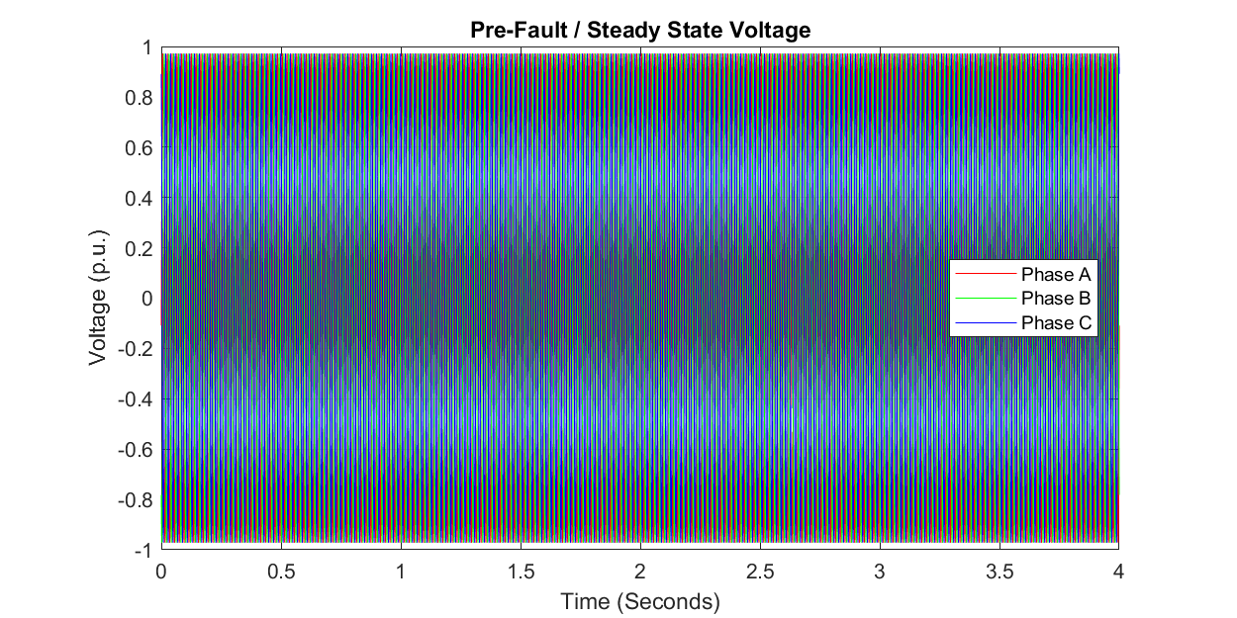
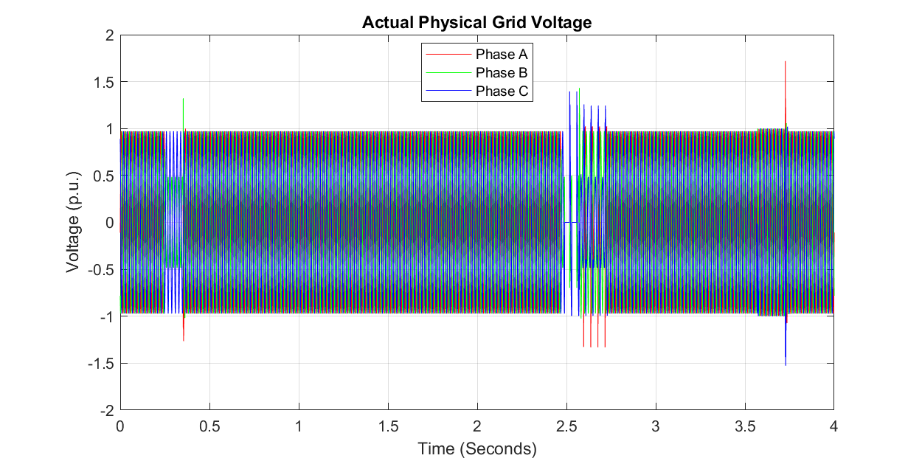
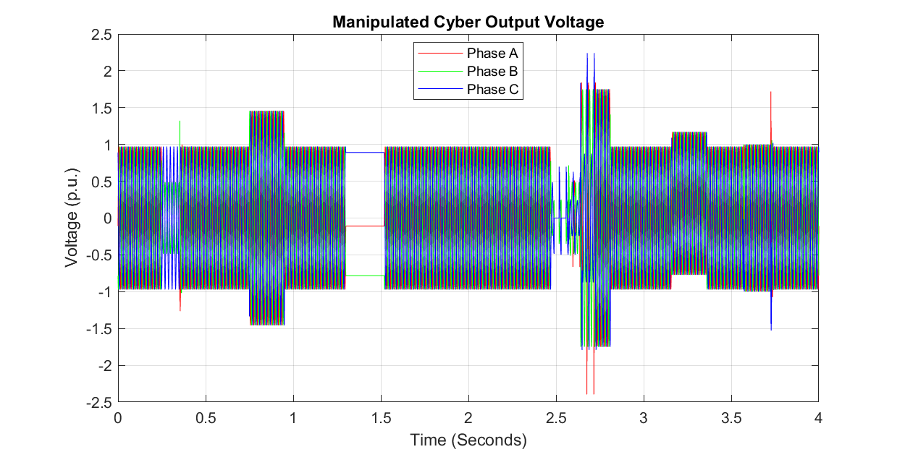
Result Analysis — Physical Fault Classification Results
Fig 5.4: 3-Phase Voltage Comparison — Left: Pre-Fault Steady State | Centre: Actual Physical Fault Voltage | Right: Manipulated Cyber Output
25/4/2026
17
OUTR, Bhubaneswar

Slide 18
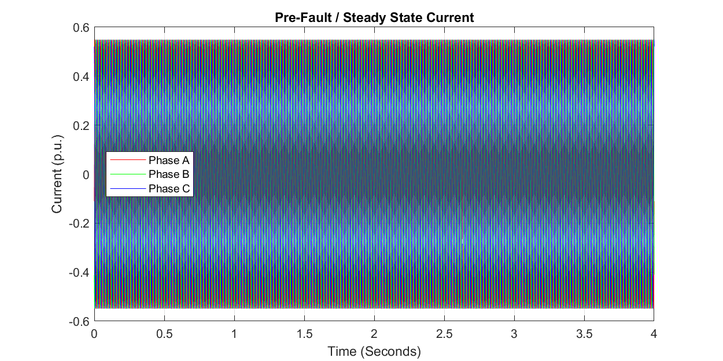
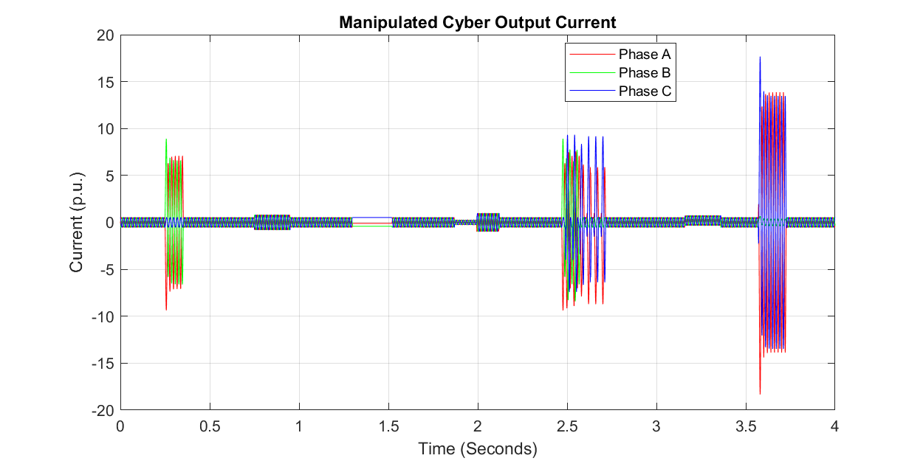
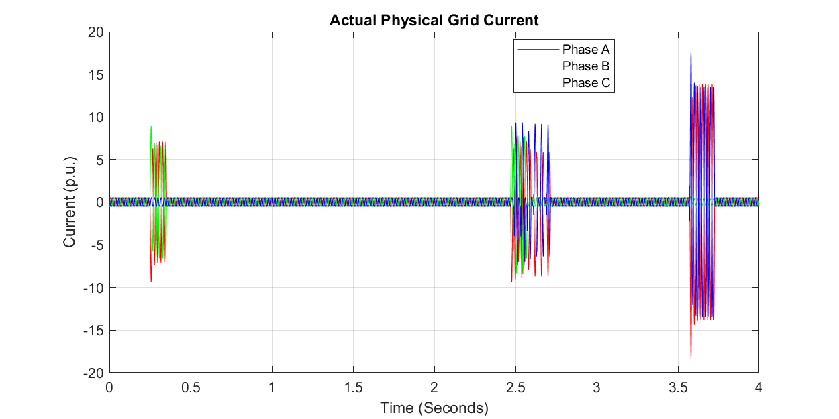
Result Analysis — Physical Fault Classification Results
Fig 5.5: 3-Phase Current Comparison — Left: Pre-Fault Steady State | Centre: Actual Physical Fault Current | Right: Manipulated Cyber Output
25/4/2026
18
OUTR, Bhubaneswar

Slide 19
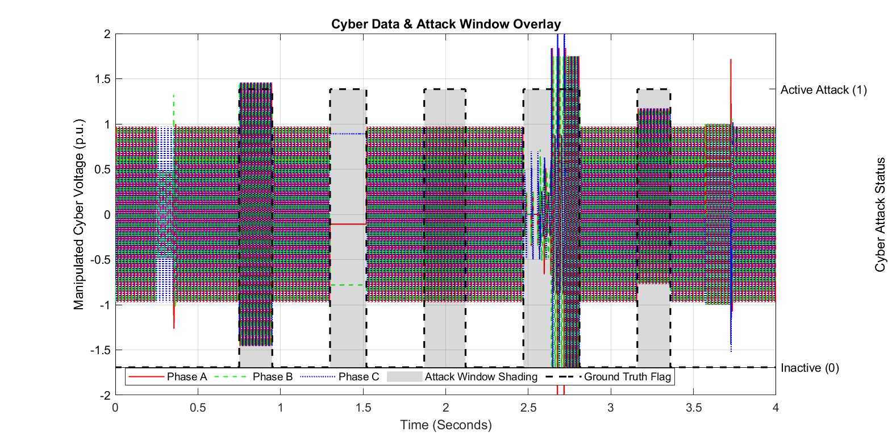
Cyber Data & Attack Window Overlay — Comparative Performance
Fig 5.6: Cyber Data & Attack Window Overlay — 3-Phase Cyber Voltages, flag_cyber_raw Digital Output, and Shaded Ground-Truth Attack Windows
25/4/2026
19
OUTR, Bhubaneswar

Slide 20
Cyber Data & Attack Window Overlay — Comparative Performance
Comparative Performance Analysis
Parameter | Proposed V-I System | State Est. BDD | ML-Based IDS
Cyber Detection Speed | 100–250 µs | Iteration delay | Inference delay
Physical Fault Speed | 150 µs (3 samples) | State update | Inference delay
Network Model Needed | No | Yes (Y-bus) | No
Training Data Needed | No | No | Yes (large)
FDI Attack Types Covered | 5 modes | Residual only | Multiple
Fault Sub-Classification | 4 types (codes 1–4) | None | Possible
False Positive Suppression | Weighted counter + blanking | Threshold only | Model-dependent
25/4/2026
20
OUTR, Bhubaneswar

Slide 21
Conclusion
A complete physics-based cyber-physical anomaly detection system has been designed, implemented, and validated for a 5-bus transmission network at 50 µs sample rate.
detect_fdi() exploits a fundamental physical law: real fault → correlated V-I response; FDI attack → uncorrelated (current unchanged). A single voltage boundary (0.6769 pu) separates the two domains.
Five FDI attack modes correctly detected with flag = 1 and no spurious physical fault alarms (fault_code = 0 in all cyber windows).
All four physical fault types correctly sub-classified with detection within 150 µs (3 sample periods) of fault inception.
Dual flag architecture (flag + flag_cyber_raw) correctly handles simultaneous cyber-and-physical scenarios — prioritising the physical fault relay action while independently signalling cyber intrusion.
Six diagnostic figures, including the Cyber Data & Attack Window Overlay (Fig 6), provide visual ground-truth validation of detection alignment with zero false positives.
No network model, no training data, no iterative computation required — fully self-calibrating from steady-state baseline.
25/4/2026
21
OUTR, Bhubaneswar

Slide 22
Future Scope
Extension to larger benchmark networks (IEEE 14-bus, 30-bus, 118-bus) to evaluate detection scalability and threshold recalibration.
Investigation of coordinated simultaneous attacks (FDI injection during a physical fault) designed to trigger fault_code misclassification.
Integration of PMU synchrophasor data to enhance RPF and intermittent fault sensitivity.
Adaptive baseline calibration — auto-update V_mean_base, I_mean_base, and Z_mean_base as loading conditions change.
Hardware-in-the-Loop (HIL) validation on RTDS or OPAL-RT real-time simulators.
Extension to inverter-dominated microgrids where fault current signatures differ from synchronous machine behaviour.
Investigation of multi-point FDI attacks targeting both voltage and current sensors at multiple buses simultaneously.
Formal alignment with IEC 62351 cybersecurity standards and IEC 61850 substation automation protocols.
25/4/2026
22
OUTR, Bhubaneswar

Slide 23
References
[1] A. Anwar, A. N. Mahmood, and Z. Tari, "A data-driven approach to distinguish cyber-attacks from physical faults in a smart grid," Proc. 8th Int. Conf. Secur. Inf. Netw. (SIN), 2015.
[2] "Centralized dynamic state estimation algorithm for detecting and distinguishing faults and cyber-attacks in power systems," IEEE Xplore, 2025.
[3] M. M. Aman, G. B. Jasmon, Q. A. Khan, A. H. B. Abu Bakar, and J. J. Jamian, "Modeling and simulation of reverse power relay for generator protection," Proc. IEEE Int. Power Eng. Optim. Conf. (PEOCO), 2012, pp. 317–322.K. Nagaraj, "Data-driven physics-based solution for false data injection diagnosis in smart grids," Proc. IEEE PESGM, 2019.
[4] S. Sridhar, A. Hahn, and M. Govindarasu, "Cyber-physical system security for the electric power grid," Proc. IEEE, vol. 100, no. 1, pp. 210–224, 2012.
[5] V. S. Rajkumar, M. Tealane, A. Ştefanov, A. Presekal, and P. Palensky, "Cyber Attacks on Power System Automation and Protection and Impact Analysis," 2020 IEEE PES Innovative Smart Grid Technologies Europe (ISGT-Europe), 2020. doi: 10.1109/ISGT-Europe47291.2020.9248840.
25/4/2026
23
OUTR, Bhubaneswar

