Slide 1
Optoma ML1080 Projector Evaluation
Photometric Characterization, CAD Optical Scaling & Curing Failure Analysis
OpenCAL Computed Axial Lithography Project | Experimental & Theoretical Validation

Slide 2
1. Background: Why We Chose It & Print Test Outcome
Consultation with Berkeley OpenCAL Lead & Initial Test Print Failure
Why We Ordered the Optoma ML1080
Consultation with Taylor Waddell (UC Berkeley Lead):
In our email exchange on March 24, 2026, we reviewed hardware configurations for OpenCAL. Taylor evaluated the Optoma ML1080 RGB laser projector and confirmed it looked like a strong fit for our setup.
Key Assumed Advantages:
• Triple RGB Laser Engine: Narrow spectral emission peaks (~450 nm blue) matching photoinitiator absorption.
• Compact Form Factor: Ideal for compact benchtop rig integration.
• Short Throw Ratio (1.2:1): Efficient working distance for collimating optics.
Target Expectations:
Expected rapid volumetric gelation within 30 to 90 seconds based on published literature values.
Initial Print Test: The Captive Ring Failure
Experimental Setup:
• Part: Mini captive ring benchmark model.
• Mode: Projector at 100% Bright Mode (maximum laser output).
• Material: Standard CAL acrylate resin with camphorquinone (CQ) / amine initiator.
Observations During Exposure:
• Target curing time (30 - 90 s) produced completely uncured liquid resin.
• At 5 minutes: No discernible gel boundary forming inside the rotating vial.
• Extended exposure to 10 full minutes (600 seconds): Solidification finally initiated, but the part was severely ruined.
Failure Mechanics:
Excessive exposure time allowed severe oxygen diffusion and thermal/species cross-diffusion. Resulted in overcured outer slag with an ungelled liquid inner core. Clear evidence of photon starvation at the actinic wavelength.

Slide 3
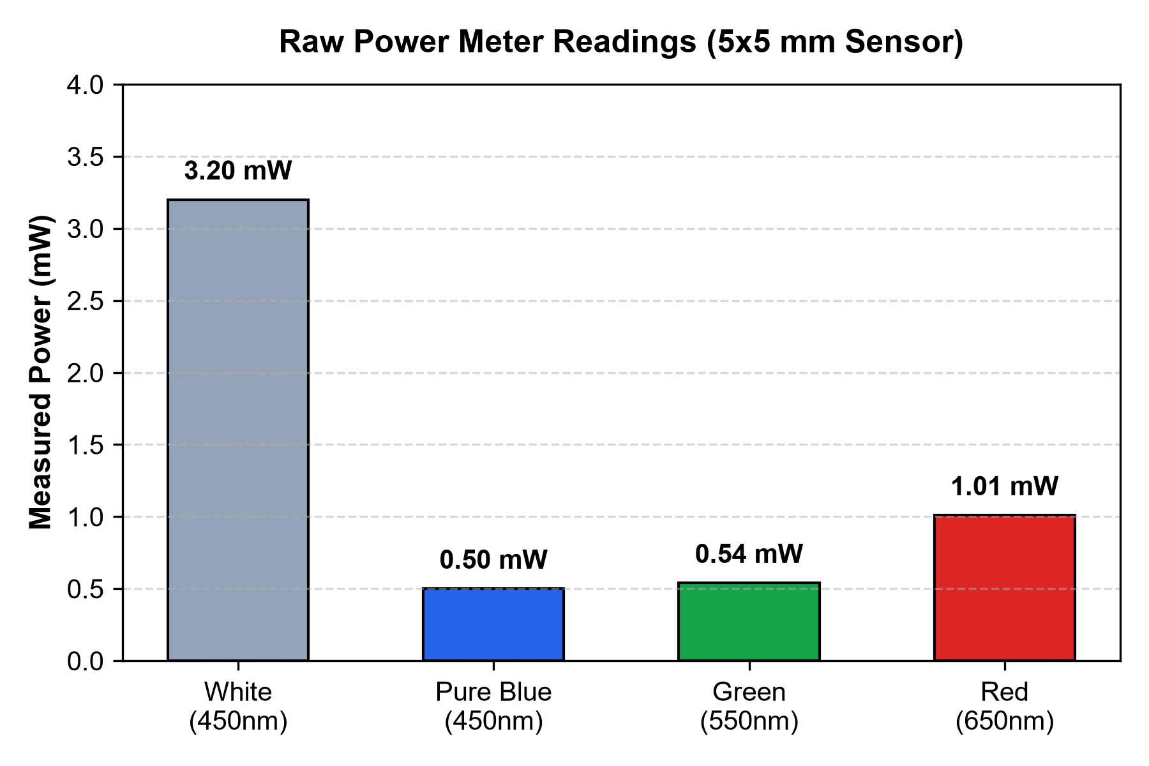
2. Optical Measurements: Photodiode Characterization
Direct Power Meter Readings at Vial Position across Channels and Wavelength Settings
Projected Color | Power Meter λ | Measured Power | Calculated Irradiance
Full White | 400 nm | 4.09 mW | 16.36 mW/cm²
Full White | 430 nm | 3.50 mW | 14.00 mW/cm²
Full White | 450 nm | 3.20 mW | 12.80 mW/cm²
Pure Blue | 400 nm | 0.60 mW | 2.40 mW/cm²
Pure Blue | 430 nm | 0.56 mW | 2.24 mW/cm²
Pure Blue | 450 nm | 0.50 mW | 2.00 mW/cm² (Actinic)
Pure Green | 550 nm | 0.54 mW | 2.16 mW/cm²
Pure Red | 650 nm | 1.01 mW | 4.04 mW/cm²
Key Measurement Note:
Sensor: Gentec-EO Silicon Photodiode (5 x 5 mm aperture, area = 0.25 cm²). At the active photoinitiator wavelength (450 nm pure blue), the measured power was only 0.50 mW, yielding an irradiance of exactly 2.00 mW/cm².

Slide 4
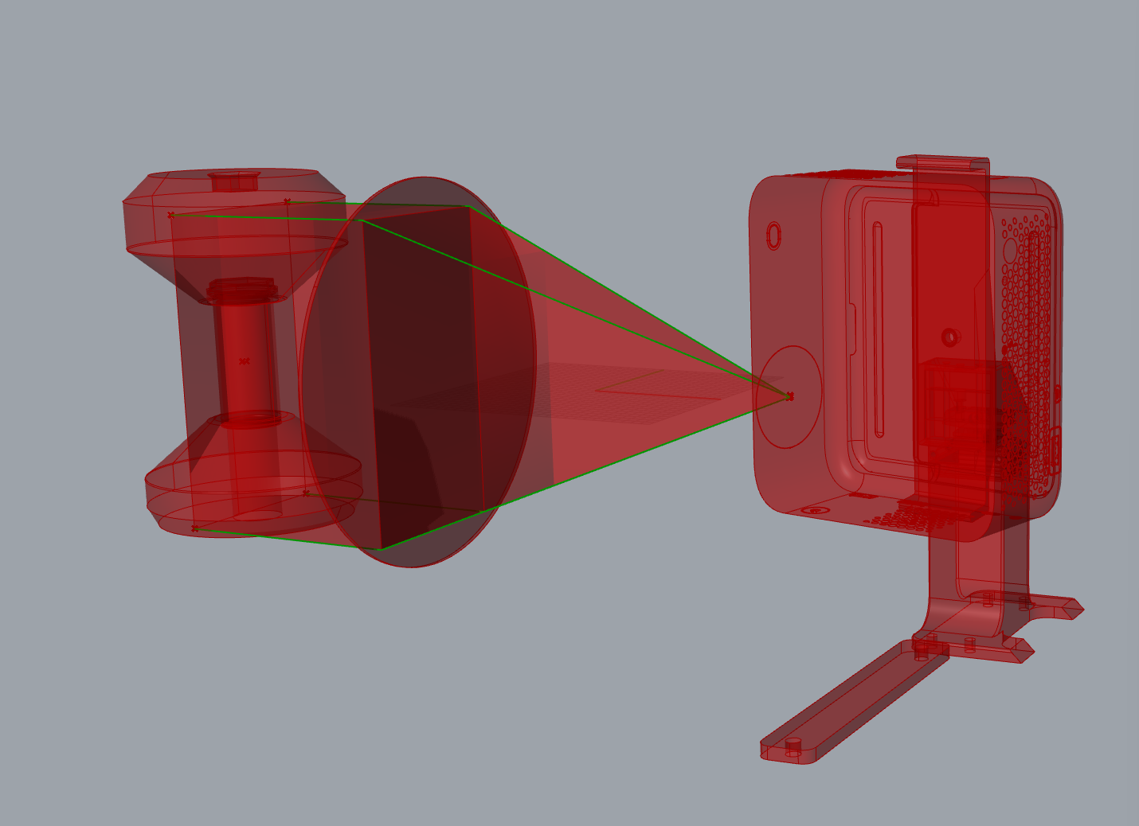
3. Spot Sizing in GUI & Sensor Alignment
Correlating GUI Presets to the 5x5 mm Aperture & Optical Cone Ray-Tracing
GUI Calibration & Physical Sensor Mapping
Projector GUI Presets (scripts/projector_gui.py):
The calibration interface provided discrete presets: [1px, 5px, 10px, 25px, 50px, 100px, 200px], alongside continuous Width/Height sliders (1 to 500 px) with a [x] Lock 1:1 aspect toggle.
At optical distance D ≈ 204 mm (80.1 μm/px H, 88.3 μm/px V):
• Scenario A (50px Preset Selected):
Physical spot = 50 px * 0.0801 mm/px = 4.0 mm (H) x 4.4 mm (V).
Spot Area ≈ 17.6 mm² sits 100% inside the 5.0 x 5.0 mm (25 mm²) aperture.
• Scenario B (Slider Tuned to ~60-62 px):
Physical spot matches 5.0 x 5.0 mm (25.0 mm²) exactly 1:1.
Zero Spillover Proof:
In both scenarios, 100% of projected photons fell entirely within the active silicon photodiode window. Zero optical power was clipped outside the detector frame.
Consistent Total Power Math:
• If 50 px (2,500 px / 0.12% chip): P_total = 0.50 mW / 0.00121 ≈ 0.41 W
• If 60 px (3,700 px / 0.18% chip): P_total = 0.50 mW / 0.00178 ≈ 0.28 W
Both scenarios prove the total blue engine output is capped at ~0.3 - 0.4 W.
Optical CAD Ray-Tracing:
Total projected 1080p frame at D = 204 mm is ~16,180 mm² (1920 x 1080 = 2,073,600 px). The 5 x 5 mm sensor patch corresponds to only ~3,534 px (0.17% of total frame).

Slide 5
4. Mathematical Validation & Literature Correlation
Correlating Measured Power with Electrical Limits and Photo-Kinetics
Step 1: Measured Irradiance at Vial Position
Photodiode Area:
A_sensor = 5 mm * 5 mm = 25 mm² = 0.25 cm²
Irradiance Calculation:
I_meas = P_meas / A_sensor
I_meas = (0.50 mW) / (0.25 cm²) = 2.00 mW/cm²
Actinic flux delivered directly to the resin vial is exactly 2.00 mW/cm².
Step 2: Total Blue Optical Power (CAD Scaling)
Chip Fraction Sampled by 5x5 mm Sensor:
f_area = N_spot / N_total = (3,534 px) / (2,073,600 px) ≈ 0.170% = 0.00185
Extrapolated Total Blue Optical Power:
P_total,measured = P_meas / f_area
P_total,measured = (0.50 mW) / 0.00185 ≈ 0.27 W
The full Optoma ML1080 blue engine produces only 0.27 W across the whole frame.
Step 3: Theoretical Proof (From 32W Wall Draw)
Electrical Power Budget:
• Total Wall Power Consumption = 32 W
• Electronics, SOC, cooling fans, and DMD logic draw ~25 W
• Electrical power available to blue laser diode = ~5 to 7 W
Theoretical Optical Output:
P_total,theoretical = P_elec * Efficiency_diode
P_total,theoretical = 7 W * 0.40 (GaN blue efficiency) ≈ 0.29 W
Comparison: 0.27 W (CAD Measured) vs 0.29 W (32W Power Limit) -> 93% MATCH!
Step 4: Literature Correlation (Kelly et al. 2019)
Energy Unit Definition (Joules from Watts):
Energy (J) = Power (W) * Time (s) --> 1 mJ = 1 mW*s
Volumetric Critical Gelation Dose (Acrylate Resin):
H_crit = I * t = 1200 mJ/cm² = 1200 (mW*s) / cm²
Exposure Time Required with Optoma ML1080:
t_req = H_crit / I_meas = (1200 mW*s/cm²) / (2.00 mW/cm²) = 600 s (10 min)
Outcome: At 10 minutes, oxygen diffusion ruins axial resolution.

Slide 6
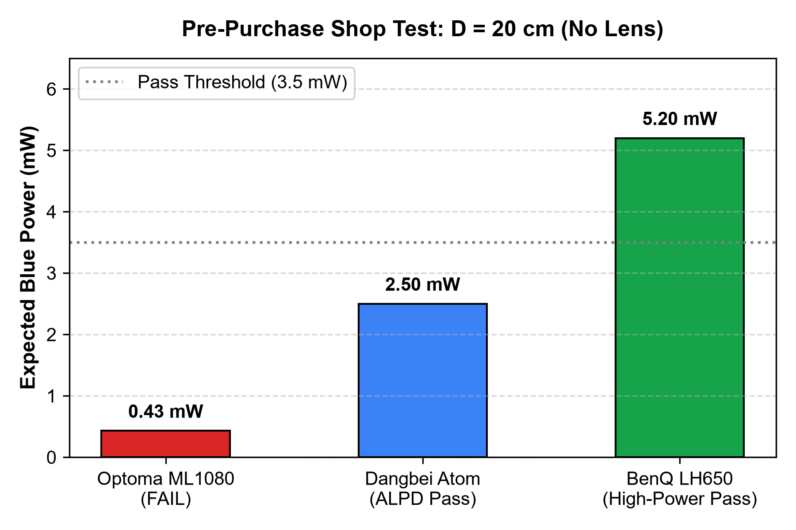
5. Pre-Purchase Verification: In-Store Testing Protocol
Using CAD Optical Scaling to Verify Replacement Projectors In-Shop Without Rig Optics
In-Shop Benchmark Test (No Lens Required)
Equipment to Bring to the Shop:
Laptop + Gentec-EO Silicon Photodiode Power Meter (5 x 5 mm aperture, 0.25 cm²).
Measurement Procedure:
1. Set projector to maximum brightness on a pure blue test slide (450 nm).
2. Place sensor aperture directly in the raw diverging beam at D = 20.0 cm from front pupil.
3. Read the power meter display directly.
CAD Optical Geometry at D = 20 cm:
• Projected Frame Width = 16.7 cm, Height = 9.4 cm
• Total Diverging Beam Area = 157 cm²
• Sensor Capture Fraction = (0.25 cm²) / (157 cm²) ≈ 0.16% of total beam
Pass / Fail Criteria:
• Optoma ML1080 (32W): Reads 0.43 mW -> P_blue = 0.27 W (FAIL - Insufficient)
• Minimum Required (>15 mW/cm²): Must read ≥ 3.5 mW at D = 20 cm
• Recommended (BenQ LH650, 200W): Reads 4.0 to 5.2 mW -> P_blue = 2.5 to 3.3 W (PASS)

