Slide 1
Tableau Analysis
Sales Representative Analysis

Slide 2
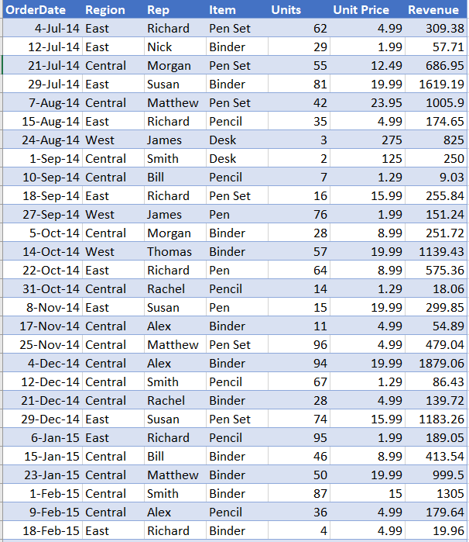
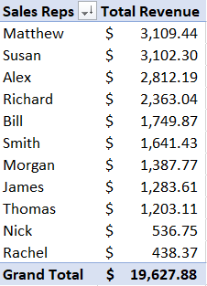
Figure 2
The Figure 1 on the left most side shows the sample of a sales data from a company which sells Office Supplies.
The above Figure 2 is the summarized data for the Sales Reps created by using Pivot Table from Microsoft Excel.
These are the high level summaries of the data.
Figure 1

Slide 3
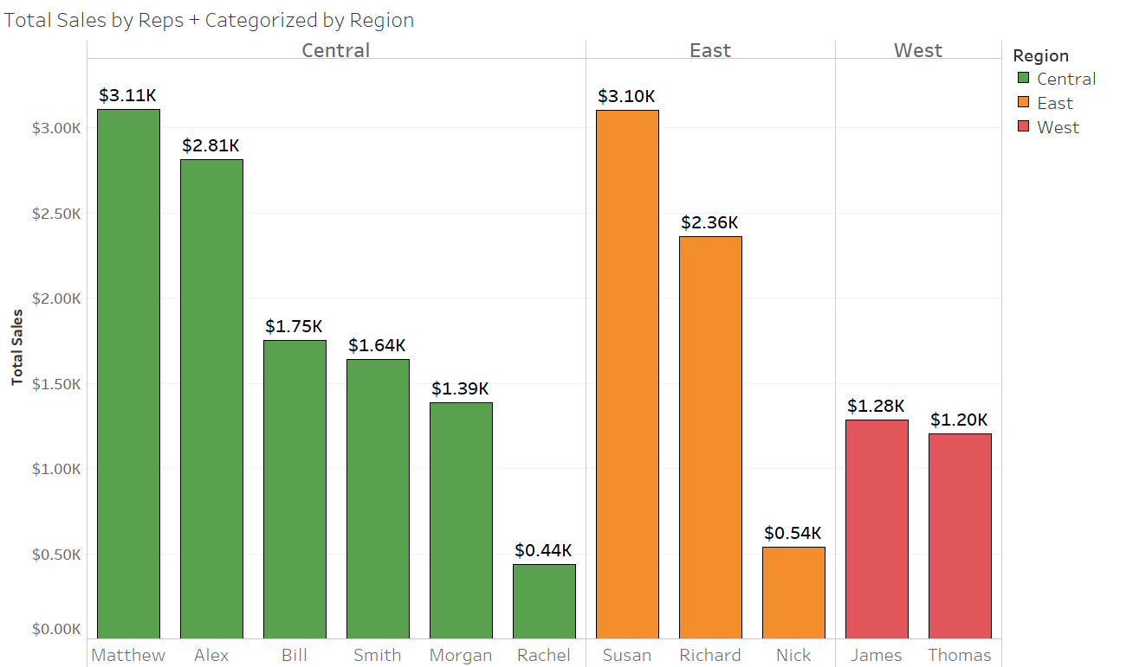
Figure 3
Figure 3 shows an insight over how different reps categorized by their allocated region have performed over the last quarter.
Matthew has been the top salesperson in the Central Region, Susan in the East and James in the West.

Slide 4
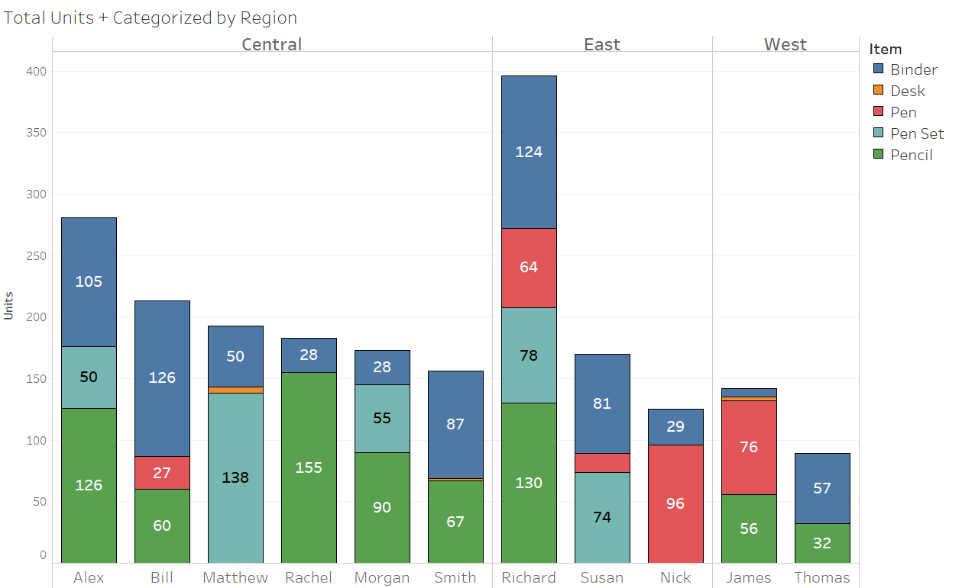
Figure 4
The Figure 4 provides information regarding demand of the office items categorized by regions.
For the central region, it is clear that Pencils have been sold the most and are in high demand. Next to pencils are the Binders. Individual pens are in less demand, so may be we can offer some incentive or else, we can stop distributing it and focus on other products. People have shown inclination towards buying a whole pen set rather than pen alone.
Similarly, it seems that for the East region, binders and pens have created most of the sales.
West region has more sales in pens and pencils.

Slide 5
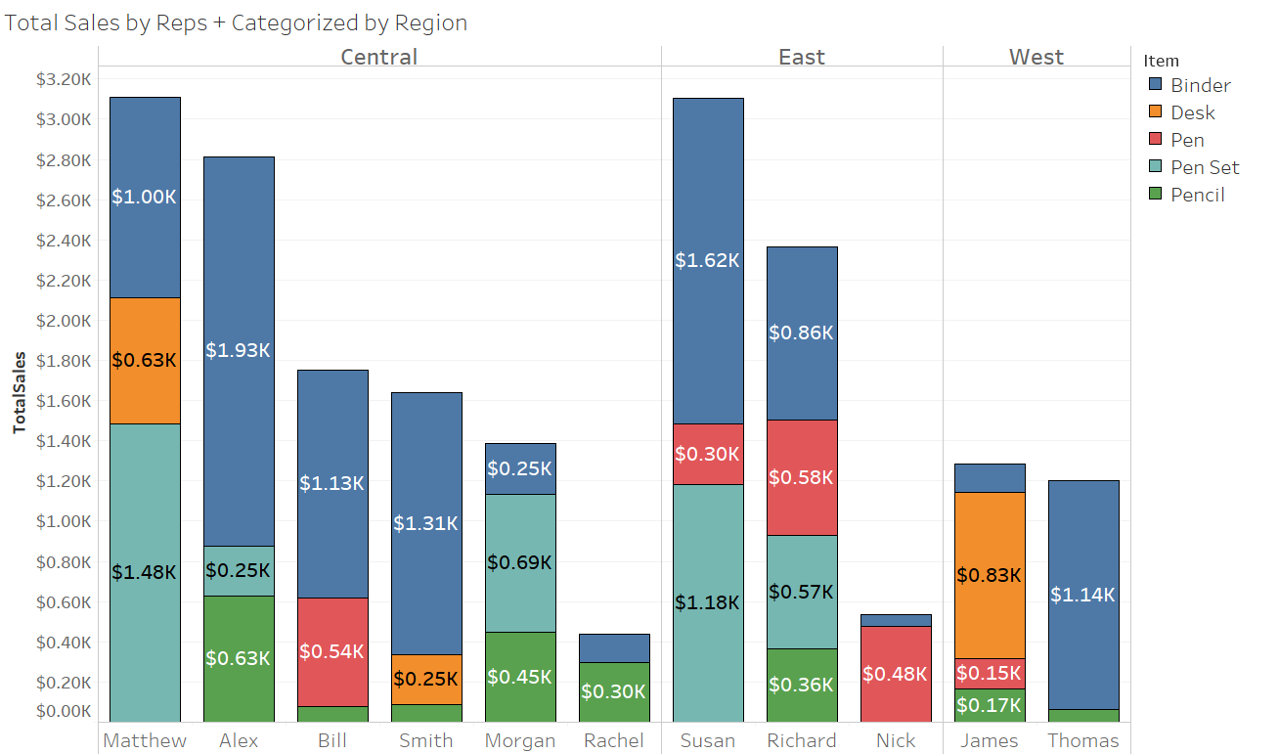
Figure 5
Figure 5 gives an insight over the revenue and gives s information on the most valuable office supply.
Last slide showed that for the Central region, pencils have been the most demanding item. However, it is seen here that it generates the lowest revenue. Comparitively, Binders and Pen Set have been giving us more revenue. So more focus should be made on these products.
For East, even though pens were sold more, it was pen set that brought more money after Binders.

Slide 6
Conclusion
The above was a short analysis on the sales data generated for a consumer office supply store done with the help of Tableau.
The first information is regarding the best salesperson according to the region.
Second was regarding the most demanded product and most sellable item.
Third information was regarding the revenue generation.

