Slide 1

Cultivate the Climate: A Game of Sustainable Agriculture​
FAO AGRIFOOD SIMULATION GAME
Community leaders' cards

Slide 2

Community Leader
The community leader translate and enforce policymaker's directives in local farming by organizing educational workshops, managing resource distribution, facilitating knowledge-sharing, and setting up policy-beneficial farm demonstrations.
Player Profile

Slide 3
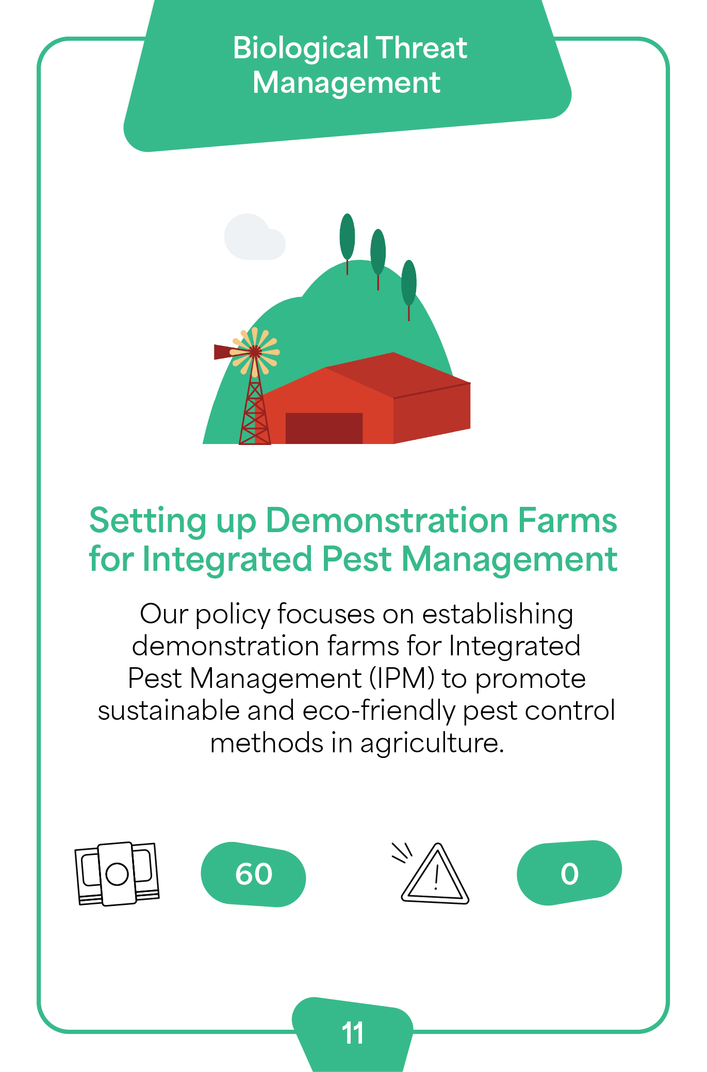
Community Leader
Card 1
Index number 11

Slide 4
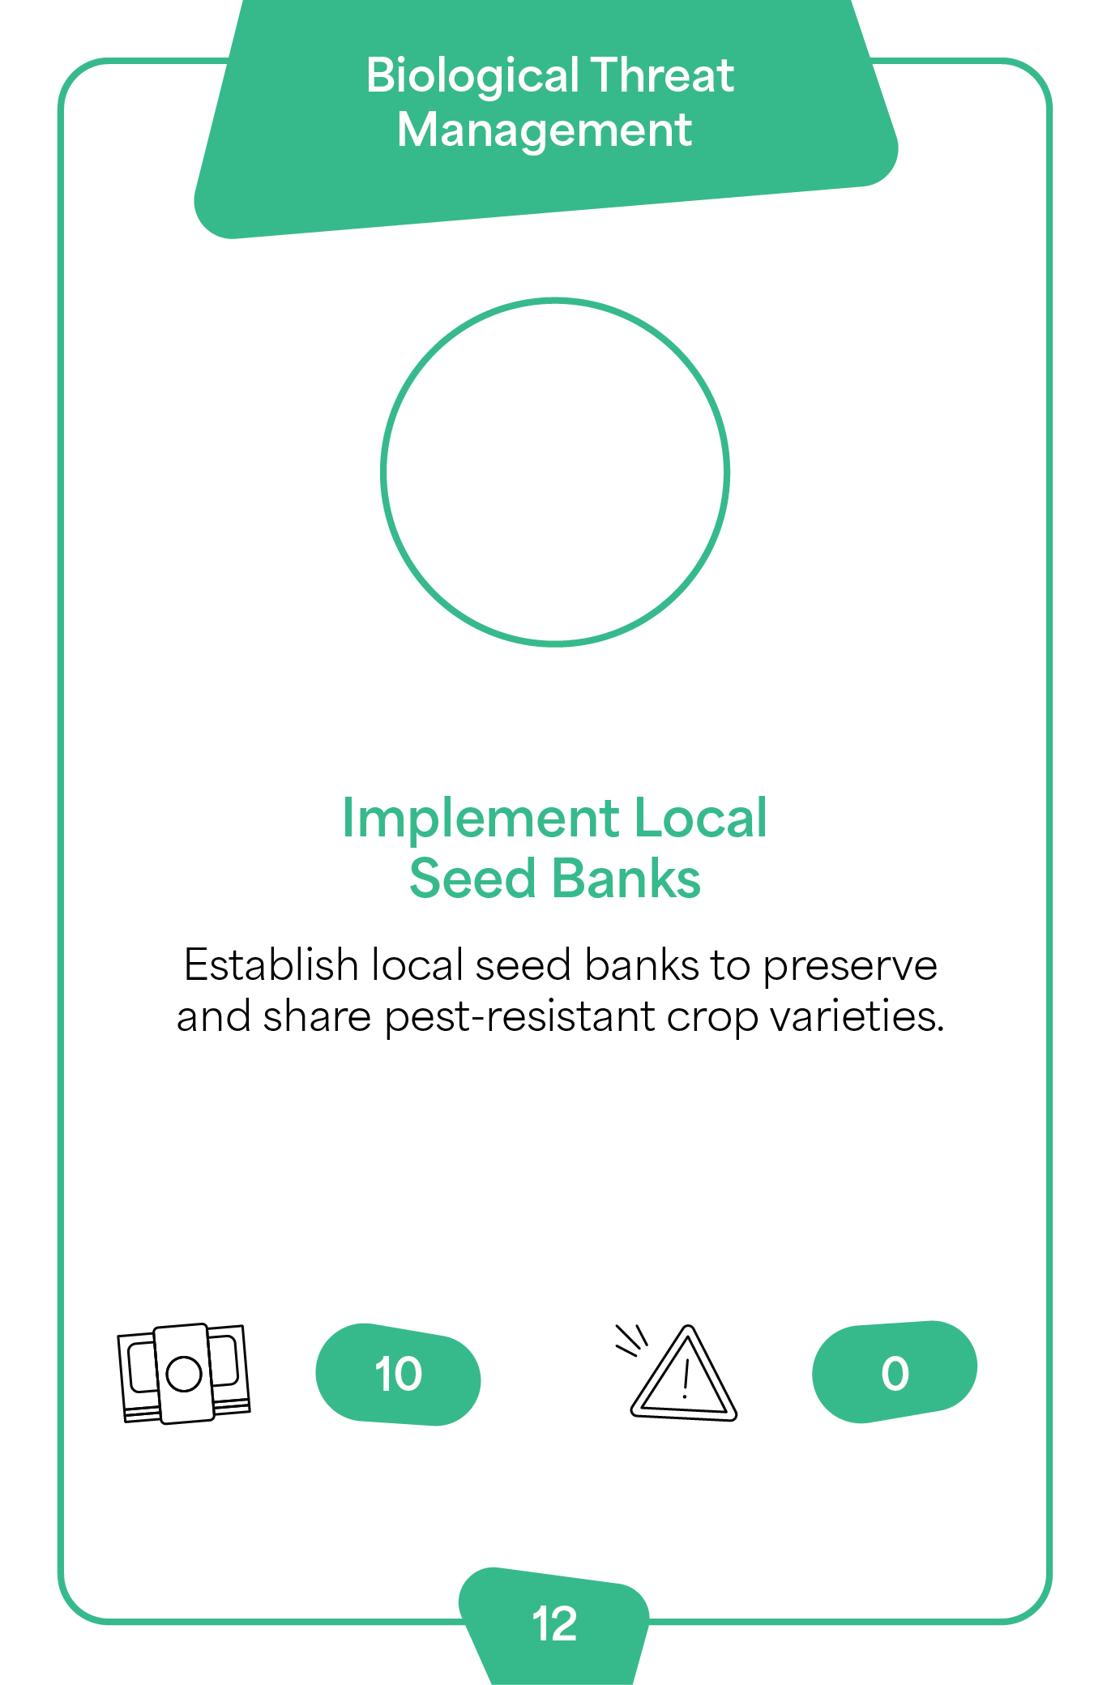
Community Leader
Card 2
Index number 12

Slide 5

Community Leader
Card 3
Index number 13

Slide 6
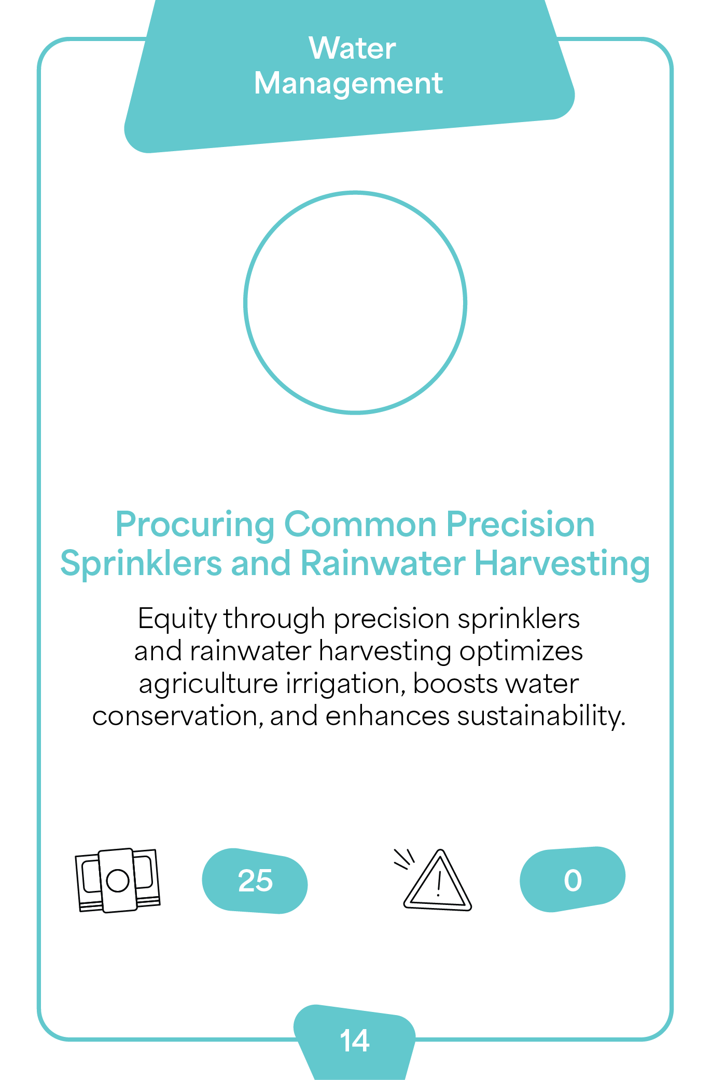
Community Leader
Card 4
Index number 14

Slide 7

Community Leader
Card 5
Index number 15

Slide 8

Community Leader
Card 6
Index number 16

Slide 9

Community Leader
Card 7
Index number 17

Slide 10
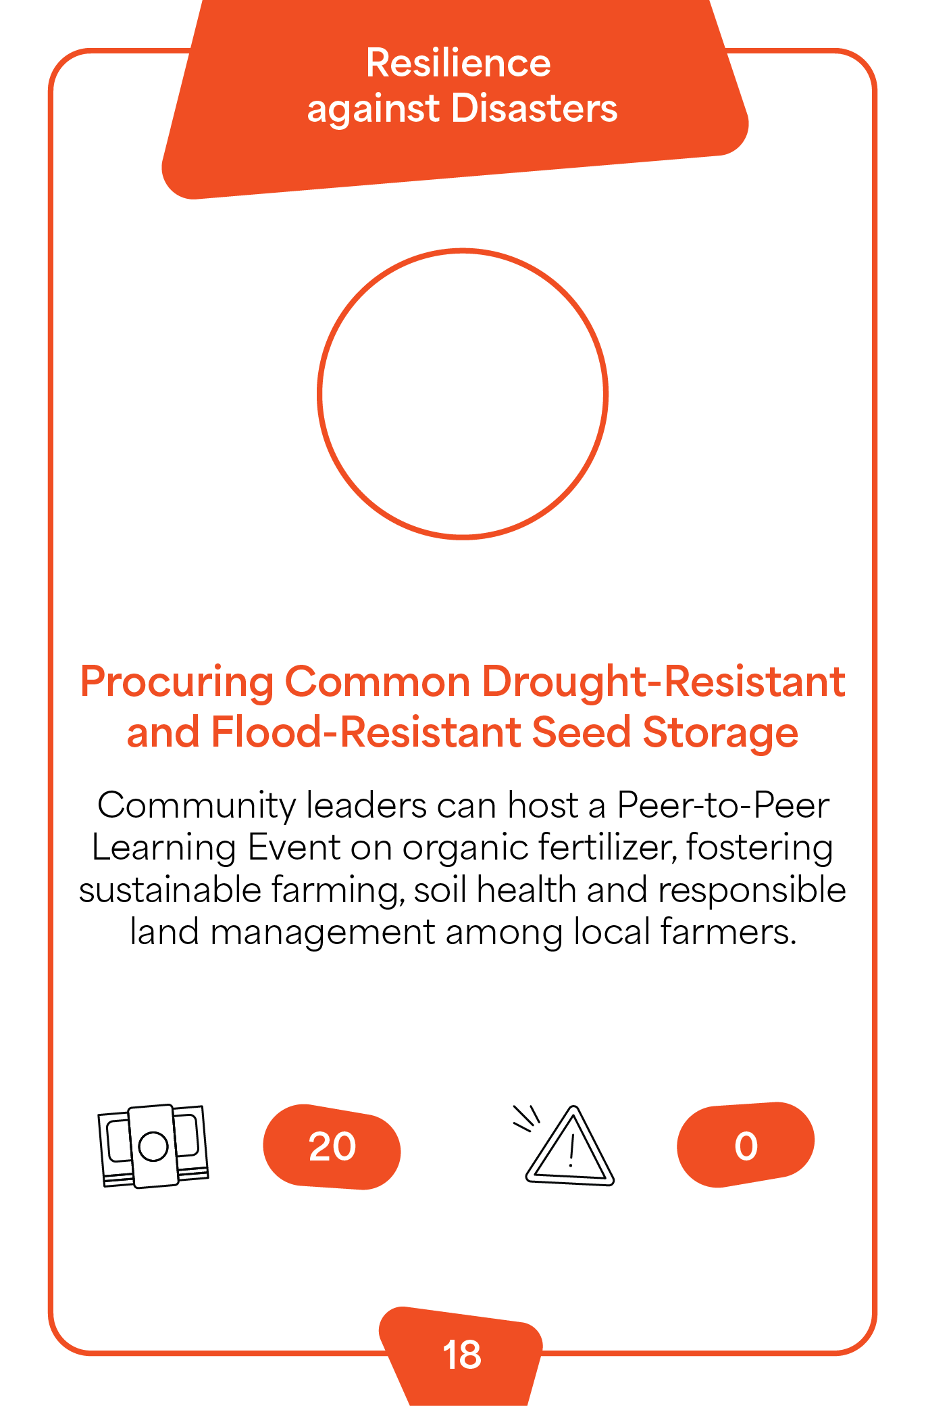
Community Leader
Card 8
Index number 18

Slide 11
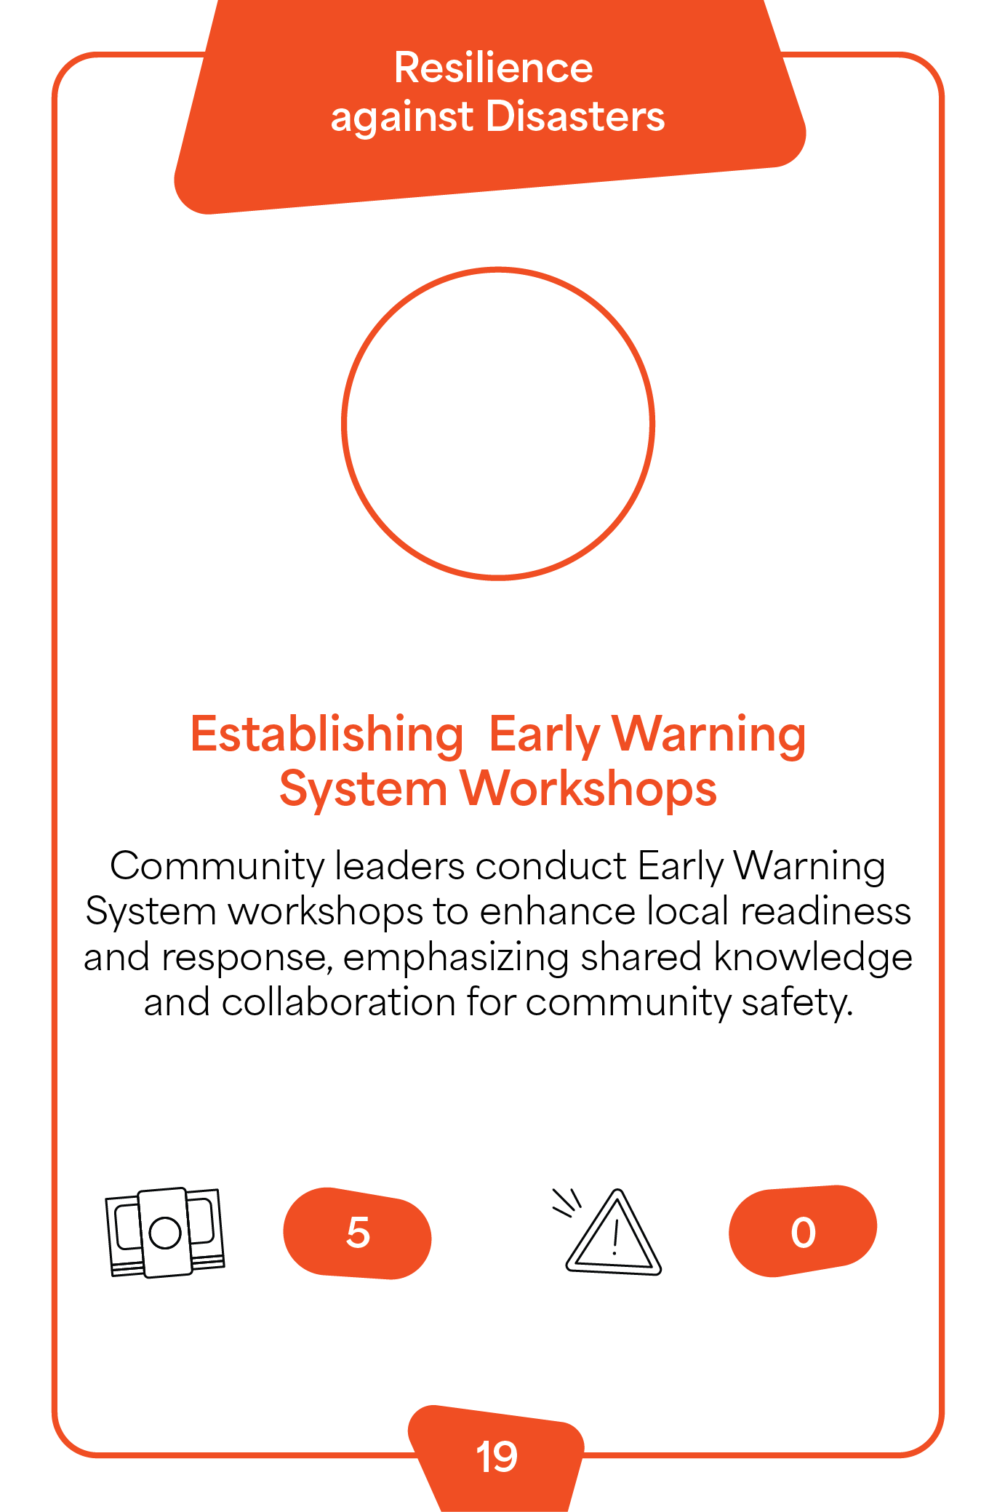
Community Leader
Card 9
Index number 19

Slide 12

Community Leader
Card 10
Index number 20

